Slide 1
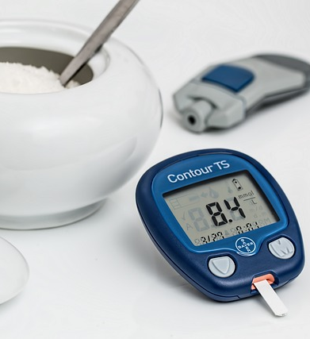
Diabetes Dataset Analysis
Insights from 130 US Hospitals (1999-2008)

Slide 2
Overview
·Summary of the dataset
·Visualization and summary statistics I chose
·Analysis Summary:Challenges and Conclusion

Slide 3
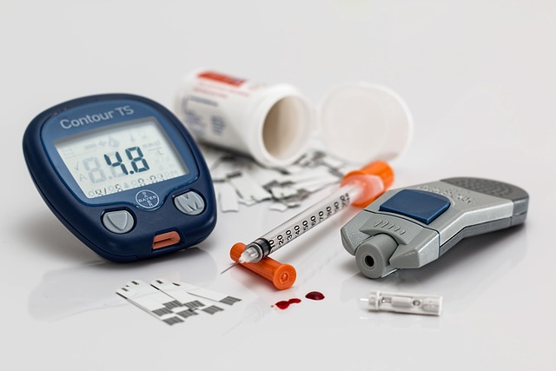
Summary of the dataset
·Source: UCI Machine Learning Repository
·Time Frame: 1999-2008
·Location: 130 US Hospitals
·Features: Patient ID, race, gender, age, admission type, time in hospital, primary physician specialty, number of lab tests, HbA1c test results, diagnosis, number of medications, etc.

Slide 4
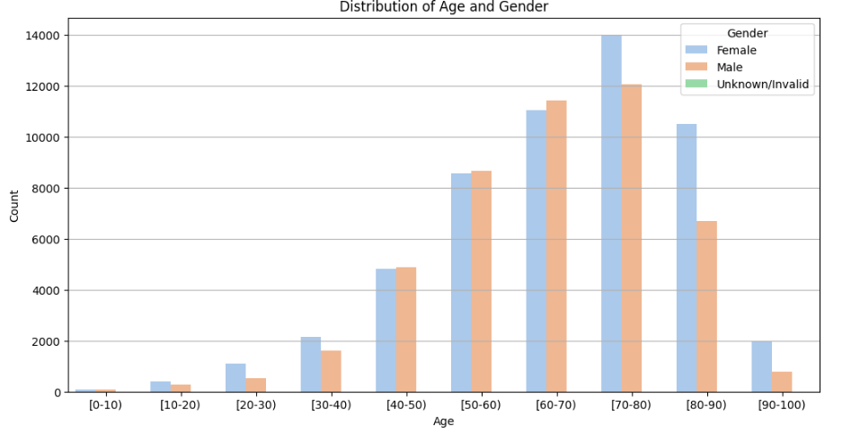
Visualization : Distribution of Age and Gender
Findings:
·Highest prevalence in ages 60-80.
· Females outnumber males across most age groups.
· Significant increase in cases from age 40 onwards.
· Minimal unknown gender data.

Slide 5
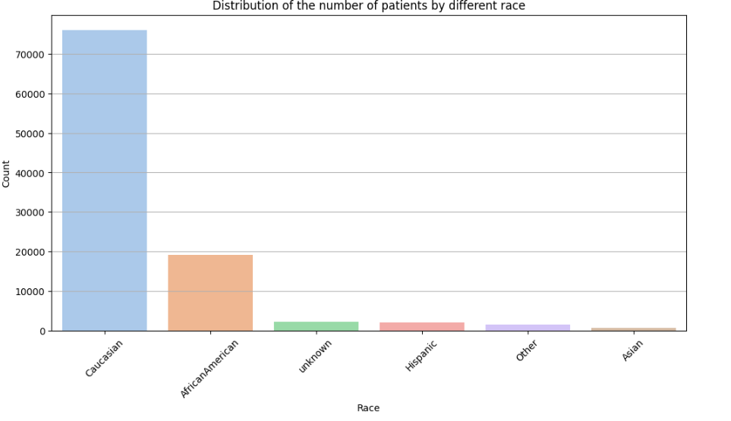
Visualization : Distribution of number of patients by different race
Findings:
· The Caucasian group has the highest number of patients, exceeding 70,000.
· African American patients are the second largest group, nearing 20,000.
· Hispanic, Other, and Unknown racial groups have relatively fewer patients, all below 10,000.
· The chart clearly indicates a significant majority of Caucasian patients compared to other racial groups.

Slide 6
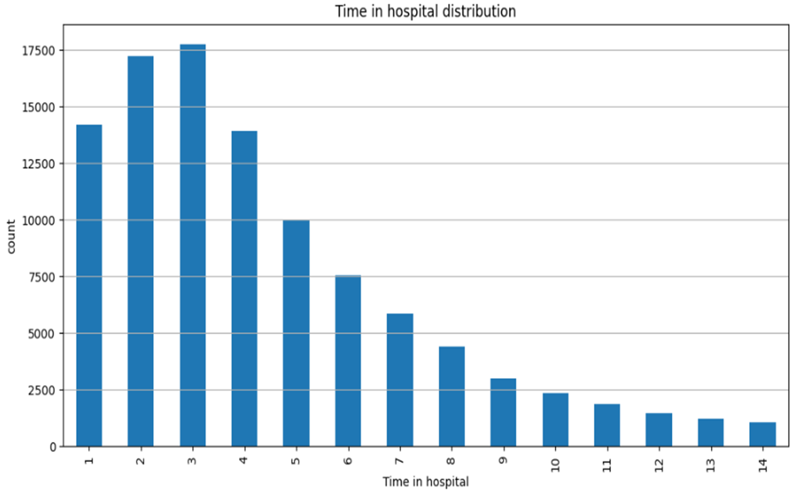
Visualization : Distribution of time in hospital distribution
Findings:
· The number of patients with a hospital stay of 2 days and 3 days is the highest, both exceeding 17,000.
· The number of patients with a hospital stay of 1 day is also relatively high, close to 15,000.
· As the hospital stay increases, the number of patients gradually decreases.

Slide 7
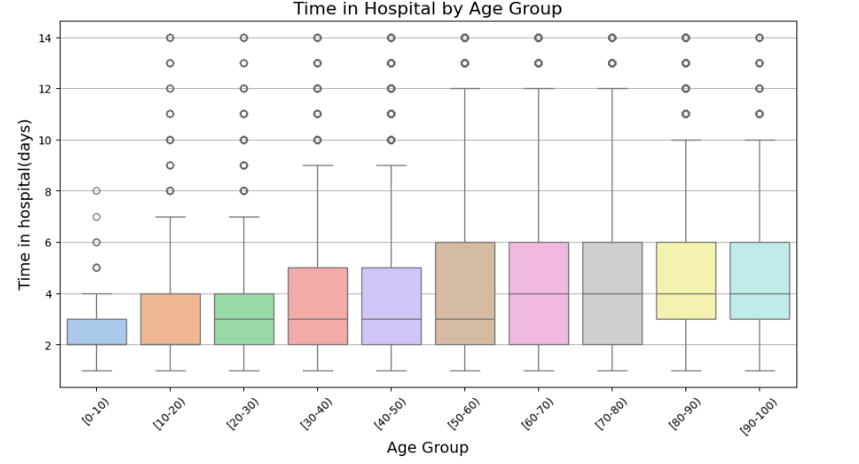
Visualization : Time in Hospital by Age Group
Findings:
· Median time in hospital rises slightly with age group.
· Most age groups have outliers.
· Data distribution range varies by age group.

Slide 8
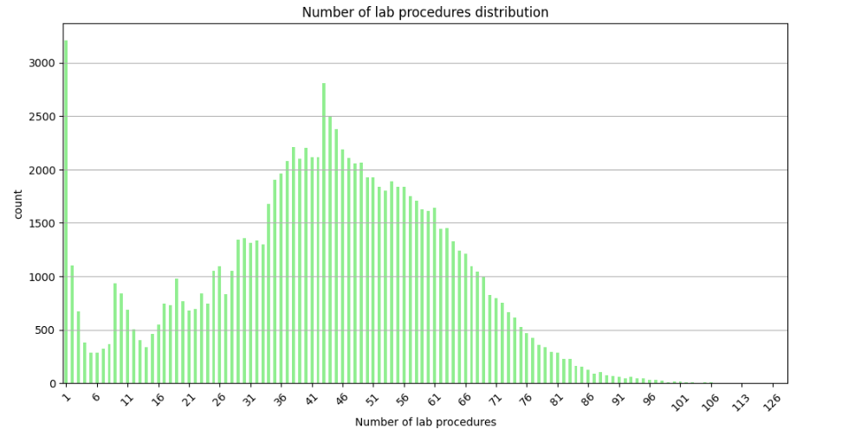
Visualization : Number of lab procedures distribution
Findings:
· The distribution is skewed to the right, with a peak around 41 lab procedures. This means that the majority of patients have a relatively low number of lab procedures, and the frequency decreases as the number of procedures increases.
· There are some patients with a very high number of lab procedures (over 100), but they are in the minority.

Slide 9
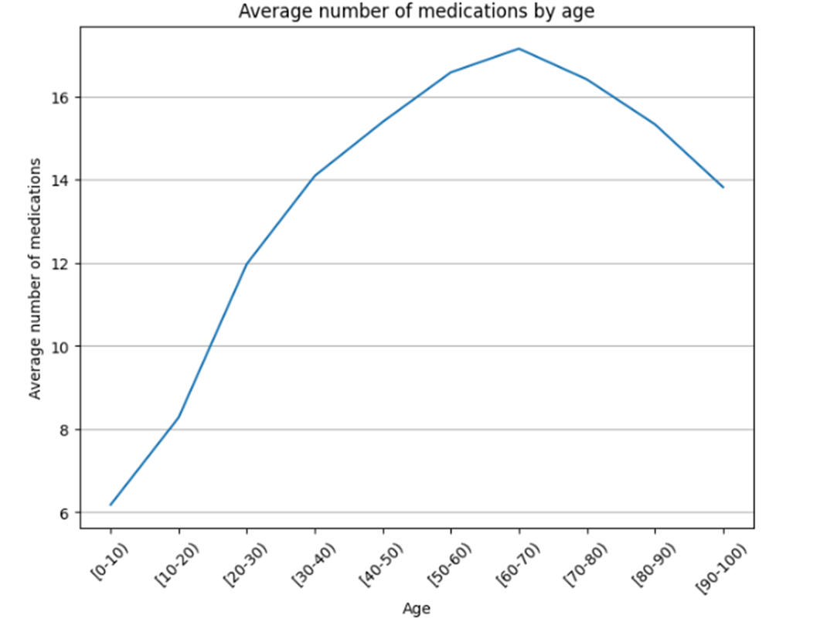
Visualization : Average number of medications by age
Findings:
· The average number of medications generally increases with age up to the [50-60) age group, where it reaches a peak of around 17.
· After the [50-60) age group, the average number of medications starts to decrease gradually as the age group increases.
Conclusion: There is an increasing trend in the average number of medications taken by patients as they age up to around 60 years old, followed by a decreasing trend in older age groups.

Slide 10
Analysis Summary
Challenges
Handling Missing Data:
1.Some critical columns, such as weight and payer_code, contained a large number of missing values.
Solution: Columns with more than 50% missing values were dropped, while others were imputed using the mode or median, ensuring minimal information loss.
2.Visualizing High-Dimensional Data:
The dataset's high dimensionality made some visualizations cluttered and hard to interpret.
Solution: Feature selection was applied to focus on the most relevant variables, and groupings were created to make visualizations clearer.
Conclusion:
· This is a basic data analysis and does not provide definitive conclusions. Further research is needed to validate the findings.
· Readmission rates may be influenced by hospital stay, medication counts, and lab procedures.
· Racial disparities and high-risk patients with more medications require further attention.

Slide 11
Reference
Beata Strack, Jonathan P. DeShazo, Chris Gennings, Juan L. Olmo, Sebastian Ventura, Krzysztof J. Cios, and John N. Clore, “Impact of HbA1c Measurement on Hospital Readmission Rates: Analysis of 70,000 Clinical Database Patient Records,” BioMed Research International, vol. 2014, Article ID 781670, 11 pages, 2014.

