Slide 1
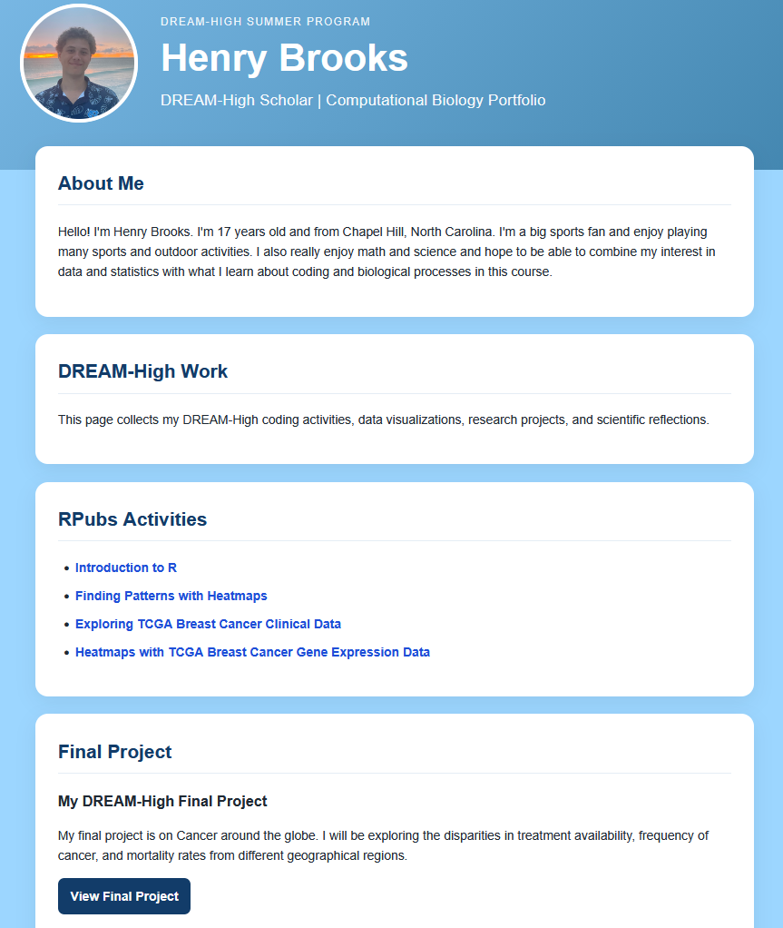
NCI CANCER SYSTEMS BIOLOGY CONSORTIUM • OUTREACH & EDUCATION
DREAM-High: From Genes to Patients
Teaching Cancer Systems Biology Across Scales
Diana Murray¹, Claudia Ludwig², Andrew Gentles³, Jason Somarelli⁴, Angie Bowen⁵
¹Columbia University · ²Institute for Systems Biology · ³Stanford University · ⁴Duke University · ⁵Sage Bionetworks
Authentic cancer data. Student-led investigation. A growing scientific community.
120
students have participated to date
5
alumni helped teach and expand the 2026 course
$75,000
additional grant for proposed 2027 developments
WHY DREAM-HIGH?
LEARNING & COMMUNITY
PARTICIPANTS → CONTRIBUTORS
High school students investigate cancer across biological scales, connecting molecular variation with cellular behavior and clinical outcomes while developing computational skills.
End-of-program reflections reveal strong student-reported connection to science and mentors.
Five alumni helped teach and expand the 2026 course through breakout-room mentoring, learning activities, and final-project support.
Responses after DREAM-High
FROM GENES TO PATIENTS
Agree
Strongly agree
Disagree
Students from the 2026 cohort want to help plan, teach, and mentor in 2027—creating a pathway from participation to leadership.
Saw myself reflected in STEM professionals
01 Genes & tumors
57.7%
42.3%
Integrate TCGA gene expression and clinical data; identify tumor subtypes and explore expression patterns with heat maps.
Could see myself in a STEM career
30.8%
69.2%
PROPOSED 2027 DEVELOPMENTS
02 Cells & microenvironments
Plan to stay connected with mentors
The additional $75,000 grant creates an opportunity to invest in people, curriculum, and creative collaboration.
Compare cancer cell line expression profiles with physical phenotypes measured in environments that mimic the extracellular environment.
53.8%
46.2%
Plan to stay connected with my cohort
More independent R coding
46.2%
26.9%
26.9%
Respond to student feedback: modify code → complete steps → debug scripts → design an analysis. Offer core tasks and optional challenges.
03 Patients & outcomes
Four-point scale: strongly disagree, disagree, agree, strongly agree. Strongly disagree: 0% for all four items. Percentages from supplied slides; respondent count not provided.
Use METABRIC data and linear regression to explore associations between cancer-associated gene expression and patient survival.
More voices in cancer research
These reflections describe perceptions and intentions; they do not directly measure coding proficiency.
Expand small-group conversations with scientists and patient advocates; connect analysis with research questions and patient experience.
HOW STUDENTS LEARN
STUDENT WORK IN PRACTICE
An online course combines browser-based RStudio, Pathwright activities, mentor-supported breakout rooms, and capstone projects.
From analysis to communication
Alumni planning & mentoring
Form a student advisory group; train returning students for supported teaching and peer-mentor roles, with stipends where permitted.
Henry Brooks’ portfolio connects R activities, data visualizations, and a final project exploring geographic differences in cancer and treatment access.
A question of their own
DREAM-High Artist-in-Residence
Students choose a question, analyze authentic data, interpret findings, and communicate their work through a project website. Scientists and a patient advocate connect the analyses to research careers and lived experience.
Lead “From Data to Story”: students translate findings into illustrations, visual narratives, or animations with scientific review and patient input.
Example student portfolio from the supplied course slides.
Evaluate growth with coding and interpretation tasks alongside reflections and alumni follow-up.
JOIN THE DREAM-HIGH COMMUNITY
LET’S CONNECT
We welcome CSBC partners to contribute research-based modules, meet students, support mentors, and broaden participation.
Diana Murray
dm527@cumc.columbia.edu
Notes:
SOURCE AND REVIEW NOTES
Content: CSBC_DREAM-High_Abstract_DM.docx and DREAM-High_slides.pptx supplied by the user. User's additional instructions establish the $75,000 grant and proposed 2027 developments.
Participation and alumni counts: abstract. Course platforms: slides 2-4. Alumni activities: slide 5. Scientist and patient-advocate interactions: slide 6. Portfolio: slide 8. Survey values: native chart in slide 11.
Survey: original values preserved and displayed rounded to one decimal place; labels shortened for readability. No respondent count or survey cohort/year supplied. Do not infer a denominator from rounded percentages. Confirm the count, cohort, timing, and item-level missing responses before printing. Student-reported perceptions are distinct from demonstrated proficiency.
The portfolio screenshot is an embedded source image; surrounding text, chart bars and labels, and all other layout elements are editable. Confirm permission for public display of the student name and portrait.
Confirm exact funding acknowledgment, grant numbers, and required logos before printing. The supplied institutional logos do not establish funding attribution. No award identifier has been invented.
2027 developments are proposals, not commitments. Confirm grant scope and allowable expenses.
Illustrative $75,000 allocation, not an approved budget:
Independent-coding curriculum and instructor preparation: $20,000
Alumni planning, teaching, and mentoring stipends: $18,000
Artist-in-Residence and collaborative projects: $12,000
Scientist and patient-advocate participation: $8,000
Access support and accessibility: $7,000
Evaluation and follow-up: $5,000
Coordination and contingency: $5,000
Total: $75,000
Print at 100% on 48 x 48-inch stock. The PDF is a rendered proof; the PowerPoint is the editable master.

