Slide 1
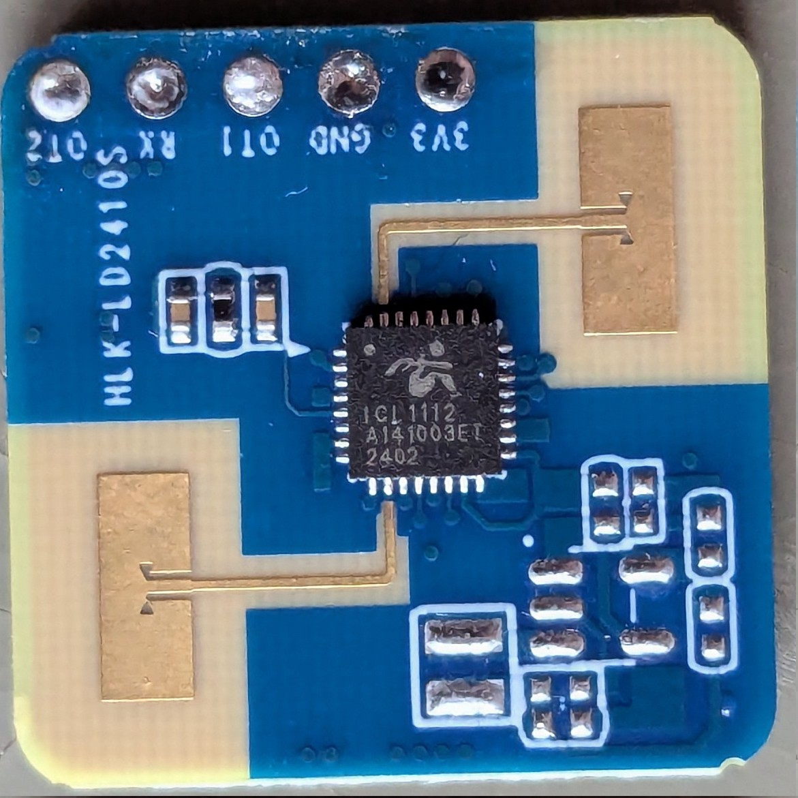
SPI
CLK
SPI
MOSI
SPI
CSn
I2C_SCL
I2C_SDA

Slide 2
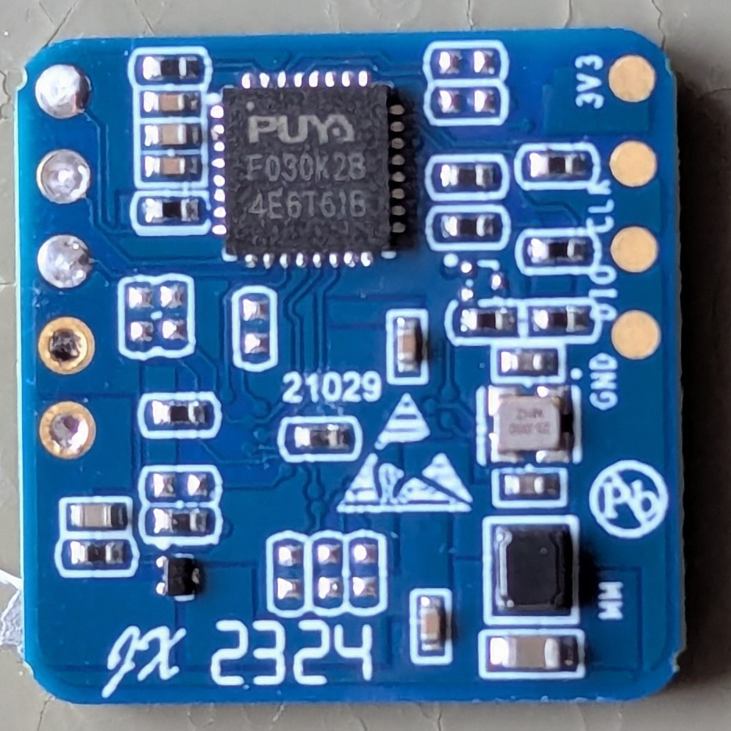
SDA
SCL

