Slide 1
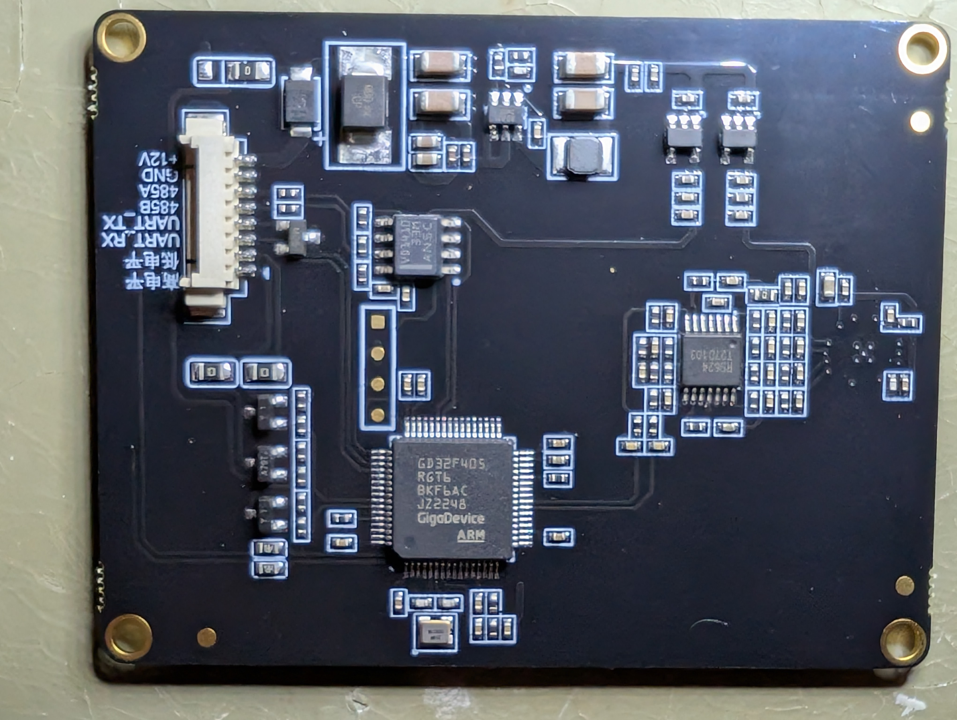
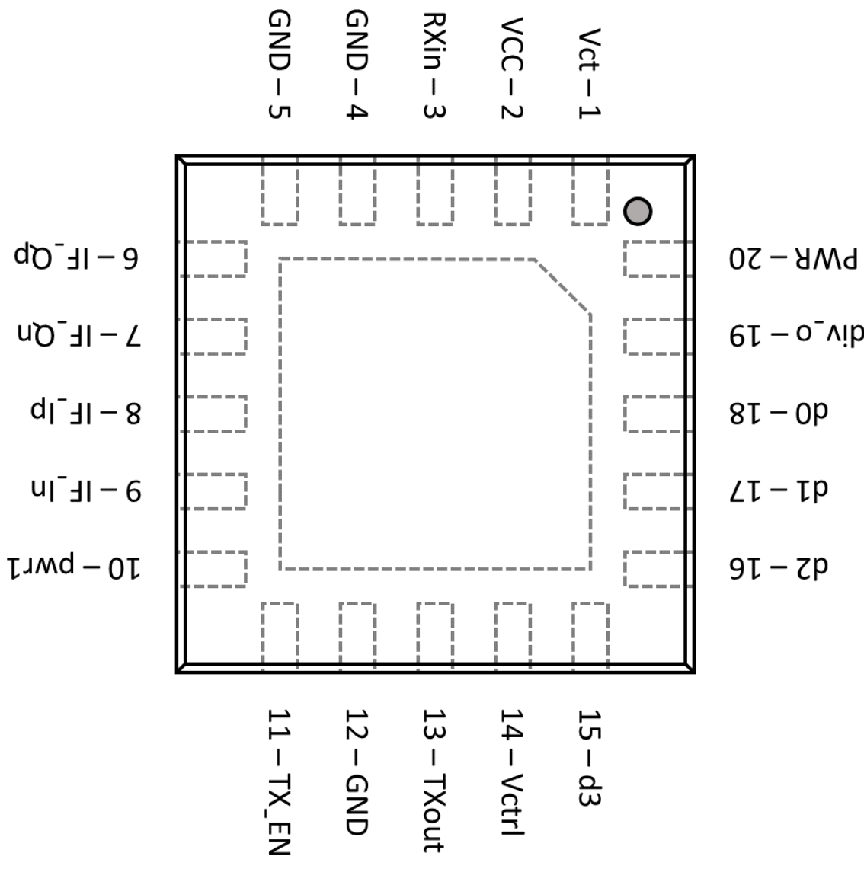
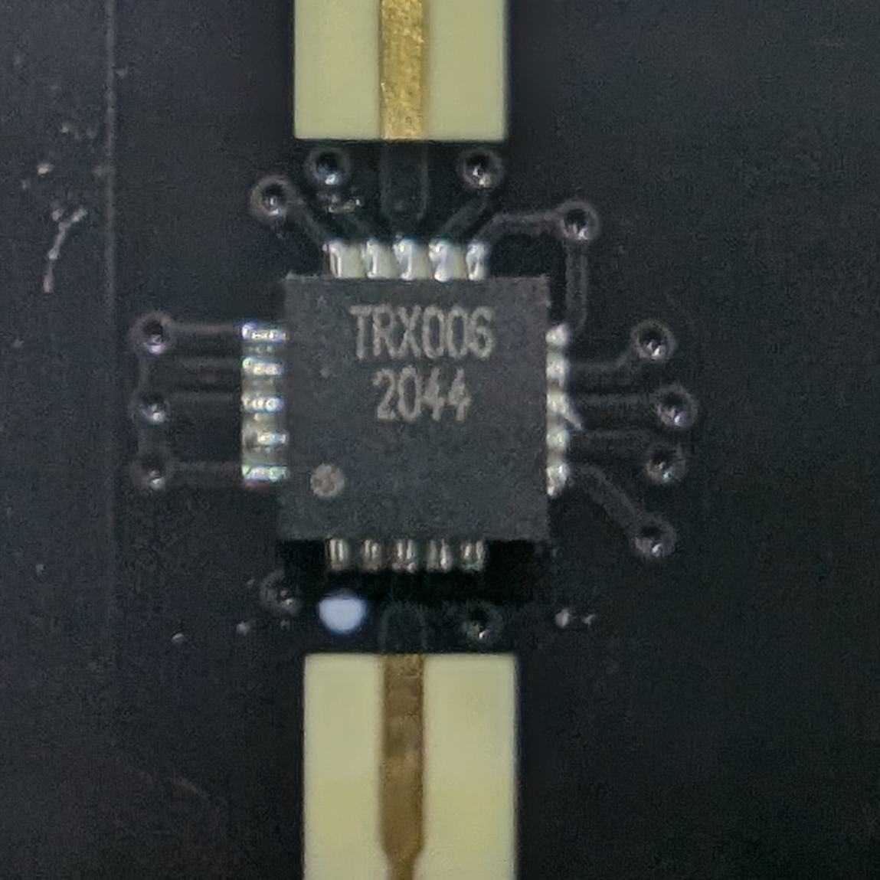
DC-DC
LDO
uC
LDO
Radar
RS485
GND
PA10, USART0_RX
PA14
PA14
VCC
PA9, USART0_TX
OpAmp
SWCLK
PC10, USART2/3_RX
SWD
PC11, USART2/3_TX
PC4, ADC01_IN14
PA7, ADC01_IN7
16MHz

