Slide 1
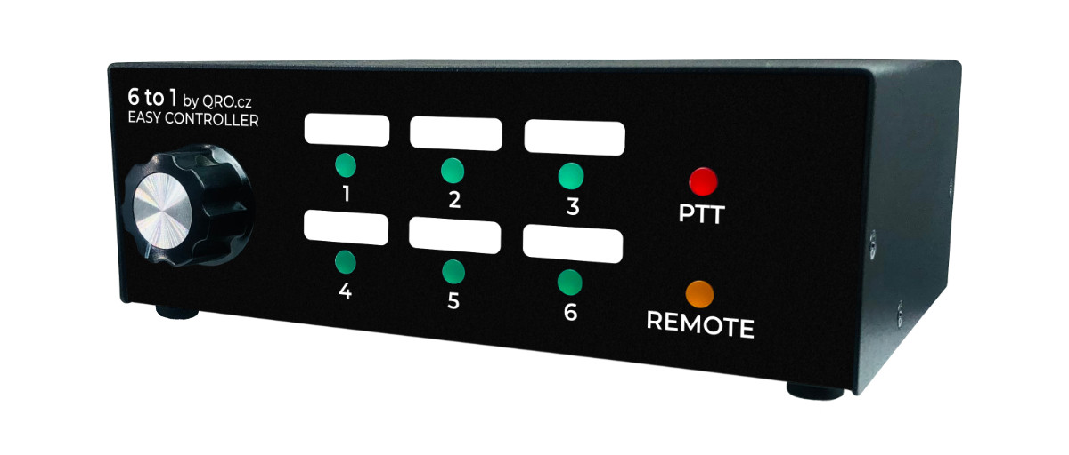

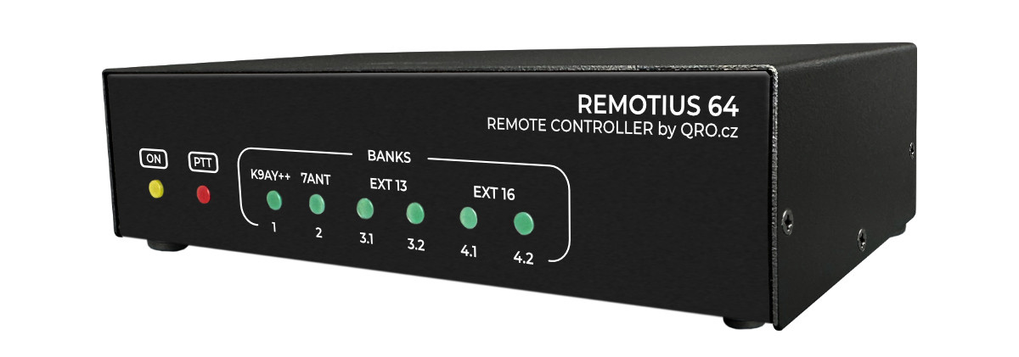
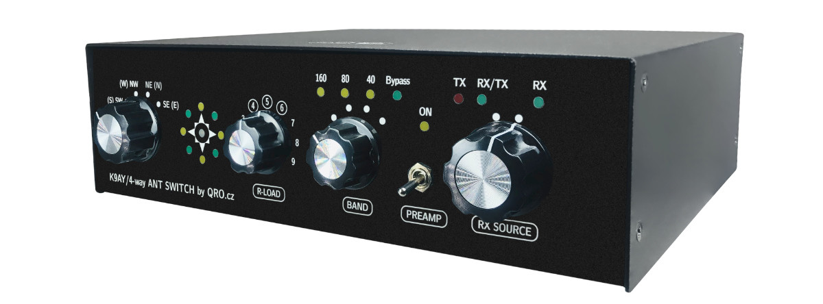
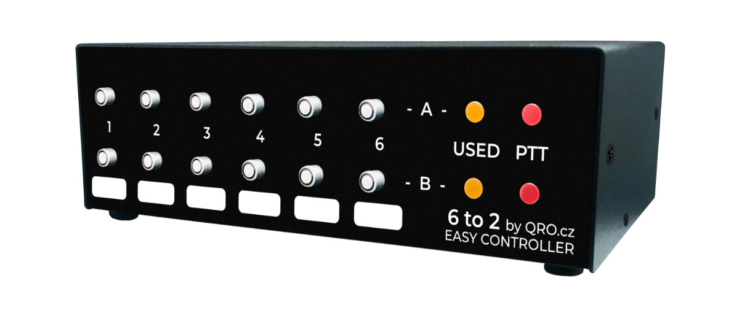
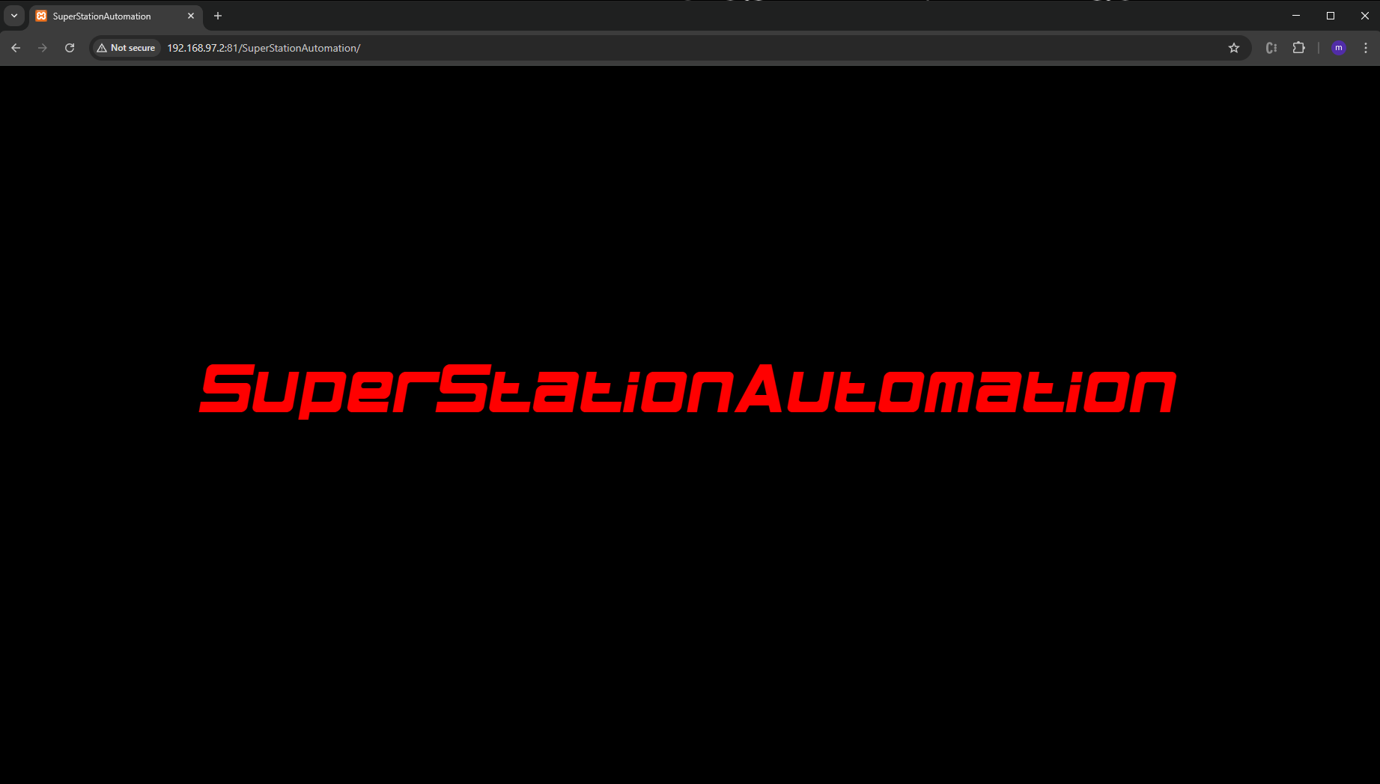
LAN / ETHERNET / WAN
Super.Station.Automation
LAN / ETHERNET / WAN
XX

Slide 2
The problem:
YOU need to click on many buttons to set up your desired station: bands, antennas, filters…?
YOU need to click on many buttons to change a current state of your station?
YOU just want an easy way to controll, setup and orchestrate you station by just on click?
YOU want to fire different commands with a decent delay and chain them?
YOU want to create customizable dashboards with simple call to action buttons?
YOU want to store the individual states of all of your controllers after configuration?
YOU want to recall a saved state of all of your controllers any time: wpx2021, cqww2023ssb, cqww2025cw, …. Setup done in seconds!
→ All this included and for free for your qro.cz / hamparts.shop controller! ←
The solution:
1
Super.Station.Automation
2
XX

Slide 3
The goal:
Reduce setup time!
Reduce time for changing!
Reduce and hide complexity!
Increase reliability!
Save a current complete controllers/station setup in a file or as many as u like!
Recall stored complete controllerstates/station setups – as many as u like!
Build as many and as simple dashboards for call to actions/buttons as u like!
Chain commands of local controllers, of different controllers in ur networks, or even controllers in australia together behind a button!
On-button-click => Fast, reliable execution!
The choice is yours: Local App on your computer or put it on your webserver
API to trigger the buttons by a url
Write your own Plugins for DXLog, Streamdeck, NodeRed, …
Super.Station.Automation
XX

Slide 4
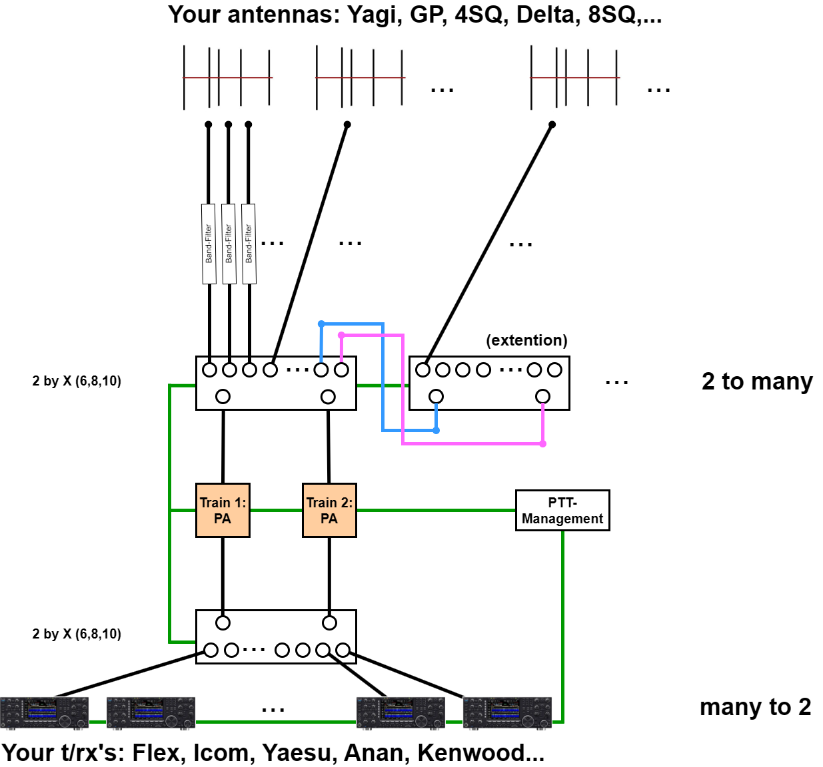
What is your setup?
Lessons learned:
many have more antennas
many have even more ants per band
many have more then 1 trx :p
many want to have 2 signals on the air
many have more than one amp
doing contest in a team is fun
So the most basic setup to achieve this, we call „The 2train standard setup“.
But also in this small setup, you have always at least 3 actors to switch:
2x a 2 by X (6/8/10 from hamparts.shop)
ptt management (e.g. OLIIP16)
Time for automation!
Super.Station.Automation
XX

Slide 5
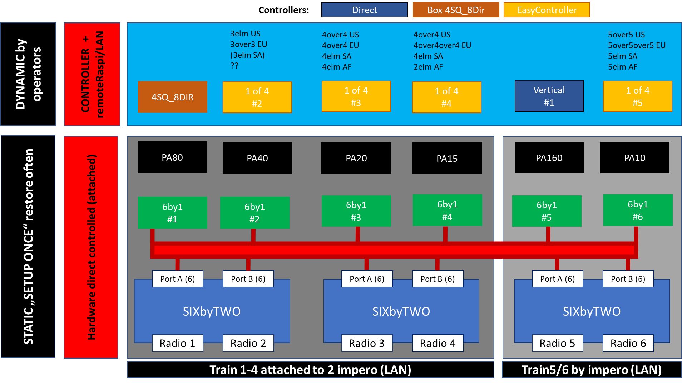
Are you a super big?
+controllers
Super.Station.Automation
+ptt_management
This setup contains more 250 relays! Want to config and change all this by hand? STORE & RECALL!
XX

Slide 6
LAN / ETHERNET / WAN
What is a „controllers / station setup“?
Connecting the qro.cz controllers is easy and plug an play: Power it on, connect it to your shack network via lan cable. See the „Your entry point“ to gain more information.
Each controller gets ist own IP address and you can speak „http“ or „ws (websockets)“ => see remoteSwitchFramework
So the setup at your station consists of one or many qro.cz-controllers. This is the stations infrastructure.
Super.Station.Automation
XX

Slide 7
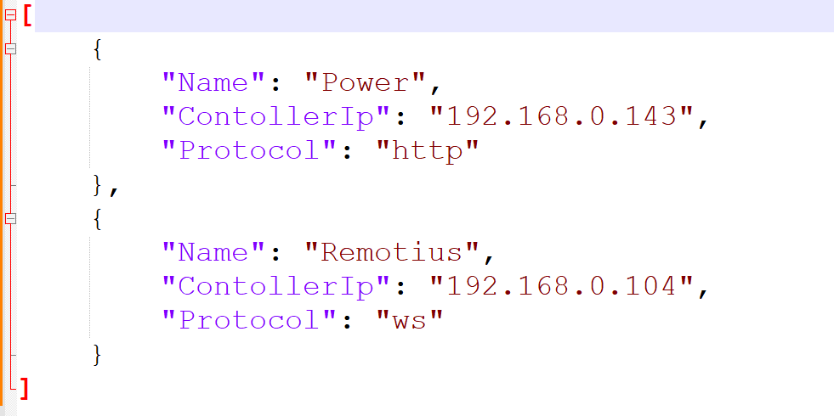
What is a controllers setup-configuration of a station?
All configuration are done using the file-system and a data format called JSON.
To introduce your controllers to the Super.Station.Automation, there is a (default/example) JSON-File called „controllers.json“ (in the dir „JSON“).
This files needs to be edited first.
Example: 2 Controllers are in the network. 1 Remotius and 1 OLIIP16
Super.Station.Automation
Give a controller a name
Add the controlles ip
The communication mode
Use „ws“ if possible
You will learn how to configure this later :p
XX

Slide 8
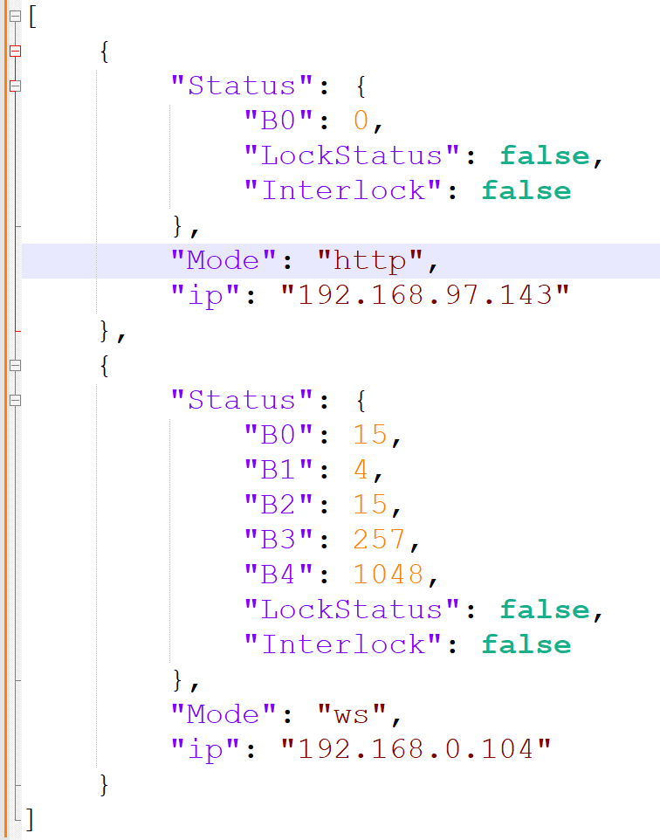
What is a „state“ of a controller?
The state of a controller is ist set output-pins. The qro.cz controller are using one (most controllers) or up to 4 (remotius) so called „banks“. Each bank represents 16 outputs (count starts with 0 for the first pin,…15).
Some controllers dont expose all pins, but under the hood, all is matched to a bank.
Since you have one to many controllers in your network, you can collect their states and store them as a file, e.g. JSON->statesWPX2024.json. You can have as many of them as you want – you can load and set the states persited in the file to you station setup.
Super.Station.Automation
Hint: There is nothing to edit manually here. Just save and recall the file to the controllers and you are done!
XX

Slide 9
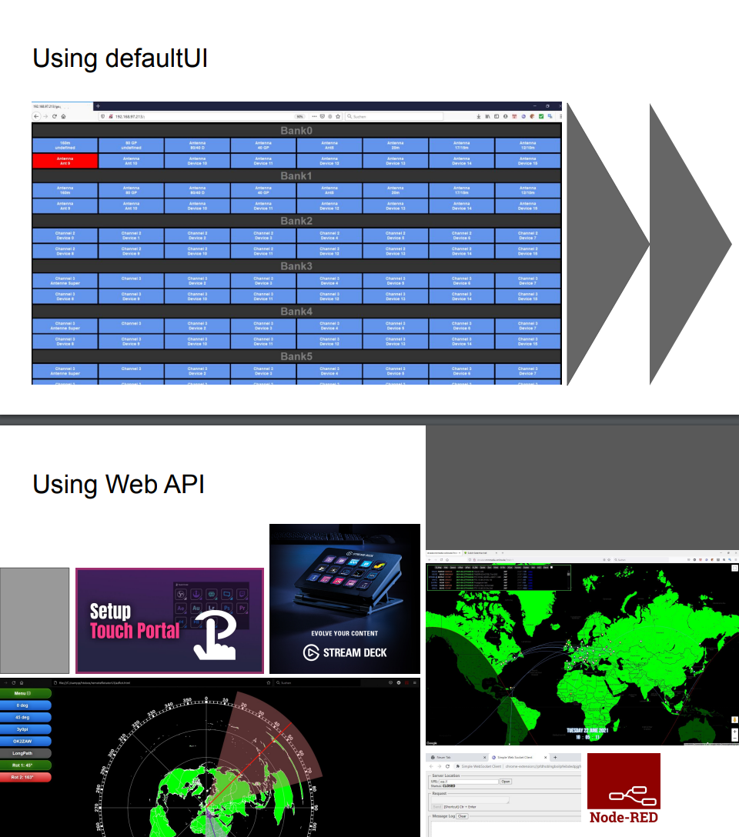
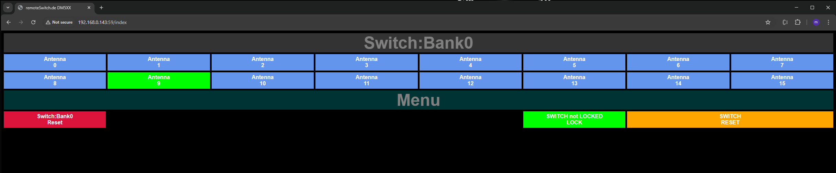
What is the default „dashboard“ of a controller?
Super.Station.Automation
At the end, all controllers have their own dashboard (aka default UI) for many or just one bank. Orchistrating different dashboards needs some clicks. And thats where the Super.Station.Automation takes over!
Learn more about our UIs and APIs
XX

Slide 10
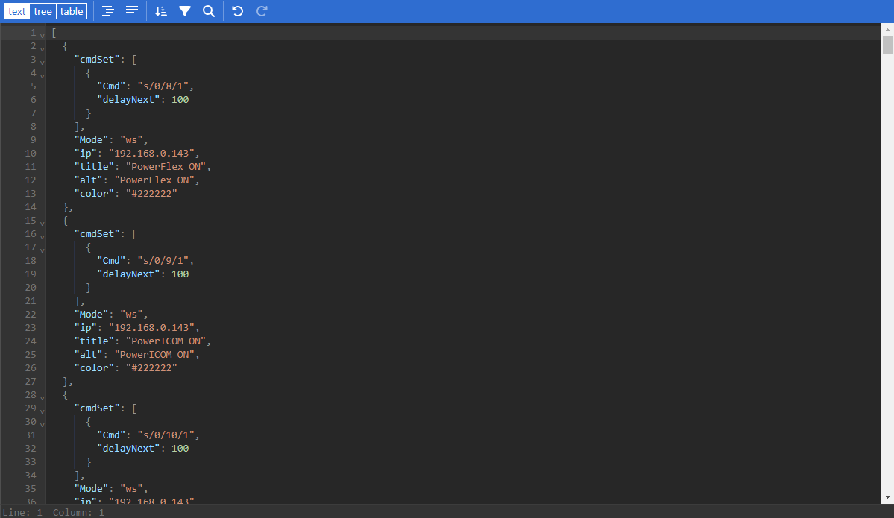
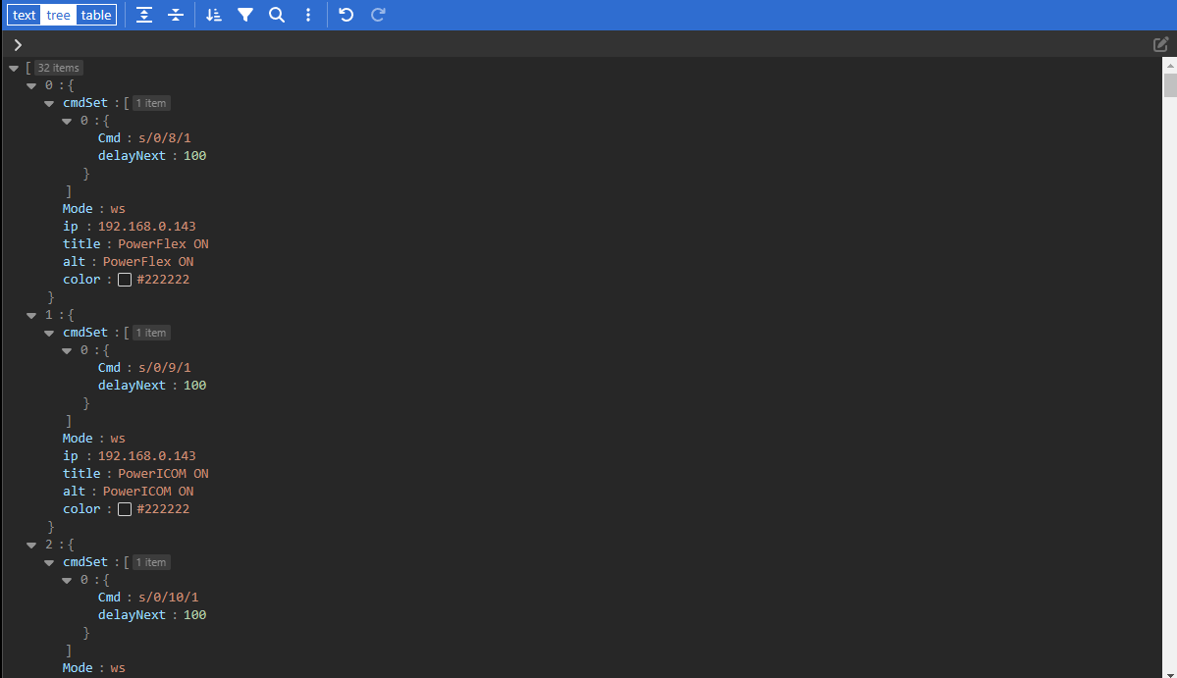
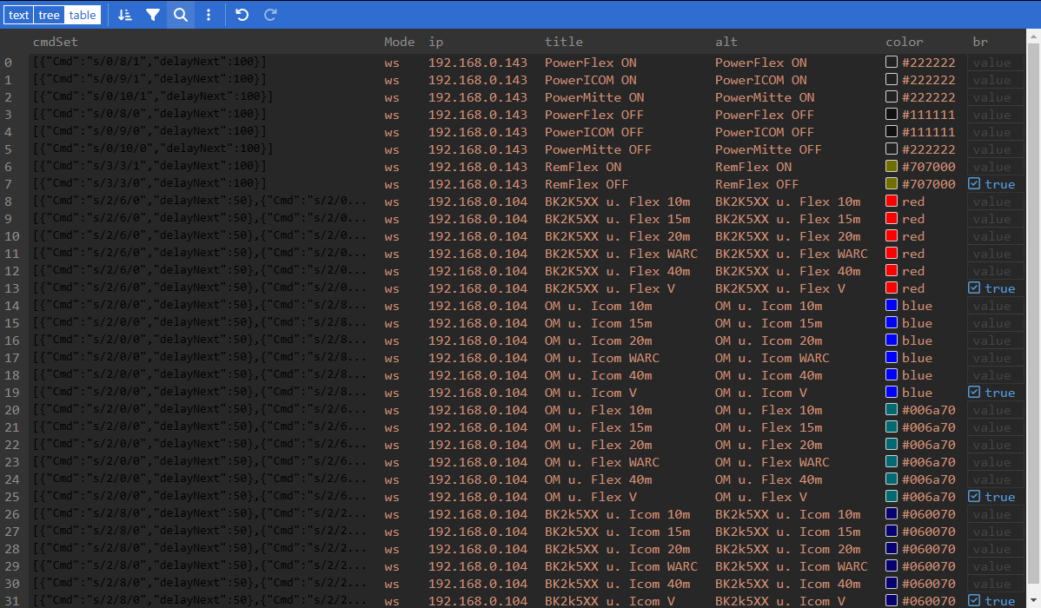
Editing configurations: JSON Editor
For editing json files, the data format of the internet, we added a JSON Editor to the web application. Choos the way you like to edit your files: Text, Tree, Table or Table view
Super.Station.Automation
You can learn and get familar with it trying the demo online version of the editor: https://jsoneditoronline.org/
Hint: Whatever file you edit, make sure you have a backup! So if you made a mistake, you always
can go back to a working verions :P
XX

Slide 11
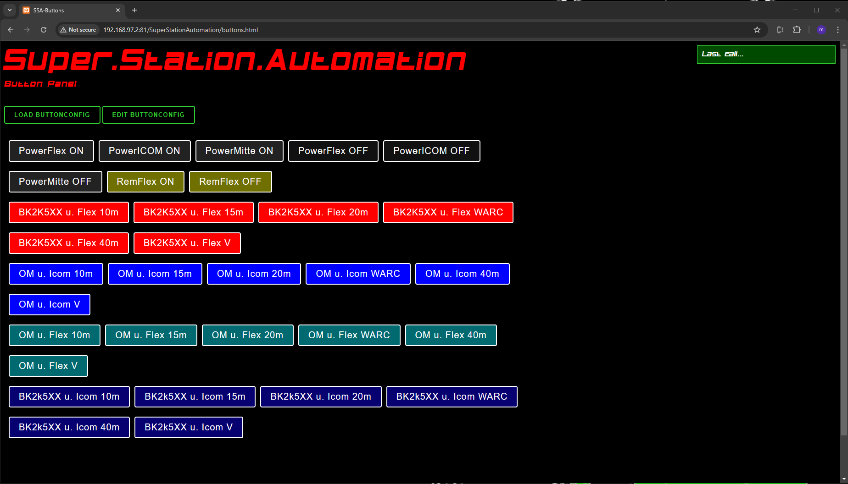
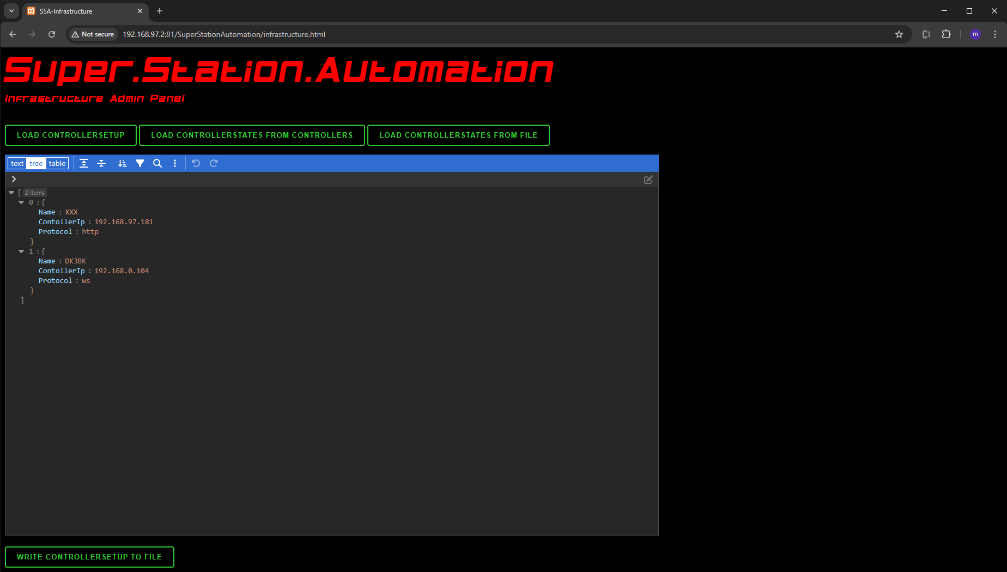
1
2
Super.Station.Automation
Button Panel
Infrastructure Admin Panel
XX

Slide 12
1
What can i do?
Load / Edit / Save a button-configuration (json)
Click a desired button and execute it‘s command set (fire‘n forget): => Delayed execution of different controller commands aka chained
Hint: Create different dashboards for different use cases!
Super.Station.Automation
Button Panel
XX

Slide 13
2
What can i do?
Load / Edit / Save a controllersetup-configuration (json)
Load/save current states of those controllers from/to the defined controllers
Load/save states of those controllers from/to a file
Hint: Create different config files for different use cases!
Super.Station.Automation
Infrastructure Admin Panel
XX

Slide 14
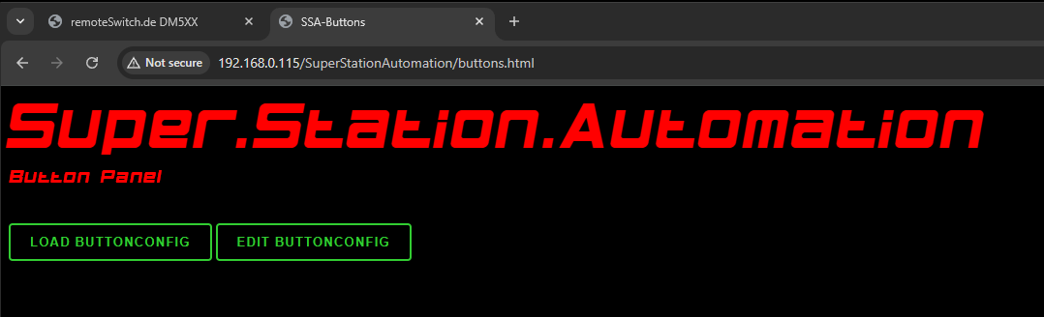
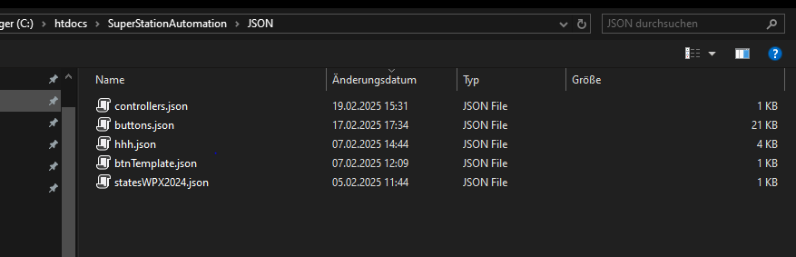
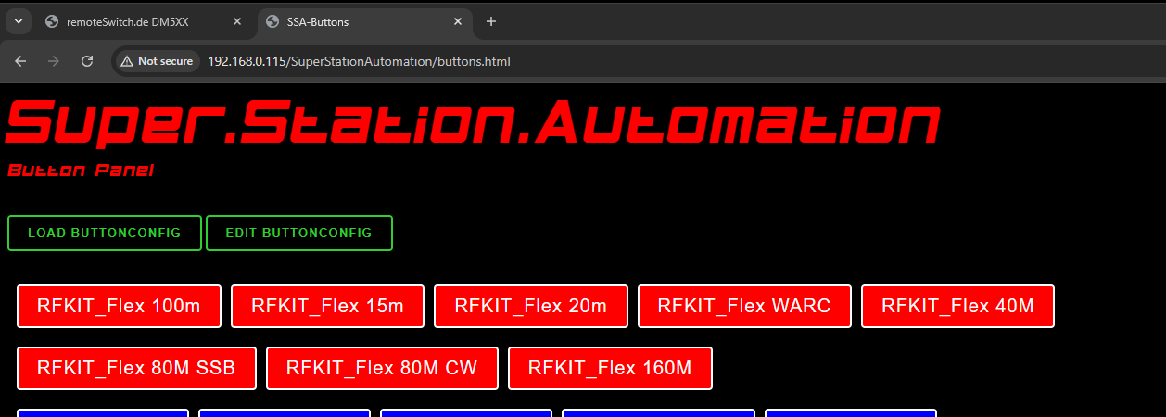
Button Panel
1
Button Panel: Load a config (*)
*Load from local disc. Server see later
Super.Station.Automation
Load a button config
XX

Slide 15
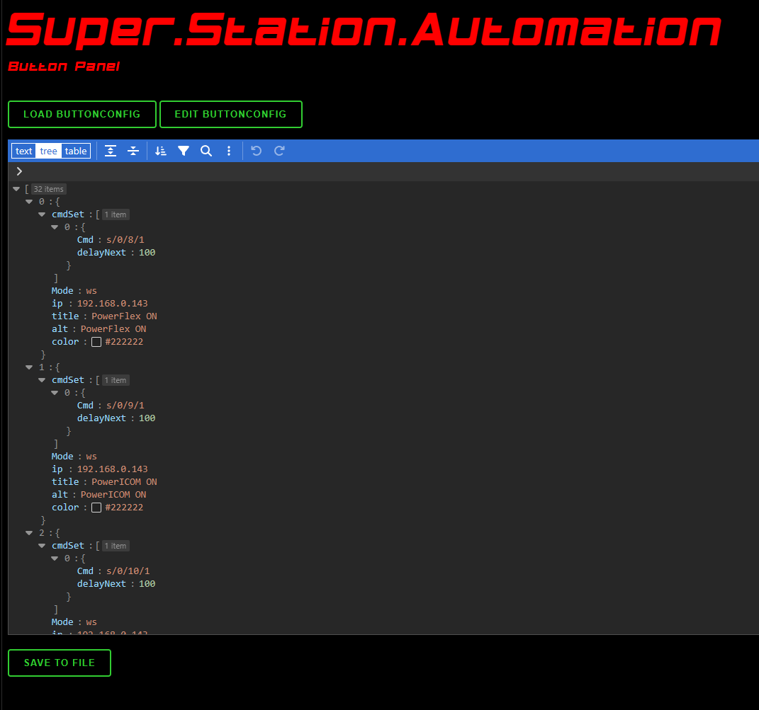
Button Panel
1
Button Panel: Edit a config (*)
Super.Station.Automation
Edit a button config
*Load from local disc. Server see later
Save the current content of the editor:
to an existing files (overwrite)
to a new file (choose a useful file name)
Hint: Use Explorer for delete and rename!
XX

Slide 16
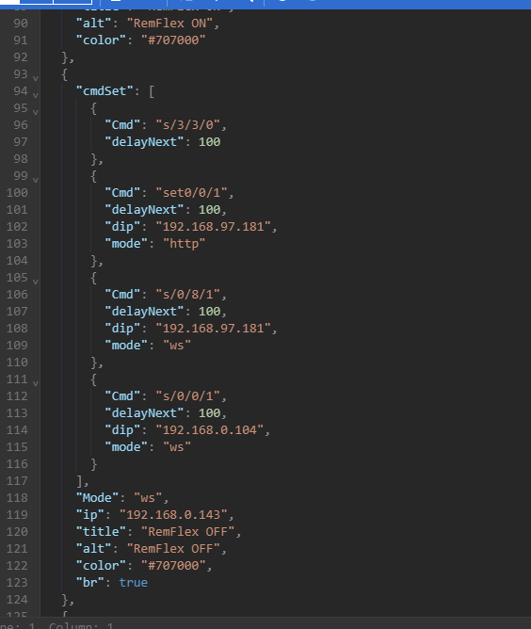
Button Panel
1
Buttons and command(chains)?
A button has a Mode (1), ip (2), title (3), alt text (4), a color (5) and a br/break (6) in ist common definition. The commands are chained in command set (X) with a Cmd (7), a delayed exec.in ms (8) and a differnt Ip (9) and/or mode (10) if this specific command shd go to a different controller. A list of button objects creates your button panel.
Hint: Make yourself familar with the JSON-Notation.
Check the meaning of [ ] { } and ,
Use the provided JSON-Editor or other online Editors. Use Textview or experiment with tree and table view. Use the view u like most. Dont forget to backup files :P
See how to use the API/Cmds: remoteSwitchFramework slide 6
Super.Station.Automation
(X)
(7)
(8)
(9)
(10)
(1)
(2)
(3)
(4)
(5)
(6)
XX

Slide 17
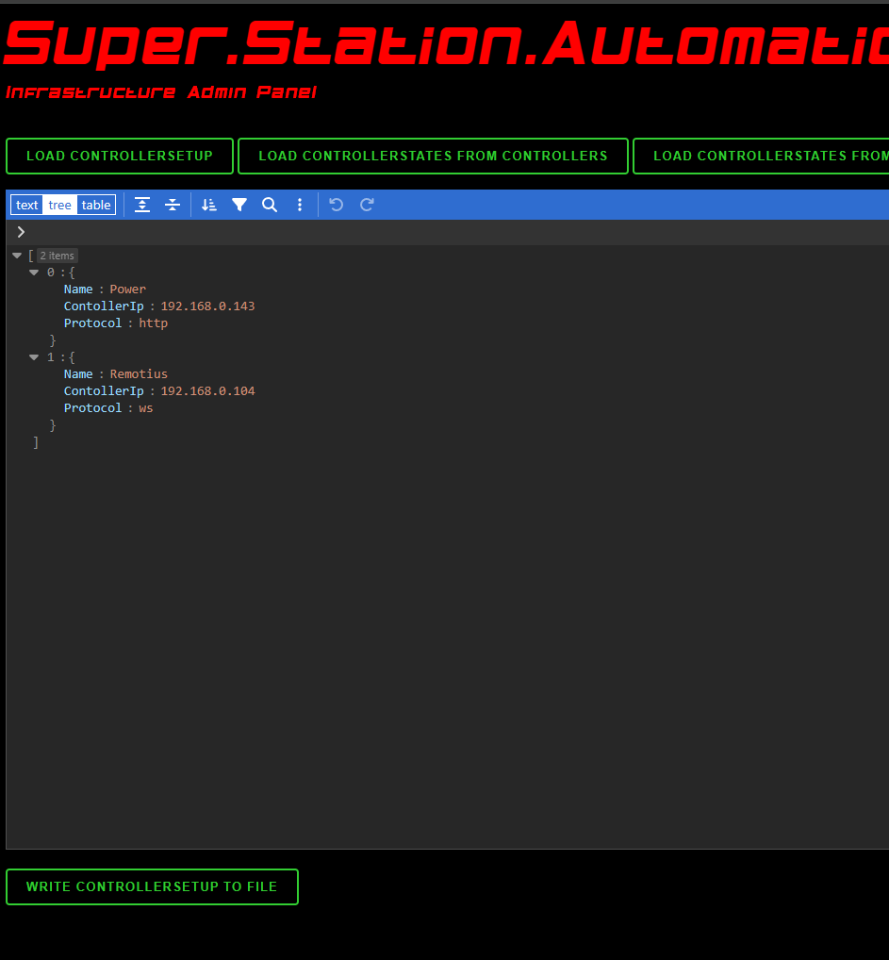
Infrastructure Admin Panel
2
Load/Edit/Write a controllers setup config (*)
1. step is always load controllers!
*Load from local storage only!
Super.Station.Automation
Save the current content of the editor:
to an existing files (overwrite)
to a new file (choose a useful file name)
Hint: Use Explorer for delete and rename!
XX

Slide 18
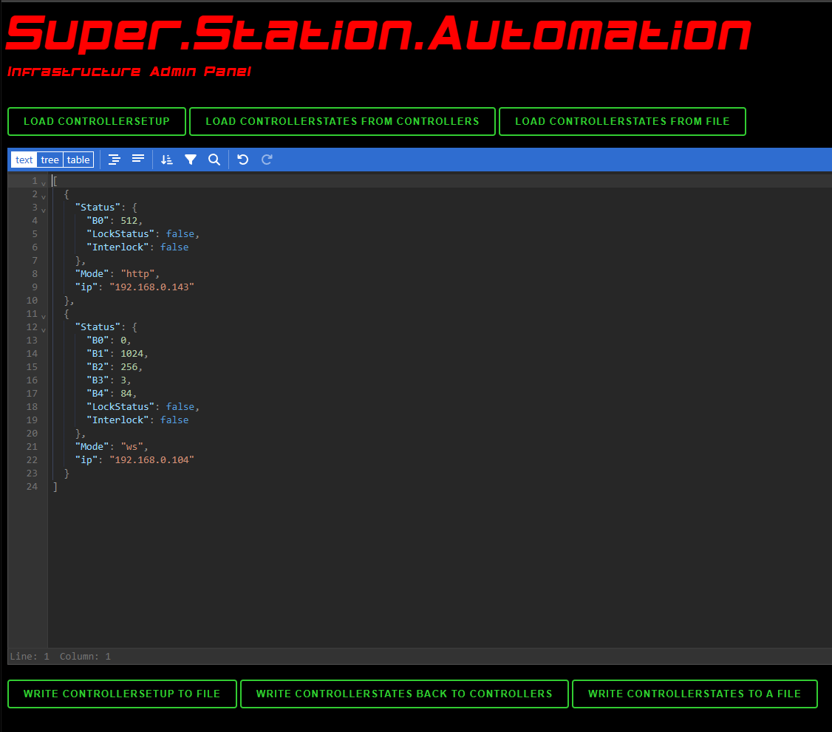
Infrastructure Admin Panel
2
Load/Write controller states (*)
2. step is load/write states!
*Load from local storage only!
Super.Station.Automation
Loading the states from the controllers set up in the config via the network!
Write the current content of the editor:
to to the contollers via network. All controllers must be online and spec. (see 1. step)
to a new controllers state file (choose a useful file name)
Hint: Take care that controllers setup file and controllers state file match 1:1 (check IPs!). Normally you dont edit something. You just load the states and write them back to have your station set to a specific state/configuration.
Loading the states from a controllers states file!
XX

Slide 19
GITHUB: https://github.com/dm5xx/SuperStationAutomation
URLs/Pagenames for local use:
Super.Station.Automation
1
2
XX
buttons.html
infrastructure.html

Slide 20
Button Panel
URLs/Pagenames for server use:
1
http://<YourServersIP>/SuperStationAutomation/creator.php?fn=buttons&jn=buttons
Name of the buttons-config. Here: „buttons“ calls button.json. Change this to ur needs. No explicit loading required!
Super.Station.Automation
2
Since the infrastructure is always some more generic, there is no server side save and recall implemented. Use infrastructure.html and your local NAS/storage!!!
Hint: Server need PHP to run the software. Be aware that the JSON dir and file should have permission 755
XX

Slide 21
What does the example cmdSet do?
The CmdSet has 4 chained commands.
(1) Use defaults, Set bank „3“, pin 3 to „0“ (off). Delay 100ms.
(2) Using mode http, set bank 0, pin 0 to „1“ (on) at the controller with the IP 192.168.97.181. Delay 100ms.
(3) Using mode ws, set bank 0, pin 8 to „1“ (on) at the controller with the IP 192.168.97.181. Delay 100ms.
(4) Using mode ws, set bank 0, pin 0 to „1“ (on) at the controller with the IP 192.168.0.104. Delay 100ms.
Hint: If you switch items that belong together for the same context, perform the „OFF“ always bevor the „ON“. Becareful what you do! Dont kill your TRX! :P
Need help? Ask for our setup service!
Super.Station.Automation
CmdSet belongs to 192.168.0.143 using default protocol ws protocol. Btn title is „RemFlex OFF“. Btn color is a deep gray.
This Btn is the last one in a row, so „br“ is set to true to make a line break
XX

Slide 22
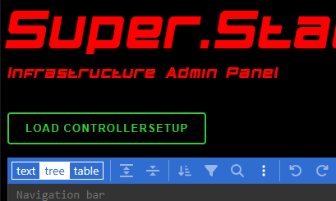
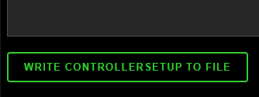

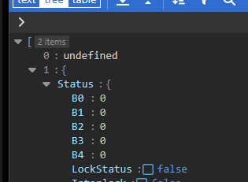
How to SAVE/RECALL controllerstates?
Make sure, all controllers who shd be part of your current setup (to be stored and recalled) are ONLINE/AVAIBLE/ON
Load your controllersetup
Edit the controllersetup, change settings, add or remove controllers
Save the Controllersetup to a file (overwrite or save as a different filename)
Reoopen the Infrastrucrue page (IMPORTANT!)
Load (a or the newly saved) controllersetup
SAVE the current controllerstates to a file:
SAVE Workflow: Load the controllerstates from Controllers (IMPORTANT: ALL
SAVE Workflow: Write Controllersstates to a file
RECALL the current controllerstates to a file:
RECALL Workflow: Load Controllerstates from a file
RECALL Workflow: Write Controllerstates back to the controllers
Super.Station.Automation
Possible problems are all related that to the only reason: ONE or more OF YOUR CONTROLLERS IS/are OFFLINE!!!
You will identify this problem by:
click to „Load controllerstates…“ takes long to display something in the editor
One or more controllers display „undefined“ as their status!
XX

Slide 23
Special setup service!
We offer a speciel setup and confguration service for our customers:
Configuring groups and locks on your controller (custom firmware)
Special Updates and configured firmware cut to your needs
And:
Initial setup of Super.Station.Automation Software with controllers and buttons
Install on your web server
Videocalls and education on the software
Custom Super Station Development
Super.Station.Automation
Ask mike DM5XX – dm5xx@gmx.de
XX

