Slide 1
IBM Platform Symphony L3 workload tracing system tutorial
Dec, 2014
Da Ma

Slide 2
Agenda
Background
When/How to log L3 workload effort
Search L3 workload efforts
FAQ
Notes:
MT, Security machine

Slide 3
Background
The support & DEV/QA are reported to different VP now
DEV/QA did not get enough budget for L3
SUPPORT need detail of effort in L3
Review workload/HC in L3 with support every year
Notes:
MT, Security machine

Slide 4
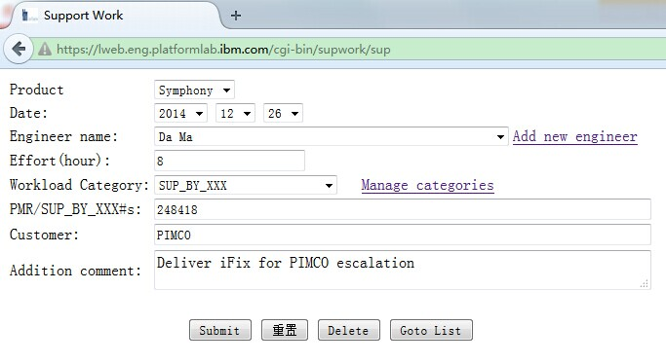
Log L3 workload effort when task finished
URL to access following page: https://lweb.eng.platformlab.ibm.com/cgi-bin/supwork/sup
Product Name: PMC, LSF or Symphony
Category Name | Description
SUP_BY_XXX | The effort on defect, including fix defect, review code, log build, QA testing and so on
APAR/PMR | The effort on APAR/PMR, if no RTC defect to trace; add workload detail as additional comment
PRODUCT_ISSUE | The effort on escalation, helping L2 and so on
In house Issues | The effort on in house defect fix
PSIRT | The effort on PSIRT investigation & fix
FixPack | The effort on FixPack
SMC | The effort on SMC article
Build | The effort for build team to handle patch release
ID | The effort for ID on message & readme review for the patch
Others | The effort on other track/item; add detail comments in record
Task completion time
Find your name in the select list; “Add new engineer” for freshman
(uses Notes ID as user name)
Select a category for the workload, refer to the right table for the description
Submit record to the system
Notes:
The unit of effort is hour; the effort also includes overtime
Log L3 workload when task finished; a defect may include several records, one record for each tasks
If no ID for the workload (such as meeting with L2), keep “PMR/SUP_BY_XXX#s” empty and add detail into “Addition comment”

Slide 5
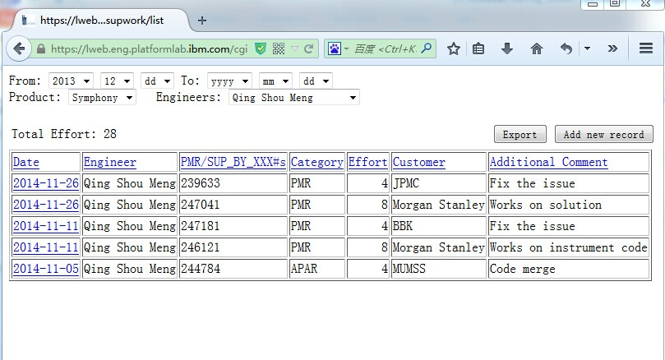
Search L3 workload item
URL to access following page: https://lweb.eng.platformlab.ibm.com/cgi-bin/supwork/list
Search workload effort by owner
“Export” the search result in excel for analysis
Search workload effort by production
Go to “Log L3 workload effort” for new record
NOTE:
The unit of effort & total effort is hour
The relationship be multiple query condition is "and“; e.g. the above query is “the effort that Qingshou Meng expend from Dec 2013 (including Dec 2013) to now in Symphony”

Slide 6
FAQ
Who will use this system?
  All engineers that involved in L3 work items, e.g. Fixpack, patch, escalation, L1/L2 questions and so on
When to use this system?
How to use this system?
  Individual engineer
  Team Lead of L3
  L1/L2

