Slide 1
Detection of AI-Generated Arabic Text using Pyspark
Moutzz Abokhashabh

Slide 2
Introduction
project objectives:
Design and implement a distributed data processing pipeline for Arabic text analysis using Apache Spark
To develop comprehensive Arabic text preprocessing functions, including diacritic removal, character normalization, stopword filtering, and stemming, implemented as distributed Spark UDFs for parallel execution
To engineer hybrid features that combine TF-IDF vectors,
To train and evaluate multiple classification models (Logistic Regression, Random Forest, Linear SVM, and Naive Bayes) on a balanced dataset of human and AI-generated Arabic abstracts
To implement a streaming module using Spark Structured Streaming that demonstrates real-time inference capability on simulated file-based input streams

Slide 3
Dataset Description
Source: The dataset is KFUPM-JRCAI/arabic-generated-abstracts loaded from Hugging Face.
Structure: The dataset contains three splits:
by_polishing: 2,851 rows
from_title: 2,963 rows
from_title_and_content: 2,574 rows

Slide 4
Dataset Description
Label | Generated By | Count | Percentage
0 (AI) | allam | 8,388 | 20.0%
0 (AI) | jais | 8,388 | 20.0%
0 (AI) | llama | 8,388 | 20.0%
0 (AI) | openai | 8,388 | 20.0%
1 (Human) | human | 8,388 | 20.0%

Slide 5
Feature Engineering
Feature | Code | Description | Computation
F023 | avg_syllables_per_word | Mean syllable count per word | Cluster-based vowel detection (Arabic long/short vowels)
F046 | num_nouns | Noun frequency per abstract | camel-tools POS tagging (fallback: heuristic with ال prefix + common suffixes)

Slide 6
Preprocessing Functions
Step 1: Remove diacritical marks (tashkeel)
Step 2: Normalize character variants
Step 3: Filter Arabic stopwords by using NLTK

Slide 7
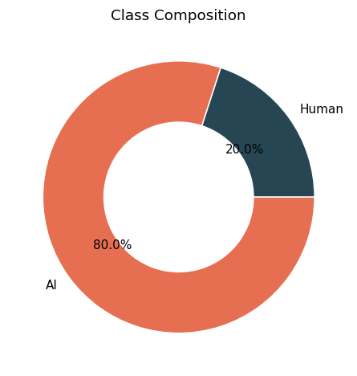
Exploratory Data Analysis
Class Distribution

Slide 8
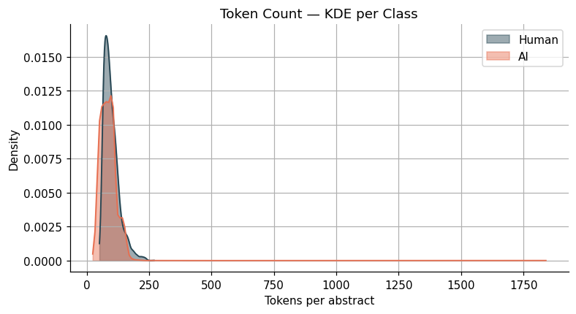
Exploratory Data Analysis
Token Density

Slide 9
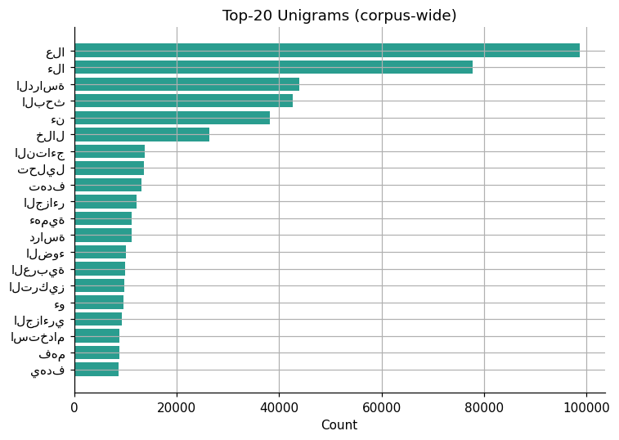
Exploratory Data Analysis
Top Unigrams

Slide 10
Model Training Configuration
Split | Percentage | Row Count
Training | 70% | 29,345
Validation | 15% | 6,430
Test | 15% | 6,161

Slide 11
Results
Model | Accuracy | F1-Score | AUC-ROC
Logistic Regression | 0.9802 | 0.9804 | 0.9955
Linear SVM | 0.9750 | 0.9751 | 0.9946
Naive Bayes | 0.9087 | 0.9137 | 0.7275
Random Forest | 0.8123 | 0.7396 | 0.9872

Slide 12
Evaluation
Best Model (Logistic Regression) Performance
Metric | Score
Accuracy | 98.25%
F1-Score | 0.9826
AUC-ROC | 0.9961

Slide 13
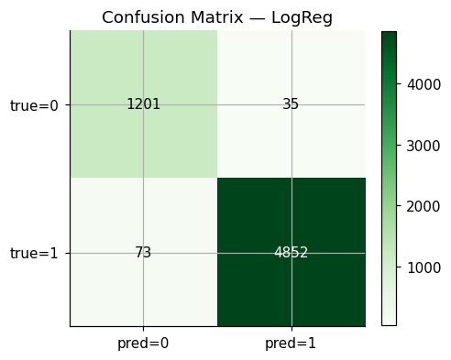
Confusion Matrix
The model shows excellent performance with only 35 false positives (AI misclassified as human) and 73 false negatives (human misclassified as AI). The low error rates indicate strong discriminative capability.

Slide 14
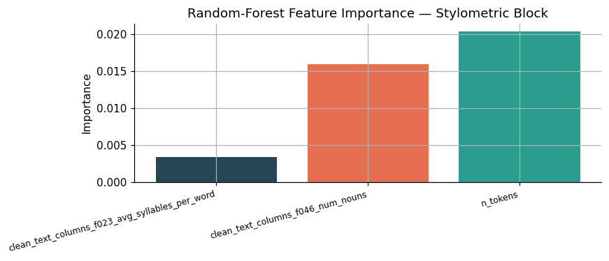
Feature Importance
Token count (n_tokens) showed the highest importance among stylometric features, followed by noun count. Average syllables per word contributed minimally, suggesting that syllable-level features may be less discriminative than lexical density measures for this dataset.

Slide 15
Streaming Implementation
JSON Files
Spark Structured Streaming
Preprocessing UDFs ↓
TF-IDF Pipeline Transform
Model Inference (Logistic Regression)
Parquet Output

Slide 16
Streaming Implementation
Metric | Value
Total records | 50
Batches | 5
Processing mode | Append, 3-second trigger
Output format | JSON (partitioned)
Accuracy (simulated) | 95.0%

Slide 17
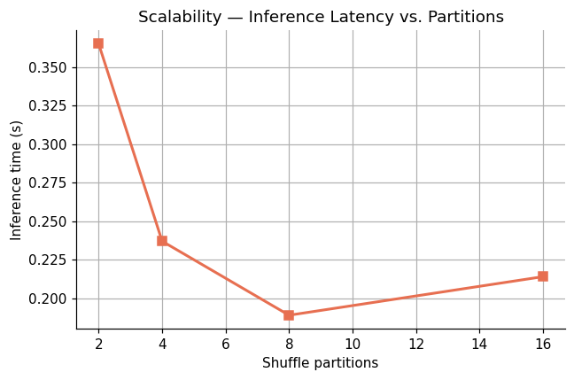
Scalability Benchmark
Partitions | Time (seconds) | Efficiency
2 | 0.365 | Baseline
4 | 0.237 | Optimal
8 | 0.189 | Improved
16 | 0.214 | Overhead increase

Slide 18
Summery
This project successfully implemented a distributed big data pipeline for Arabic AI-text detection using Apache Spark. The Logistic Regression model, trained on a hybrid feature set combining TF-IDF and stylometric features (average syllables per word and noun count), achieved excellent performance (98.25% accuracy, 0.9826 F1-score, 0.9961 AUC). The streaming implementation demonstrated real-time inference capability, and scalability analysis identified optimal parallelism at 8 partitions.

