Slide 1
GPU Programming Contest

Slide 2
Contents
Target: Clustering with Kmeans
How to use toolkit1.0
Towards the fastest program

Slide 3
Target application：clustering with Kmeans
A famous method for clustering
A program with kmeans method for a host processor is given. Modify it so that it works on GPU as fast as possible.
For final results, only the runs on the compute nodes of Fermi or Longhorn will be considered.

Slide 4

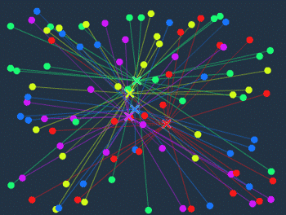
Kmeans method(1/5)
Initial state：
Nodes in a certain color is distributed randomly.
(Here, 100nodes with 5 colors are shown)
STEP1:
Centre of gravity is computed for
each colored node set.
(X in the figure is each centre)
Reference URL:
http://d.hatena.ne.jp/nitoyon/20090409/kmeans_visualise

Slide 5
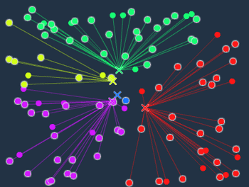
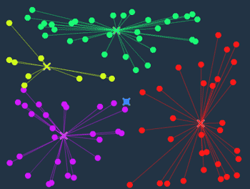
Kmeans method(2/5)
STEP2
The color of each node is changed into that of the nearest centre.
STEP1:
Again, the centre of gravity is computer in node set with the same color.

Slide 6
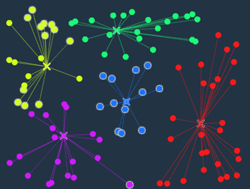
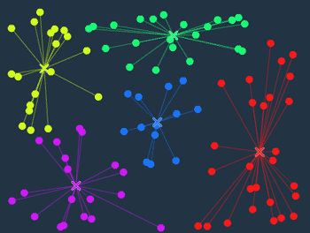
Kmeans method(3/5)
STEP2:
Again, the color of each node is changed into that of the nearest centre.
STEP1:
Again, the centre of gravity is computer in node set with the same color.

Slide 7
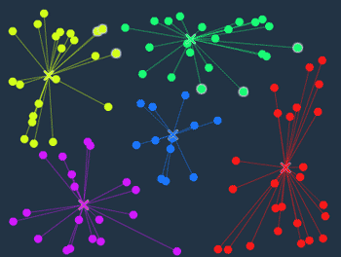
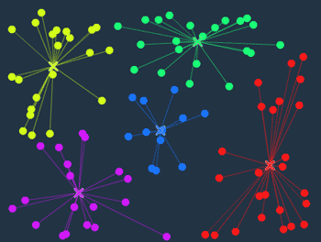
Kmeans method(4/5)
STEP2:
Again, the color of each node is changed into that of the nearest centre.
STEP1:
Again, the centre of gravity is computer in node set with the same color.

Slide 8
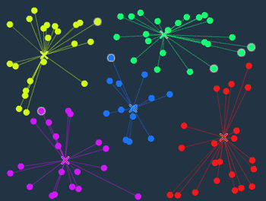
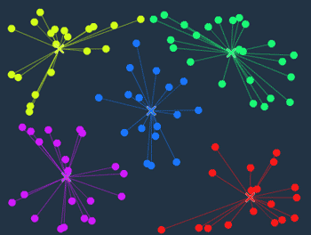
Kmeans method(5/5)
STEP2:
Again and again, the color of each node is changed into that of the nearest centre.
Terminate Condition：
The color of all nodes are the same as the color of the centre, thus, there is no need to change the color.
→Terminate.

Slide 9
How to start
Download kmeans.tar.gz and ungip.
There are useful sample codes in kmeans.
Mission１：Make GPU version based on CPU version.
  Describe gpuKMeans in kmeans.cu
  cpuKMeans in main.cu is a CPU version for reference.
Mission２：Optimize the GPU code so that it runs as fast as possible.

Slide 10
Toolkit1.0
kmeans.cu
  To describe K-means program for GPU
  Please modify this file
main.cu
  To read input data, describe CPU program
  Modification forbidden
check.c
  To visualize output data by OpenCV
gen.c
  To generate input data
Makefile
data/
  Input data
result/
  Output data

Slide 11
How to use Toolkit1.0
$ make
  Compile
$ make gpu
  Execute GPU Program
$ make cpu
  Execute CPU Program
$ ./gen SEED (SEED = 0,1,2,…)
  Generate input data

Slide 12
Sample Code
Vector addition program for GPU
  $ make : Compile
  $ ./main : Program run
Point
  Memory allocation on GPU
    cudaMalloc(), cudaFree()
  Data transfer between CPU and GPU
    cudaMemcpy()
  Format of GPU kernel function

Slide 13
Towards the fastest program
Minimum requirement
  Implementation K-means program on GPU
  Parallelizing STEP1 or STEP2 in K-means
How to optimize program
  Parallelizing both of STEP1 and STEP2
  Shared memory, Constant memory
  Coalesced Memory Access etc
Web Site
  NVIDIA GPU Computing Document: http://developer.nvidia.com/nvidia-gpu-computing-documentation
  Fixstars CUDA Infromation Site: http://gpu.fixstars.com/index.php/

Slide 14
Announcement:
Deadline：8th August 10:00 PM
If you have any question about the contest, please use Piazza.

