Slide 1

BINGE
Danielle Maddox, William Hoy, Michael Balagia, and Desiree Tien

Slide 2
What is binge?
Whether it be a relaxing night at home, watching party, or a date night; BINGE is your one stop shop guide for an evening of consuming.
You can add to/view a list of books, tv shows, movies and the drinks and meals people enjoy pairing with them
You can vote to help the best combinations achieve a higher rating

Slide 3
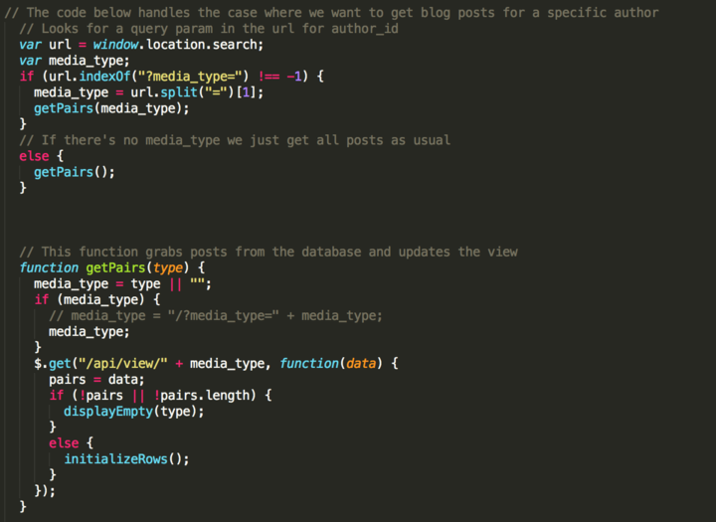
Getting the Table info from the DB

Slide 4
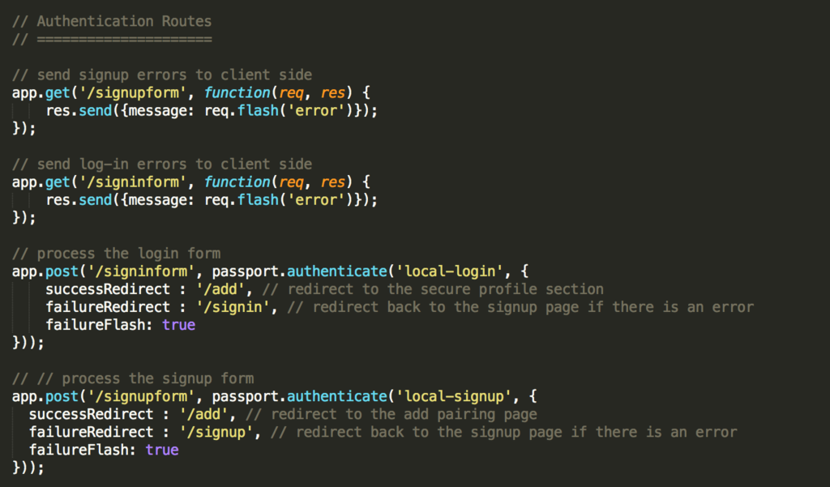
Passport.js routing for user Login, Signup and Authentication

Slide 5
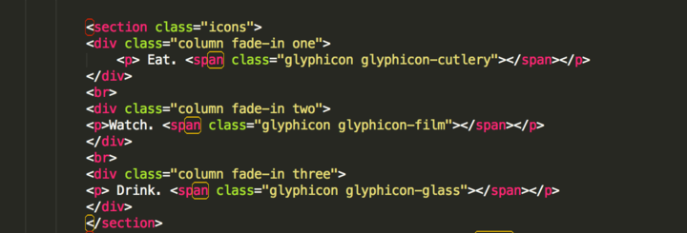
Fade-in classes add Dynamic UI to Home Page

Slide 6
App breakdown
Basic Features
User can input book or movie & a pairing of food and drink.
User can input URL's for food & drink recipes
User can view all in the DB
Version 2
Users can vote on favorite pairings
User accounts

Slide 7
Challenges and successes
User Accounts – Via passport
Config file alignment – helped with our data management
Voting system

Slide 8
Future development
Version 3
Clickable “Eat” “Watch” “Drink” buttons
Connect API data
Add Spotify Playlists!
Search by media title
Limiting to 1 vote
Version 4
"I'm Feeling Lucky" - users can get a random recommendation

Slide 9

Walkthrough

