Slide 1
Tipsy!
Amit Ganju
Courtney Parker
Danielle Maddox
Matt Douglas

Slide 2
Tipsy!
Concept:
Search & display drink recipes based on alcohols and mixers provided by the user.

Slide 3
Tipsy!
APIs used:
1. TheCocktailDB
2. WalmartLabs Search API

Slide 4
Tipsy!
API Overview: TheCocktailDB
Search API that takes a single ingredient as input and returns array of objects.
Challenge:
Since API does not provide for multiple inputs, our code needs to filter results based on 2nd, 3rd, etc. ingredients given by the user.

Slide 5
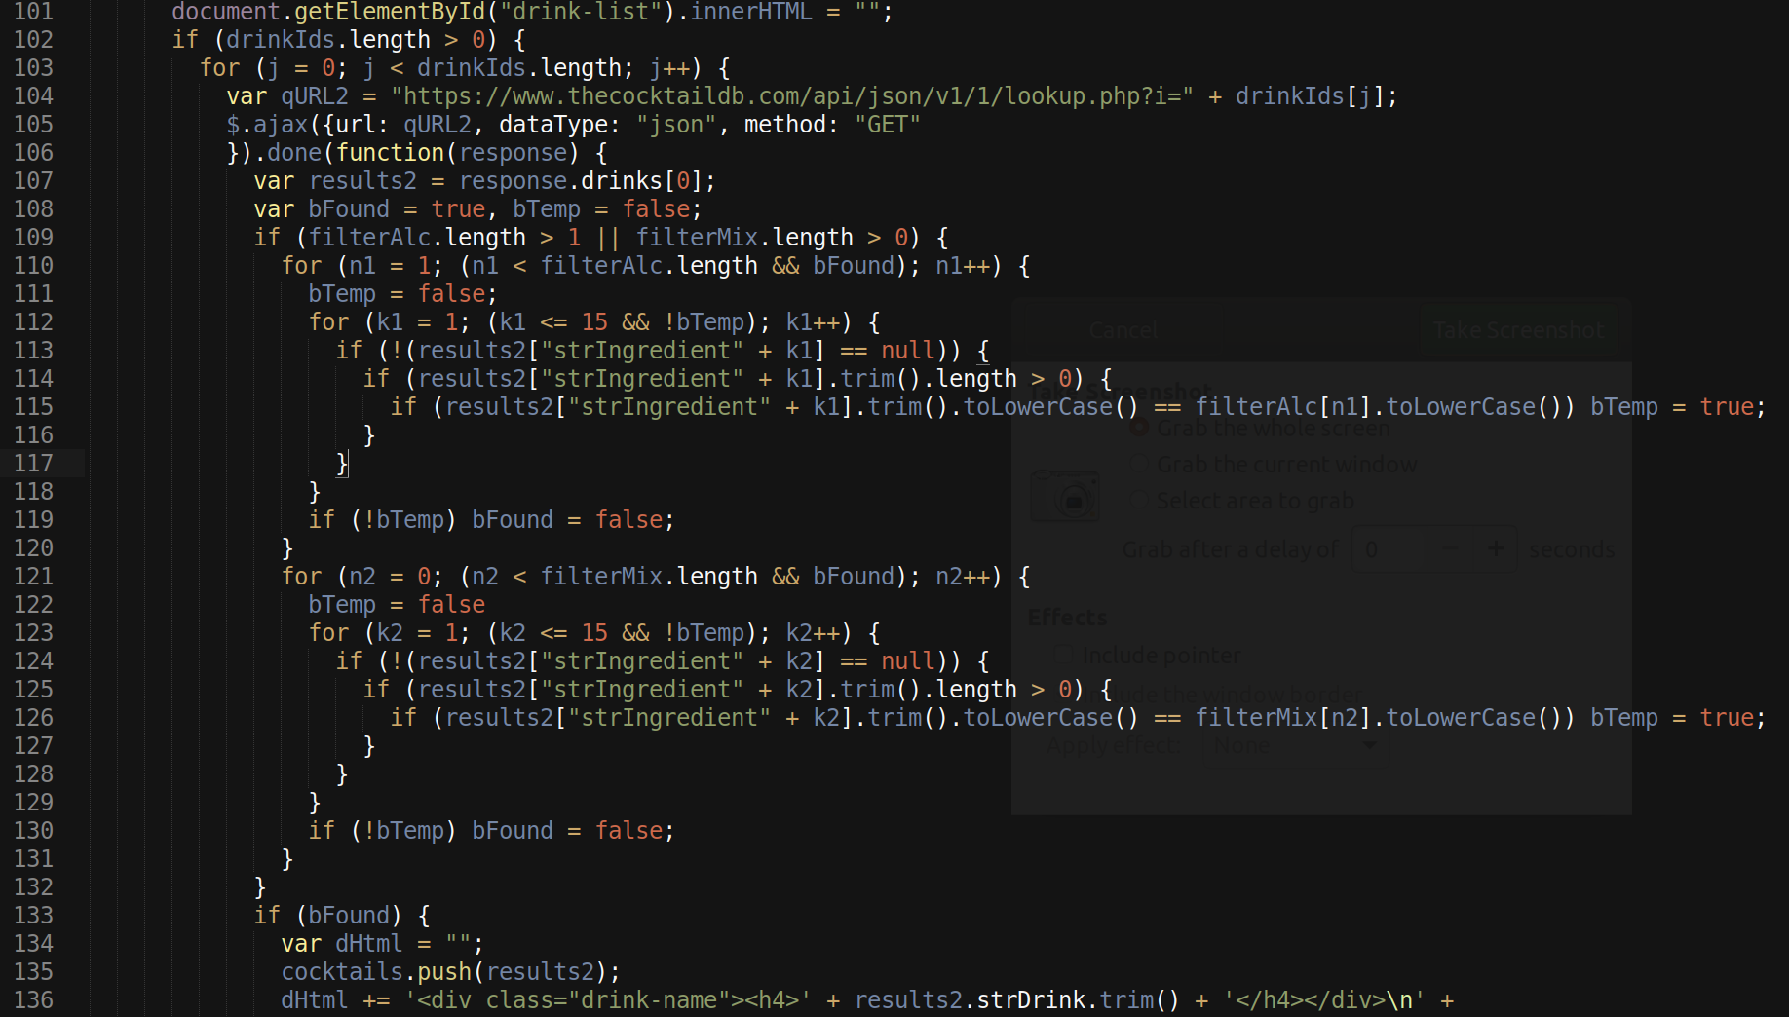
Tipsy!

Slide 6
Tipsy!
API Overview: WalmartLabs Search API
Search API that . . .
Challenge:
Text, text, text

