Slide 1

TEAM N-PROJECT 7 About Wellness Sign-in System
Abstract
A Sign-in system to enhance customer experience and staff efficiency at an About Wellness dispensary
Gregory B., Danielle M., Shayna C.
HCI-UX SS20

Slide 2
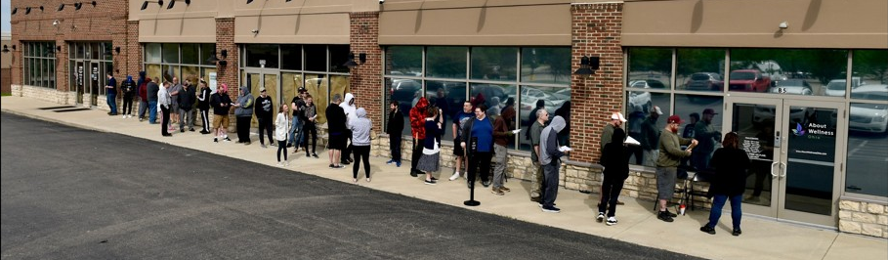
System Concept
Provides more efficient sign-in method
Reduces waiting times due to customer sign-in procedure
Increases staff knowledge of customer needs
Increases customer knowledge of products

Slide 3
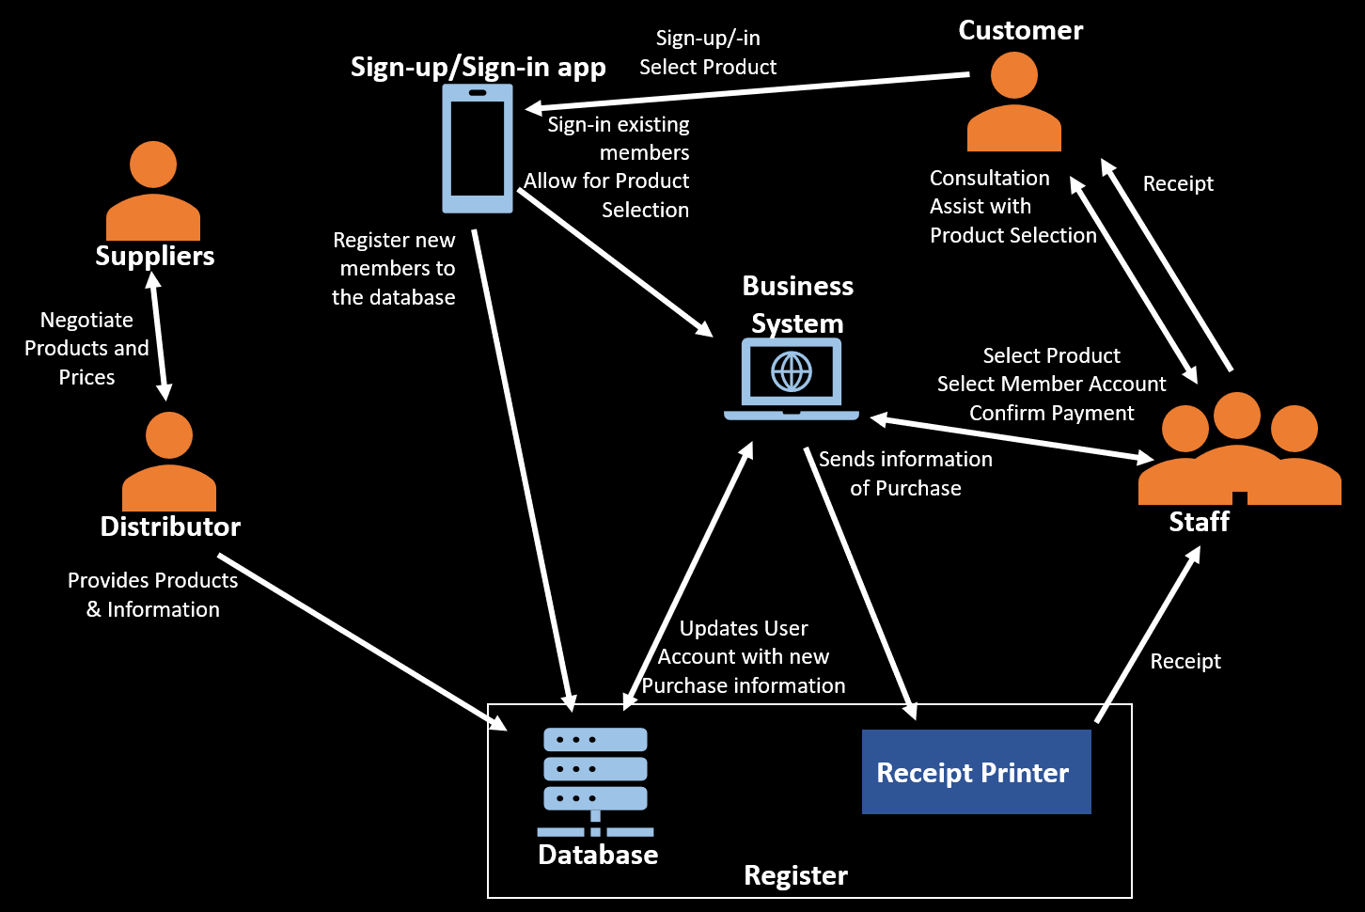
First vision of the project: Hardware & Software
Hardware: tablets to allow for multiple user sign-ins simultaneously
A sign-in application much like a salon sign-in app
Database to store
Product information
Customer accounts
Order information

Slide 4
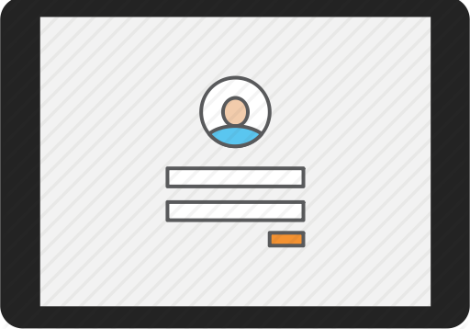
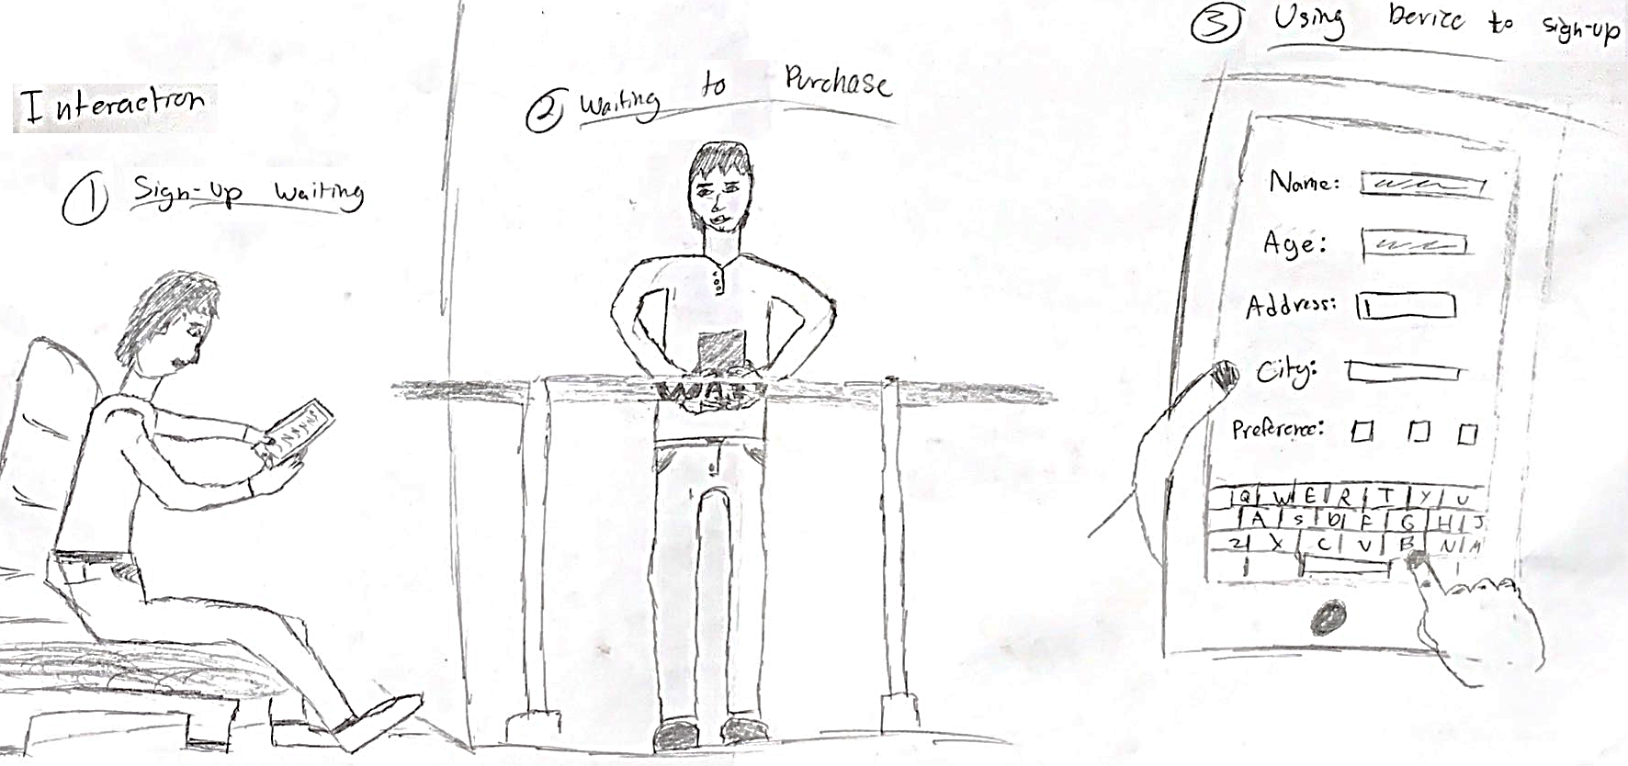
First vision of the project: Customer interaction
Customer account creation and alteration
Accessibility Features
Language
Disabilities (deaf, legally blind)
Product recommendation and favorites
Product in-house ordering

Slide 5
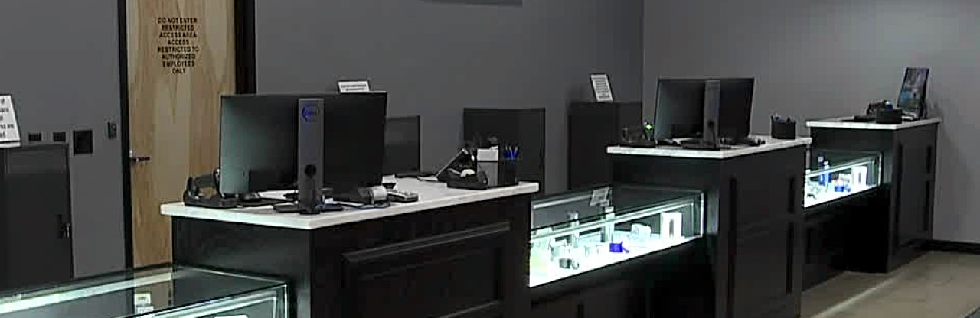
First vision of the project: Staff interaction
Access to sign-in queue
Ability to review user requests, comments, or questions
View in-house orders for efficient check out

Slide 6
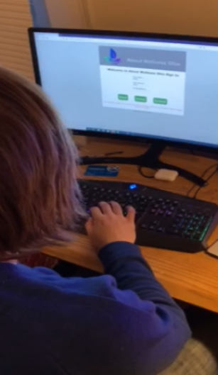
Project Story: Understanding User Needs
Users need medicine from the dispensary
Must able to make purchase in timely manner
Busy people
Risk of illness
Many suffer from ailments and disabilities and may require assistance with purchases
Need a calm, relaxing atmosphere
Participant testing the website. Permission given to use photo.

Slide 7

Project Story: Design Solutions
Automate registration process to remove paperwork
Much faster for customers
Employees don’t need to manually enter information
Give customers freedom to perform common store actions, with staff available if needed
Sign-up/Sign-in
View products and make orders
More efficiency and organization through sign-in queue
No cutting in line

Slide 8
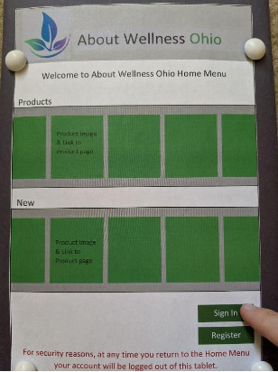
Project Story: Prototype Candidates
Wireframe prototype
Sketched with major components
Black and white
Physical, cardboard prototype
Emotional Design: colorful layout, well-developed icons
Website prototype
HTML, CSS
Robust UI
Interactable; refined layout
Cardboard Prototype

Slide 9
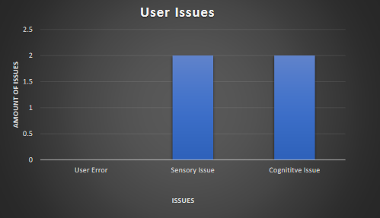
Project Story: Evaluate UX
Determined two tasks users would perform during evaluation
Monitored users as they were performing tasks, recording information as they did it.
Time to complete tasks
Any wrong paths/errors encountered
Any remarks about project
Analyzed data and found patterns
Quickly corrected issues

Slide 10
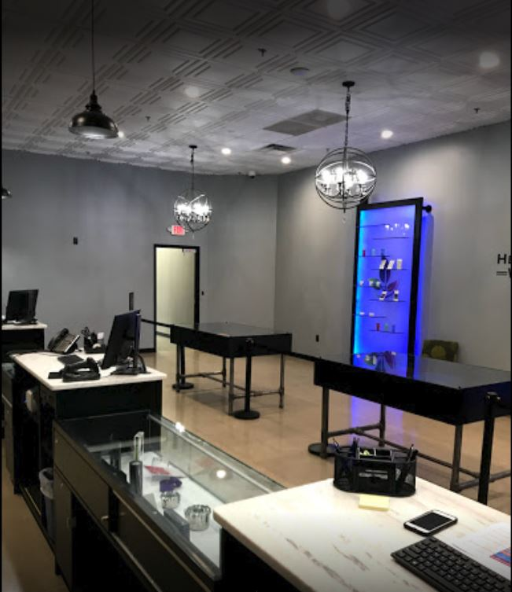
Learnings about applying the lifecycle to something real
Interesting if a company will give the team enough time
A lot of steps in the life cycle
Planning phases
Wireframes/Prototypes
Evaluations
Modifications
Hiring Companies to design

Slide 11
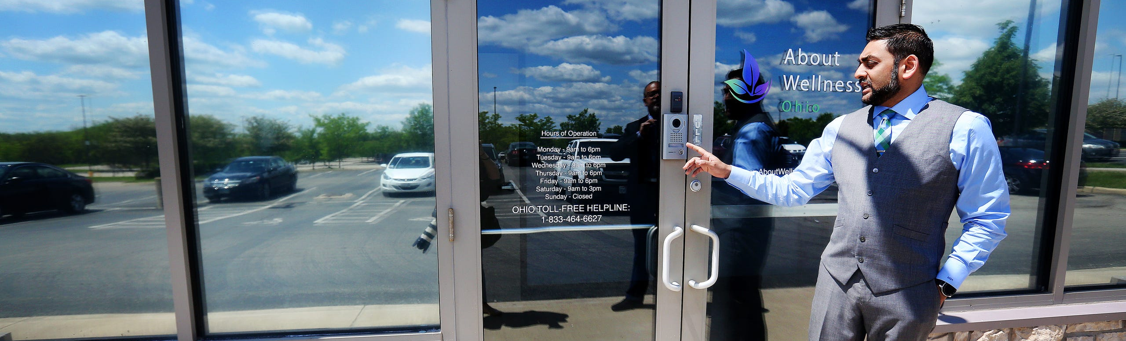
Keeping the project dynamic through the lifecycle
Altered Functions that would be displayed
Added tasks as we moved along
Altered Functions to keep in line with main operation of sign-in application

Slide 12
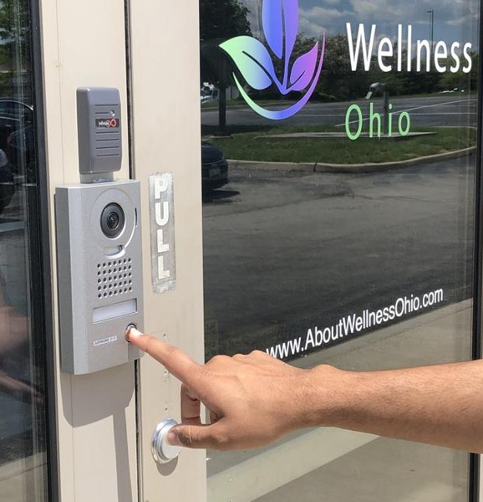
Personal Learnings
Danielle
Creating models
Theoretical concepts of design
Gregory
Solutions will be unique for every problem
Timing is key
Shayna
Planning Is Vital
Research is very important

