Slide 1
Accelerated DataFrames for all: Bringing GPU acceleration to pandas and Polars SciPy 2025 Thursday, July 10, 4:30pm
Vyas Ramasubramani - NVIDIA

Slide 2
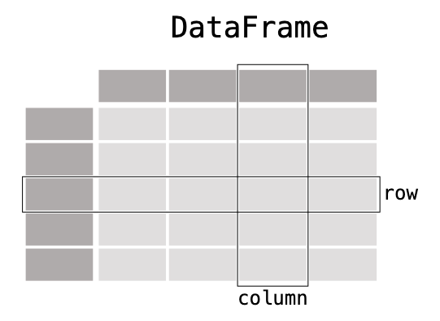







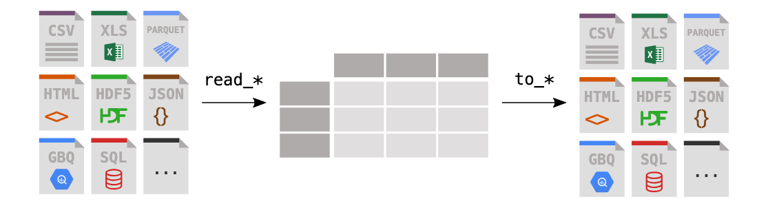


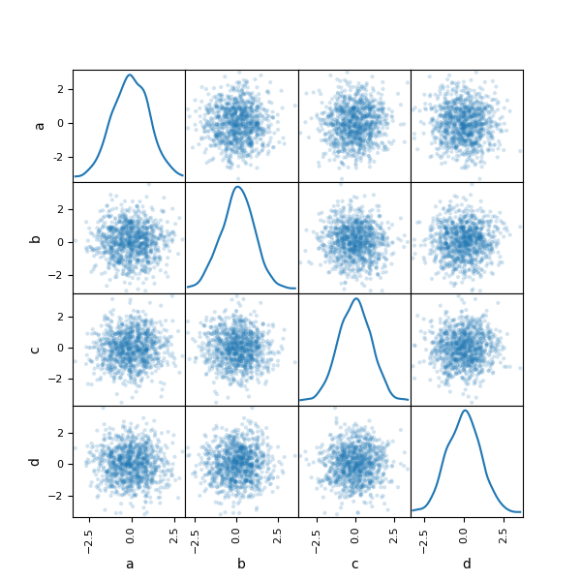
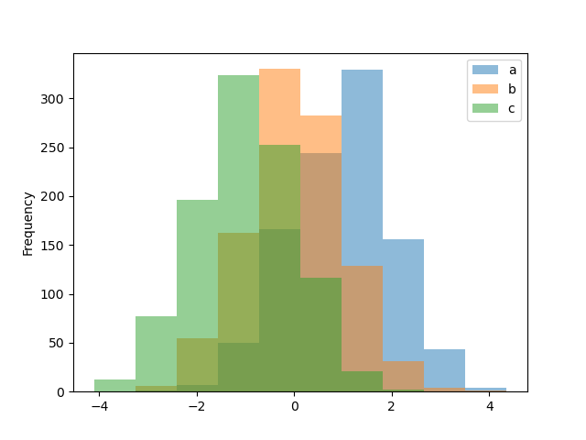
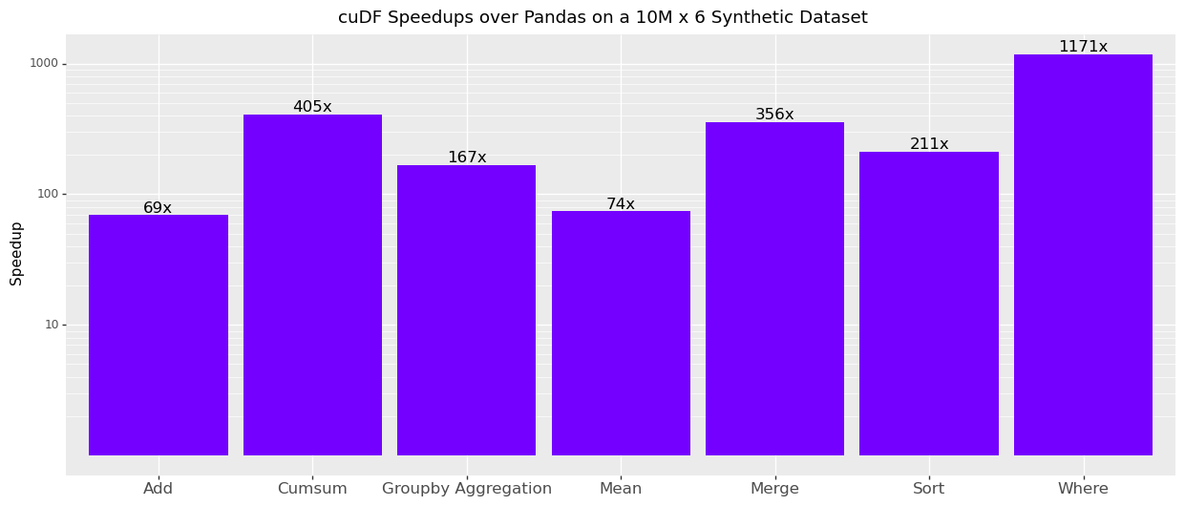
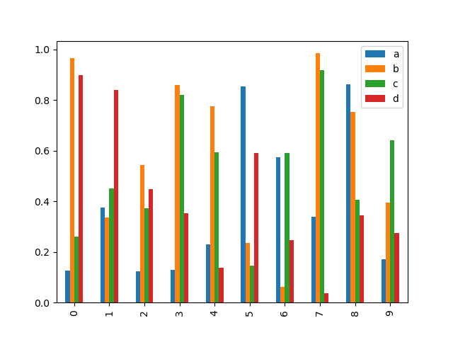
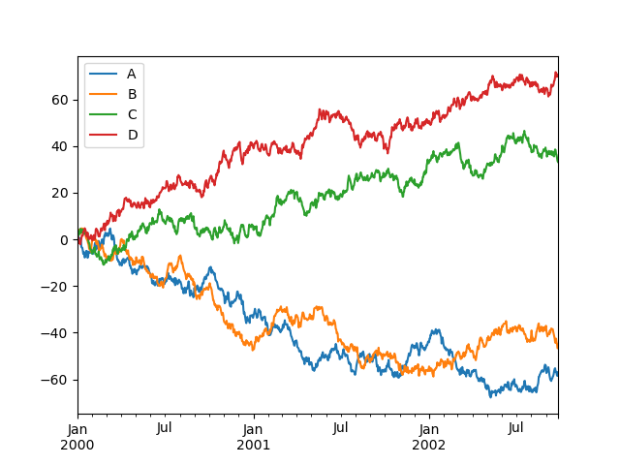
DataFrames in Python
pandas is the giant in the room, ...
import pandas as pd
import cudf as pd
https://pandas.pydata.org

Slide 3
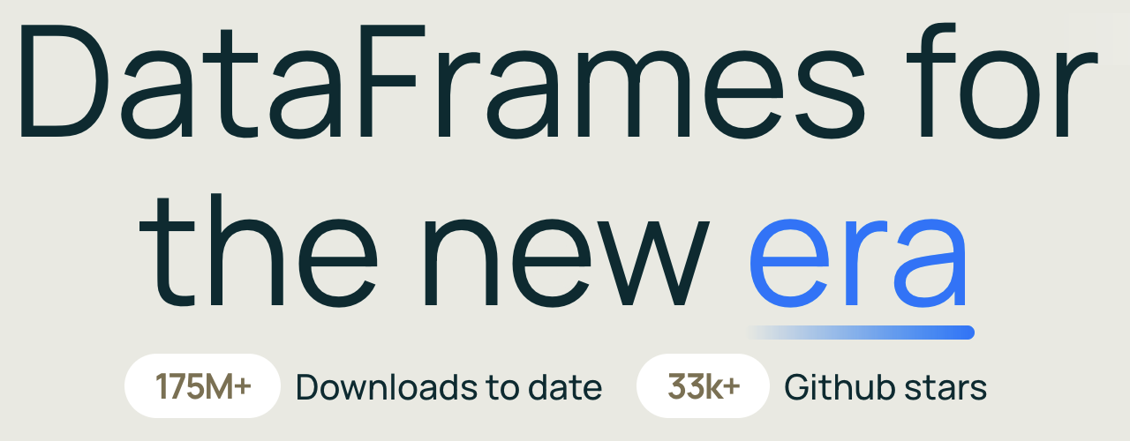

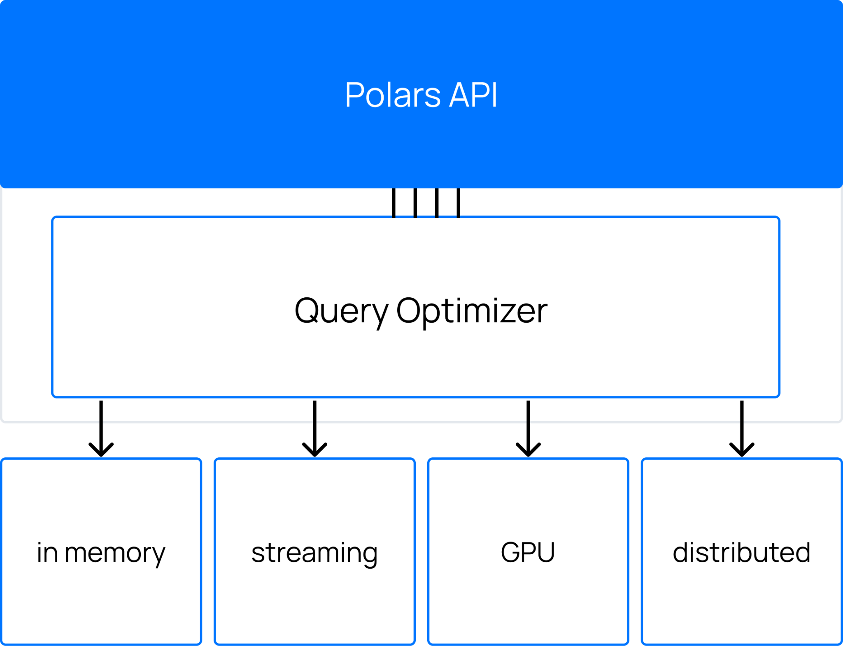
DataFrames in Python
But others like Polars and DuckDB have picked up steam
https://pandas.pydata.org
https://pola.rs

Slide 4
Accelerated DataFrames in Python
cudf.pandas and cudf-polars allow pandas and Polars users to accelerate their code with GPUs
# script.py
import pandas as pd
pd.DataFrame({“a”: [1, 2]}).sum()
# script.py
import polars as pl
pl.LazyFrame({“a”: [1, 2]}).sum().collect()
cudf.pandas
“zero code change”
cudf-polars
“back end”
# script.py
import polars as pl
pl.LazyFrame({“a”: [1, 2]}).sum().collect(
engine=“gpu”
)
IPython: %load_ext cudf.pandas
CLI: $ python –m cudf.pandas <script.py>

Slide 5
Under the Hood of cudf.pandas and cudf-polars
cudf.pandas hijacks pandas imports, while cudf-polars is a natively integrated GPU dispatch mechanism
cudf.pandas
cudf-polars
Custom meta path finder → importing pandas produces a custom ModuleAccelerator,
All imports produce proxy modules
Accessing attributes of proxy modules produces proxy objects (classes, functions, methods, …)
Using proxies triggers a try-except that uses cudf, then falls back to pandas if that fails
Ultimately still leverages the classic cudf package’s functionality under the hood
Support in Polars for a custom callback to process the Polars expression (requires using the lazy API)
User requests to execute a given expression tree on the CPU or the GPU
Decision to execute on the GPU or not is made at the level of plan translation
❯ for f in cudf cudf_polars; do echo -n $f && find python/$f/$f -name "*.py" -exec wc -l {} \; | less | awk '{ s += $1 }; END { print " LOC: ", s }'; done
cudf LOC: 185029
cudf_polars LOC: 15401

Slide 6


The GPU DataFrame Stack
cudf.pandas and cudf-polars are built on a deep stack of libraries
import polars as pl
ldf = ...
df = ldf.collect(engine="gpu"))
Libcudf: the standard GPU implementation of the Arrow spec in C++ (libarrow on the GPU)
Pylibcudf: the standard GPU implementation of the Arrow spec in Python (pyarrow on the GPU)
Cudf: the classic pandas-like GPU Python interface
Cudf.pandas: the zero-code-change pandas engine
Cudf-polars: the Polars GPU back end
%load_ext cudf.pandas
import pandas
import cudf
Pandas
+ cudf.pandas
Polars
cudf (pandas-like)
cudf-polars
Cython
pylibcudf
CUDA C++
libcudf
import pylibcudf as plc

Slide 7
The GPU DataFrame Stack
cuDF is the underlying GPU implementation used by cudf.pandas
pandas
cudf
“drop-in replacement”
>>> import pandas as pd
>>> df = pd.read_csv("filepath")
>>> df.groupby(“col”).mean()
>>> df.rolling(window=3).sum()
CPU
import cudf
cudf (pandas-like)
cuDF
>>> import cudf
>>> df = cudf.read_csv("filepath")
>>> df.groupby(“col”).mean()
>>> df.rolling(window=3).sum()
Cython
pylibcudf
GPU
CUDA C++
libcudf
Average Speed-Ups: 10-100x
import pylibcudf as plc

Slide 8
pylibcudf: Reusable Low-Level Python Primitives
pylibcudf is pyarrow on the GPU
pyarrow
>>> import pyarrow as pa
>>> arr = pa.array([“a”, “b”, “c”])
>>> tbl = pa.table({“col”: arr})
>>> indices = pa.array([0, 2])
>>> pa.compute.take(tbl, indices))
CPU
Key takeaways
Keep bindings layer as thin as possible
Avoid baking front-end semantics into primitives
pylibcudf
>>> import pylibcudf as plc
>>> c = plc.Column.from_iterable_of_py(["a", "b", "c"])
>>> tbl = plc.Table([c])
>>> indices = plc.Column.from_iterable_of_py([0, 2])
>>> plc.copying.gather(tbl, indices)
Use cases
Achieving peak performance
Integrating GPU support into DataFrame libraries (like cudf classic and cudf-polars)
GPU
Cython
pylibcudf
CUDA C++
libcudf
import pylibcudf as plc

Slide 9
Polars Engines
Polars supports multiple modes of operation for executing tasks
sales = pl.DataFrame({
"fruit": ["apple", "banana", ..],
"price": [0.7, 10.0, ..],
"store": ["amsterdam", "london", ..],
})
fruit_facts = pl.DataFrame({
"fruit": ["apple", "pear", ...],
"color": ["red", "orange", ..],
})
sales
.join(fruit_facts, on="fruit")
.filter(pl.col.color == "green")
.with_columns(
sale_pct=pl.col.price / pl.col.price.sum()
)
Eager

Slide 10
Polars Engines
Polars supports multiple modes of operation for executing tasks
sales = pl.DataFrame({
"fruit": ["apple", "banana", ..],
"price": [0.7, 10.0, ..],
"store": ["amsterdam", "london", ..],
})
fruit_facts = pl.DataFrame({
"fruit": ["apple", "pear", ...],
"color": ["red", "orange", ..],
})
sales.lazy()
.join(fruit_facts.lazy(), on="fruit")
.filter(pl.col.color == "green")
.with_columns(
sale_pct=pl.col.price / pl.col.price.sum()
)
.collect()
Eager
Lazy

Slide 11
Polars Engines
Polars supports multiple modes of operation for executing tasks
sales = pl.DataFrame({
"fruit": ["apple", "banana", ..],
"price": [0.7, 10.0, ..],
"store": ["amsterdam", "london", ..],
})
fruit_facts = pl.DataFrame({
"fruit": ["apple", "pear", ...],
"color": ["red", "orange", ..],
})
sales.lazy()
.join(fruit_facts.lazy(), on="fruit")
.filter(pl.col.color == "green")
.with_columns(
sale_pct=pl.col.price / pl.col.price.sum()
)
.collect(streaming=True)
Eager
Lazy
(Lazy) Streaming

Slide 12
Polars GPU Engines
cudf-polars provides implementation of GPU engines
sales = pl.DataFrame({
"fruit": ["apple", "banana", ..],
"price": [0.7, 10.0, ..],
"store": ["amsterdam", "london", ..],
})
fruit_facts = pl.DataFrame({
"fruit": ["apple", "pear", ...],
"color": ["red", "orange", ..],
})
sales.lazy()
.join(fruit_facts.lazy(), on="fruit")
.filter(pl.col.color == "green")
.with_columns(
sale_pct=pl.col.price / pl.col.price.sum()
)
.collect(engine=“gpu”)
Lazy

Slide 13
Polars GPU Engines
cudf-polars provides implementation of GPU engines
sales = pl.DataFrame({
"fruit": ["apple", "banana", ..],
"price": [0.7, 10.0, ..],
"store": ["amsterdam", "london", ..],
})
fruit_facts = pl.DataFrame({
"fruit": ["apple", "pear", ...],
"color": ["red", "orange", ..],
})
sales.lazy()
.join(fruit_facts.lazy(), on="fruit")
.filter(pl.col.color == "green")
.with_columns(
sale_pct=pl.col.price / pl.col.price.sum()
)
.collect(engine=GPUEngine(
executor=“streaming”
)
)
Lazy
Streaming

Slide 14
Polars GPU Engines
cudf-polars provides implementation of GPU engines
sales = pl.DataFrame({
"fruit": ["apple", "banana", ..],
"price": [0.7, 10.0, ..],
"store": ["amsterdam", "london", ..],
})
fruit_facts = pl.DataFrame({
"fruit": ["apple", "pear", ...],
"color": ["red", "orange", ..],
})
sales.lazy()
.join(fruit_facts.lazy(), on="fruit")
.filter(pl.col.color == "green")
.with_columns(
sale_pct=pl.col.price / pl.col.price.sum()
)
.collect(engine=GPUEngine(
executor=“streaming”,
executor_options={“scheduler”: “distributed”}
)
)
Lazy
Streaming
Distributed

Slide 15
The Mechanics of cudf.pandas and cudf-polars
Different constraints lead to different design choices
Queue operations lazily
Load cudf.pandas
Call collect
Generate logical plan
Your Code
Third-Party Libraries Using Pandas
Request CPU execution
Request GPU execution
Translation fails
Translate plan to GPU physical plan
You call function
If data on CPU
Generate CPU physical plan
Copy to GPU
Copy to GPU
If copy fails
Execute on CPU
Execute on GPU
Try cuDF Function
If GPU execution fails
Copy to CPU
Copy to CPU
Call pandas Function
Result
Result

Slide 16
The Mechanics of cudf.pandas and cudf-polars
Different constraints lead to different design choices
Queue operations lazily
Load cudf.pandas
Call collect
Generate logical plan
Your Code
Third-Party Libraries Using Pandas
Request CPU execution
Request GPU execution
Translation fails
Translate plan to GPU physical plan
You call function
How do we scale performantly to larger-than-memory workloads?
Managed memory
Streaming data
If data on CPU
Generate CPU physical plan
Copy to GPU
Copy to GPU
If copy fails
Execute on CPU
Execute on GPU
Try cuDF Function
If GPU execution fails
Copy to CPU
Copy to CPU
Call pandas Function
Result
Result

Slide 17
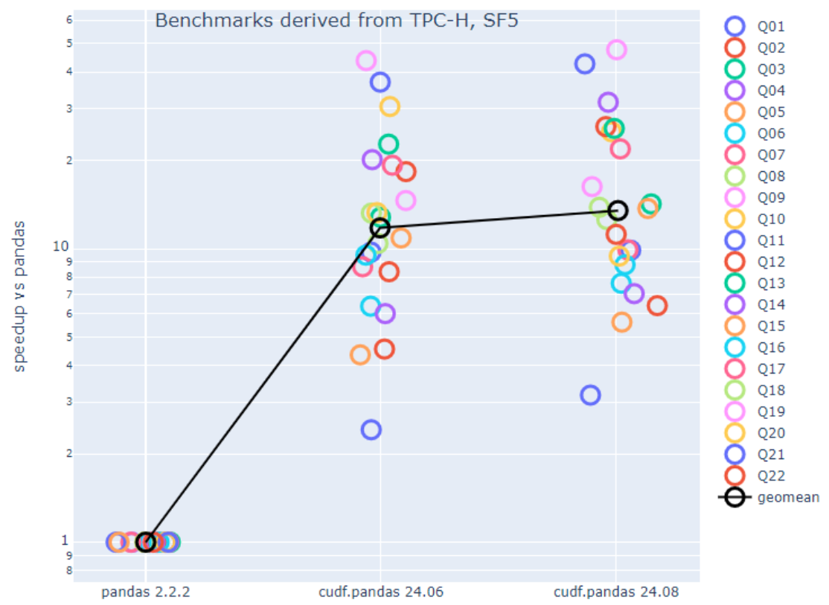
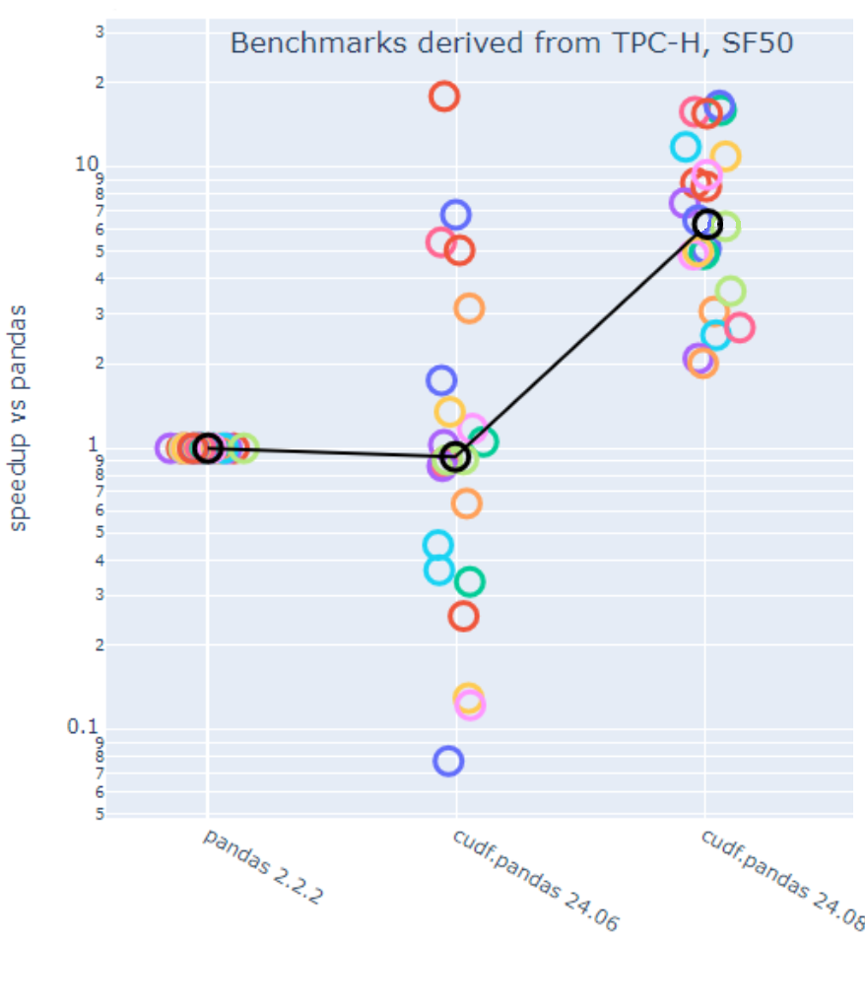
Scaling cudf.pandas
Managed memory is good enough for most cases
Undersubscribed
Oversubscribed ~2-3x
Managed memory allows 2-20x speedups when oversubscribed with no meaningful impact on undersubscribed performance
Speedup
CPU
GPU
GPU w/mm
CPU
GPU
GPU w/mm
GPU: NVIDIA T4 | CPU: Dual socket Intel Xeon 8480CL (Sapphire Rapids) | Storage: Local NVMe.
Derived from https://github.com/fireducks-dev/polars-tpch/blob/fireducks/queries/pandas

Slide 18
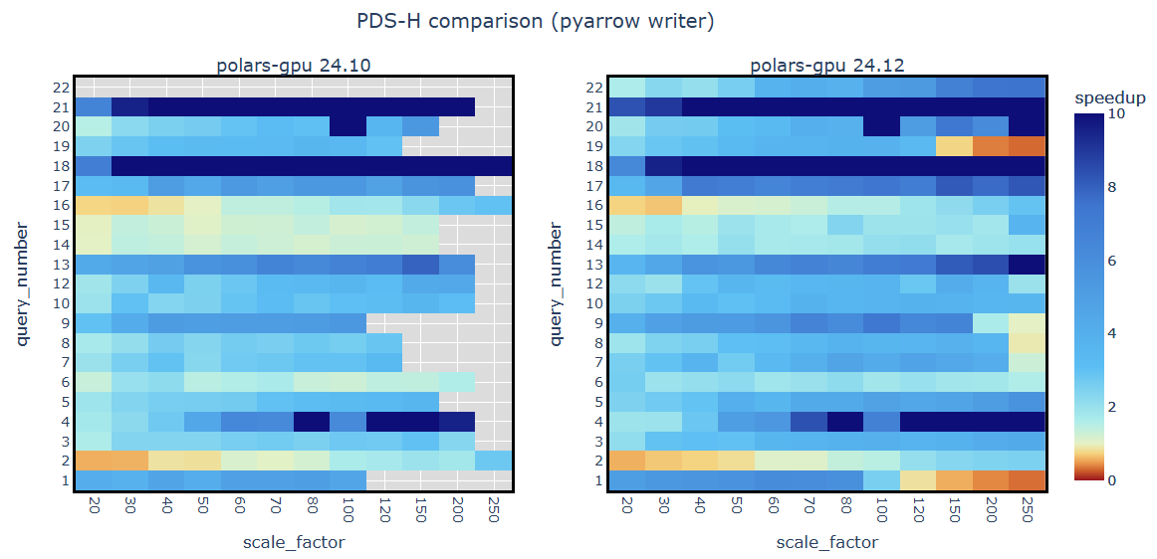
Scaling cudf-polars
Managed memory avoids OOMs, but scaling performance still lags CPU
cudaMalloc
cudaMallocManaged
Managed memory allows queries to complete on the GPU that previously would not
GPU: NVIDIA H100 | CPU: Dual socket Intel Xeon 8480CL (Sapphire Rapids) | Storage: Local NVMe.
Derived from https://github.com/pola-rs/polars-benchmark

Slide 19
Beyond Managed Memory for Scaling in cudf-polars
Moving towards a streaming model
In-memory execution → operation graph==task graph
All inputs and the output of a node must fit in memory
Operator execution is completely sequential
sales.pq
columns: [item, count]
items.pq
columns: [item, price]
filter: color == “green
join
on = “item”
with_columns
cost = count * price
select
cost / cost.sum()

Slide 20
Beyond Managed Memory for Scaling in cudf-polars
Moving towards a streaming model
sales1.pq
columns: [item, count]
In-memory execution → operation graph==task graph
All inputs and the output of a node must fit in memory
Operator execution is completely sequential
Streaming execution → operation graph decomposes into more granular task graph
Lowers memory footprint
Supports larger-than-memory processing
Some operator execution can be overlapped
sales2.pq
columns: [item, count]
items.pq
columns: [item, price]
filter: color == “green
sales3.pq
columns: [item, count]
join
on = “item”
with_columns
cost = count * price
tmp += cost.sum()
select
cost / cost.sum()

Slide 21
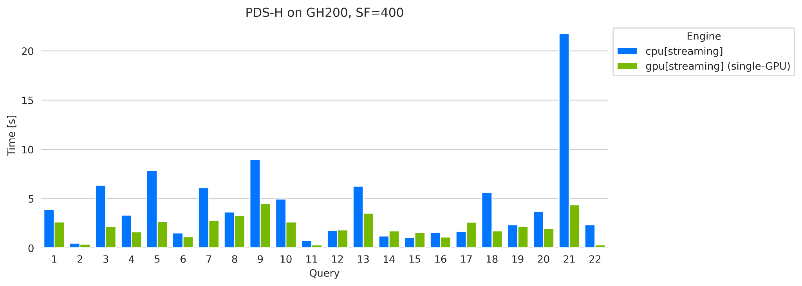
Beyond Managed Memory for Scaling in cudf-polars
Moving towards a streaming model
In-memory execution → operation graph==task graph
All inputs and the output of a node must fit in memory
Operator execution is completely sequential
Streaming execution → operation graph decomposes into more granular task graph
Lowers memory footprint
Supports larger-than-memory processing
Some operator execution can be overlapped
Engine | Time [s]
CPU streaming | 97.0
GPU streaming | 47.0
Benchmark performed on 72-core GH200 with 480GiB RAM. Running on scale factor 400 including I/O. Queries available at https://github.com/pola-rs/polars-benchmark

Slide 22
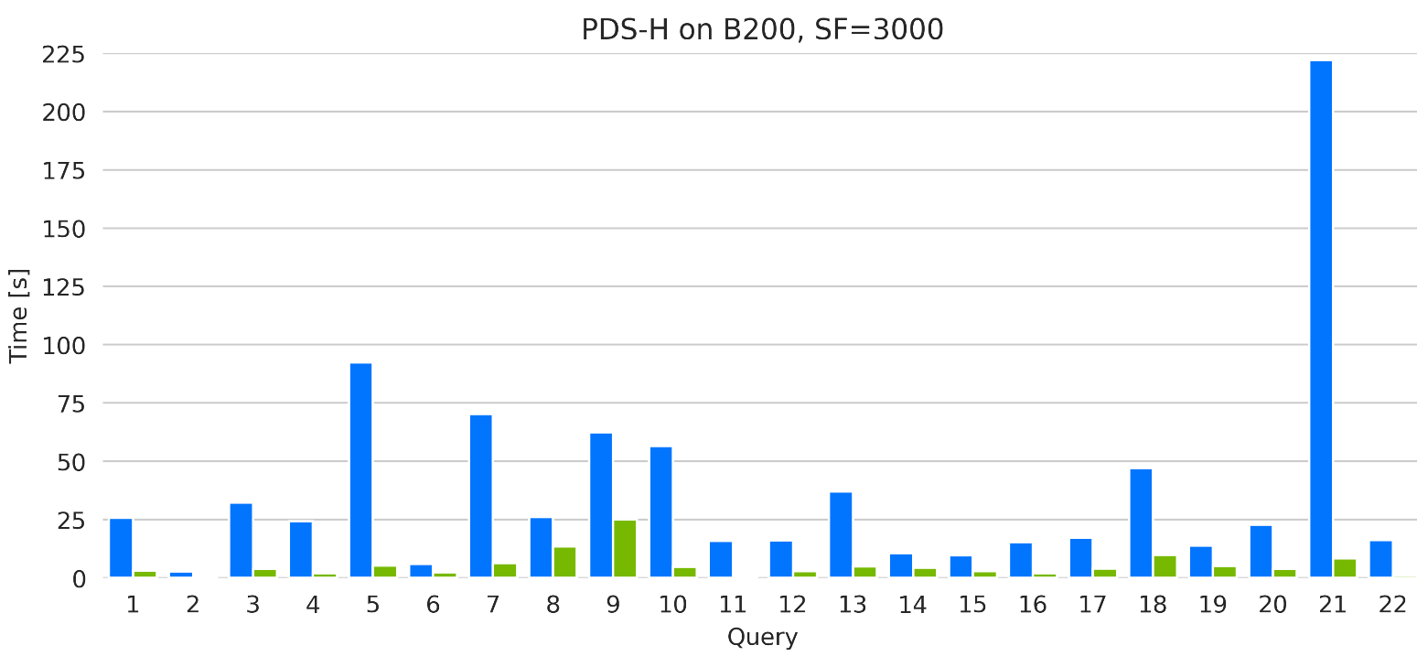
Multi-GPU Execution
Streaming also allows dispatching partitioned work across GPUs
In-memory execution → operation graph==task graph
All inputs and the output of a node must fit in memory
Operator execution is completely sequential
Streaming execution → operation graph decomposes into more granular task graph
Lowers memory footprint
Supports larger-than-memory processing
Some operator execution can be overlapped
Streaming allows distributed execution
Currently uses dask
Engine | Time [s]
CPU streaming | 842.7
Multi-GPU | 117.1
Benchmark performed on 112-core Intel 8570 with 2 TiB RAM. and 8xB200. Running on scale factor 3000 including I/O. Queries available at https://github.com/rapidsai/cudf

Slide 23
Relevant Resources
cuDF Github - https://github.com/rapidsai/cudf
RAPIDS website - https://rapids.ai
pip install cudf-cu12 polars
conda install -c rapidsai -c conda-forge cudf polars
Find us at SciPy​
BoF: Accelerated Python - Friday 4:40 PM, room 317
Table right outside the ballroom

Slide 24
The Stack of Theseus
Exposing low-level building blocks directly to Python allows us to seamlessly build different APIs
Libcudf: the standard GPU implementation of the Arrow spec in C++ (libarrow on the GPU)
Pylibcudf: the standard GPU implementation of the Arrow spec in Python (pyarrow on the GPU)
Cudf: the classic pandas-like GPU Python interface
import cudf
cudf (pandas-like)
Cython
pylibcudf
CUDA C++
libcudf

Slide 25
The Stack of Theseus
Exposing low-level building blocks directly to Python allows us to seamlessly build different APIs
Libcudf: the standard GPU implementation of the Arrow spec in C++ (libarrow on the GPU)
Pylibcudf: the standard GPU implementation of the Arrow spec in Python (pyarrow on the GPU)
Cudf: the classic pandas-like GPU Python interface
Cudf.pandas: the zero-code-change pandas engine
%load_ext cudf.pandas
import pandas
import cudf
Pandas
+ cudf.pandas
cudf (pandas-like)
Cython
pylibcudf
CUDA C++
libcudf

Slide 26
From “Close Enough” to a Drop-In Replacement
Focusing on a zero-code-change user experience
How do we expand support beyond pandas-like APIs?
Pandas
+ cudf.pandas
Python
cudf (pandas-like)
Cython
Internal bindings
CUDA C++
libcudf

Slide 27
cuDF: NVIDIA’s Core PyData/C++ ELT/ETL Solution
GPU DataFrames in C++ and a drop-in replacement for pandas in Python
Pandas-like API on the GPU
pandas
>>> import pandas as pd
>>> df = pd.read_csv("filepath")
>>> df.groupby(“col”).mean()
>>> df.rolling(window=3).sum()
CPU
Python
cudf (pandas-like)
cuDF
>>> import cudf
>>> df = cudf.read_csv("filepath")
>>> df.groupby(“col”).mean()
>>> df.rolling(window=3).sum()
Cython
Internal bindings
GPU
CUDA C++
libcudf
Average Speed-Ups: 10-100x

Slide 28
When cuDF Isn’t Enough
“Close” to pandas-compatible isn’t close enough
The problem: drop-in replacements aren’t perfectly zero-code-change
“We just don't have time to rewrite our code in a new paradigm.”
- PNC Bank
Python
cudf (pandas-like)
Cython
Internal bindings
“The behavior of pandas and cudf is slightly different…”
- ML Engineer / Kaggle Master
CUDA C++
libcudf

Slide 29
Today’s Topics
What we’ve built for GPU-accelerated DataFrames and how we’ve built it
Requirements for a GPU engine:
Must support every feature the CPU engine does (or fall back transparently
Must be at least as fast as the CPU engine
Today’s talk will focus on
How our current architecture supports as much shared infrastructure as possible
How we satisfy the above criteria for pandas and Polars
Why these front-ends require very different implementations
How the above requirements apply at scale
When we move beyond these requirements
Python
cudf (pandas-like)
Cython
Internal bindings
CUDA C++
libcudf

Slide 30
The Challenges of Drop-In Replacements
The new tool has to ”just work” on anything the old tool did
import polars as pl
ldf = ...
df = ldf.collect(engine="gpu"))
Requirements for a GPU engine:
Must support every feature the CPU engine does (or fall back transparently
Must be at least as fast as the CPU engine
Today’s talk will focus on
How our current architecture supports as much shared infrastructure as possible
How we satisfy these criteria for pandas and Polars
Why these require such different implementations
How these requirements apply at scale
%load_ext cudf.pandas
import pandas
import pylibcudf as plc
import cudf
Pandas
+ cudf.pandas
Polars
cudf (pandas-like)
cudf-polars
Cython
pylibcudf
CUDA C++
libcudf

Slide 31
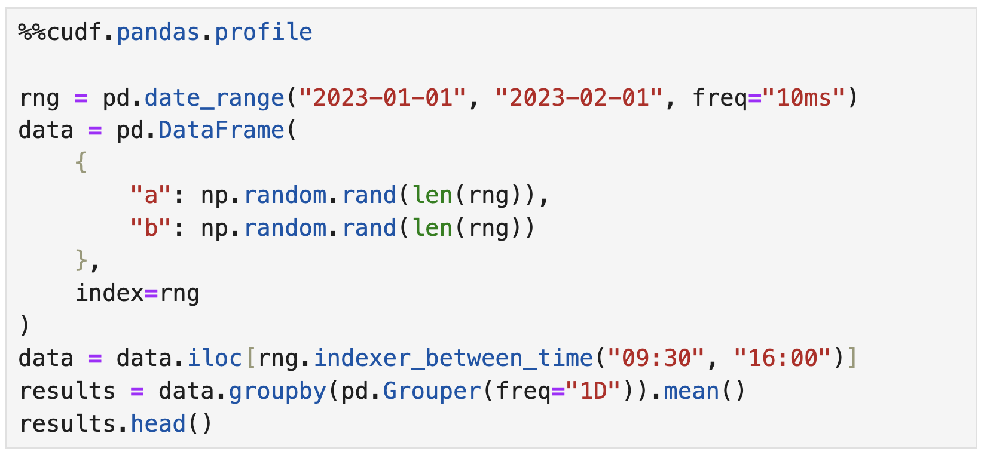
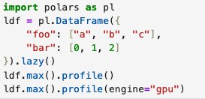
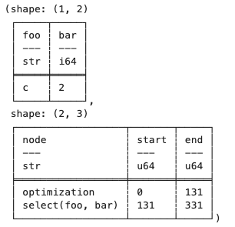
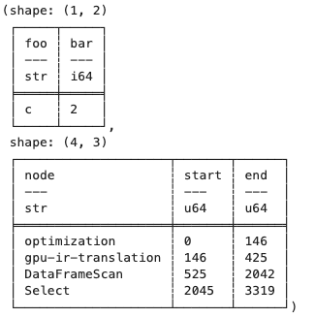
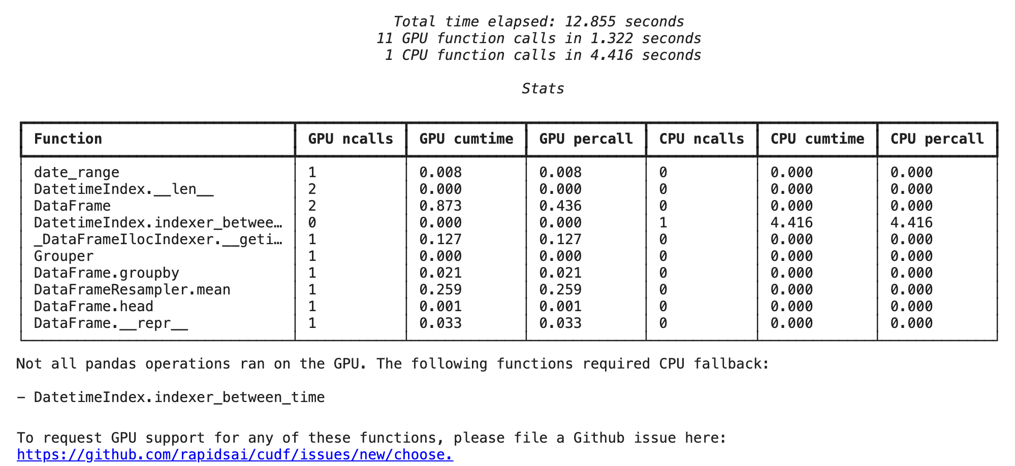
Profiling comparison
Profiling cudf.polars follows the more traditional meaning
TODO: Discuss fallback and ways to prevent (env vars, collect flags)
Notes:
Discuss fallback and ways to prevent it
Show environment variables that control this

Slide 32

Evolution of Accelerated Computing
Finding the right niche for every kind of user
Easier to
Use
Zero Code Change: Acceleration Plugins (no-code change)
cudf.pandas: Accelerated Pandas, nx-cugraph: Accelerated NetworkX, RAPIDS Spark Accelerator, Array-API backed Scikit-learn, …
Hybrid CPU/GPU libraries (minimal change)
Pytorch, FAISS, Tensorflow, XGBoost, cuML-CPU, Dask, pySpark, …
GPU Python Libraries (GPU Python code)
RAPIDS core libraries (RMM, cuDF, cuML, cuGraph, cuVS…), CuPy, Numba, OpenAI Triton, …
Python/CUDA libraries (Hybrid Python / CUDA code)
CuPy RawKernels, Numba CUDA, Cython wrappers for CUDA, …
C++/CUDA high level (High-level C++/CUDA code)
Libcudf, CCCL (Thrust, CUB, libcucxx), cuBLAS, cuDNN, cuSolver, cuSPARSE, …
Higher
Performance
CUDA Toolkit (C++/CUDA code and kernels)
Raw CUDA kernels
Notes:
For those of you who saw my talk last year, this was the state of accelerated computing last year when I presented

