Slide 1

Accelerating scientific data releases: Automated metadata generation with LLM agents

Slide 2





About Us
Tudor Garbulet
Senior Software Engineer
Chirag Shah
Environmental Data Science Engineer
Austin Aguilar
Software Engineer
Quan Quy
Research Intern
Travis Ping
Research Intern
Atmospheric Radiation Measurement (ARM) Data Center, Oak Ridge National Laboratory
Science Data Management, Core Science Systems, US Geological Survey

Slide 3
What is Metadata?
Describes information about data, including:
who
what
where
when
why, and
how, so it can be understood, re-used, and integrated with other data
Follows standard formats to enable interoperability
Notes:
Add, more on what is metadata, why do we need metadata, what are the uses of metadata?

Slide 4
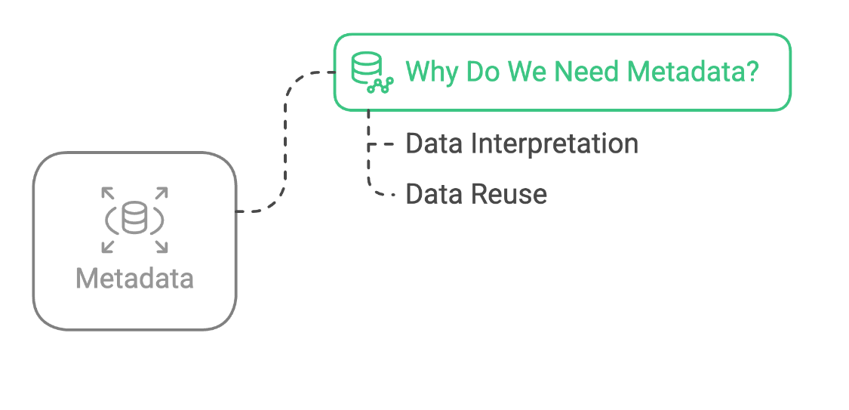
Why do we need Metadata?
Crucial for any use or reuse of data
Explains how the data were created
Where/why it is geographically located
Details about the structure of the data
Notes:
Add, more on what is metadata, why do we need metadata, what are the uses of metadata?

Slide 5
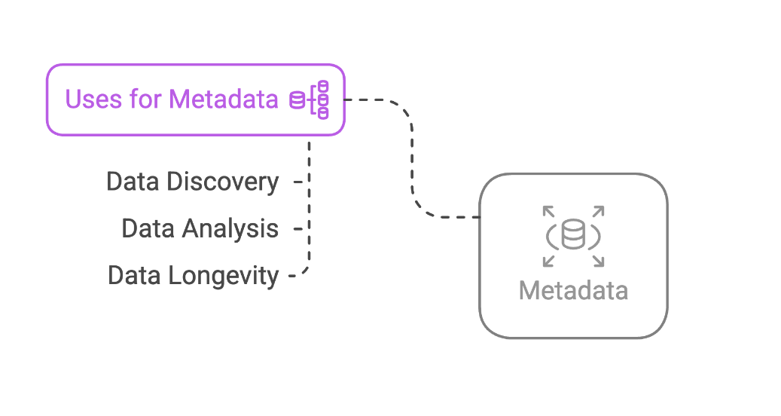
What are the uses of Metadata?
Enabling data discovery
Understanding data
Analysis and synthesis
Maintaining data
Tracking progress of a research project
Demonstrating return on investment for research at an institution
Notes:
Add, more on what is metadata, why do we need metadata, what are the uses of metadata?

Slide 6
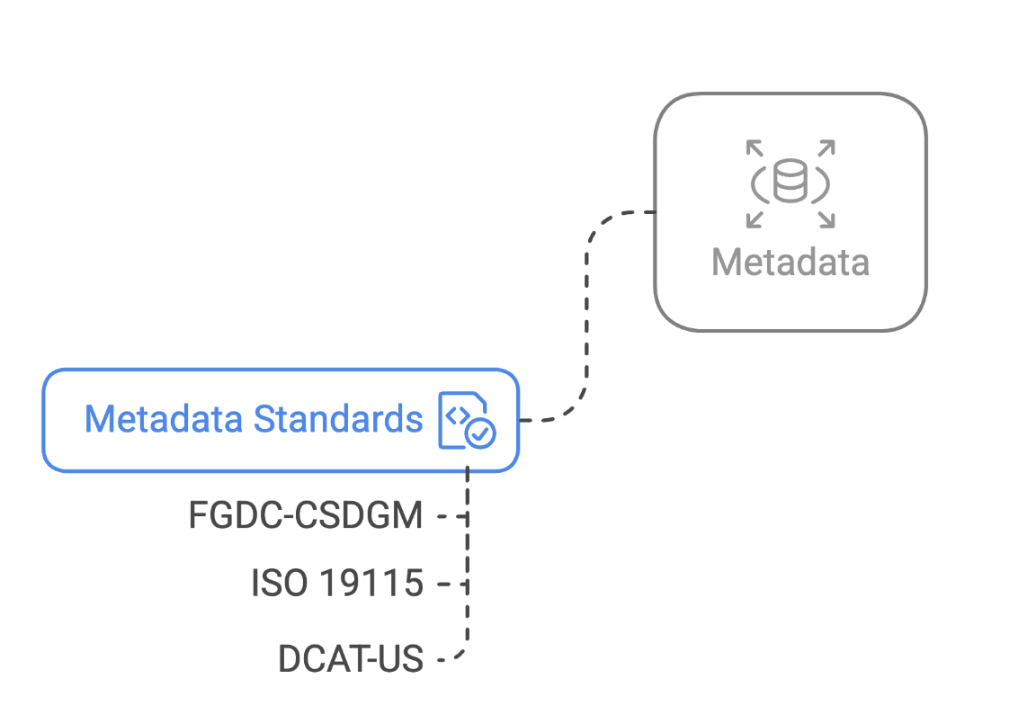
Different Metadata Standards
Content Standard for Digital Geospatial Metadata (CSDGM) or its extensions
International Organization for Standardization (ISO) series of standards (19115, 19115-2, 19139, etc.)
Data Catalog Vocabulary (DCAT)
Notes:
Add, more on what is metadata, why do we need metadata, what are the uses of metadata?

Slide 7
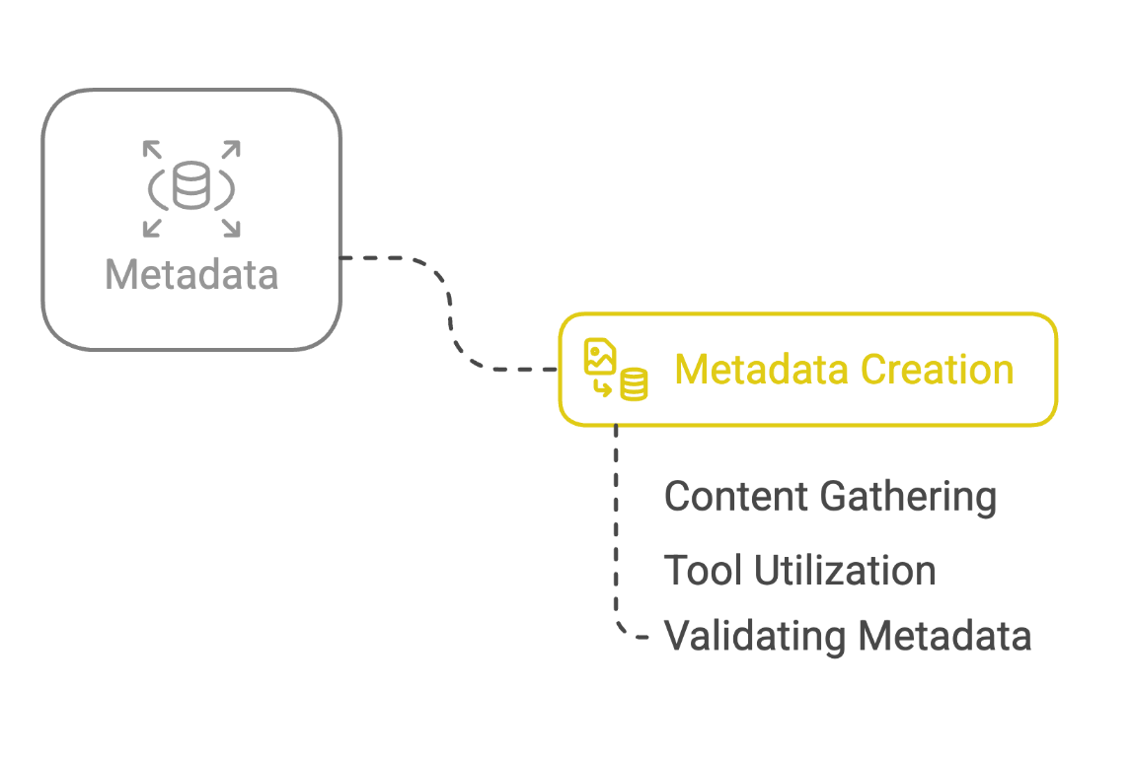
Metadata Management & Creation
Use different tools such as Metadata Wizard, mdEditor, Online Metadata Editor (OME), Microsoft XML Notepad, etc. to create metadata
Involves best practices to ensure accuracy
Requires validation to meet institutional or domain-specific needs
Notes:
Add, more on what is metadata, why do we need metadata, what are the uses of metadata?

Slide 8
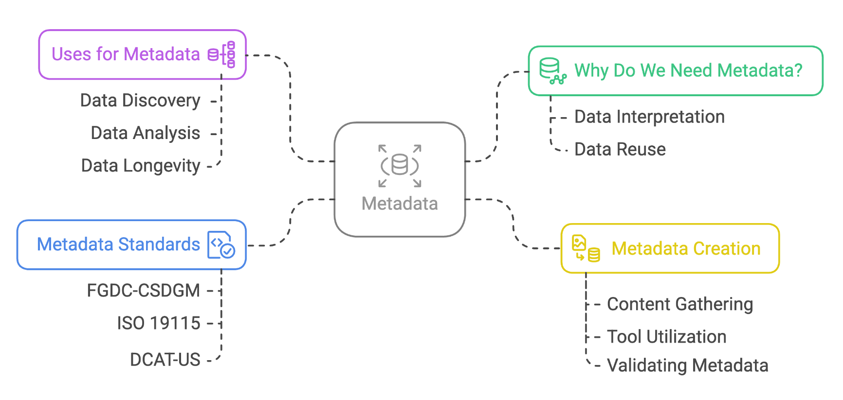
Use Case - USGS
Metadata Creation
Metadata Standards
Tools for creating Metadata
Best Practices for Metadata
Validating Metadata

Slide 9
So Metadata…

Slide 10
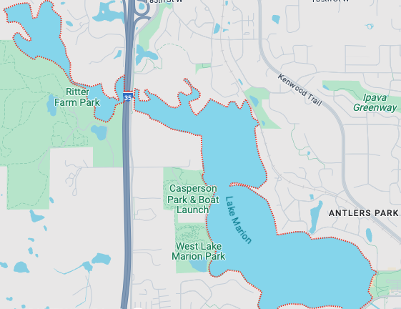
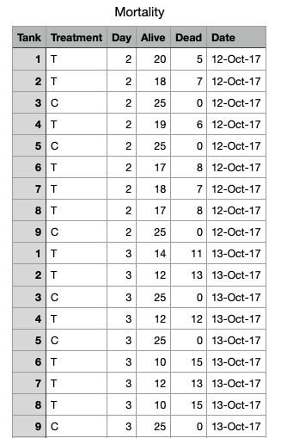
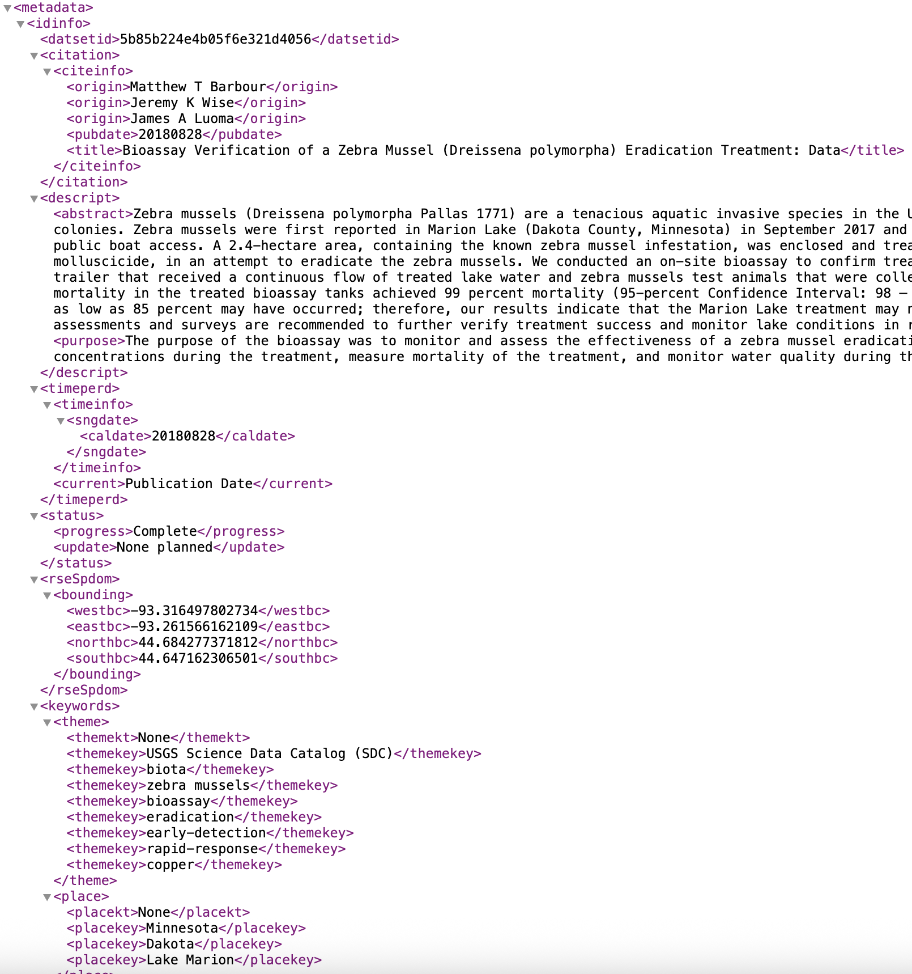
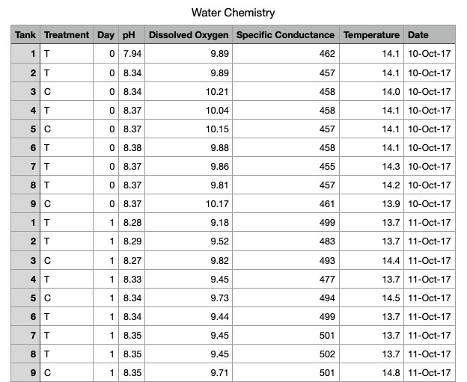
USGS Use Case: Zebra mussels eradication treatment dataset

Slide 11
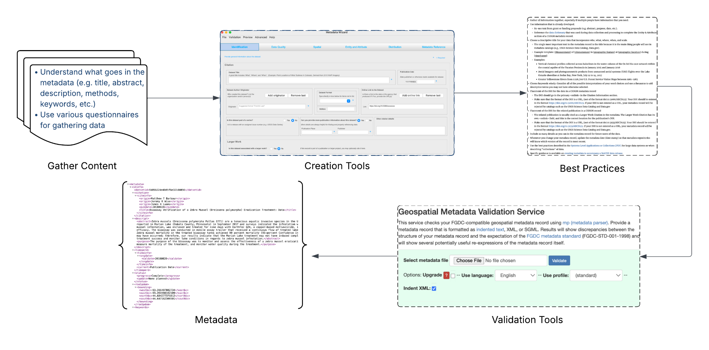
Existing Creation Workflow
Source: https://www.usgs.gov/data-management

Slide 12
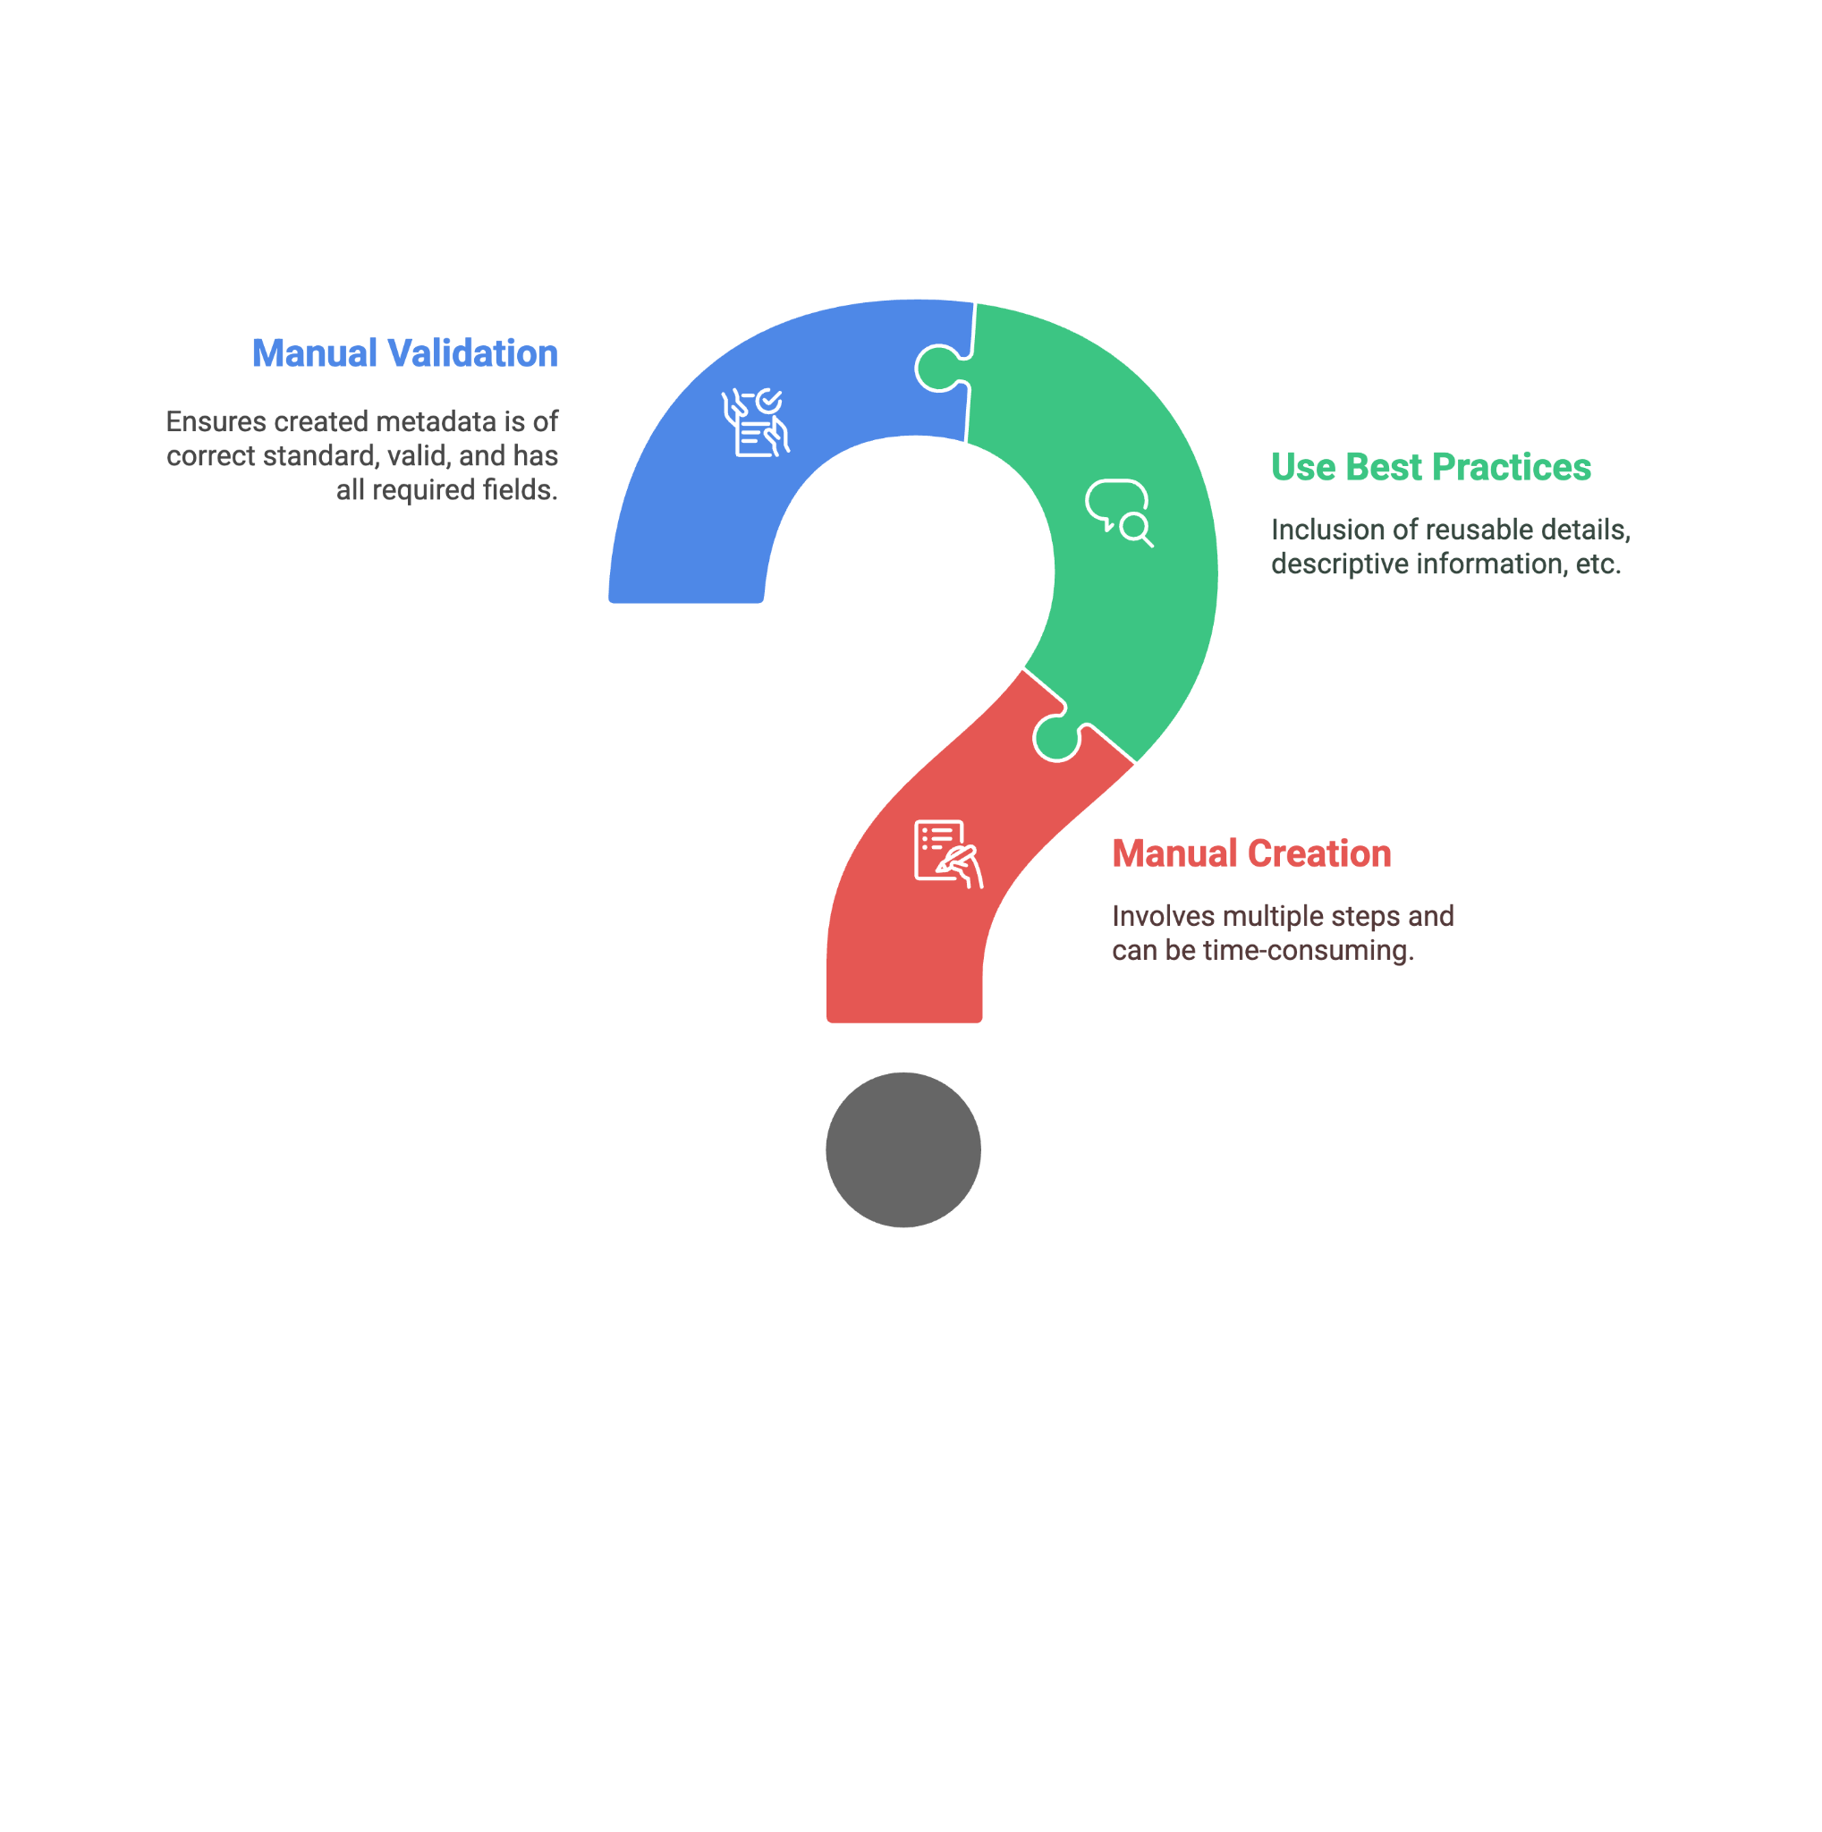
The Problem?
How to effectively manage and automate Metadata creation?

Slide 13
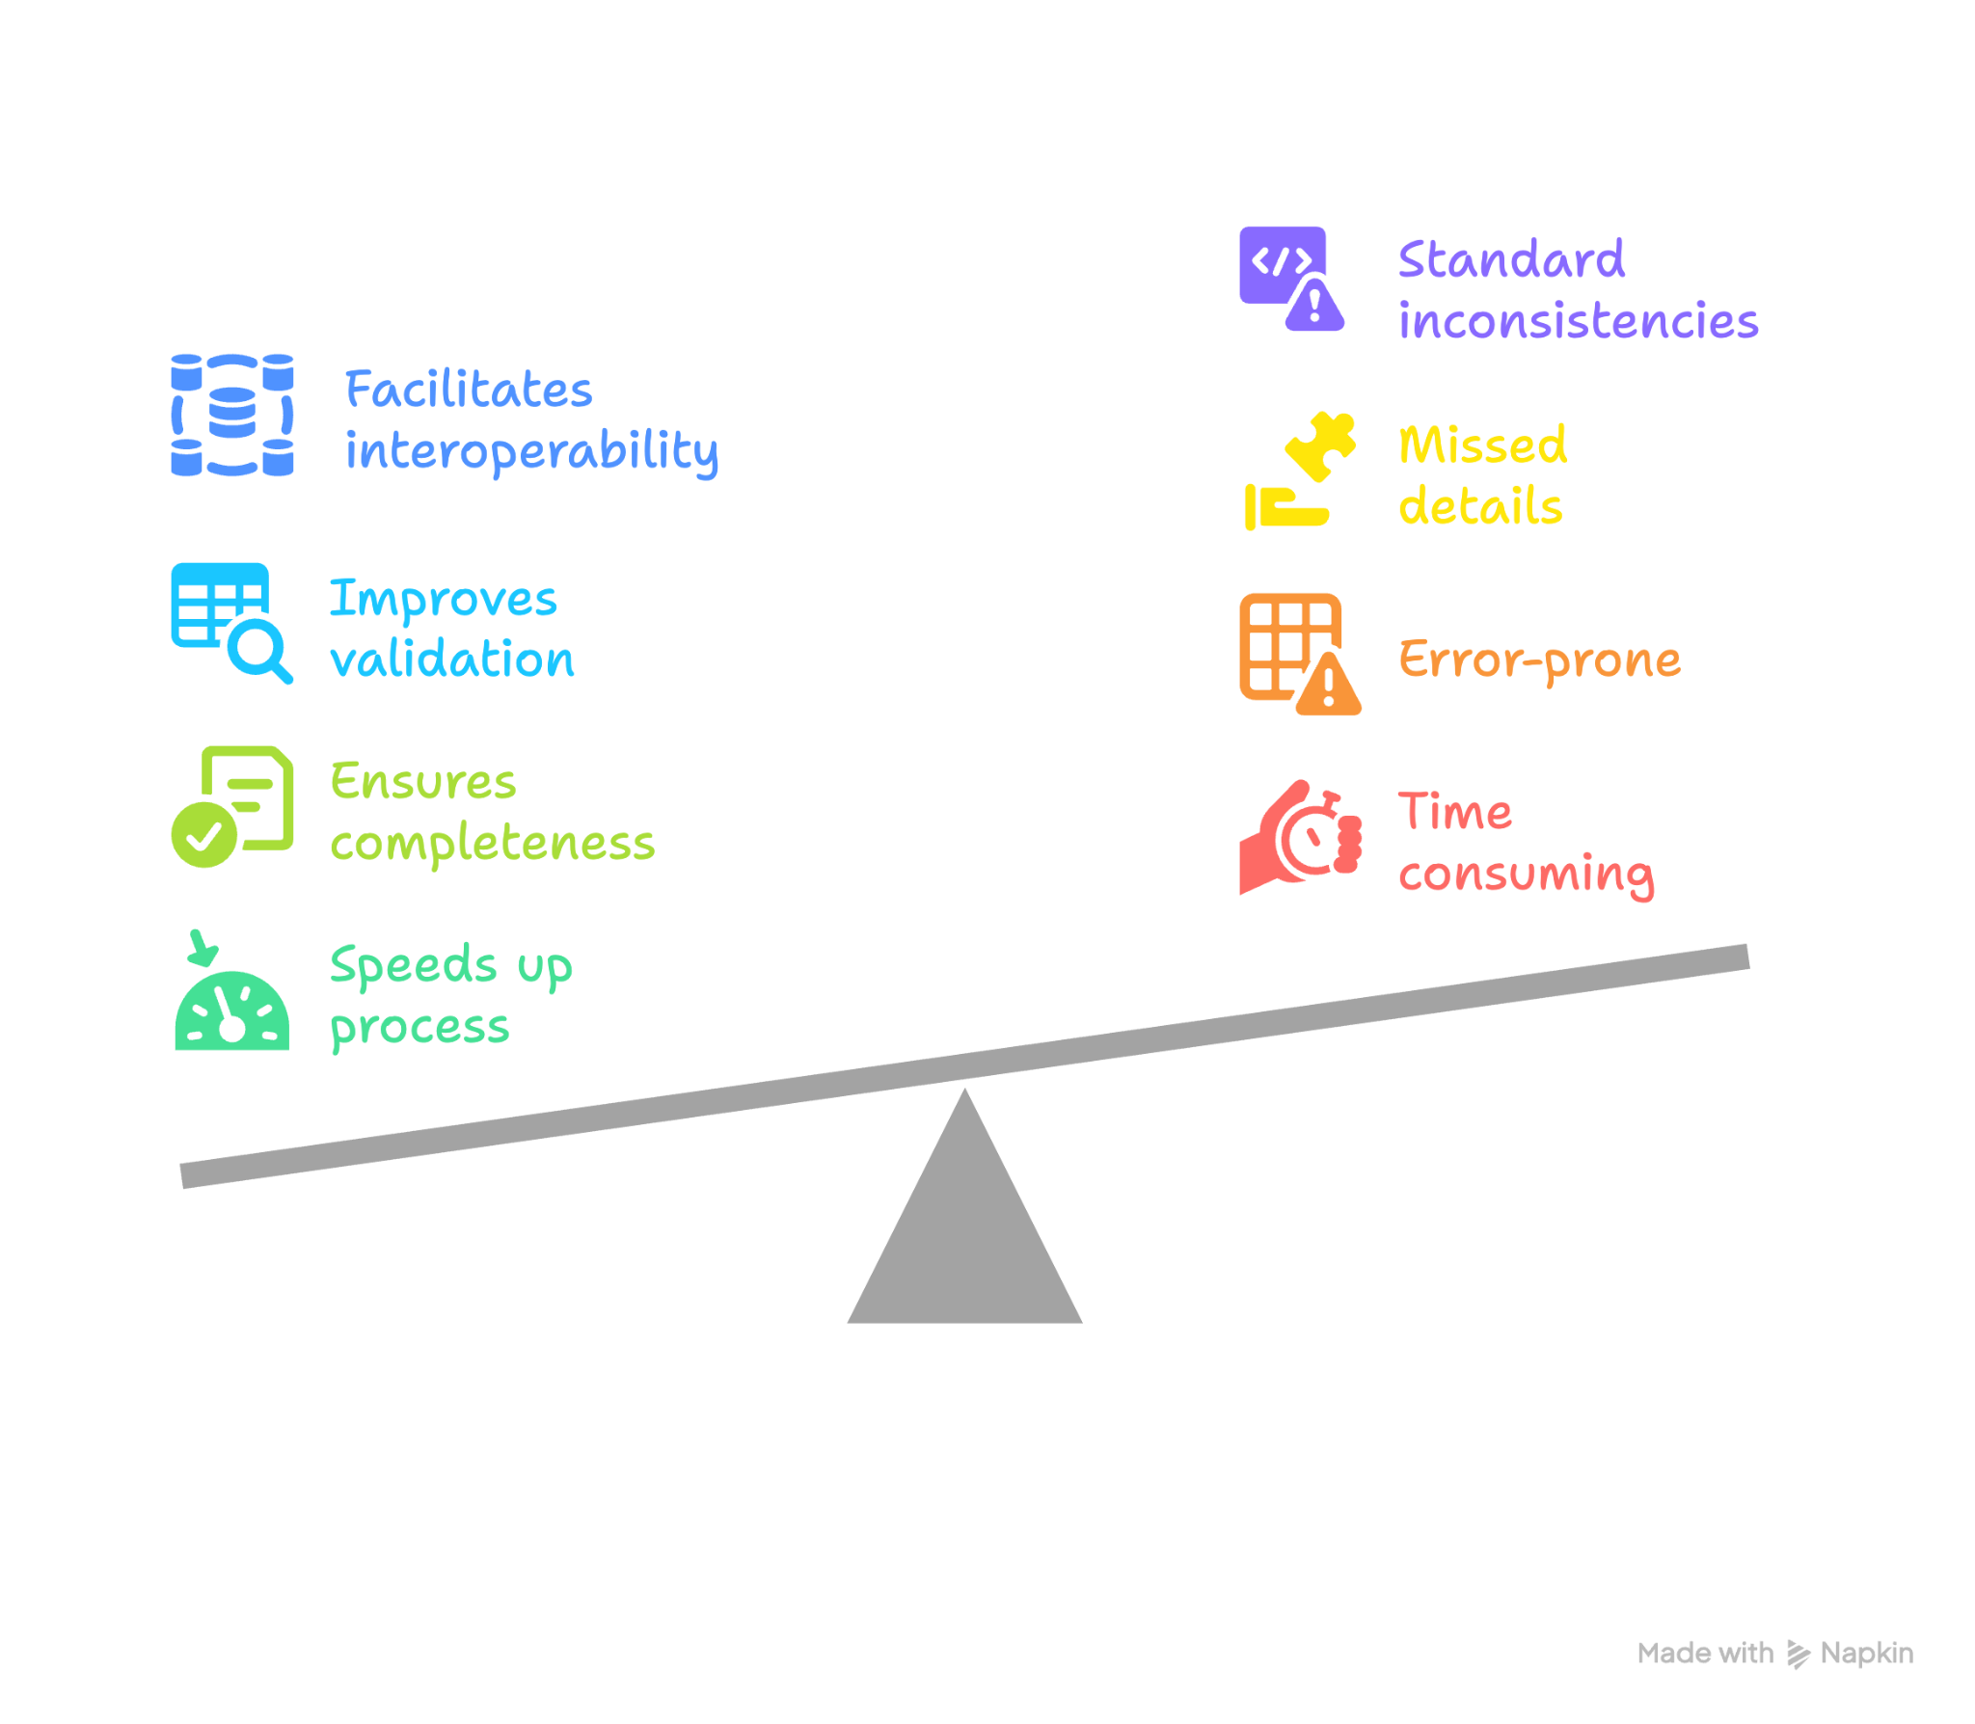
Why Automate it?

Slide 14
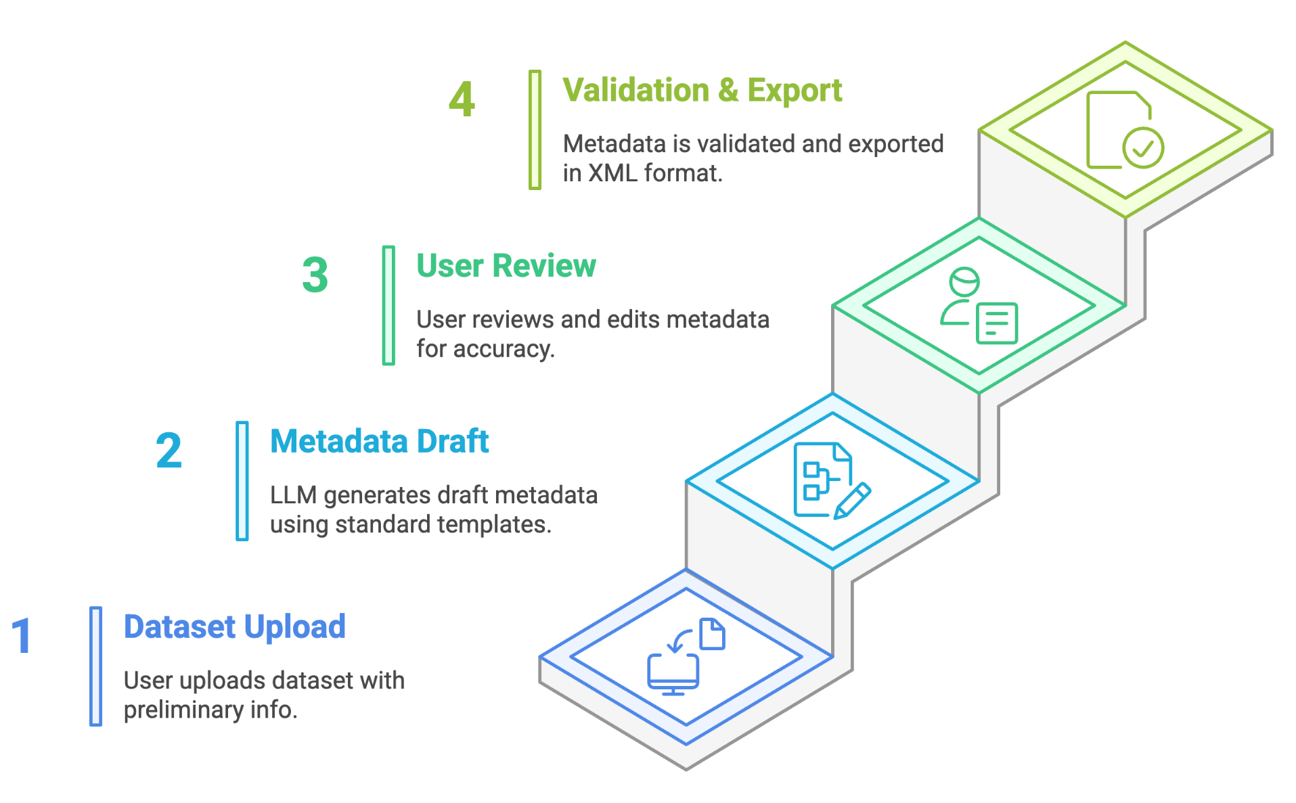
How can generative AI help?
By extracting relevant information and leveraging it within a fine-tuned large language model (LLM). This model uses the gathered details in conjunction with predefined metadata templates, enabling it to autonomously generate a draft metadata file that adheres to compliance standards.
Notes:
By automating this task, generative AI not only streamlines workflows but also reduces the potential for human error, ensuring that the final output is both accurate and aligned with compliance requirements.

Slide 15
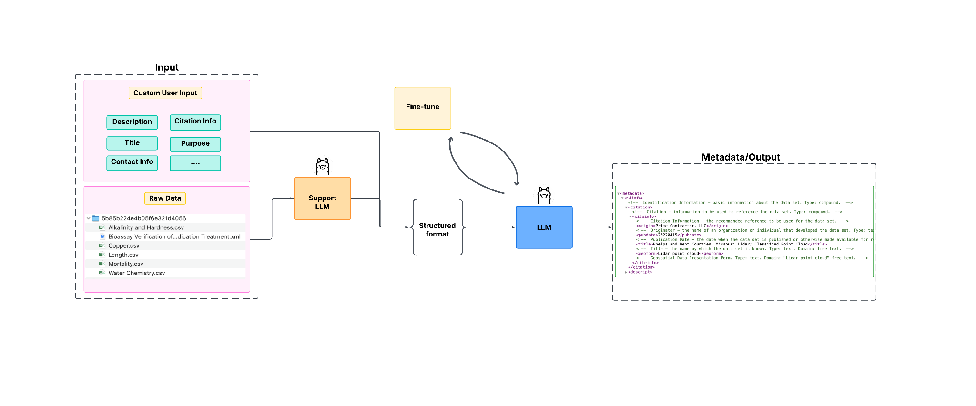
Initial Research
Datasets:
12,000 USGS ScienceBase records (Through ScienceBase API)
Total files downloaded: ~577 GB
Train Rows (Tabular): 22,646
After further processing: ~70k-80k
Train Rows (Documents): 13,323
Resources:
ARM Data Center (ADC) Cumulus (4 GPUs* | A100 80GB)
LLMs:
LLaMA 3.1, 3.2, Mistral
Custom trained datasets
Transfer learning
Hyperparameters tuning
LoRA/QLoRA quantization fine-tuning

Slide 16
Limitation(s)?
Data requirements
Substantial amount of labeled data representing specific domain
Overfitting Risk
May perform poorly on unseen data
Resource Intensive
Longer training times and requiring significant hardware resources
Model Size constraints
Difficult to manage
Customization Cost
Specific use case may involve additional engineering and adjustments
Custom trained datasets
Transfer learning
Hyperparameters tuning
LoRA/QLoRA quantization fine-tuning

Slide 17
Other Approaches
Adding Retrieval Augmented Generation (RAG) and Data Augmentation
Agentic Approach
Agent 2 Agent protocol (A2A)
Model Context Protocol (MCP)

Slide 18
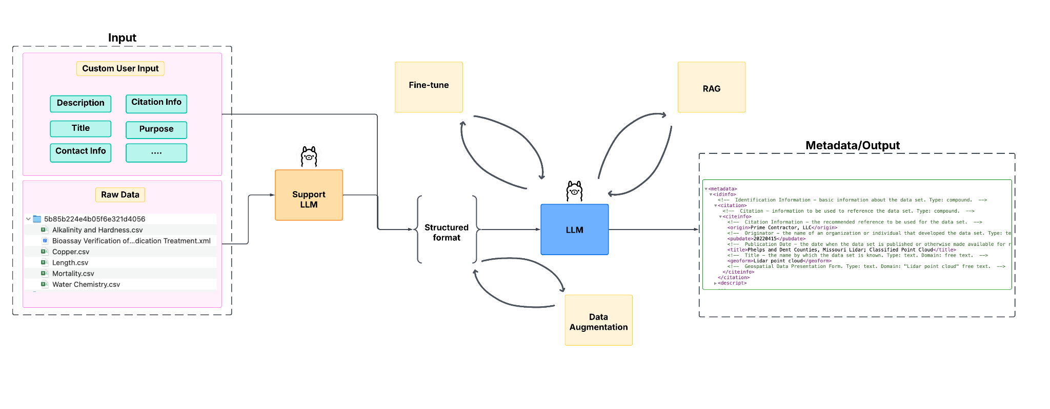
Adding RAG and Data Augmentation
What is RAG?
Datasets:
12,000 ScienceBase records (Through ScienceBase API)
Total files downloaded: ~577 GB
Train Rows (Tabular): 22,646
After further processing: ~70k-80k
Train Rows (Documents): 13,323
Resources:
ARM Data Center (ADC) Cumulus (4 GPUs* | A100 80GB)
LLM in use:
LLaMA 3.1, Mistral
Custom trained datasets
Transfer learning
Hyperparameters tuning
LoRA/QLoRA quantization fine-tuning
Embedded documents in PGvector for efficient semantic search, integrated with LangChain
Infer metadata from diverse input types
Random dropout at the data level to improve model generation and resilience

Slide 19
What is RAG?
Enhances LLM output by referencing external, authoritative data during generation
Avoids retraining models - injects domain-specific knowledge specifically
Bridges static LLM training with evolving knowledge sources for relevance and accuracy
Key enabler for building agentic systems that interact with changing environments

Slide 20

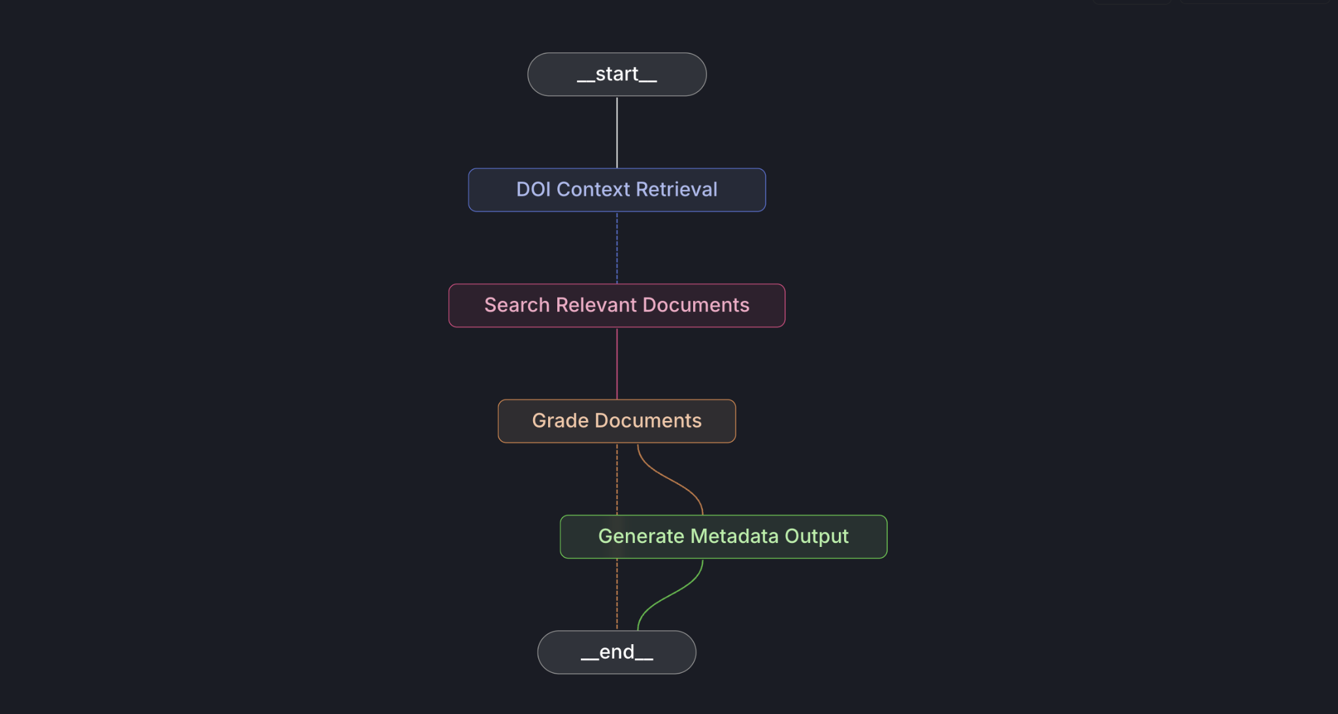
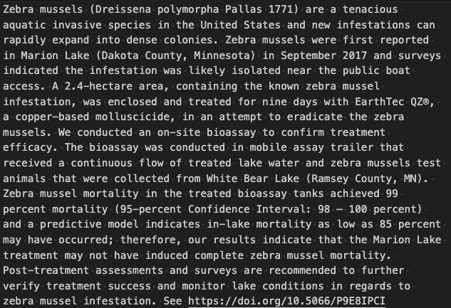
RAG Workflow with LangGraph

Slide 21
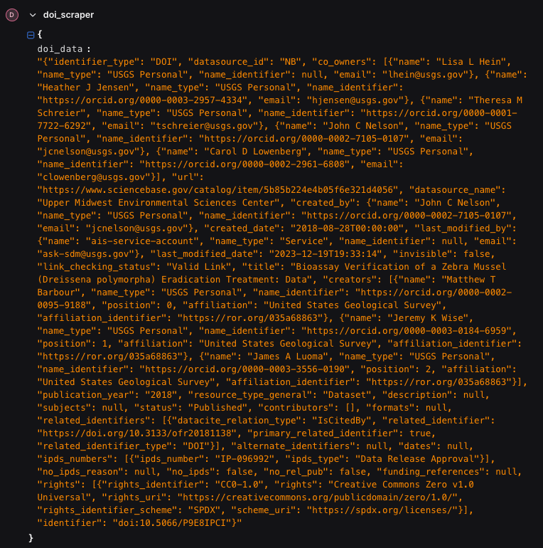
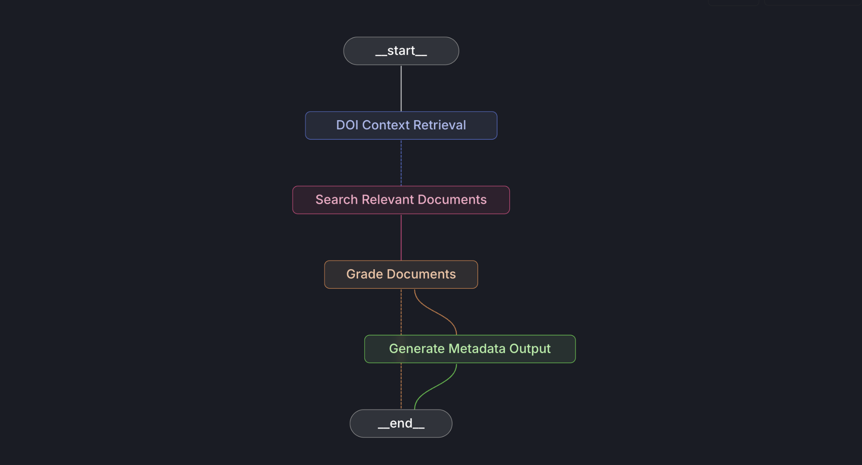
RAG Workflow with LangGraph

Slide 22
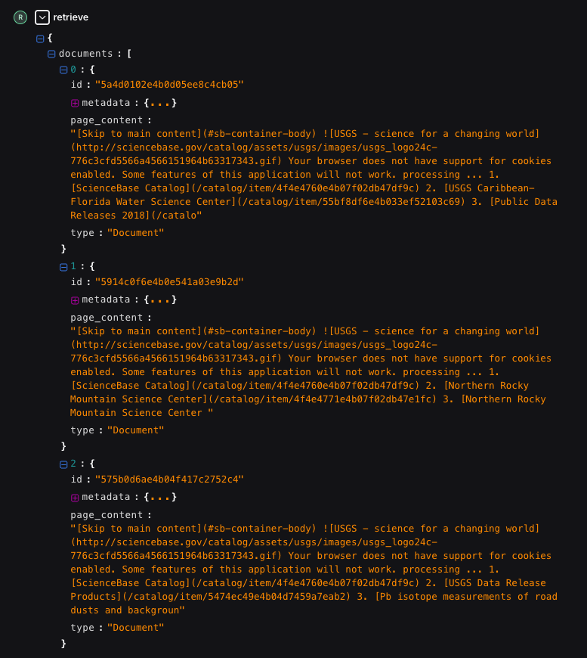
RAG Workflow with LangGraph

Slide 23

RAG Workflow with LangGraph

Slide 24
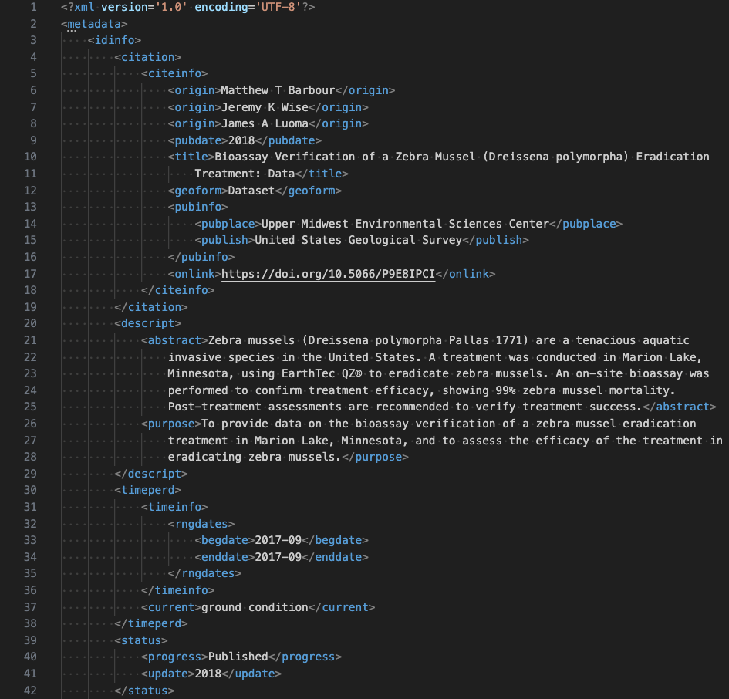
RAG Workflow with LangGraph

Slide 25
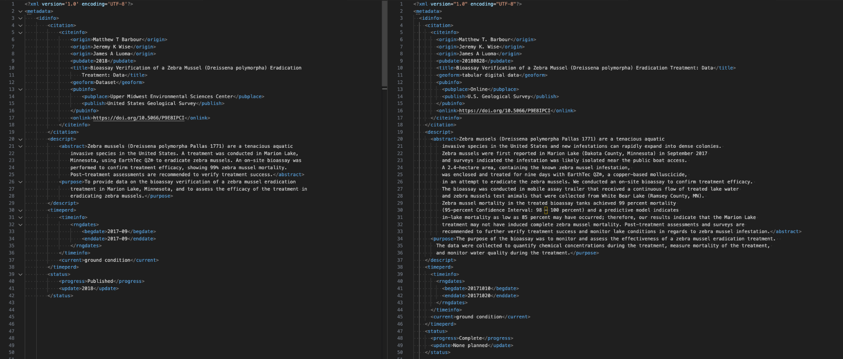
RAG Workflow with LangGraph

Slide 26
Agentic AI Approach
What are AI Agents?
Self-directed autonomous application that harness LLM reasoning, tool usage, context-awareness from different sources to carry out various tasks
Agents can:
think through chain-of-thought,
plan
execute, and
refine their actions as needed
What is Agentic AI?
An AI system that can take initiative and perform sequence of actions to complete tasks by
reasoning
learning, and
adapting to changing conditions

Slide 27
Agentic AI Approach
How agents are different than models?
Model (like LLM):
Simply generates outputs based on its training data and the given prompt
No mechanism (typically) for external actions, or complex decision loops and validations
Agent:
Includes the model but goes further
Maintains a stateful process
Uses external tools to get recent data or perform actions
Follows a defined orchestration logic
Overall, adds capabilities needed for autonomous, goal-directed behaviour

Slide 28
Agentic AI Approach
Model Context Protocol (MCP)
Open standard, connects AI agents to relevant data sources, such as repositories, tools, or external APIs
Provides universal interface to connect multiple relevant sources to feed right context to the models and agents
Simplifies how agents access relevant context, leading to better task outcomes, execution and more consistent performance
Agent 2 Agent Protocol (A2A)
Multiple agents communicate each other
Securely exchange information
Coordinate actions
Integrate capabilities
A2A fosters multi-agent collaborations otherwise siloed systems
Direct communication between agents only solves half the problem
Agents also need relevant, up-to-date data and context

Slide 29
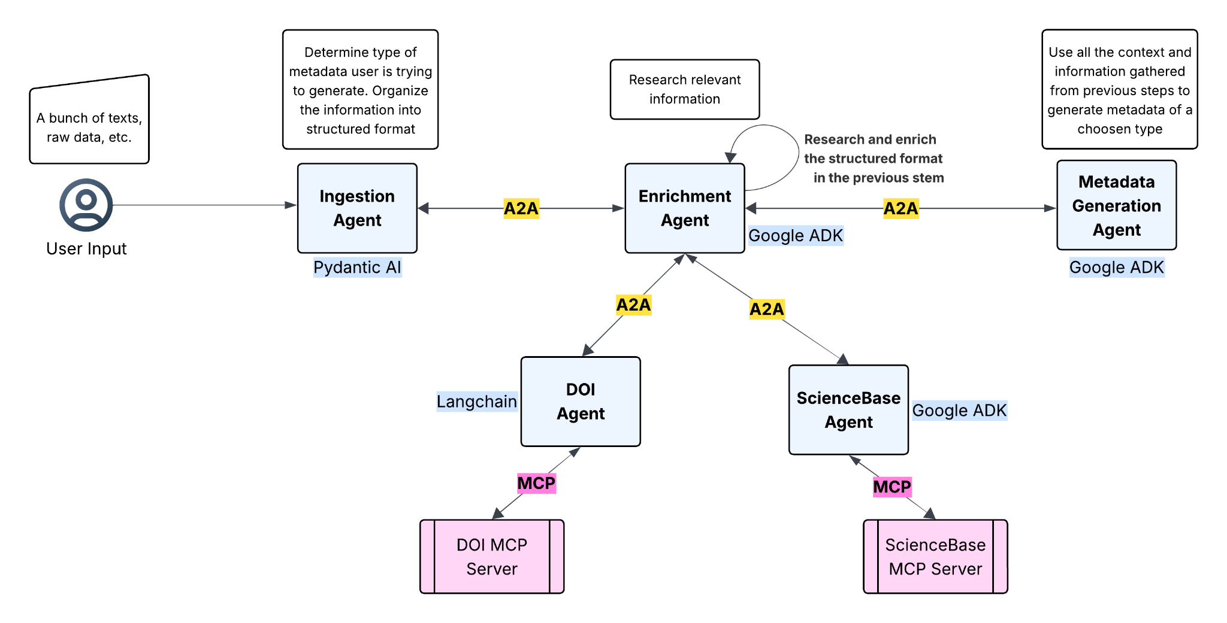
Sneak Peak - Proposed Workflow

Slide 30
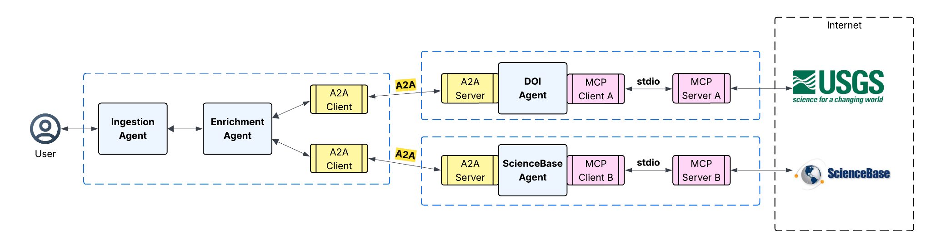
Sneak Peak - A2A Multi-Agent

Slide 31
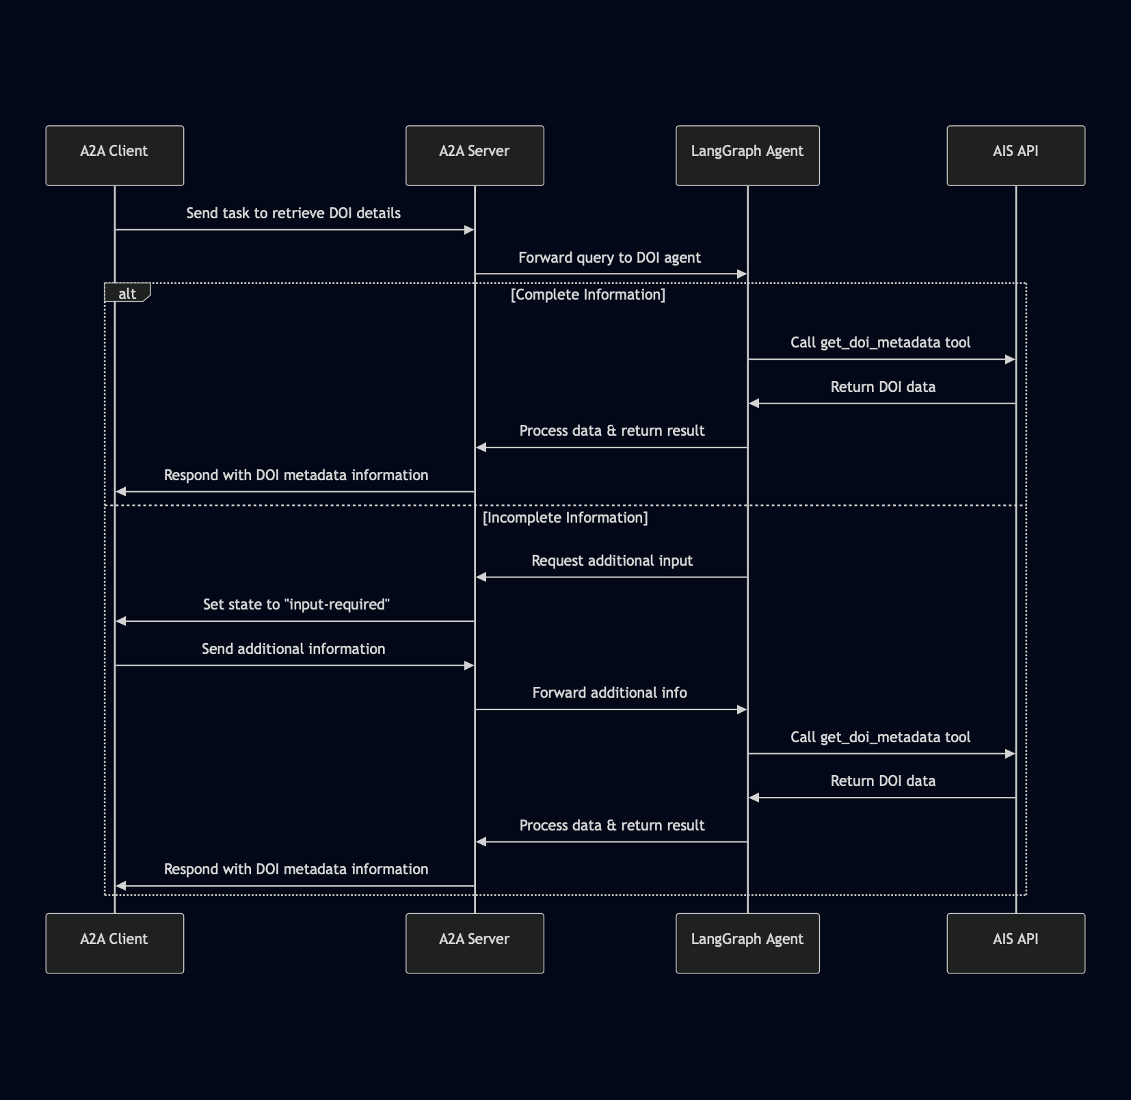
Sneak Peak - A2A Multiagent

Slide 32
Sneak Peak - A2A Communication

Slide 33
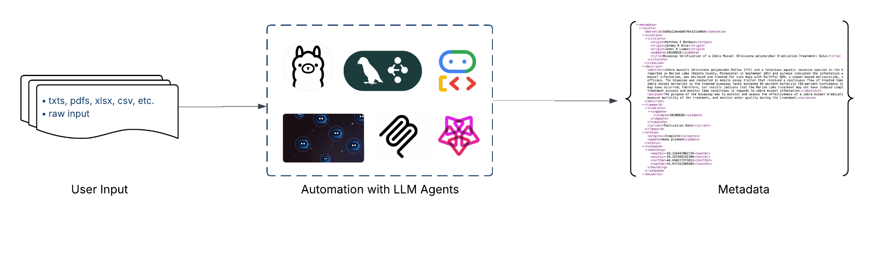
Summary

Slide 34

Thank you!
For questions, reach us at:
Tudor Garbulet: garbuletvt@ornl.gov Chirag Shah: shahch@ornl.gov
Austin Aguilar: aguilaral@ornl.gov

