Slide 1



Keeping Python Fun
Using Robotics Competitions to Teach Data Analysis and Application Development
Issaquah Robotics Society
Notes:
[Stacy kicks off presentation with some opening remarks]
[Olivia starts presentation]
Good afternoon. Welcome to our presentation:
Keeping Python Fun
Using Robotics Competitions to Teach Data Analysis and Application Development

Slide 2
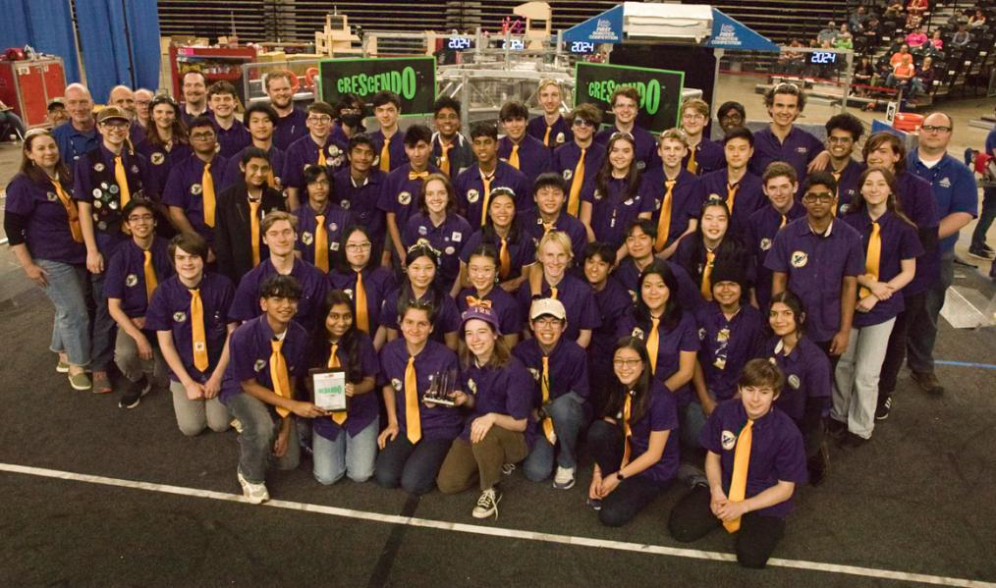

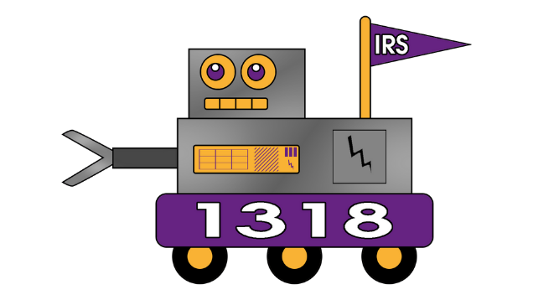

Issaquah Robotics Society (IRS)
FRC 1318
Presenters
Brianna
Class of 2027
Archit
Class of 2026
Ela
Class of 2028
Olivia
Class of 2027
Aarav
Class of 2028
Stacy Irwin
Class of 1986
Notes:
My name is Olivia. Today I will be joined by Brianna, Archit, Ela, and Aarav
We are all students at Issaquah High School and members of the Issaquah Robotics Society, otherwise known as
First Robotics Competition Team 1318.
We are also known under the acronym IRS -- a little tax agency joke that has found its way into our formal uniforms and ties
We are joined today by one of our team's mentors, Stacy Irwin. Stacy is a data scientist with the Pacific Northwest National Laboratory.

Slide 3
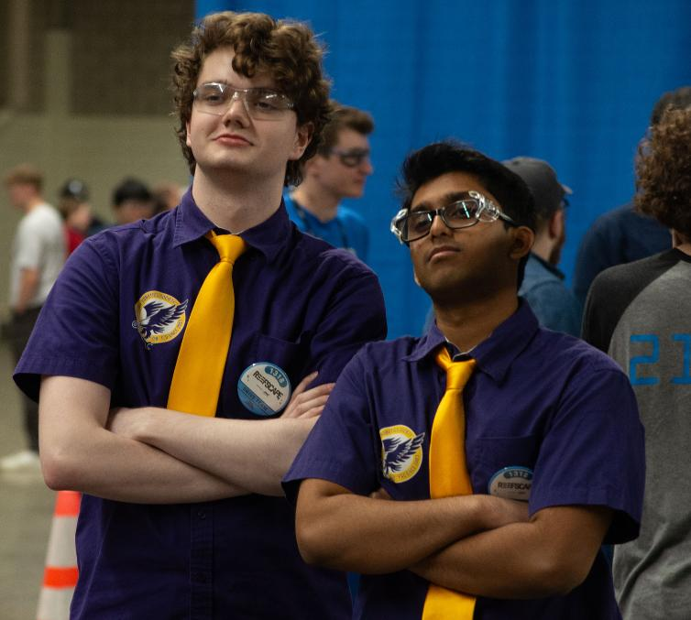
But First ...
Let’s set one thing straight!
Notes:
We're very excited to get started with our presentation... But before we proceed, there is one thing we need to set straight.

Slide 4

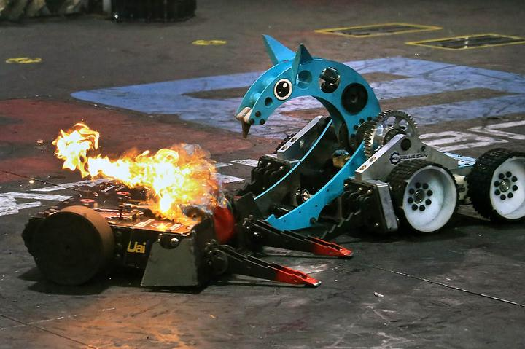
But First ...
We’re not Battlebots!
Notes:
[Try to sound a bit exasperated when delivering this slide, but in a funny way.]
We're not BattleBots.
We don't shoot flames out of our robots.
We don't have giant spinning sawblades, battering rams, or hydraulic crusher attachments.
We don't even try to flip our opponents over. That would probably result in being disqualified.
So if we're not BattleBots, what's our version of robotics? We'll cover that during the rest of this presentation.

Slide 5
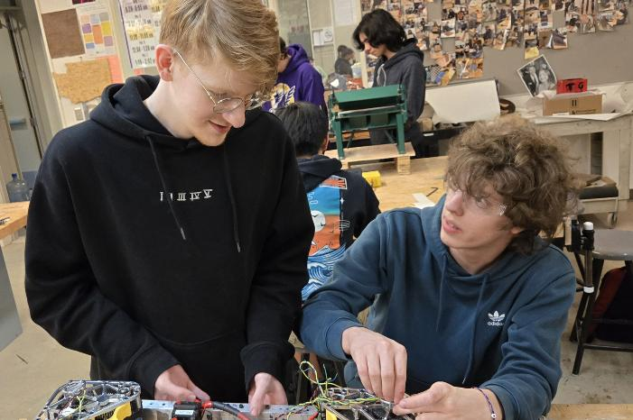
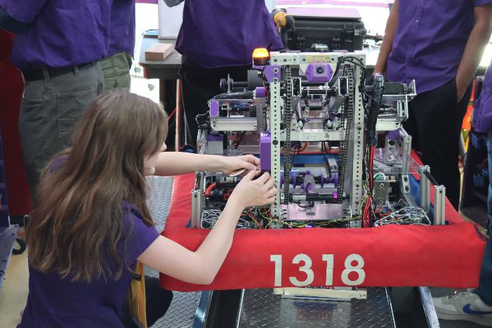
Outline
Why Robotics?
Our Mission
Why We Need Analytics
Understanding Our Students
Advantages of Teaching with Robotics
Challenges and Solutions
Takeaways
Notes:
Today, we're going to talk about how we use robotics competitions to learn Python, data analysis, and application development.
We'll cover some of the realities faced by today's high school students, and the challenges that stem from teaching Python as part of an elective, extra-curricular activity.
And finally, we'll cover good practices we've learned when facing those challenges -- lessons that are applicable to more than just high schoolers.

Slide 6
Further Reading
Ten Quick Tips for Teaching Programming
Neil C. C. Brown, Greg Wilson (2018)
PLoS Comput Biol 14(4): e1006023
https://doi.org/10.1371/journal.pcbi.1006023
10 Things Software Developers Should Learn about Learning
Neil C.C. Brown, Felienne F.J. Hermans, Laruen E. Marguileux (2024)
Communications of the ACM, Volume 67, Issue 1, Pages 78 - 87
https://doi.org/10.1371/journal.pcbi.1006023
Top 10 Myths About Teaching Computer Science
Mark Guzdial (2015)
Article posted on Communications of the ACM website
https://cacm.acm.org/blogcacm/top-10-myths-about-teaching-computer-science/
Notes:
Before we proceed, I should point out that our presentation doesn't contain anything that's actually new.
There are many things that we figured out by trial and error. But it didn't take much research to discover that everything we learned had already been discovered by other educators and researchers.
Here are a few articles that we like.
The authors listed here are affiliated with
Kings College, London; Plotly, VU Amsterdam; Georgia State;
and the University of Michigan.

Slide 7
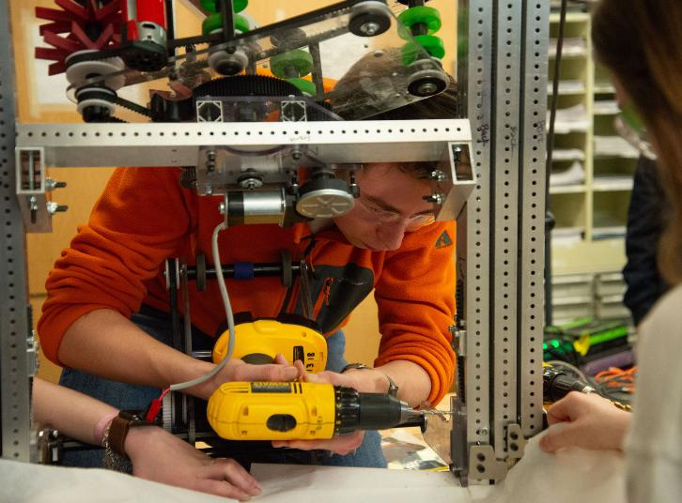

FIRST Robotics
For Inspiration and Recognition of Science and Technology
785,000 students globally
Helps students become future STEM leaders
5 program levels
Our level is called FRC (FIRST Robotics Competition)
About 3500 active FRC teams from 28 countries
Notes:
So, we know we aren't battlebots, but what we ARE is a team under FIRST robotics
FIRST, For Inspiration and Recognition of Science and Technology, is a global robotics program reaching almost 800 thousand students annually with a mission to give students skills needed to become future leaders in STEM. FIRST Robotics Competition, FRC, is one of their programs aimed for high schoolers

Slide 8
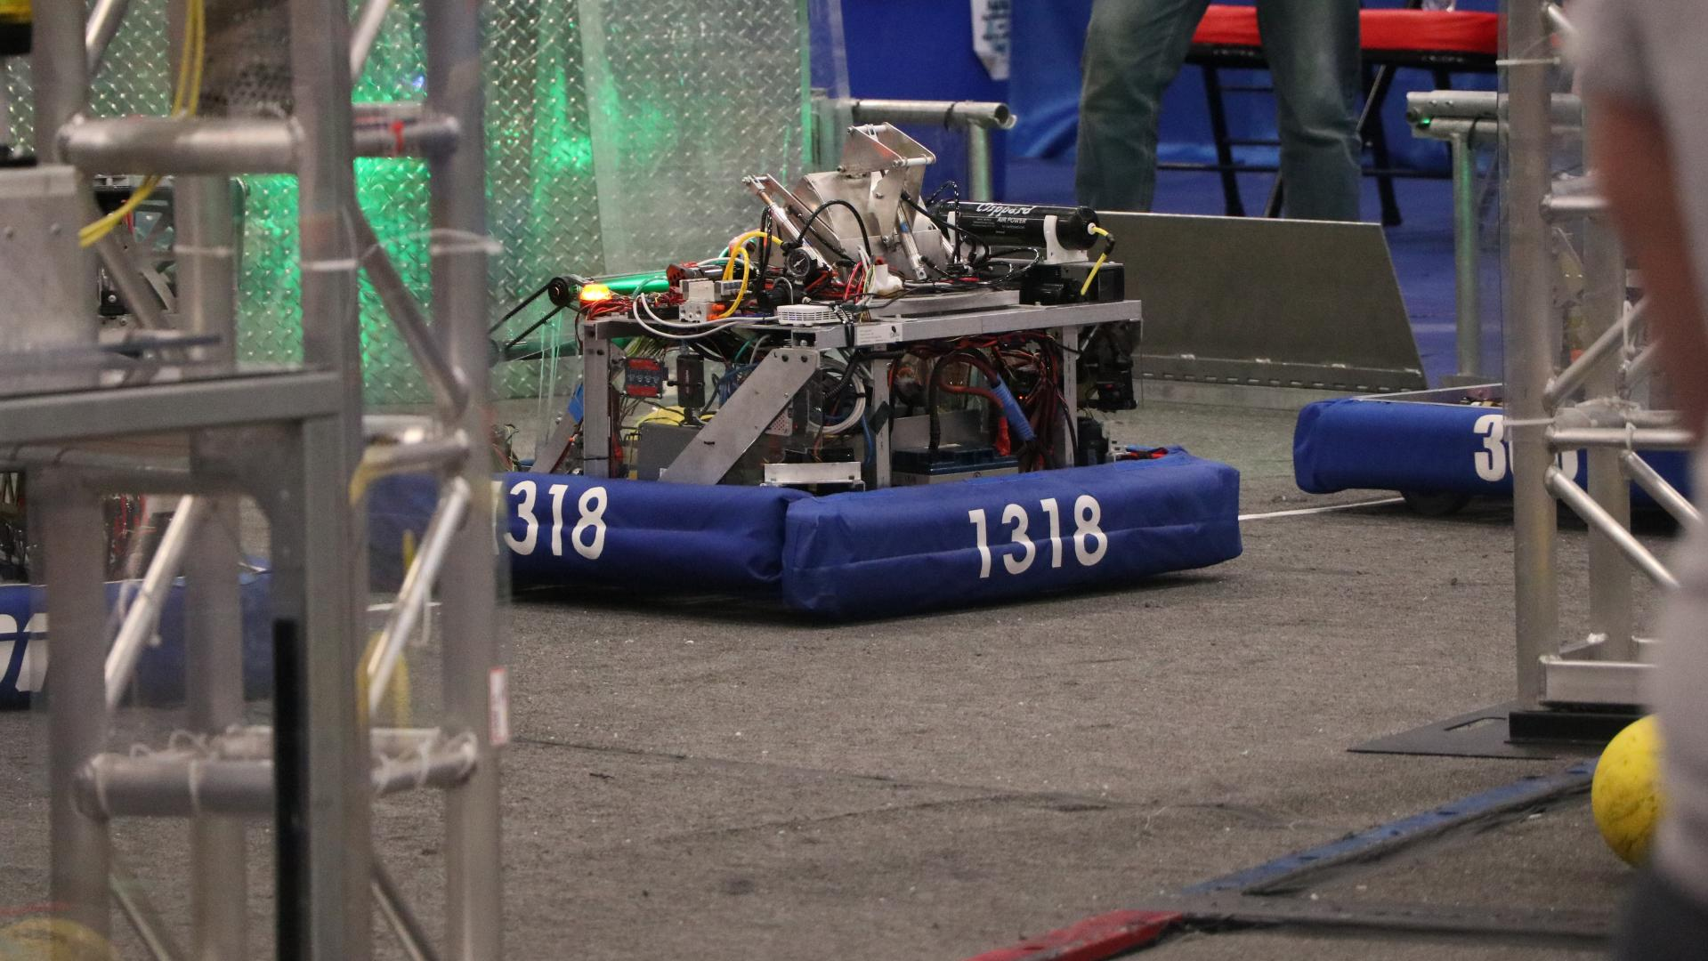
FRC Rapid React
2022
Why Robotics?
Notes:
First off -- we'll briefly discuss what our robotics program is all about.
By the way, this is a photo of the robot that we built for the 2022 game, which was called Rapid React.
We like robot photos, so that's what we're using for transition slides.

Slide 9
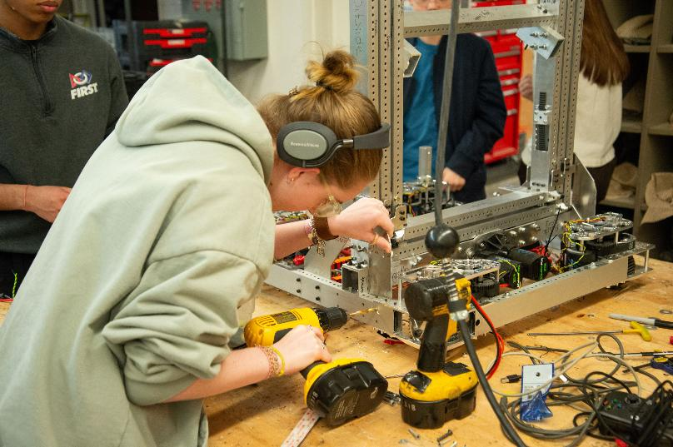
Why Robotics?
Broaden STEM interest
Notes:
We aim to widen STEM interest by providing the students at our school with access to learn skills through robotics.

Slide 10

Why Robotics?
Learn and apply STEM skills to solve problems in a practical environment
Broaden STEM interest
Notes:
We also give them hands on experience, so they can use those skills in real-life applications.

Slide 11
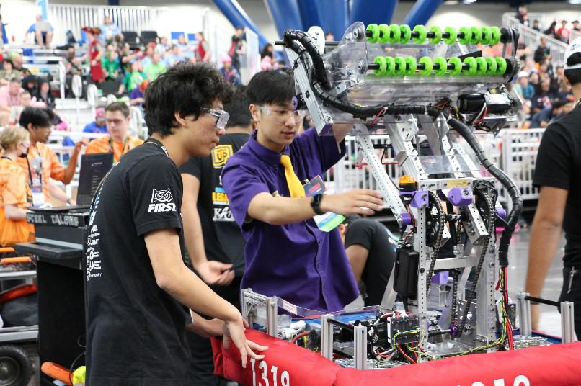
Why Robotics?
Can cooperate and compete at the same time: “Coopertition”
Learn and apply STEM skills to solve problems in a practical environment
Broaden STEM interest
Notes:
On a higher-level though, our ultimate goal is to foster a mix of cooperation and competition
* that allows students in the program to grow and also have fun.
(switch to next slide at *)

Slide 12
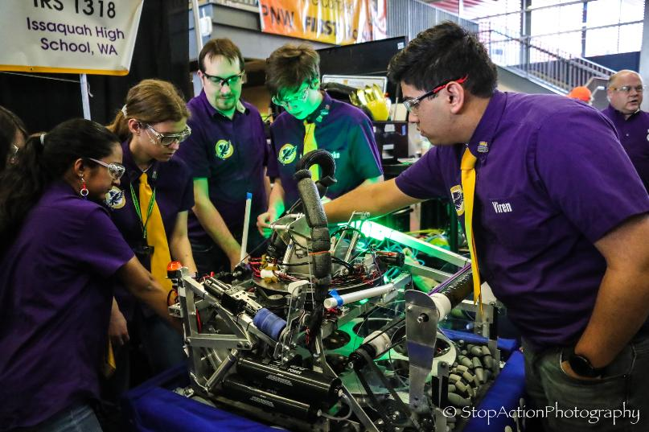
Why Robotics?
Achieve growth and have fun :)
Can cooperate and compete at the same time: “Coopertition”
Learn and apply STEM skills to solve problems in a practical environment
Broaden STEM interest
Notes:
that allows students in the program to grow and also have fun.

Slide 13
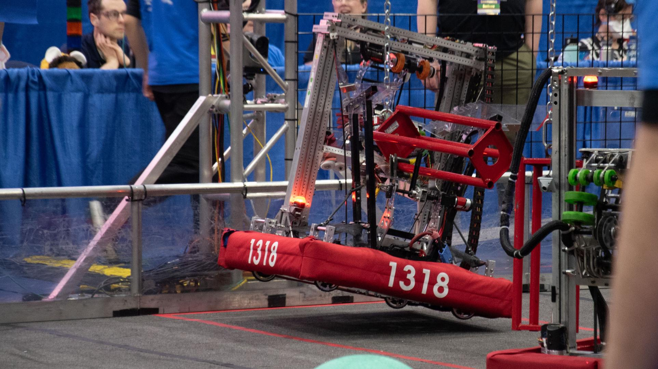
FRC Reefscape
2025
Analytics’ Mission
Notes:
And now I will turn over to Archit who will discuss the mission of the Analytics Group.
[Archit]
Hello everyone. I'm Archit and I'll be explaining how our group, the Analytics group, supports our team's mission.

Slide 14
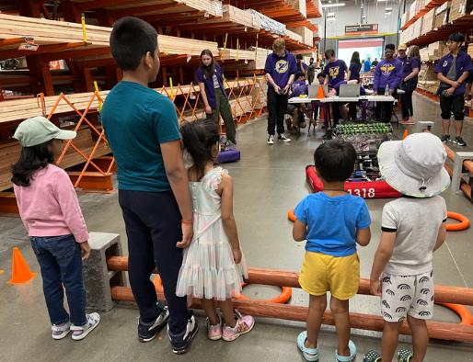
IRS Analytics Mission
Use data to support the IRS’s operations and mission
Notes:
The analytics group is one of many sub-teams within the Issaquah Robotics Society.
Ultimately, we support the team's overall mission, which is to give students confidence that they can be good at science and technology and pursue STEM careers.
We do that by collecting, analyzing, and presenting data specifically to improve the team's knowledge in decision making

Slide 15





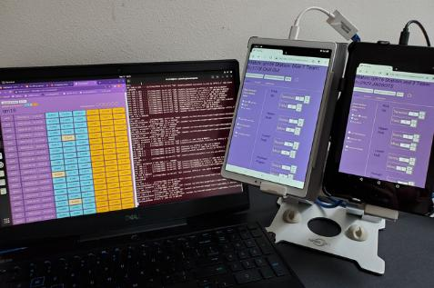
IRS Analytics Mission
Teach transferable, decision making skills
Use data to support the IRS’s operations and mission
Notes:
In a practical sense, we want to teach analytical skills that students can use later on in college, the workplace, or just for fun. We mostly use open-source tools that can be used anywhere without worrying about licensing.

Slide 16
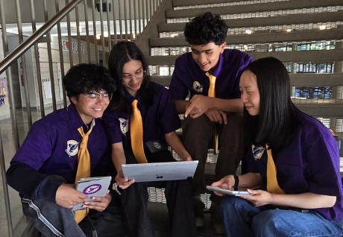
IRS Analytics Mission
Students gain confidence in their programming skills
Teach transferable, decision making skills
Use data to support the IRS’s operations and mission
Notes:
Giving students opportunities to practice programming and analytics in a fun and supportive environment promotes confidence.
Students with confidence are more likely to learn new skills and attempt challenging tasks.
But to be honest ...

Slide 17
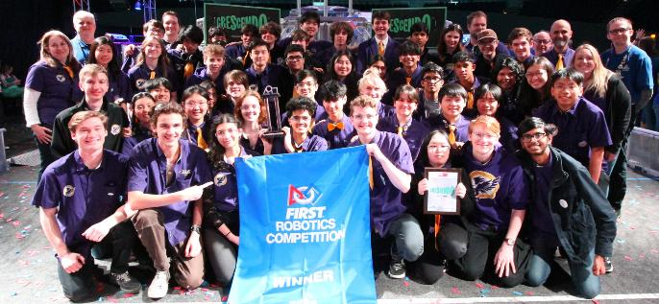
IRS Analytics Mission
Win robotics competitions!
Students gain confidence in their programming skills
Teach transferable, decision making skills
Use data to support the IRS’s operations and mission
Notes:
We seem to spend most of our time figuring out how to use data to win robotics competitions.
All of the other objectives are achieved via fortuitous side-effects

Slide 18
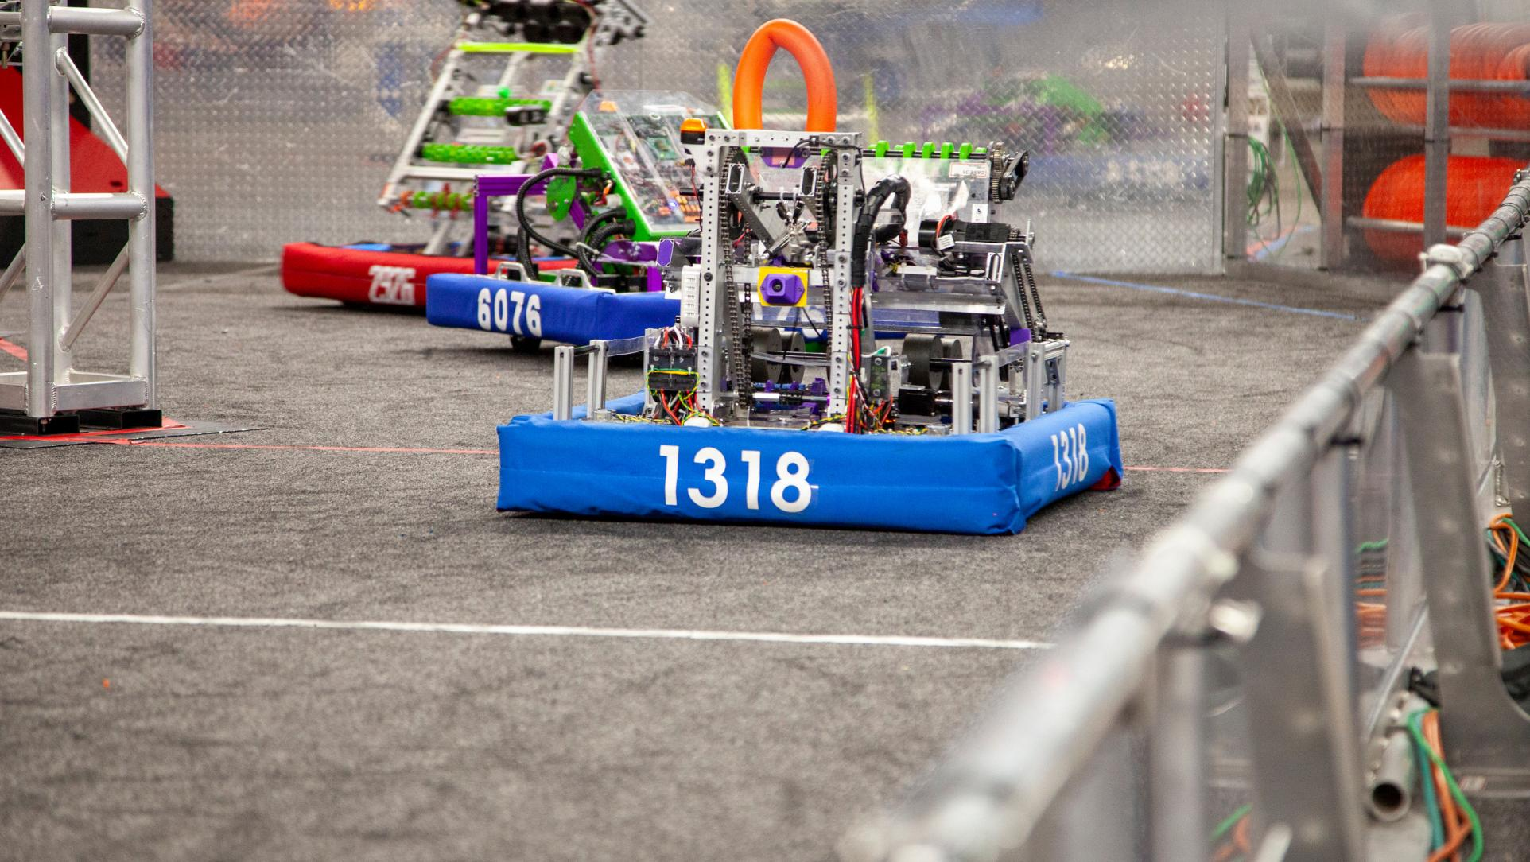
FRC Crescendo
2024
Why We Need Analytics
Notes:
Now I'll discuss how data analytics helps us be more competitive.

Slide 19
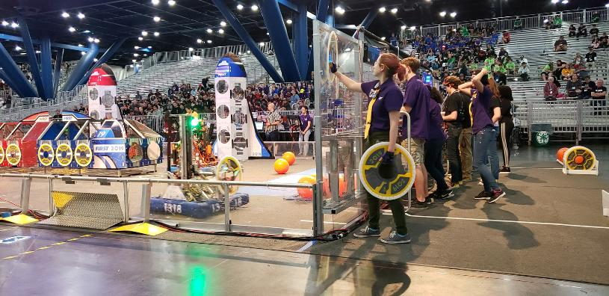
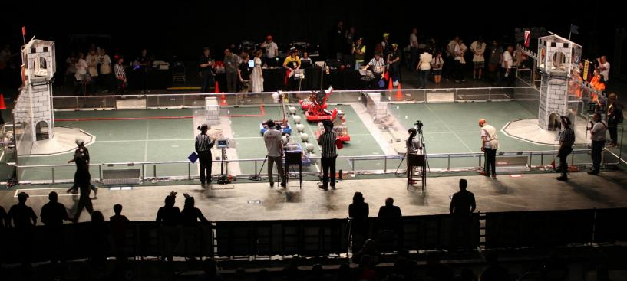
FIRST Robotics Competition
New game announced annually
Eight weeks to build robot and scouting system
Seven weeks of competition to put it into action
Notes:
First, a little about how FIRST Robotics Competitions work.
Each year, a completely new game is announced, and teams have eight weeks to design and build their robot.
We also have to build whatever other tools that we want for competition during that time, ..., like our analytics applications!

Slide 20
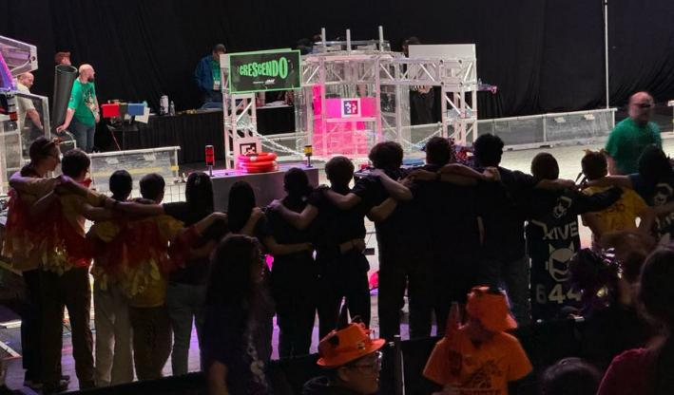
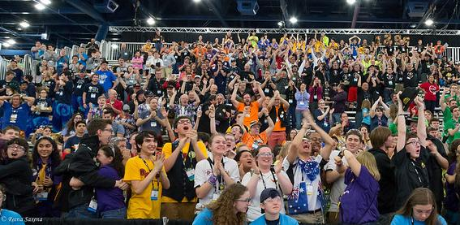
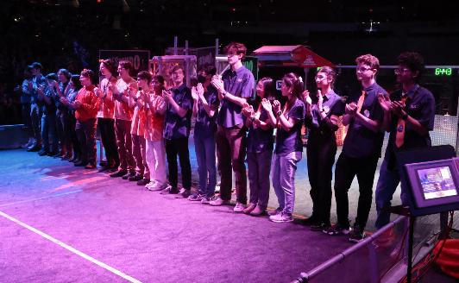
Purpose of Analytics
Why use data analytics?
To help us win competitions!
20
Notes:
That brings up the question- with such limited time, why does analytics deserve any resources?
Well, it helps us win competitions!

Slide 21
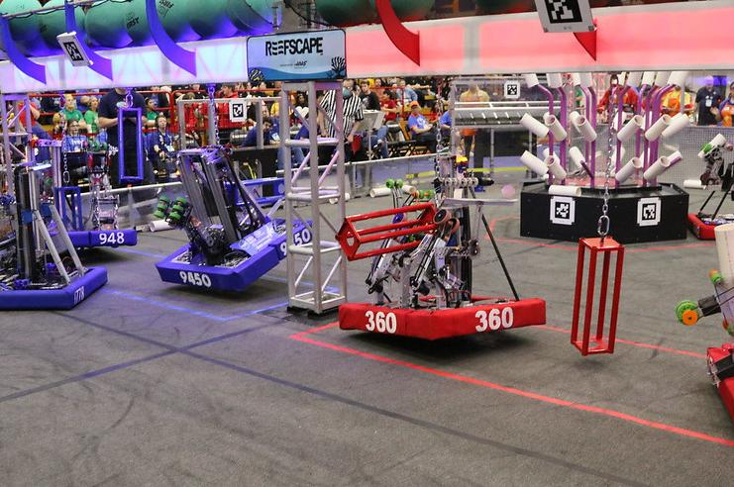
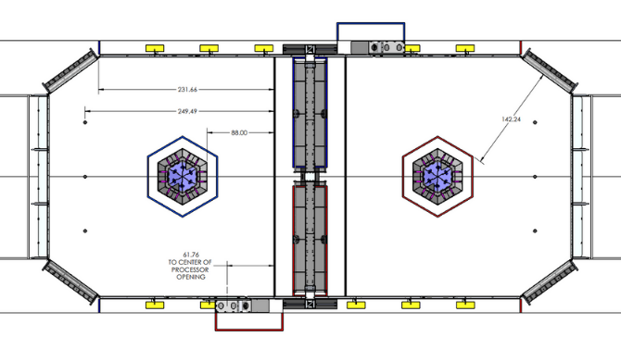
Competition Format
Competitions have two sections:
Qualification matches
Elimination bracket
6 robots compete at once
3 teams in each alliance
Teams individually ranked from qualifications
30 - 75 teams at a single competition
Notes:
But, how?
Competitions are divided into two parts: qualification matches then an elimination bracket.
In each of these matches, 6 robots compete at a time. These robots are separated into two alliances of 3 robots each. The alliances compete against each other to score points by completing different objectives.
In qualification matches, the teams in each alliance are randomly selected. Robots are then ranked individually based on average performance in these randomized rounds, acquiring ranking points which determine their seeding.
All three robots on the winning alliance receive the same number of ranking points, regardless of how well the individual robot performed (hard to differentiate between them).

Slide 22

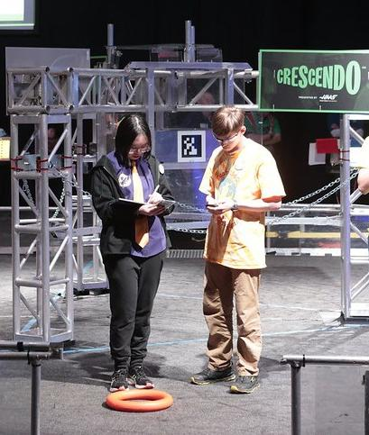
Alliance Selection
this is scary...
Top teams choose the alliance they work with during elimination rounds at...
Alliance Selection!
22
Notes:
Teams that are the highest ranked in qualification matches get to select which teams they would like to work with for the elimination rounds!
This process is known as alliance selection. It's basically a draft, but it occurs during the middle of our competitions.

Slide 23
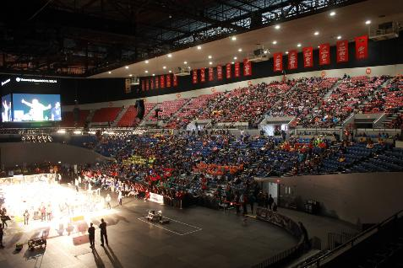
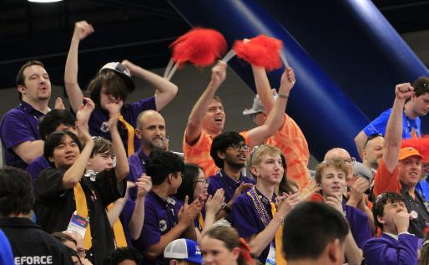
Alliance Selection
this is scary...
Top teams choose the alliance they work with at...
Alliance Selection!
High pressure decision with thousands watching
23
Notes:
Alliance selection is a timed, high pressure environment, where the team must select 1 out of up to 75 teams in under a minute
(dcmp) - At one of our competitions this year, rankings were changing in the last minutes before selection, giving us only a few seconds to make our decisions.
Having our visualizations made it a lot easier to make more objective decisions quickly under pressure

Slide 24
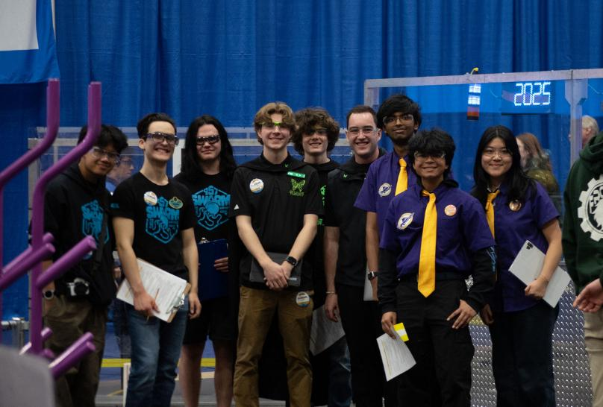
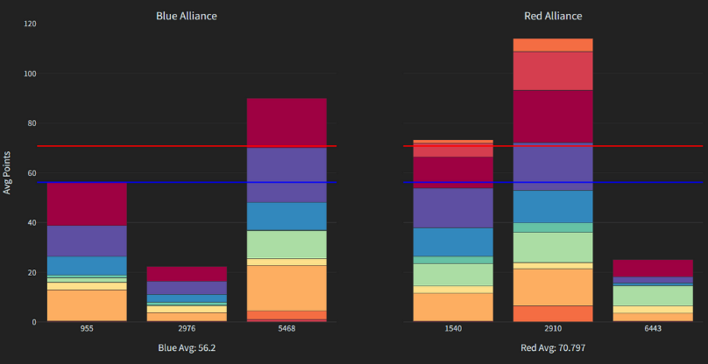
Purpose of Analytics
Without analytics, no team-specific data to use to make decisions
Informs us about individual team’s strengths and weaknesses
Match-to-match decisions
24
Notes:
With analytics, we can make decisions about individual teams and opponents on a per match basis, instead of relying only on public, aggregated data which does not accurately show an individual robot's capabilities.
>>> make notes and slides talk about with/without

Slide 25
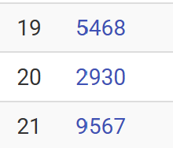
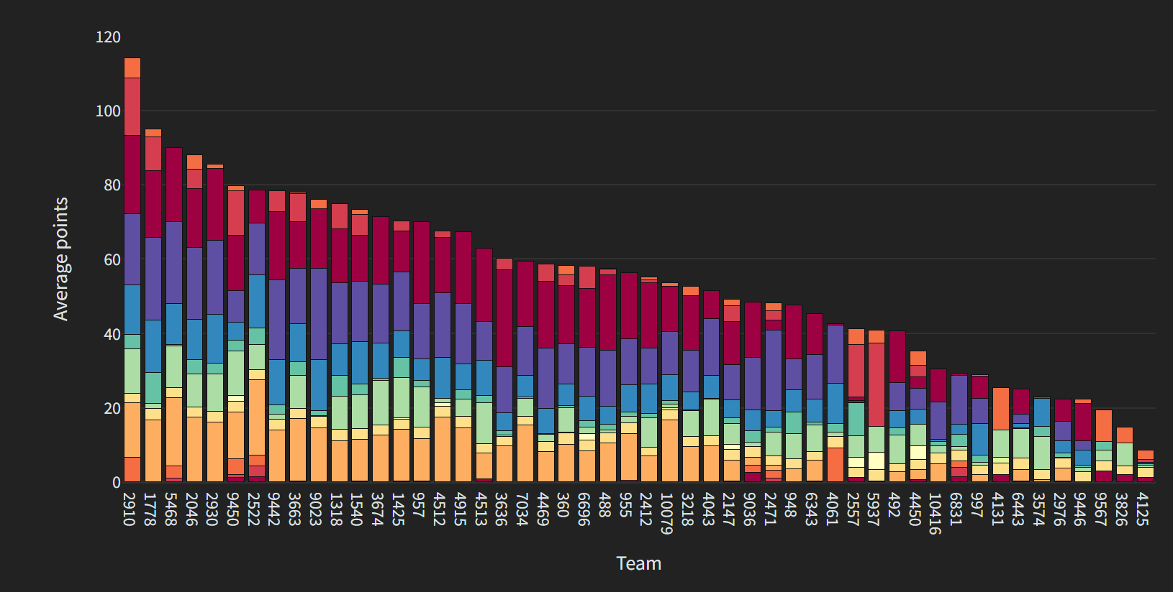
An Example: Team 2930
Official ranking (20th)
Actual scoring (5th!)
Notes:
can we keep this as a quick visual/example (shown in like 5 seconds)
The ranking a team gets during qualification matches are often not at all representative of a team’s actual skill. Matches are with other robots, and so depending on how lucky (or unlucky) a team gets with their schedule, their rankings can be skewed. This is why we opt to use our own data in important decisions.
This is just one example of how analytics helps us improve our decision making. There are many other tactical decisions that we have to make at competitions that are easier to make with good data and analysis.

Slide 26
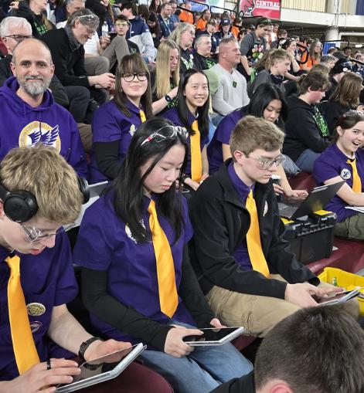
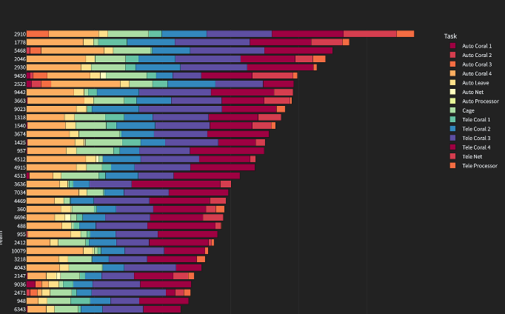
Our Analytics Applications
Need for data analysis → fun and competitive use for a Python application!
Two main applications:
Python Flask app for data collection
Plotly Dash app for data visualization
Notes:
>>> should we move this slide to after FRC intro? audience will know what applications were talking abt if its before the rest of slides
By the way, we develop and use two different applications throughout the season.
- a Python Flask app to collect data,
- and a Plotly Dash app to visualize it.
The photo in the upper right shows students using our data collection application, which runs on a laptop server and Andoid clients.
The photo in the lower right is a screenshot from one of the charts in our data visualization application.

Slide 27
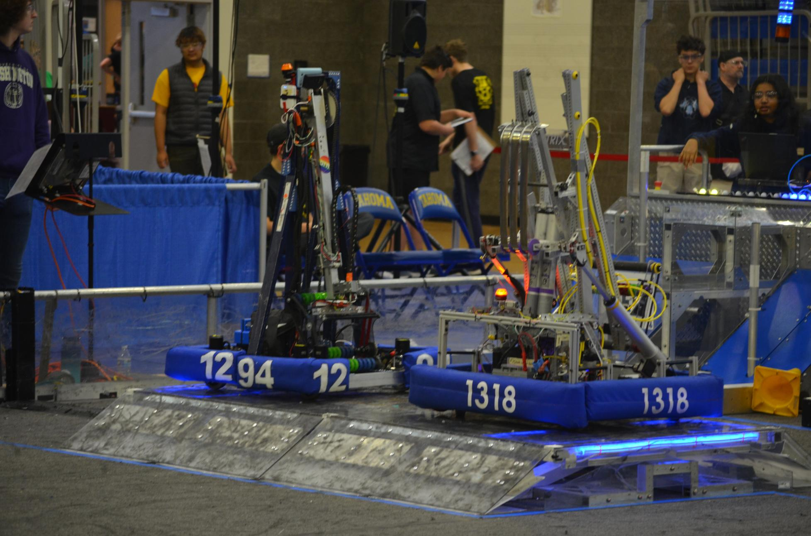
Understanding
Our Students
2023
FRC Charged Up
Notes:
And now, Ela will tell you a little bit about our robotics students.
[Switch to Ela]
Hi, I'm Ela.
So now that you've learned about our program and our need for data analysis applications, let's learn about the students who we'll be training to build those applications.
If we want to have an effective training program that helps our students to learn and thrive [two hands, one at a time], we have to understand where our students are coming from.

Slide 28
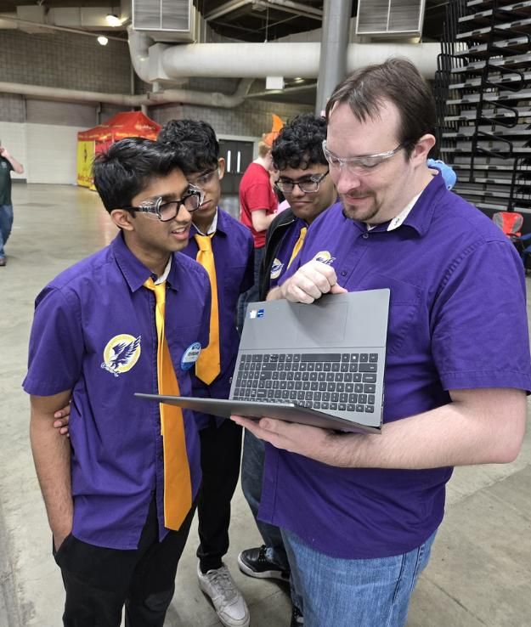
Participation in Computer Science
50% of schools in Washington state offer computer science classes
5.1% participated - 28% girls
Hands-on experience without formal instruction
Source: Code.org, CSTA, ECEP Alliance (2024). 2024 State of Computer Science Education. Retrieved from https://advocacy.code.org/stateofcs
Notes:
First, let's go on a tangent(!) and discuss computer science education in secondary schools in our state.
In Washington, only half of high schools offer computer science courses, with our school included.
However, in the last school year, only 5.1% of students participated in a computer science course, and of that small percentage only 28% of them were girls.
One of the benefits of our robotics program is that it gives students another opportunity [one hand to the side] to learn about computer science, without ever [x] having formal instruction.

Slide 29
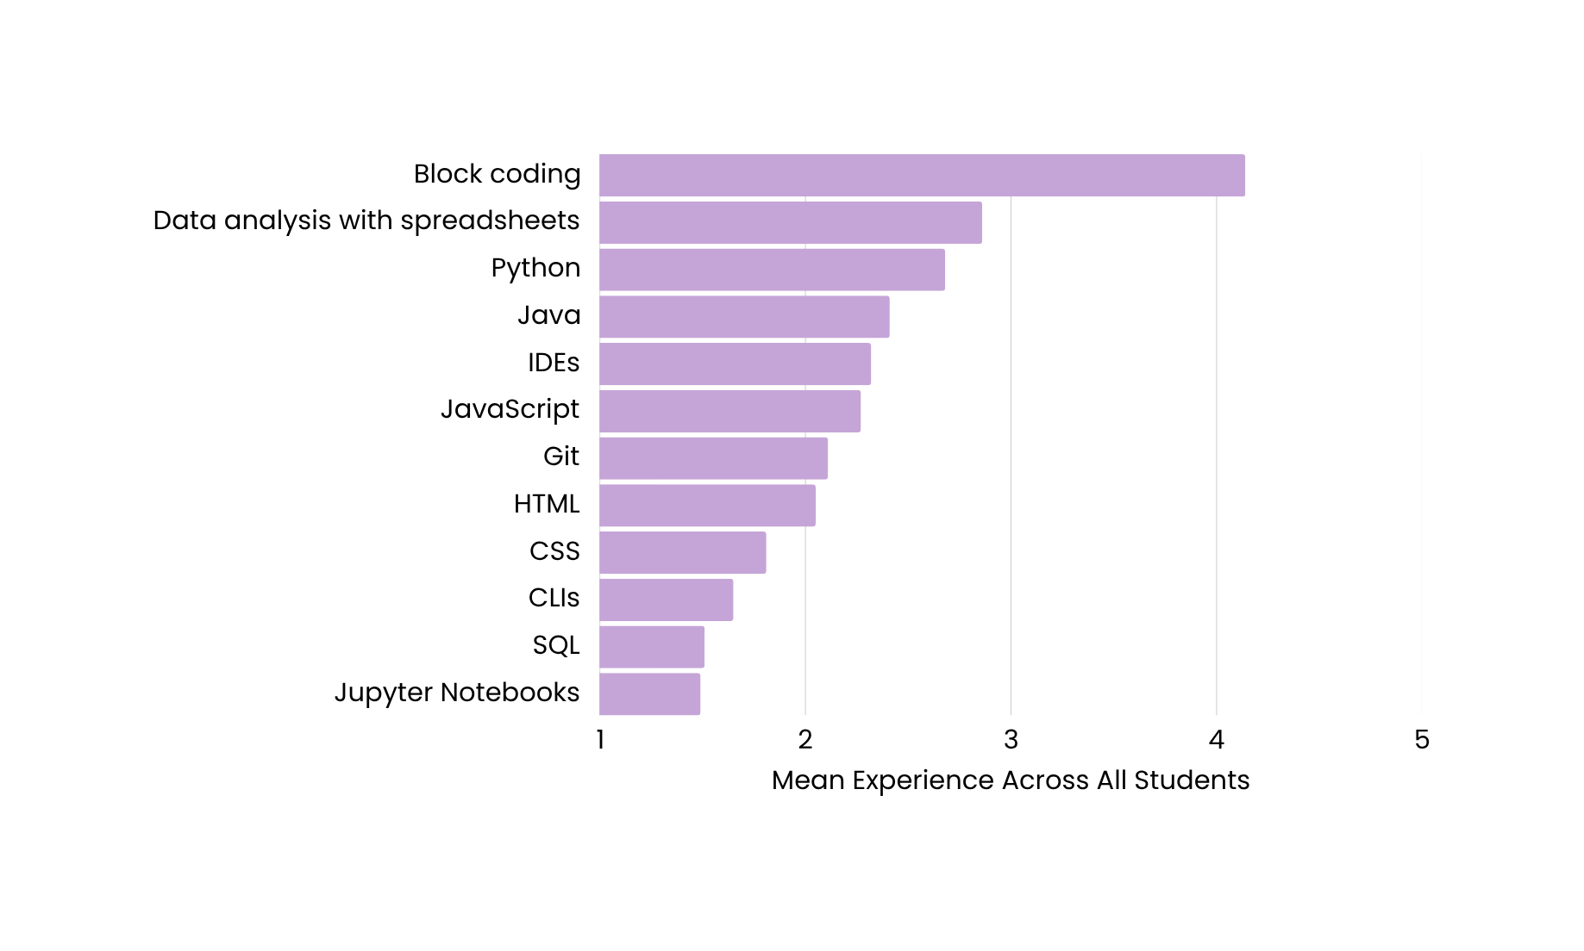
Experience Prior to Robotics
1: Unaware of existence
2: Heard of but never used
3: Used it a little
4: Comfortable using
5: Highly proficient
Data Source:
An unscientific survey of 37 robotics students
Notes:
Now let's consider the students on our team, the IRS.
We're a large [] suburban high school in an area where many families work in the tech industry. We took an informal survey to learn more about our student's experience prior to joining robotics.
We found that most of the people who join our team start out with very limited experience. Although many of our members feel comfortable using block coding, many feel less comfortable using more complicated languages like Python, Java, and JavaScript [count].
Tools that often facilitate the use of languages, like CLIs and IDEs are also mostly unused or unheard [two hand] of by our students.

Slide 30
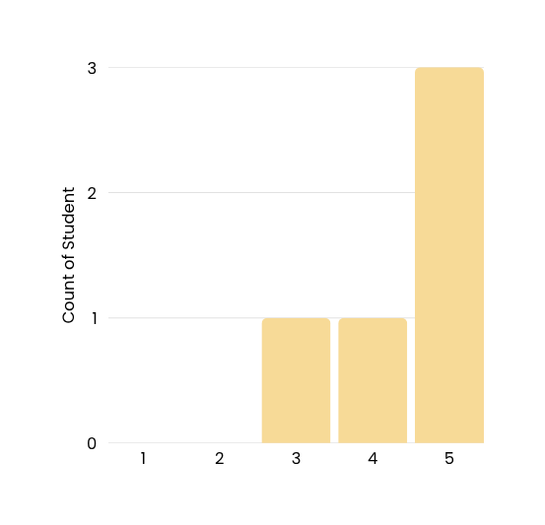
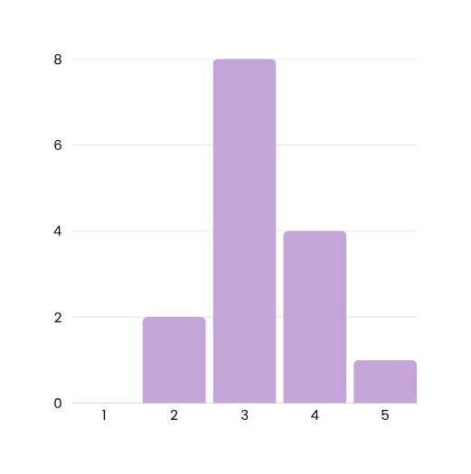
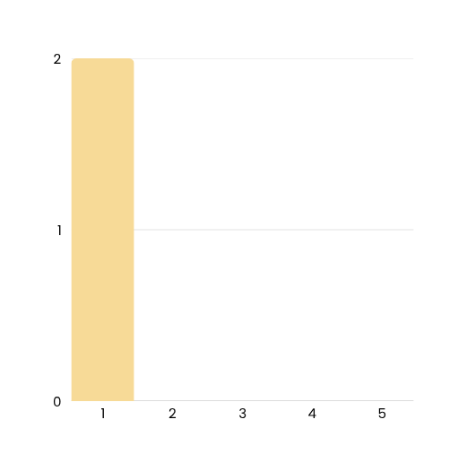
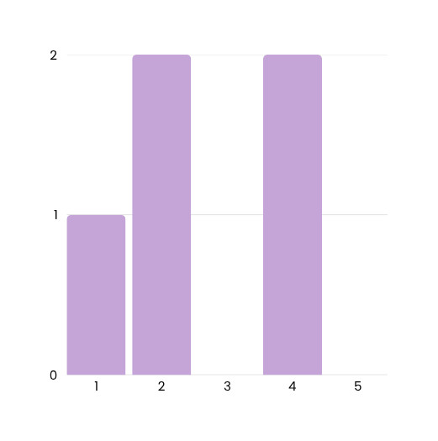
1: Not at all
2: A little bit
3: Somewhat
4: Mostly
5: Heavily CS reliant
Attitudes Towards Programming
CS/Programming
Engineering
Non-STEM
Bio/Medicine
3
8
2
2
6
2
Number of Students
4
1
1
1
2
0
0
0
0
1
2
3
4
5
1
2
3
4
5
1
2
3
4
5
1
2
3
4
5
How much do you think programming will align with your career path?
Notes:
>>> move the question :programming align w career" above graphs? to match how audience will naturally read slides top to bottom (and ig key could fit in top right better idk)
Despite this, almost all of the students on our team intend to pursue a STEM-related career.
We were curious about how our students' attitudes towards programming changed depending on their intended career.
Attitudes varied [spread hands] within each career area, but we do have students who intend to pursue medical, engineering, or scientific [count] careers who don't expect programming to play a significant role in their future careers.

Slide 31
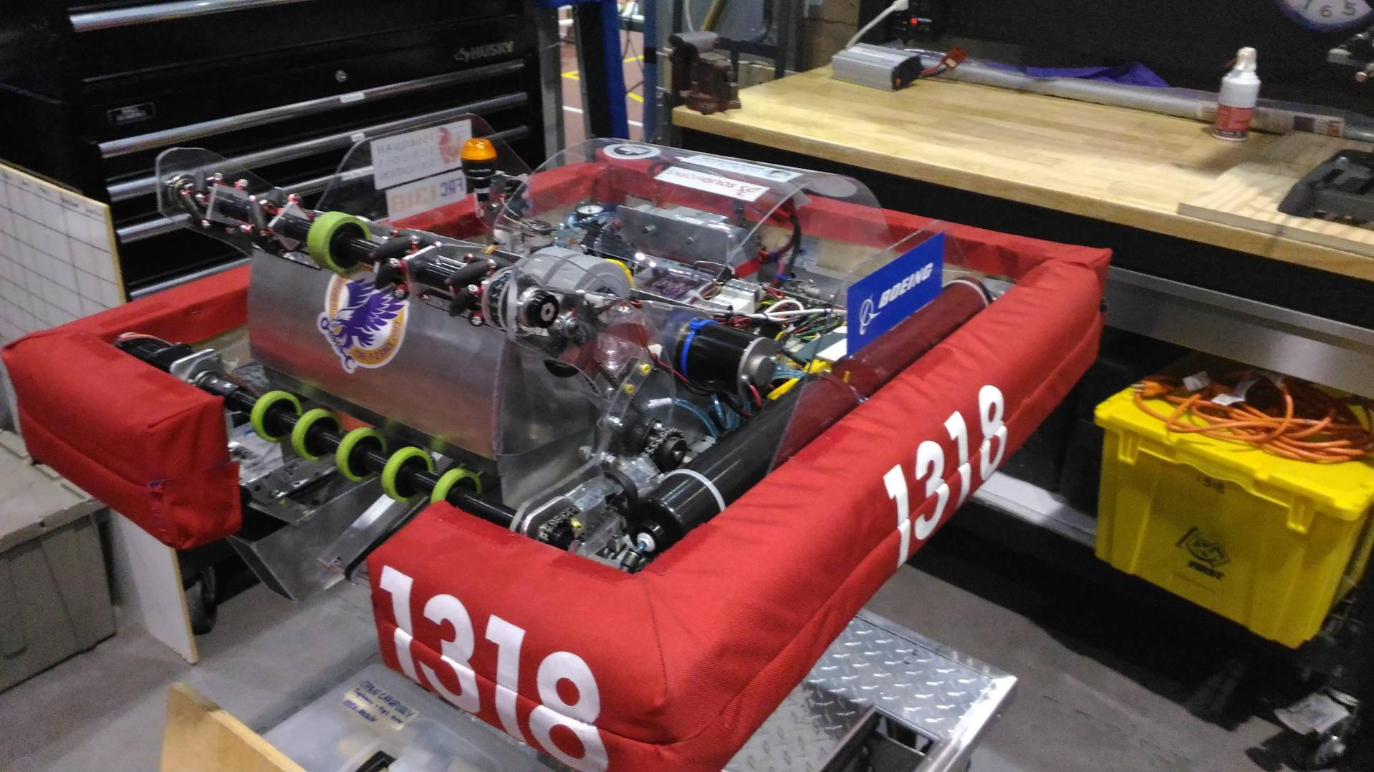
FRC Stronghold
2016
Advantages of Teaching with Robotics
Notes:
Now we'll review some of the advantages that come from teaching with robotics.

Slide 32
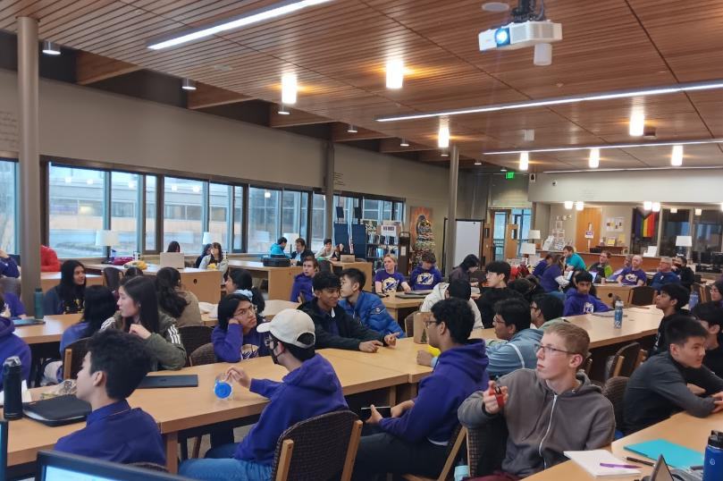
Time Constraints and Uncertainty
New robot game every year
Released in January
First competition eight weeks later, in March
Notes:
People often think of time constraints and uncertainty as bad things. But we consider them to be beneficial aspects of our program.
One of the unique challenges of robotics competitions is the short [] timeframe. There are only 8 weeks to design, create, and test [circle] our applications.
New competitions each year means new code to write and new challenges to work through!

Slide 33
Time Constraints and Uncertainty
Must build an app to analyze a game that’s never been played before
New robot game every year
Released in January
First competition eight weeks later, in March
Notes:
But that also means we have to create an application to analyze a game that's never been played before.
Students have to deal with that uncertainty by analyzing the game rules, making predictions, and choosing what data to track and how to display it.

Slide 34
Time Constraints and Uncertainty
Forces prioritization of features
Gives quick feedback on design decisions
New robot game every year
Released in January
First competition eight weeks later, in March
Must build an app to analyze a game that’s never been played before
Notes:
This fast paced process pushes us to learn how to prioritize features, get quick feedback on design decisions, and carefully manage time to get everything [2 hand wave kinda] done before competition.

Slide 35
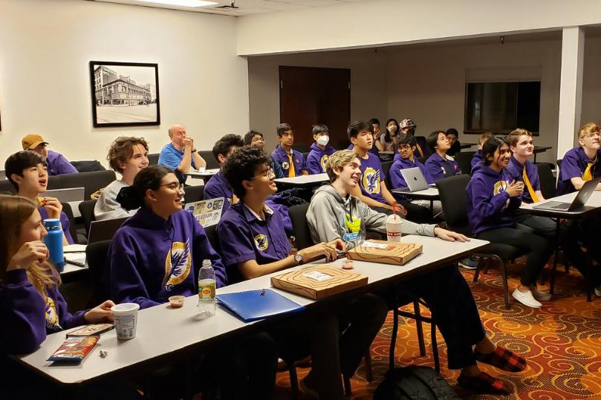
Building Real-World Applications
Application used by:
All members of our team
Allied teams
Application used to win competitions
Makes the learning rewarding
Notes:
Another advantage is that we get to build an application that we're actually going to use.
Our data visualizations are used by all students on our team and by many others on our alliance. This means applications need to be easy to understand and reliable to actually help meet our goal of winning competitions.
Although this creates additional pressure, having a real purpose in mind throughout the learning process makes robotics so much more rewarding than classwork.

Slide 36
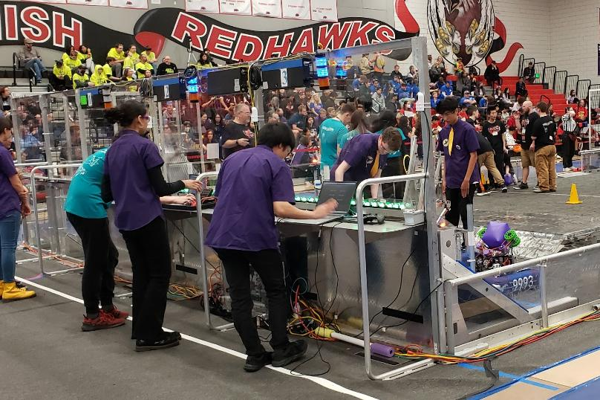
Healthy Pressure
At competition, if the code doesn’t work it can’t be used
A LOT of time is spent debugging at competitions...
Notes:
The experience at competition is another unique feature of robotics.
With so many outcomes depending on alliance selection, it's extremely important to the team that our applications work. That's why often, our time at competitions is spent debugging.
This miiiiiight be a sign that we should improve our testing process...
CHANGE SLIDE :000000

Slide 37
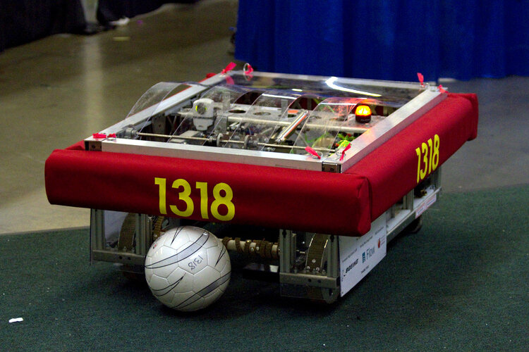
FRC Breakaway
2010
Challenges and Solutions
Notes:
And now, Brianna is going to talk about some of the challenges we face and how we address them.
[Switch to Brianna]
Hi everyone. I'm Brianna. I'm going to cover some of the challenges that are related to teaching application development as a time-constrained extra-curricular activity.
As you can see, our team has some issues..........
But! Throughout years, we have gone through these challenges and we have found ways to keep them fun!

Slide 38
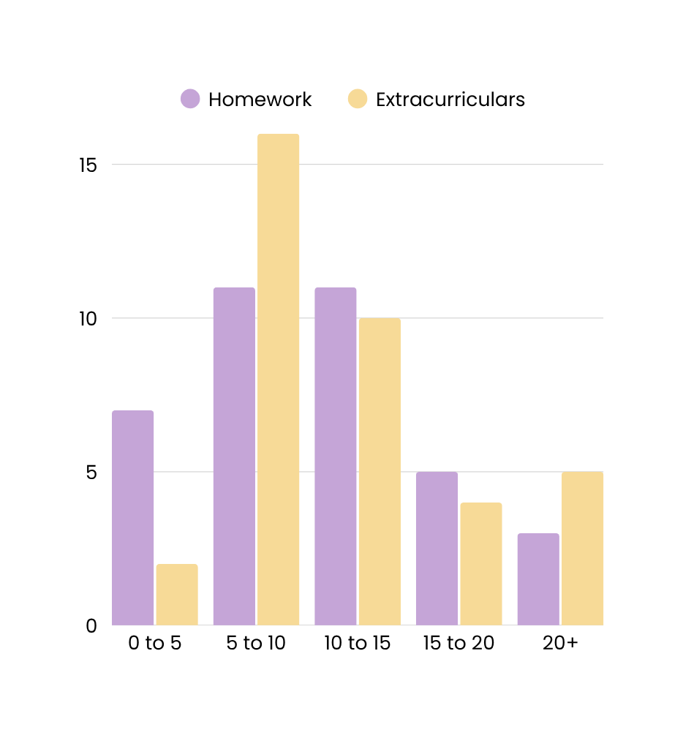
Competing for Attention
50% of robotics students spend 20+ hours a week on school related activities
Other sports, jobs, and family commitments
Number of Students
Hours Spent on Homework and Extracurriculars Weekly
Notes:
One of the challenges we face is getting students committed to learning through robotics.
High schoolers have many other commitments that keep them busy.
Over half of our team spends over 20 hours per week on homework, extracurriculars, and other commitments like jobs and family.
This means we have students with a lot to learn but not much time on their hands, so what gets them to stay with robotics?

Slide 39
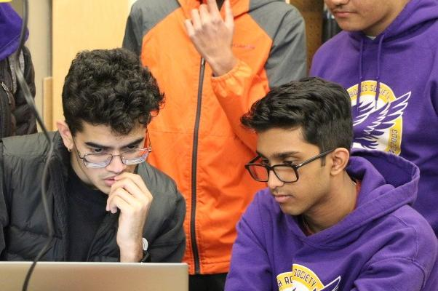
Competing for Attention
MADE FUN✅
Solution
Get to the fun stuff fast
And keep it fun
How?
Casual, relaxed environment
Use group activities where students interact with peers
Notes:
Our solution is to strive to make robotics fun!
In order to keep students engaged and coming back, we need to get to the fun stuff fast and keep it fun. This means differentiating robotics from schoolwork by creating a fun and casual environment, using group activities so students can interact with others, and staying away from anything resembling homework

Slide 40
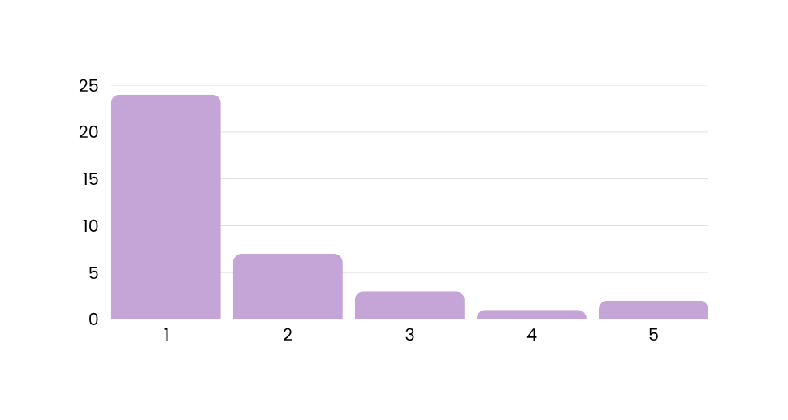
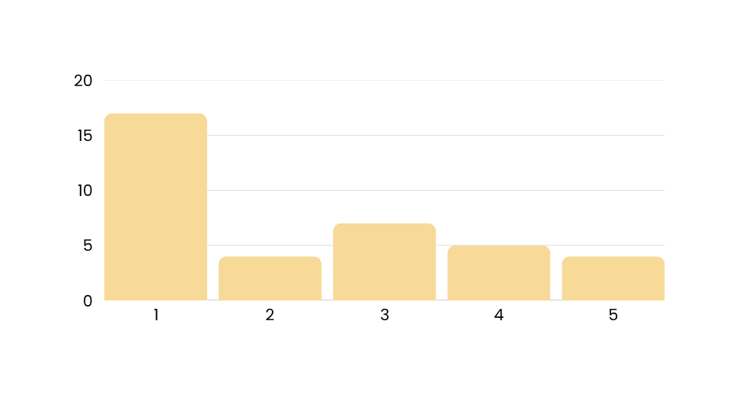
1: Unaware of existence
2: Heard of but never used
3: Used it a little
4: Comfortable using
5: Highly proficient
Lack of Experience with Tools
Most new students have never used a command-line interface (CLI)
Setting up virtual environments and cloning repos is not fun
CLI
17
IDEs
Notes:
(Another challenge we have is...) a lack of knowledge using programming tools
For example, most of our students have never heard of or used a command-line interface or IDE before joining robotics.
[Stacy - proposed additional info]
This makes it difficult to use many online training resources, because most of them assume that students have some proficiency with these tools.
When teaching programming, it's hard to not overload students too early with all the tools needed to edit and share version history as a team

Slide 41
Lack of Experience with Tools
NOT FUN
Teaching all tools in one sitting without giving hands-on experience
Tool proficiency can become a bottleneck to the fun parts of robotics
Git
Powershell
Environment Variables
VS Code
Terminal
Pip
Github
Hosting Service
Virtual Environments
Pyproject.toml
Notes:
This means you'll have to put a lot of thought into how you'll manage instruction during the first few training sessions.
Whatever you do, don't spend the first few hours of instruction installing Git, cloning repos, or creating virtual environments.
We call this TOOL TRAUMA... >:/
And we're talking from experience here. We used to spend the first couple meetings in the Fall setting up new computers, so students couldn't even write a single line of Python until a few weeks after they joined our team, if they even stayed for that long.

Slide 42
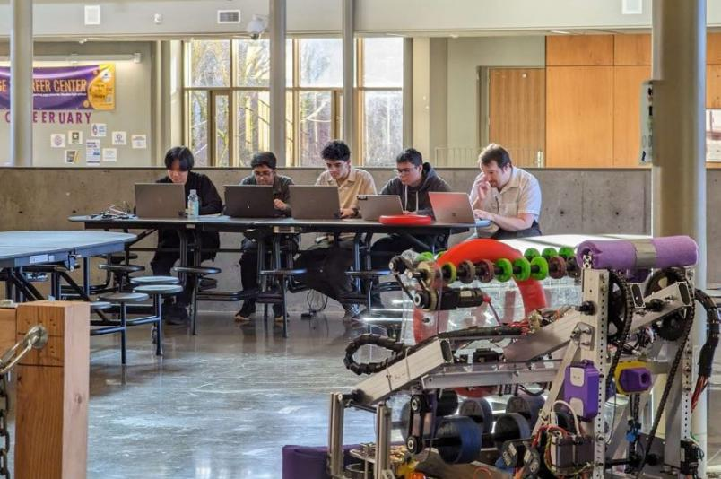
Lack of Experience with Tools
Online notebook environments
Preconfigured computers
Put students in small groups to reduce number of computers needed
Use teaching assistants who can quickly solve tool problems
MADE FUN✅
Notes:
But, there are several ways to avoid tool trauma!
- By putting students into small groups to work and learn together, we limit the total amount of technology and set up needed, while promoting peer to peer feedback.
- With this, we don't bore new students with how to use all of our tools. One way we do this is by starting with online notebook environments, as they eliminate complicated outside tools like CLI and IDEs.
- Also, students with many years of experience using these tools can guide new students whenever they need help
- And finally, having fun and easily accessible guides that match new student's knowledge on how to use these tools allows them to learn tools independently and own their own time.

Slide 43








Python is Not Enough
Non-trivial applications require an entire suite of technologies
New students can’t learn all this in a year
Notes:
Now for our next challenge.
We all love Python...
But when making web applications, there are many other languages and technologies needed for the front and back end, which students can't learn and master all within one competition season.

Slide 44

Python is Not Enough
NOT FUN
Reading Assignments
Homework
Lectures
Notes:
When trying to learn several new applications, giving high school students who are already burdened by classwork more assignments and lectures makes robotics unenjoyable and no different than actual school work.

Slide 45

Python is Not Enough
MADE FUN✅
Students choose the technologies they want to learn
(Don’t try to teach everything to everybody)
For example, IRS Analytics uses skill groups
Flask, Jinja, HTML, and JavaScript
SQL and Sqlite
Dash and Plotly
Packaging and hosting
Notes:
By allowing our students to choose the technologies they want to master, we have many people able to collaborate with each other and come together to build a full system.
Our analytics team is divided into collections, who focuses on making the front end with tools like HTML and JavaScript in Flask, and visualization, who visualize our collected data on Plotly
Next, our mentor Stacy is going to discuss a few more challenges.

Slide 46

Difficult to Give Feedback
Students learn faster if they receive individualized feedback (1)
Providing feedback is challenging for robotics teams.
Extra-curricular activity
No grades
No mandatory homework
One adult mentor for as many as 20 students
(1) Alberola, Juan M., and Ana García-Fornes. Using feedback for improving the learning process in programming courses. IEEE Revista Iberoamericana de Tecnologias del Aprendizaje 9.2 (2014): 49-56.
Notes:
Hello again.
I'm going to discuss challenges related to giving feedback to students on their work.
Of all the challenges we face, this is the one that I've struggled with the most.
Most of us would agree that receiving constructive feedback from more experience programmers helps us learn and avoid pitfalls.
This is an area where our intuition is correct. There is academic research that constructive feedback helps people learn.
Now, why is providing feedback challenging?
Robotics is an extra-curricular activity, so we don't have the ability assign grades or even to compel students to submit code for my review. Furthermore, outside of our build and competition season, we only see students once a week. Last fall we had over 25 students show up to try out analytics, which is a lot.

Slide 47

Feedback
NOT FUN
Anything resembling grades and homework didn’t work.
Notes:
Here's a news flash. Anything resembling grades or homework didn't work.
I can't imagine that anyone here is surprised by this. It seems obvious.
I have to admit that for several years it wasn't obvious to me. We have new students do some coding exercises in Google Collab notebooks. I always requested that our new students save their notebooks to their Google drive and share them with me, so I could send them an email with some pointers.
I never had more than two or three notebooks shared with me a year. It didn't matter that I wasn't assigning grades, or how friendly and positive I tried to be.

Slide 48

Feedback
MADE FUN✅
Peer feedback
Occurs when working on group projects
Often comes from more-experienced students
Happens in real time
Notes:
The solution I finally discovered is ... Don't worry about it.
In our program, there are two kinds of feedback that just occur naturally.
Peer feedback occurs when we structure our learning activities so that students work on them in small groups. We often assign more experienced students to work together with the newer students. Students are able to give each other feedback as they are working through a problem.
And the feedback happens in real time. That's huge. When students submitted code for my review (which rarely occurred), it usually took me several days to review their work and get back to them.

Slide 49

Feedback
MADE FUN✅
Reality-based feedback
Bugs
Application crashes
Using your application for a real-world task
Feedback from other users
Notes:
The second kind of feedback is what I call reality-based feedback.
We're building an application that we're actually going to use.
Every bug and application...
The experience of using an application that you built...
Hearing from other users what they like and don't like about your application,...
That's all excellent feedback.
So that changes my role as a mentor and educator. I need to hang back, monitor what's going, and steer students away from any obvious pitfalls.
This was hard for me. Here's a bit about myself. I'm a retired Navy Commander. I spent twenty years in our nuclear Submarine Force. Hanging back and monitoring is not something I was trained to do. But sometimes to be successful, you have to un-learn some old habits.

Slide 50

Different Skill Levels
Some students have never programmed or seen a command line before...
While others already have an app on the app store.
Notes:
Next, I'm going to discuss how to work with students with varying skill levels.
While most high school freshmen have never used a command line interface before, we occasionally get students who have already taught themselves to program.

Slide 51

Different Skill Levels
NOT FUN
Focusing on the advanced students
Focusing on the least-experienced students
Notes:
There are two things you definitely don't want to do.
If you focus entirely on the advanced students, the new programmers will feel lost.
But if you only cater to the beginning programmers, the advanced students will get bored and find something else to do.

Slide 52

Different Skill Levels
MADE FUN✅
Have a range of training activities, from easy to challenging
Put students in groups
Group by skill level, OR
Combine experienced and less experienced students
Grouping strategy depends on training activity
Mix it up – don’t always use the same groups
Notes:
We address this challenge by having a range of training activities.
At any given meeting, if it's not build season and we're not getting ready for a competition, we'll usually have a few different groups of students working on different training activities in parallel.
Sometimes we group students by skill level, but for other activities we combine advanced and beginning students.
And we like to mix it up, so we don't always use the same groups.

Slide 53

FRC Infinite Recharge
2020
Takeaways
Notes:
We're almost at the end. Aarav is going to take over now and discuss some of our key takeaways.
[Switch to Aarav]

Slide 54

Takeaway #1
What works for high school students works for everybody.
Our techniques are suitable for adult learners
Notes:
So far, We've been talking about teaching Python to high school students.
However, training techniques that work on high schoolers don't just stop working when they graduate and become adults.
The techniques we used, like hands-on and partner learning, real-world applications, and breaking down complex concepts into digestible parts aren’t just helpful for teens. They’re effective and useful for adult learners too

Slide 55

Takeaway #2
You don’t need a robotics team to teach Python.
Our methods are just project-based learning
Dates from 19th century
John Dewey, an early advocate of project-based learning
Notes:
Another key point we want to leave you with is this: you don’t need a robotics team to teach Python effectively.
Everything we've talked about can be considered project-based learning, which has been around for a long time.
One of the earliest and well-known advocates of project-based learning was John Dewey, a philosopher and psychologist whose career spanned the late 19th and early 20th centuries.

Slide 56

Takeaway #3
Begin with the student in mind, not the subject matter.
Notes:
Also, It's not an accident that one of our presentation sections was titled "Understanding our Students."
Effective training programs reflect their students' knowledge, experience, and goals.
Some good questions to ask when designing a Python training program include:
What do your students want to do with Python? or
How much time do they have to learn?
Do they have prior experience with programming tools?
Will they be working mostly on their own, or as part of a team?

Slide 57

Takeaway #4
Embrace real-world projects, time constraints, and unpredictability.
Notes:
Our next takeaway might not be obvious, which is that real-world projects, time constraints, and unpredictability all sound like things you'd want to avoid while trying to learn a concept, except that they end up teaching you more.
Time constraints and unpredictability mean that you have to learn faster and prioritize, which are good life skills for more than just learning Python.
Real-world projects sound tough for a learner, but they provide a more engaging way to learn than rote memorization, and you get to practice Python in ways you might actually use in the future.
Now, Brianna will talk about the next few takeaways
CHANGE SLIDE :000000

Slide 58

Takeaway #5
Keep it fun.
Use group activities
Avoid lectures and rote learning
Notes:
By getting to the fun part fast, we keep people engaged and returning to robotics.
Avoid anything that even remotely resembles homework and allow students to work together to focus on their individual strengths.

Slide 59

Takeaway #6
Avoid Tool Trauma.
Early training activities should require minimal proficiency with tools
Carefully introduce new tools
Not all at once
Incorporate tools into training activities
Students should understand how and why they are used
Notes:
Tool trauma can scare away a learner from Python, or other subjects.
To avoid this, early training shouldn't require extensive knowledge of tools. Instead, they should be carefully introduced over time and incorporated into training activities to not overwhelm learners from the start. This way, students are more likely to remember and understand how and why these tools are used.
And now, Archit!

Slide 60

Takeaway #7
No grades or formal feedback is ok.
Use real-time feedback during training activities
Project-based learning provides its own feedback
Notes:
[summarize takeaways]
Students are still able to learn effectively without grades or formal feedback.
We've found that informal peer feedback works great.
And furthermore, every failure and success with a project provides its own feedback for our learning.
And now Stacy will cover the final takeway.

Slide 61

Takeaway #8
Embrace all skill levels.
Everyone has potential to be a great programmer
Notes:
The final take away is to embrace all skills levels. We want to make everyone feel welcome regardless of their prior experience level.
So back when our group was just getting started, I did a lot of pair programming with incoming freshmen. One time, I remember spending about twenty minutes trying to get a student to understand the concept of a function's return value. I eventually got frustrated and just started giving code dictation. I admit that I was wondering whether that student had a future in software development.
That student recently completed a computer science degree and is working in the tech industry.
You just can't tell how good a developer someone will be based on how fast they learn Python when they are just starting to learn. So always be patient and supportive.

Slide 62



Thanks a bot!
Notes:
And with that, we want to thank you all for coming to listen to our presentation!
To learn more...
QR codes: info about FIRST, info about our team
And with our remaining time, we'd like to welcome any question you may have :)

