Slide 1


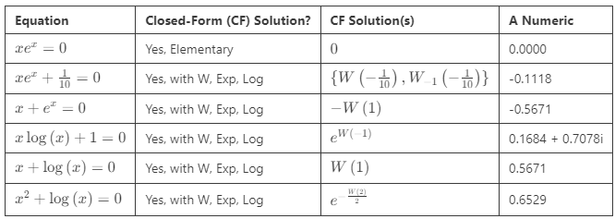
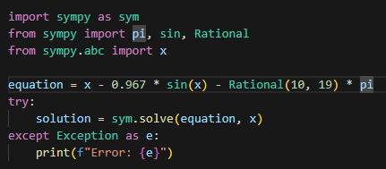

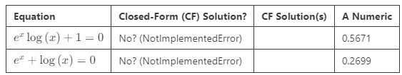
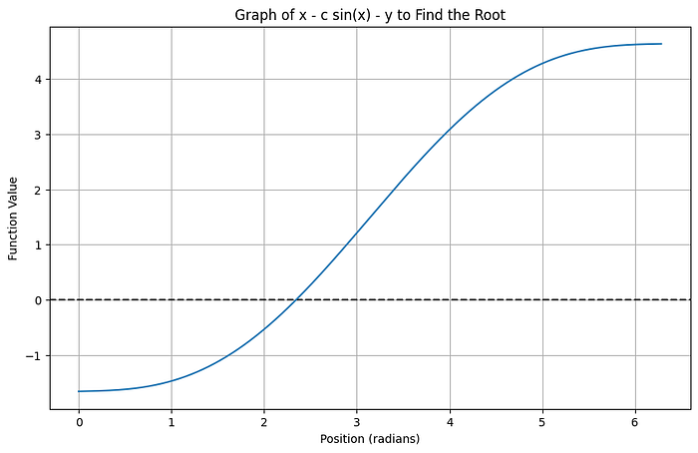
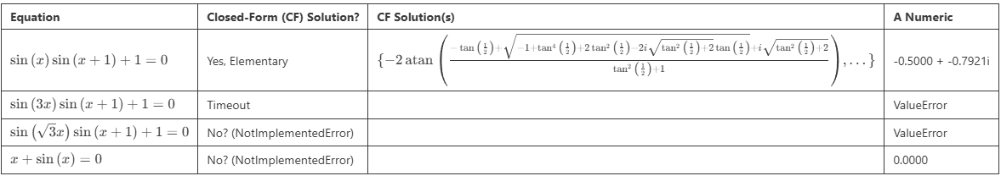
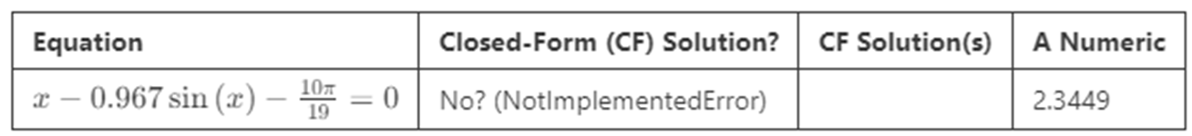

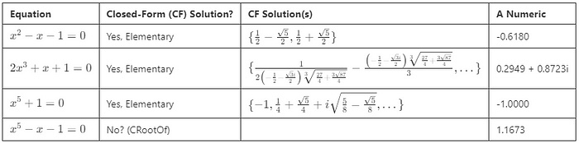
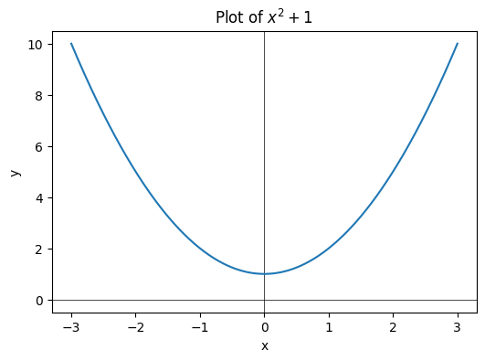

Definitions
Closed-Form Solutions: finite combos of standard operations (+, –, ×, ÷, √) and functions (exp, sin, etc.)
SymPy: an open-source computer-algebra package for Python
Explore Solvable and Unsolvable Equations with SymPy by Carl M. Kadie, FaST-LMM Open-Source Genomics Project
https://medium.com/@carlmkadie
Why can we solve some equations easily, while others seem impossible?
Also: why is this knowledge hidden from us?
Challenge: Solve for x
y = x² ✅
y = x −c sin(x) ❌
Trick: “Cheat” with SymPy
Article
Python Notebook
Source Code
https://bit.ly/EqSolve
The “Right” Way: Galois (“gal-WAH”) theory, transcendental number theory, algebraic geometry.
The “Wrong” Way: sympy.solve(…) #NotAMathematician
The “Good Enough” Way: sympy.nsolve(…)
Exp, Log and x
Allow Lambert’s W function? Yes!
NotImplementedError: multiple generators [x, sin(x)] No algorithms are implemented to solve equation x - 967*sin(x)/1000 - 10*pi/19
Trigonometric
Simple, yes
Commensurate Frequency, depends
Non-Commensurate, usually not
Trigonometric and x, Exp, Log
Mostly nope
Polynomials
Takeaways
Nopes
5th degree polynomial
exp or log with x (Yep, with W)
exp and log together
Just Trig: see above
Trig and x/exp/log
Surprises
Allow W
SymPy useful & fun
Another project: Newtonian physics isn’t deterministic
Numerical when needed
≤ degree 4, Closed Form
May involve i, complex numbers
A Python Refereeing an Italian Renaissance Mathematics Duel

