Slide 1
IQBRAVE
Project Progress
Learning Management System
Presentation
Student
H.M.S.J. Herath
System Analysis & Evaluation Report
Submission Date
24 March 2026
Laravel 12
PHP 8.2+
Academic Year
2024 – 2025
NVQ Framework
MVC Architecture
CONFIDENTIAL · ACADEMIC SUBMISSION

Slide 2
IQBRAVE LMS — Project Progress Presentation
AGENDA
01
Executive Summary
02
System Architecture
Project overview & goals
MVC, tech stack & design
03
Core Modules
04
NVQ Verification Flow
Key features & workflows
Multi-tier assessment process
05
Security & Testing
06
Implementation Roadmap
Protection & QA strategy
Timeline & milestones
07
Strengths & Challenges
08
Recommendations
SWOT analysis
Future improvements

Slide 3
01 / EXECUTIVE SUMMARY
Laravel 12
NVQ
4 Roles
5 Phases
Core Framework
Standard Compliant
RBAC System
Implementation Plan
What is IQBRAVE LMS?
IQBRAVE is a bespoke, monolithic MVC web application built on Laravel 12 (PHP 8.2+), engineered specifically for National Vocational Qualification (NVQ) education. Unlike generic LMS platforms, it features a native multi-tier assessment verification workflow that bridges Students, Instructors, and Assessors — ensuring complete NVQ regulatory compliance.
Purpose-Built
Secure & RBAC
Auto-Credentialing
Designed from scratch for NVQ vocational education — not a generic platform adaptation.
Admin, Instructor, Assessor, Student roles with strict middleware-enforced boundaries.
QR-verified PDF certificates auto-generated on successful multi-tier verification.

Slide 4
02 / SYSTEM ARCHITECTURE
MODEL LAYER
Business logic, database queries, relationships
Eloquent ORM (Active Record)
VIEW LAYER
Server-rendered HTML, reactive UI, responsive layouts
Blade + Tailwind CSS + Alpine.js
CONTROLLER LAYER
Request routing, RBAC enforcement, data aggregation
Laravel HTTP Controllers + Middleware
Monolithic Server-Side Rendered (SSR) architecture — prioritises deployment simplicity, developer cohesion, and maintainability over microservice complexity.

Slide 5
02 / TECHNOLOGY STACK
Backend
ORM
Frontend
PHP 8.2+ / Laravel 12
Eloquent ORM
Alpine.js + Tailwind CSS
Build
PDF
QR Code
Vite (HMR)
barryvdh/laravel-dompdf
simplesoftwareio/simple-qrcode

Slide 6
03 / CORE MODULES
M1
Auth & RBAC
Secure login, Bcrypt hashing, Role-Based Access Control (Admin / Instructor / Assessor / Student)
M2
Curriculum Mgmt
Hierarchical: Courses → Modules → Units → Lessons with NVQ field mapping
M3
Assessment Engine
Dual-track: Auto-graded quizzes + file-upload assignments with instructor rubric grading
M4
NVQ Verification
Multi-tier workflow: Pending → Graded → Assessor Reviewed → Verified with audit log
M5
Certification
DOMPDF-rendered QR-verified PDF certificates auto-generated upon final verification

Slide 7
04 / NVQ VERIFICATION WORKFLOW
01
02
03
04
STUDENT
INSTRUCTOR
ASSESSOR
CERTIFICATE
Submits Assignment
Grades Submission
Verifies Grade
Auto-Generated
▶
▶
▶
File upload with deadline enforcement
Rubric-based grading, marks pending
NVQ compliance check, approves/rejects
QR-verified PDF issued to student
Submission States: Pending → Graded → Assessor Reviewed → Verified → Certificate Issued

Slide 8
03 / DATABASE & API DESIGN
Database Architecture
API & Communication
▪ Highly normalised RDBMS with foreign key constraints
Classic HTTP
▪ Pivot tables: course_user, module_user, enrollments
Synchronous request-response via POST with CSRF tokens (Blade-injected)
▪ Status enums: pending → graded → verified
Progressive Enhancement
Axios + Alpine.js (x-data, x-on) for micro-interactions without full page reloads
▪ Audit trailing via verification_logs table
Lesson Completion
Key Relationships
AJAX toggling via LessonProgress — instant UX without server round-trip
Entity A | Bridge | Entity B
Users (1) | Enrollments | Courses
Courses (1) | Modules | Units/Lessons
Courses (1) | Assignments | Submissions
Quiz Validation
Real-time answer checking via Axios calls on submission

Slide 9
05 / SECURITY & TESTING STRATEGY
Security Analysis
Testing Strategy
Authentication
Unit Testing
Bcrypt password hashing — plain-text storage impossible via model casts
Tool: PHPUnit / Pest
Isolated logic — progress calculators, grade formulas, division-by-zero guards
RBAC Middleware
Role boundaries enforced at route level — privilege escalation blocked
Integration / Feature
Tool: Laravel Feature Tests
Input Sanitation
Full NVQ chain simulation: submit → grade → assess → verify in automated sequence
Eloquent prepared statements prevent SQL Injection & XSS
E2E / Browser
Certificate Integrity
Tool: Laravel Dusk
QR codes link to unauthenticated verify route — forgery impossible
Alpine.js interactions, modal triggers, Axios UI updates on lesson completion

Slide 10
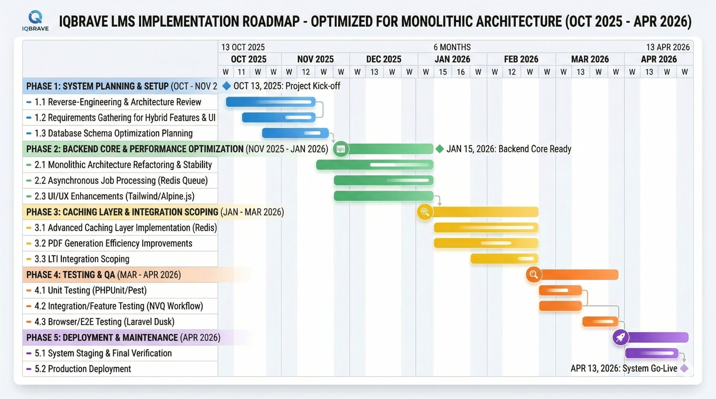
06 / IMPLEMENTATION ROADMAP
Oct 2025 – Apr 2026 · 5 Phases · 6 Months
Figure: IQBRAVE LMS Implementation Gantt Chart — Optimised for Monolithic Architecture

Slide 11
06 / ROADMAP PHASES
Phase 1
System Planning & Setup
Reverse-engineering · Requirements gathering · DB schema planning
Oct – Nov 2025
Phase 2
Backend Core & Performance
Monolithic refactoring · Redis Queue · UI/UX enhancements
Nov 2025 – Jan 2026
Phase 3
Caching Layer & Integration
Advanced Redis caching · PDF optimisation · LTI scoping
Jan – Mar 2026
Phase 4
Testing & QA
PHPUnit/Pest · Feature/Integration tests · Laravel Dusk E2E
Mar – Apr 2026
Phase 5
Deployment & Maintenance
Staging & final verification · Production go-live
Apr 2026

Slide 12
07 / STRENGTHS & WEAKNESSES
✔ STRENGTHS
✖ WEAKNESSES
Domain Specificity
Synchronous Bottlenecks
Uniquely addresses NVQ multi-tier verification — no off-the-shelf alternative matches this workflow.
PDF certificate generation and bulk email notifications degrade performance under heavy load.
Architectural Simplicity
Monolithic Scaling
Cohesive monolith is far easier to deploy and maintain for small-to-mid scale institutions.
Entire application must be replicated as one unit — no independent module scaling possible.
Robust ORM
LTI Non-Compliance
Eloquent pivot tables provide granular role & permission flexibility without extra complexity.
Cannot integrate with third-party LMS tools or university ecosystems without LTI implementation.

Slide 13
08 / RECOMMENDATIONS
R1
HIGH
R2
HIGH
Async Job Processing
Advanced Caching Layer
Delegate PDF generation, emails & heavy DB queries to Laravel Redis Queue — drastically improves response speed under load.
Cache static curricular hierarchies (Courses, Modules) with Redis/Memcached — reduces DB queries and improves dashboard load times.
R3
MED
R4
MED
API Extraction
LTI Integration
Extract business logic into RESTful / GraphQL API via Laravel Sanctum to enable a future Flutter or React Native mobile client.
Implement LTI (Learning Tools Interoperability) standard to integrate with third-party tools and position IQBRAVE as enterprise-grade.

Slide 14
CONCLUSION
IQBRAVE LMS is a highly competent, purpose-built vocational education platform.
By natively accommodating a complex, multi-tiered NVQ assessment and verification workflow on top of a robust Laravel 12 MVC architecture, IQBRAVE is well-positioned for real-world institutional deployment. With the recommended enhancements — async queuing, caching, API extraction, and LTI compliance — the system is ready to evolve into a fully enterprise-grade, standards-compliant platform.
NVQ
Secure
Extensible
Regulation Ready
RBAC + Bcrypt
API-Ready
H.M.S.J. Herath · Academic Year 2024–2025 · 24 March 2026

