Slide 1
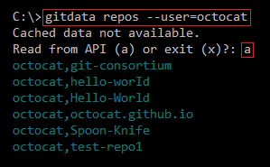
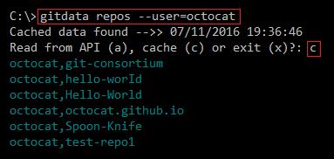
cache01.png
When data is retrieved from the GitHub API, a cache file is automatically saved.
Subsequent requests can read from the cache file, or read from the API (and thereby refresh the cache).
cache02.png
Filename (in gh_cache folder) describes the data:
Authentication username (_anon = anonymous)
Selection criteria (e.g., users-octocat)
Type of information (e.g., repos)
_anon_users-octocat-repos.json
cache03.png

