Slide 1
Exploring Machine Learning Models and Data Poisoning to solve real-life issues with AI
Hackathon 2026
Pronob Kumar
Trevor Michel
Walter Weber
Ian McKinzie

Slide 2
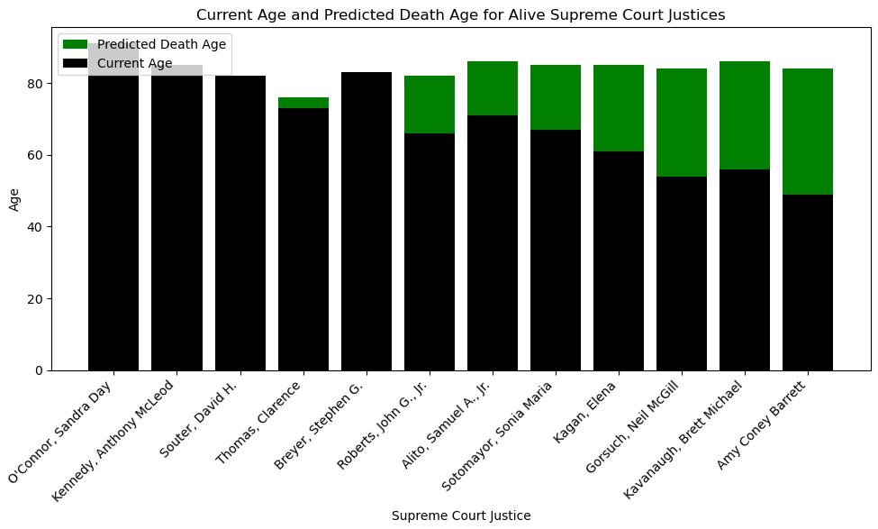
Dataset: Supreme Court Justices
Predicted when alive Supreme Court Justices were going to die using machine learning
The black bar represents how old each person (in 2021) was compared to how long they are expected to live
Some data elements used to predict age are birth date, term start date, as well as categorical elements such as political party or sex

Slide 3
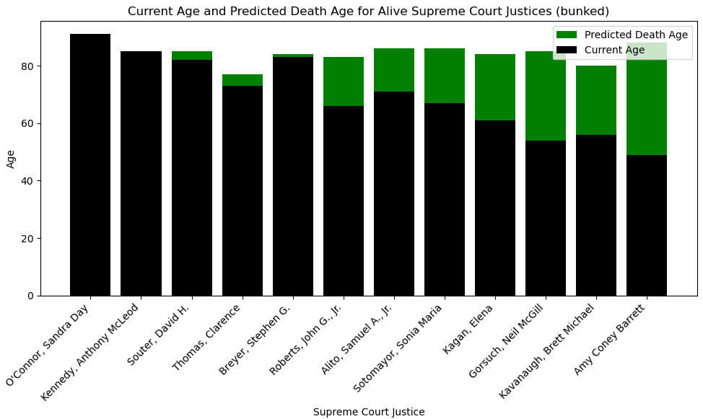
Results after data poisoning
This model appears to be quite robust to data poisoning
The differences between this graph and the previous graph are miniscule

Slide 4
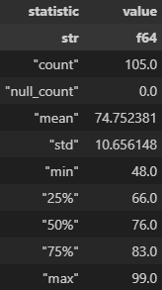
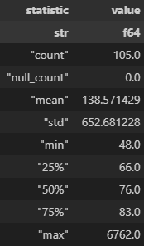
Descriptive Statistics for age
Original ages of the data
Messed up ages with data poisoning
Utilized K-Nearest Neighbors machine learning model to make our final predictions. Seemingly, KNN is not affected much by these wildly variant ages. The KNN model fundamentally ignores outliers, so this model is resistant to data poisoning in the form of adding outliers.

Slide 5
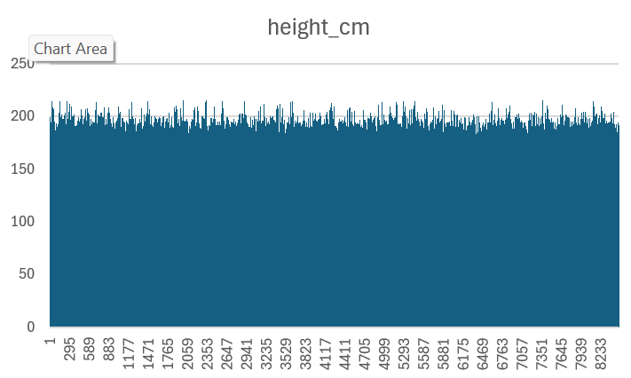
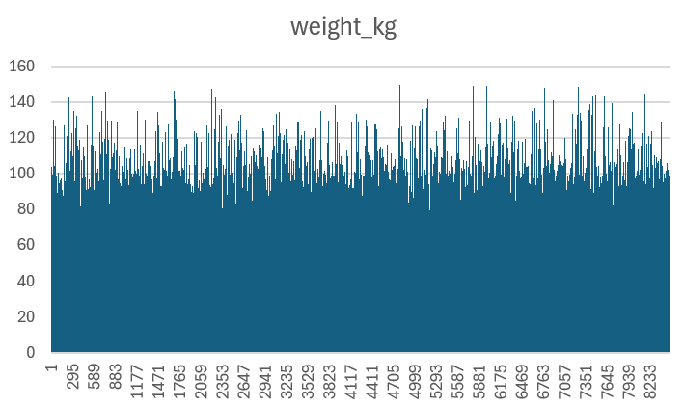
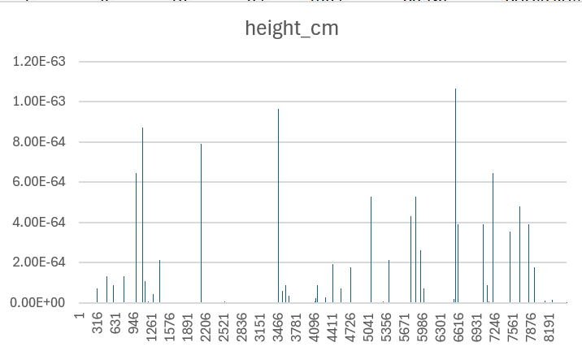
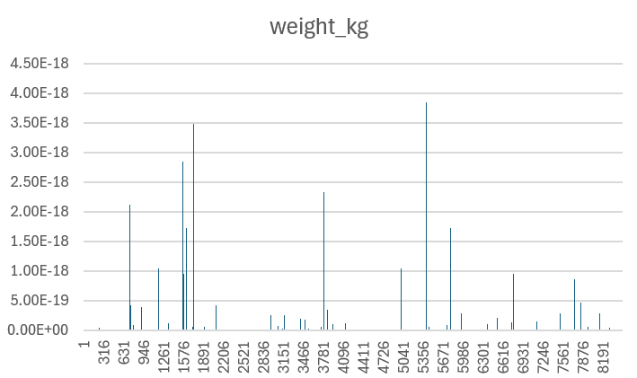
Predicting Olympic medalists
With 8000 competitors 6500 did not earn medals
Height
Height
Weight
Good Data
Bad Data

Slide 6
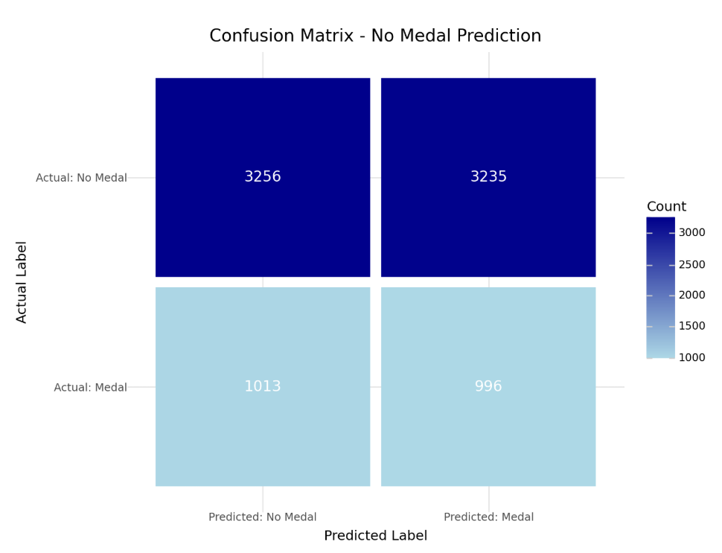
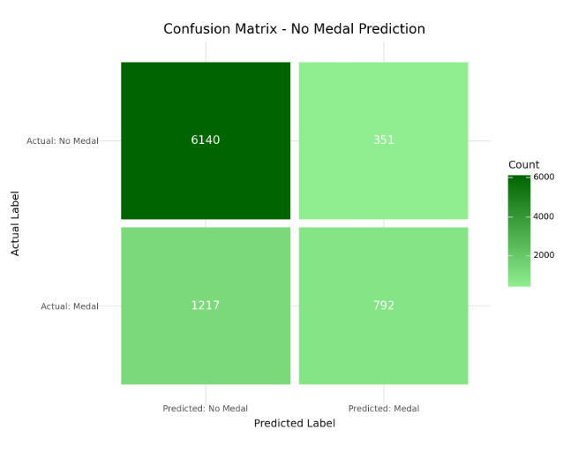
Good Data: Knn Classifier has better predictions
Linear Classifier Success
KNN Regressor Success Rate
Terms:
Photo-finish silver| Equipment issue | Final appearance

Slide 7
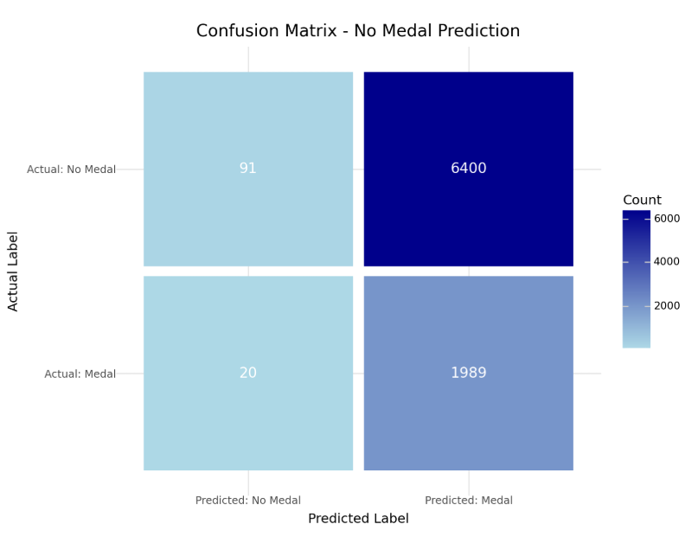
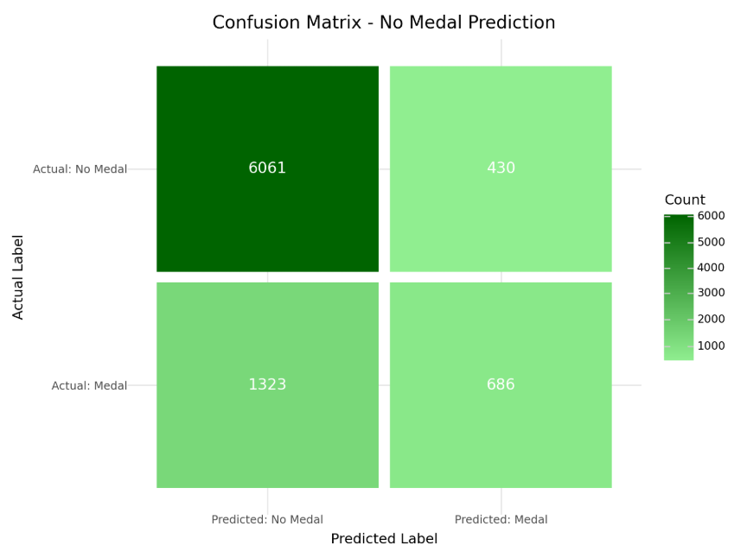
Bad Data: Knn Classifier has better Predictions​
Linear Classifier Is Worse
KNN Regressor Is Unchanged

Slide 8
Dataset: Heart Disease
The dataset had multiple variables that are associated with heart disease.
Tried to predict whether someone is going to have heart disease or not.
Analyzed data with the Logistic Regression model, along with Machine Learning Models like random forest and XGboost.
Made an applet which will use AI and take data from the user to predict the percentage of them having any Heart Diseases.

Slide 9
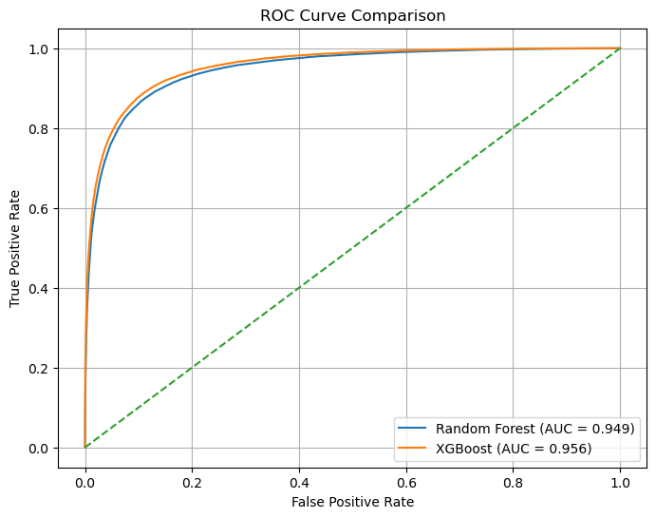
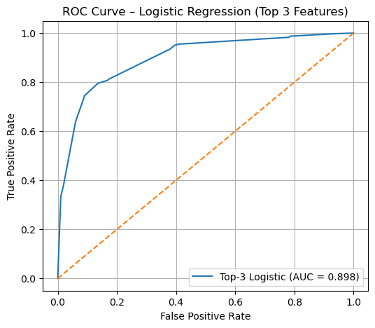
ROC curve comparison
Accuracy for both machine learning models are better than the logistic regression models

Slide 10
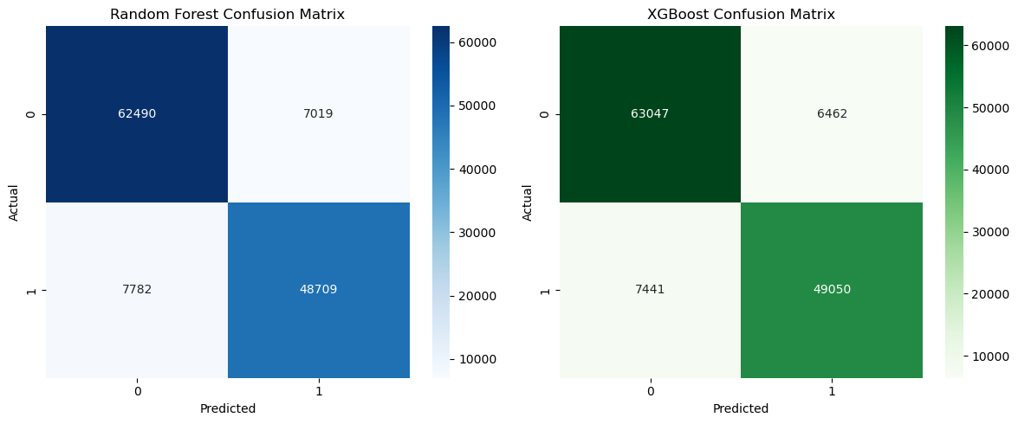
Confusion Matrix
We have more actual positives negatives than false positives and negatives.

Slide 11
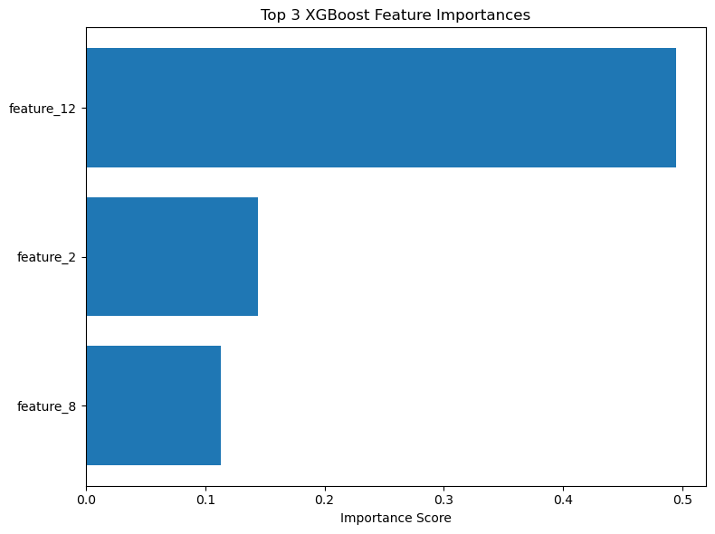
Most important features
Anova Model: logit(p) = -0.3161 + (1.2171 * Thallium) + (1.0663 * Chest pain type) + (0.7445 * Exercise angina)

Slide 12
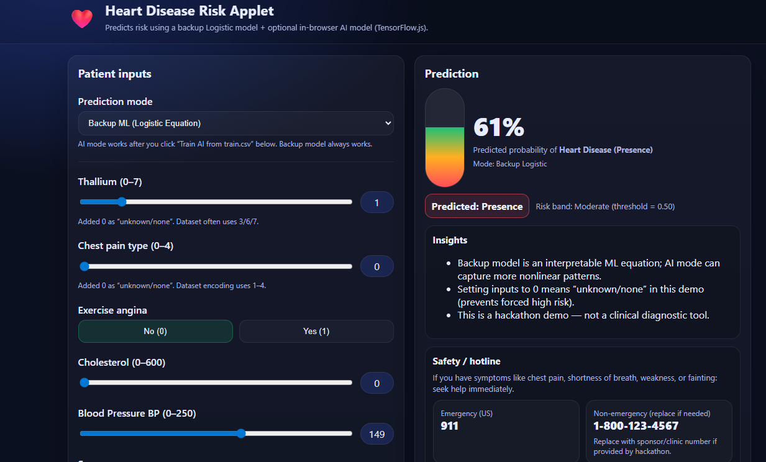
App for the Predicting

Slide 13
Thank you for listening
Questions
GitHub Link: https://github.com/dmail5802/hackathon_competition
We used Python, JS, HTML, CSS as programming languages.

