Slide 1
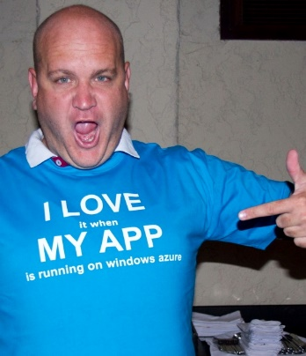
Indexing nirvana with DocumentDB
Ryan CrawCour Program Manager, Microsoft @ryancrawcour | David Makogon Cloud Architect, Microsoft @dmakogon

Slide 2
Today’s talk
What is DocumentDB? (5-minute lightning-round edition)
Meet today’s data: Movies
Queries and indexing: Demos mixed with Q&A
Loud applause and amazing tweets

Slide 3
DocumentDB: Lightning Round Edition
{
name:"DocumentDB",
deployedAs: "Service",
dbType: "Document",
connectVia: [ "rest", "sdk" ],
deployVia: [ "portal", "rest", "cli" ],
scaleVia: [ "portal", "rest", "cli" ], differentHow: [ "javascript", "indexing", "consistency" ]
}
Notes:
Jump to portal to show features

Slide 4




DocumentDB Resource Model
Account
Databases
Collections
Documents
Attachments
1010100100
Users
Stored Procedures
JS
Triggers
{
“id” : “123” “name” : “joe”
“age” : 30
“address” : {
“street” : “some st”
}
}
Permissions
JS
User Defined Functions
JS
Notes:
SQL syntax – familiarity with traditional
- automatically indexed
- flexible schemas
Multi-document transactions
- stored procedures/triggers is transactional
Tunable and fast – consistency levels
- strong
- bounded staleness
- session
- eventual
- indexing
-consistent
-lazy
Highly scalable – customers with terabytes
- fully managed
- quick startup

Slide 5
DocumentDB Overview
{ }
JS
SQL
flexible schema
&
queryable
multi-document
transactions
tunable & fast
scalable
&
fully managed
Notes:
SQL syntax – familiarity with traditional
- automatically indexed
- flexible schemas
Multi-document transactions
- stored procedures/triggers is transactional
Tunable and fast – consistency levels
- strong
- bounded staleness
- session
- eventual
- indexing
-consistent
-lazy
Highly scalable – customers with terabytes
- fully managed
- quick startup

Slide 6
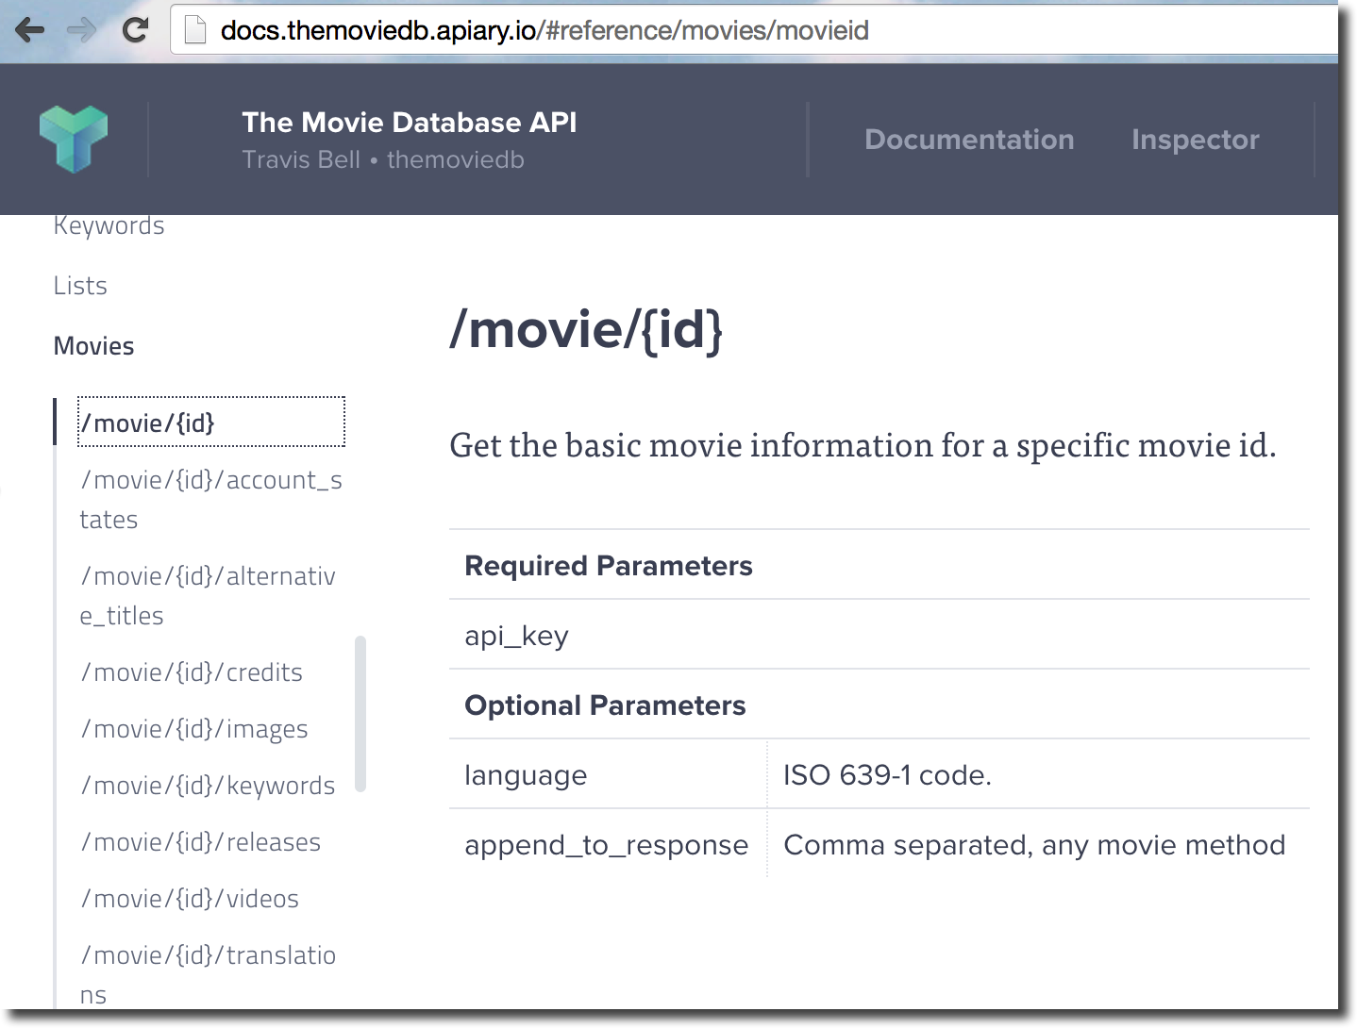
Meet today's demo data: Lots of movies

Slide 7
Demo time …
Importing some data
Simple query with equality / inequality
Query against nested arrays
Query on ranges
Query on distance using geospatial capabilities SELECT *
FROM cinemas c
WHERE ST_DISTANCE(c.Location, {
"type": "Point",
"coordinates": [-121.889125, 37.33034]
}) < 5 * 1600

Slide 8
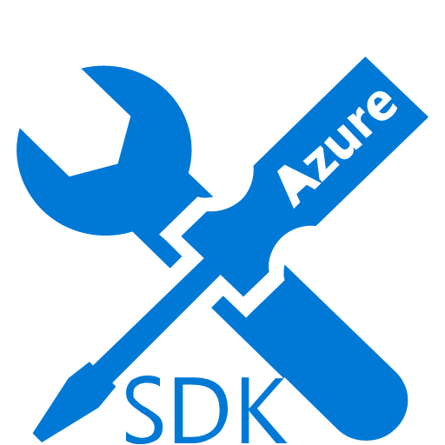



SDKs and Tooling
SDKs
Azure Portal
Studio
aka.ms/docdbsdks
portal.azure.com
aka.ms/docdbstudio
Notes:
DocumentDB offers SDKs and tooling to help you develop against and manage data in the service.
All APIs are accessible as REST over HTTP, we also provide .Net, Node, Java and Python SDKs
I already shown provisioning through the portal – the Azure Preview portal offers a variety of development, monitoring and management capabilities.
DocumentDB Studio is an open source app that allows you to manage and interact with the service from a GUI tool
The Data Migration tool allows you import existing data into DocumentDB

Slide 9



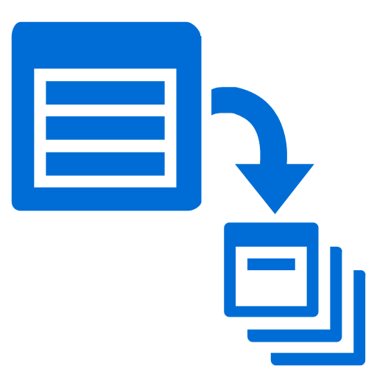

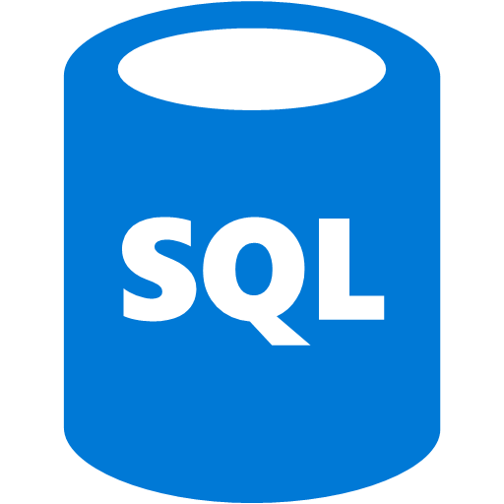
Get Started Today
select * from playground p where p.name = “DocumentDB”
explore playground
build an app
move some data
aka.ms/docdbplayground
aka.ms/docdbstarter
aka.ms/docdbimport

