Slide 1
AzureCon 2015 DocumentDB
Ryan CrawCour - @ryancrawcour
David Makogon - @dmakogon

Slide 2
Today’s talk
What is DocumentDB? (5-minute lightning-round edition)
Meet today’s data: Movies
Queries and indexing: Demos with a side of Q&A
Loud applause & amazing #DocumentDB @ #AzureCon tweets!

Slide 3
DocumentDB – Lightning Round
{
name:"Azure DocumentDB",
classification: "NoSQL",
dbType: "Document",
connectVia: [ "rest", "sdk" ],
manageVia: [ "portal", "rest", "cli", "sdk" ],
differsVia: [ "service",
"js",
"indexing",
"consistency"
]
}

Slide 4




DocumentDB – Resource Model
Account
Databases
Collections
Documents
Attachments
1010100100
Users
Stored Procedures
JS
Permissions
Triggers
JS
User Defined Functions
JS

Slide 5
Service Consumption
{
units:"RequestUnit",
tiers: [250, 1000, 2500],
behavior: [ "consistent", "predictable" ],
measured: "per operation",
reportedVia: "response header",
granularity: "hour",
}

Slide 6
Out-of-the-box Indexing
{
"id" : "123",
"age" : 30, "name" : "joe",
"address" : {
"street" : "some st",
"city" : "San Jose"
}
}
/id /age
/name /address /address/street
/address/city
Range index
Hash index

Slide 7
Demos

Slide 8
Example movie JSON
{
"id": "movie203801",
"title": "The Man from U.N.C.L.E.",
"tagline": "A Higher Class of Hero.",
"genres": [
{ "id": 35, "name": "Comedy" },
{ "id": 28, "name": "Action" },
{ "id": 12, "name": "Adventure" } ],
"overview": "In the early 1960s, ...",
"release_date": "2015-08-14",
"runtime": 116,
"vote_average": 3.5,
"type": "movie"
}

Slide 9
Demo recap

Slide 10
Default Indexing
SELECT * FROM movies m
WHERE m.title = "Ant-Man"
SELECT * FROM movies m WHERE m.vote_average >= 3 AND m.vote_average <= 4
Equality on strings
Range on numbers

Slide 11
Arrays
SELECT m.title, m.overview
FROM movies m
JOIN g IN m.genres
WHERE g.name="Comedy"

Slide 12
Ranges on strings?
SELECT *
FROM Movies m
WHERE m.title BETWEEN "A" AND "B"

Slide 13
Exclude path(s) from index
SELECT *
FROM Movies m
WHERE m.overview = 'Documentary'

Slide 14
Geospatial
SELECT * FROM cinemas c WHERE ST_DISTANCE(c.location, {
"type": "Point",
"coordinates": [-122.137146, 47.642101]
}) < 5 * 1600
SELECT * FROM cinemas c WHERE ST_WITHIN(c.location, {
"type": "Polygon",
"coordinates": [[ [-122.160,47.683], [-122.159,47.634], [-122.098,47.633],
[-122.064,47.656], [-122.064,47.690], [-122.127,47.698],
[-122.160,47.683]
]]})

Slide 15
Summary
{
default: [
"every path",
"hash on number",
"range on string"
],
indexKind : ["Hash", "Range", "Geospatial"],
paths: ["Include", "Exclude"],
mode: [ "Consistent", "Lazy"],
automatic: [ true, false ],
indexTransforms: ["on demand", "online"]
}

Slide 16




SDKs and Tooling
SDKs
Azure Portal
Studio
aka.ms/docdbsdks
portal.azure.com
aka.ms/docdbstudio

Slide 17






Get started today
select * from playground p where p.name = "DocumentDB"
explore playground
build an app
move some data
aka.ms/docdbplayground
aka.ms/docdbstarter
aka.ms/docdbimport

Slide 18
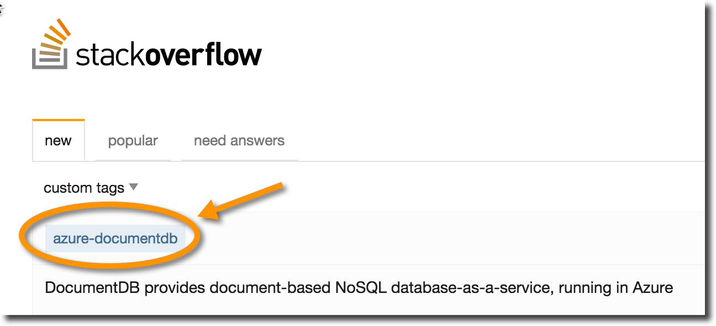
Wrapping up
documentdb.com
@DocumentDB
@dmakogon
@ryancrawcour
github.com/azure/azure-documentdb-node
github.com/azure/azure-documentdb-net
github.com/dmakogon/azurecon2015

