Slide 1
Indexing nirvana with DocumentDB
Ryan CrawCour Program Manager, Microsoft @ryancrawcour | David Makogon Cloud Architect, Microsoft @dmakogon

Slide 2
Today’s talk
What is DocumentDB? (3-minute lightning-round edition)
Meet today’s data: Movies
Queries and indexing: Demos mixed with Q&A
Loud applause and amazing tweets

Slide 3
DocumentDB: Lightning Round Edition
{
name:"DocumentDB",
deployedAs: "Service",
dbType: "Document",
connectVia: [ "rest", "sdk" ],
deployVia: [ "portal", "rest", "cli" ],
scaleVia: [ "portal", "rest", "cli" ]
}
Notes:
Jump to portal to show features

Slide 4
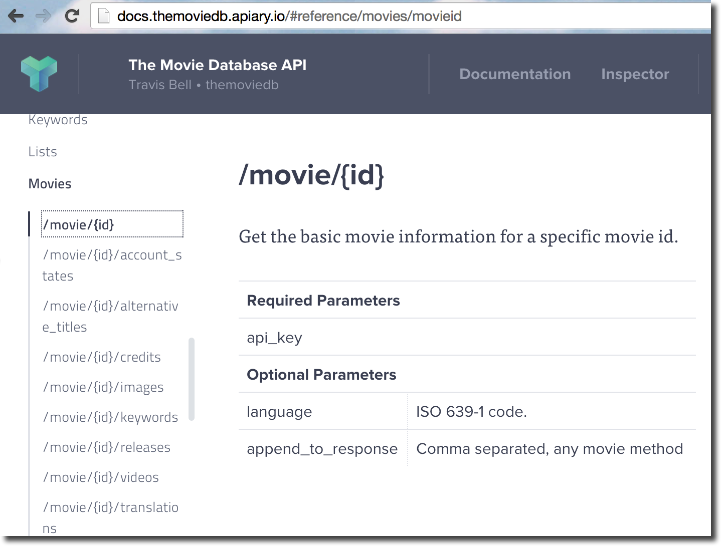
Meet today's demo data: Lots of movies

Slide 5
Demo time…

