Slide 1
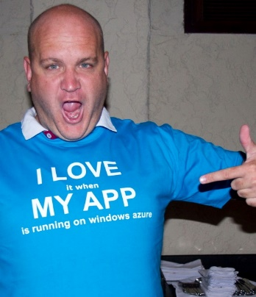
Indexing nirvana with DocumentDB
Ryan CrawCour Program Manager, Microsoft @ryancrawcour | David Makogon Cloud Architect, Microsoft @dmakogon

Slide 2
Today’s talk
What is DocumentDB? (5-minute lightning-round edition)
Meet today’s data: Movies
Queries and indexing: Demos mixed with Q&A
Loud applause and amazing tweets

Slide 3
DocumentDB: Lightning Round Edition
{
name:"DocumentDB",
deployedAs: "Service",
dbType: "Document",
connectVia: [ "rest", "sdk" ],
deployVia: [ "portal", "rest", "cli" ],
scaleVia: [ "portal", "rest", "cli" ], differentHow: [ "javascript", "indexing", "consistency" ]
}
Notes:
Jump to portal to show features

Slide 4




DocumentDB Account
Databases
Collections
Documents
Attachments
101
010
Users
Stored Procedures
JS
Triggers
Permissions
{
“id” : “123” “name” : “joe”
“age” : 30
“address” : {
“street” : “some st”
}
}
JS
User Defined Functions
JS

Slide 5
DocumentDB Overview
{ }
JS
SQL
flexible schema
and
queryable
multi-document
transactions
tunable and fast
scalable
and
fully managed
Notes:
SQL syntax – familiarity with traditional
- automatically indexed
- flexible schemas
Multi-document transactions
- stored procedures/triggers is transactional
Tunable and fast – consistency levels
- strong
- bounded staleness
- session
- eventual
- indexing
-consistent
-lazy
Highly scalable – customers with terabytes
- fully managed
- quick startup

Slide 6

The Basics
DocumentDB Resources
Database Account
Unique DNS namespace
Access boundary (master key)
Billable entity
Assigned default consistency
Database Account
Databases
Collections
Documents
{ }
{ }
Users
Stored Procedures
JS
Triggers
Permissions
JS
User Defined Functions
JS
Notes:
Before diving in deeper into DocumentDB, it’s helpful to understand the resource model.
This will give you some guidance as to where you put what in the system

Slide 7
The Basics
DocumentDB Resources
Databases
Authorization namespace
Container for data collections
Scale out with more collections
Database Account
Databases
Collections
Documents
{ }
{ }
Users
Stored Procedures
JS
Triggers
Permissions
JS
User Defined Functions
JS

Slide 8
The Basics
DocumentDB Resources
Collections
Container for heterogeneous documents
Data partition* for document storage – 10GB partition size
Scope for queries and transactions
Billable resource (S1, S2, S3)
Database Account
Databases
Collections
Documents
{ }
{ }
Users
Stored Procedures
JS
Triggers
Permissions
JS
User Defined Functions
* Collection != Table
JS

Slide 9
The Basics
DocumentDB Resources
Documents
Application defined JSON
No enforced schema
All properties indexed by default
Optimized for many small documents
Database Account
Databases
Collections
Documents
{ }
{ }
Users
Stored Procedures
JS
Triggers
Permissions
{
"id" : "123" "name" : "joe"
"age" : 30
"address" : {
"street" : "some st"
}
}
JS
User Defined Functions
JS

Slide 10
The Basics
DocumentDB Resources
Resource Attributes
Addressable by logical URI
Represented as JSON
Partitioned for scale out
Replicated for HA
RESTful interaction over HTTP
HTTP and TCP connectivity
Database Account
Databases
Collections
Documents
{ }
{ }
Users
Stored Procedures
JS
Triggers
Permissions
JS
User Defined Functions
JS

Slide 11
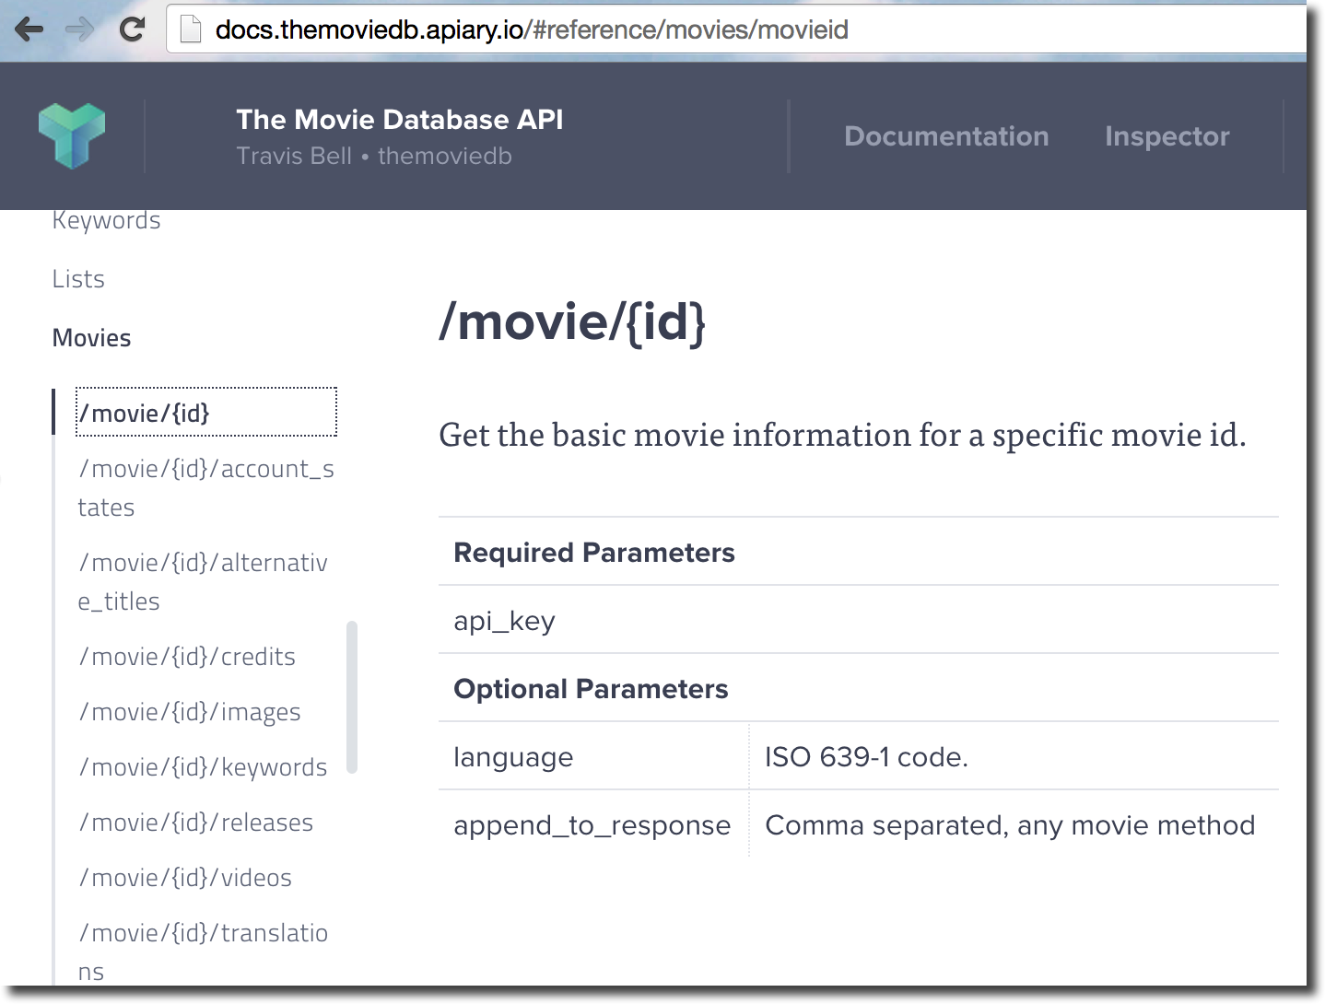
Meet today's demo data: Lots of movies

Slide 12
Demo time…

Slide 13





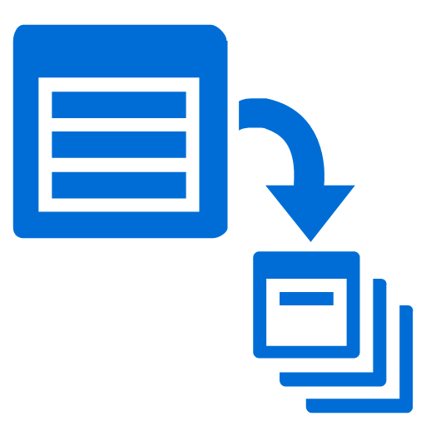

SDKs and Tooling
SDKs
Azure Portal
Studio
Data Migration
http://aka.ms/docdbsdks
http://portal.azure.com
http://aka.ms/docdbstudio
http://aka.ms/docdbimport
Notes:
DocumentDB offers SDKs and tooling to help you develop against and manage data in the service.
All APIs are accessible as REST over HTTP, we also provide .Net, Node, Java and Python SDKs
I already shown provisioning through the portal – the Azure Preview portal offers a variety of development, monitoring and management capabilities.
DocumentDB Studio is an open source app that allows you to manage and interact with the service from a GUI tool
The Data Migration tool allows you import existing data into DocumentDB

Slide 14



Get Started Today
select * from playground p where p.name = “DocumentDB”
explore the playground
build an app
import some data
http://aka.ms/docdbplayground
http://aka.ms/docdbstarter
http://aka.ms/docdbimport

Slide 15
Resources
Product Page – http://aka.ms/documentdb
Docs & Tutorials -http://aka.ms/documentdbdocs
Team blog - http://aka.ms/documentdbblog
Twitter - @documentdb

