Slide 1
Cosmos DB Performance Tuning
DA22
David Makogon
Principal Software Engineer, Microsoft
Twitter: @dmakogon

Slide 2
Agenda for today
Understanding and measuring Request Units
Reads or queries?
The cost of "free" indexes
Queries and partitions
Consistency
Regions and replication

Slide 3
Request Units

Slide 4
Cosmos DB Request Units
Data is stored in containers
Operations are performed within containers
Create
Read
Query
Replace
Delete
}
Each operation has a cost
Measured in "Request Units" (RU)

Slide 5
Reserving Request Units
Each container gets Request Units:
Fixed (10GB): 400-10,000 RU
Partitioned: 1,000 and beyond (any amount ☺)
With partitioned collections:
RUs are shared across physical partitions

Slide 6
Request Unit Pools
New feature! Just announced at Build!
Database-level Request Units
All collections in database may share RU's
This can help with cost management
This can help to avoid throttling!

Slide 7
Reads and Queries

Slide 8
Reads
When retrieving a single document
And you know its ID
ReadDocument() is lowest-cost option
For 1 KB document: 1 RU

Slide 9
Queries
When retrieving a single document
And you don't know its ID
Use CreateDocumentQuery()
Cost is more than 1 RU
Depends on complexity of query

Slide 10
Demo

Slide 11
Indexes

Slide 12
Indexes
Documents are JSON: groups of property:value pairs
{
"sessionID": "DA22",
"title": "Cosmos DB Tuning",
"speaker": "David Makogon"
}
Default: All properties are indexed

Slide 13
Indexes
Indexes greatly speed up queries
But...
Indexes increase write cost
More properties? More cost

Slide 14
Indexes
Solution: Custom index plan
Configure in code or portal
{
include...
exclude...
}

Slide 15
Indexes
Further index cost reduction:
Use "lazy" mode instead of "consistent"
Might not be worth it... Small saving

Slide 16
Demo

Slide 17
Consistency

Slide 18
Consistency
Five levels of consistency
Strong
Bounded staleness
Session
Consistent Prefix
Eventual

Slide 19
Cost of consistency
Strong and Bounded Staleness cost the most
Then Session
Eventual is cheapest

Slide 20
Cost of consistency
You may choose consistency:
At the database level
For each read or write

Slide 21
Demo

Slide 22
Replication

Slide 23
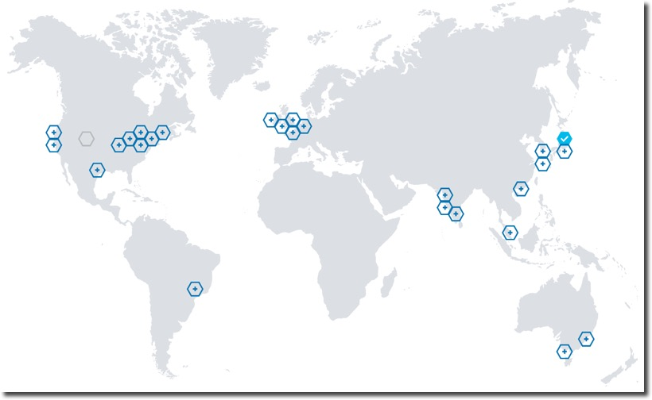
Replication
You can choose additional regions...

Slide 24
Replication
Remember your RU cost?
It now applies to each extra region
1000 RU? 5 regions? 5000 RU

Slide 25
Replication
Multiple regions are good for:
Failover
Better "read" performance
You must decide if it's worth it

Slide 26
Wrap-up

Slide 27
Where is everything?
Me, on twitter: @dmakogon
Code demos:
github.com/dmakogon/cosmosdb-performance
Slides:
github.com/dmakogon/decode2018

