Slide 1


The shape of JSON: Document Modeling 101
#DecodedConf
David Makogon, Microsoft
@dmakogon

Slide 2
For your brain today:
Un-learn relational habits
Crush common modeling challenges
Grok real-world use cases
Thought-provoking?
Notes:
Ryan

Slide 3
Modeling challenges
Related data
Normalization vs denormalization
Homogeneous vs heterogeneous data
Notes:
DLM: Removed Atomic Operations
Added normalization/denormalization section below, reordered labels here

Slide 4
Use cases
Hierarchical trees
Keyword search
Telemetry
Logging

Slide 5
Document modeling
Notes:
David

Slide 6
Kinds of databases
Relational
Non-relational (NoSQL) Column-family Key-value Graph Document

Slide 7
Document Databases
{
"name": "Microsoft",
"homepage_url": "www.microsoft.com",
"blog_url": "blogs.microsoft.com/",
"products": [
{
"name": "Azure",
"permalink": "azure.com"
}
],
"offices": [
{
"address1": "1 Redmond Way",
"zip_code": "98052",
"city": "Redmond",
"state_code": "WA",
"country_code": "USA"
}
]
}
Built for simplicity
Built for scale + performance
No enforced schema
Json documents

Slide 8



Document Databases
Not these documents…

Slide 9
Document Databases
{
"id": "docmodeling101",
"title": "Shape of JSON",
"speakers": [
{ "name": "David" }
],
"synopsis": "Doc modeling challenges",
"tags": ["data", "nosql"],
"level": 200
}

Slide 10
Document modeling
Document modeling is important
Just as important as relational modeling
There's still a schema, just not enforced
Typically model around use cases
Models can (and do) evolve
Notes:
David

Slide 11
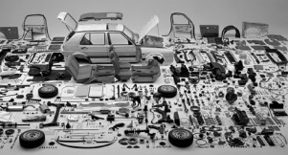
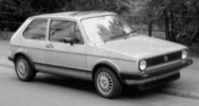


Un-learn relational
ORM
Data normalization
Come as you are
Notes:
Ryan

Slide 12

Modeling data, the relational way
Person
PersonContactDetails
ContactDetail
Id
PersonId
Id
ContactDetailId
Address
ContactDetailType
Id
Id
Notes:
Ryan

Slide 13
Modeling data, the document way
{ "id": "0ec1ab0c-de08-4e42-a429-...",
"addresses": [
{ "street": "1 Redmond Way",
"city": "Redmond", "state": "WA",
"zip": 98052}
],
"contactDetails": [
{"type": "home", "detail": “555-1212"},
{"type": "email", "detail": “me@ms.com"}
],
...
}
Person
Id
Addresses
Address
…
Address
…
ContactDetails
ContactDetail
…
Notes:
Ryan

Slide 14
Modeling challenge: Related data
Notes:
David

Slide 15
To embed or to reference, that is the question
{
"sessionId": "session1",
"sessionName": "Document modeling",
"speakers": [
{ "id": 1, "name": "Ryan",
"thumbnailUrl": "...",
"shortProfile": "..."
},
{ "id": 2, "name": "David",
"thumbnailUrl": "...",
"shortProfile": "..."
}
]
}
{
"sessionId": "session1",
"sessionName": "Document modeling",
"speakers": [{ "id": 1 },{ "id": 2 }]
},
{
"id": "1", "name": "Ryan",
"thumbnailUrl": "...",
"shortProfile": "..."
},
{
"id": "2", "name": "David",
"thumbnailUrl": "...",
"shortProfile": "..."
}
embed
reference
Notes:
David
DLM: Animation: Now click to see embed, then click to see reference.
Also changed "Doc modeling" to "Document modeling"

Slide 16
Related data: Embedding
Notes:
David

Slide 17
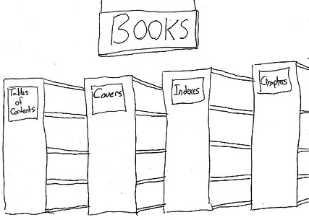
To embed or to reference, that is the question
Data from entities are queried together
Notes:
Ryan

Slide 18
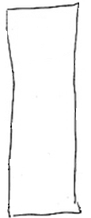




To embed or to reference, that is the question
Data from entities are queried together
Notes:
Ryan

Slide 19
To embed or to reference, that is the question
Data from entities are queried together
{
"id": "book1",
"covers": [
{"type": "front", "artworkUrl": "http://..."},
{"type": "back", "artworkUrl": "http://..."}
],
"chapters": [
{"id": 1, "synopsis": "", "pages":24, "words":1456},
{"id": 2, "synopsis": "", "pages":18, "words":960}
]
}
Notes:
Ryan
DLM: Yellow highlights on closing array brackets
Added quotes to everything, remaning pageCount / wordCount to pages / words

Slide 20
To embed or to reference, that is the question
Data from entities are queried together
The child is a dependent e.g. Order Line depends on Order
{
"id": "order1",
"customer": "customer1",
"orderDate": "2014-09-15T23:14:25.7251173Z"
"lines": [
{"product": "monitor", "price": 200.00, "qty": 50 },
{"product": "Keyboard", "price":23.67, "qty":4},
{"product": "CPU", "price":87.89, "qty":1}
]
}
Notes:
David
DLM: Animation: Must click first to see JSON
Added quotes

Slide 21
To embed or to reference, that is the question
Data from entities are queried together
The child is a dependent e.g. Order Line depends on Order
1:1 relationship
{
"id": "person1",
"username": "jsmith",
"profile": {
"name": "John Smith",
"joinDate": "2016-03-01"
}
}
Notes:
Ryan
DLM: Animation – must click before seeing JSON

Slide 22
To embed or to reference, that is the question
Data from entities are queried together
The child is a dependent e.g. Order Line depends on Order
1:1 relationship
Similar volatility
{
id: "person1",
name: "John Smith",
email: "jsmith@contoso.com",
socialIds: [
{"twitchat" : "jsmith"},
{"instabook" : "jsmith"}
]
}
Notes:
David
DLM: Animation

Slide 23
To embed or to reference, that is the question
Data from entities are queried together
The child is a dependent e.g. Order Line depends on Order
1:1 relationship
Similar volatility
The set of values or sub-documents is bounded (1:few)
{
"title": "The Shape of JSON: Document Modeling 101",
"day": "2016-05-05",
"track": "data",
"tags": [ "Azure", "data"]
}
Notes:
Show mongo demo

Slide 24
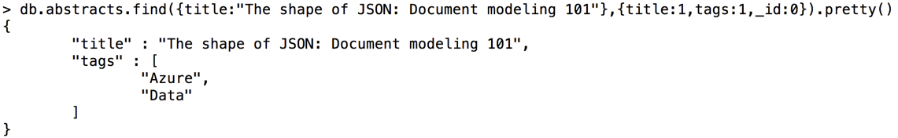

Slide 25
To embed or to reference, that is the question
Data from entities are queried together
The child is a dependent e.g. Order Line depends on Order
1:1 relationship
Similar volatility
The set of values or sub-documents is bounded (1:few)
Typically embedded data models provide better read performance
Notes:
David

Slide 26
Related data: Referencing
Notes:
Ryan

Slide 27
To embed or to reference, that is the question
one-to-many relationships (unbounded)
{
"title": "The Shape of JSON: Document Modeling 101", "tags": [ "Azure", "data" ],
"comments": [
{"id": "c1", "comment": "Cool talk!"},
{"id": "c2", "comment": "Totally decoded."},
{"id": "c3", "comment": "Mind. Blown."}
...
{"id": "c99999", "comment": "Smooth as Irish Whiskey."}
]
}
Notes:
Ryan
DLM: Click to make JSON appear
Animation speed

Slide 28
To embed or to reference, that is the question
one-to-many relationships (unbounded)
{
"id": "t1",
"title": " The Shape of JSON: Document Modeling 101", "tags": [ "Azure", "data" ]
}
{"id": "c1", "talkId": "t1", "comment": "Cool talk!"}
{"id": "c2", "talkId": "t1", "comment": "Totally decoded."}
{"id": "c3", "talkId": "t1", "comment": "Mind. Blown."}
…
{"id": "c99999", "talkId": "t1", "comment": "Smooth as..."}
Notes:
Ryan
Now you can select a subset of comments (e.g. last 5).
Todo: build data and query (david)

Slide 29
To embed or to reference, that is the question
one-to-many relationships (unbounded)
many-to-many relationships
{
"id": "s1", "name": "Stefan"
}
{ "id": "s2",
"name": "Anthony"
}
{ "speakerId": "s1", "sessionId": "t1"
}
{
"speakerId": "s2",
"sessionId": "t1" }
{ "id": "t1",
"description": "Security I"
} { "id": "t2",
"description": "Security II"
}
Look familiar?
It should …. It's the "relational" way
Notes:
David
DLM: Animation – fade vs appear

Slide 30
To embed or to reference, that is the question
one-to-many relationships (unbounded)
many-to-many relationships
{
"id": "s1",
"name": "Stefan",
"sessions": [
{"id":"t1"},
{"id":"t2"}
]
}
{
"id": "s2",
"name": "Anthony",
"sessions": [
{"id":"t1"},
{"id":"t2"}
]
}
{ "id": "t1",
"name": "Security I",
"speakers": [
{"id":"s1"},
{"id":"s2"}
]
}
{
"id": "t2",
"name": "Security II",
"speakers": [
{"id":"s1"},
{"id":"s2"}
]
}
Notes:
David
DLM: Changed animations from Appear to ade

Slide 31
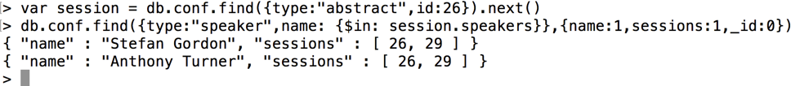
To embed or to reference, that is the question
Notes:
David
DLM: Changed animations from Appear to ade

Slide 32
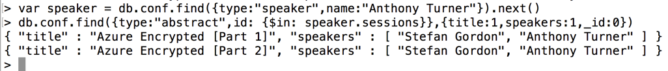
To embed or to reference, that is the question
Notes:
David
DLM: Changed animations from Appear to ade

Slide 33
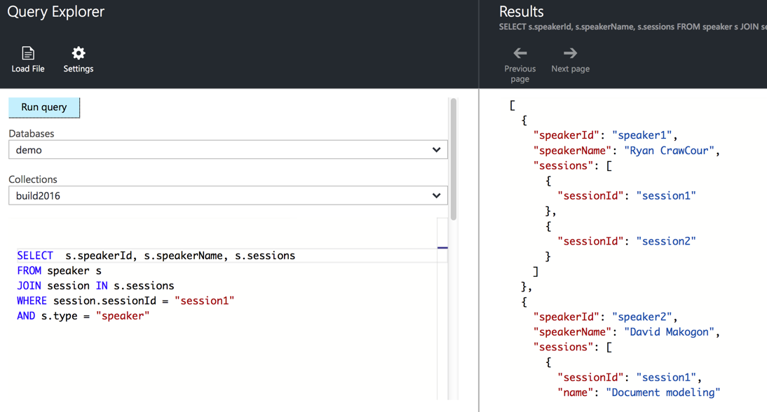
To embed or to reference, that is the question
Notes:
David
DLM: Changed animations from Appear to ade

Slide 34
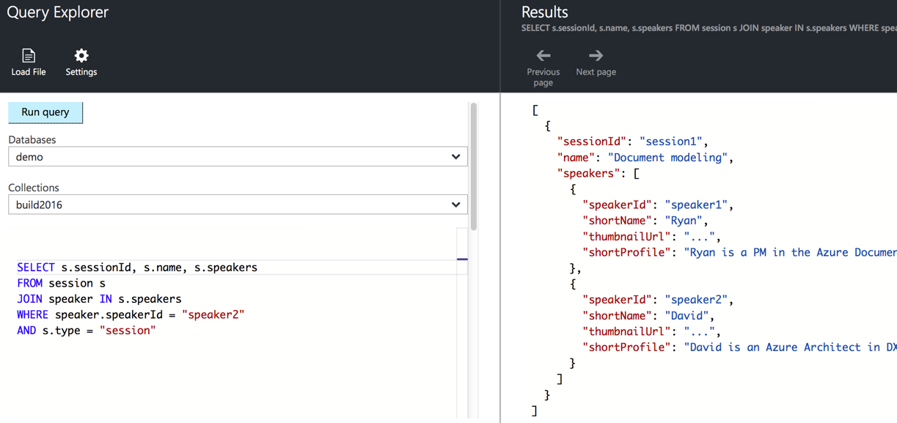
To embed or to reference, that is the question
one-to-many relationships (unbounded)
many-to-many relationships
{
"id": "s1", "name": "Ryan",
} { "id": "s2", "name": "David"
}
{ "id": "t1", "name": "Modeling document databases", } { "id": "t2", "name": "Fun with data", }
"sessions": [ {"id":"t1"}, {"id":"t2"} ]
"speakers": [ {"id":"s1"}, {"id":"s2"} ]
"sessions": [ {"id":"t1"} ]
"speakers": [ {"id":"s1"} ]
Notes:
David
DLM: Re-alligned code window

Slide 35
To embed or to reference, that is the question
one-to-many relationships (unbounded)
many-to-many relationships
related data changes with differing volatility
{
"id": "online1",
"title": "The Shape of JSON: Document Modeling 101",
"tags": [ "Azure", "data" ],
"speakers": [ "David"],
"likes": 499,
"views":500
}
Notes:
Ryan
DLM: must click to see JSON
Changed animation speed of yellow highlight

Slide 36
To embed or to reference, that is the question
one-to-many relationships (unbounded)
many-to-many relationships
related data changes with differing volatility
{
"id": "online1",
"title": "The Shape of JSON: Document Modeling 101",
"tags": [ "Azure", "Data" ],
"speakers": [ "David ]
}
{ "onlineId": "online1", "likes":499,"views":500 }
Notes:
Ryan
DLM: Changed animation speed of highlight

Slide 37
To embed or to reference, that is the question
one-to-many relationships (unbounded)
many-to-many relationships
related data changes with differing volatility
referenced entity is a key entity used by many others
{
"id": "session1",
"title": "The Shape of JSON: Document Modeling 101",
"room": { "id": "201","cap":200,"recording":true }
}
Notes:
David
DLM: must click to see JSON
Added highlight

Slide 38
To embed or to reference, that is the question
one-to-many relationships (unbounded)
many-to-many relationships
related data changes with differing volatility
referenced entity is a key entity used by many others
{
"id": "session1",
"title": "The Shape of JSON: Document Modeling 101",
"roomId": "r201"
}
{"id": "r201", type:"room", "cap": 200, "recording": true }
Notes:
David
DLM: Changed highlight speed
Added highlight to roomId reference

Slide 39
To embed or to reference, that is the question
one-to-many relationships (unbounded)
many-to-many relationships
related data changes with differing volatility
referenced entity is a key entity used by many others
Typically referencing provides better write performance
Reading may require more round trips to the server
Notes:
Ryan

Slide 40
Combining embed + reference
Notes:
David

Slide 41
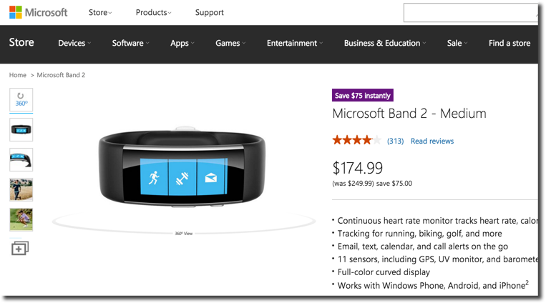
Embedded: Denormalized summary data
Notes:
David

Slide 42
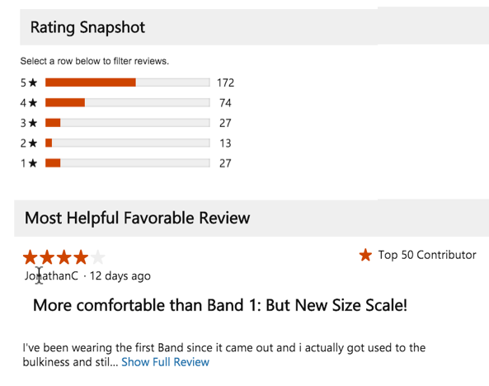
Referenced: summary data
More volatile than product
Partial content embedded
Notes:
David

Slide 43
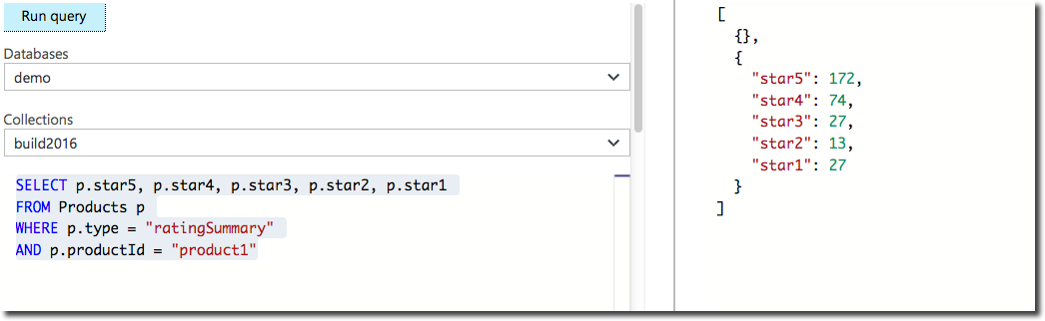
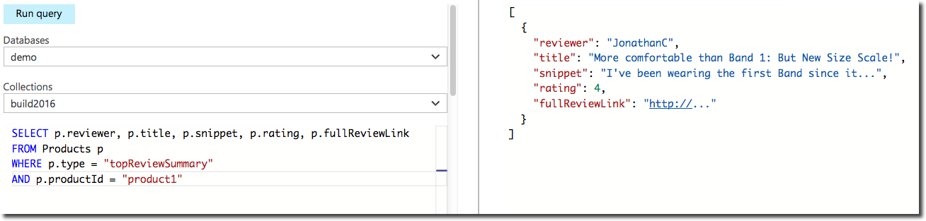
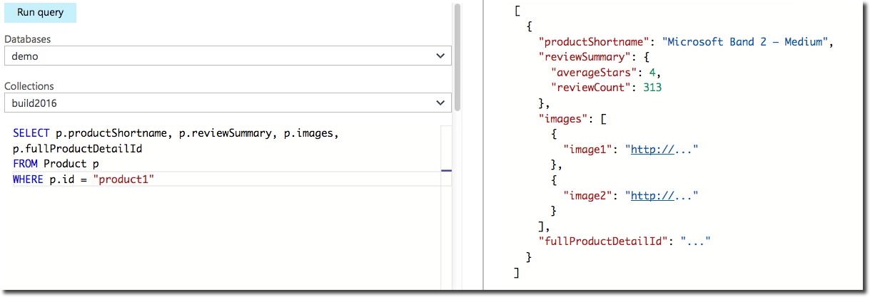
Embed + Reference: Full product
{
"id": "product1",
"type": "product",
"name": "Microsoft Band 2 – Medium",
"price": "174.99",
"summary": "Continuous heart rate monitor tracks heart rate...",
"images": [ {"image1": "http://..."}, { "image2": "http://..."} ],
"reviewSummary": {
"averageStars": 4,
"reviewCount": 313
}
}
Notes:
David
DLM: Need to re-run and repair rating summary query (get rid of extra { } )

Slide 44
Referencing: Direction
{
"id": "speaker1",
"type": "speaker",
"fullName": "Ryan CrawCour",
"sessions": [ {"id":"session1", "title":"Document modeling"}],
"images": [{"thumbnail": "http://..."},{"profile": "http://..."}],
"profile": "Ryan is a PM in the DocumentDB team",
},
{
"id": "speaker2",
"fullName": "David Makogon",
"profile": "David is an Azure Architect in DX"
}
Notes:
DLM: Click to show JSON
Changed highlight animation speed

Slide 45
Referencing: Direction
{
"sessionId": "session1",
"sessionName": "Document modeling",
"speakers": [
{ "speakerId": 1, "shortName": "Ryan",
"thumbnailUrl": "...",
"shortProfile": "Ryan is DocumentDB PM..."
},
{ "speakerId": 2, "shortName": "David",
"thumbnailUrl": "...",
"shortProfile": "David is an architect..."
}
]
}
Notes:
DLM: Changed highlight animation speed

Slide 46
Modeling challenge: Normalization vs denormalization
Notes:
Ryan
DLM: New section

Slide 47
Normalized
{
"sessionId": "session1",
"sessionName": "The Shape of JSON: Document Modeling 101",
"speakers": [
{ "speakerId": "speaker1" }
]
},
{
"id": "speaker1",
"fullName": "David Makogon",
"shortName": "David",
"profile": "Fueled by Azure, NoSQL, photography...",
"images": [{"thumbnail": "http://..."},{"profile": "http://..."}]
}
Notes:
Ryan
DLM: Changed highlight animation speed

Slide 48
Denormalized
{
"sessionId": "session1",
"sessionName": "The Shape of JSON: Document Modeling 101",
"speakers": [
{ "speakerId": "speaker1",
"shortName": "David",
"thumbnailUrl": "...",
"shortProfile": "David is an Azure architect..."
...
}
]
}
Notes:
Ryan
DLM: Changed highlight animation speed

Slide 49
Normalize vs denormalized
Normalized data may save some space, but…
Requires multiple reads
Doesn't align with classes/objects
Typically provides faster write speed
Denormalized data aligns with classes/objects but…
Requires updates in multiple places
Typically provides faster read speed
Notes:
Ryan

Slide 50
Modeling challenge: Homogeneous vs Heterogeneous data
Notes:
David

Slide 51
Homogeneous collections
It's easy to imagine one collection per data type:
Speaker
Session
Room
However, this could have an impact on:
Billing
Transactions
Queries
Notes:
David

Slide 52
Heterogeneous collections
Consider multiple types in a single collection:
{
"type": "speaker",
"speakerId": "speaker1", "speakerName": "David Makogon",
"sessions": [
{"sessionId": "session1", "desc": "Polyglot Persistence"},
{"sessionId": "session2", "desc": The Shape of JSON"}
]
},
{
"type": "session",
"sessionId": "session2",
"name": "The Shape of JSON",
"speakers" : [
{"speakerId": "speaker1", "shortName": "David" }
]
}
Notes:
David
DLM: Click to show JSON
Highlighted types

Slide 53
Heterogeneous collections
Consider multiple types in a single collection:
Notes:
David
DLM: Changed code window animation to Fade

Slide 54
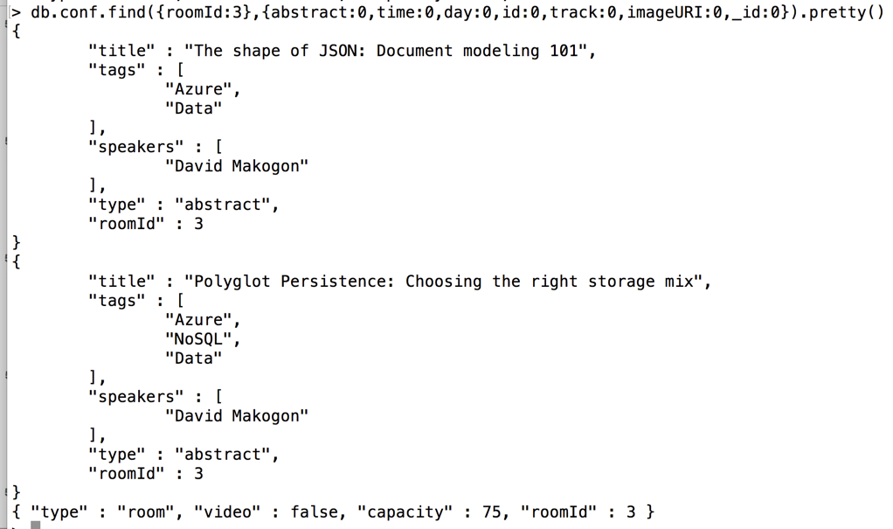
Heterogeneous collections
Consider multiple types in a single collection:
Notes:
David
DLM: Changed code window animation to Fade

Slide 55
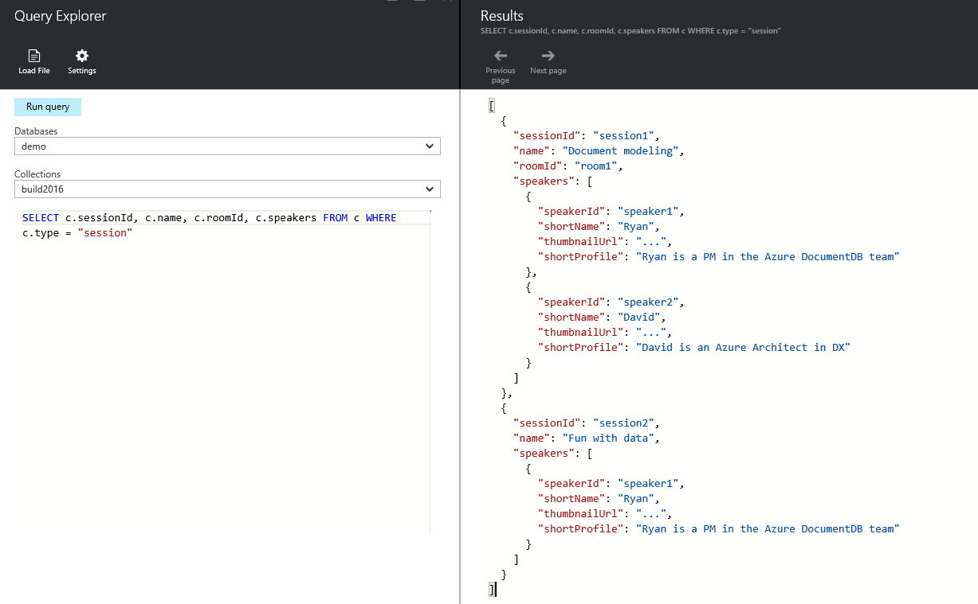
Heterogeneous collections
Consider multiple types in a single collection:
Notes:
David
DLM: Changed code window animation to Fade

Slide 56
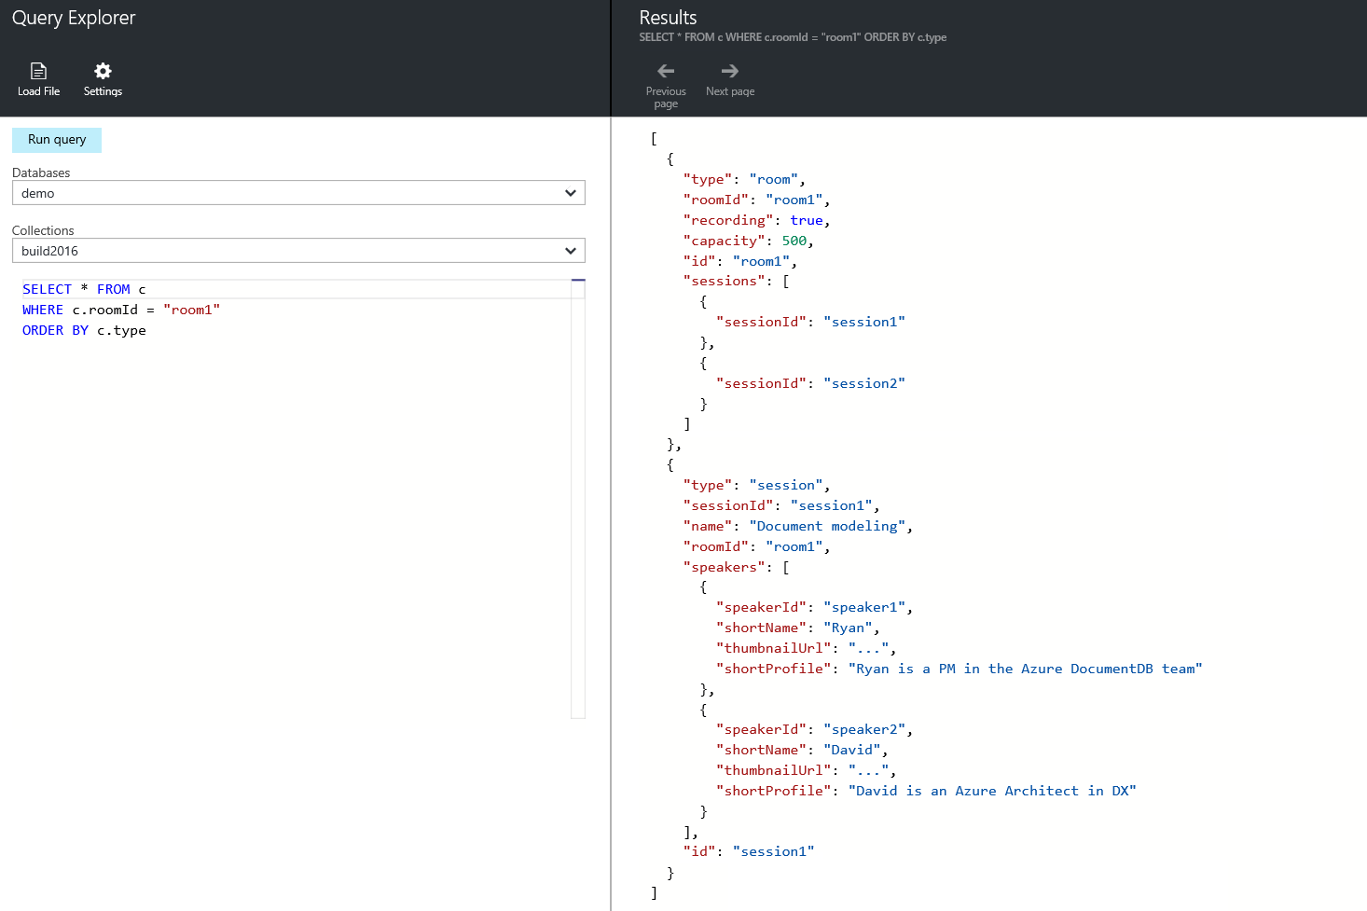
Notes:
David
DLM: Moved code window and boxes
Change code window to Fade

Slide 57
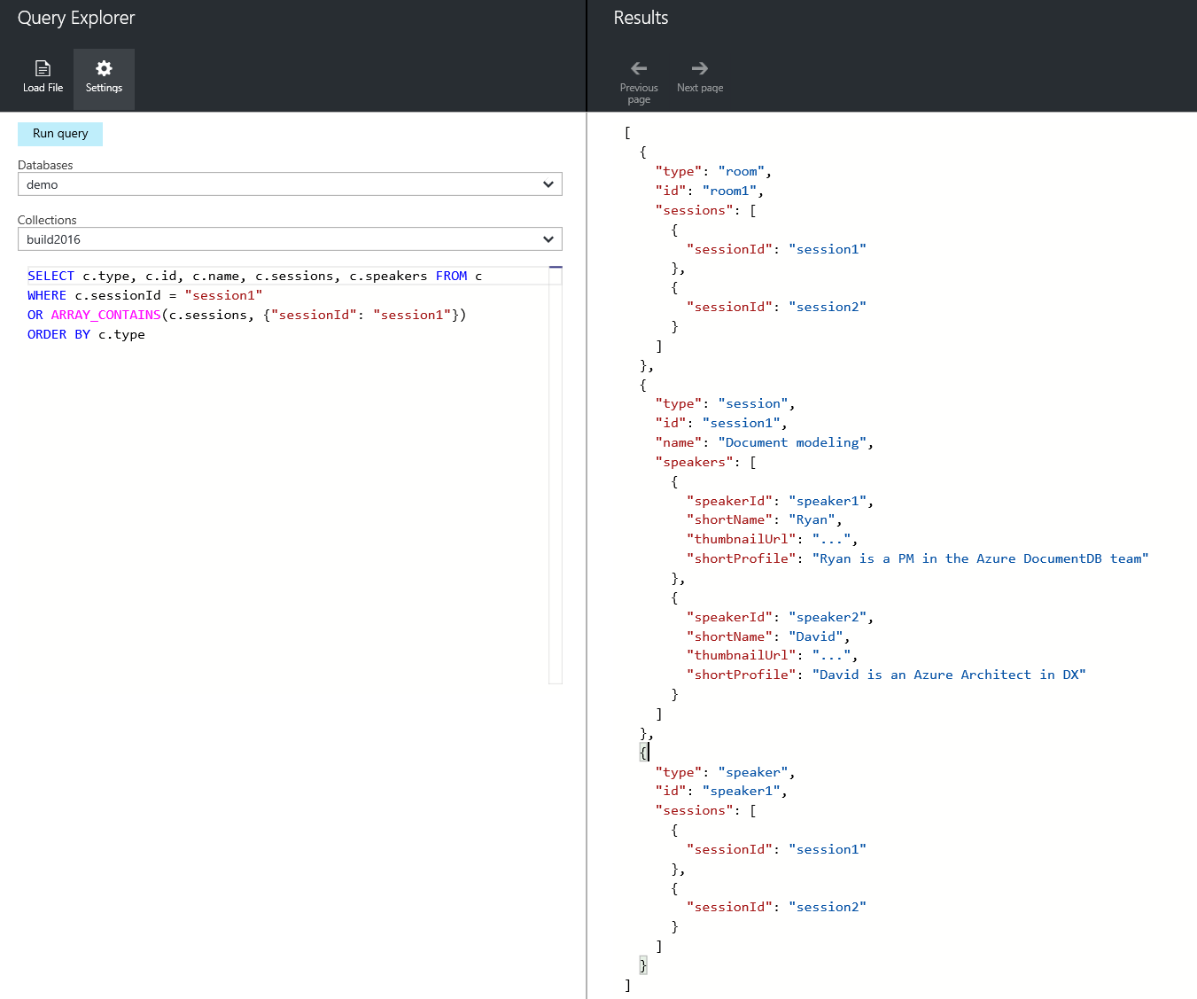
Notes:
David

Slide 58
Use case: Hierarchies
Notes:
Ryan

Slide 59
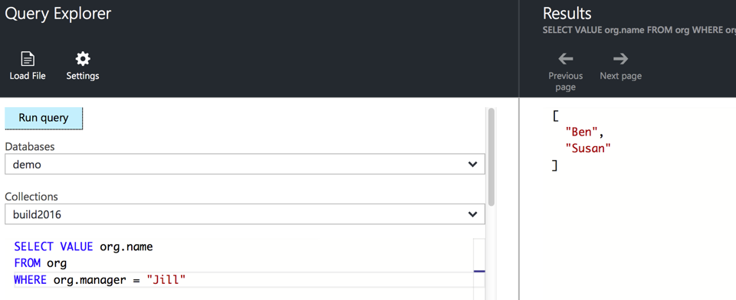
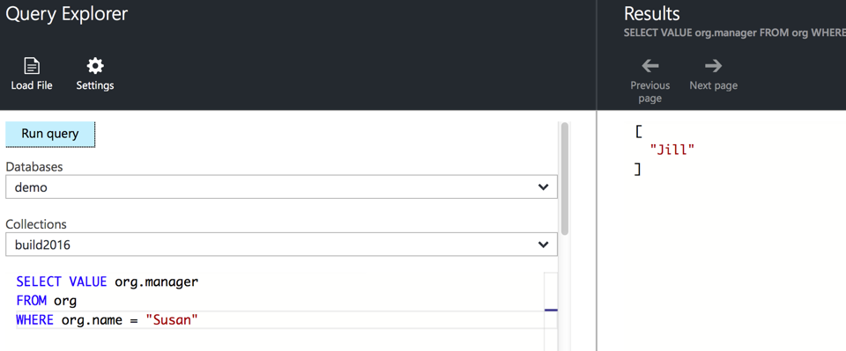
Use case: Hierarchical trees
{
{"name": "Jill" },
{"name": "Ben", "manager": "Jill" },
{"name": "Susan", "manager": "Jill" },
{"name": "Andrew", "manager": "Ben" },
{"name": "Sven", "manager": "Susan" },
{"name": "Thomas", "manager": "Sven" }
}
Jill
Ben
Susan
Andrew
Sven
Thomas
Notes:
Ryan
DLM: Moved 2nd query alignment

Slide 60
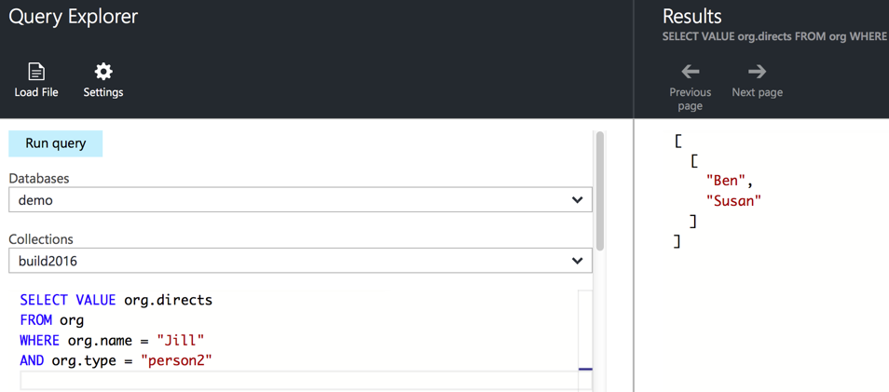
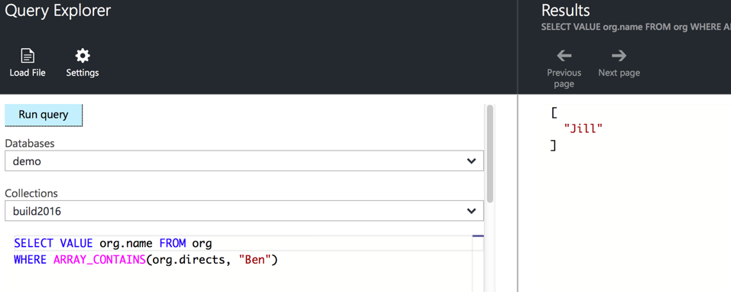
Use case: Hierarchical trees
Jill
{
{"name": "Jill", directs:["Ben","Susan"] },
{"name": "Ben", directs:["Andrew"] },
{"name": "Susan", directs: ["Sven"] },
{"name": "Andrew" },
{"name": "Sven", directs: ["Thomas"] },
{"name": "Thomas" }
}
Ben
Susan
Andrew
Sven
Thomas
Notes:
Ryan
DLM: Shifted 2nd query alignment

Slide 61
Use case: Keywords
Notes:
Ryan

Slide 62
Keyword search
{
"id": "CDC101",
"title": "Fundamentals of database design",
"credits": 10
}
Notes:
Ryan
DLM: Quoted fields

Slide 63
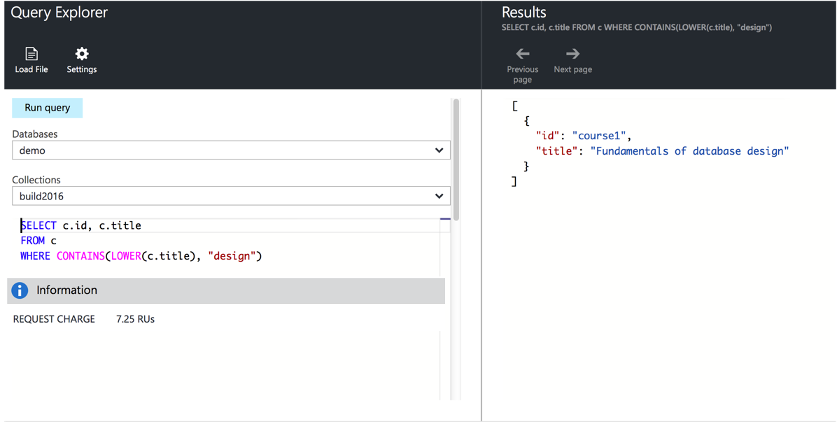
Keyword search
Notes:
Ryan
DLM: Query window now fades
Click to draw red box
Added box around CONTAINS

Slide 64
Keyword search
{
"id": "CDC101",
"title": "Fundamentals of Database Design", "keywords":["database","design","database design"],
"credits": 10
}
RegEx to transform words to lowercase, remove punctuation.
Strip out stop words like “to”, “the”, “of” etc.
Denormalize keywords into key phrases
Notes:
Ryan
DLM: Bigger font below
SELECT books.title FROM books WHERE ARRAY_CONTAINS(books.titleWords, "database")

Slide 65
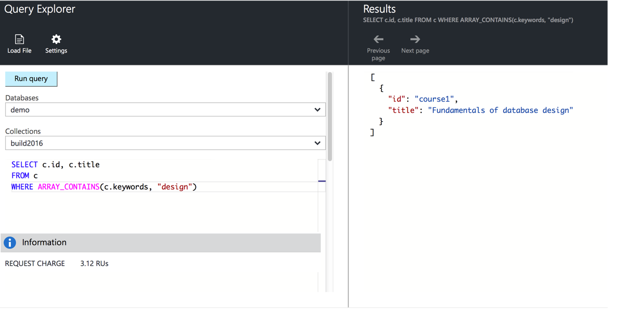
Keyword search
Notes:
Ryan
DLM: Animated code window to Fade
Added red rectangle around ARRAY_CONTAINS

Slide 66
Use case: Telemetry
Notes:
David

Slide 67
Telemetry
Consider storage of time-series data
Device readings: Weather stations, sensors, etc.

Slide 68
Telemetry
One document per reading:
{
"deviceId": "device1",
"timestamp": "...",
"reading": 123
}
Chatty, and requires overhead for each reading

Slide 69
Telemetry
One document per time period, per device:
{ "id": "...",
"timestampMinute": "...",
"readings": [
{"minute":0, "reading":123}, {"minute":1, "reading":456}, ...
{"minute":59,"reading":999}
]
}
Less chatty; easier to aggregate per time-period Larger series (e.g. hourly) require more in-place updates

Slide 70
Use case: Logging

Slide 71
Logging
Similar to telemetry; consider parsing log entries
{
"id: "...",
"timestamp": "...",
"logData": {"attr1": "value1", "attr2": "value2", ...}
}
Partition per time period, event type, region, etc.

Slide 72
Summary
Notes:
Ryan

Slide 73
Summary
{
options: ["Embed", "Reference"],
rules: "There are no rules, merely guidelines",
embed: [
"1:1",
"Child is a dependent",
"Similar volatility" ]
reference: [
"related data changes frequently",
"many:many"
]
remember: [
"Don't be scared to experiment and mix & match",
"Models change & evolve",
"Hybrid models"
]
}

Slide 74
Questions?
Keep in touch!
Twitter: @dmakogon
Blog: dmak.io
Materials at github.com/dmakogon/decodedconf2016

Slide 75
Notes:
Dark gray background.

