Slide 1


The shape of JSON: Document Modeling 101
#DECODEDConf
David Makogon, Microsoft
@dmakogon

Slide 2
For your brain today:
Re-train your "relational" brain for documents
Learn to overcome common modeling challenges
See real-world use cases

Slide 3
Modeling challenges
Related data
Normalization vs denormalization
Homogeneous vs heterogeneous data

Slide 4
Use cases
Hierarchical trees
Keyword search
Telemetry
Logging

Slide 5
Document modeling

Slide 6



Document Databases
Not these documents…

Slide 7
Document Databases
{
"id": "docmodeling101",
"title": "Shape of JSON",
"speakers": [ { "name": "David" } ],
"synopsis": "Doc modeling challenges",
"tags": ["data", "nosql"],
"level": 200
}

Slide 8
Document modeling
Modeling is important in a document database
Just as important as relational modeling
There's still a schema, just not enforced
Typically model around use cases
Models can (and do) evolve

Slide 9
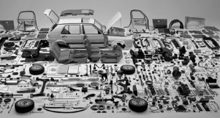
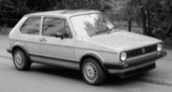


Retrain your relational brain
ORM
Data normalization
Come as you are

Slide 10
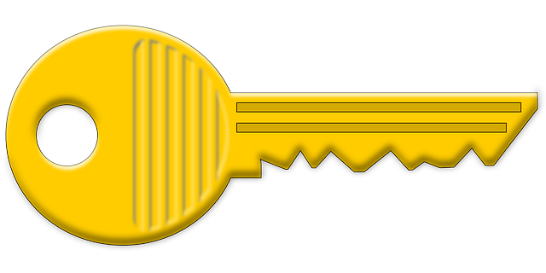
Modeling data, the relational way
Person
PersonContactDetailLnk
ContactDetail
Id
PersonId
Id
ContactDetailId
Address
ContactDetailType
Id
Id

Slide 11
Modeling data, the document way
{ "id": "0ec1ab0c-de08-4e42-a429-...",
"addresses": [
{ "street": "1 Redmond Way",
"city": "Redmond", "state": "WA",
"zip": 98052}
],
"contactDetails": [
{"type": "home", "detail": “555-1212"},
{"type": "email", "detail": “me@ms.com"}
],
...
}
Person
Id
Addresses
Address
…
Address
…
ContactDetails
ContactDetail
…

Slide 12
Modeling challenge: Related data

Slide 13
To embed or to reference, that is the question
{
"sessionId": "session1",
"sessionName": "Document modeling",
"speakers": [
{ "id": 1, "name": "Ryan",
"thumbnailUrl": "...",
"shortProfile": "..."
},
{ "id": 2, "name": "David",
"thumbnailUrl": "...",
"shortProfile": "..."
}
]
}
{
"sessionId": "session1",
"sessionName": "Document modeling",
"speakers": [{ "id": 1 },{ "id": 2 }]
},
{
"id": "1", "name": "Ryan",
"thumbnailUrl": "...",
"shortProfile": "..."
},
{
"id": "2", "name": "David",
"thumbnailUrl": "...",
"shortProfile": "..."
}
embed
reference

Slide 14
Related data: Embedding

Slide 15
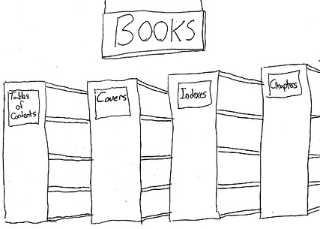
To embed or to reference, that is the question
Data from entities are queried together

Slide 16
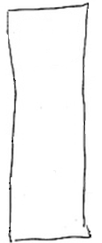




To embed or to reference, that is the question
Data from entities are queried together

Slide 17
To embed or to reference, that is the question
Data from entities are queried together
{
"id": "book1",
"covers": [
{"type": "front", "artworkUrl": "http://..."},
{"type": "back", "artworkUrl": "http://..."}
],
"chapters": [
{"id": 1, "synopsis": "", "pages":24, "words":1456},
{"id": 2, "synopsis": "", "pages":18, "words":960}
]
}

Slide 18
To embed or to reference, that is the question
Data from entities are queried together
The child is a dependent e.g. Order Line depends on Order
{
"id": "order1",
"customer": "customer1",
"orderDate": "2014-09-15T23:14:25.7251173Z"
"lines": [
{"product": "monitor", "price": 200.00, "qty": 50 },
{"product": "Keyboard", "price":23.67, "qty":4},
{"product": "CPU", "price":87.89, "qty":1}
]
}

Slide 19
To embed or to reference, that is the question
Data from entities are queried together
The child is a dependent e.g. Order Line depends on Order
1:1 relationship
{
"id": "person1",
"username": "jsmith",
"profile": {
"name": "John Smith",
"joinDate": "2016-03-01"
}
}

Slide 20
To embed or to reference, that is the question
Data from entities are queried together
The child is a dependent e.g. Order Line depends on Order
1:1 relationship
Similar volatility
{
id: "person1",
name: "John Smith",
email: "jsmith@contoso.com",
socialIds: [
{"twitchat" : "jsmith"},
{"instabook" : "jsmith"}
]
}

Slide 21
To embed or to reference, that is the question
Data from entities are queried together
The child is a dependent e.g. Order Line depends on Order
1:1 relationship
Similar volatility
The set of values or sub-documents is bounded (1:few)
{
"title": "The Shape of JSON: Document Modeling 101",
"day": "2016-05-05",
"track": "data",
"tags": [ "Azure", "data"]
}

Slide 22
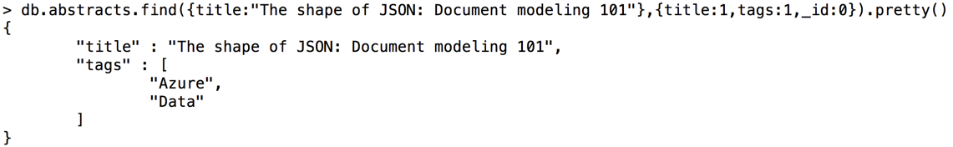

Slide 23
To embed or to reference, that is the question
Data from entities are queried together
The child is a dependent e.g. Order Line depends on Order
1:1 relationship
Similar volatility
The set of values or sub-documents is bounded (1:few)
Typically embedded data models provide better read performance

Slide 24
Related data: Referencing

Slide 25
To embed or to reference, that is the question
one-to-many relationships (unbounded)
{
"title": "The Shape of JSON: Document Modeling 101", "tags": [ "Azure", "data" ],
"comments": [
{"id": "c1", "comment": "Cool talk!"},
{"id": "c2", "comment": "Totally decoded."},
{"id": "c3", "comment": "Mind. Blown."}
...
{"id": "c99999", "comment": "Smooth as Irish Whiskey."}
]
}

Slide 26
To embed or to reference, that is the question
one-to-many relationships (unbounded)
{
"id": "t1",
"title": " The Shape of JSON: Document Modeling 101", "tags": [ "Azure", "data" ]
}
{"id": "c1", "talkId": "t1", "comment": "Cool talk!"}
{"id": "c2", "talkId": "t1", "comment": "Totally decoded."}
{"id": "c3", "talkId": "t1", "comment": "Mind. Blown."}
…
{"id": "c99999", "talkId": "t1", "comment": "Smooth as..."}

Slide 27
To embed or to reference, that is the question
one-to-many relationships (unbounded)
many-to-many relationships
{
"id": "s1", "name": "Stefan"
}
{ "id": "s2",
"name": "Anthony"
}
{ "speakerId": "s1", "sessionId": "t1"
}
{
"speakerId": "s2",
"sessionId": "t1" }
{ "id": "t1",
"description": "Security I"
} { "id": "t2",
"description": "Security II"
}
Look familiar?
It should …. It's the "relational" way

Slide 28
To embed or to reference, that is the question
one-to-many relationships (unbounded)
many-to-many relationships
{
"id": "s1",
"name": "Stefan",
"sessions": [
{"id":"t1"},
{"id":"t2"}
]
}
{
"id": "s2",
"name": "Anthony",
"sessions": [
{"id":"t1"},
{"id":"t2"}
]
}
{ "id": "t1",
"name": "Security I",
"speakers": [
{"id":"s1"},
{"id":"s2"}
]
}
{
"id": "t2",
"name": "Security II",
"speakers": [
{"id":"s1"},
{"id":"s2"}
]
}

Slide 29
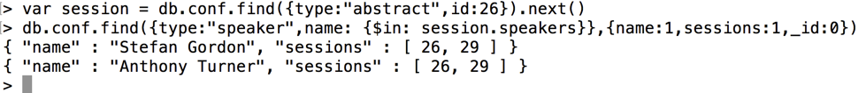
To embed or to reference, that is the question
Notes:
MongoDB example

Slide 30
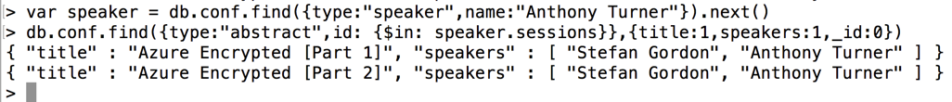
To embed or to reference, that is the question
Notes:
MongoDB example

Slide 31
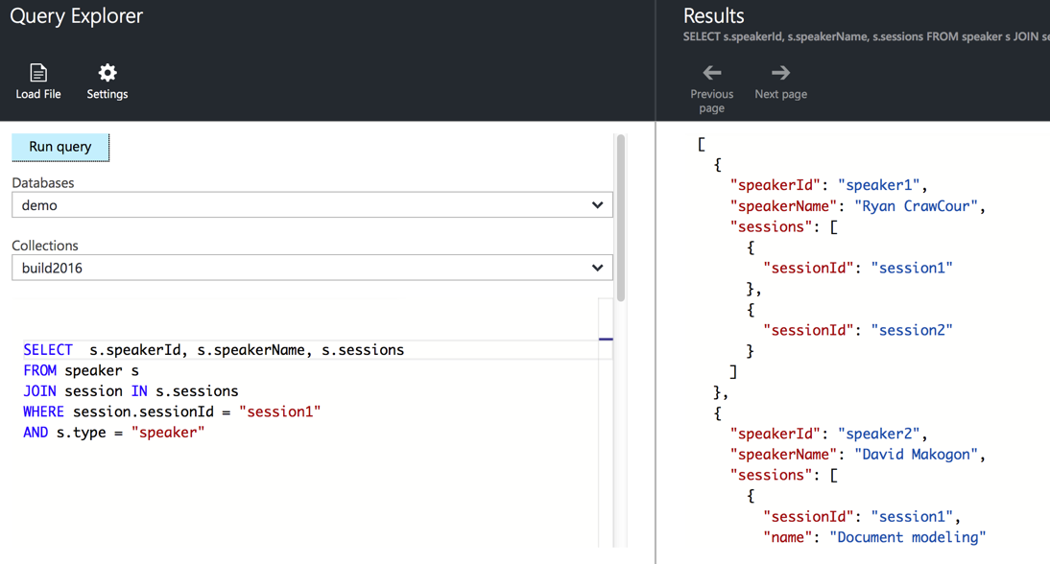
To embed or to reference, that is the question
Notes:
DocumentDB example

Slide 32
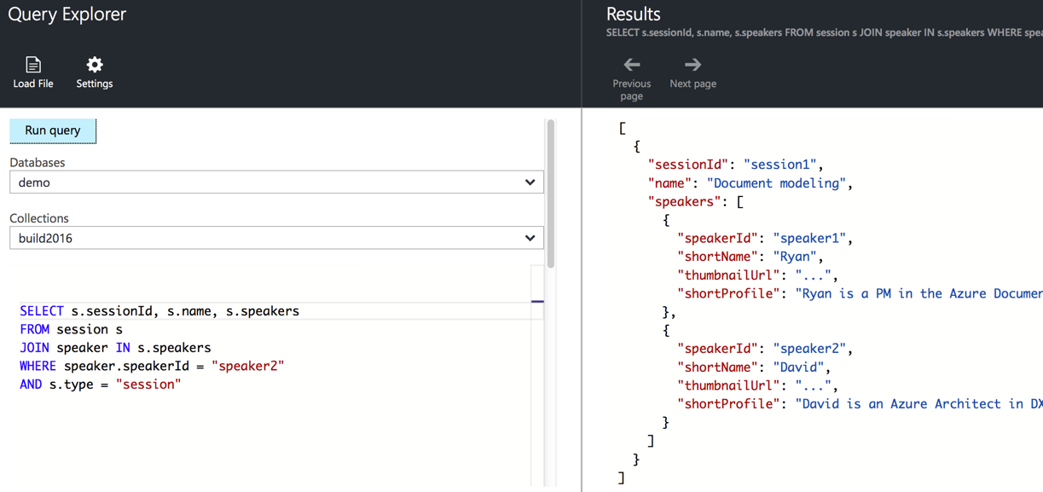
To embed or to reference, that is the question
one-to-many relationships (unbounded)
many-to-many relationships
{
"id": "s1", "name": "Ryan",
} { "id": "s2", "name": "David"
}
{ "id": "t1", "name": "Modeling document databases", } { "id": "t2", "name": "Fun with data", }
"sessions": [ {"id":"t1"}, {"id":"t2"} ]
"speakers": [ {"id":"s1"}, {"id":"s2"} ]
"sessions": [ {"id":"t1"} ]
"speakers": [ {"id":"s1"} ]
Notes:
DocumentDB example

Slide 33
To embed or to reference, that is the question
one-to-many relationships (unbounded)
many-to-many relationships
related data changes with differing volatility
{
"id": "online1",
"title": "The Shape of JSON: Document Modeling 101",
"tags": [ "Azure", "data" ],
"speakers": [ "David"],
"likes": 499,
"views":500
}

Slide 34
To embed or to reference, that is the question
one-to-many relationships (unbounded)
many-to-many relationships
related data changes with differing volatility
{
"id": "online1",
"title": "The Shape of JSON: Document Modeling 101",
"tags": [ "Azure", "Data" ],
"speakers": [ "David ]
}
{ "onlineId": "online1", "likes":499,"views":500 }

Slide 35
To embed or to reference, that is the question
one-to-many relationships (unbounded)
many-to-many relationships
related data changes with differing volatility
referenced entity is a key entity used by many others
{
"id": "session1",
"title": "The Shape of JSON: Document Modeling 101",
"room": { "id": "201","cap":200,"recording":true }
}

Slide 36
To embed or to reference, that is the question
one-to-many relationships (unbounded)
many-to-many relationships
related data changes with differing volatility
referenced entity is a key entity used by many others
{
"id": "session1",
"title": "The Shape of JSON: Document Modeling 101",
"roomId": "r201"
}
{"id": "r201", type:"room", "cap": 200, "recording": true }

Slide 37
To embed or to reference, that is the question
one-to-many relationships (unbounded)
many-to-many relationships
related data changes with differing volatility
referenced entity is a key entity used by many others
Typically referencing provides better write performance
Reading may require more round trips to the server

Slide 38
Combining embed + reference

Slide 39
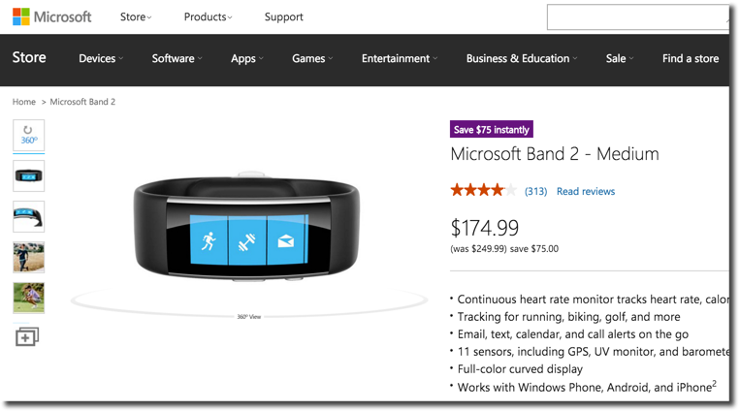
Embedded: Denormalized summary data

Slide 40
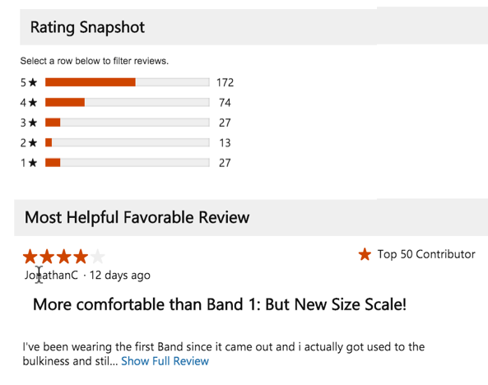
Referenced: summary data
More volatile than product
Partial content embedded

Slide 41
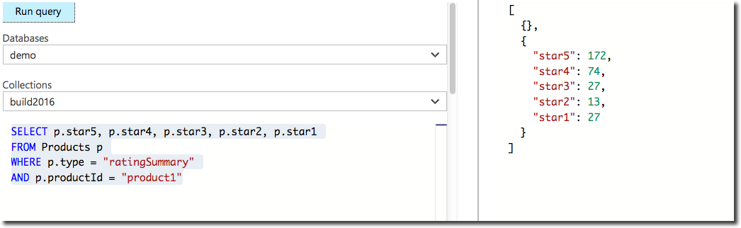
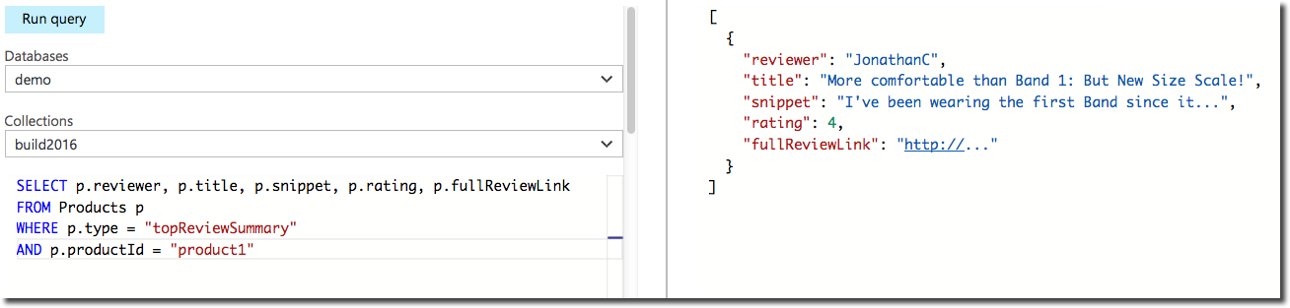
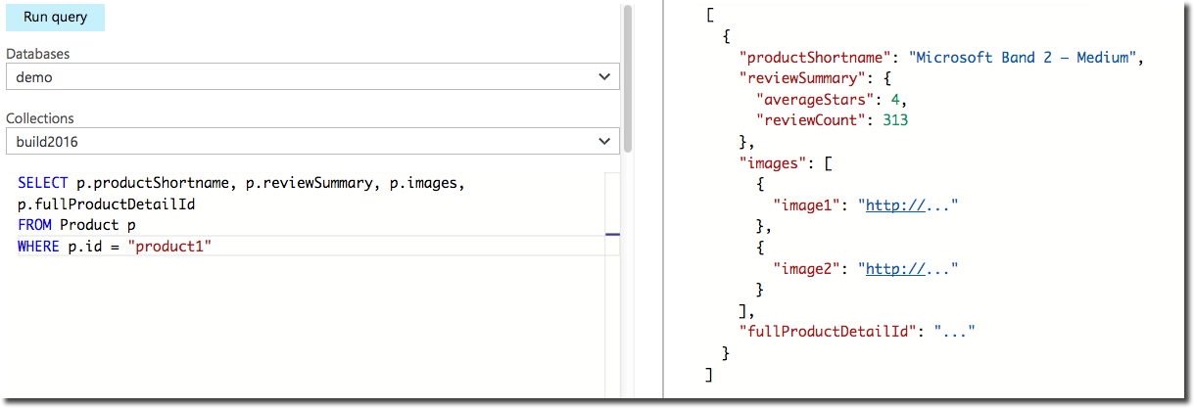
Embed + Reference: Full product
{
"id": "product1",
"type": "product",
"name": "Microsoft Band 2 – Medium",
"price": "174.99",
"summary": "Continuous heart rate monitor tracks heart rate...",
"images": [ {"image1": "http://..."}, { "image2": "http://..."} ],
"reviewSummary": {
"averageStars": 4,
"reviewCount": 313
}
}

Slide 42
Modeling challenge: Normalization vs denormalization

Slide 43
Normalized
{
"sessionId": "session1",
"sessionName": "The Shape of JSON: Document Modeling 101",
"speakers": [
{ "speakerId": "speaker1" }
]
},
{
"id": "speaker1",
"fullName": "David Makogon",
"shortName": "David",
"profile": "Fueled by Azure, NoSQL, photography...",
"images": [{"thumbnail": "http://..."},{"profile": "http://..."}]
}

Slide 44
Denormalized
{
"sessionId": "session1",
"sessionName": "The Shape of JSON: Document Modeling 101",
"speakers": [
{ "speakerId": "speaker1",
"shortName": "David",
"thumbnailUrl": "...",
"shortProfile": "David is an Azure architect..."
...
}
]
}

Slide 45
Normalize vs denormalized
Normalized data may save some space, but…
Requires multiple reads
Doesn't align with classes/objects
Typically provides faster write speed
Denormalized data aligns with classes/objects but…
Requires updates in multiple places
Typically provides faster read speed

Slide 46
Modeling challenge: Homogeneous vs Heterogeneous data

Slide 47
Homogeneous collections
It's easy to imagine one collection per data type:
Speaker
Session
Room
However, this could have an impact on:
Billing
Transactions
Queries

Slide 48
Heterogeneous collections
Consider multiple types in a single collection:
{
"type": "speaker",
"speakerId": "speaker1", "speakerName": "David Makogon",
"sessions": [
{"sessionId": "session1", "desc": "Polyglot Persistence"},
{"sessionId": "session2", "desc": The Shape of JSON"}
]
},
{
"type": "session",
"sessionId": "session2",
"name": "The Shape of JSON",
"speakers" : [
{"speakerId": "speaker1", "shortName": "David" }
]
}

Slide 49
Heterogeneous collections
Consider multiple types in a single collection:
Notes:
MongoDB

Slide 50
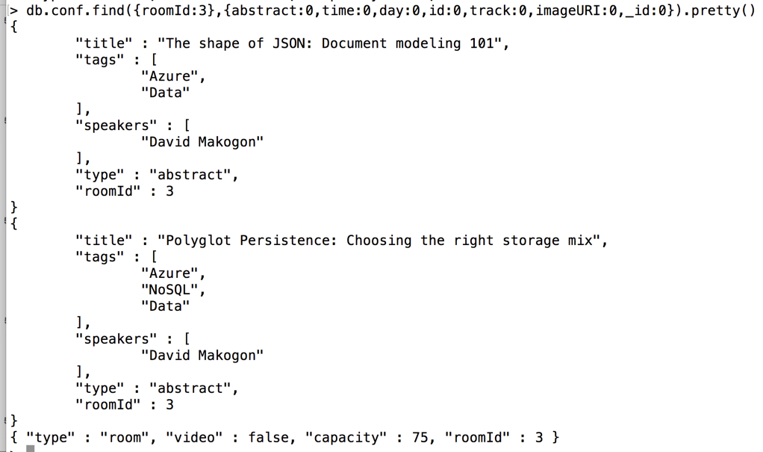
Heterogeneous collections
Consider multiple types in a single collection:
Notes:
MongoDB

Slide 51
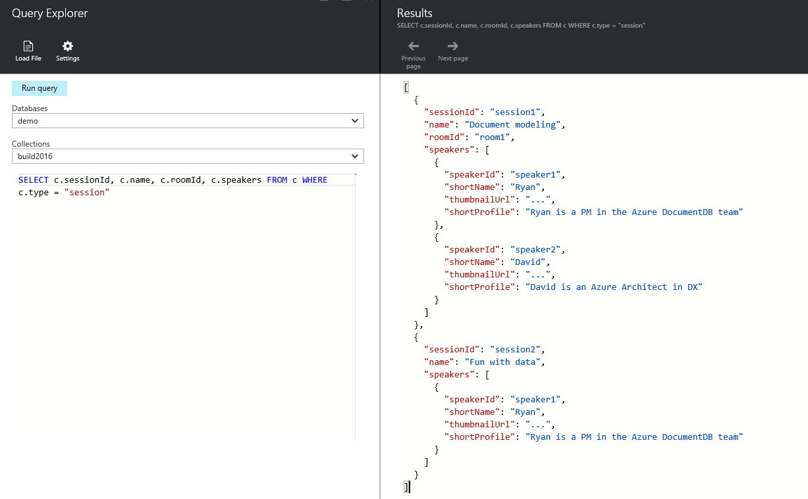
Heterogeneous collections
Consider multiple types in a single collection:
Notes:
DocumentDB

Slide 52
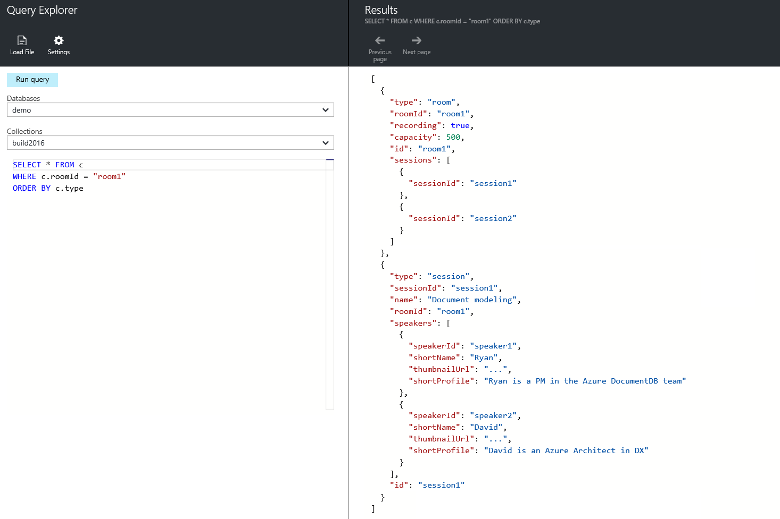
Notes:
DocumentDB

Slide 53
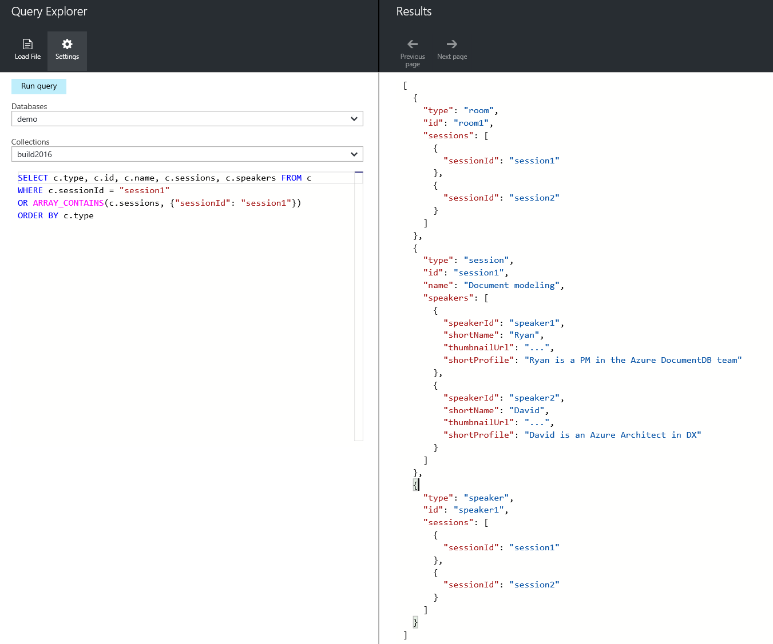
Notes:
DocumentDB

Slide 54
Use case: Hierarchies

Slide 55
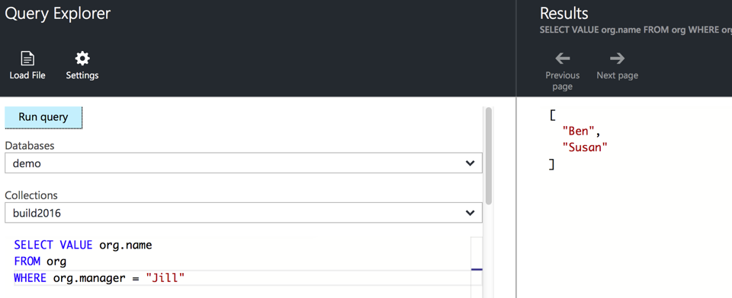
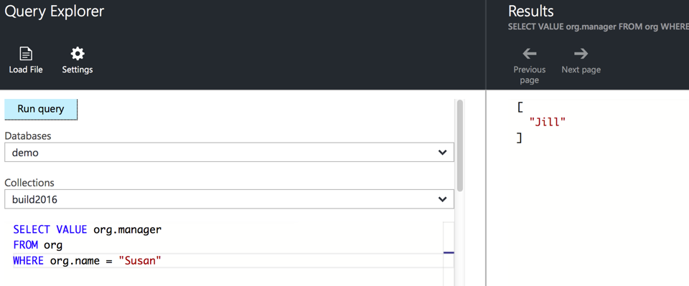
Use case: Hierarchical trees
{
{"name": "Jill" },
{"name": "Ben", "manager": "Jill" },
{"name": "Susan", "manager": "Jill" },
{"name": "Andrew", "manager": "Ben" },
{"name": "Sven", "manager": "Susan" },
{"name": "Thomas", "manager": "Sven" }
}
Jill
Ben
Susan
Andrew
Sven
Thomas

Slide 56
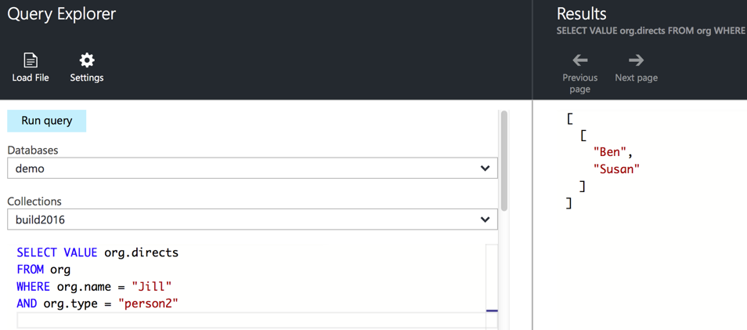
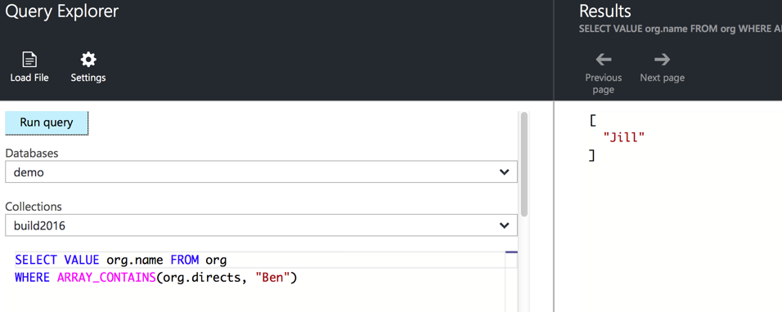
Use case: Hierarchical trees
Jill
{
{"name": "Jill", directs:["Ben","Susan"] },
{"name": "Ben", directs:["Andrew"] },
{"name": "Susan", directs: ["Sven"] },
{"name": "Andrew" },
{"name": "Sven", directs: ["Thomas"] },
{"name": "Thomas" }
}
Ben
Susan
Andrew
Sven
Thomas

Slide 57
Use case: Keywords

Slide 58
Keyword search
{
"id": "CDC101",
"title": "Fundamentals of database design",
"credits": 10
}

Slide 59
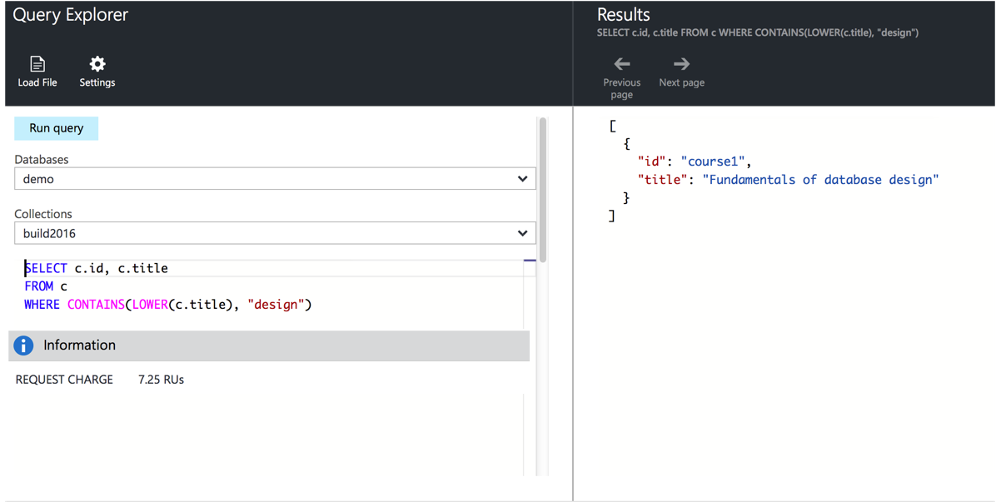
Keyword search
Notes:
DocumentDB

Slide 60
Keyword search
{
"id": "CDC101",
"title": "Fundamentals of Database Design", "keywords":["database","design","database design"],
"credits": 10
}
RegEx to transform words to lowercase, remove punctuation.
Strip out stop words like “to”, “the”, “of” etc.
Denormalize keywords into key phrases

Slide 61
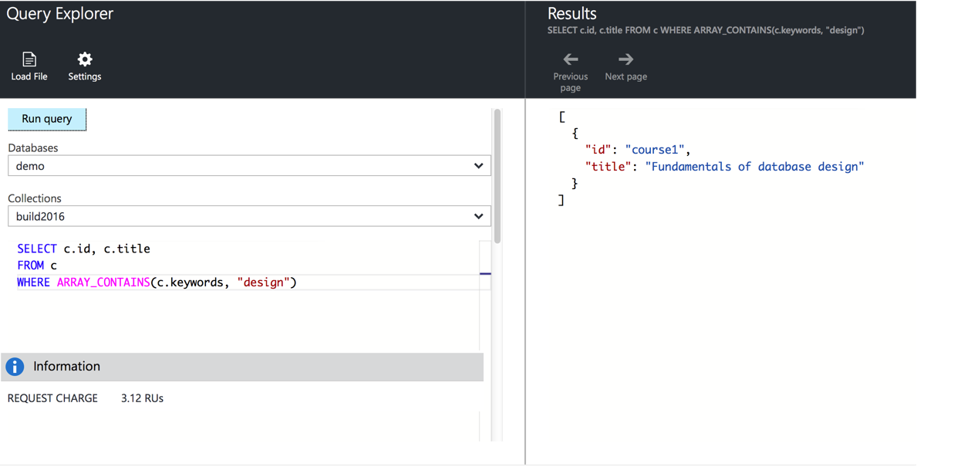
Keyword search
Notes:
DocumentDB

Slide 62
Use case: Telemetry

Slide 63
Telemetry
Consider storage of time-series data
Device readings: Weather stations, sensors, etc.

Slide 64
Telemetry
One document per reading:
{
"deviceId": "device1",
"timestamp": "...",
"reading": 123
}
Chatty, and requires overhead for each reading

Slide 65
Telemetry
One document per time period, per device:
{ "id": "...",
"timestampMinute": "...",
"readings": [
{"minute":0, "reading":123}, {"minute":1, "reading":456}, ...
{"minute":59,"reading":999}
]
}
Less chatty; easier to aggregate per time-period Larger series (e.g. hourly) require more in-place updates

Slide 66
Use case: Logging

Slide 67
Logging
Similar to telemetry; consider parsing log entries
{
"id: "...",
"timestamp": "...",
"logData": {"attr1": "value1", "attr2": "value2", ...}
}
Partition per time period, event type, region, etc.

Slide 68
Summary

Slide 69
Summary
{
options: ["Embed", "Reference"],
rules: "There are no rules, merely guidelines",
embed: [
"1:1",
"Child is a dependent",
"Similar volatility" ]
reference: [
"related data changes frequently",
"many:many"
]
remember: [
"Don't be scared to experiment and mix & match",
"Models change & evolve",
"Hybrid models"
]
}

Slide 70
Questions?
Keep in touch!
Twitter: @dmakogon
Blog: dmak.io
Materials at github.com/dmakogon/decodedconf2016

Slide 71
Notes:
Dark gray background.

