Slide 1
Intro to graph databases with Neo4j
David Makogon
@dmakogon
david.makogon@microsoft.com
stackoverflow.com/users/272109/david-makogon

Slide 2
Today’s talk
Setting the stage: Database types
Graph database primer
Demos, with Neo4j + Cypher
.net demo

Slide 3



Who am I??? (hint: → David Makogon)
Software guy
Photographer
Author of puns

Slide 4
Database types
Guesses?
Relational
Document
Key/value
Column
Graph

Slide 5
What’s a graph database?
Nodes and relationships
And properties
And all the query stuff

Slide 6



What’s a graph database?
Maybe I should see that movie…
I reviewed that movie!
Reviewed
Friends with

Slide 7
Why a graph database? Why not?
Optimal:
Ideal for complex connections
Easy navigation between things (nodes) and connections
No need for complex joins
Easy to add to (and evolve) existing model

Slide 8
Why a graph database? Why not?
Less-than-optimal:
Complex relational data
OLAP

Slide 9
Options in Azure?
Whatever you can run in IaaS:
Neo4j
Dex
OrientDB
InfiniteGraph
AllegroGraph
And many more!

Slide 10
Neo4j, .net

Slide 11
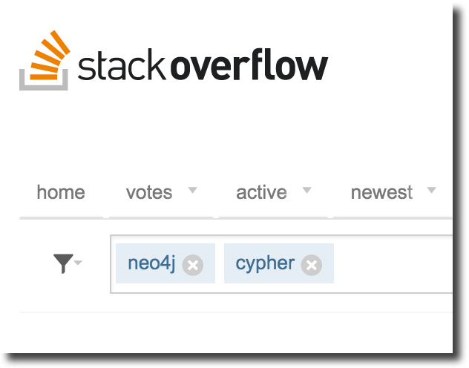
Wrapping up
@dmakogon
@neo4j
neo4j.org
http://neo4j.com/developer/dotnet/
github.com/Readify/Neo4jClient
github.com/dmakogon/dotnetdc2015

