Slide 1

Projects in Data Science:
Final Project
Group Penguins

Slide 2
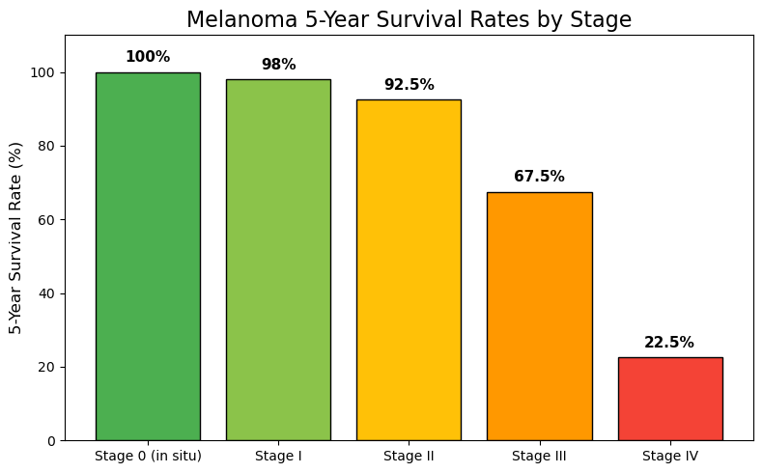
Project
Motivation:
Early Detection
of Skin Cancer
* Same survival rates for early stages of BCC and SCC.
However, MEL is the most lethal of them all.
https://www.molecheck.com.au/statistics-on-survival-rates-with-early-detection-of-skin-cancer/
https://www.sciencedirect.com/science/article/pii/S2949713224000582#:~:text=BCC%20is%20the%20most%20commonly,most%20skin%20cancer%2Drelated%20deaths.

Slide 3
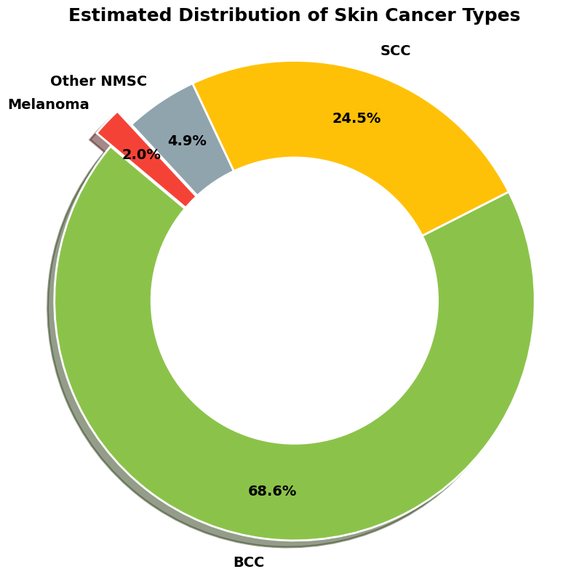
Project
Motivation:
Early Detection
of Skin Cancer
Why generalize to skin cancer instead
of focusing on melanoma?
https://www.molecheck.com.au/statistics-on-survival-rates-with-early-detection-of-skin-cancer/
https://www.sciencedirect.com/science/article/pii/S2949713224000582#:~:text=BCC%20is%20the%20most%20commonly,most%20skin%20cancer%2Drelated%20deaths.
Caveat: Using the ABC rule for melanoma detection to predict any skin cancer (BCC, SCC or MEL)
Notes:
even though melanoma is the deadliest of all skin cancers, its also very uncommon. BCC for example is very usual, reason for which detecting it is as important as detecting melanoma, focusing on the survival rate at the early stages. we also acknowledge that the algorithm we will create uses the ABC rule used for melanoma detection, and we extend it to BCC and SCC even though this is not common in clinical approaches.
ABC just for melanoma
Normal mole with faded border and color irregularity
BCC is more crusty, looking like infection and inflammation
For other two they normally look at texture
Can rapidly metastasize to lymph nodes, lungs, brain, liver - melanoma

Slide 4
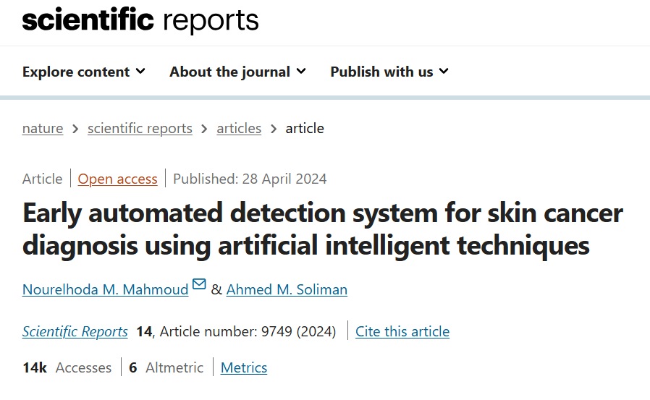
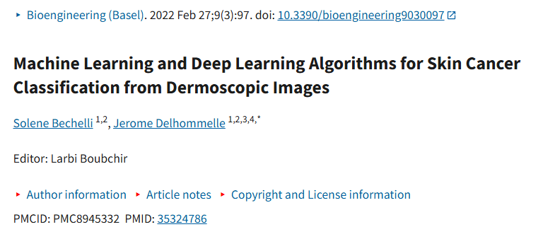
Motivation: Many existing early detection algorithms
https://pmc.ncbi.nlm.nih.gov/articles/PMC8945332/
https://www.nature.com/articles/s41598-024-59783-0
Notes:
we simply mention all the already existing algorithms for melanoma detection that work with the ABC feature extraction + model

Slide 5
Typical pipeline
Image Preprocessing
Segmentation
Feature Extraction
Model Training
Evaluation
1
2
3
4
5
Noise reduction: Hair Removal
https://www.nature.com/articles/s41598-024-59783-0
Notes:
we mention what the already existing algorithms for melanoma detection have in common and bring up the hair removal step as preprocessing step, to later explain why our research question is related to before vs after hair removal

Slide 6
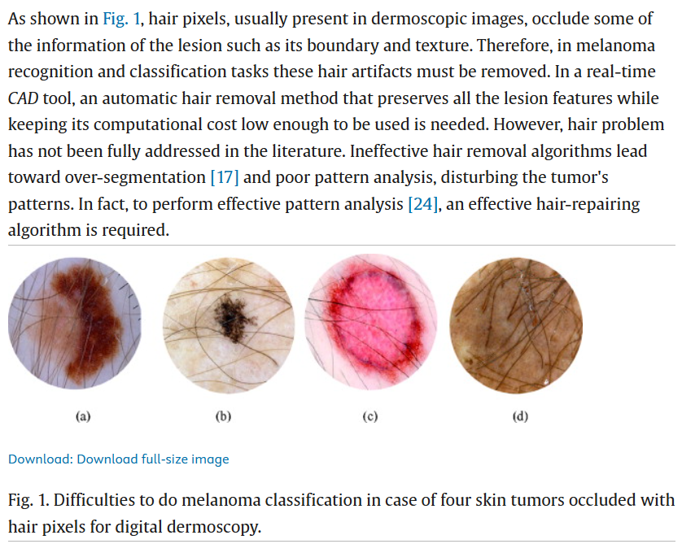
Hair Removal: Avoiding Bias
https://www.sciencedirect.com/science/article/abs/pii/S1746809411000048
Notes:
hair removal can interfere with the model:
showing some proof that hair is considered noise and leads to bias and incorrect features

Slide 7
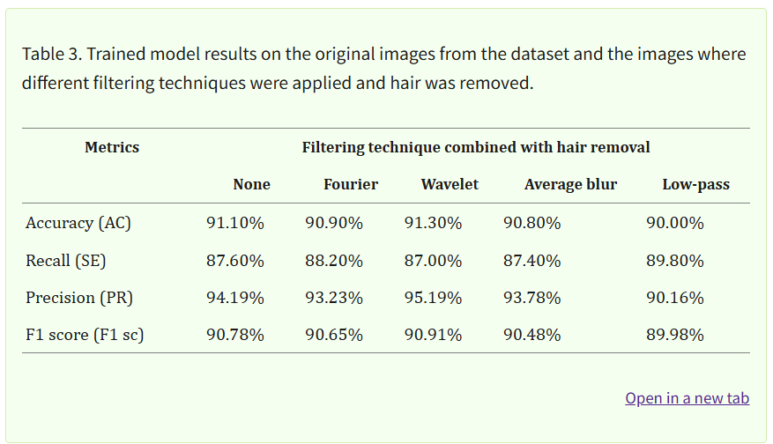
Hair Removal: Impact on Performance
https://pmc.ncbi.nlm.nih.gov/articles/PMC11041978/
Notes:
These chart represents different techniques of hair removal and their impact on performance of models. Meaning that a good hair removal algorithm can be indeed helpful (or make it worse too).

Slide 8
Research Question
How much does the removal of hair prior to feature extraction improve our model performance?
Notes:
improve had to affect

Slide 9
Approach
Two Models
Baseline
Extended
Segmentation
Feature Extraction
Model Training
Hair Removal
Segmentation
Feature Extraction
Model Training
Evaluation
Compare
Evaluation
Notes:
we will ad hair removal as the preprocessing step: We explain how our project is outlined to answer this research question

Slide 10
Workflow
Implement Feature Extraction
Inspect Dataset
Inspect Masks & Augment
Select Baseline Model
Integrate Hair Removal
Evaluate & Conclude
1
2
3
4
5
6
Notes:
based on material we already have, we mention what are the steps to follow the approach mentioned in the previous slide

Slide 11
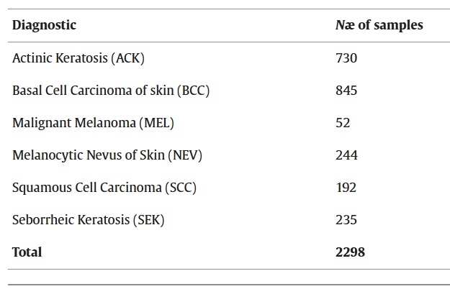
Dataset Inspection
PAD-UFES-20: https://www.sciencedirect.com/science/article/pii/S235234092031115X
Notes:
2298
1373 patients

Slide 12
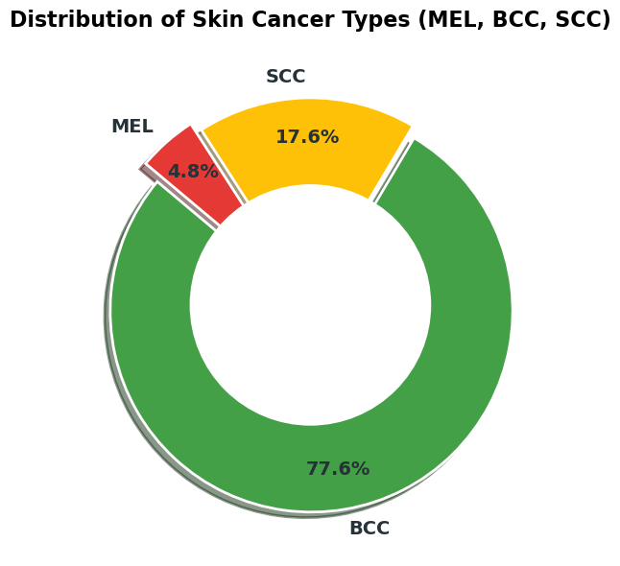
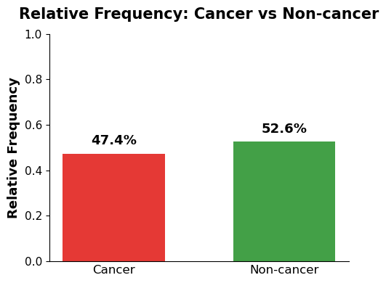
Dataset Inspection
Notes:
Upon inspection we noticed that
we have a pretty balanced distribution of cancer and non cancerous leasions in the data set
the distribution matches the ratio seen in reality
melanoma is only 2% of the cancer types diagnosed
our data set it is around 4%
justifying even more the need for an algorithm that not only predicts melanoma but also other cancer types.
avoids the need for correcting data imbalance, since the cancer/non cancer classes are balanced.

Slide 13
2. Masks Inspection
Provided by previous years’ students

Slide 14
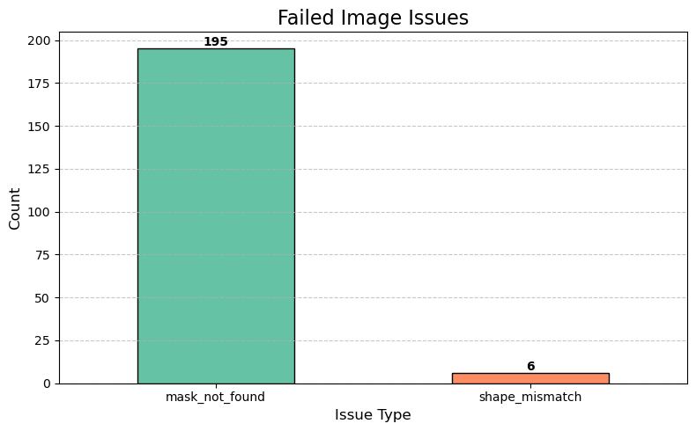
Masks Challenge
Notes:
when matching the masks to images we encountered a shape mismatch try/except error that stopped the code earlier and made it so we skipped a few images
195 masks missing
6 masks with a shape mismatch error (mask was smaller than original picture and vice versa)
our number was differently

Slide 15
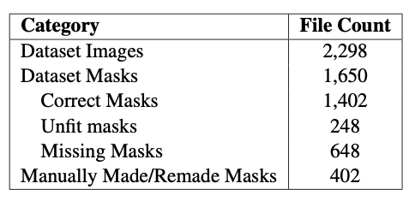
Mask Matching Results
Notes:
we ended up with 648 missing masks from that error
worked with 1650
divided into categories
and remade some masks from scratch to increase the number of available data
the categories were made as such:

Slide 16
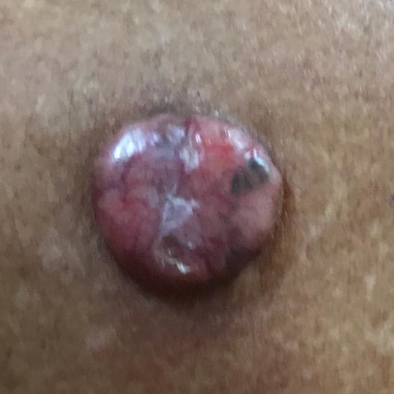
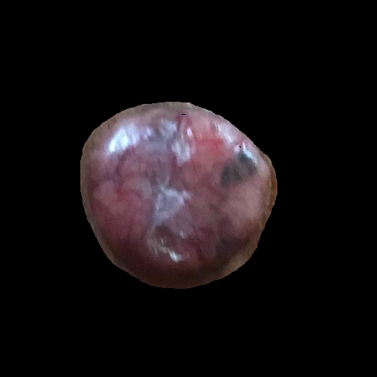
Correct Masks: Examples
PAT_78_118_164

Slide 17
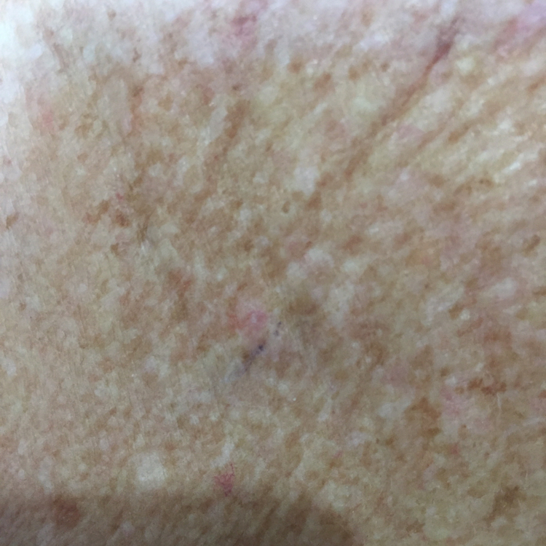
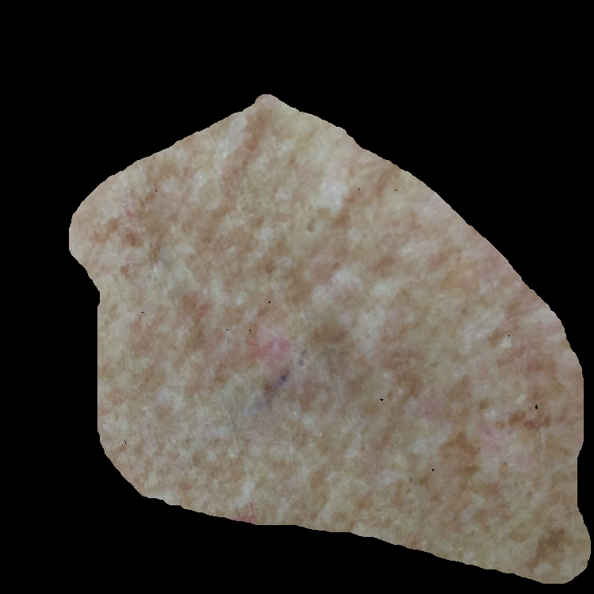
Unfit Masks: Examples
PAT_996_6_886
Notes:
the shape of the segmented area is not representative
asymmetry and border measures will be misleading for this lesion

Slide 18
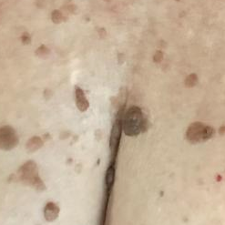
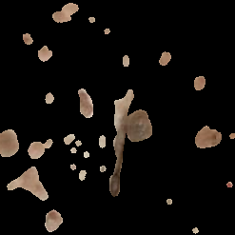
Unfit Masks: Examples
PAT_87_133_810
Notes:
our algorithm doesnt account for multiple lesions so its unfit for the model
it is categorised as unfit and either remade or discarded

Slide 19
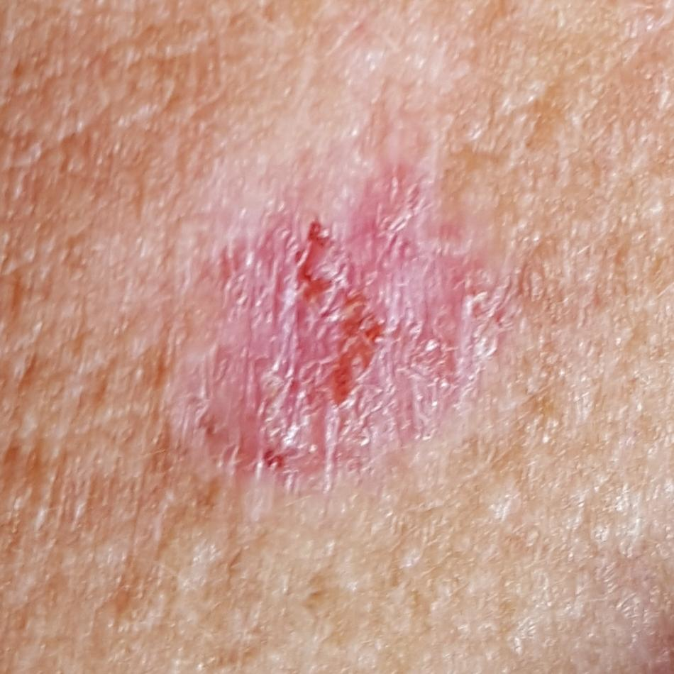
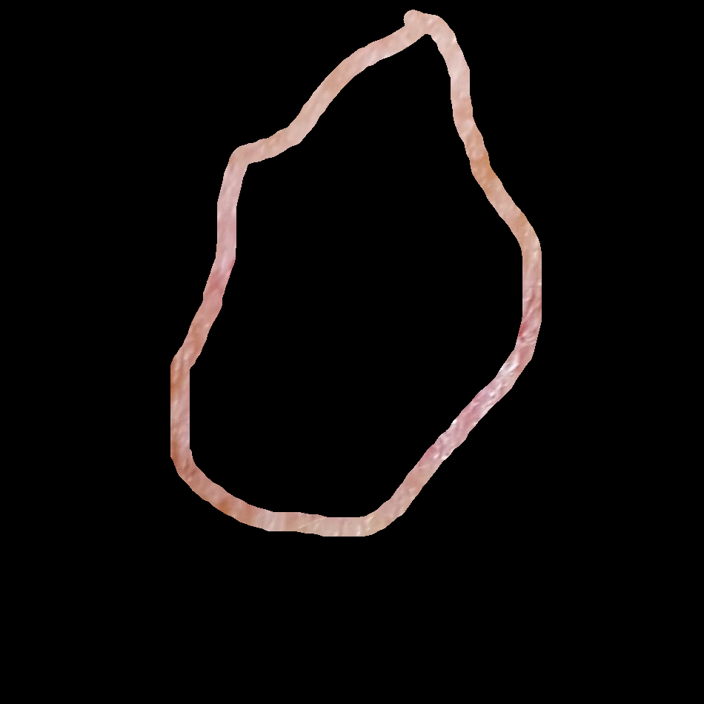
Unfit Masks: Examples
PAT_385_783_22
Notes:
incorrect mask for some reason, needs to be remade

Slide 20
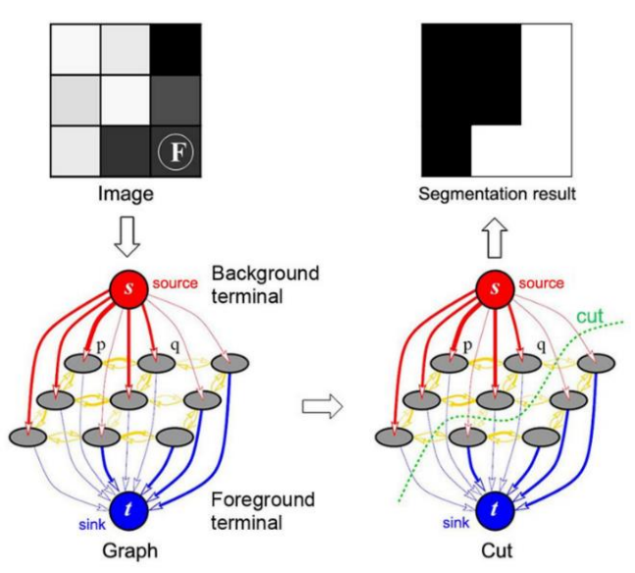
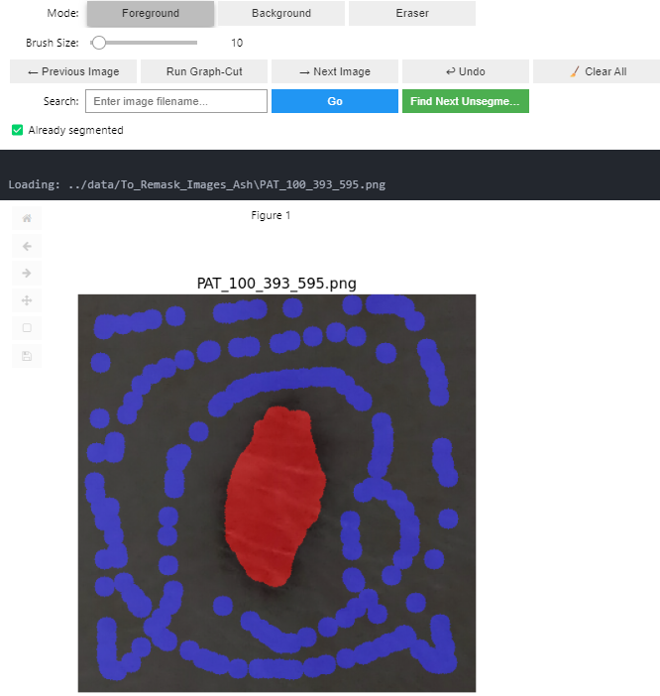
Region-based Segmentation Algorithm: Graph Cut
https://itta.cyber.az/2024/papers/09.pdf
Notes:
why we used graphcut:
we needed some high precision masks
to obtain precise border
and asymmetry features

Slide 21
3. Feature Extraction

Slide 22
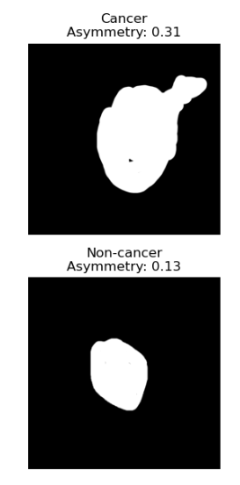
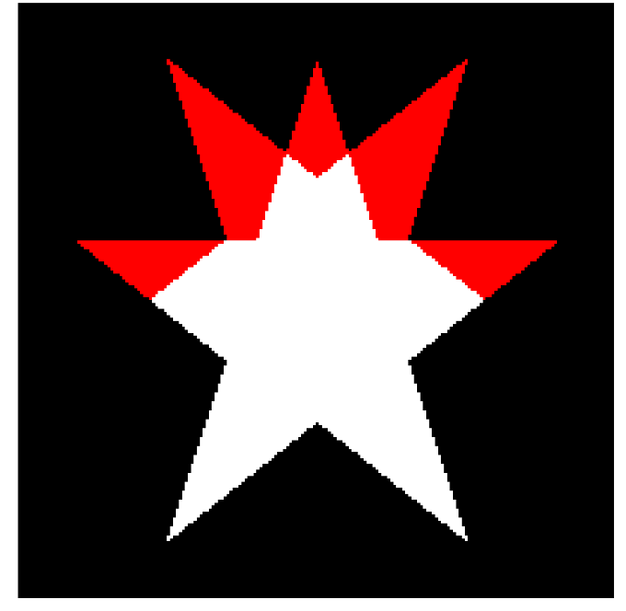

Asymmetry
Method:
Cut mask
Find center
Split in halves
Flip halves
Count mismatched pixels
Normalize by the area → asymmetry score
Rotate the lesion several times
Repeat for all directions
Return mean asymmetry
Notes:
We used provided code
The numbers made sense and it was also tested on synthetic data
Higher asymmetry score more asymmetric the object is
denominator 2x since we account for both vertical and horizontal mismatch

Slide 23
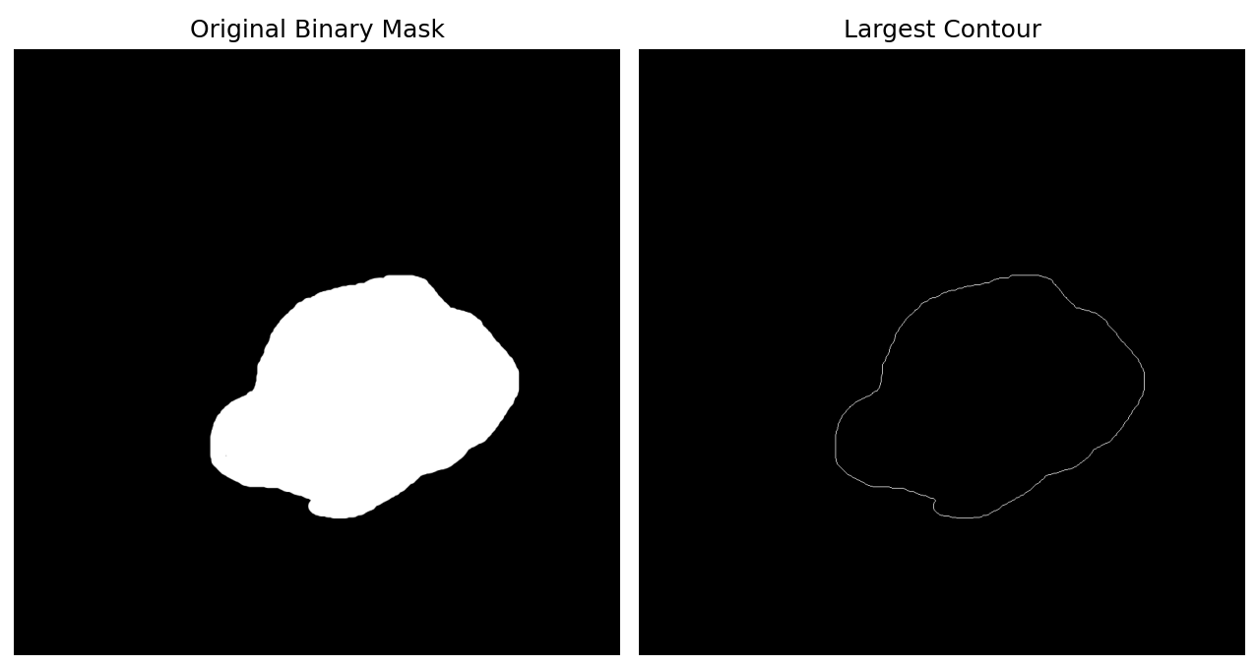
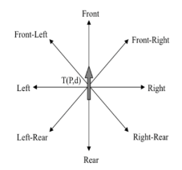

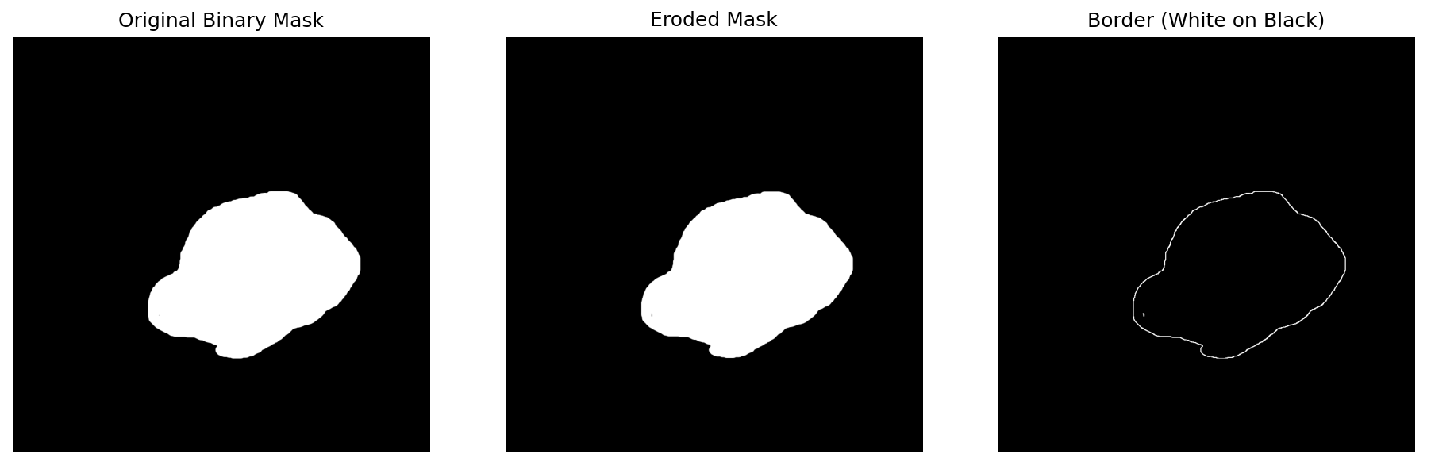


Border
Idea:
Find all contours (border-following algorithm)
Select largest
Perimeter (coordinate-based math)
Area
Compactness score
Validation:
Compactness: 0.06
Compactness: 0.8
Notes:
Contour detection: cv2.findContours(mask, cv2.RETR_EXTERNAL, cv2.CHAIN_APPROX_SIMPLE)
Passes binary mask
RETR_EXTERNAL outer most contour retrieved - ignores contours inside lesion mask! important for precise scores
OpenCV uses the Suzuki–Abe border-following algorithm
Extracting contour with largest area, before that we assure that this contour is external, not inside lesion
Perimeter was calculated using euclidean distances between contour pixels and noting start and end pixel → more precise than sum of pixels in the contour. Summing pixels approach fails to account for diagonal/curved transitions!
Area was calculated using contour as a polygon, Green's Theorem (crossed product sum) - formula for calculating closed curves area it also aligns with euclidean distance perimeter that we calculated
Compactness - how tightly is the area packed inside the contour? 4pi - normalization constant, perimeter squared to adjust for units
Why not classical erosion? Erosion assumes that mask is filled in, can see in the picture small doth inside the mask
why not just summing up pixels? —> Key Advantages of Euclidean Distance:
Considers Spatial Relationships
Summing pixel values treats all pixels individually, ignoring their positions in the image.
Euclidean distance calculates the true spatial distance between edge points, preserving the lesion's shape.
Accounts for Irregular Borders
Many skin lesions have non-uniform, jagged edges that require precise measurement.
Euclidean distance captures variations in shape better than a simple pixel sum.
More Reliable for Border Compactness Analysis
Compactness measures how closely lesion pixels are clustered.
Summing pixels does not reflect border regularity, while Euclidean distance provides a more objective geometric analysis.
Useful for Feature Extraction in AI Models
In machine learning for melanoma detection, Euclidean distance helps quantify lesion asymmetry and boundary irregularity.
This improves classification accuracy by distinguishing benign vs. malignant lesions.

Slide 24
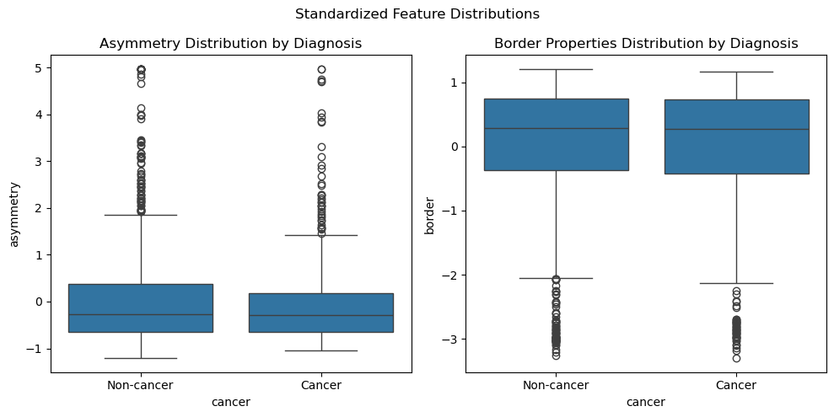
Border and Asymmetry Limitations
Notes:
Since border and asymmetry overlap classes and are correlated probably don't give useful information

Slide 25
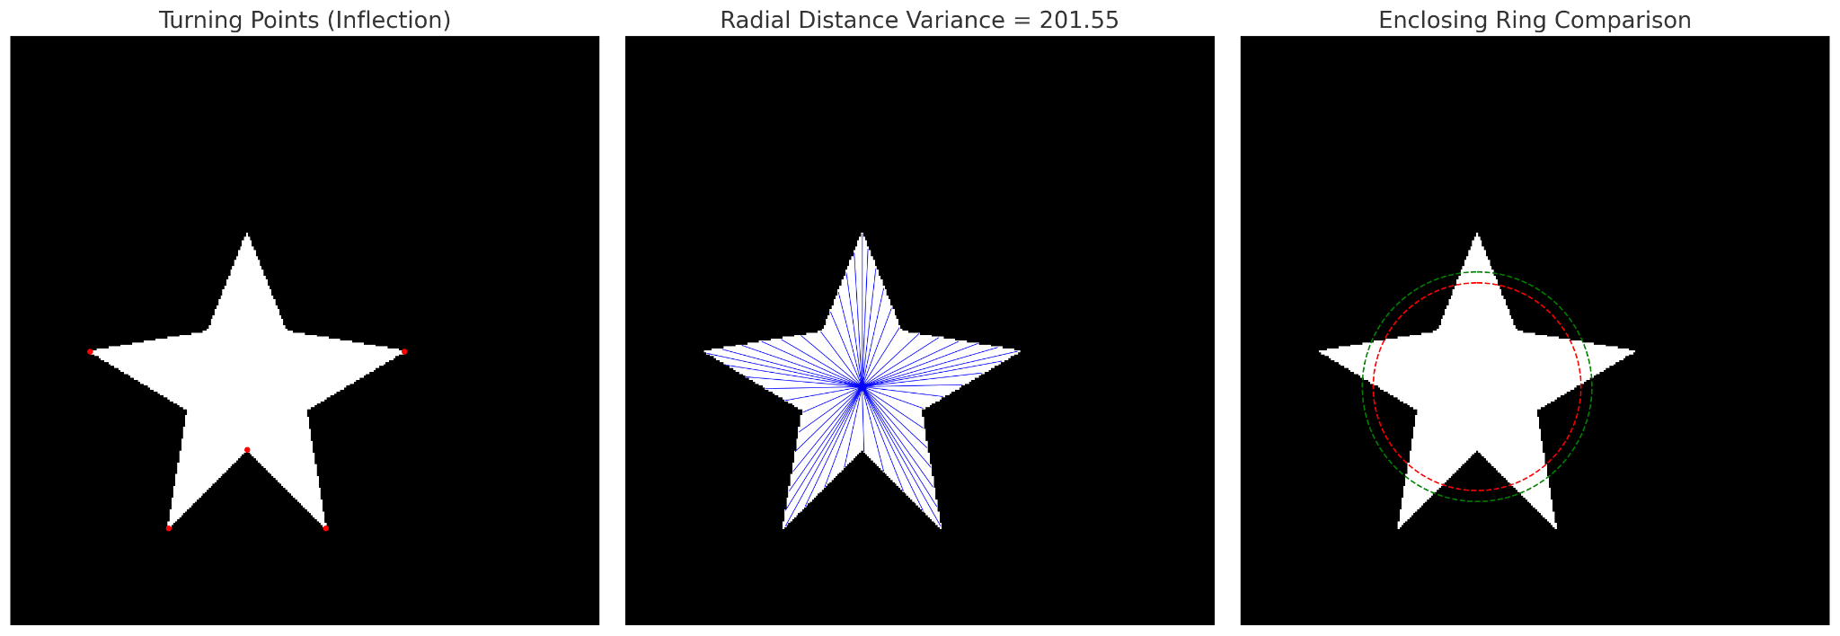
More ideas for border

Slide 26
Color
No.
melanoma
colors
HSV statistics
Hue
Entropy
Notes:
Benign lesions often have a uniform color → low hue entropy
Malignant lesions (especially melanoma) often show irregular, patchy pigmentation → high hue entropy

Slide 27
HSV statistics pipeline
Superpixel
mean HSV
Downsizing
1
3
2
4
Lesion mean HSV & std dev
SLIC

Slide 28
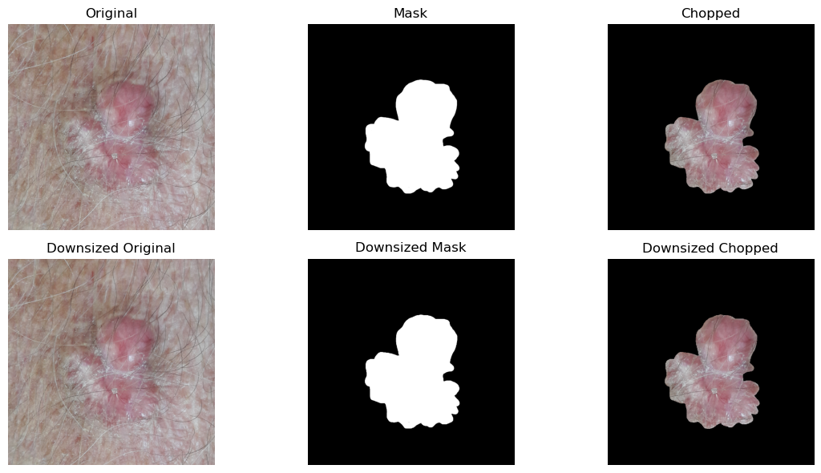
Downsizing: Reducing computational complexity

Slide 29
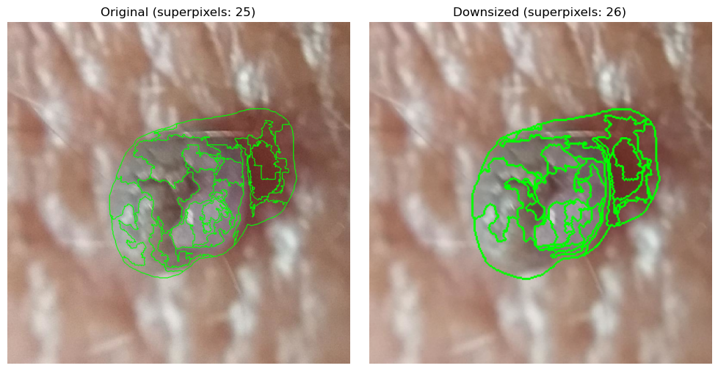
SLIC segmentation: Improving robustness

Slide 30
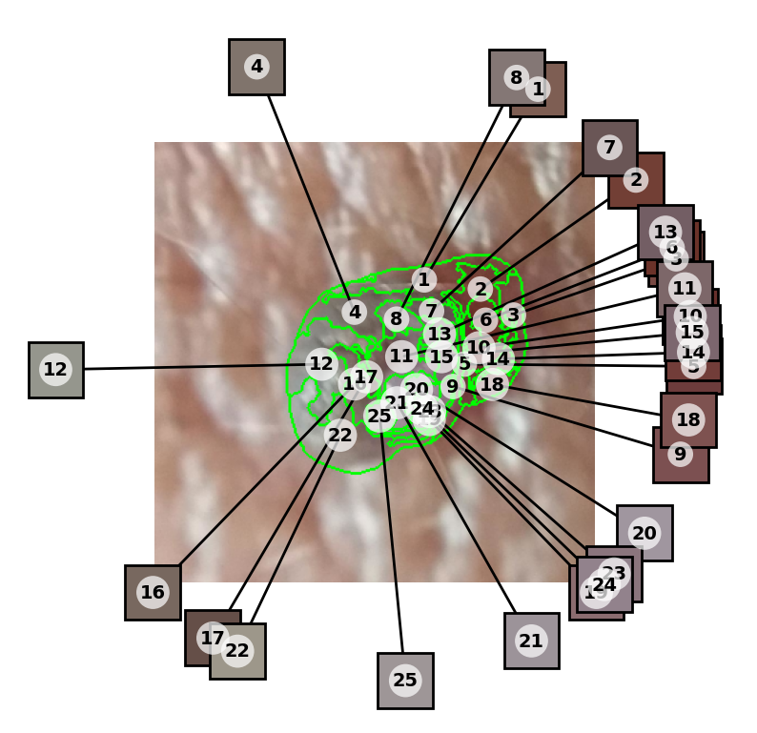
Superpixel Mean HSV

Slide 31
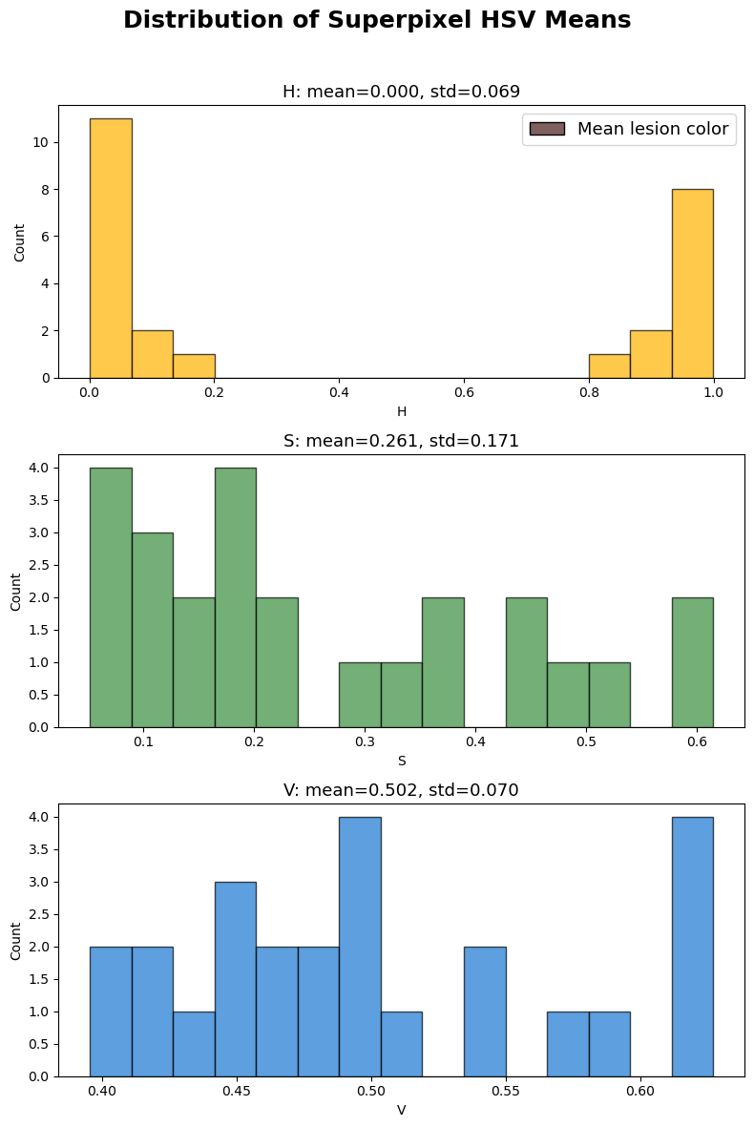
Lesion Mean HSV
& Std Dev

Slide 32

Considerations
The higher the number of superpixels, the higher std dev values will be
High std dev values are indicators of color irregularity
Area-weighted statistics
would have reflected more representative numbers

Slide 33
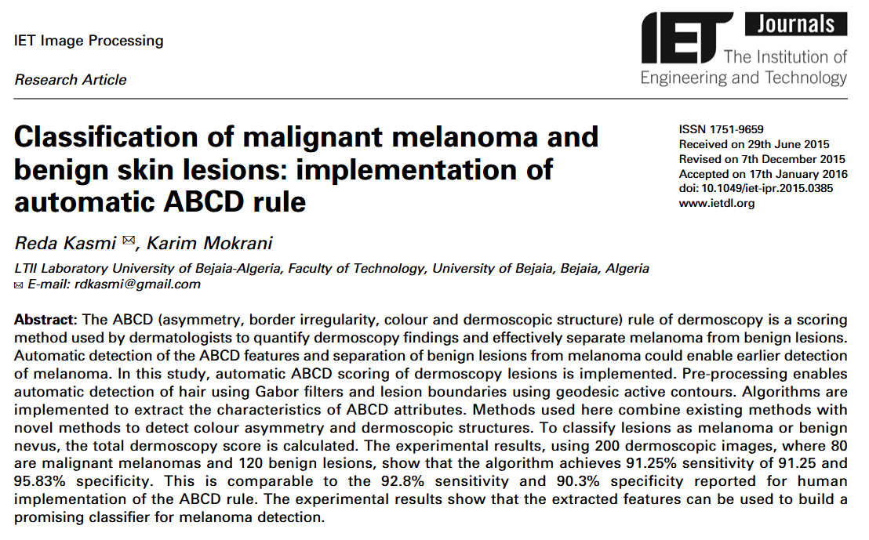
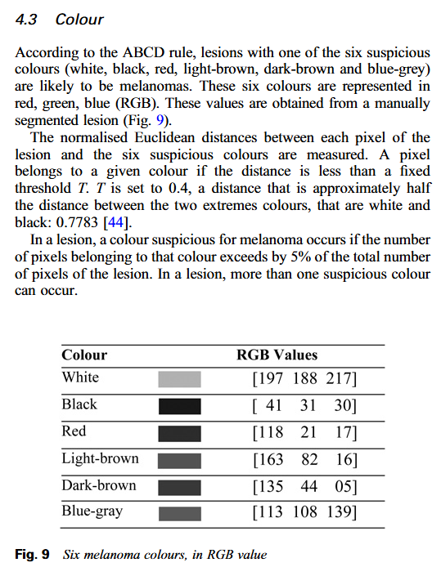
Number of Melanoma Colors: Motivation
https://ietresearch.onlinelibrary.wiley.com/doi/epdf/10.1049/iet-ipr.2015.0385

Slide 34
Number of Melanoma Colors: Current Approach
Recycling SLIC superpixels & working in HSV
Inputs HSV
means array
This array is also used as input to the function mean & std dev HSV of the lesion.
04
Return no. of
MEL colors
Ranging from 0 to 6.
01
03
Euclidean Distances
Between each superpixel HSV mean value and the 6 melanoma colors. Careful manipulation of the distance in H.
Smallest Distance
& Selection
Chooses the melanoma color which the superpixel is closest to. If distance is less than T=0.4, then that melanoma color is present.
02

Slide 35
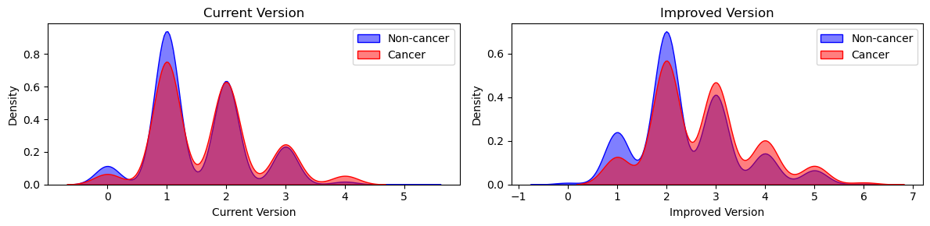
Number of Melanoma Colors:
Current Approach vs Better Approach

Slide 36
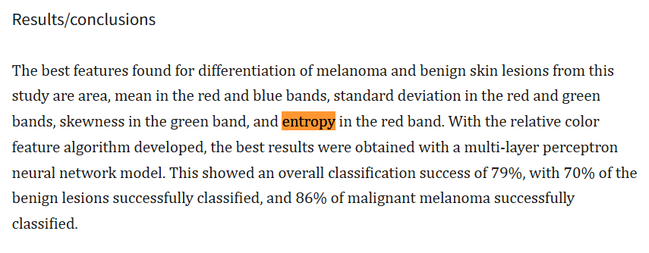
Hue Entropy: Motivation
https://pmc.ncbi.nlm.nih.gov/articles/PMC3184884/

Slide 37
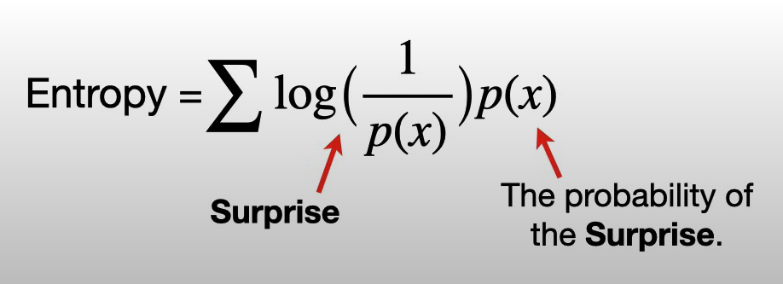
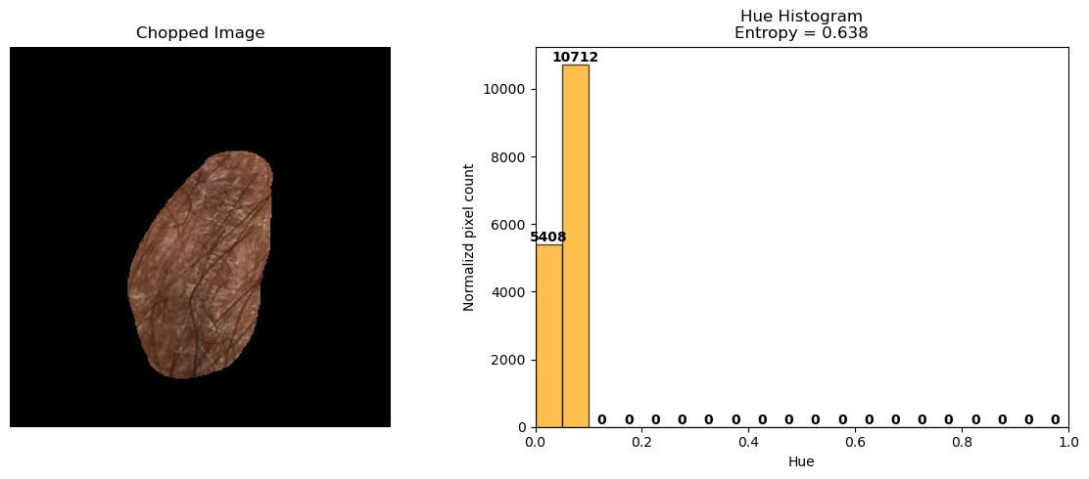
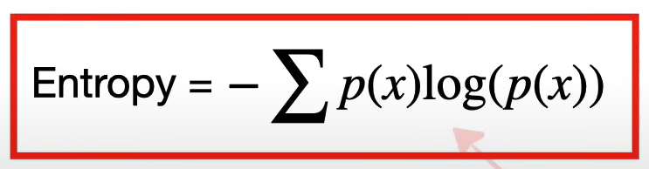
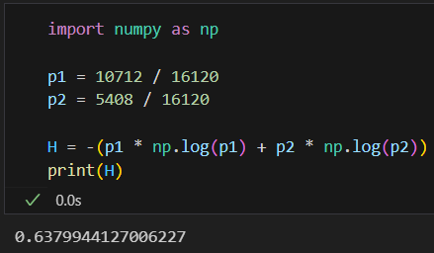
Hue Entropy: Theory
A measure of color diversity/randomness
Mostly uniform lesion: low entropy

Slide 38
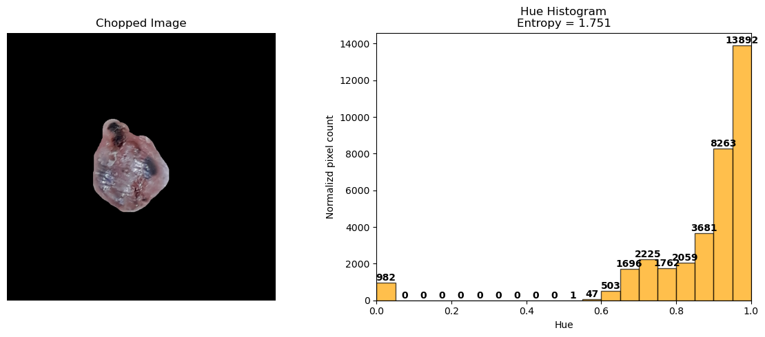
Hue Entropy: Theory
A measure of color diversity/randomness
Irregular lesion: high entropy

Slide 39
4. Best Baseline

Slide 40
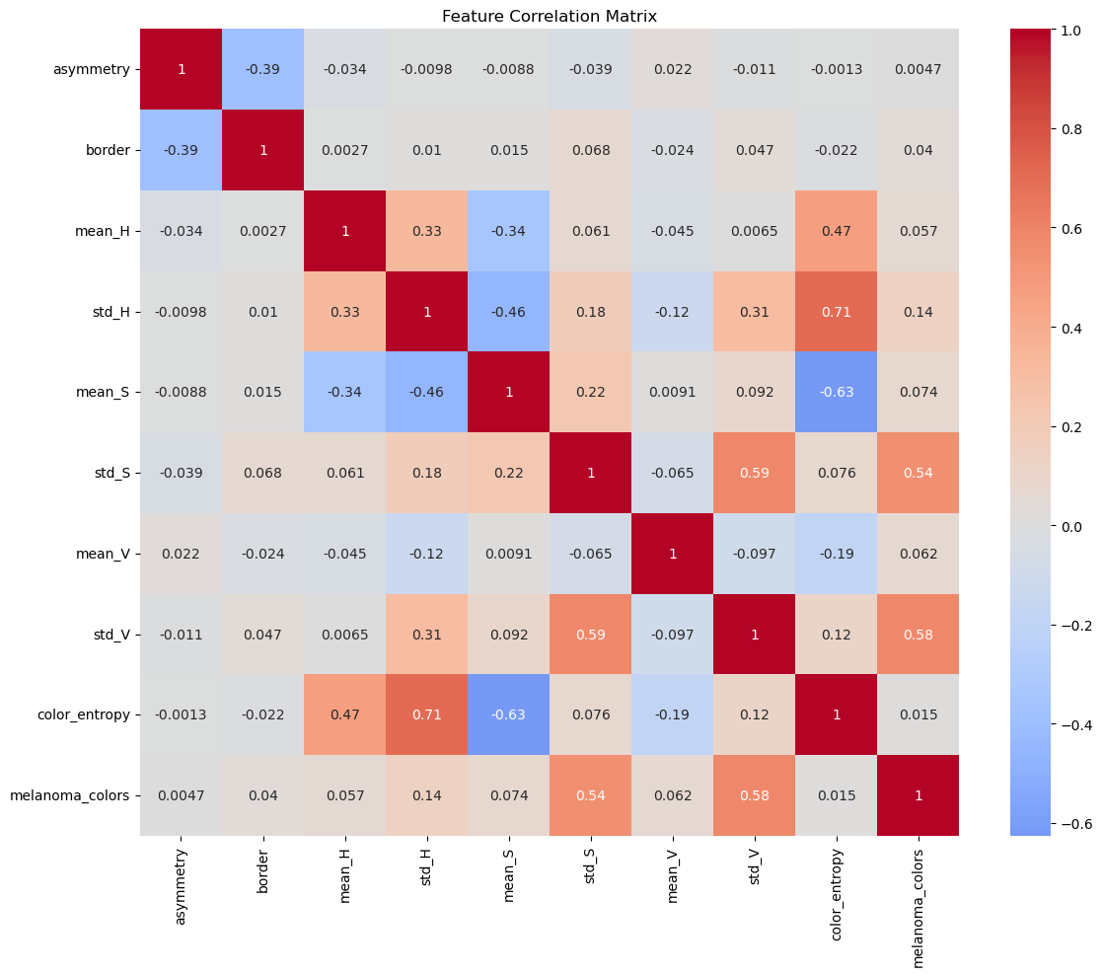
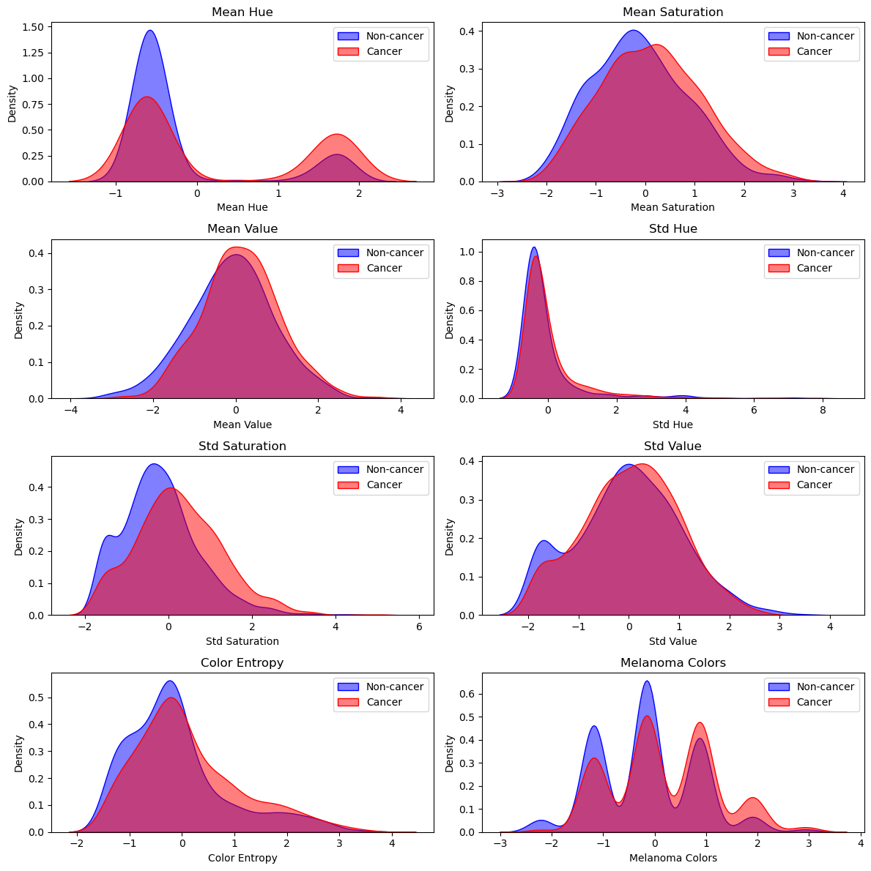
Feature analysis

Slide 41
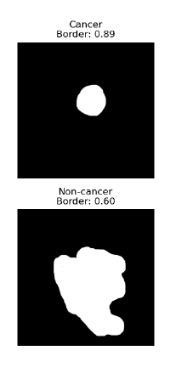
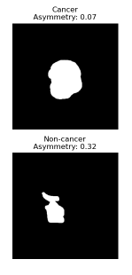
Algorithm choice —> Decision tree
From feature observations:
Complex feature interactions → non-linear decision boundary
Outliers and noisy data
Many correlated features
Benign and malignant lesions:
Share similar color ranges
Overlap in border irregularity
Differ only subtly in combinations of features
Notes:
A lesion might only be suspicious if asymmetry is high and certain melanoma colors are present, but not if only one of these is true.
Outliers or noisy values often don’t affect the majority of samples, so they tend not to be selected for the top-level splits.
Trees automatically ignore irrelevant or redundant features during splitting.
Why not:
We also have discrete variable
Logistic reg. → linear decision boundary
Knn → affected by noisy data
Random forest → doesn’t inherently respect group structures (like patient-level splits)

Slide 42
Testing features with cross validation - Decision tree
Features | Depth | AUC | STD
All | 3 | 0.7056 | 0.0340
No color entropy | 3 | 0.6972 | 0.0373
No H, S, V stds | 4 | 0.7059 | 0.0433
No border + stds | 3 | 0.7057 | 0.03262
No asymmetry + stds | 3 | 0.7043 | 0.0307
No asymmetry + border + stds | 6 | 0.7218 | 0.0353
Notes:
we tried excluding color entropy and stds because they were highly correlated
after cross validation we see that entropy is more important and stable than stds, so we decided to exclude stds
we also noticed some correlation and noise between border and asymmetry so we played around but in the end we decided to keep them to avoid specification bias
Why best performance when border and asymmetry excluded? noisy data
The tree grew deeper (to 6) to fully exploit the remaining, cleaner features — leading to a higher AUC and better generalization.
Removing these “distractor” features forced the tree to explore other (better) paths more deeply.

Slide 43
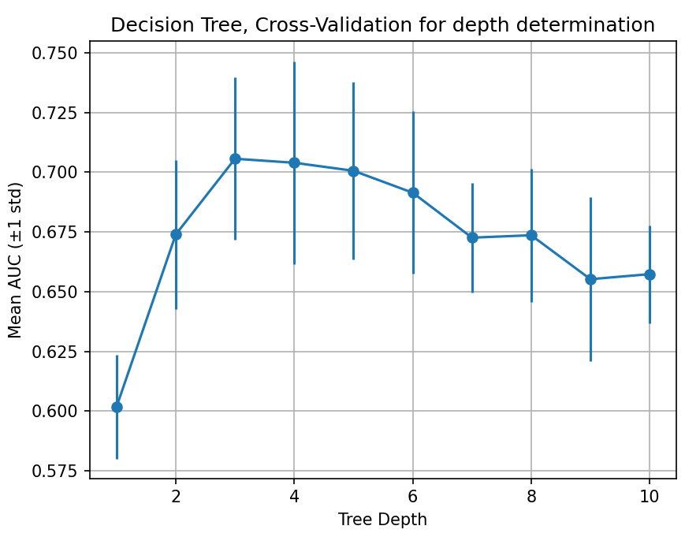
Cross validation and tuning
Notes:
We reported with all features, since we did not have time to decide which features to exclude and felt too risky → was not a bad performance as well
We said in the report that best choice was 4 we misread

Slide 44
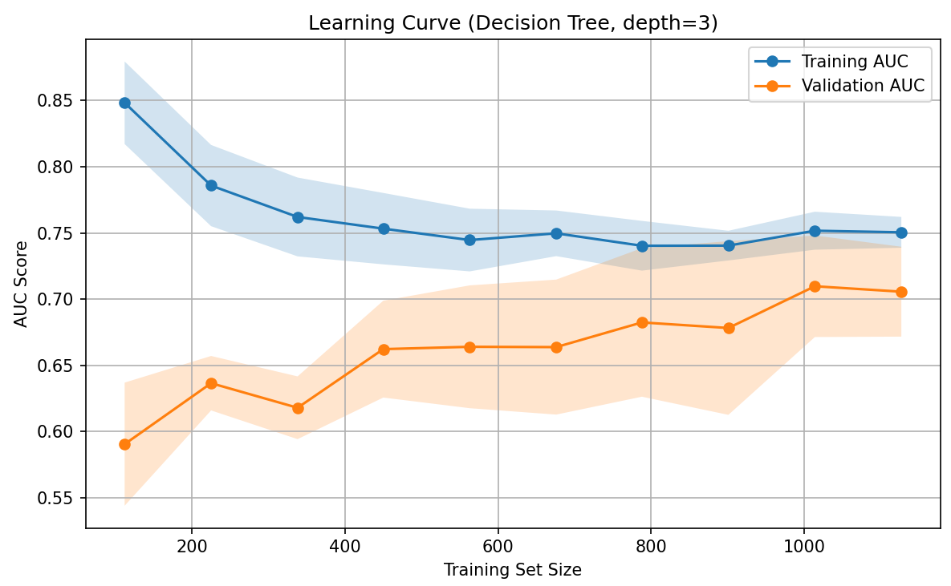
Checking overfitting
Notes:
the amount of features (10 total) did not affect overfitting, and we can see that in the learning curve. also, we observe in testing that the AUC value stays similar and even higher than the cross validation mean value.

Slide 45
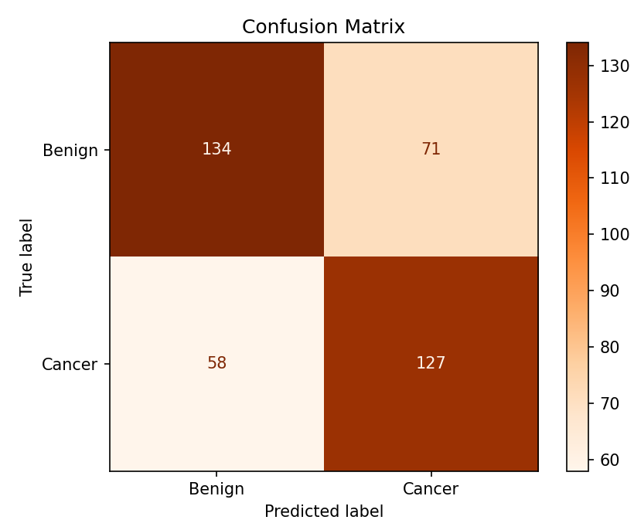
Evaluation on all features model, depth = 3
Accuracy: 0.6692
Recall: 0.6865
AUC: 0.7100
Precision: 0.6414
F1 Score: 0.6632
Notes:
Accuracy alone might be misleading in imbalanced datasets, as a model could achieve high accuracy by simply predicting the majority class (non-cancerous). → f1 score mean of recall and precsion
the fact that we obtained the same AUC than in cross validation is a GOOD sign of NO overfitting. also, this is promising considering the imperfections our feature extraction code had and that we discovered they could be improved later on. this number could have been even higher if the feature extraction code was tuned (ie not a superpixel approach maybe). An AUC of 70 indicates the model is definitely not random but there is still room for improvement to consider it GOOD. Normally, basic models tend to show an AUC of 0.75-0.85 depending on how good/bad the segmentation + feature extraction implementation is. It is also worth mentioning that a high precision in the masks is also crucial to detect features like border and asymmetry, features in which we observed high overlap, so this can also be a reason for which the model could still be better.

Slide 46
5. Hair Removal

Slide 47
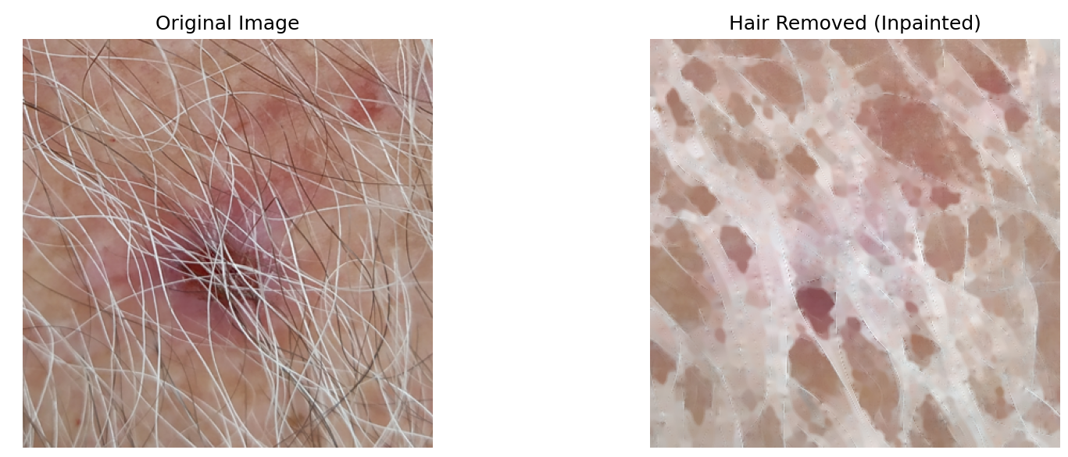
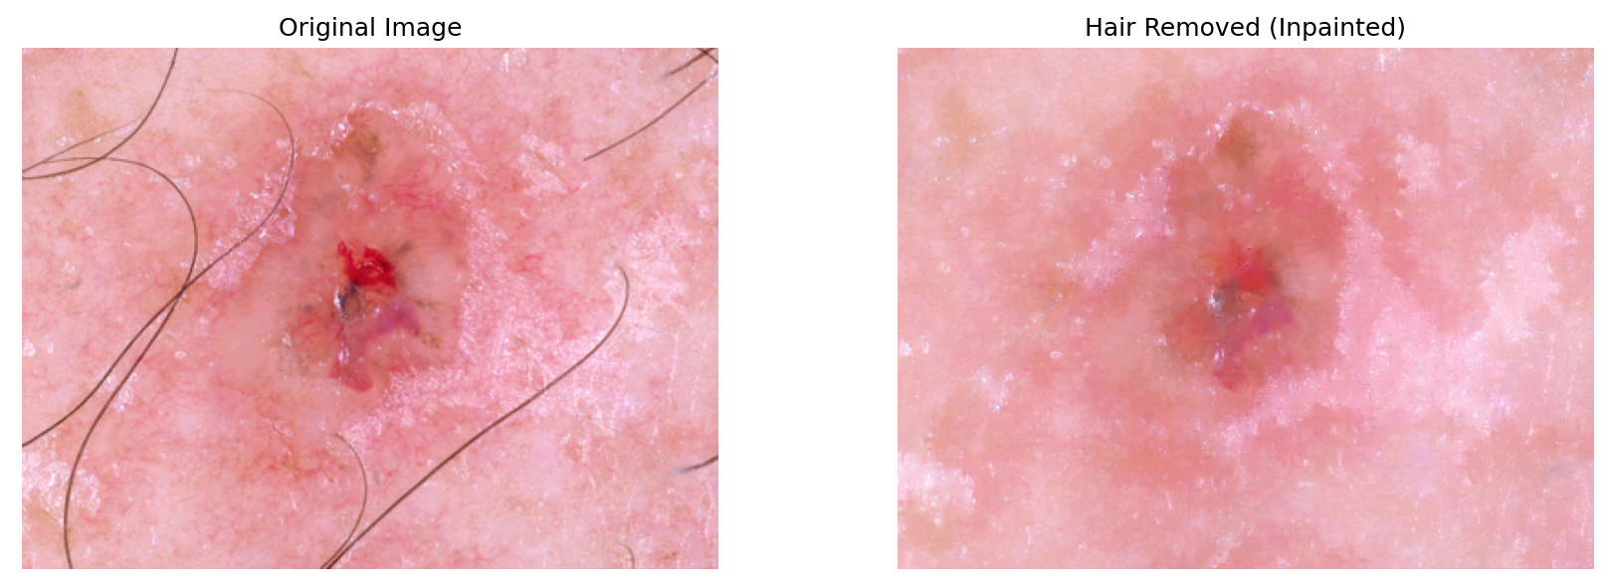

Hair Removal
Challenges Encountered
Light-colored hair
Uneven lighting
Retained artifacts
Blurred lesion
Initial Idea
Adjusting the inpainting kernel size based on hair coverage, while keeping the rest unchanged.
Notes:
We tried simple idea, by just adjusting the blackhat kernel size based on hair coverage
But blackhat doesn't work on the white hair, and there were other issues so we decided to improve the given code reflecting those issues

Slide 48






Hair Feature: Hair Coverage
Method:
Enhancing hair detection by improving:
Contrast (CLAHE)
Hair edges for hair mask (Sobel + Laplacian)
Binary hair mask: manual thresholding
Count:
All pixels in the lesion area
Hair pixels inside the lesion
Compute hair coverage ratio:
Hair pixels ÷ Lesion pixels = Hair coverage
For validation of the feature extraction:
Hair pixels ÷ Image pixels
Notes:
We used CLAHE to enhance hair visibility
Combination of Laplacian and Sobel, because Sobel marks thick hair better and Laplacian marks thin hair, so they compensate each other when are combined (see images)
Examples are given of both lesion image with hair and without to show that hair coverage works (showed method that was used for validation, but method for extended model accounts for hair coverage only inside the lesion area, just extra numpy mask it doesnt need to be visualized it is not a complex)
Histogram is showing combined Sobel and Laplacian operators image, how the pixels distribution in gray scale looks like. It was used to determinate the threshold for the binary hair mask -> result was 0.3*255 (30% of max pixel intensity)
However method is not perfect because:
If lesion edges are strong they will be accounted → but too rare cases
Markers on skin with no hair increased → hair coverage score
continue if you found more things to say
How could we do it the other way:
Just using tophat and blackhat → but depends on the hair color

Slide 49



Validation of the hair feature
Annotations analysis:
Fleiss' Kappa = 0.706
Threshold for kernel size adjustment
Notes:
The graph shows that there was a good separation between lesions with a lot of hair and less or none, but huge overlap between less or none, because there was not a clear distinction between 0 and 1 annotations
Even tho Fleiss Kappa score suggest substantial agreement there was still not a clear distinction between 0 and 1
We used hair feature in hair removal to adjust kernel size, and chose threshold according to the distributions
It would have been better if annotations were made based on lesion area only
Pen marks problem

Slide 50
Hair Removal
Challenges Encountered
Light-colored hair
Uneven lighting
Retained artifacts
Blurred lesion
Improvements Implemented
Image enhancement (same as in hair feature)
Combined Blackhat and Tophat: 60/40 ratio
Adaptive threshold
Smaller inpainting kernel
Too much tuning caused pixel clustering !!!
Notes:
But blackhat doesn't work on the white hair, and there were other issues so we decided to improve the given code reflecting those issues
Why did pixels cluster:
Adding 60% Black-hat and 40% Top-hat produces higher intensity values in overlapping areas.
Adaptive thresholding works locally — so even small local changes get binarized.
Small block size (blockSize=11) in adaptive thresholding
Thresholding applied on a noisy image

Slide 51




What did we oversee?
Biggest concern: how to be independent of the hair color
We oversaw the hair mask made for hair coverage calculations
Challenge: detects hair edges but hair look hollow
Solution: small kernel with closing operation
Which kernel size → hair coverage
Notes:
We were interested in removing hair everywhere
We had made hair mask that was independent of hair color and it was done in hair coverage part, the problem is that when you apply binarization it highlights edges and not inside of the hair, but this can be solved using small kernel and closing operation. The other challenge is to adjust the small kernel size and threshold value, but we can use hair coverage as reference.
This is not perfect for all pictures still needs adjustments when hair coverage is really high, but it happens rarely
Why we didn't care about hollow hair mask in hair coverage? Should have, but the difference did not seem to be high, plus avoiding highlighting of the lesion artifacts which would inflate the number for images with no hair
What else could be done better: use hair coverage information only on the lesion area, if there is no hair on the lesion but only around don't perform hair removal because it would blurr perfectly fine lesion (so obvious now)

Slide 52


Hair removal + hair feature Hair removal
Best performance:
Tree depth: 4.0
Mean AUC: 0.7158 ± 0.0388
Best performance:
Tree depth: 4.0
Mean AUC: 0.7186 ± 0.0411
Notes:
In report was hair removal + hair feature
Adding the hair coverage feature does not improve performance — in fact, it slightly lowers the AUC.
The difference is marginal and within standard deviation, so not statistically significant.
Therefore, hair removal helps, but hair coverage as a feature adds no real value — possibly due to:
Ambiguous annotation between classes 0 and 1
Weak correlation between hair coverage and cancer

Slide 53

Model on test data with hair removal
Metrics on test set:
Accuracy: 0.6359
Recall: 0.6486
AUC: 0.6633
Precision: 0.6091
F1 Score: 0.6283

Slide 54
Comparison of Models
METRIC | BASELINE (test) | Baseline cross validation | EXTENDED (test) | Extended cross validation
ACCURACY | 0.6692 |  | 0.6359
RECALL | 0.6865 |  | 0.6486
AUC | 0.7100 | 0.7056 ± 0.0340 (d=3) | 0.6633 | 0.7158 ± 0.0388 (d=4)
PRECISION | 0.6414 |  | 0.6091
F1 SCORE | 0.6632 |  | 0.6283
Notes:
Extended metrics dropped
Hair removal:
Not a complete hair removal
Misleading color values due to clustering after removal
Conclusion: image preprocessing highly affects model performance

Slide 55
7. Open Question

Slide 56
Open Question:
Can texture improve lesion classification?
“This paper describes a pattern recognition system for the detection of melanomas in dermoscopy images. We tried to answer to following question: which features, texture or color, convey the most relevant information? It has been concluded that both features achieve very interesting results (SE=82.4%, SP=76.7% and SE=82.4%, SP=74.7% respectively) if used alone. If we combine both types of features the performance of the system increases (SE=94.1%,SP=77.4%).”
https://www.researchgate.net/publication/235387906_On_the_role_of_texture_and_color_in_the_classification_of_dermoscopy_images

Slide 57

Current Texture Implementation
A lot of room for improvement

Slide 58

Current Implementation Limitation
Notes:
Another indication of our hair removal not being perfect

Slide 59

Final thoughts

Slide 60
Back-up

Slide 61

More interpretability: aligns with human
perception of color
Potential decrease in feature dimensionality: hue directly represents the color type
More robust to lighting
changes
Brightness accessible through the V channel
Why HSV?
Notes:
https://www.sciencedirect.com/science/article/pii/S0895611107000146?via%3Dihub
https://www.researchgate.net/publication/328759615_A_Comparison_of_RGB_and_HSV_Colour_Spaces_for_Visual_Attention_Models

Slide 62

SLIC segmentation: Improving robustness

Slide 63

Area-weighted
statistics

Slide 64


Weaknesses:
SLIC might generalize too much even with low compactness
Std dev values might not reflect real spread in the lesion
Statistics (mean & std dev) do not reveal nature
of the distribution, which can be multimodal
Too much dependence on one algorithm (SLIC) is risky

Slide 65


Weaknesses:
SLIC might generalize too much even with low compactness
Std dev values might not reflect real spread in the lesion
Statistics (mean & std dev) do not reveal nature
of the distribution, which can be multimodal
Too much dependence on one algorithm (SLIC) is risky

Slide 66
Could have tested saturation entropy as a complement of hue entropy
Value (brightness) entropy would have revealed some texture patterns (stay tuned for open question)
Could have tried red entropy, since the majority of the skin lesions lie in a shade of red
Could have tried other histogram-based values such as skewness
Considerations

Slide 67
Considerations
Unnecessary work in HSV, overcomplicated
Dependence on SLIC algorithm
Some lesions have 2 or 3 superpixels, limiting the range of this feature
Some superpixels are a bit too small: might not represent 5% of the lesion

Slide 68

Hue Entropy: Motivation
https://pmc.ncbi.nlm.nih.gov/articles/PMC3184884/

Slide 69

Hue Entropy: Motivation
https://pmc.ncbi.nlm.nih.gov/articles/PMC3184884/

Slide 70
Number of Melanoma Colors: Better Approach
Avoid creativity & follow Kasmi’s approach - work in RGB
Inputs RGB image matrix + mask
04
Return no. of
MEL colors
Compute the relative frequency of melanoma colors within the lesion, then return the number of melanoma colors whose % is higher than 0.05%
01
03
Euclidean Distances
Smallest Distance & Selection
02

Slide 71

Number of Melanoma Colors: Better Approach
Avoid creativity & follow Kasmi’s approach - work in RGB

Slide 72

Hue Entropy:
Insights
Entropy quantifies how spread out or unpredictable the hue values are in the image.
If all pixels have the same hue (color), entropy is low (close to 0).
If pixels are evenly spread across many hues, entropy is high.
Entropy ranges from 0 to ln(N), where N=bins

Slide 73

Border and Asymmetry Limitations
Notes:
Since border and asymmetry overlap classes and are correlated probably don't give useful information

Slide 74


No A and B With A and B
Notes:
Can see that noise actually affected feature selection in the tree

Slide 75


No border and stds No asymmetry and stds
Notes:
Looks like asymmetry is more important since it can explore more features

Slide 76


Hair removal changed + hair feature Hair removal changed
Best performance:
Tree depth: 3.0
Mean AUC: 0.6995 ± 0.0310
Best performance:
Tree depth: 3.0
Mean AUC: 0.7028 ± 0.0315

Slide 77

Evaluation on all features model, depth = 3
Accuracy: 0.6692
Recall: 0.6865
AUC: 0.7100
Precision: 0.6414
F1 Score: 0.6632

Slide 78


Decision tree on test data - no border and stds, depth = 3
Accuracy: 0.6692
Recall: 0.7135
AUC: 0.7166
Precision: 0.6346
F1 Score: 0.6718

Slide 79

Most important features

Slide 80

Hair Removal
Challenges Encountered
Light-colored hair
Uneven lighting
Retained artifacts
Blurred lesion
Improvements Implemented
Image enhancement (same as in hair feature)
Combined Blackhat and Tophat: 60/40 ratio
Adaptive threshold
Smaller inpainting kernel
Too much tuning caused pixel clustering
Notes:
But blackhat doesn't work on the white hair, and there were other issues so we decided to improve the given code reflecting those issues
Why did pixels cluster:
Adding 60% Black-hat and 40% Top-hat produces higher intensity values in overlapping areas.
Adaptive thresholding works locally — so even small local changes get binarized.
Small block size (blockSize=11) in adaptive thresholding
Thresholding applied on a noisy image

Slide 81

Original hair removal Adjusted hair removal
Notes:
Most likely not all hair removed or so artifacts were left

Slide 82

Extended model with texture
but no hair feature (adjusted removal)
Best performance:
Tree depth: 6.0
Mean AUC: 0.6858 ± 0.0253
Notes:
looks the same as extended model with hair feature
texture was extracted after hair removal

Slide 83

Original hair removal method
Best performance:
Tree depth: 4.0
Mean AUC: 0.7144 ± 0.0399
Notes:
my guess is that there are some artifacts of hair left

Slide 84

Changed hair removal (no hair feature)
Metrics on test set:
Accuracy: 0.6897
Recall: 0.6757
AUC: 0.7262
Precision: 0.6720
F1 Score: 0.6739

Slide 85
Discussion
Baseline (ABC features) was most reliable.
Asymmetry and color had the biggest impact.
Slight performance drop: likely due to poor hair removal or model bias (e.g., associating dark hair with cancer).
Best Model
Top features
Hair feature
Texture
Lesson
No clear benefit: likely tested too late or not well captured.
New features must be tested early and implemented carefully to avoid misleading results.
Notes:
Best model:
The baseline (ABC features only) performed the best overall — interpretable and reliable.
Most impactful features:
Asymmetry and color variation were the most informative for classification.
Hair feature impact:
Adding hair coverage slightly reduced performance.
This may be due to poor hair removal quality or the model learning biased patterns (e.g., associating dark hair with cancer).
Texture (Open question):
Texture feature (Sobel) showed no added value — possibly tested too late or not well-captured.
Feature importance should be assessed earlier in model development.
Key takeaway:
Handcrafted ABC features remain robust. But new features must be added carefully — both in implementation and timing — to avoid misleading or biased outcomes.

Slide 86
Future notes
adjust/move?
Dataset investigation
Maks making
Annotators training
Modular programming
Coordination and time planning (we spent too much time on details)
Random forest

Slide 87

All features - Knn
Best cross-validation result:
k 26.000000
mean_auc 0.738069
std_auc 0.028553
Best k: 26.0

Slide 88

Knn on test data
Metrics on test set:
Accuracy: 0.6641
Recall: 0.6216
AUC: 0.7098
Precision: 0.6534
F1 Score: 0.6371

Slide 89

Overfitting detremination

Slide 90

Logistic regression
Best performance:
c = 1
mean_auc 0.74
std_auc 0.03

Slide 91

Logistic regression on test data
Metrics on test set:
Accuracy: 0.6256
Recall: 0.5351
AUC: 0.6974
Precision: 0.6226
F1 Score: 0.5756

