Slide 1
Project Pipeline
01
Dataset
02
Feature
extraction
03
Open
question
04
Train/test
split
05
Model
process
06
Results
→
→
→
→
→

Slide 2
01
Dataset
02
Feature
extraction
03
Open
question
04
Train/test
split
05
Model
process
06
Results
→
→
→
→
→

Slide 3
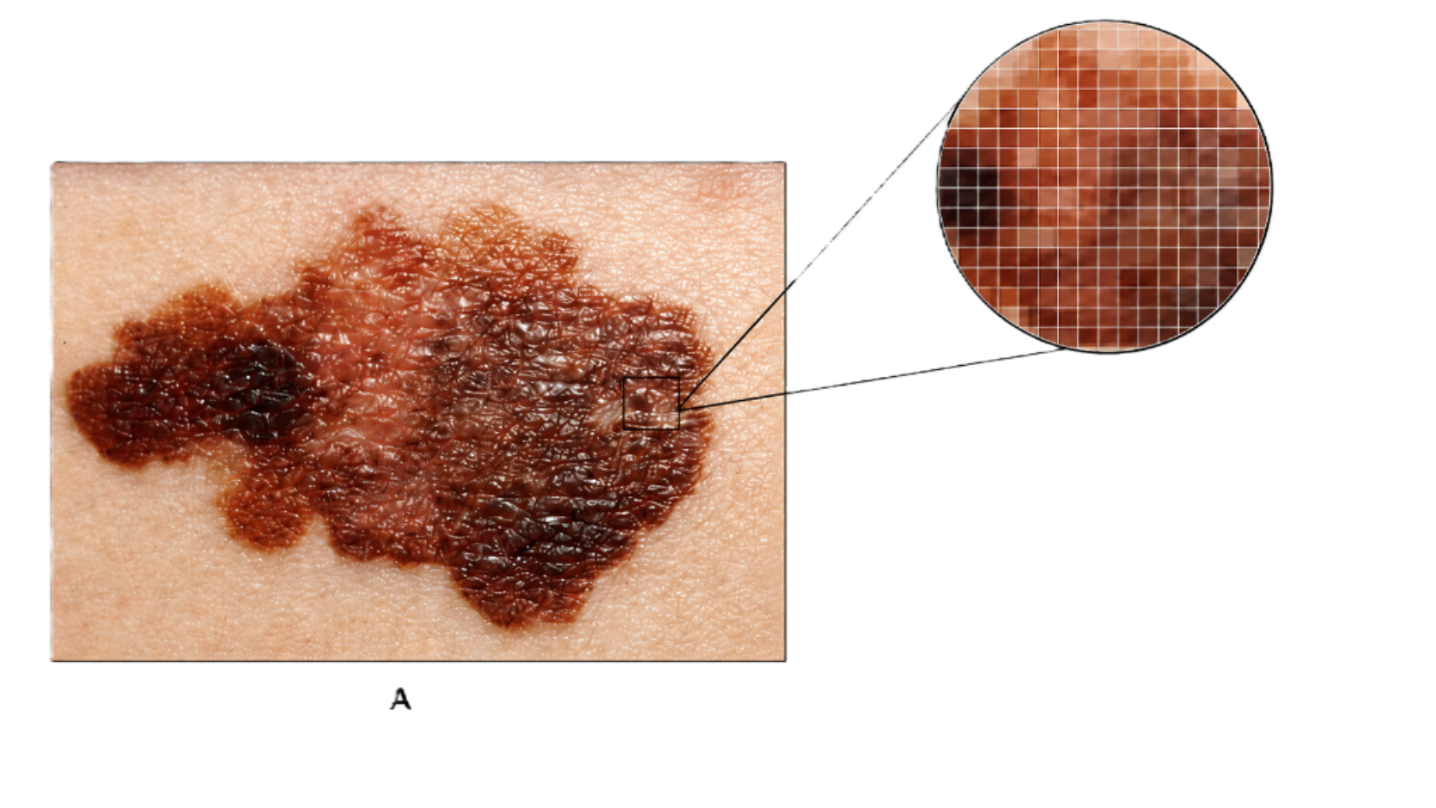
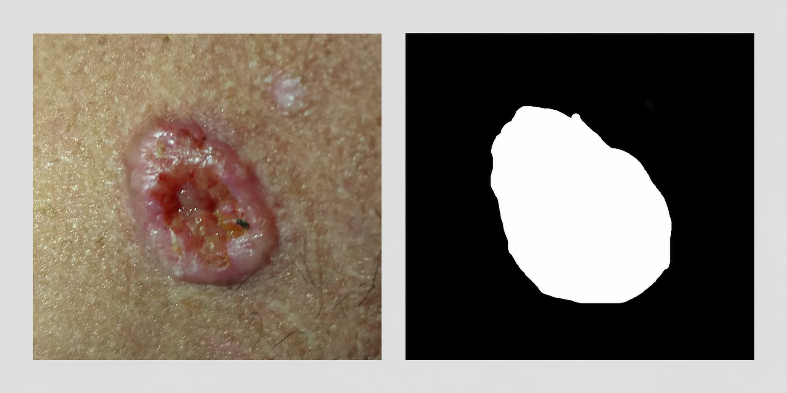
FEATURE EXTRACTION
What is feature extraction?
A lesion PNG and its mask are reduced to a row of interpretable values for the classifier model.
input
extract
output
Asymmetry
Border
…
img_id
A
B
C
→
→
→
...
0.31
0.62
18 stats
one row per usable image
Feature extraction is the process of having a raw image as input and saving decimal values to put into the classifier model.

Slide 4
BASELINE PIPELINE
The baseline model: Trivial ABC features.
Dermatology standard of diagnosis
A
Asymmetry
B
Border
C
Colour
midpoint crop
mirror XOR
6 rotations
erode mask
estimate perimeter
Polsby-Popper
HSV pixels
mean/std/skew
5p/50p/95p
→
→
→
baseline
feature table
binary
classifier
patient
img
A
B
hue_mean
sat_std
→
→
P...
IMG...
0.31
0.62
0.11
0.08
cancer vs non-cancer

Slide 5

FEATURE A
Asymmetry is the average mirror disagreement across six rotations.
binary mask
area midpoint
crop + mirror
XOR difference
rotate 30°
repeat × 6
→
→
→
→
left
flip
different
pixels
0°...180°
half area
score = average( XOR(crop, mirror(crop)) / (2 × lesion area))
higher score means less symmetric

Slide 6
COMBINED ANNOTATIONS
Combined votes are averaged before shortcut application
Shared rule
at least 4 valid votes before trusting an annotation
data/annotations_combined.csv: 1,637 annotated images, with five hair votes and five pen votes per image.
HAIR
PEN
Average five hair votes, then map score to application category.
Average five pen votes, then map score to present or absent.
hair_1
...
hair_5
count valid
votes
trust if
≥4
pen_1
...
pen_5
count valid
votes
trust if
≥4
→
→
→
→
<4 valid votes → auto / not trusted
average valid
hair votes
<4 valid votes → auto / not trusted
average valid
pen votes
score ≤ 0.5
skip
score < 0.5
absent
0.5 < score ≤ 1.25
moderate
score ≥ 0.5
present
score > 1.25
heavy
Source: data/annotations_combined.csv and src/shortcuts.py

Slide 7
01
Dataset
02
Feature
extraction
03
Open
question
04
Train/test
split
05
Model
process
06
Results
→
→
→
→
→

Slide 8
OPEN QUESTION
Adding RGB plus greyscale on top of HSV
The extra extraction tested whether raw channel intensity or brightness added information beyond HSV.
saved validation accuracy
Base HSV
? %
feature expansion
add RGB:
red / green / blue
mean, std, skew,
5p, 50p, 95p
Grey
? %
baseline colour
HSV stats
→
? %
model variants
compare colour sets
RGB
→
RGB + Grey
? %
add greyscale:
0.2989R + 0.5870G
+ 0.1140B
Extended HSV
? %
HSV + Grey
? %
All Colour
? %
Best performer: To be continued…

