Slide 1
Computer Vision for Thermo Fisher Scientific Manufacturing
Dale DeFord
Aug. 2024

Slide 2
Agenda
01
02
03
04
05
06
Business Problem
Exploratory Data Analysis
Predictive Modeling
Conclusions
Recommendation
Next Steps

Slide 3
Business Problem
01
Thermo Fisher Scientific (TFS) in Hillsboro, OR manufactures Scanning Electron Microscopes (SEM). In production, Liquid Metal Ion Source (LMIS) units are imaged at a SEM and human inspected for quality issues. This process is costly and can be problematic due to varying human biases.
Goal:
Create an automated Computer Vision process that will accurately classify LMIS SEM images, thus reducing cost incurred in man-hours and quality problems due to varying human inspection biases.

Slide 4
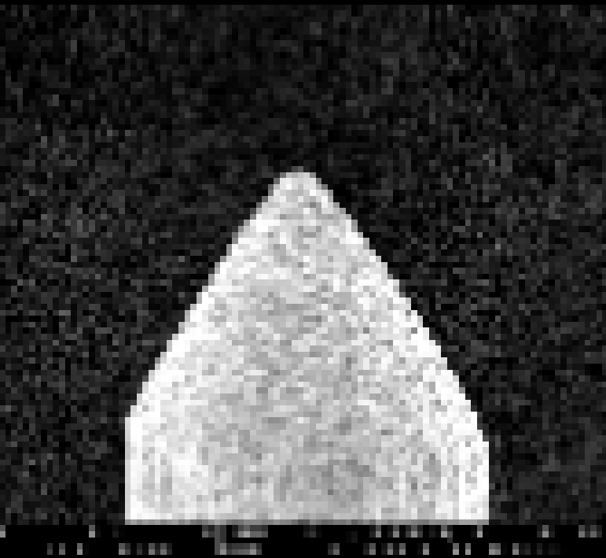
Data Analysis
02
LMIS SEM images were downloaded from TFS under Non-Disclosure Agreement (NDA).
7,019 grayscale SEM image files
Images pre-labeled and sorted into 5 class folders
Details will be omitted or intentionally vague due to NDA
NOTE: SEM images have been intentionally scaled down to protect intellectual property

Slide 5
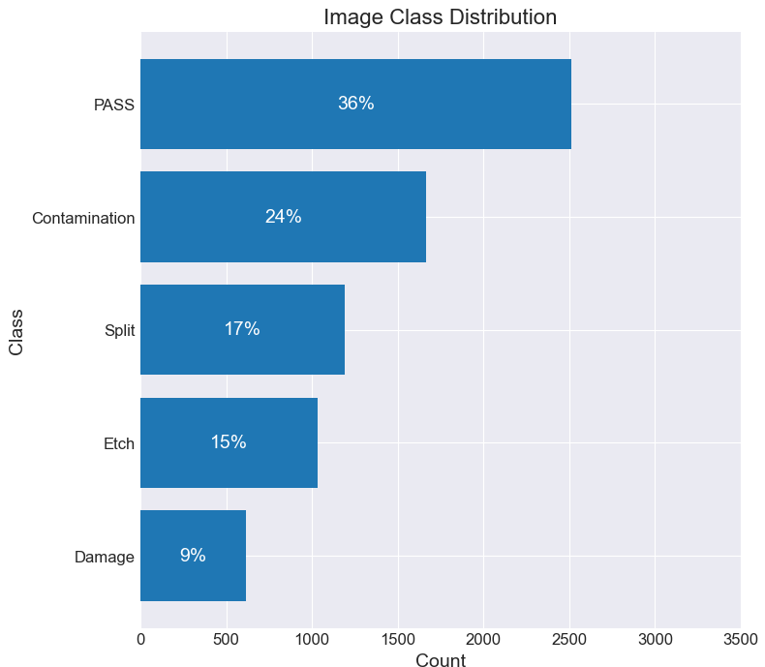
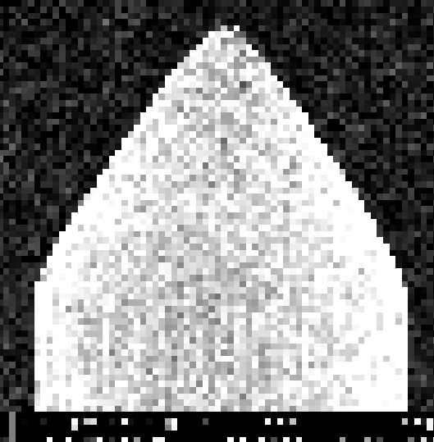
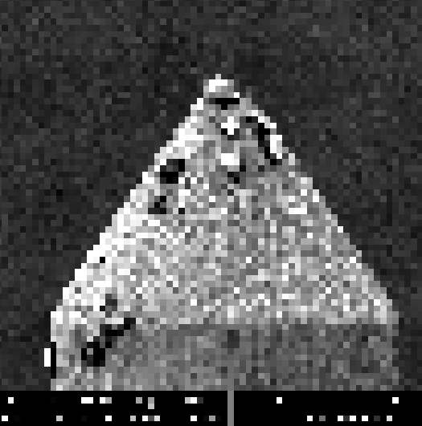
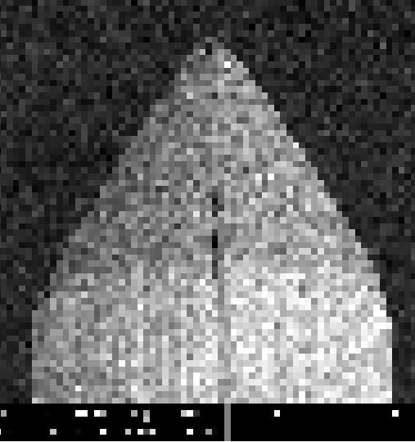
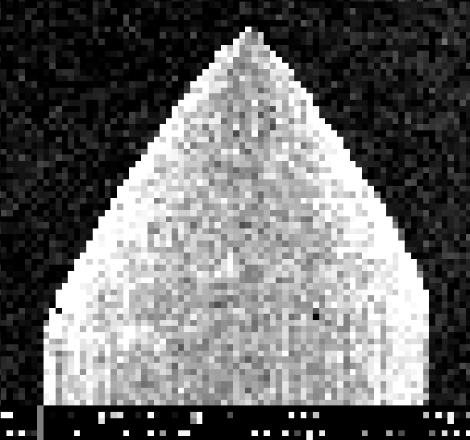
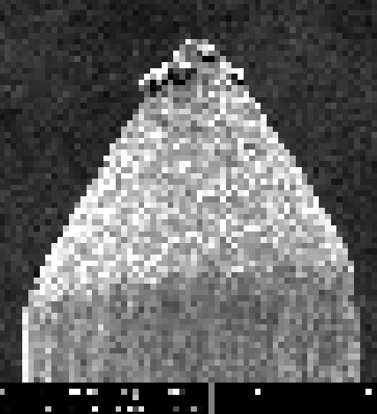
Image Data Class Distribution

Slide 6
Predictive Modeling
03
BUSINESS REQUIREMENT:
Scoring Metric: Accuracy
Minimization of false-positives in the PASS class:
Top priority: avoid shipping non-PASS class units to the customer.
False-Positive rate within PASS class must be < 2%

Slide 7
Baseline – Convolutional Neural Network
Feature Extraction Architecture:
Feature Maps 4
Feature Maps 3
Base Image
Augmented Image
Feature Maps 1
Feature Maps 2
SCALE +
AUGMENT
CONV 3x3
MAXPOOL
CONV 3x3
MAXPOOL
CONV 3x3
MAXPOOL
CONV 3x3
MAXPOOL
32
64
128
256
Input Layer
(relu)
Hidden Layer 1
(relu)
Output Layer (softmax)
1
1
1
Classification Architecture:
2
2
2
MULTICLASS CLASSIFICATION
MAXPOOL +
FLATTEN
…
…
…
512
512
4

Slide 8
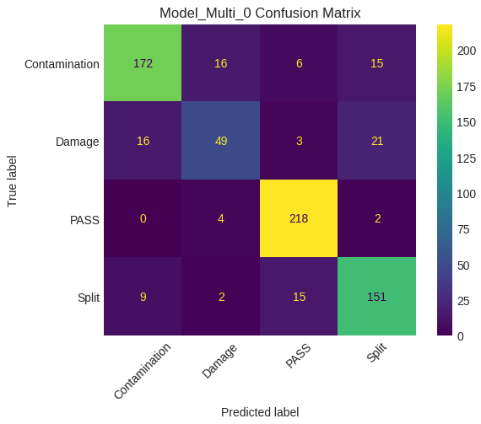
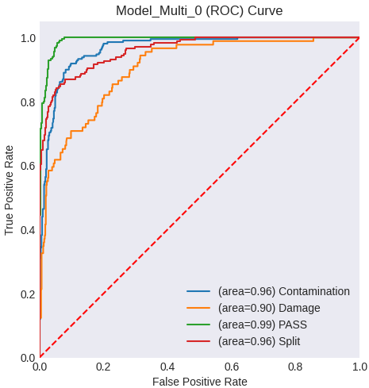
Baseline Model – Convolutional NN
=======================
Training Accuracy: 1.000
Validation Accuracy: 0.845
Test Accuracy: 0.844
=======================
Results:

Slide 9
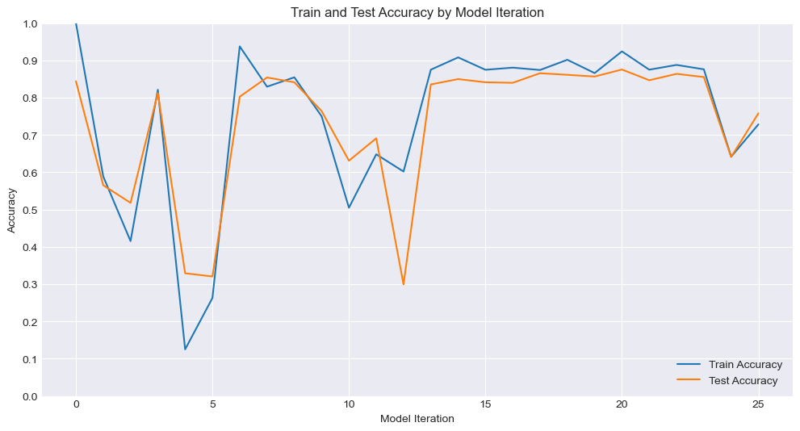
Model Iteration Trend
Best PASS FPR
Etch Class Added
Fixed Colab batching Issue
Experimenting with 6 CONV
Experimenting BatchNorm
Experimenting mini AlexNet, ResNet50

Slide 10
Conclusion
04
Final Model Test Metrics:
Precision: 97.7%
Accuracy: 97.8%
Final Business Metrics:
False Pos Rate (HAM going to SPAM): 0.9%
False Neg Rate (SPAM going to HAM): 6%

Slide 11
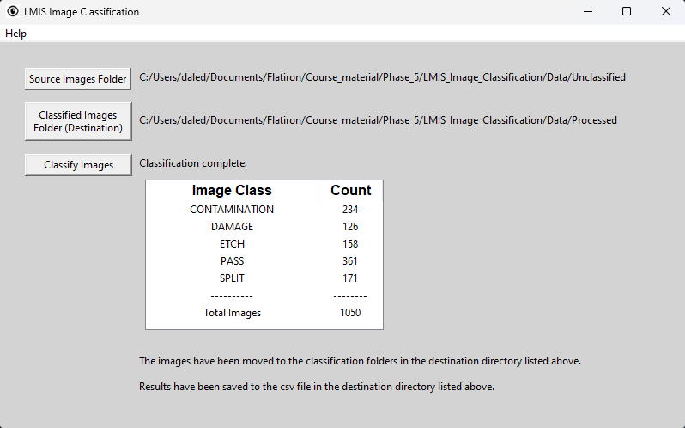
Recommendation
05
Initiate a production pilot of provided LMIS Image Classification executable and assess its performance vs. human inspection
Runs the best model, sorts images into class folders for human review
Logs classification results to .cvs file

Slide 12
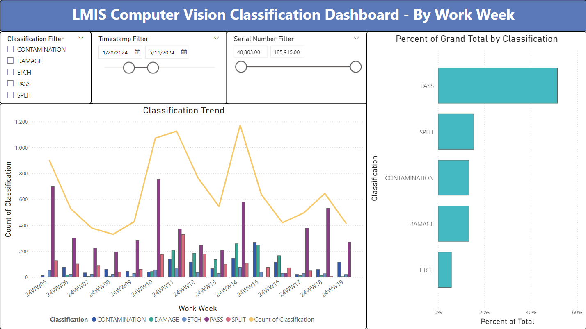
Recommendation
Monitor script classification results via provided Power BI dashboard
Pulls production data from the csv log file
Real-time monitor of classification trends and distributions
Filter by class, date or unit serial number
NOTE: Fictitious data shown, not actual TFS production data

Slide 13
Recommendation
Recommended pilot evaluation plan:
Human review every image for 1 month. After 1 month:
If PASS class false-positive rate <2%, discontinue human evaluation of PASS class images as process of record.
Continue long-term human review of all non-PASS images as process of record until model can be improved.

Slide 14
Next Steps
06
Continue to improve the model
…
…

Slide 15


Thanks!
Questions? Please contact me at:
Dale DeFord
daledeford@gmail.com

