Slide 1


Information retrieval document system
Deepthi Manam
(NU ID: 001743609)
Info-6205(Program Structure and Algorithms)

Slide 2
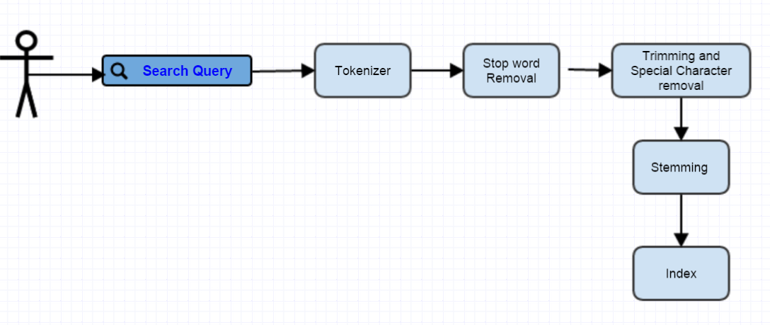
Creating the Search Query Index

Slide 3
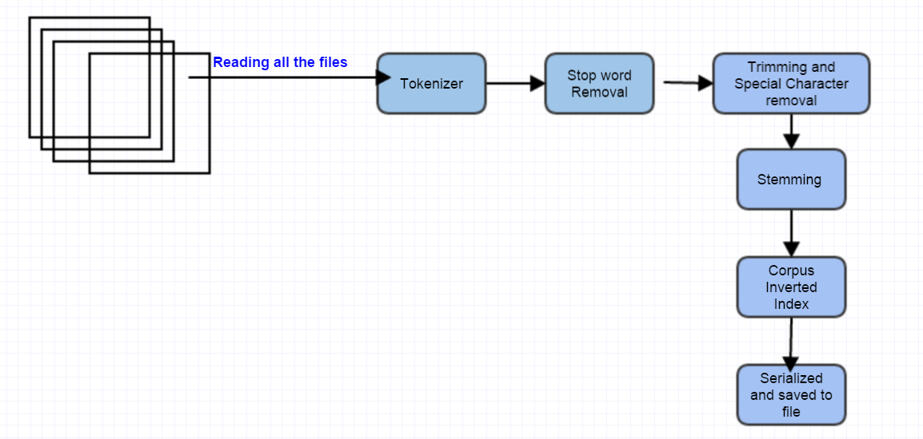
Creating the Corpus Index

Slide 4
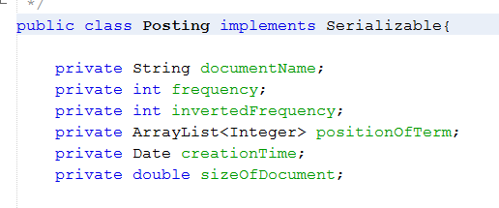
Structure of Corpus Index
HashMap<String, HashMap<String, Posting>> corpusInvertedFreqMap;
The key is the word or term.
The value is the HashMap with key as Document Name and value as Posting of the term in document.
Where the Posting class contains the information about the frequency, inverted frequency, position of the terms, size of the document..etc

Slide 5
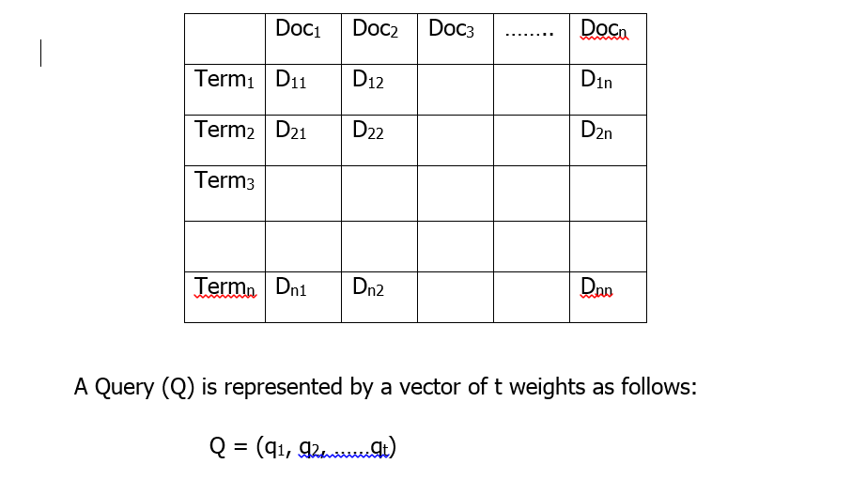
Vector Space Model
In this model, documents and queries are assumed to be part of a t-dimensional vector space.
A document collection containing n documents can be represented as a matrix of term weights, where each row represents a term and each column represents a document, where dij represents the weight of the i^{th} term in j^{th} document.

Slide 6
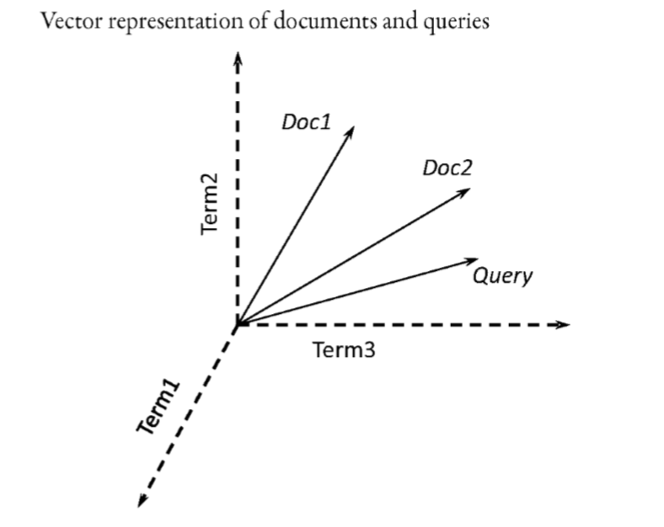
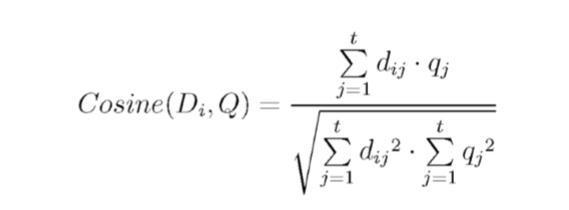
Vector Space Model
The cosine correlation measures the cosine of the angle between the query and the document vectors.

Slide 7
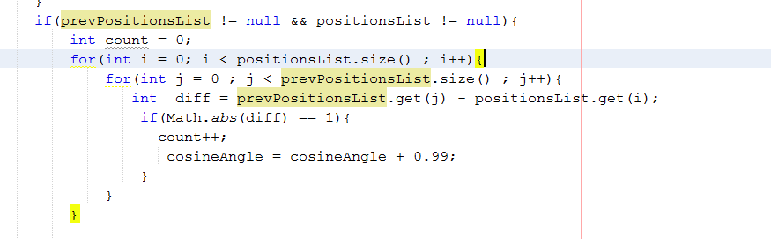
Retrieval of Phrase Queries
The positions of the term in a document is stored as list in Posting, which helps in finding the phrases in the documents.
If the absolute difference between the position of terms in posting is 1, then the terms are consequent

Slide 8
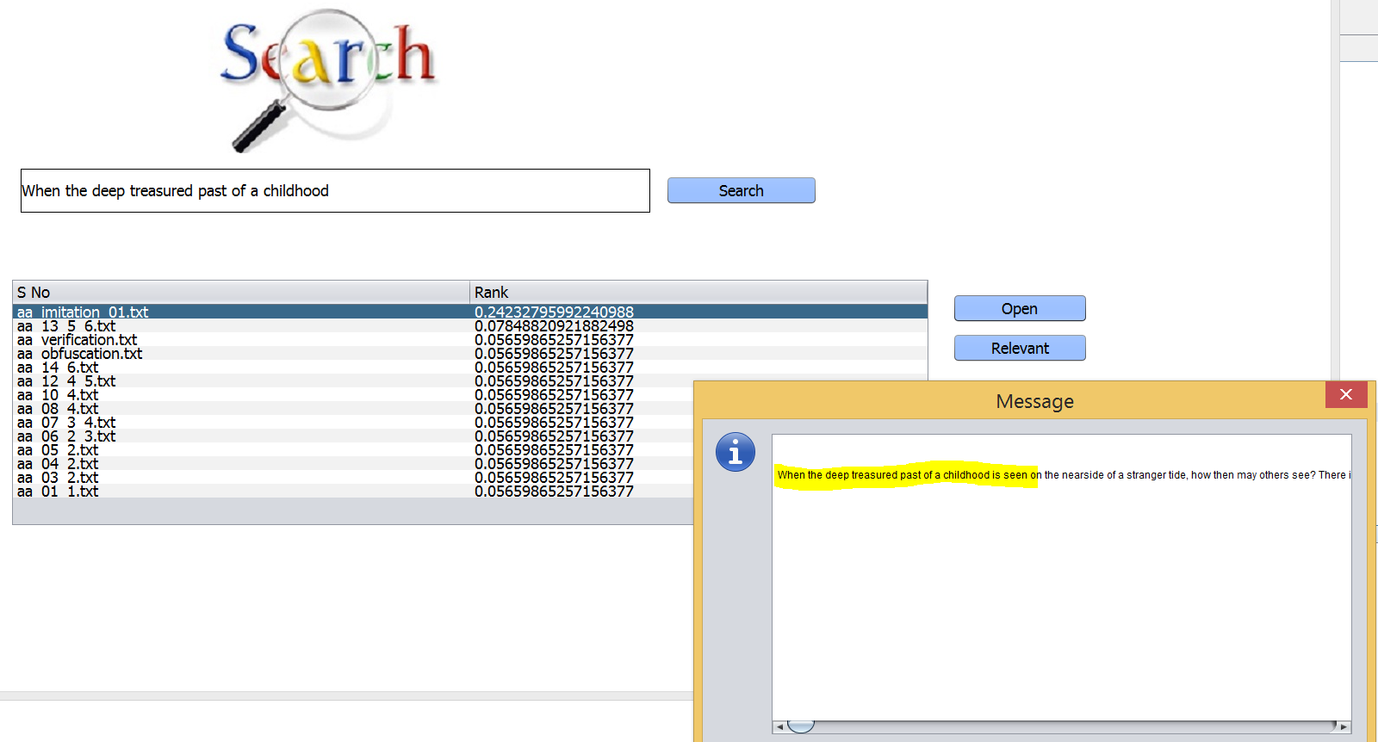

Slide 9
Incorporating Relevant Feedback
When the user selects a document as relevant to the search, the priority of the document is increased.
The priority feedback of the document is used in the calculation of future weight/rank of the document.
The ranks are again normalized to the scale of cosine.

Slide 10
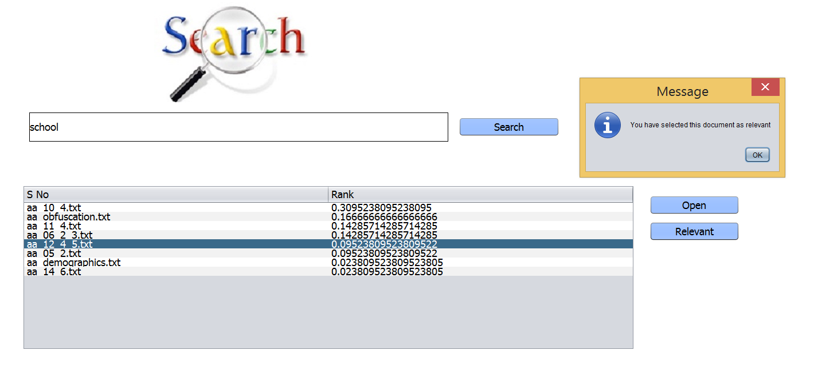
User selecting a document as relevant to the search

Slide 11
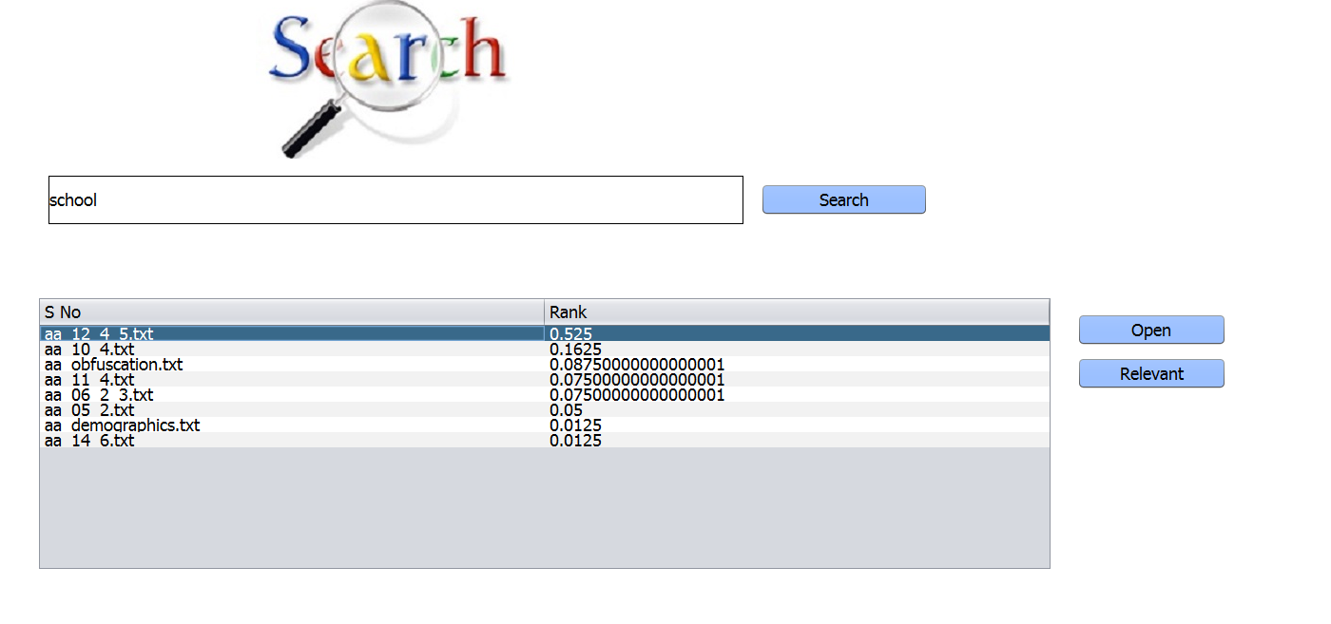
The feedback helps in increasing the weight of the document and thus it is normalized again to the range of 0 to 1. .

Slide 12
References:
1)Search Engine Information Retrieval in practice
W.BruceCroft ,Donald Metzler, Trevor Strohman
2)An Introduction to Information Retrieval
By: Christopher D. Manning, Prabhakar Raghavan, Hinrich Schütze

