Slide 1

Healthcare : Communication gateway for Patient-Centered Care
Deepthi Manam
NEU ID: 001743609
Web Tools and Development

Slide 2
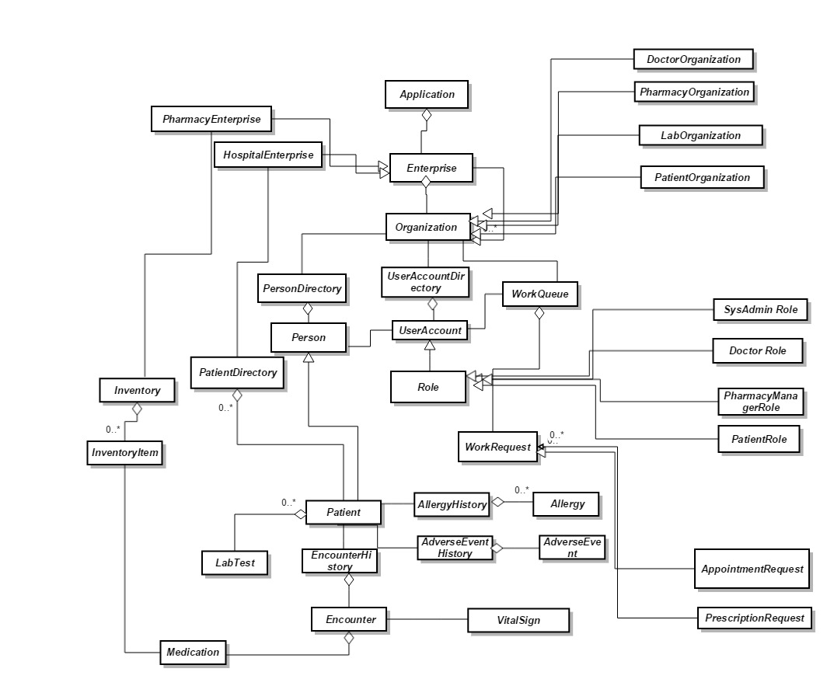
OBJECT MODEL

Slide 3
Technical Specifications:
Spring Web Flow
Jackson API
Java Mail
iText API
Commons upload
Commons io
Google Translator
Spring Framework
JSTL
Hibernate
Velocity
Free Marker
Ajax
JQuery
MySQL

Slide 4
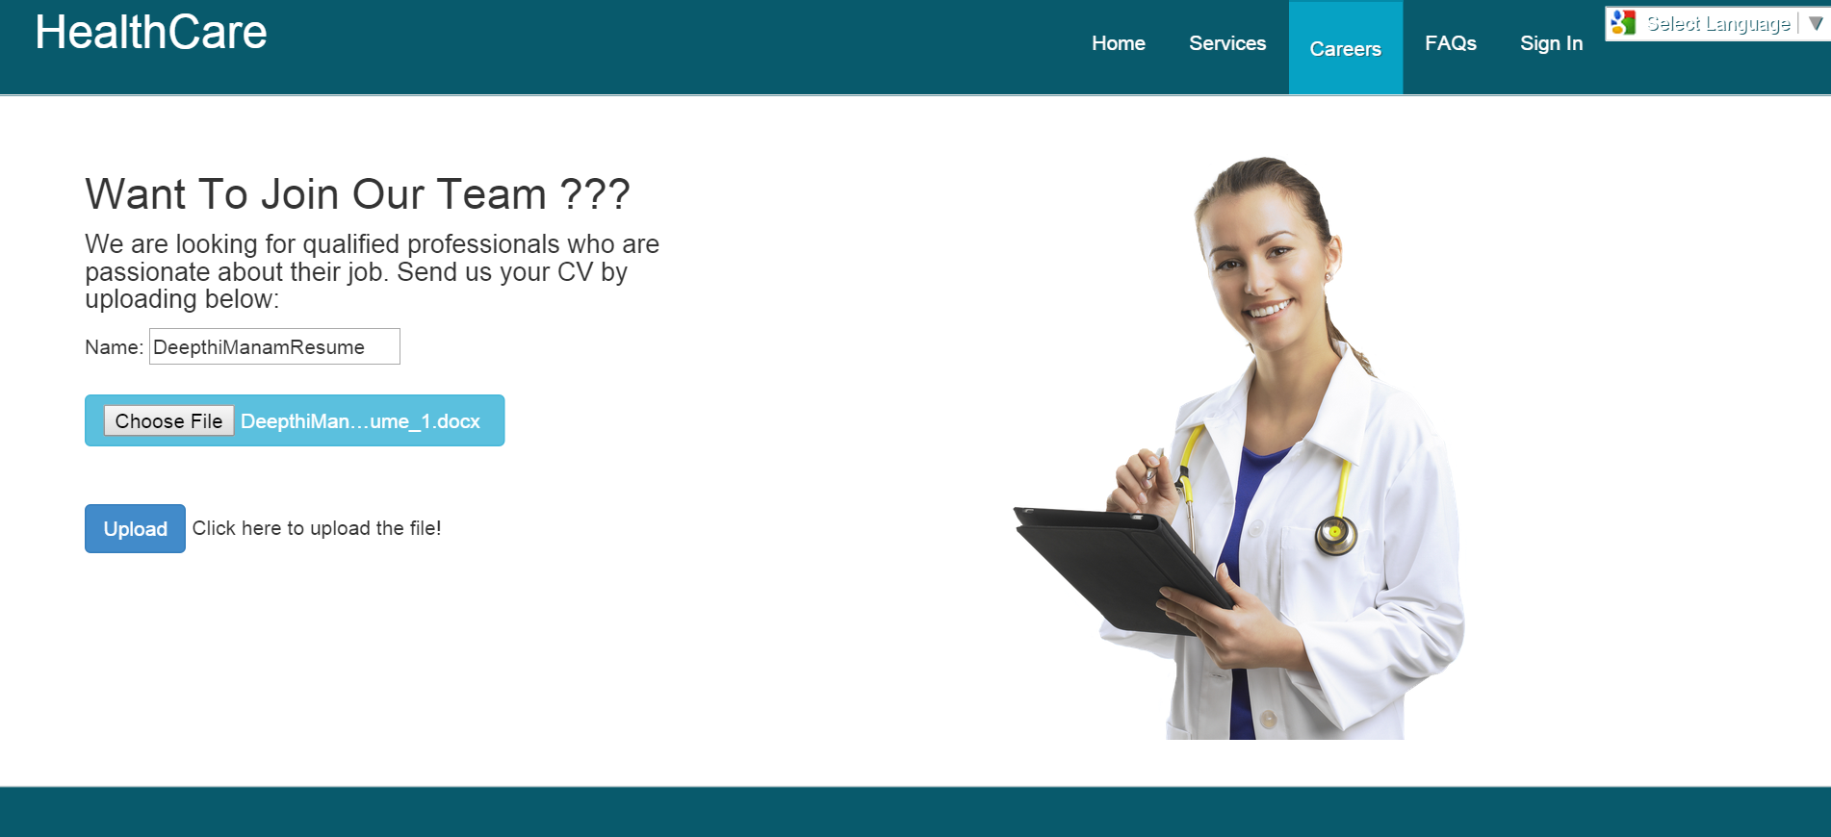

Slide 5
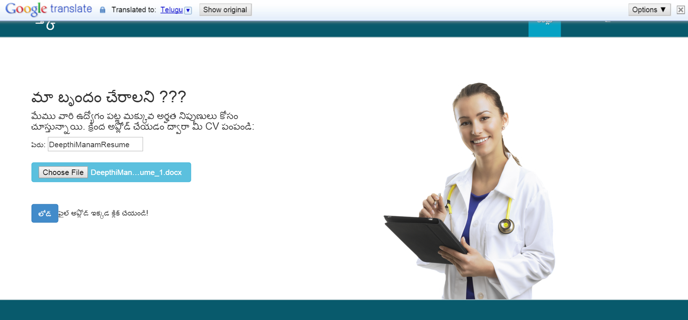

Slide 6
System Administrator Responsibilities
Responsible for adding enterprises into the system.
Responsible for adding employees into the system.
Responsible for downloading the resumes uploaded in the career section .

Slide 7
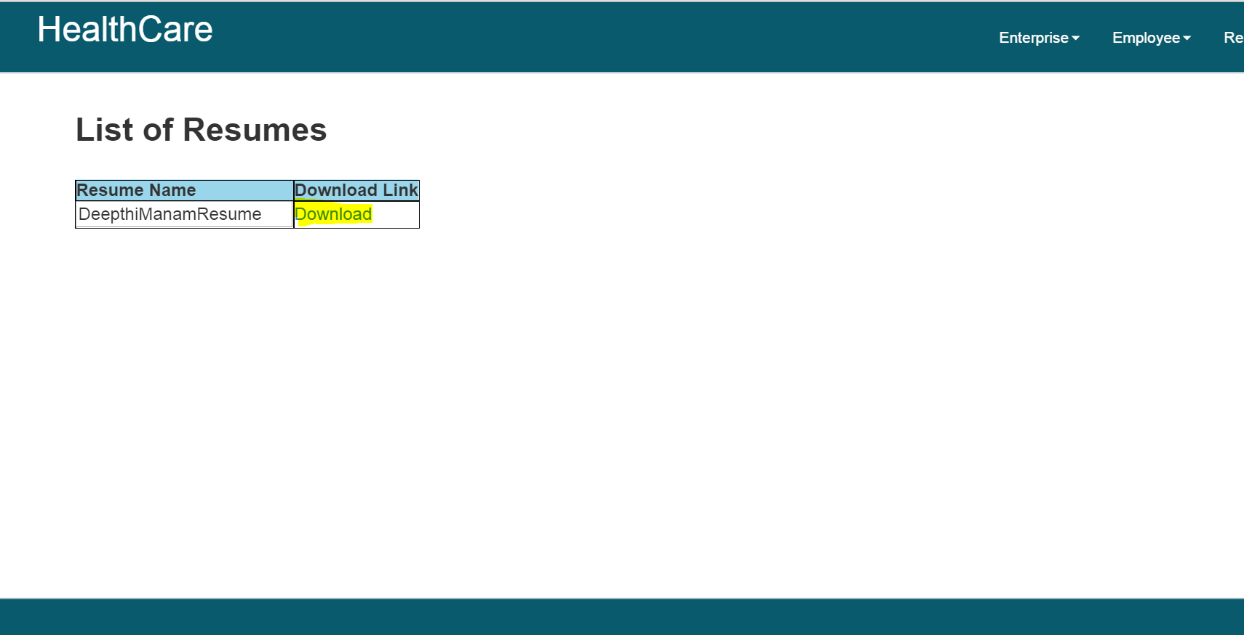

Slide 8
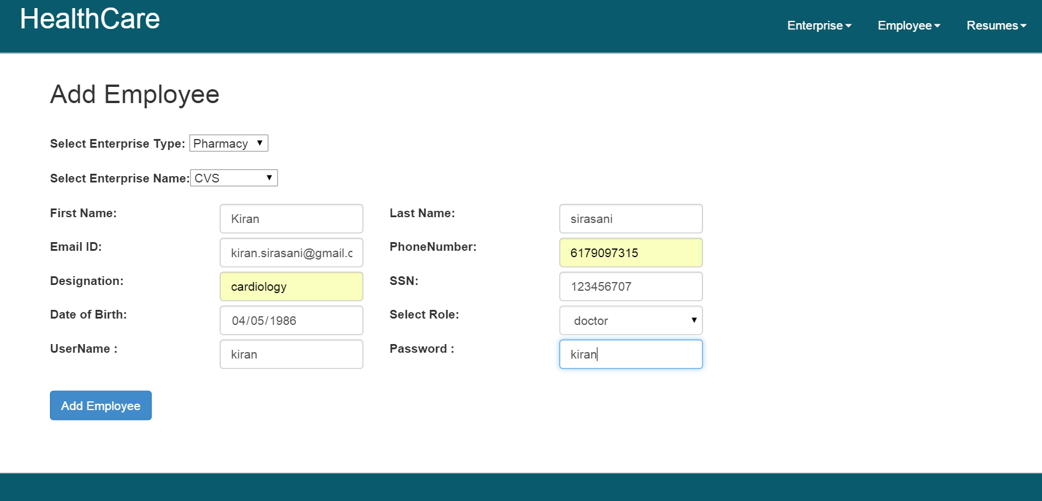

Slide 9
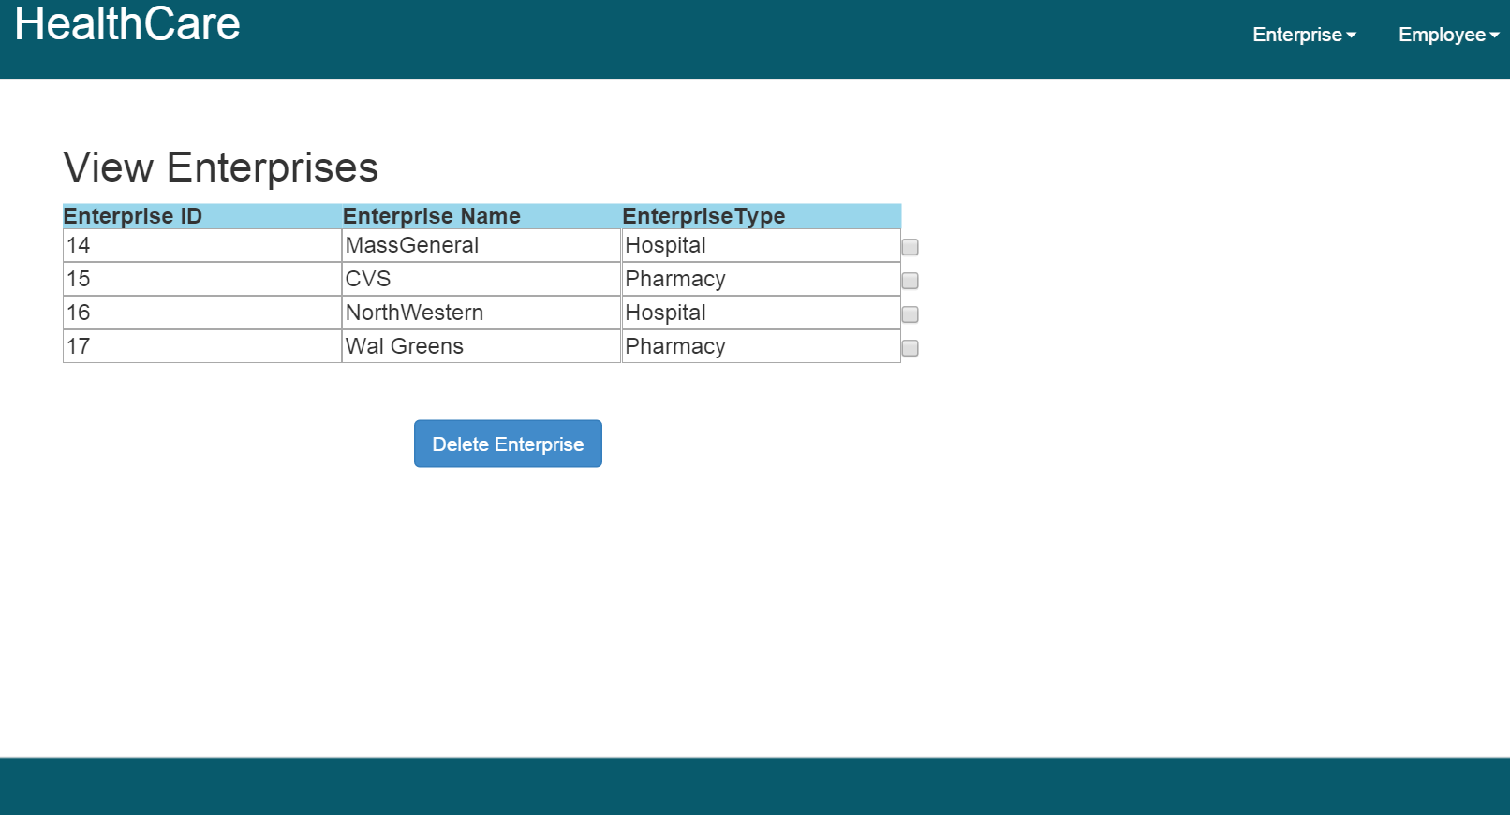

Slide 10
Doctor Responsibilities
Responsible for creating the patient profile in the hospital.
Searches for the patient information like vital signs, lab tests and encounter history.
Creates an encounter for the patient.
Messages the patient in case of any concerns.

Slide 11
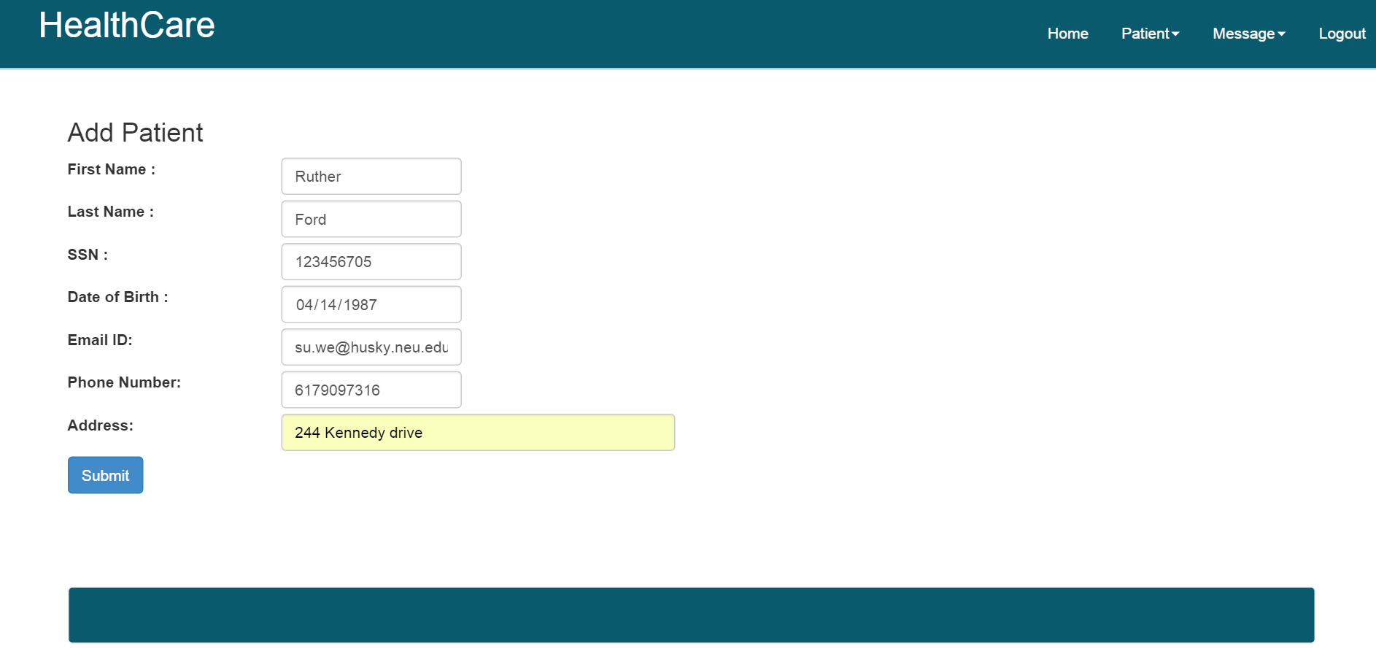

Slide 12
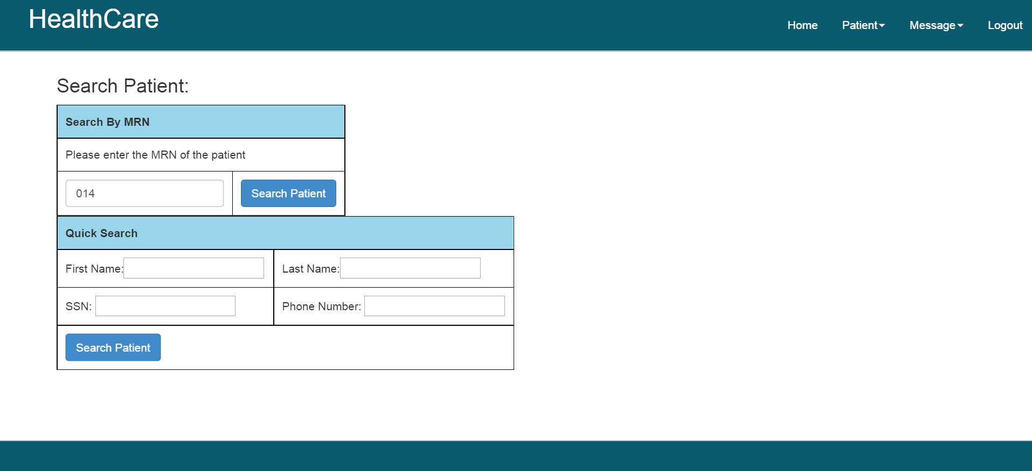

Slide 13
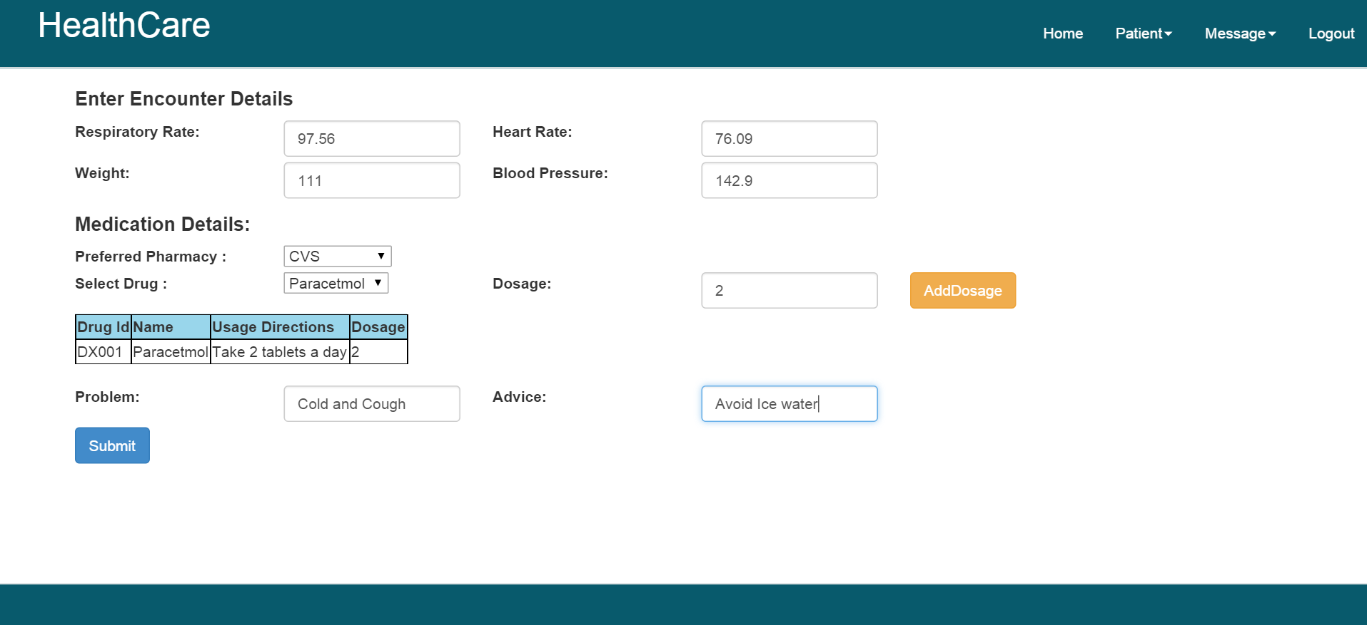

Slide 14
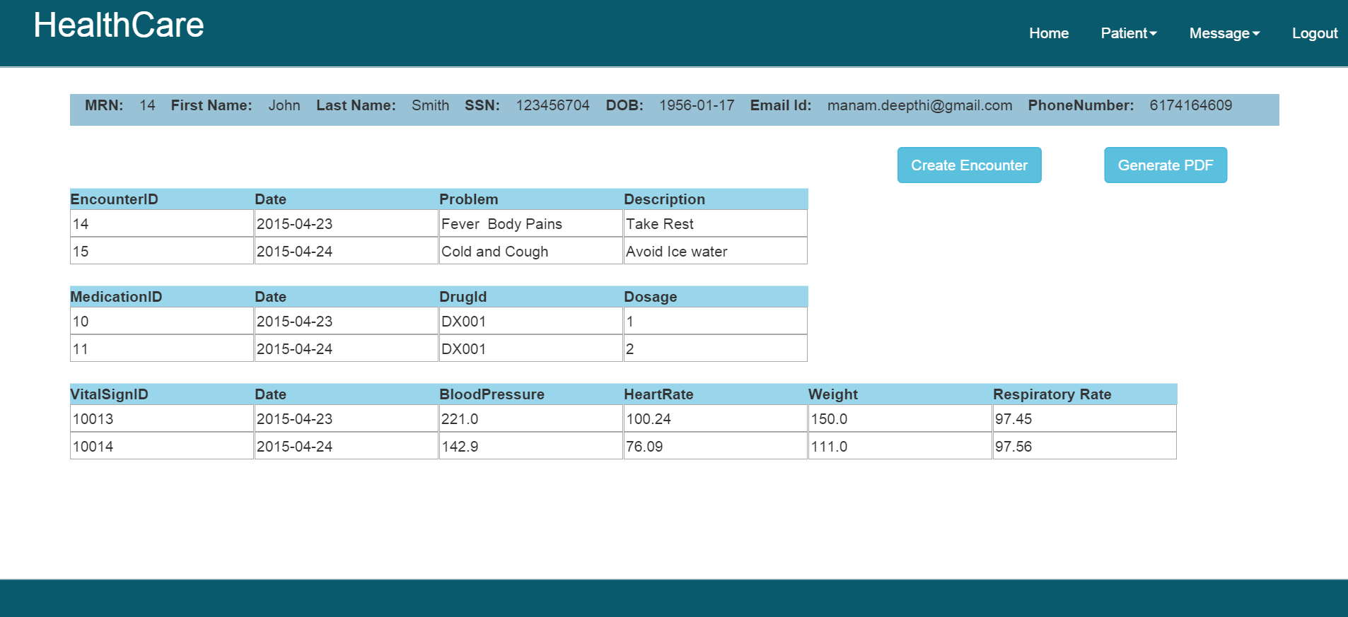

Slide 15
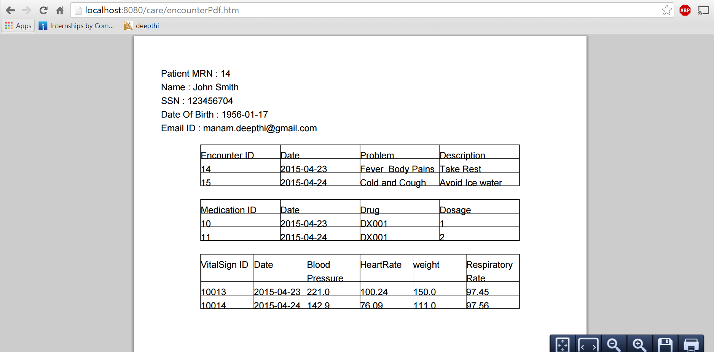

Slide 16
Patient Responsibilities
Registers to the health care services using the MRN number given by primary doctor.
Views the complete health information such as vital signs, lab tests , medication history etc.
Messages the Doctor for any queries or information.

Slide 17
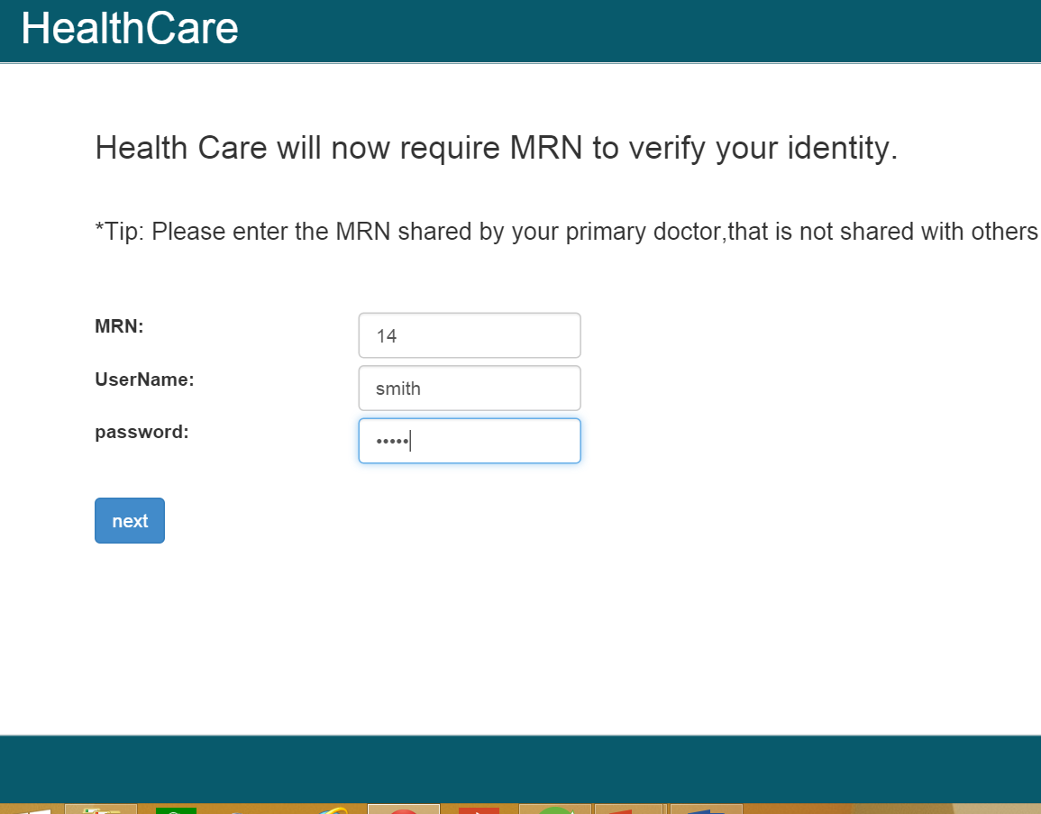

Slide 18
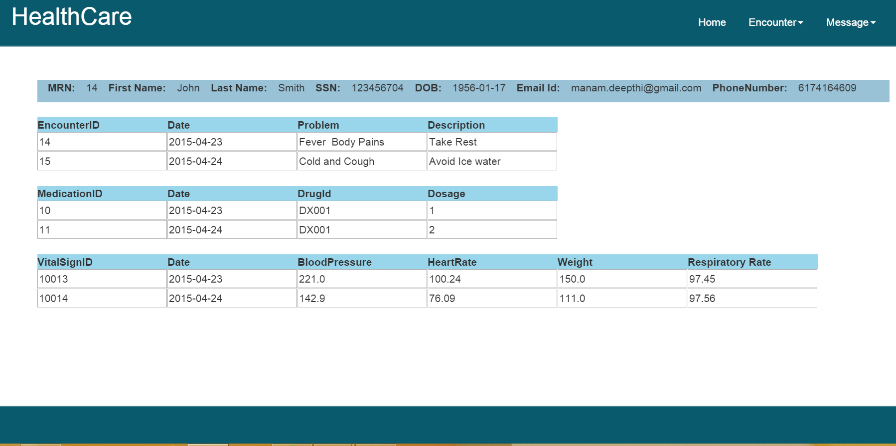

Slide 19
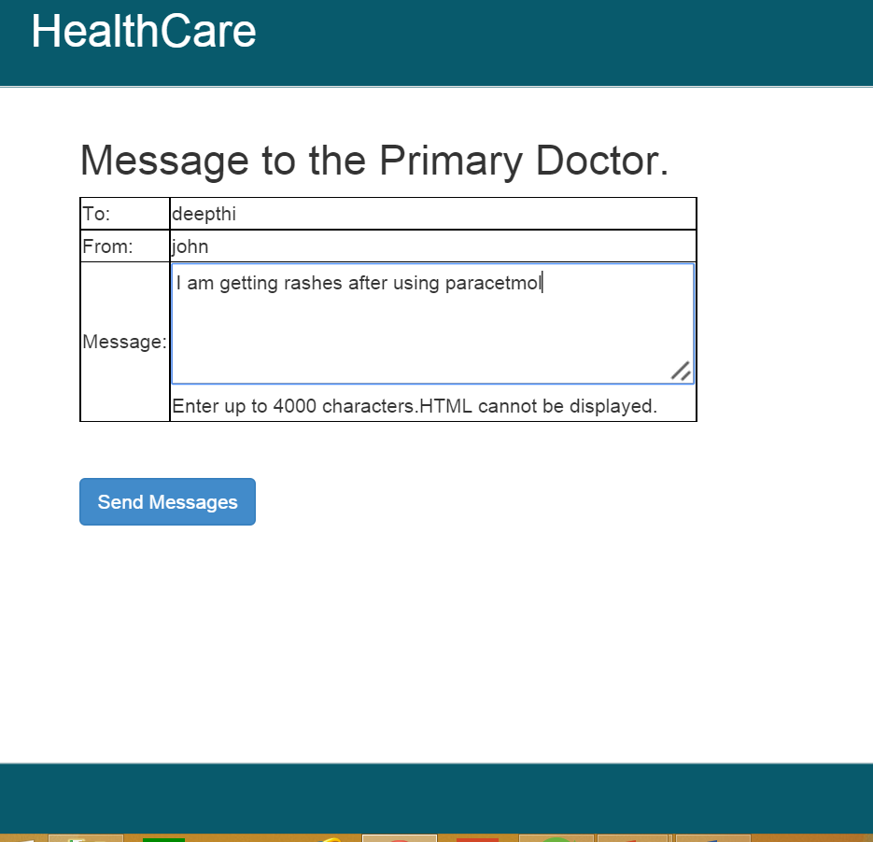

Slide 20
Patient Responsibilities
Responsible for processing the prescriptions sent by doctor.
Views the medication details of the patient and deliver them to patients.

Slide 21
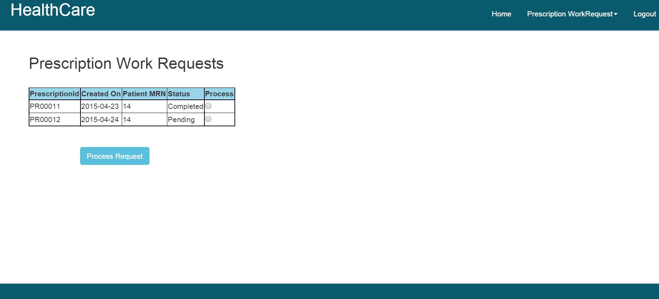

Slide 22
