Slide 1
Un algoritmo predictivo de stem loops en ARNm con secuencias específicas
David A. Mancilla

Slide 2
Introducción
Primero cargamos y limpiamos los resultados obtenidos con LASLO para listado de genes unidos a Smaug en D. melanogaster,y con secuencias random:
# Carga de archivos df <- loadFiles(path="../data/fruitfly_bound/", pattern = "*.csv") # Eliminar variables innecesarias df <- formatEnsembl(df)

Slide 3
Sumario de columnas
Estadística descriptiva
summary(subset(df, select = -c(GenID, TranscriptoID, GenSymbol, SequenceLength, Loop)))
## Chromosome LoopPattern TerminalPair N.2 N.1 N2 ## 2L:453 CNGG :960 AU: 538 A: 643 A: 538 A:1318 ## 2R:577 CNGGN :892 CG: 945 C: 903 C: 945 C: 792 ## 3L:716 CNGGNN :707 GC:1083 G:1144 G:1257 G: 364 ## 3R:870 CNGGNNN :346 GU: 174 U: 883 U: 833 U:1099 ## 4 : 11 CNGGNNNN :415 UA: 554 ## X :946 CNGGNNNNN :153 UG: 279 ## CNGGNNNNNN:100 ## N5 N6 N7 N8 Pairments WooblePairs ## : 960 :1852 :2559 :2905 Min. : 4.000 Min. :0.000 ## A:1076 A: 601 A: 416 A: 296 1st Qu.: 7.000 1st Qu.:0.000 ## C: 722 C: 526 C: 252 C: 135 Median : 8.000 Median :1.000 ## G: 283 G: 190 G: 109 G: 41 Mean : 8.132 Mean :1.173 ## U: 532 U: 404 U: 237 U: 196 3rd Qu.:10.000 3rd Qu.:2.000 ## Max. :14.000 Max. :6.000 ## ## Bulges InternalLoops A_PercentSequence C_PercentSequence ## Min. :0.0000 Min. :0.0000 (0,0.25] : 883 (0,0.25] :1370 ## 1st Qu.:0.0000 1st Qu.:0.0000 (0.25,0.5]:2690 (0.25,0.5]:2203 ## Median :0.0000 Median :1.0000 (0.5,0.75]: 0 (0.5,0.75]: 0 ## Mean :0.7162 Mean :0.8825 (0.75,1] : 0 (0.75,1] : 0 ## 3rd Qu.:1.0000 3rd Qu.:1.0000 ## Max. :5.0000 Max. :4.0000 ## ## G_PercentSequence U_PercentSequence AU_PercentPairs CG_PercentPairs ## (0,0.25] :1510 (0,0.25] :3191 (0,0.25] :1131 (0,0.25] : 247 ## (0.25,0.5]:2063 (0.25,0.5]: 382 (0.25,0.5]:1894 (0.25,0.5]:1560 ## (0.5,0.75]: 0 (0.5,0.75]: 0 (0.5,0.75]: 378 (0.5,0.75]:1431 ## (0.75,1] : 0 (0.75,1] : 0 (0.75,1] : 18 (0.75,1] : 330 ## NA's : 152 NA's : 5 ## ## ## GU_PercentPairs PurinePercentStem RnaFoldMFE RelativePosition ## (0,0.25] :1931 (0,0.25] : 0 Min. :-18.900 (0,0.2] :671 ## (0.25,0.5]: 532 (0.25,0.5]:1277 1st Qu.: -7.500 (0.2,0.4]:855 ## (0.5,0.75]: 9 (0.5,0.75]:2293 Median : -5.100 (0.4,0.6]:737 ## (0.75,1] : 0 (0.75,1] : 3 Mean : -5.474 (0.6,0.8]:755 ## NA's :1101 3rd Qu.: -3.000 (0.8,1] :555 ## Max. : 0.000 ## ## Serie ## 0:2429 ## 1:1144 ## ## ## ## ##

Slide 4
Bases N
Graficamos la distribución de bases en las distintas posiciones N del stem loop:

Slide 5
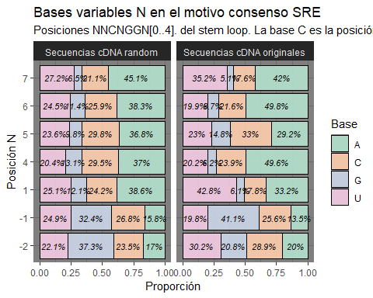

Slide 6
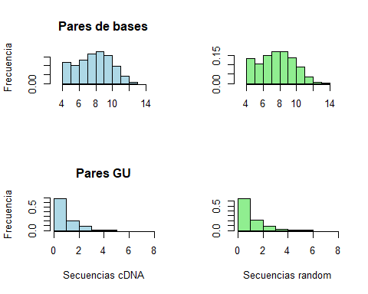
Medidas del stem

Slide 7
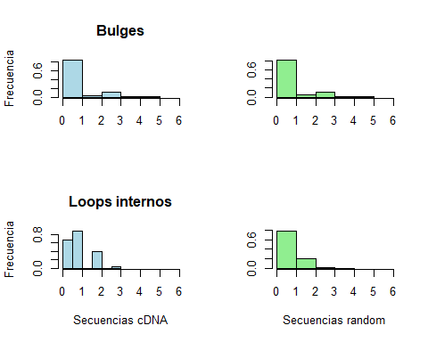

Slide 8
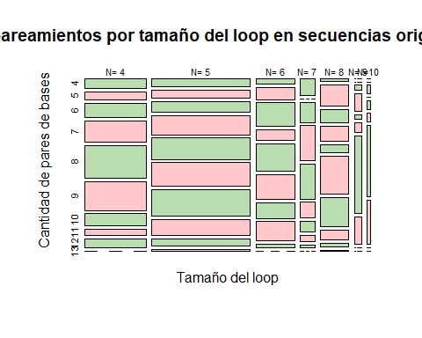
Comparación del tamaño del loop con la cantidad de pares

Slide 9
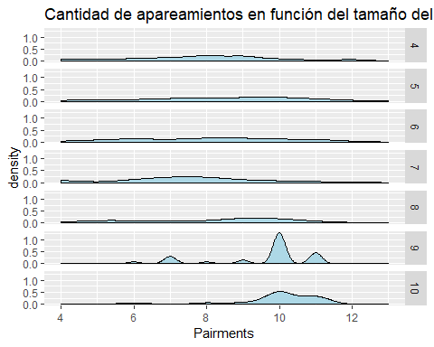
Otro gráfico…

Slide 10
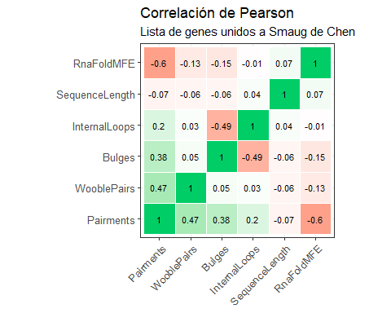
Correlación de Pearson

Slide 11
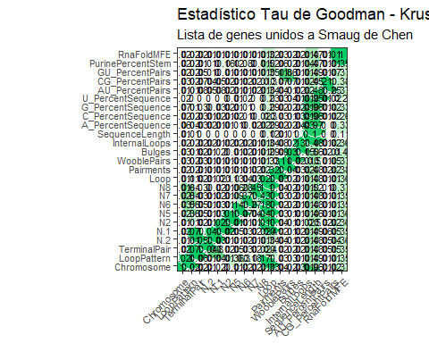
Medida Tau de Goodman-Krusk

