Slide 1
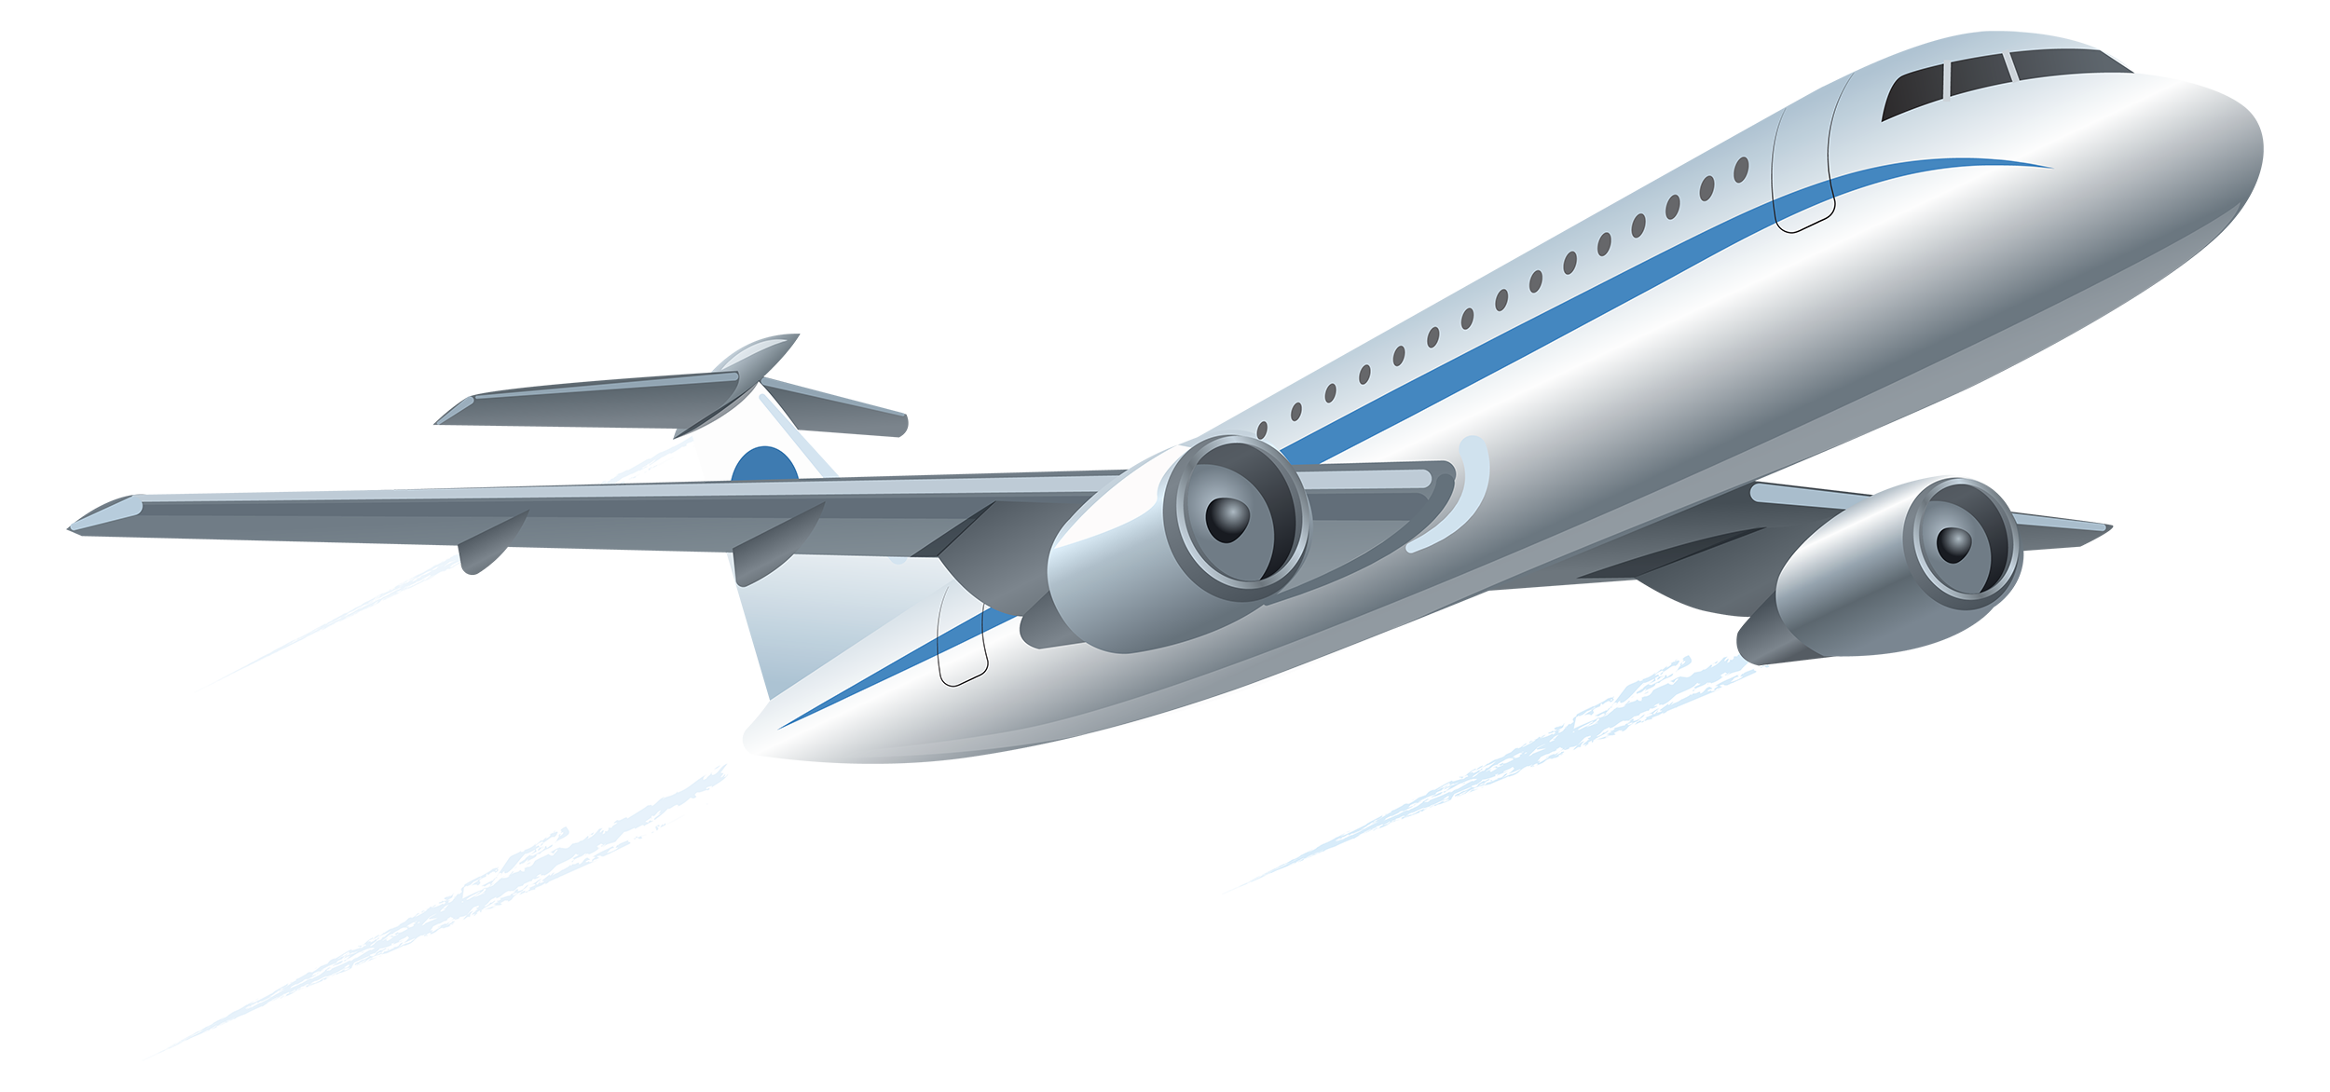
Aviation Trends
By
Manoj Danthuluru

Slide 2
Problem Statement
To identify Northwoods Airline biggest competitors using the dataset provided. The dataset contains information about the Airline, Airport and Flight information which must be loaded into the cloud environment to further perform analysis.
Objective
The objective of this project is to create the necessary tables in snowflakes using tooling provided in Databricks or snowflakes.
To perform ETL using snowflake Connectors.
Loading the data from shared location and finally creating views and gathering the meaningful insights from the reports.

Slide 3
Loading the data from external source
Connection between databricks and snowflake
Write the data into snowflakes
Reading the data in the Tables into Dataframes
Creating Views in Snowflake
Executing Views in Databrick
Using the view tables in PowerBI for further analysis

Slide 4
Loading the data from external source
Connection between databricks and snowflake
Write the data into snowflakes
Reading the data in the Tables into Dataframes
Creating Views in Snowflake
Executing Views in Databrick
Using the view tables in PowerBI for further analysis

Slide 5
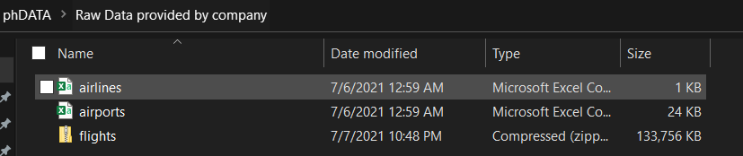
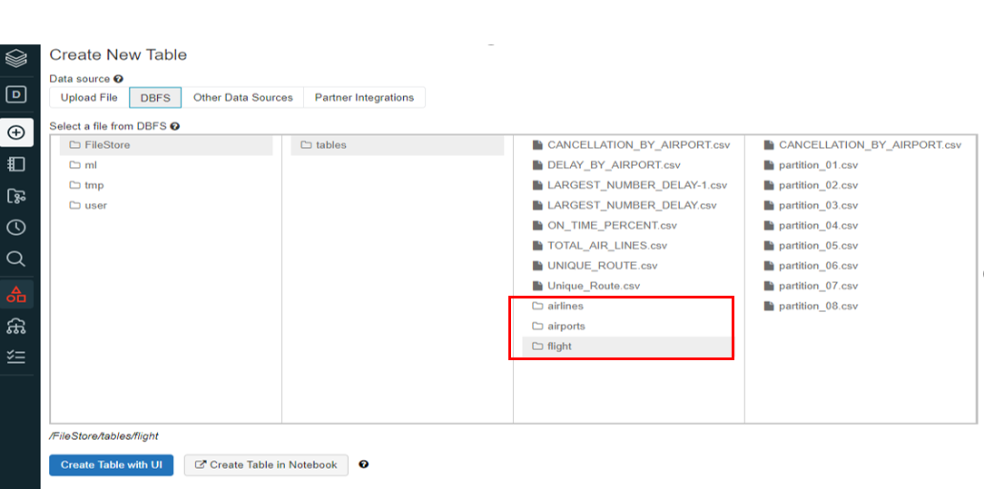
Loading data from external source

Slide 6
Loading the data from external source
Connection between databricks and snowflake
Write the data into snowflakes
Reading the data in the Tables into Dataframes
Creating Views in Snowflake
Executing Views in Databrick
Using the view tables in PowerBI for further analysis

Slide 7


Connection between databricks and snowflake
Connectors
val options = Map(
"sfUrl" -> "pq23550.us-east-2.aws.snowflakecomputing.com",
"sfUser" -> "manojd",
"sfPassword" -> "Dash@_007",
"sfDatabase" -> "AIR_TRAVEL",
"sfSchema" -> "PUBLIC",
"sfWarehouse" -> "NORTHWOODS_DWH_01"
)

Slide 8
Loading the data from external source
Connection between databricks and snowflake
Write the data into snowflakes
Reading the data in the Tables into Dataframes
Creating Views in Snowflake
Executing Views in Databrick
Using the view tables in PowerBI for further analysis

Slide 9
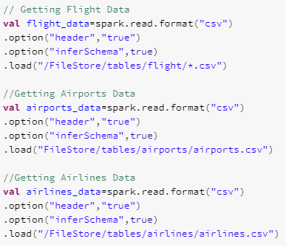
Reading the data in the Tables
Scala code in databricks for loading the data from tables.

Slide 10
Loading the data from external source
Connection between databricks and snowflake
Write the data into snowflakes
Reading the data in the Tables into Dataframes
Creating Views in Snowflake
Executing Views in Databrick
Using the view tables in PowerBI for further analysis

Slide 11
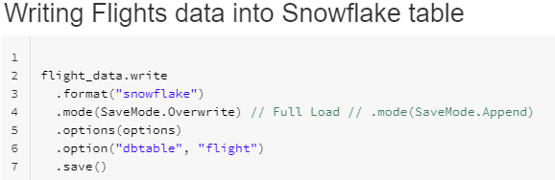
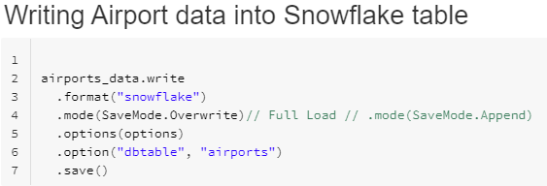

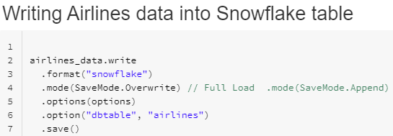
Write the data into snowflakes

Slide 12
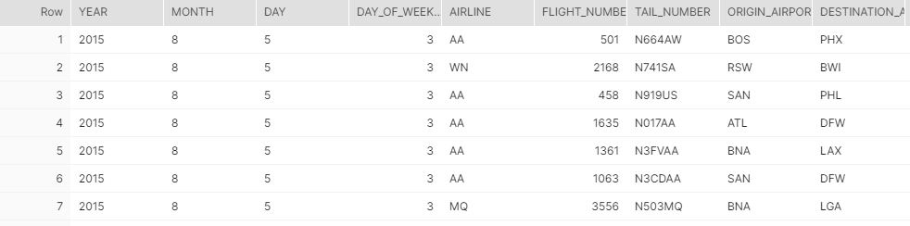
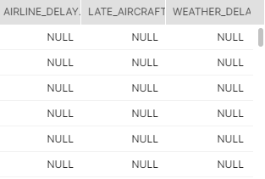
.....

Slide 13

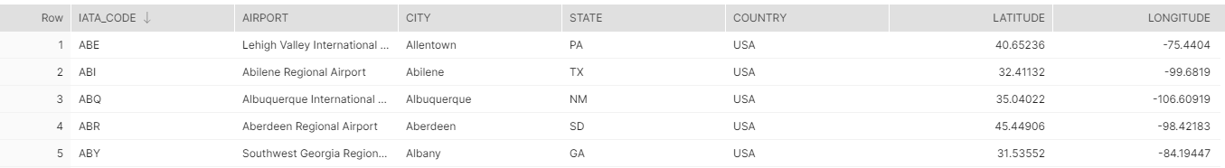

Slide 14
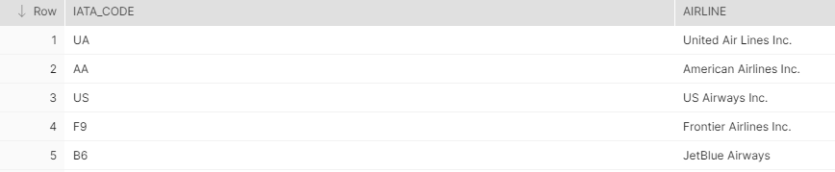

Slide 15
Loading the data from external source
Connection between databricks and snowflake
Write the data into snowflakes
Reading the data in the Tables into Dataframes
Creating Views in Snowflake
Executing Views in Databrick
Using the view tables in PowerBI for further analysis

Slide 16
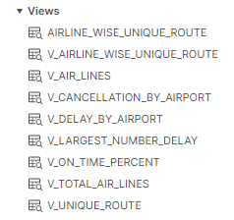
SQL for creating views in snowflake

Slide 17
Loading the data from external source
Connection between databricks and snowflake
Write the data into snowflakes
Reading the data in the Tables into Dataframes
Creating Views in Snowflake
c
Executing Views in Databrick
Using the view tables in PowerBI for further analysis

Slide 18
Loading the data from external source
Connection between databricks and snowflake
Write the data into snowflakes
Reading the data in the Tables into Dataframes
Creating Views in Snowflake
Executing Views in Databrick
c
Using the view tables in PowerBI for further analysis

Slide 19
Future Scope
WN and DL airlines are our biggest competitors and since airports like ATL and ORD have the largest total number of flights by airport we should consider those locations to be our target origin airports.
It is not just important to have highest number of flights, but we must also maintain the consistency in increasing the percentage of being on time and maintaining a smaller number of delays. This can be achieved by constantly analyzing these metrics and identifying where there is lag.
Weather plays a major role in the cancellation of Flights; it is seen that highest number of flights have been cancelled due to reason Weather(B) To avoid the inconvenience passengers should be informed earlier about the flight cancellation by looking at the weather forecast.
Delays caused by Airport was highest at ATL airport and 3rd highest at ORD airport. Majority of delays by airport were only caused by Air System of the Airports. We can overcome this by pushing the boarding time earlier so the flight can get ready for take off as per the estimated departure timing.
Flying flights in Unique routes can be tricky to gain profits, but we can over come this by choosing either the origin or the destination airports which are busiest among all to get more flyers.

Slide 20
Thank you

