Slide 1

DATA MINING AND ANALYSIS 17ECSC303 Course Project 2017-18 Title: WALMART STORES SALES FORCASTING
Earlier known as
B. V. B. College of Engineering & Technology
TEAM DEATAILS:
TEAM NO : 3A2
NAME | ROLL NO | USN
BHADRA K.SHAH | 39 | 01FE15BCS043
DEEPIKA BAGRECHA | 50 | 01FE15BCS054
DIVYANSH SRIVASTAVA | 52 | 01FE15BCS056
ELLURU PRUTHVI SAI | 53 | 01FE15BCS057

Slide 2
CONTENTS:
Problem statement 3
List of csv files 4
Description of the files 5-10
Biblography 11

Slide 3
PROBLEM STATEMENT
Predicting sales in stores during festive season (Super Bowl, Labour Day, Thanksgiving, Christmas) based on departments and Markdowns (1-5).
And, affect of unemployment rate on sales.

Slide 4
LIST OF CSV FILES
STORES
FEATURES
TRAIN
TEST
SIZE OF THE FILES : 15.8MB

Slide 5
DESCRIPTION OF FILES
CSV FILE | TOTAL ROWS | TOTAL COLUMNS | COLUMNS
STORES | 46 | 3 | Store, Type, Size
FEATURES | 8191 | 12 | Store, Date, Temperature, Fuel_Price, MarkDown1, MarkDown2, MarkDown3, MarkDown4, MarkDown5, CPI, Unemployment, IsHoliday

Slide 6
CSV FILE | TOTAL ROWS | TOTAL COLUMNS | COLUMNS
TEST | 115065 | 4 | Store, Dept, Date, IsHoliday
TRAIN | 421571 | 5 | Store, Dept, Date, Weekly_Sales, IsHoliday

Slide 7
DESCRIPTION OF STORES CSV FILE
Store : refers to the store number.
Type : which type of store does it belongs.
Size : it refers to area of the store.

Slide 8
DESCRIPTION OF FEATURES CSV FILE
Store : refers to the store number.
Date : the week.
Temperature : average temperature in the region.
Fuel_Price : cost of fuel in the region.
MarkDown1-5 : anonymized data related to promotional markdowns that Walmart is running. (MarkDown data is only available after Nov 2011)
CPI : the consumer price index.
Unemployment : the unemployment rate.
IsHoliday : whether the week is a special holiday week.

Slide 9
DESCRIPTION OF TEST CSV FILE
Store : refers to the store number.
Dept : the department number.
Date : the week.
IsHoliday : whether the week is a special holiday week.

Slide 10
DESCRIPTION OF TRAIN CSV FILE
Store : refers to the store number.(Total=45)
Dept : the department number.(Total=99)
Date : the week.
Weekly_Sales : sales for the given department in the given store.
IsHoliday : whether the week is a special holiday week.

Slide 11
BIBLOGRAPHY
https://www.kaggle.com/c/walmart-recruiting-store-sales-forecasting/data

Slide 12
DESCRIPTION OF PRE-PROCESSING
Our project’s problem statement depends on attributes like Markdown(1-5).
Markdowns were analyzed by plotting graph which inferred the count of null values in particular year from 2010 to 2013.
In 2010, the Markdown null values were more in number comparatively with not null values. So the null values were replaced with -1, because these null values are not considered in further analysis.

Slide 13
In 2011, 2012 and 2013 the count of null vales were very less comparatively with not null values. So the null values or missing values were replaced by average of the not null values of that particular year.
The algorithm we used for cleaning i.e. For filling the missing values is replacing null values by average of a particular class. The reason for not considering the whole column for calculation of average is, if whole column average there would be possibility of generation of extreme values which would affect further analysis. So to avoid this we replaced null values by average of that particular year.

Slide 14
In stores.csv file we don’t need fuel_price and temperature attributes for analysis and prediction so we implicated data reduction in our file.
CPI and Unemployment attributes also has null values. We replaced null values by average of the whole column because there were no extreme values in these columns.

Slide 15
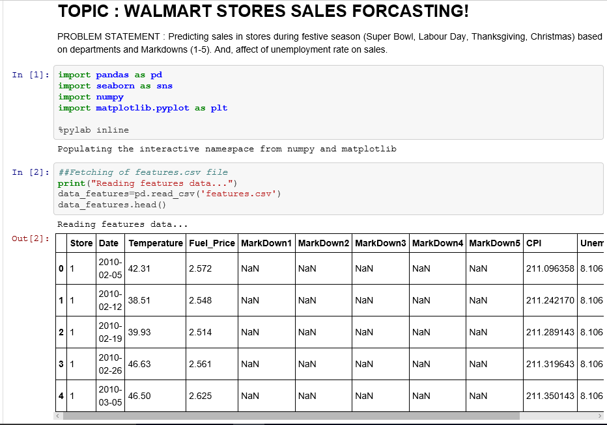
1. Original Data

Slide 16
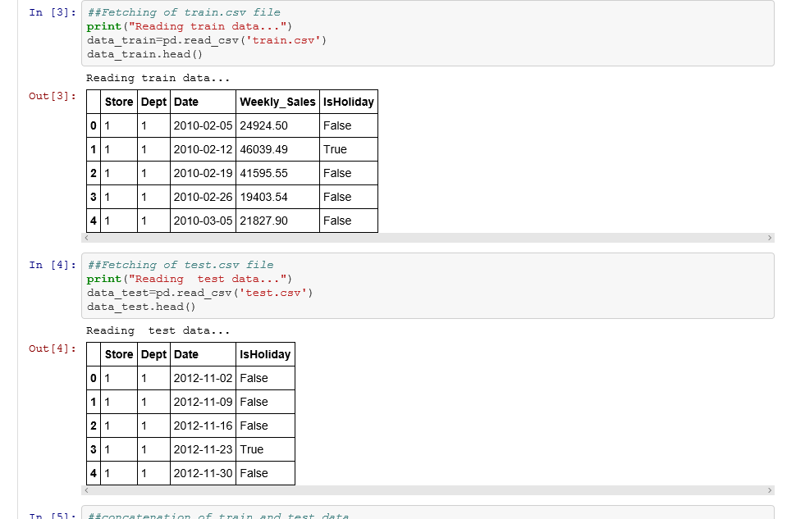
2. Test and train dataset

Slide 17
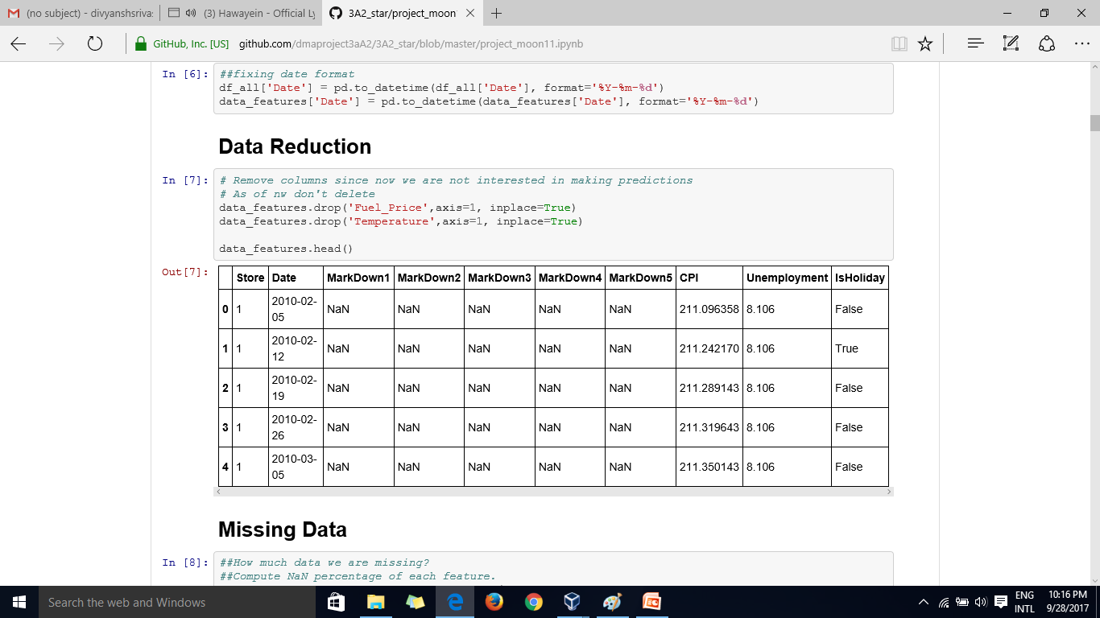
3.Unwanted data has been removed

Slide 18
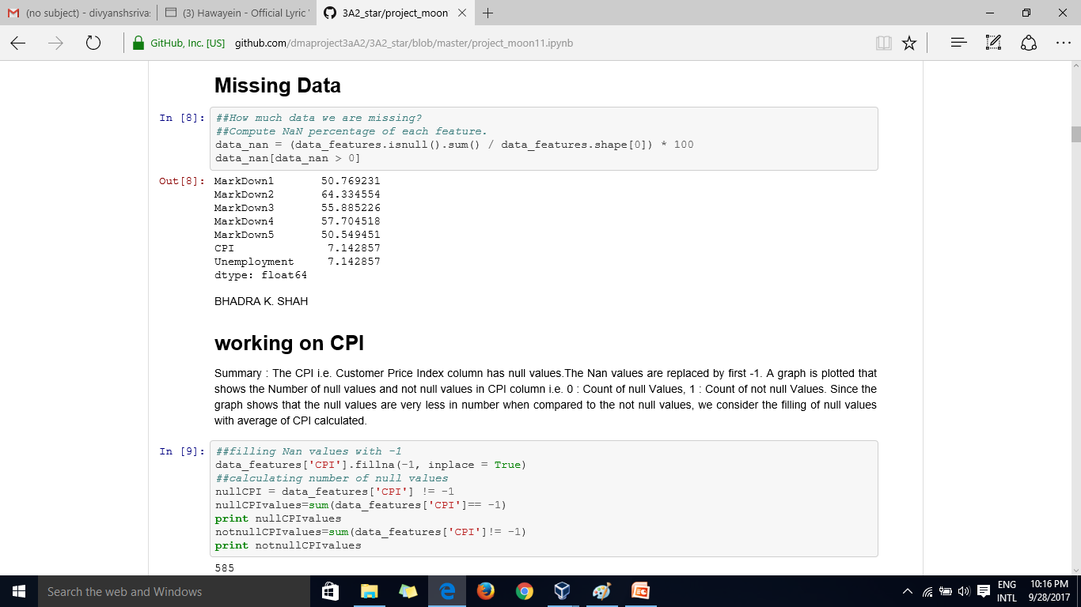
4.Calculation of the missing data

Slide 19
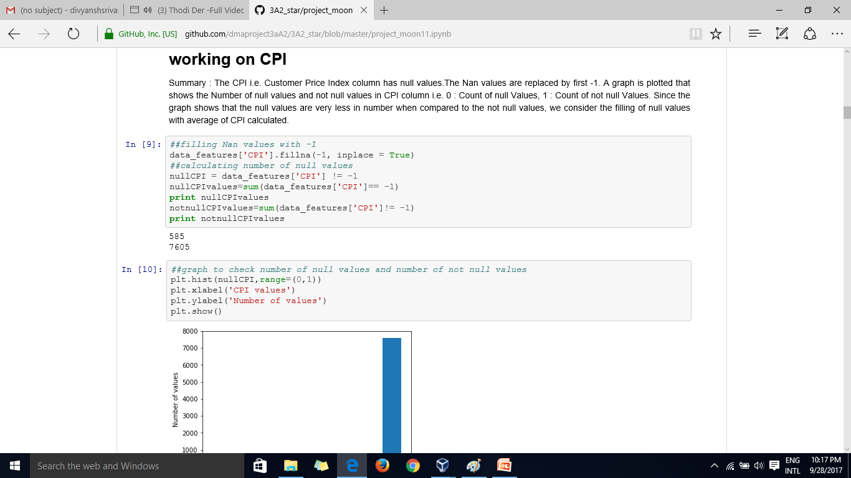
5.CPI – Data cleaning and filled null places with -1

Slide 20
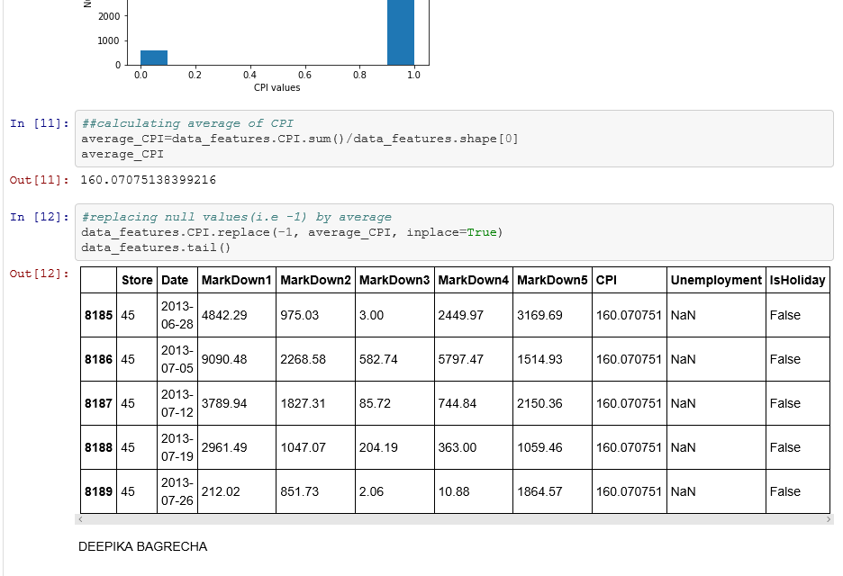
6.Table after replacing CPI values

Slide 21
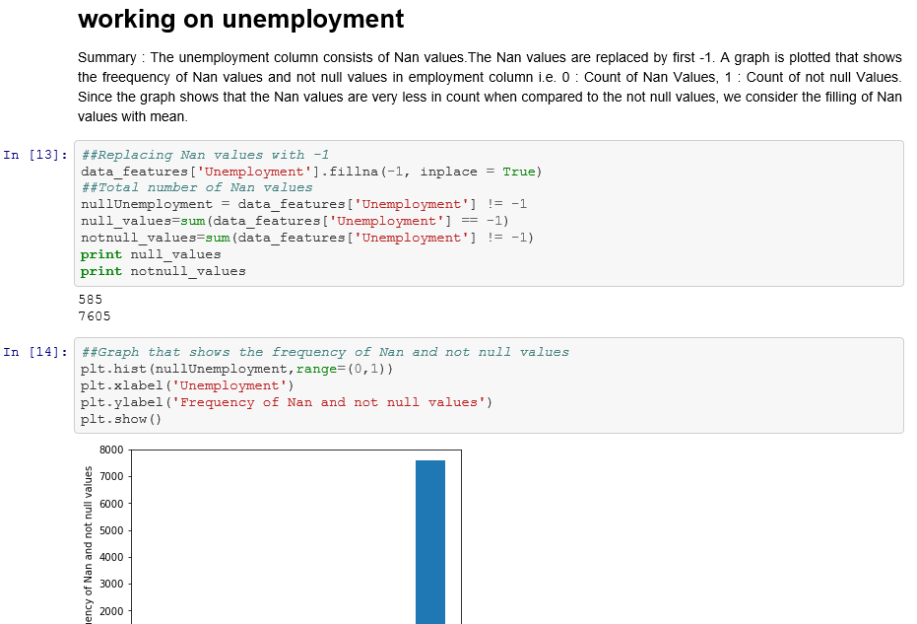
7.Cleaning unemployment data and filling Nan values with mean

Slide 22
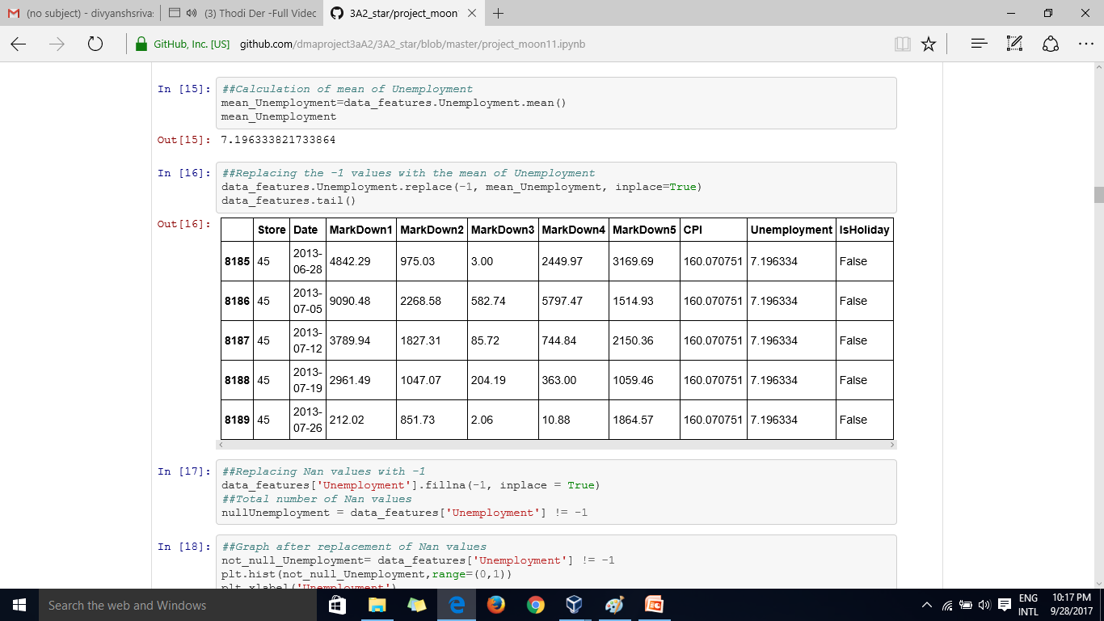
8.Table after replacing Unemployment values

Slide 23
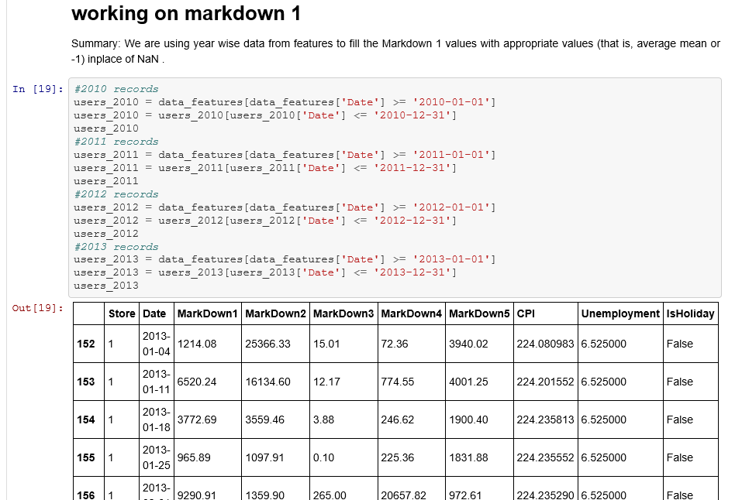
9. Markdown 1 of each year from 2010 to 2013 have been filled by average mean where it was Nan

Slide 24
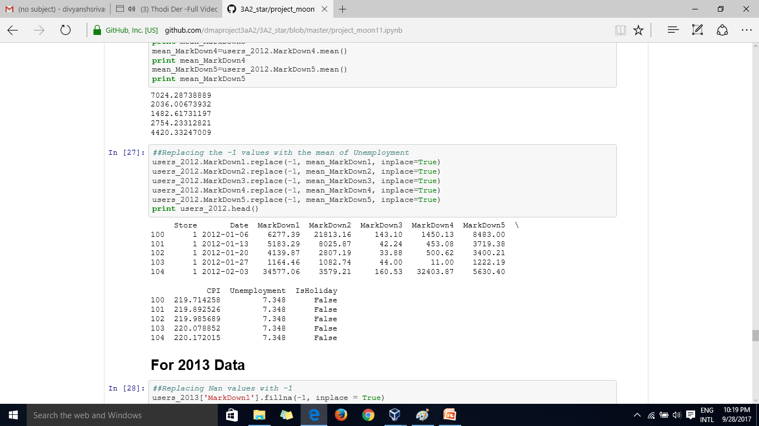
10.Table after preprocessing

Slide 25
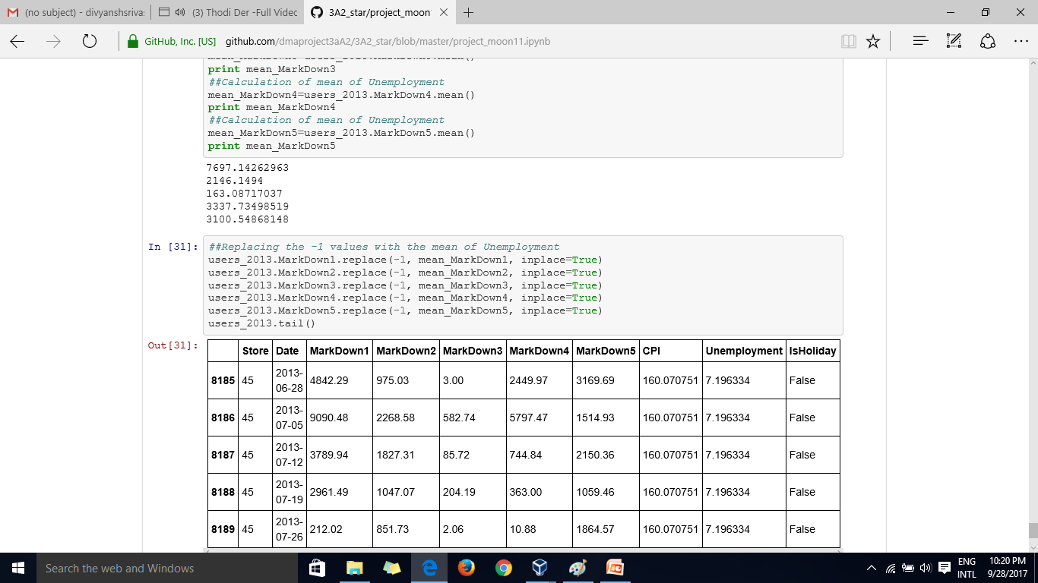
11. Preprocessed features table of year 2013

Slide 26
-THANK YOU

