Slide 1

Mortality Rates in USA
- 10 Leading Cause of Death
- Heart Disease ..to .. Suicide
Mauricio Gonzalez, David Marcus, Juan Galeazzi, Mukit Samad

Slide 2




Data Visualization
Analysis and Framework
Notes:
Alt-Tab to Tableau
Alt-Tab to Excel Pivot Tables

Slide 3
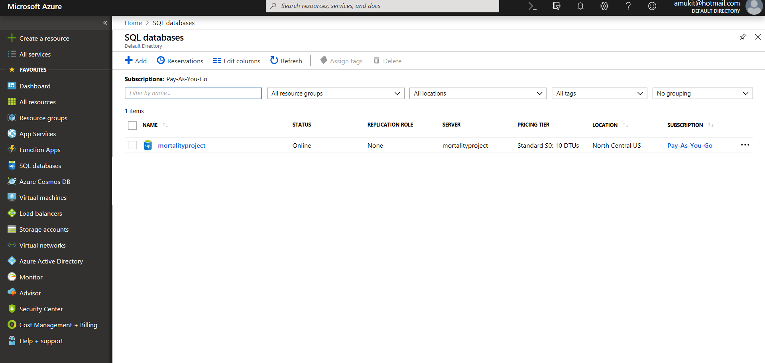
Microsoft Azure

Slide 4
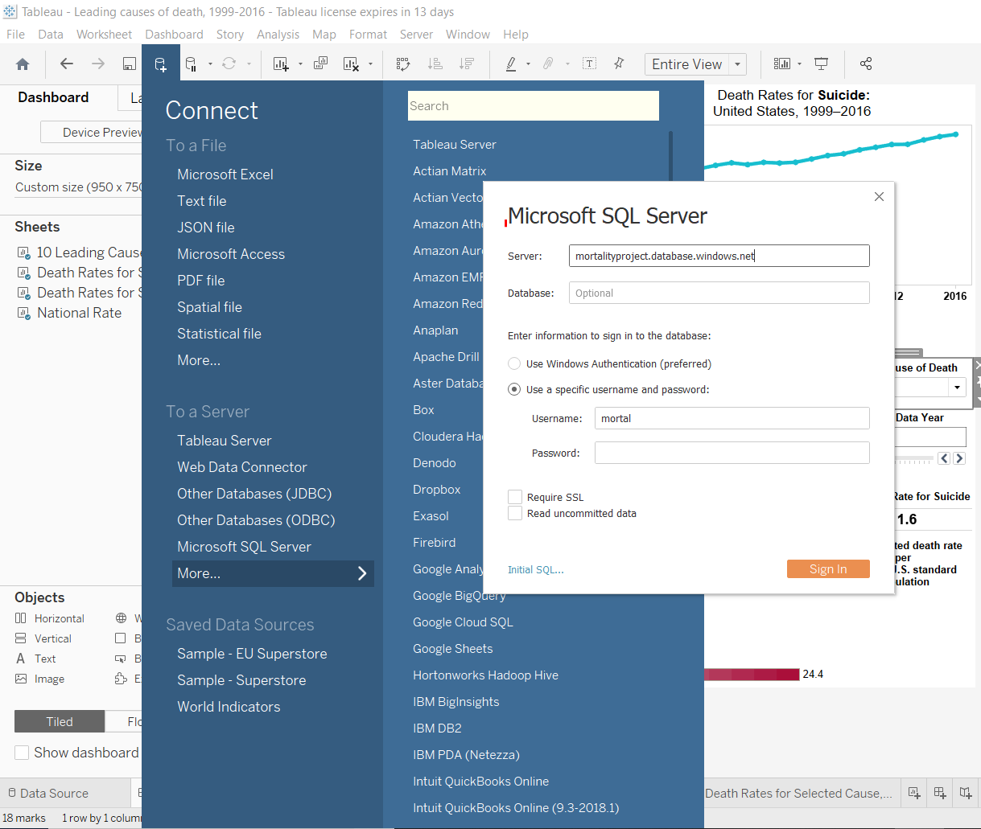
Connect Data Source from Azure

Slide 5
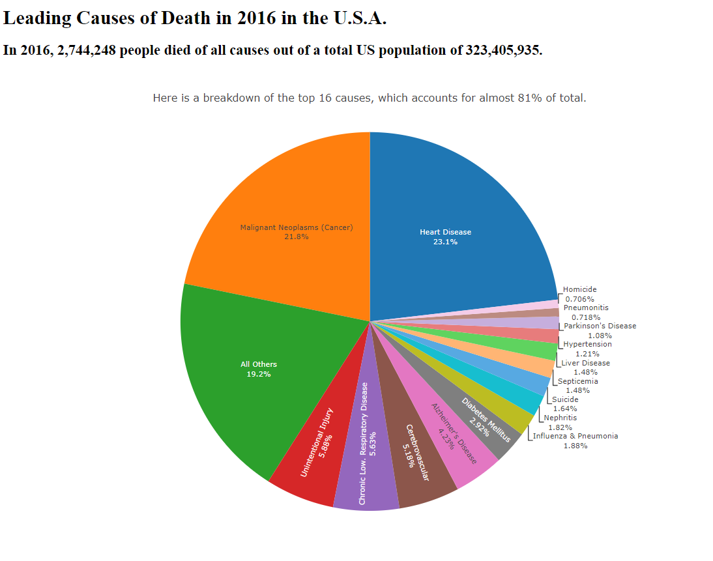

Slide 6
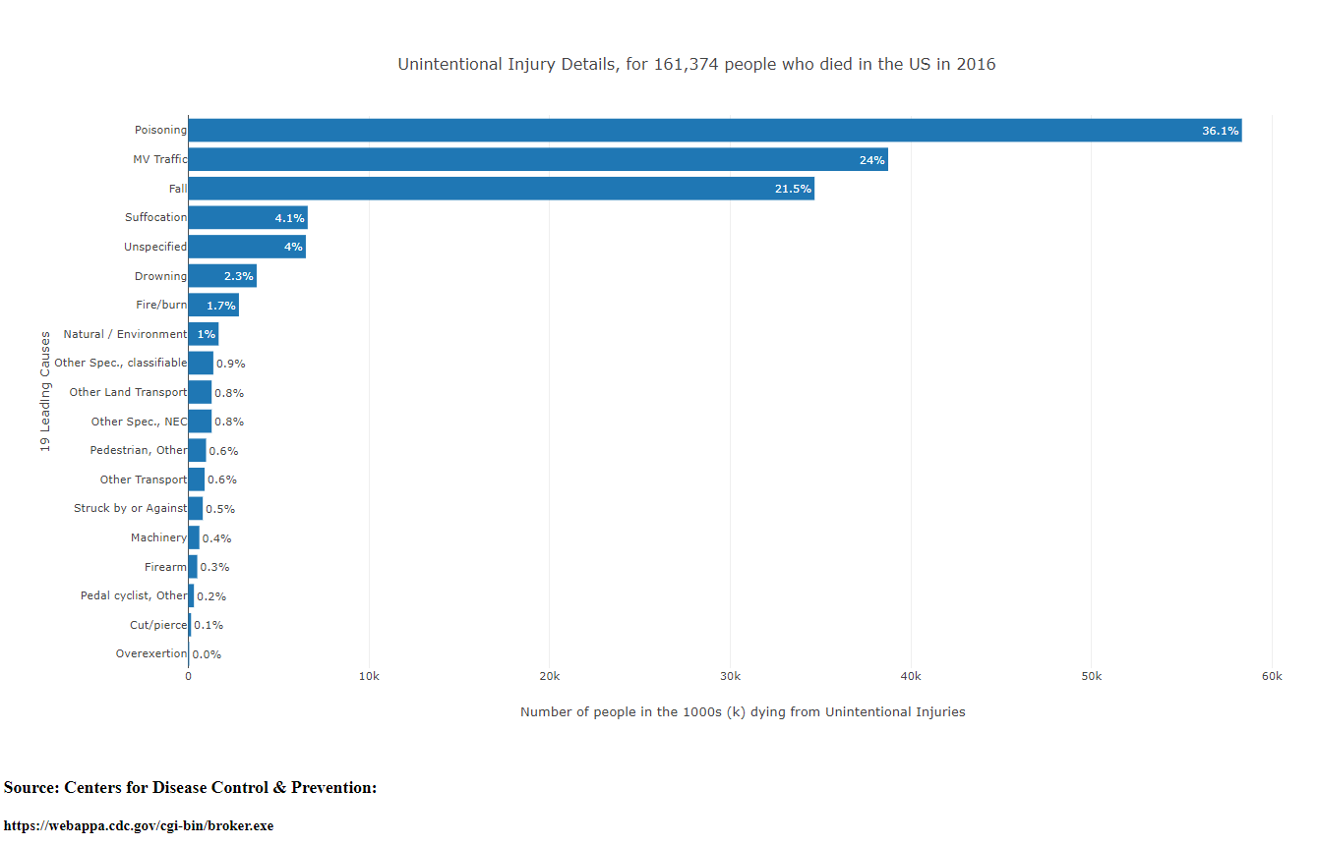

Slide 7
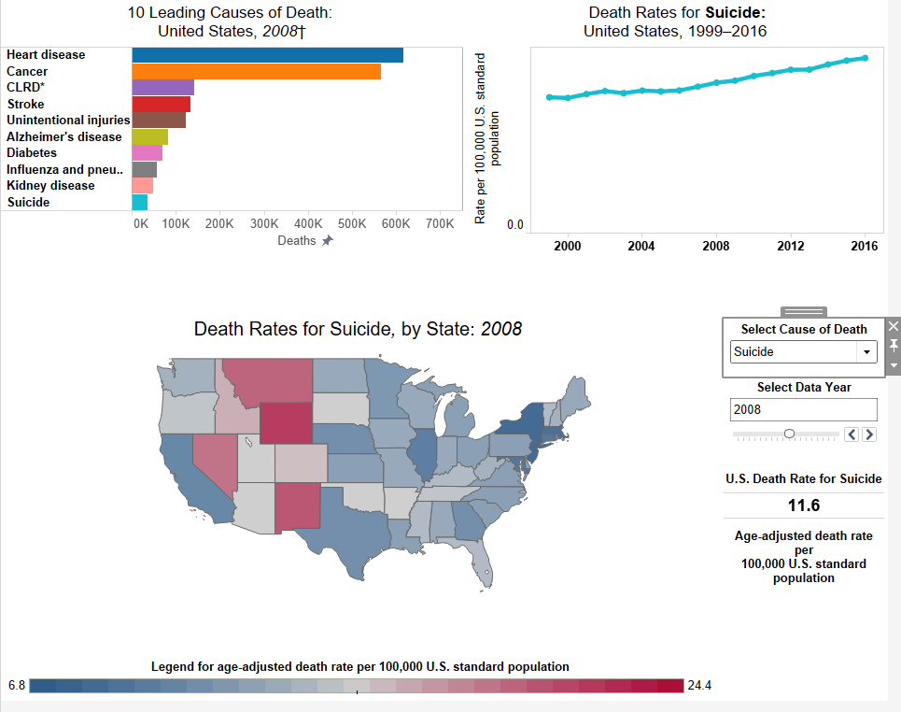

Slide 8
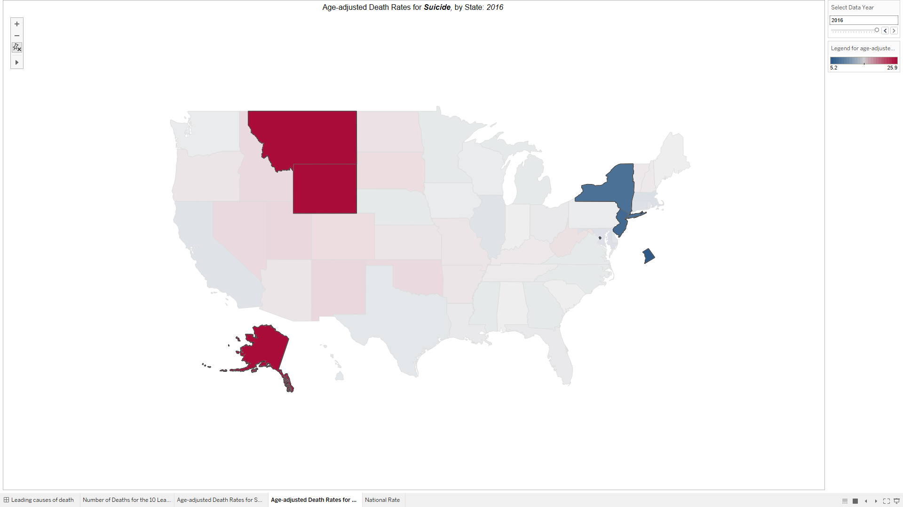
Case Study: Suicide

Slide 9
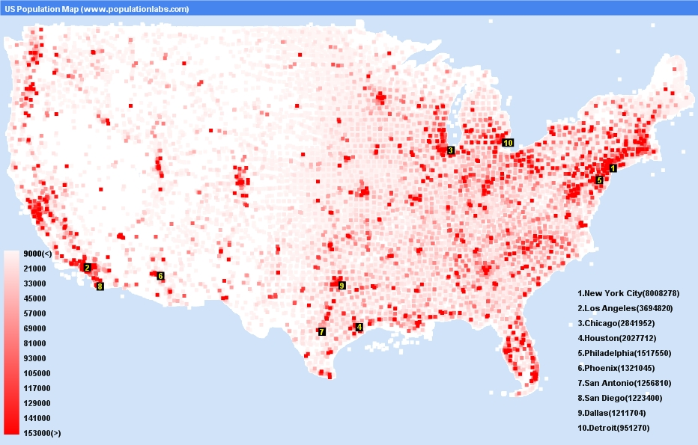
“Population Density US.” Map of USA States, phumyvungtaurental.com/population-density-map-of-usa/us-population-map-statistics-graph-most-populated-cities-density-population-density-map-of-usa-932-x-595-pixels/.
United States Population Density Map

Slide 10
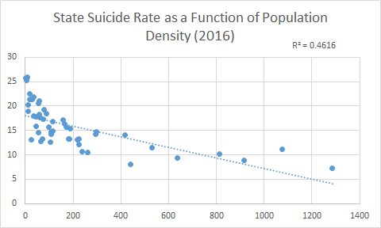
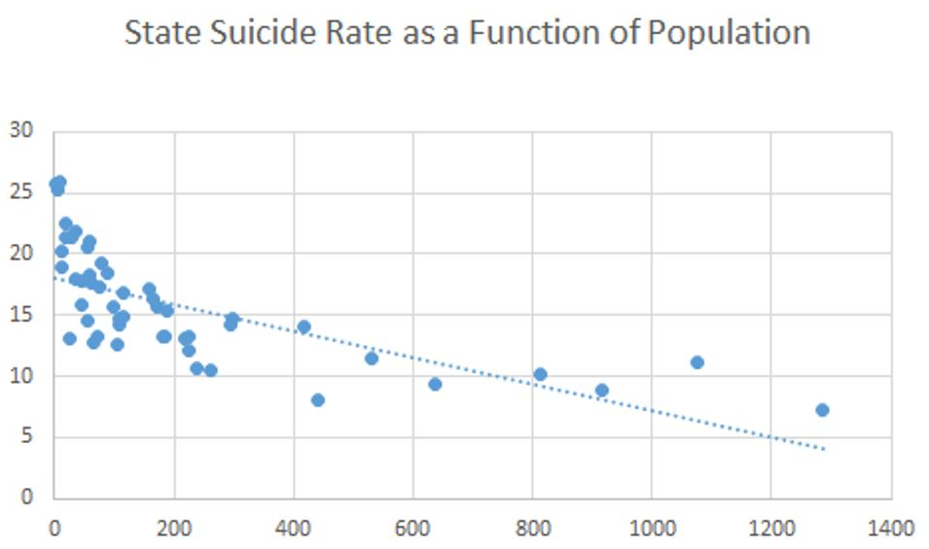
State Suicide Rate as a Functionof Population Density (2016)

Slide 11
Conclusion
Strong inverse correlation between suicide rate and population density
Loneliness → Higher rates of suicide

Slide 12
Coming Soon
World poverty with Death rate
How education effect the Death rate
Overdose Drug
Marijuana related death for treatment vs Recreation

