Slide 1
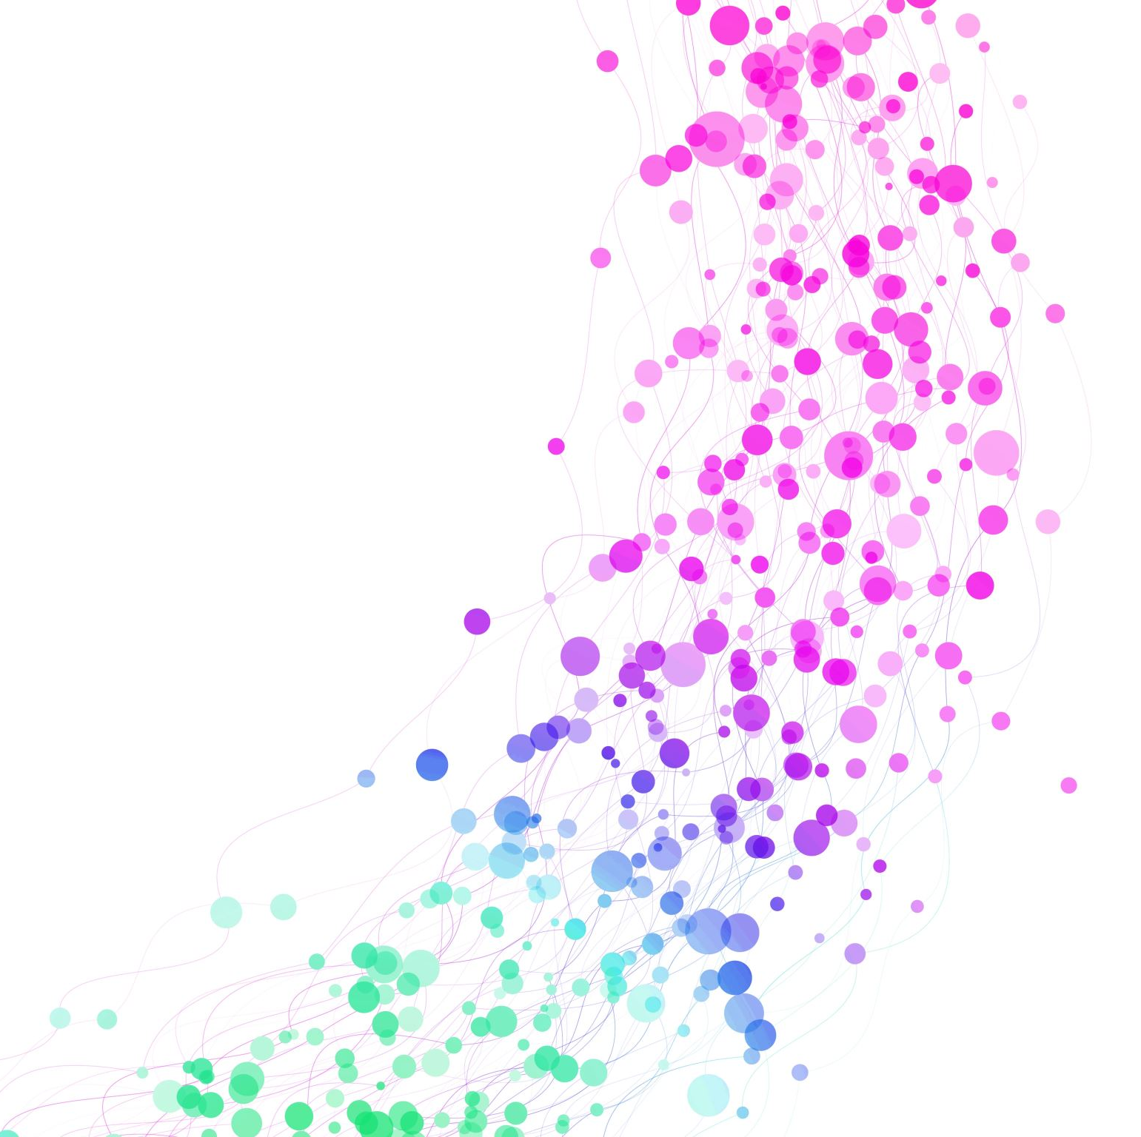
Exploring the NCBI E. coli pangenome functions
Cabreiro Lab retreat
Daniel Martínez Martínez

Slide 2
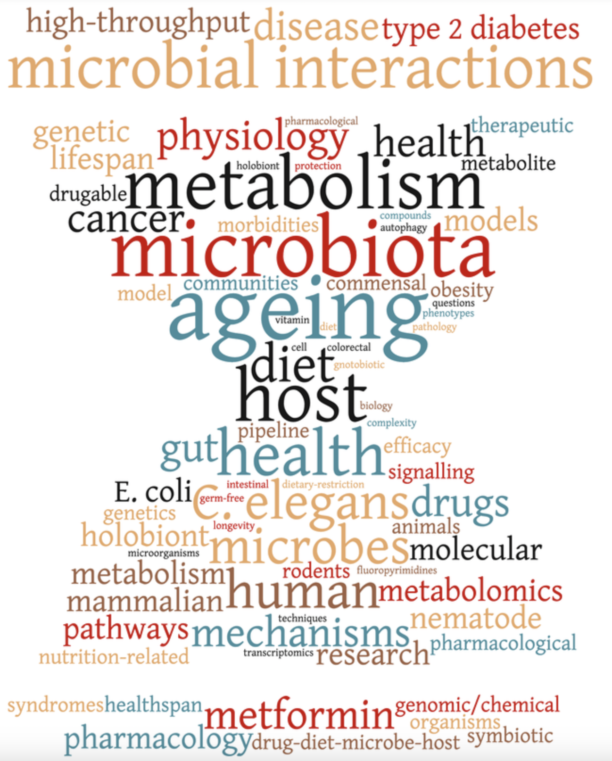

NCBI collection
9292 strains
Cabreiro collection
741 strains
Escherichia coli
10033 strains

Slide 3




Phylogenetic tree
Phylogroups
NCBI collection
28867 strains
ClermonTyping
IQTree
Assemblies
mash
Core genome alignment
Escherichia coli
29608 strains
Quality
Distances
bakta
panaroo/mash
Annotations
Pangenome
Gene P/A
Cabreiro collection
741 strains
panaroo
Reference genes / proteins

Slide 4

Phylogenetic tree
Phylogroups
NCBI collection
28867 strains
ClermonTyping
IQTree
Assemblies
mash
Core genome alignment
Escherichia coli
29608 strains
Quality
Distances
bakta
panaroo/mash
Annotations
Pangenome
Gene P/A
Cabreiro collection
741 strains
panaroo
Reference genes / proteins
proteInfer
CLEAN
deepFRI
AlphaFold 2
ESM
OpenFold
InterPro
eggNOG
Diamond
Function prediction
InterPro analysis
eggnog analysis
progenomes blast
protein structure
GO terms
GO terms
COG categories
protein seq. similarity
protein 3D structure
PCA
t-SNE
UMAP
mapping
PCA
t-SNE
UMAP

Slide 5


Phylogenetic tree
Phylogroups
NCBI collection
28867 strains
ClermonTyping
IQTree
Assemblies
mash
Core genome alignment
Escherichia coli
29608 strains
Quality
Distances
bakta
panaroo/mash
Annotations
Pangenome
Gene P/A
Cabreiro collection
741 strains
panaroo
Reference genes / proteins
proteInfer
CLEAN
deepFRI
AlphaFold 2
ESM
OpenFold
InterPro
eggNOG
Diamond
Function prediction
InterPro analysis
eggnog analysis
progenomes blast
protein structure
GO terms
GO terms
COG categories
protein seq. similarity
protein 3D structure
PCA
t-SNE
UMAP
mapping
PCA
t-SNE
UMAP

Slide 10
Coinfinder for gene-gene association and look into functional similarities within cliques/clusters

