Slide 1

SC WAVE
Development Stages + Key Qualities

Slide 2
SC Wave provides an enjoyable and positive environment for soccer players. Our mission is to promote individual development of all our players and assist them to reach their full potential, both within the game and outside of the game of soccer. Our players focus on proper preparation through discipline, determination, dedication, hard work and teamwork while playing with a passion and competing every time they step on the field.
MISSION
SC Wave will develop complete soccer players with excellent soccer intelligence, technical skills, and a competitive mentality. Players will learn to love the game and will compete at their appropriate level, while experiencing life-lessons beyond the game. We aim to prepare our players to the next level of College Soccer and in some instances professional soccer.
VISION

Slide 3
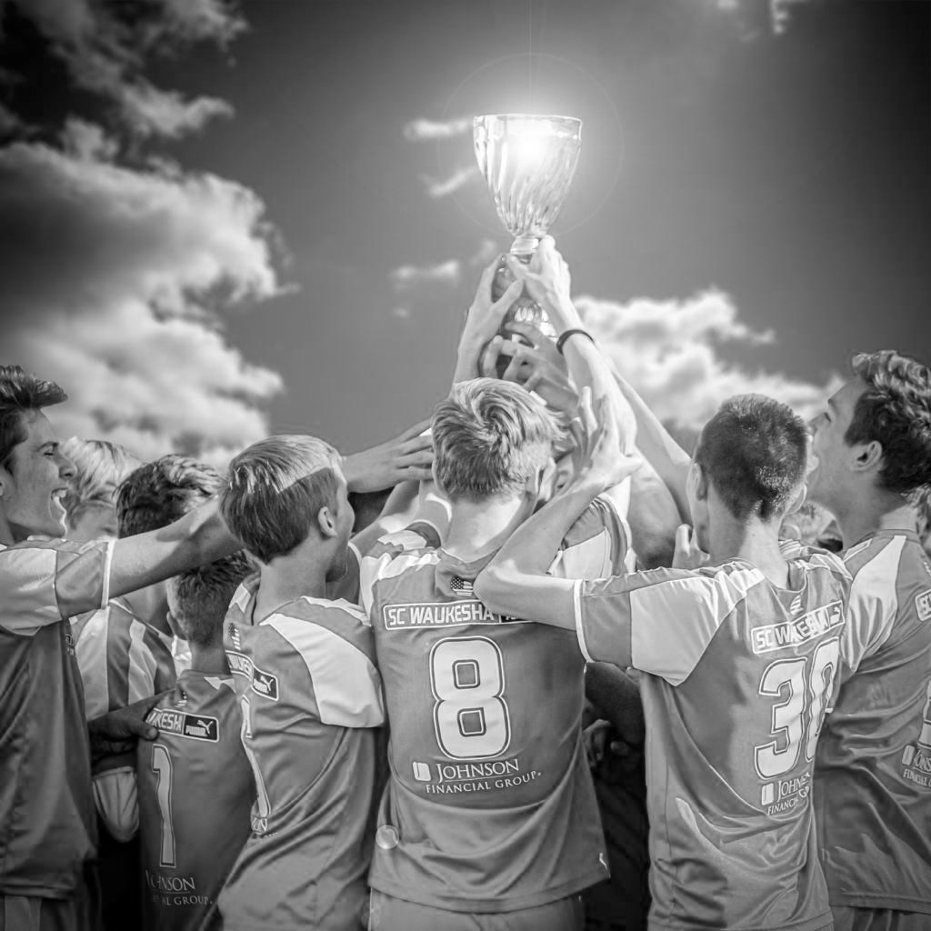
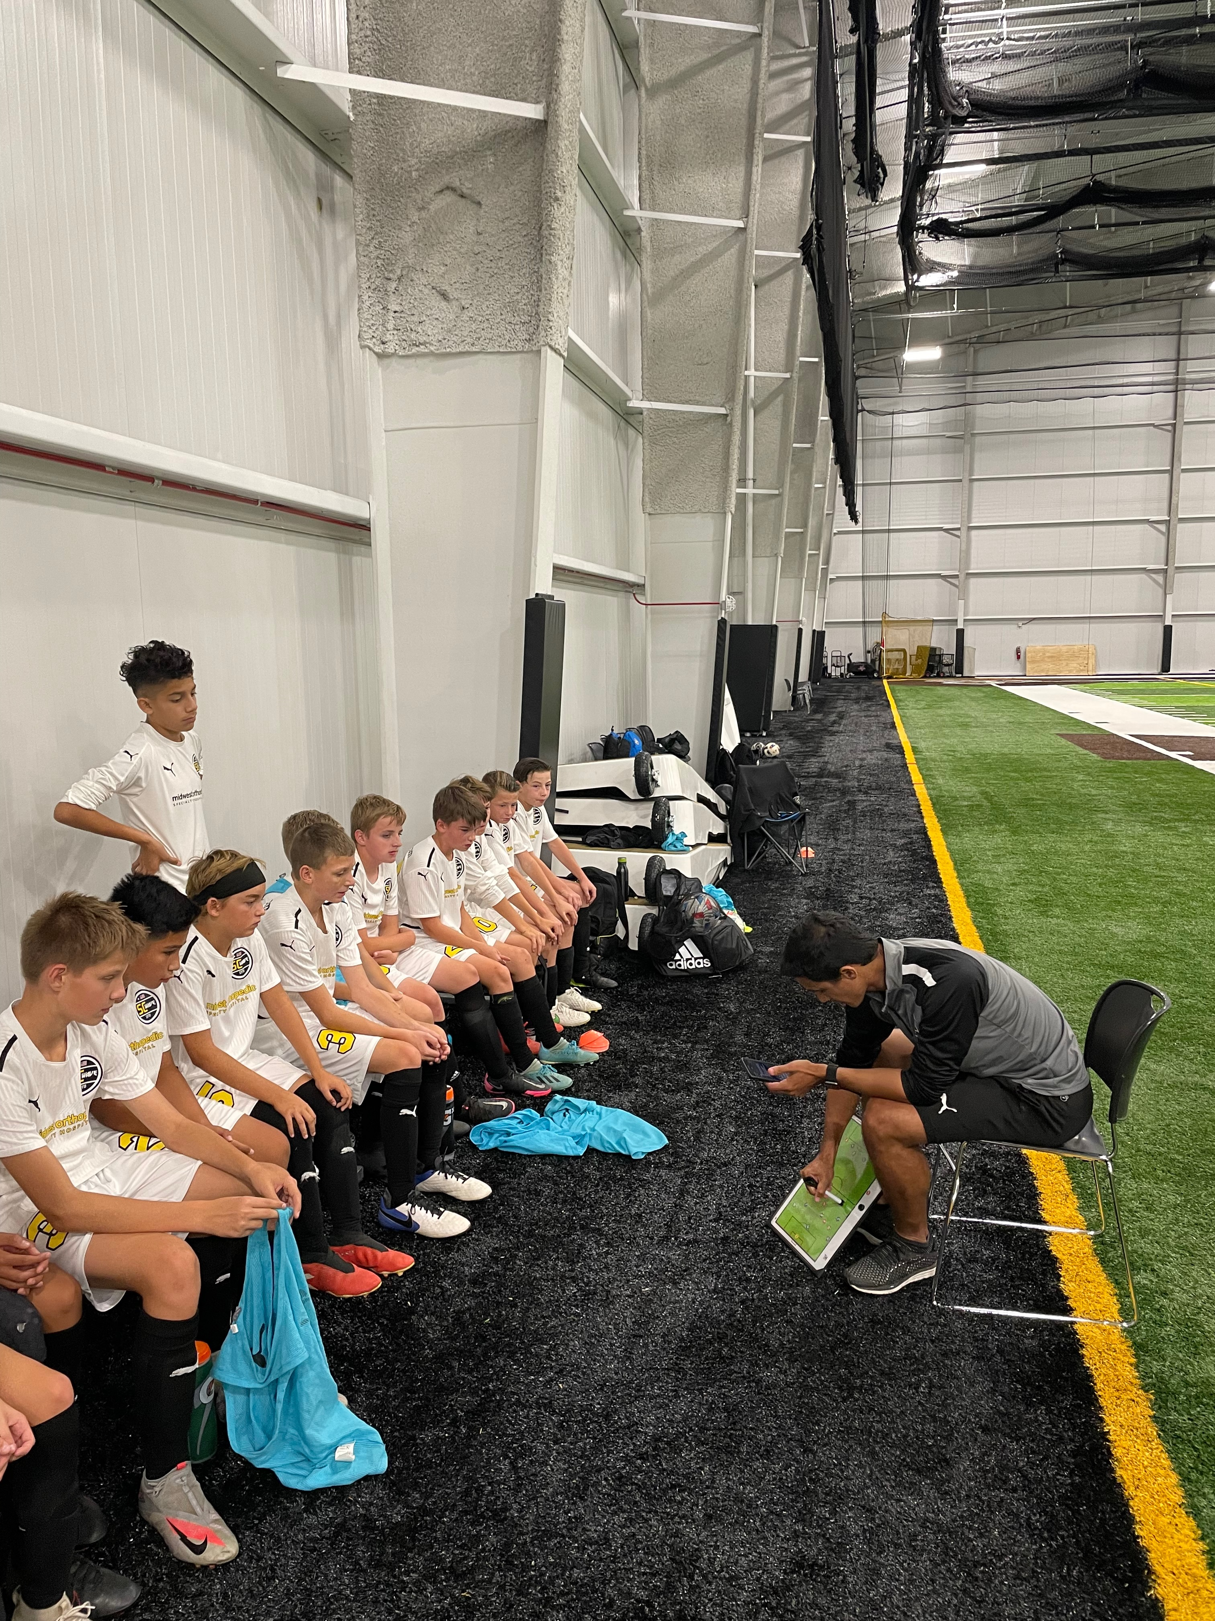
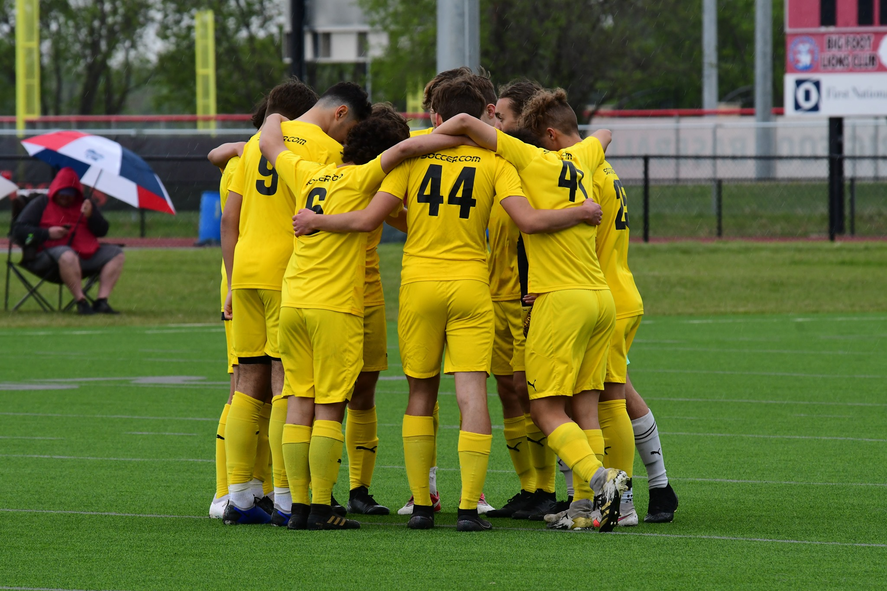
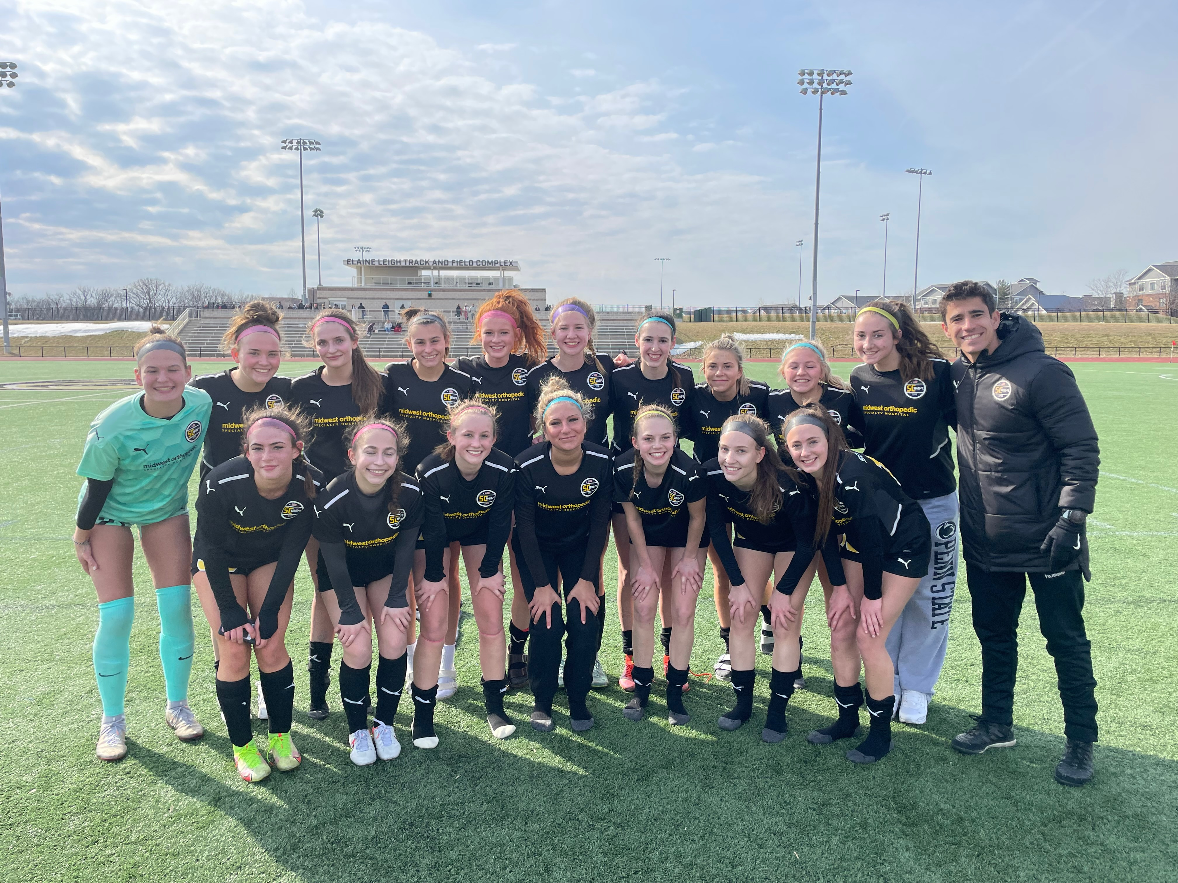
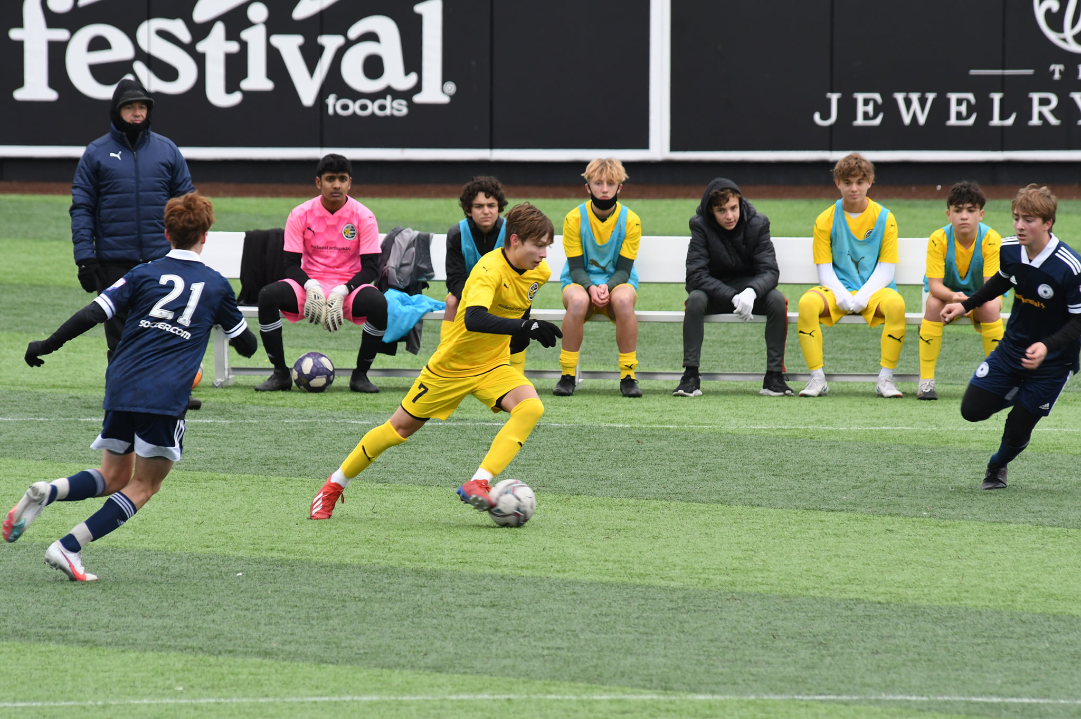
VALUES
MERITOCRACY
Our attitudes and behaviors reflect what we deserve
TEAM SPIRIT
Collective achievements generate individual benefits
RESPECT
We respect the environment; referees, opponents, teammates and facilities. We are proud to represent the club and our community
RESILIENCE
Giving up is not an option. You fail only when you quit
CREATIVITY
We are brave and confident to create/generate something unpredictable

Slide 4
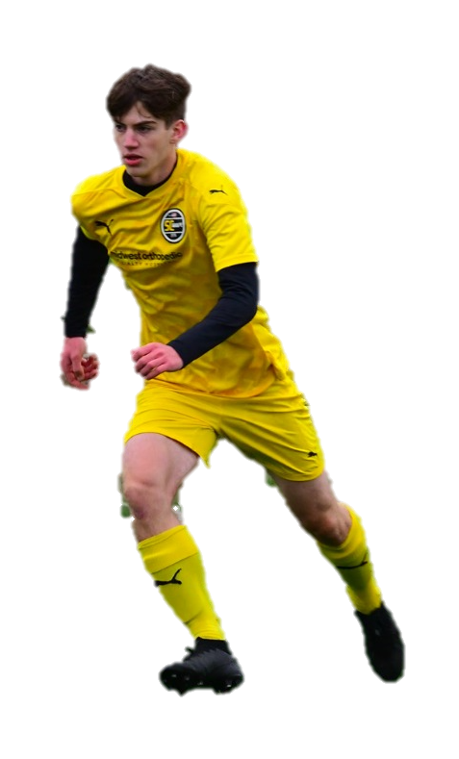
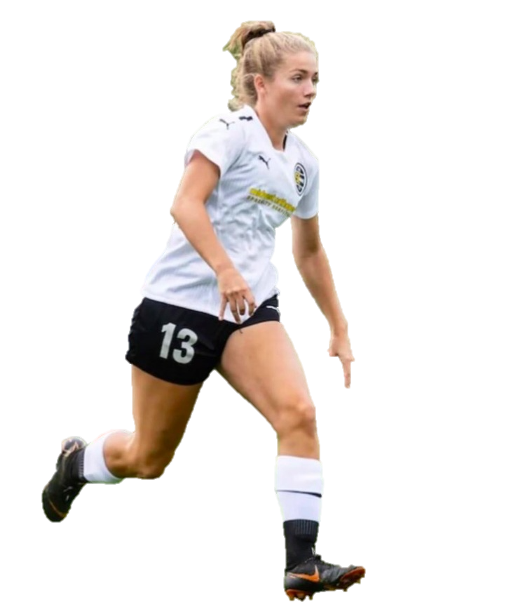
SC WAVE PLAYERS PATHWAY
GA & MLS NEXT
Regional Level
State Level
Recreational
Select
Academy
College & PRO

Slide 5
TRAINING ENVIRONMENT
August | September | October | November
December | January | February | March
April | May | June
SPRING
WINTER
FALL
4 SESSIONS PER WEEK
Mon: Recovery Day – technical/skill day (free play). Tactical Focus (Individual)
Tues/Wed: Tactical Focus (Group/Team)
Thurs: Organizational Sessions (set pieces/plays, patterns, detail oriented, Game Preparation)
Location: Brookfield and/or Franklin, WI
2-3 SESSIONS PER WEEK
U13 & U14: Futsal Training 1x week (focus on technical and tactical benefits translation to the outdoor game)
Video Sessions & EXOS: Speed/Agility/Strength Program
SC Wave Winter League: 7-8 Games hosted at MOSH
Location: MOSH (Franklin) and New Berlin, WI
4 SESSIONS PER WEEK
Mon: Recovery Day – technical/skill day (free play). Tactical Focus (Individual)
Tues/Wed: Tactical Focus (Group/Team)
Thurs: Organizational Sessions (set pieces/plays, patterns, detail oriented, Game Preparation)
Location: Brookfield and/or Franklin, WI

Slide 6
SC WAVE DNA
ATTACKING
Proactive and objective ball possession utilizing our positional play principles to create space and attack the opponent’s goal.
Immediate reaction to vertically attack opponent if space is available or keep the ball as we restructure our attacking organization.
DEFENDING
TO
ATTACKING
ATTACKING
TO
DEFENDING
When losing possession, we seek to react quickly, in an organized manner, immediately to recover the ball or protect our goal.
DEFENDING
Defensive organization seeking to gain ball possession high up the field utilizing a mid or high compact block structure. If we can’t, we will look to force opponent to pre-established trapping zones.

Slide 7
Player Behaviors and Team Tactical Principles based on stages of development U-13 through U-19 age groups

Slide 8
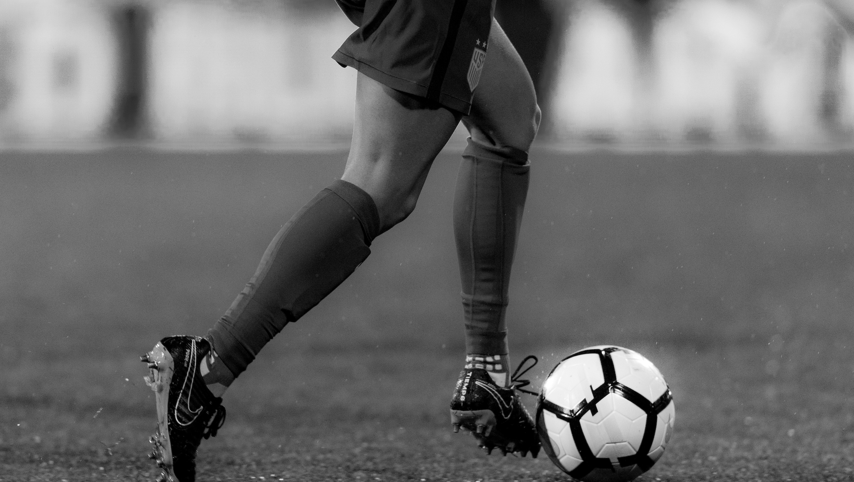
PLAYER DEVELOPMENT STAGES
(ZONE 2)
U19
Development of the specific qualities of a player to be the best player in their position to win the game
(ZONE 2)
U18
Development of the individual qualities of a player in a team concept (e.g. roles and tasks of players)
11v11 Introduction
Intro to Club’s Game Model & Principles
(ZONE 2)
U17
Development of the specific qualities of a player in their position to maximize their contribution to the result of the game
U16
U17-U19 EXECUTE THE KEY QUALITIES SUCCESSFULLY IN ORDER TO WIN THE GAME
U15
(ZONE 1)
U14
Development of the individual qualities of a player in a team environment (not based on position. Continuous development of fundamentals)
U-15 & U-16 EXECUTE THE KEY QUALITIES SUCCESSFULLY
U13
U12
U9
U-13 & U-14 DEVELOP THE KEY QUALITIES
U-12 INTRODUCTION TO THE KEY QUALITIES

Slide 9
U-13 & U-14 DEVELOP THE KEY QUALITIES
Development of the individual qualities of a player in a team concept (e.g. roles and tasks of players)
U-13 & U-14 player behaviors to look for
Game understanding & Decision Making Understands all the phases of the game relative to our style of play and makes quick decisions Applies our principles of play to scenarios in the game Initiative Proactive in situations, looks for new ideas Attacks opponents (1v1, dribble/movement to drag opponents out of position) Focus Plays to win every game Is brave and competes in every moment Optimal Technical Technically proficient to be successful in all situations Proficient in 1v1 to create attacking prowess Optimal Physical Protects the ball with body and correct improvement Responsible (On & Off Field) Is involved and engaged throughout every game, training session, and exercise Accountable for actions Handles (un)expected challenges and problems with flexibility and accountability Develops own goals to reach their personal learning objectives

Slide 10
U-13 & U-14 DEVELOP THE KEY QUALITIES
Development of the individual qualities of a player in a team concept (e.g. roles and tasks of players)
Team Tactical Principles U-13 & U-14 Player
 | ATTACKING | DEFENDING
Attacking 1/3 | Different types of runs to get behind/between last line of defenders | Mix of zonal and man to man
 | Find key players where they can succeed
 |  | Pressing: Recognize the moment to make play predictable
 | Find space to combine and become a passing option
 |  | Look to always pressure the player on the ball
 | Get numbers in the box
 |  | Stay and keep it compact, limit the space between lines and units
 | Move away from defender = creating space
Midfield 1/3 | Movement of players to create numbers up | Keep the ball in front of us, force play wide
 | Full backs and wingers occupying different channels
 |  | Look to always pressure the player on the ball in your zone
 | Find space to combine and become a passing option
 |  | Zonal defending – communicate player movement
 | Create numbers up on one side to find teammate on the other side in open space or 1v1
 |  | Stay and keep it compact, limit the space between lines and units
 | Move away from defender = creating space
Defending 1/3 | Create numbers up to move the ball forward | Get compact and stay compact – don’t allow passes through you
 | Beat the first defender by passing or dribbling
 |  | Get behind the ball, force play wide
 | Create diagonal passing lanes to support teammate
 |  | Look to always pressure the player on the ball
 | Find separation away from defender = creating space
 |  | Inside the box man mark, outside the box mark space
 | Occupy 5 vertical lanes with 5 defenders

Slide 11
U-13 & U-14 DEVELOP THE KEY QUALITIES
Development of the individual qualities of a player in a team concept (e.g. roles and tasks of players)
Team Tactical Principles U-13 & U-14 Player
 | TRANSITION A>D | TRANSITION D>A
Attacking 1/3 | Pressure player on the ball as soon as possible | Play the highest player on the field if possible
 | Numbers behind the ball immediately, get compact/organized
 | Ball orientated press, Create numbers up around the ball
 | Force play back | Dribble towards the goal and shoot on target
 | When first pressure gets broken, drop deep and get organized/compact
 | No pressure on the ball, drop/delay
Midfield 1/3 | Pressure player on the ball as soon as possible | Play the first pass to the closest player ahead of the ball
 | Numbers behind the ball immediately, get compact/organize
 | Ball orientated press, Create numbers up around the ball
 |  | Pass backwards if you can not go forward
 | Force play outside
 | Zonal defending – don’t cross in front or behind each other
Defending 1/3 | Pressure player on the ball as soon as possible | Play the first pass to the closest player ahead of the ball
 | Numbers behind the ball immediately, get compact/organize
 | Ball orientated press, Create numbers up around the ball
 | Force play outside
 |  | Pass backwards if you can not go forward
 | (Defensive) Zonal defending, man to man within the box
 | When first pressure gets broken or no pressure, drop deep (edge of the D lowest point of confrontation) and get organized/compact.

Slide 12
PLAYER DEVELOPMENT STAGES
(ZONE 2)
Development of the specific qualities of a player in their position Development & Performance
Execute Club’s Game Model & Principles
(ZONE 2)
U19
Development of the specific qualities of a player to be the best player in their position to win the game
U18
U17
U16
U17-U19 EXECUTE THE KEY QUALITIES SUCCESSFULLY IN ORDER TO WIN THE GAME
U15
(ZONE 2)
Development of the individual qualities of a player in a team concept (e.g. roles and tasks of players
(ZONE 1)
U14
Development of the individual qualities of a player in a team environment (not based on position. Continuous development of fundamentals)
U-15 & U-16 EXECUTE THE KEY QUALITIES SUCCESSFULLY
U13
U12
U9
U-13 & U-14 DEVELOP THE KEY QUALITIES
U-12 INTRODUCTION TO THE KEY QUALITIES

Slide 13
U-15 & U-16 EXECUTE THE KEY QUALITIES SUCCESSFULLY
Development of the specific qualities of a player in their position to maximize their contribution to the result of the game
U-15 & U-16 player behaviors to look for
Game understanding & Decision Making Understands all the phases of the game relative to our style of play and makes quick decisions Applies our principles of play to scenarios in the game Coordinates actions with teammates, opponents, and positions within the field Is the best player at their position based on the style of play of the team Initiative Proactive in situations, looks for new ideas Attacks opponents (1v1, dribble/movement to drag opponents out of position) Thinks ahead Focus Plays to win every game Is brave and competes in every moment Recovers quickly from an adverse moment Optimal Technical Technically proficient to be successful in all situations Proficient in 1v1 to create attacking prowess Technical skills to create attacking moments under pressure | Optimal Physical Protects the ball with body and correct improvement Has the physical fitness to execute tasks at the highest level for every game Responsible (On & Off Field) Is involved and engaged throughout every game, training session, and exercise Accountable for actions Handles (un)expected challenges and problems with flexibility and accountability Develops own goals to reach their personal learning objectives Analyzes game & training performance in relation to positional requirements in the system of play Creates their own PDP…Personal Development Plan Is dependable and reliable (leadership)

Slide 14
U-15 & U-16 EXECUTE THE KEY QUALITIES SUCCESSFULLY
Development of the specific qualities of a player in their position to maximize their contribution to the result of the game
Team Tactical Principles U-15 & U-16 Player
 | ATTACKING | DEFENDING
Attacking 1/3 | Vary the type of runs to get behind/between last line of defenders | Stay and keep it compact - Vertical 5-7 yards and Horizontal Compactness 3-5 yards
 | Find key players where they can succeed)
 |  | Get behind the ball, force play wide
 | Utilize space and triangulate to create passing options
 |  | Look to always pressure the player on the ball
 | Get numbers in the box
 |  | In box man>zone, outside the box zone>man
 | Find separation away from defender = creating space
Midfield 1/3 | Movement of players to create numbers up | Keep the ball in front of us, force play wide
 | Wide Players occupying different channels (full backs/wingers)
 |  | Look to always pressure the player on the ball in your zone
 | Utilize space and triangulate to create passing options
 |  | Zonal defending – don’t cross in front or behind each other
 | Create #s up one side to exploit opposite side isolation (1v1, open space)
 |  | Stay and keep it compact - Vertical 8-10 yards and Horizontal Compactness 5-7 yards
 | Find separation away from defender = creating space
Defending 1/3 | Create numbers up to advance ball forward | Stay and keep it compact - Vertical 5-7 yards and Horizontal Compactness 3-5 yards
 | Break first line of defenders on the dribble or pass
 |  | Get behind the ball, force play wide
 | Create diagonal passing lanes - break lines of pressure with diagonal pass
 |  | Look to always pressure the player on the ball
 | Getting unmarked, creating space
 |  | In box man>zone, outside the box zone>man
 | Occupy 5 vertical lanes with 5 defenders (Appropriate spacing of back 5)

Slide 15
U-15 & U-16 EXECUTE THE KEY QUALITIES SUCCESSFULLY
Development of the specific qualities of a player in their position to maximize their contribution to the result of the game
Team Tactical Principles U-15 & U-16 Player
 | TRANSITION A>D | TRANSITION D>A
Attacking 1/3 | Pressure player on the ball as soon as possible | Play the most goal dangerous pass immediately
 | Numbers behind the ball
 | Ball orientated press, Create numbers up around the ball
 | Force play back | Dribble toward goal and shoot on target
 | When first pressure gets broken, drop deep and get organized/compact
 | No pressure on the ball, drop/delay
Midfield 1/3 | Pressure player on the ball as soon as possible | Play the first pass to the closest player ahead of the ball
 | Numbers behind the ball
 | Ball orientated press, Create numbers up around the ball
 |  | Keep the ball if you can’t play forward
 | Force play outside
 | Zonal defending – don’t cross in front or behind each other
Defending 1/3 | Pressure the ball immediately | Play the first pass to the closest player ahead of the ball
 | Numbers behind the ball immediately, get compact/organize
 | Ball orientated press, Create numbers up around the ball
 | Force play outside
 |  | Keep the ball if you can’t play forward
 | (Defensive) Zonal defending, man to man within the box
 | When first pressure gets broken or no pressure, drop deep (edge of the D lowest point of confrontation) and get organized/compact.

Slide 16
PLAYER DEVELOPMENT STAGES
U17-U19 EXECUTE THE KEY QUALITIES SUCCESSFULLY IN ORDER TO WIN THE GAME
(ZONE 2)
U19
U18
(ZONE 2)
U17
Development of the specific qualities of a player in their position to maximize their contribution to the result of the game
U16
U15
Development of the specific qualities of a player to be the best player in their position to win the game
Performance & Results
Total Implementation of Club’s Game Model & Principles
(ZONE 2)
Development of the individual qualities of a player in a team concept (e.g. roles and tasks of players
(ZONE 1)
U14
Development of the individual qualities of a player in a team environment (not based on position. Continuous development of fundamentals)
U-15 & U-16 EXECUTE THE KEY QUALITIES SUCCESSFULLY
U13
U12
U9
U-13 & U-14 DEVELOP THE KEY QUALITIES
U-12 INTRODUCTION TO THE KEY QUALITIES

Slide 17
U-17 & U-18 EXECUTE THE KEY QUALITIES SUCCESSFULLY IN ORDER TO WIN THE GAME
Development of the specific qualities of a player to be the best player in their position to win the game
U-17 & U-18 player behaviors to look for
Game understanding & Decision Making Understands all the phases of the game relative to our style of play and makes quick decisions Applies our principles of play to scenarios in the game Coordinates actions with teammates, opponents, and positions within the field Is the best player at their position based on the style of play of the team Manages the moments within the game at the appropriate pace Initiative Proactive in situations, looks for new ideas Attacks opponents (1v1, dribble/movement to drag opponents out of position) Thinks ahead Scanning the field and finding space for the next movements Focus Plays to win every game Is brave and competes in every moment Recovers quickly from an adverse moment Emotionally composed Optimal Technical Technically proficient to be successful in all situations Proficient in 1v1 to create attacking prowess Technical skills to create attacking moments under pressure Technical skills to dictate the pace of the game | Optimal Physical Protects the ball with body and correct improvement Has the physical fitness to execute tasks at the highest level for every game Demonstrates power and speed Responsible (On & Off Field) Is involved and engaged throughout every game, training session, and exercise Accountable for actions Handles (un)expected challenges and problems with flexibility and accountability Develops own goals to reach their personal learning objectives Analyzes game & training performance in relation to positional requirements in the system of play Creates their own PDP…Personal Development Plan Is dependable and reliable (leadership) Personal lifestyle aligns with becoming an elite performer Is a 'coach' on the field

Slide 18
U-17 & U-19 EXECUTE THE KEY QUALITIES SUCCESSFULLY IN ORDER TO WIN THE GAME
Development of the specific qualities of a player to be the best player in their position to win the game
Team Tactical Principles U-17 & U-19 Player
 | ATTACKING | DEFENDING
Attacking 1/3 | Vary the type of runs to get behind/between last line of defenders | Stay and keep it compact - Vertical 5-7 yards and Horizontal Compactness 3-5 yards
 | Find key players where they can succeed)
 |  | Get behind the ball, force play wide
 | Utilize space and triangulate to create passing options
 |  | Look to always pressure the player on the ball
 | Get numbers in the box
 |  | In box man>zone, outside the box zone>man
 | Find separation away from defender = creating space
Midfield 1/3 | Movement of players to create numbers up | Keep the ball in front of us, force play wide
 | Wide Players occupying different channels (full backs/wingers)
 |  | Look to always pressure the player on the ball in your zone
 | Utilize space and triangulate to create passing options
 |  | Zonal defending – don’t cross in front or behind each other
 | Create #s up one side to exploit opposite side isolation (1v1, open space)
 |  | Stay and keep it compact - Vertical 8-10 yards and Horizontal Compactness 5-7 yards
 | Find separation away from defender = creating space
Defending 1/3 | Create numbers up to advance ball forward | Stay and keep it compact - Vertical 5-7 yards and Horizontal Compactness 3-5 yards
 | Break first line of defenders on the dribble or pass
 |  | Get behind the ball, force play wide
 | Create diagonal passing lanes - break lines of pressure with diagonal pass
 |  | Look to always pressure the player on the ball
 | Getting unmarked, creating space
 |  | In box man>zone, outside the box zone>man
 | Occupy 5 vertical lanes with 5 defenders (Appropriate spacing of back 5)

Slide 19
U-17 & U-18 EXECUTE THE KEY QUALITIES SUCCESSFULLY IN ORDER TO WIN THE GAME
Development of the specific qualities of a player to be the best player in their position to win the game
Team Tactical Principles U-17 & U-19 Player
 | TRANSITION A>D | TRANSITION D>A
Attacking 1/3 | Pressure player on the ball as soon as possible | Play the most goal dangerous pass immediately
 | Numbers behind the ball
 | Ball orientated press, Create numbers up around the ball
 | Force play back | Dribble toward goal and shoot on target
 | When first pressure gets broken, drop deep and get organized/compact
 | No pressure on the ball, drop/delay
Midfield 1/3 | Pressure player on the ball as soon as possible | Play the first pass to the closest player ahead of the ball
 | Numbers behind the ball
 | Ball orientated press, Create numbers up around the ball
 |  | Keep the ball if you can’t play forward
 | Force play outside
 | Zonal defending – don’t cross in front or behind each other
Defending 1/3 | Pressure the ball immediately | Play the first pass to the closest player ahead of the ball
 | Numbers behind the ball immediately, get compact/organize
 | Ball orientated press, Create numbers up around the ball
 | Force play outside
 |  | Keep the ball if you can’t play forward
 | (Defensive) Zonal defending, man to man within the box
 | When first pressure gets broken or no pressure, drop deep (edge of the D lowest point of confrontation) and get organized/compact.

Slide 20
Positional Roles and Responsibilities & Key Qualities
In all moments of the game

Slide 21
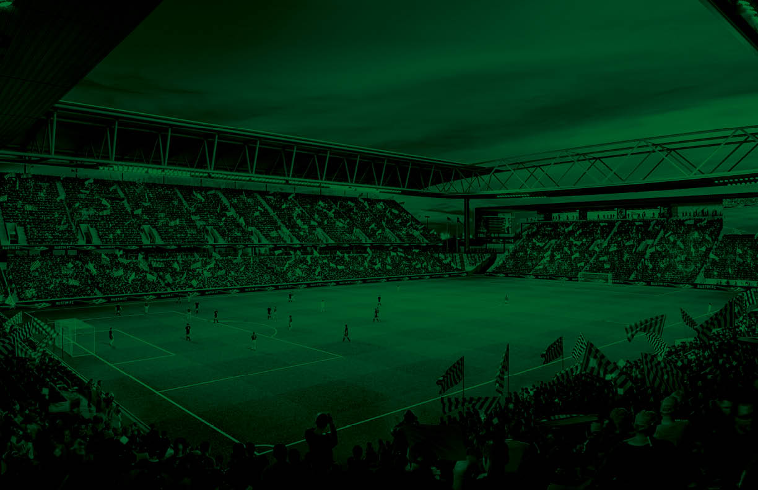
Key Qualities of a Player
#1 Goalkeeper
Confident
Athletic
Decisive
Coach on the field
Accurate, Confident Passing (short and long distances)

Slide 22
NO. 1
Goalkeeper
Player Actions
Attacking
DEFENSIVE 1/3:
Position to support for back pass if ball cannot be played forward
Pass forward or wide to spread out and/or begin build-up
MIDDLE 1/3:
Position to support for back pass if ball cannot be played forward
OFFENSIVE 1/3:
Push up the defensive line and organize (coach) teammates to position themselves to prevent counter attacks
Transition Defending to Attacking
DEFENSIVE 1/3:
Pass forward (long) quickly to exploit the opponent and create 1v1
Keep the ball when you cannot play forward
MIDDLE 1/3:
Push the defensive line up
Give support for back pass if ball cannot be played forward
OFFENSIVE 1/3:
Organize (coach) teammates to position themselves to prevent counter attacks
Transition Attacking to Defending
DEFENSIVE 1/3:
Stay connected to the back line – organize (coach) teammates
MIDDLE 1/3:
Organize (coach) teammates – balanced and compact
OFFENSIVE 1/3:
Position behind defensive line to take preventative defensive action
Defending
DEFENSIVE 1/3:
Organize (coach) teammates when to switch from zonal marking to player tracking (organization on set pieces)
Anticipate crosses and shots and position to stop or regain the ball
MIDDLE 1/3:
Position to provide cover to anticipate and intercept long balls behind defensive line
OFFENSIVE 1/3:
Position to provide cover to anticipate and intercept long balls behind defensive line

Slide 23
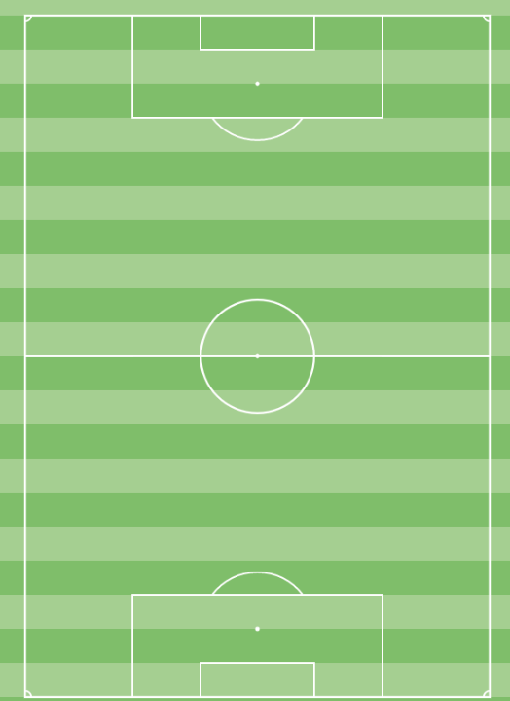
Principles and Player Qualities:
Disorganize opponent
Variety in distribution
Confidence in distribution
Principles and Player Qualities:
Disorganize opponent
Available for backward pass
Push up with the team
Awareness of field position
Principles and Player Qualities:
Push up with the team
Awareness of field position
#1
(GK)
O
F
F
E
N
S
I
V
E
Offensive Phase
Build Out
Offensive Phase
Advancement Phase
Offensive Phase
Chance Creation/Scoring Phase
1
1
1

Slide 24
Principles and Player Qualities:
Recover ball
Secure hands when catching
Command the box
Aggression and confidence
Read opponent’s body shape
Principles and Player Qualities:
Recover ball
Move forward when opponent plays backward
Ready to come off line to intercept
Principles and Player Qualities:
Organize teammates in front
Read opponent’s body language
#1
(GK)
D
E
F
E
N
S
I
V
E
Defensive Phase
Defensive Third
Defensive Phase
Middle Block
Defensive Phase
Press
1
1
1

Slide 25
Key Qualities of a Player
#4 & #5 Center Backs
Positionally Dominant
Vocal Leader
Technically Skilled
Athletic
Aerially Dominant

Slide 26
NO. 4, 5
Center Back
Player Actions
Attacking
DEFENSIVE 1/3:
Position to spread out & provide passing option (for GK) in relation to other center back & defensive midfielder to outnumber opponent
Make accurate forward/diagonal passes between (or behind) the opposition defensive lines
MIDDLE 1/3:
Move forward with (and without) the ball to create 2v1
Position to support if the ball cannot be played forward
OFFENSIVE 1/3:
Push up the defensive line & organize teammates to take up preventive defensive action
Transition Defending to Attacking
DEFENSIVE 1/3:
Move quickly into position to support in space
Pass or dribble forward
MIDDLE 1/3:
Coach the defensive line to push up as a unit
OFFENSIVE 1/3:
one
Transition Attacking to Defending
DEFENSIVE 1/3:
If closest to the situation, put pressure on the ball immediately to prevent danger
MIDDLE 1/3:
Quick decision to pressure the ball, delay the opponents attack, or drop back
OFFENSIVE 1/3:
Take preventive defensive action
Defending
DEFENSIVE 1/3:
Deny opposition in 1v1 situations (air & ground) and be first to the ball on all crosses
Clear ball from danger areas
MIDDLE 1/3:
Position to monitor opponent & analyze situation to determine correct defensive action: PCB, zone, man mark, etc.
Movements & decisions in partnership with other center back
OFFENSIVE 1/3:
Lead & organize defensive line & direct other teammates
Intercept long & through passes

Slide 27
Principles and Player Qualities:
Disorganize opponent
Eliminate defenders with pass
Variety in passing
Dribble forward when no pressure
Principles and Player Qualities:
Disorganize opponent
Eliminate defenders with pass or dribble
Overload one side to isolate opposite side
Variety in passing
Principles and Player Qualities:
Disorganize opponent
Eliminate defenders with pass or dribble
Crossing from variety of positions
Pass backward to restart attack
#4/5
(CB)
O
F
F
E
N
S
I
V
E
Offensive Phase
Build Out
Offensive Phase
Advancement Phase
Offensive Phase
Chance Creation/Scoring Phase
5
4
5
4
5
4

Slide 28
Principles and Player Qualities:
Organized and compact
Intercept and recover the ball
Connected sub-groups
Limit central penetration
Communication to teammates in front
Block crosses/shots
Limit opponent's entry into our box
Principles and Player Qualities:
Organized and compact
Intercept and recover the ball
Connected sub-groups
Limit central penetration
Communication to teammates in front
Step forward when opponent
plays backward
Principles and Player Qualities:
Organized and compact
Intercept and recover the ball
Connected sub-groups
Limit central penetration
Communication to teammates in front
Proactive marking to prevent counter
#4/5
(CB)
D
E
F
E
N
S
I
V
E
Defensive Phase
Defensive Third
Defensive Phase
Middle Block
Defensive Phase
Press
5
4
5
4
5
4

Slide 29
Key Qualities of a Player
#2 & #3 Full Backs
High Level of Endurance
Proficient Dribbler
High-concentration/anticipation
Proficient Cross/Long Passing
Proficient defending 1v1

Slide 30
NO. 2, 3
Full Back
Player Actions
Attacking
DEFENSIVE 1/3:
Position to support wide & high to receive ball and/or create space for teammates
Pass forward (diagonal or behind) or hold the ball
MIDDLE 1/3:
Support the attack wide & with runs behind
Provide balance to take preventive defensive action when team is in possession/attacking on opposite side, and monitor/organize (coach) teammates from this position.
OFFENSIVE 1/3:
Pass or dribble forward, create 1v1 or 2v1 with (e.g. overlapping runs)
Play the early cross when there is space behind the defensive line
Transition Attacking to Defending
DEFENSIVE 1/3:
If closest to the situation, put pressure on the ball immediately to prevent danger
MIDDLE 1/3:
If farthest from the situation, drop back quickly to re-position with defensive line to provide balance
Based on situation, make decision to put pressure on the ball or drop with defensive line
OFFENSIVE 1/3:
If closest to the situation, put pressure on the ball immediately
Transition Defending to Attacking
DEFENSIVE 1/3:
Give quick support in space (forward & wide)
MIDDLE 1/3:
Move up with the defensive line, as part of a collective unit
OFFENSIVE 1/3:
Pass or dribble forward quickly to exploit the opponent if disorganized
Defending
DEFENSIVE 1/3:
Pressure the player with the ball to regain the ball or delay the opponents attack
Deny penetration, prevent crosses in 1v1 situations
MIDDLE 1/3:
Monitor organization & coach fellow defenders & wide forward where necessary
Move centrally to provide cover & balance when ball is on opposite side
OFFENSIVE 1/3:
Position & reposition to intercept passes while monitoring opponent

Slide 31
Principles and Player Qualities:
Disorganize opponent
Create overloads
Counter movements to create space
Dribble the ball forward when no pressure
Overload one side to exploit the other
Principles and Player Qualities:
Create overloads
Disorganize opponent
Counter movements to create space
Overload one side to exploit the other
Movement centrally to provide double 6
Awareness of field position
Principles and Player Qualities:
Create overloads
Disorganize opponent
Eliminate defenders with pass or dribble
Crossing from variety of positions
Dynamic attacking runs behind opponent
Shooting from outside the box
#2/3
(FB)
O
F
F
E
N
S
I
V
E
Offensive Phase
Build Out
Offensive Phase
Advancement Phase
Offensive Phase
Chance Creation/Scoring Phase
2
3
3
2
3
2

Slide 32
Principles and Player Qualities:
Organized and compact
Intercept and recover the ball
Connected sub-groups
Limit central penetration
Communication to teammates in front
Block crosses/shots
Limit opponent's entry into our box
Principles and Player Qualities:
Organized and compact
Horizontal and vertical compactness
Intercept and recover the ball
Connected sub-groups
Limit central penetration
Communication to teammates in front
Angle of approach to force wide
Principles and Player Qualities:
Organized and compact
Horizontal and vertical compactness
Communication to teammates in front
Connected sub-groups
Intercept and recover the ball
#2/3
(FB)
D
E
F
E
N
S
I
V
E
Defensive Phase
Defensive Third
Defensive Phase
Middle Block
Defensive Phase
Press
3
2
3
2
3
2

Slide 33
Key Qualities of a Player
#6 Defensive Midfielder
Strong Tackling Ability
Athletic
Positionally Dominant
Accurate, Efficient Distribution
Control/Dictate tempo of the game

Slide 34
NO. 6
Defensive Midfielder
Player Actions
Attacking
DEFENSIVE 1/3:
Position in central areas to support diagonally in spaces between the lines in order to receive ball & play forward and/or to create space for teammate
Position to support if the ball cannot be played forward & make diagonal passes to unbalance or destabilize the opponent
MIDDLE 1/3:
Align movements with other central midfielders/rotate positions & triangulate
Dribble forward when there is no passing option & there is open space, look to create 2v1, switch the field
OFFENSIVE 1/3:
Support the attack with forward runs & scoring goals
Position to take preventive defensive action
Transition Defending to Attacking
DEFENSIVE 1/3:
Move quickly into position to support in space & wide
Make diagonal passes forward or dribble to create 2v1
MIDDLE 1/3:
Keep the ball when cannot play forward & manage the pace of the game
OFFENSIVE 1/3:
one
Transition Attacking to Defending
DEFENSIVE 1/3:
If closest to the situation, put pressure on the ball immediately to prevent danger
MIDDLE 1/3:
Quick decision to pressure the ball, delay the opponents attack when team is disorganized, or drop back
OFFENSIVE 1/3:
Position to take preventive defensive action
Defending
DEFENSIVE 1/3:
Make decision to switch from zonal marking to player tracking (also in middle third)
MIDDLE 1/3:
Position to defend the opponent & passing lanes/central space in front of center backs
Pressure the ball & help teammates to outnumber opponent
OFFENSIVE 1/3:
Organize (coach) teammates where necessary to make/keep team compact
Deny penetration in 1v1 situations

Slide 35
Principles and Player Qualities:
Disorganize the opponent
Create diamond shape
Rotation in midfield
Eliminate defenders with pass
Awareness of position on the field
Awareness of space to exploit
Principles and Player Qualities:
Create diamond shape
Create overloads
Eliminate defenders with pass
Disorganize opponent
Rotation in midfield
Overload one side to exploit the other
Principles and Player Qualities:
Awareness of position on field
Create overloads
Disorganize opponent
Rotation in midfield
Overload one side to exploit the other
Shooting from outside the box
#6
(DCM)
O
F
F
E
N
S
I
V
E
Offensive Phase
Build Out
Offensive Phase
Advancement Phase
Offensive Phase
Chance Creation/Scoring Phase
6
6
6

Slide 36
Principles and Player Qualities:
Organized and compact
Recover ball
Limit central penetration (opponent ½ space)
Communication to teammates in front
Condense field when ball played backward
Communication to teammates in front
Principles and Player Qualities:
Organized and compact
Horizontal and vertical compactness
Make play predictable
Connected sub-groups
Limit central penetration (opponent ½ space)
Communication to teammates in front
Principles and Player Qualities:
Organized and compact
Horizontal and vertical compactness
Connected sub-groups
Limit central penetration
Communication to teammates in front
#6
(DCM)
D
E
F
E
N
S
I
V
E
Defensive Phase
Defensive Third
Defensive Phase
Middle Block
Defensive Phase
Press
6
6
6
6
6
6

Slide 37
Key Qualities of a Player
#8 Central Midfielder
High Level of Endurance
Proficient Dribbler
Calm Under Pressure
Positionally Dominant
Accurate, Efficient Passing
Accurate Finishing from Long Range (18-30yd)

Slide 38
Key Qualities of a Player
#10 Attacking Central Midfielder
Dynamic Dribbler
Creative
Calm Under Pressure
Positionally Dominant
Accurate, Dynamic Passing
Accurate Finishing from all ranges
Ability to penetrate opponent’s back line with and without the ball

Slide 39
NO. 8, 10
Center Midfielders
Player Actions
Attacking
DEFENSIVE 1/3:
Position in central areas to support diagonally in spaces between the lines in order to receive ball & play forward and/or to create space for teammate
Align movements with other central midfielders/rotate positions & triangulate
MIDDLE 1/3:
Dribble forward when there is no passing option & there is open space, look to create 2v1, switch the field
Make diagonal & through passes to unbalance or destabilize the opponent
OFFENSIVE 1/3:
Support the attack with forward runs behind the defensive line to create chances & score goals
Position to support in the box, near the goal
Transition Defending to Attacking
DEFENSIVE 1/3:
Move quickly into position to support in space
Make diagonal passes forward or dribble to create 2v1
MIDDLE 1/3:
Keep the ball when cannot play forward & manage the pace of the game
OFFENSIVE 1/3:
Position & support quickly in space to exploit opponent & create chances
Transition Attacking to Defending
DEFENSIVE 1/3:
If closest to the situation , put pressure on the ball Immediately to prevent danger
MIDDLE 1/3:
Quick decision to pressure the ball, delay the opponents attack, or drop back
OFFENSIVE 1/3:
If closest to the situation , put pressure on the ball Immediately
Defending
DEFENSIVE 1/3:
Recover into defensive third to assist 6 & 8 when needed
Take anticipated attacking action/position
MIDDLE 1/3:
Prevent opponent from dribbling or passing forward
OFFENSIVE 1/3:
Organize & coach teammates to press in identified situations
Decide to pressure the ball, stay in zonal space, or track opposition holding midfielder

Slide 40
Principles and Player Qualities:
Create overloads
Create diamond shape
Disorganize opponent
Rotation in midfield
Principles and Player Qualities:
Occupy half space
Create overloads
Create diamond shape
Disorganize opponent
Draw opponent to one side to find
Isolation on opposite side
Penetrate opponent
Principles and Player Qualities:
Create overloads
Penetrate through dribble or pass
Disorganize opponent
Rotation in midfield
Dynamic runs into the box
Shooting from outside the box
#8/10
(CM/
ACM)
O
F
F
E
N
S
I
V
E
Offensive Phase
Build Out
Offensive Phase
Advancement Phase
Offensive Phase
Chance Creation/Scoring Phase
½ Space
½ Space
10
8
8
10
8
10

Slide 41
Principles and Player Qualities:
Organized and compact
Limit opponent’s time on ball
Follow midfielder opposition into the box
Recover the ball
Principles and Player Qualities:
Horizontal and vertical compactness
Make opponent play predictably
Move forward when opponent plays
backward
Limit opponent’s passes between line
Recover the ball
Principles and Player Qualities:
Organized and compact
Make play predictable
Identify and pressure hot spot
Recover ball in hot spot
Communication to teammates in front
#8/10
(CM/
ACM)
D
E
F
E
N
S
I
V
E
Defensive Phase
Defensive Third
Defensive Phase
Middle Block
Defensive Phase
Press
Hot Spot
10
8
Cover & Balance
Pressure Opponent
Recover Ball
10
8
Limit Penetrating Passes
Horizontal & Vertical Compactness
8
10

Slide 42
Key Qualities of a Player
#7 & 11 Wide Forwards
Dynamic Dribbler (1v1)
Creative
Positionally Dominant
Accurate, Dynamic Crossing
High Endurance, Good Speed
Accurate Finishing, Inside and Outside Penalty Area

Slide 43
NO. 7, 11
Wide Forwards
Player Actions
Attacking
DEFENSIVE 1/3:
Position high & wide as starting point to spread opposition & create space for teammates
MIDDLE 1/3:
Vary supporting movements in space between or behind the defensive line of the opponent
Pass or dribble forward, create 1v1, 2v1, in both wide & central areas
OFFENSIVE 1/3:
Take on defenders 1v1 to unbalance opponent – on outside to create chances from crosses or inside to score goals
Move into goal scoring positions in the box or at the back post
Transition Defending to Attacking
DEFENSIVE 1/3:
Move quickly into position to support in space
MIDDLE 1/3:
Keep the ball when cannot play forward
OFFENSIVE 1/3:
Position & support quickly in space to exploit opponent & create chances
Transition Attacking to Defending
DEFENSIVE 1/3:
If closest to the situation, put pressure on the ball immediately to prevent danger
MIDDLE 1/3:
Quick decision to pressure the ball, delay the opponents attack, or drop back. Follow direction from teammates behind.
OFFENSIVE 1/3:
If closest to the situation, put pressure on the ball immediately
Defending
DEFENSIVE 1/3:
Recover & track into defensive third to assist fullback when needed
MIDDLE 1/3:
Move centrally to provide cover & balance when ball is on opposite side
OFFENSIVE 1/3:
Monitor situation to defend both space & opponent & press in identified situations
Prevent opponent from dribbling or passing forward (1v1)

Slide 44
Principles and Player Qualities:
Stretch opponent
Occupy half space
Create overloads
Create diamond shape
Disorganize opponent
Draw opponent to one side to find
isolation on opposite side
Principles and Player Qualities:
Occupy half space
Create overloads
Create diamond shape
Disorganize opponent
Draw opponent to one side to find
Isolation on opposite side
Eliminate defender on pass or dribble
Principles and Player Qualities:
Eliminate defenders on pass or dribble
Occupy half space
Create overloads
Draw opponent to one side to find
isolation on opposite side
Penetrate opponent in half space / box
Score and assist goals
#7/11
(WIDE FWD)
O
F
F
E
N
S
I
V
E
Offensive Phase
Build Out
Offensive Phase
Advancement Phase
Offensive Phase
Chance Creation/Scoring Phase
11
½ Space
7
7
11
7
11

Slide 45
Principles and Player Qualities:
Horizontal and vertical compactness
Make opponent play predictably
Move forward when opponent plays
backward
Limit penetration in wide areas
Principles and Player Qualities:
Horizontal and vertical compactness
Make opponent play predictably
Move forward when opponent plays
backward
Limit opponent’s passes between line
Recover the ball in wide areas
Principles and Player Qualities:
Make opponent play predictably
Limit opponent’s passes between line
Recover the ball in wide areas
Identify and pressure the hot-spot
#7/11
(WIDE FWD)
D
E
F
E
N
S
I
V
E
Defensive Phase
Defensive Third
Defensive Phase
Middle Block
Defensive Phase
Press
Recover Ball in
Wide Areas
7
11
Make Play Predictable
Recover Ball in
Wide Areas
11
7
Vertical & Horizontal
Compactness
7
11
Prevent Central Penetration

Slide 46
Key Qualities of a Player
#9 Center Forward
Dynamic Dribbler
Creative
Good Touch/Control
Positionally Dominant
Aerially Dominant
Athletic
Accurate Finishing, Inside and Outside Penalty Area

Slide 47
NO. 9
Center Forward
Player Actions
Attacking
DEFENSIVE 1/3:
Position high & centrally as a target to occupy the opposition 4 & 5, to receive, hold/protect, lay-off the ball & create space for teammates (also for middle third to help team progress)
MIDDLE 1/3:
Make varied forward runs in space behind the defensive line of the opponent
Pass or dribble forward to create 1v1 or 2v1 in central areas
OFFENSIVE 1/3:
Position to support, unmark, with varied, well timed runs in the box, near the goal to finish chances, or create chances for teammates
Transition Defending to Attacking
DEFENSIVE 1/3:
Move quickly into position (onside) to support in space high up the field
MIDDLE 1/3:
Keep the ball when cannot play forward, hold & protect the ball while teammates support the attack
OFFENSIVE 1/3:
Position & support quickly in space to exploit opponent & create chances
Transition Attacking to Defending
DEFENSIVE 1/3:
Position & support on side of field for clearances
Prevent opponent from sustaining attack by playing backward
MIDDLE 1/3:
Quick decision to pressure the ball, delay the opponents attack, or drop back. Follow direction from teammates behind
OFFENSIVE 1/3:
If closest to the situation, put pressure on the ball immediately
Defending
DEFENSIVE 1/3:
Take anticipated attacking action & positioning
MIDDLE 1/3:
Position to force the opponent to play to one side/prevent opponent from switching the field
Pressure the ball & help teammates to outnumber opponent
OFFENSIVE 1/3:
Monitor situation to defend both space & opponent & press in identified situations
Decide to pressure the ball, stay in zonal space, or track opposition center back

Slide 48
Principles and Player Qualities:
Maintain possession for team
Occupy half space
Stretch opponent backline
Eliminate defenders on pass or dribble
Create overloads
Isolation on opposite side
Principles and Player Qualities:
Maintain possession for team
Eliminate defenders on pass or dribble
Occupy half space
Create overloads
Penetrate opponent in half space / box
Score and assist goals
Stretch opponent backline
Principles and Player Qualities:
Score and assist goals
Eliminate defenders on pass or dribble
Dribble forward
Create overloads
Penetrate opponent in half space / box
Dynamic runs in the box
Stretch opponent backline – create space
#9
(FWD)
O
F
F
E
N
S
I
V
E
Offensive Phase
Advancement Phase
Offensive Phase
Build Out
Offensive Phase
Chance Creation/Scoring Phase
9
9
9

Slide 49
Principles and Player Qualities:
Force play to one side of field
Limit central penetration
Limit opponent #6 time on ball
Back pressure opponent midfield
Recover the ball
Principles and Player Qualities:
Make play predictable
Force play to one side of the field
Pressure after first pass between CB
Back pressure opponent #6
Limit central penetration
Principles and Player Qualities:
Make play predictable
Force play to one side of the field
Recover the ball and attack
Connected sub-groups
Limit central penetration
Pressure after first pass from CB
#9
(FWD)
D
E
F
E
N
S
I
V
E
Defensive Phase
Defensive Third
Defensive Phase
Middle Block
Defensive Phase
Press
Make Play Predictable
Force to one side of field, recover ball
9
Make Play Predictable
Force to one side of field, recover ball
9
9

