Slide 1

IPDP
INDIVIDUAL PLAYER DEVELOPMENT PLAN
SC WAVE 2025/26
Prepared by Coach

Slide 2
INDIVIDUAL PLAYER DEVELOPMENT PROGRAM
Name:
NATIONALITY:
BIRTHDATE:
HOMETOWN:
POSITION:
YEAR:
HEIGHT:
DREAM GOAL:
WHY YOU PLAY:
IDOL:
Video:
PLAYER PROFILE
KEY QUALITIES
Prepared by Jeremiah Johnson

Slide 3
EVALUATION
AREAS OF DEVELOPMENTAL FOCUS
Prepared by Coach

Slide 4
INDIVIDUAL PLAYER DEVELOPMENT PROGRAM
ALIGNMENT TO THE SC WAVE GAME MODEL - KEY QUALITIES OF A PLAYER
LEGEND
4 = Performs at a level that exceeds the current playing level/environment
3 = Performs at a high level for the current playing level/environment
2 = Performs at a level that is on par for the current playing level/environment and is likely an opportunity area for improvement
1 = Performance needs improvement for the current playing level/environment
EVAL | EVAL | GAME UNDERSTANDING & DECISION MAKING Read and understand the game and make autonomous decisions
 |  | Applies knowledge of the details and implications of the cues
 |  | Reads and analyzes situations regarding A/D/T in a split second and/or under pressure, thinks fast.
 |  | Aligns own actions with the other players, positions. Understands relationships/partnerships.
 |  | Is the best player at their position based on the style of play of the team.
 |  | Recognizes the transition moment as an opportunity and a threat.
 |  | Manages the game when it comes to the pace of the game and/or moment in the game.
COACH

Slide 5
INDIVIDUAL PLAYER DEVELOPMENT PROGRAM
EVAL | EVAL | FOCUS Focus for 90+ minutes on their task
 |  | Plays to win.
 |  | Has guts, is brave,
 |  | Deals with adversity (recovers quickly)
 |  | Is composed in their behavior (emotional stability).
 |  | Enhances the team and the other players by executing their task (is a giver)
 |  | Executes their task under all circumstances.
LEGEND
4 = Performs at a level that exceeds the current level/environment
3 = Performs at a high level for the current level/environment
2 = Performs at a level that is on par for the current level/environment and is likely an opportunity area for improvement
1 = Performance needs improvement for the current level/environment
EVAL | EVAL | INITIATIVE Take initiative, be proactive
 |  | Creates instead of reacts, confronts situations.
 |  | Takes opponents on (1v1, dribble to drag opponents out of position)
 |  | Thinks ahead.
 |  | Moves into space ahead of time.
COACH

Slide 6
INDIVIDUAL PLAYER DEVELOPMENT PROGRAM
EVAL | EVAL | OPTIMAL PHYSICAL Execute their task for 90+ minutes with optimal physical ability
 |  | Uses body
 |  | Has the physical fitness to execute their task at a top level during the whole game/season
 |  | Exudes power and speed
LEGEND
4 = Performs at a level that exceeds the current level/environment
3 = Performs at a high level for the current level/environment
2 = Performs at a level that is on par for the current level/environment and is likely an opportunity area for improvement
1 = Performance needs improvement for the current level/environment
EVAL | EVAL | OPTIMAL TECHNICAL Execute their task for 90+ minutes with optimal technical ability
 |  | Is technically proficient to be effective (accurate) and successful in all situations.
 |  | Is proficient in 1v1 to create of win/regain the ball.
 |  | Has the technical skills to create, even under pressure.
 |  | Has the technical skills to dictate the pace of the game.
COACH

Slide 7
INDIVIDUAL PLAYER DEVELOPMENT PROGRAM
EVAL | EVAL | RESPONSIBLE (ON & OFF FIELD) Takes responsibility and accountability for their own development and performance
 |  | Is involved and engaged throughout every game/session
 |  | Delivers on agreements and promises
 |  | Is adaptable and flexible in dealing with (un) expected challenges and problems
 |  | Articulates their own learning needs and formulates personal development goals
 |  | Evaluates and reflects on their own performance (analyzes game performance in relation to positional requirements in the system of play)
 |  | Creates a personal development plan
 |  | Is there when it is needed (leadership)
 |  | Organizes and manages personal lifestyle and environment to perform at top level
 |  | Is a coach on the field
 |  | Is a role model under all circumstances, shows exemplary behavior
 |  | Consults sources of knowledge / “experts”
 |  | Creates own learning environment
LEGEND
4 = Performs at a level that exceeds the current level/environment
3 = Performs at a high level for the current level/environment
2 = Performs at a level that is on par for the current level/environment and is likely an opportunity area for improvement
1 = Performance needs improvement for the current level/environment
COACH

Slide 8
INDIVIDUAL PLAYER DEVELOPMENT PROGRAM
DEVELOPMENTAL STAGE - ASPECTS OF THE GAME - KEY QUALITIES OF A PLAYER
EVAL | EVAL | TECHNICAL
 |  | DIRECTIONAL CONTROL
 |  | DRIBBLING
 |  | BEATING THE OPP.
 |  | SHORT PASS
 |  | LONG PASS
 |  | CROSSING
 |  | SWITCH THE FIELD
 |  | FINISHING -KICK
 |  | FINISHING -HEADER
 |  | FEINT
 |  | DEFENSIVE HEADER
 |  | INTERCEPTATION
 |  | DEFENSIVE RUN
 |  | PRESS
 |  | COVER
 |  | FREE KICKS
EVAL | EVAL | TACTICAL
 |  | SPEED
 |  | ENDURANCE
 |  | STRENGTH
 |  | AGILITY
 |  | COORDINATION
 |  | BALANCE
 |  | SUPPLENESS
 |  | REACTION
 |  | PERCEPTION
 |  | ACCELERATION
 |  | BASIC MOTOR SKILLS
 |  | AWARENESS
EVAL | EVAL | PHYSICAL
 |  | POSSESSION (RETAIN THE BALL)
 |  | TRANSITIONS (RECOGNIZE)
 |  | COMBINATION PLAY
 |  | SWITCHING PLAY
 |  | PLAY OUT OF THE BACK (CONFIDENCE TO PLAY)
 |  | ATTACKING PRINCIPLES (UNDERSTANDING)
 |  | DEFENDING PRINCIPLES (UNDERSTANDING)
 |  | PRESSING (IDENTIFY WHEN)
 |  | RETREAT (WHEN AND WHERE)
 |  | UNDERSTANDING FORMATION
 |  | UNDERSTANDING SYSTEM
 |  | UNDERSTANDING FUNCTIONS
 |  | UNDERSTANDING MOMENTS
EVAL | EVAL | SOCIAL/MENTAL
 |  | SELF-CONTROL
 |  | CONCENTRATION, CARE, DISCIPLINE
 |  | RESISTANCE TO STRESS
 |  | PSYCHOLOGICAL STAMINA
 |  | HIGH MOTIVATION, PERS. ACHIEVE.
 |  | SELF-CONFIDENCE
 |  | RISK-TAKING
 |  | PLAYING FOR THE TEAM
 |  | DRIVE FOR IMPROVEMENT
 |  | AGGRESSIVENESS
 |  | COMPETITIVENESS
 |  | LISTENING
 |  | COMMUNICATION
 |  | PROBLEM-SOLVING
 |  | DECISION MAKING
 |  | RESPECT/LEADERSHIP/INFLUENCE
LEGEND
4 = Performs at a level that exceeds the current level/environment
3 = Performs at a high level for the current level/environment
2 = Performs at a level that is on par for the current level/environment and is likely an opportunity area for improvement
1 = Performance needs improvement for the current level/environment
COACH

Slide 9
NEXT STEPS
AREAS OF DEVELOPMENTAL FOCUS
Prepared by Coach

Slide 10




INDIVIDUAL PLAYER DEVELOPMENT PROGRAM
QUALITIES OF THE PLAYER
(1st Evaluation)
(2nd Evaluation)
– Confidence
– Respect
– Concentration – Positive aggressiveness
P
R
O
C
E
S
S
– Confidence
– Respect
– Concentration – Positive aggressiveness
– Organization of play
– Zonal play – Regaining possession – Pressing/ Anticipation – Retaining possession – Using the width of the pitch – Play between the lines – Attempts to get into the opp. box.
– Counter-attacking
– Organization of play
– Zonal play – Regaining possession – Pressing/ Anticipation – Retaining possession – Using the width of the pitch – Play between the lines – Attempts to get into the opp. box.
– Counter-attacking
– Aerobic capacity
– Aerobic power
– Speed
– Jumping – Coordination – Pace and change in pace emphasis
– Aerobic capacity
– Aerobic power
– Speed
– Jumping – Coordination – Pace and change in pace emphasis
– Play both feet – General ball control – Control and passing
– Short passing – Long passing – Crossing – Shooting – Heading – 1- or 2-touch play – One-on-ones
– Play both feet – General ball control – Control and passing
– Short passing – Long passing – Crossing – Shooting – Heading – 1- or 2-touch play – One-on-ones

Slide 11
INDIVIDUAL PLAYER DEVELOPMENT PROGRAM
ACTION PLAN
DEVELOP/IMPROVE/MAINTAIN
Repertoire of technical moves and confidence on the ball Ball control skills: under pressure, at high speed, when tired, under threat from the opponent Technical skills when moving • taking the ball, controlling the first pass • dribbles, feints; various types of crosses • follow-up (head, feet) and finishing • direct play (one or two touches)
Speed of execution of move (making the right choice quickly)
Shooting out of the box and into the box.
ACTION PLAN
Player with the ball in a one-on-one duel; Exercises first performed alone, then with a partner as technical support Variations on simple exercises, using dynamic movement, rhythm, and progressively getting up to optimum speed Coordination skills and technical moves using all the contact surfaces (legs, chest, head) Player with ball, aiming for efficiency and creativity Training through progressive exercises; by drills, circuits, technical exercises and playing (1V1; 2V2; 3V3…) Finishing situations.
TECHNICAL
DEVELOP/IMPROVE/MAINTAIN
The technical qualities of defense and attack in a game situation Cognitive skills (tactical awareness), individual tactical behavior Rapid transitions from defense to attack and vice versa; Change in pace;
The tactical relationship between the players and the lines Playing in zones, based on tactical understanding; Being able to read the game and the culture of the game
Tactical behavior in terms of the game, system and tactical organization Tactical versatility in the game, in the lines (attack, midfield, defense) and in the transition from attack to defense or vice versa;
Versatility in zonal play, in mixed formations Switching tactics, systems and formations. Set pieces (dead-ball situations): techniques and tactics
Transitional moment Att-Def
ACTION PLAN
Real games situations and actions of 2v1, 4v4, 5v4 and 9v9; Exercises with varied game situations to improve concentration and cognitive qualities Progressive repetitive exercises without an opponent or with a passive opponent, then active or semi-active with match intensity; try to increase speed of execution; Game, exercise, game format Vary size of pitch for the same formation Games with numerical advantage or disadvantage; Line by line towards the idea of defending as a team: from 7v6, or 4v11 to 9v9 or 11v11 Game format and tactical exercises with formations.
Transitional games, pushing to situations non confortables.
TACTICAL

Slide 12
INDIVIDUAL PLAYER DEVELOPMENT PROGRAM
ACTION PLAN
DEVELOP/IMPROVE/MAINTAIN
Optimal physical preparation General and specific athletic and physical foundations Injury prevention Monitoring the performance level Taking into account the physical development and age
ACTION PLAN
Basic physical factors: aerobic endurance, muscle strength, suppleness, coordination and speed, from the age of ten Specific factors, aerobic endurance (aerobic power), muscle strength and reflexes, acyclic and arrhythmic speed.
Training sessions with multiple objectives: • coordination + technique and endurance • strength and speed coordination and technique • aerobic-anaerobic endurance and technical-tactical aspect
• aerobic power and speed-strength and technique • speed + coordination and suppleness Integrated training with the ball Isolated training (PARADIGME).
PHYSICAL
DEVELOP/IMPROVE/MAINTAIN
Players’ mental preparation Awareness of the psychological factors that influence performance
Training of mental aptitudes on the pitch: Concentration, attention, self-confidence, will, perseverance, aggression, controlling emotions, determination, etc.
The means to improve players’ mental strength
Deal with frustration and react.
ACTION PLAN
Training games and exercises that regularly include mental aspects
Introduce objectives of a psychological nature into training activities: Concentration, perseverance, aggression, cognitive qualities (perception/anticipation)
Tactical games with instructions or games to develop qualities of perception (anticipation, analysis, decision-making) Exercises or game format under pressure and when tired Always identify with the player the psychological factor(s) behind the success or lack of success
• visualisation, communication (talking to oneself)
• self-evaluation of performances • relaxation • personal preparation
PHYSCOLOGICAL

Slide 13
EVIDENCES
VIDEOS
Prepared by Coach

Slide 14
INDIVIDUAL PLAYER DEVELOPMENT PROGRAM
PROFILE HIGHLIGHTS
PLAYER ACTION
3 VIDEO CLIPS
USSF ‘A’ COACH P. ALMEIDA

Slide 15
ACTION PLAN
CYCLE PERIODIZATION PLAN
Prepared by Coach

Slide 16
INDIVIDUAL PLAYER DEVELOPMENT PROGRAM
TRAINING SITUATION- DEVELOPMENT FOCUS SHORT TERM
PLAYER ACTION (RESUME)
USSF ‘A’ COACH P. ALMEIDA

Slide 17
PROGRESS
GRAPHIC
Prepared by Coach

Slide 18
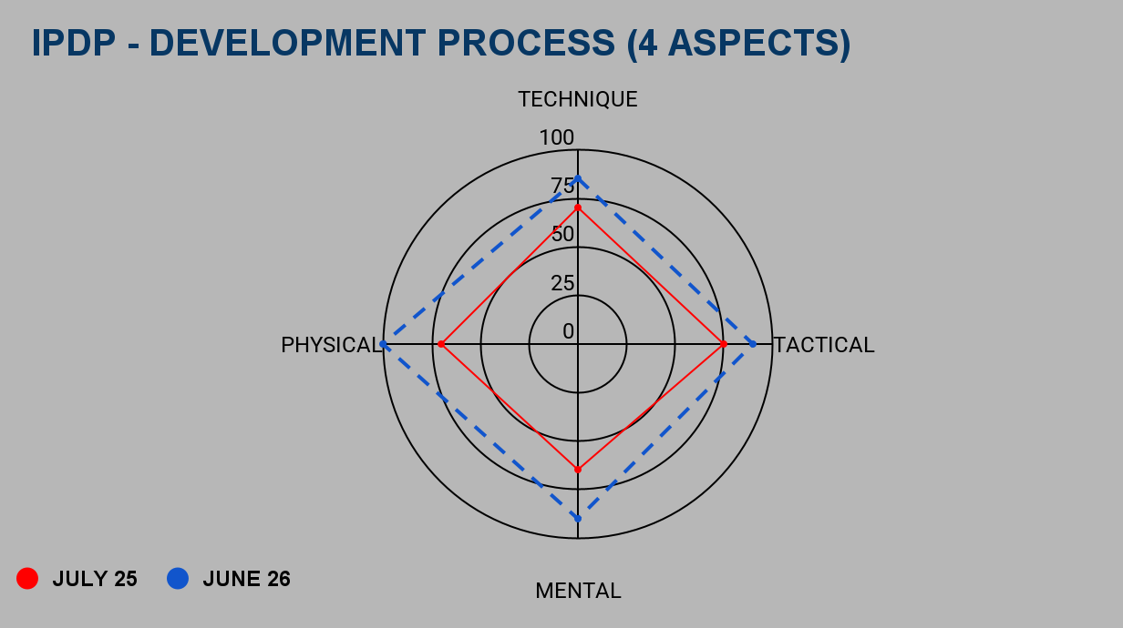
INDIVIDUAL PLAYER DEVELOPMENT PROGRAM
PROGRESS- DEVELOPMENT FOCUS SHORT TERM
USSF ‘A’ COACH P. ALMEIDA

Slide 19
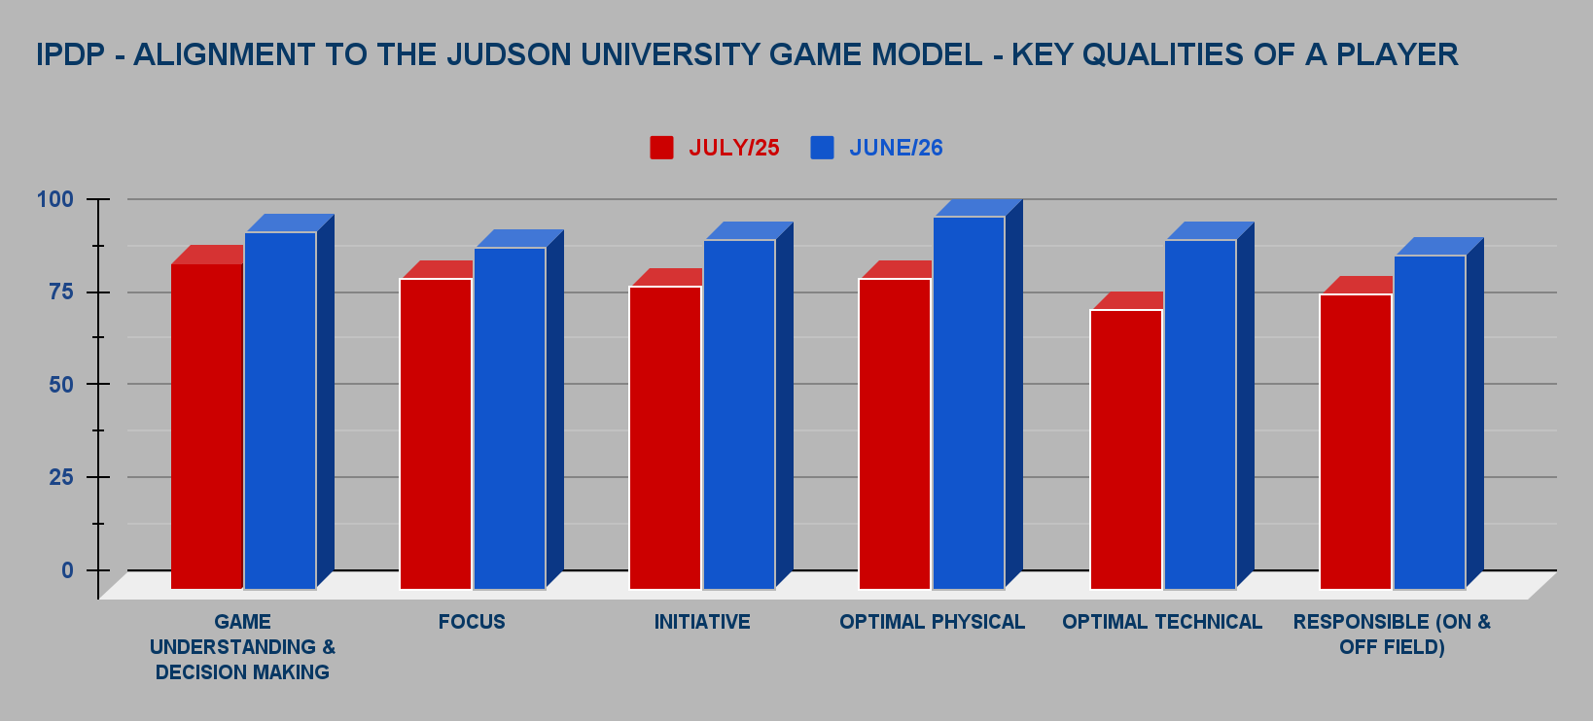
INDIVIDUAL PLAYER DEVELOPMENT PROGRAM
PROGRESS- DEVELOPMENT FOCUS SHORT TERM
USSF ‘A’ COACH P. ALMEIDA

Slide 20
DISCIPLINE + PROCESS
INDIVIDUAL PLAYER DEVELOPMENT PLAN
Prepared by Coach

