Slide 1

Positional Roles and Responsibilities & Key Qualities
In all moments of the game

Slide 2
SC Wave provides an enjoyable and positive environment for soccer players. Our mission is to promote individual development of all our players and assist them to reach their full potential, both within the game and outside of the game of soccer. Our players focus on proper preparation through discipline, determination, dedication, hard work and teamwork while playing with a passion and competing every time they step on the field.
MISSION
SC Wave will develop complete soccer players with excellent soccer intelligence, technical skills, and a competitive mentality. Players will learn to love the game and will compete at their appropriate level, while experiencing life-lessons beyond the game. We aim to prepare our players to the next level of College Soccer and in some instances professional soccer.
VISION

Slide 3
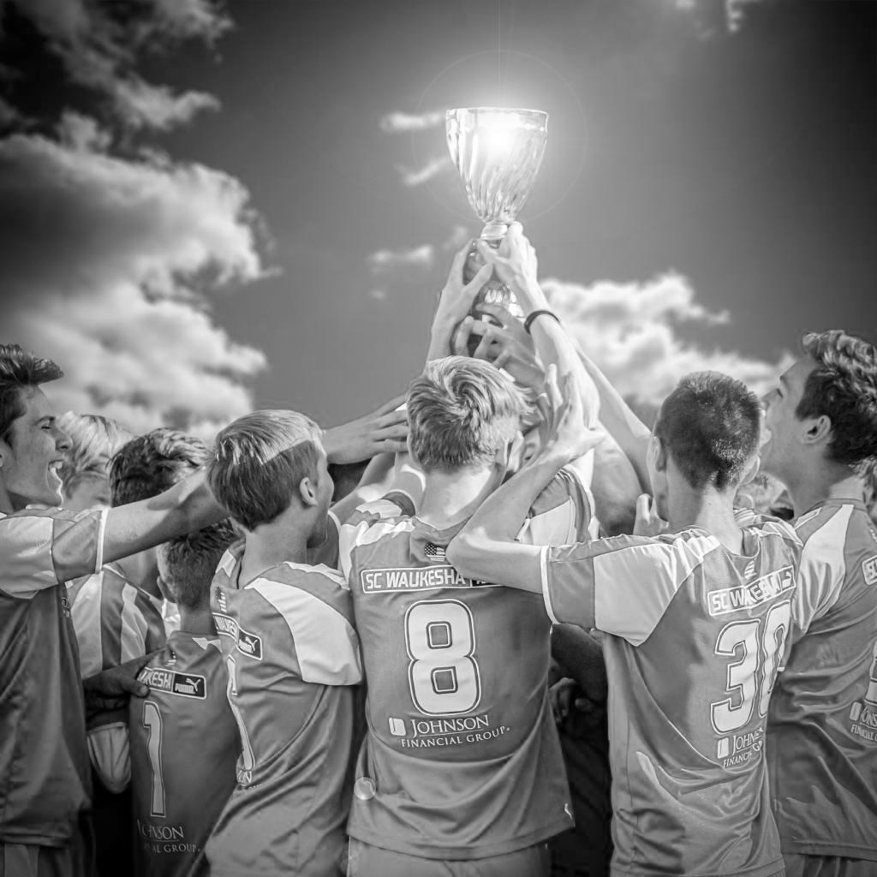
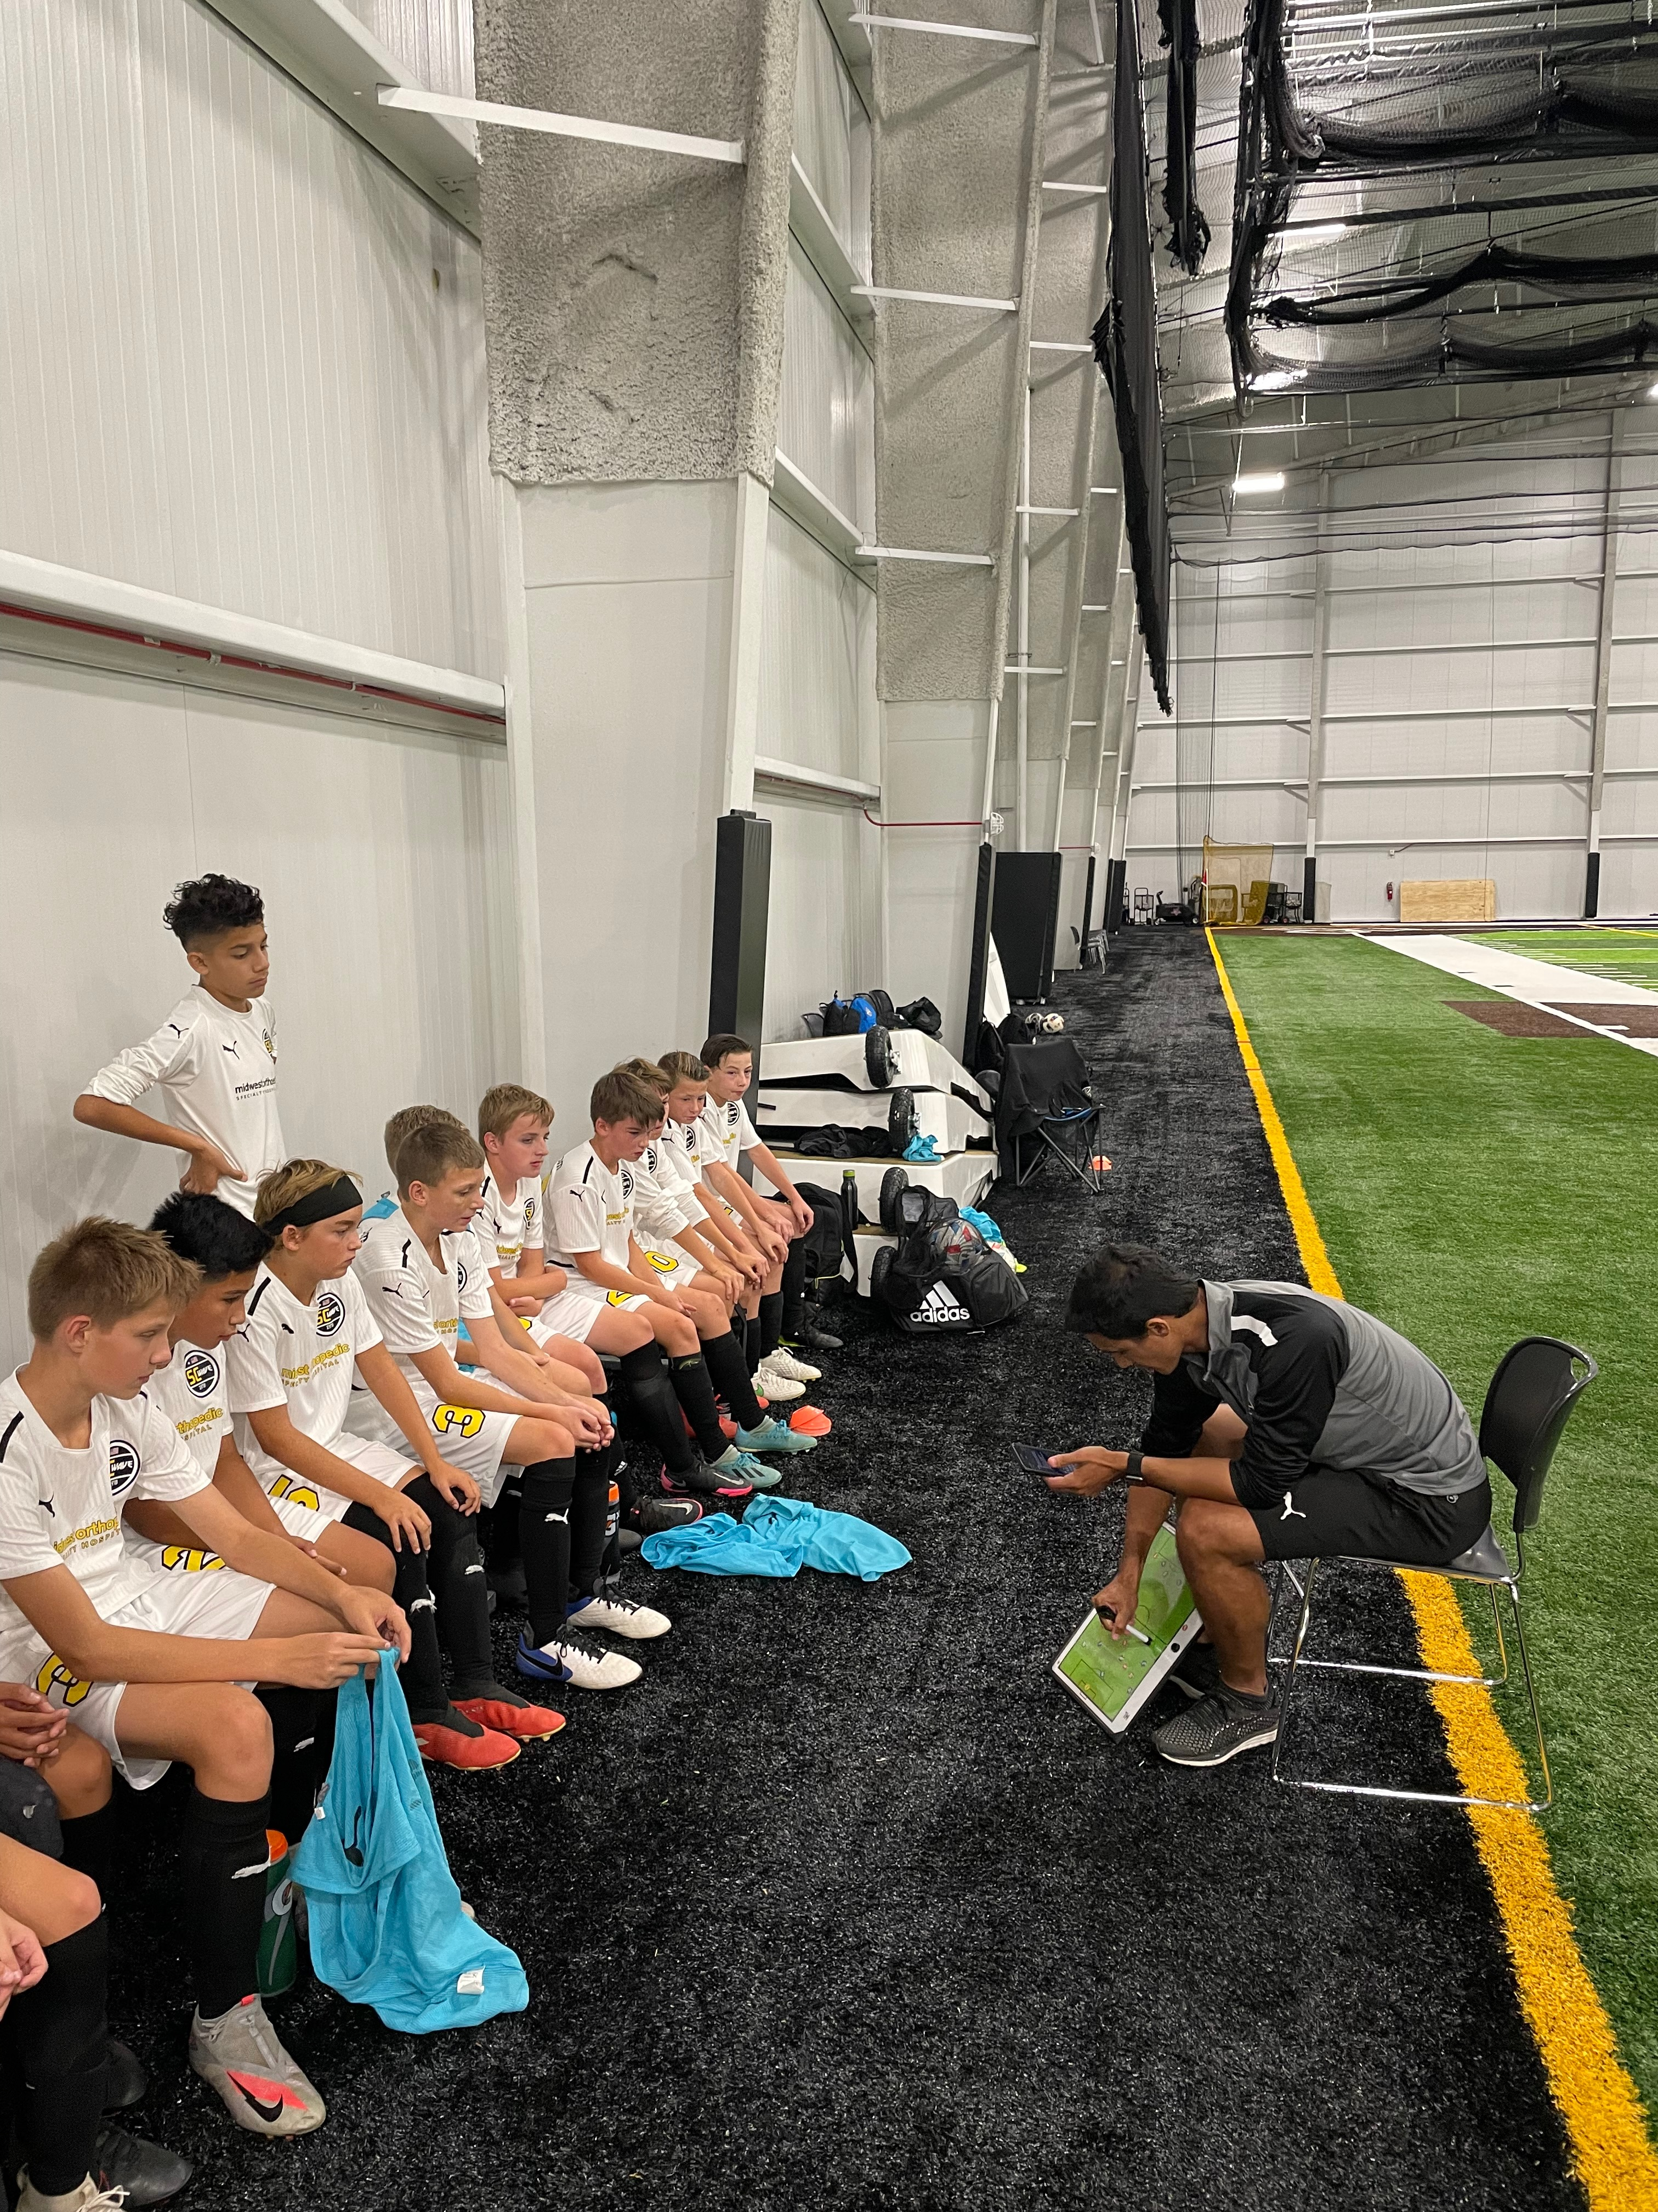
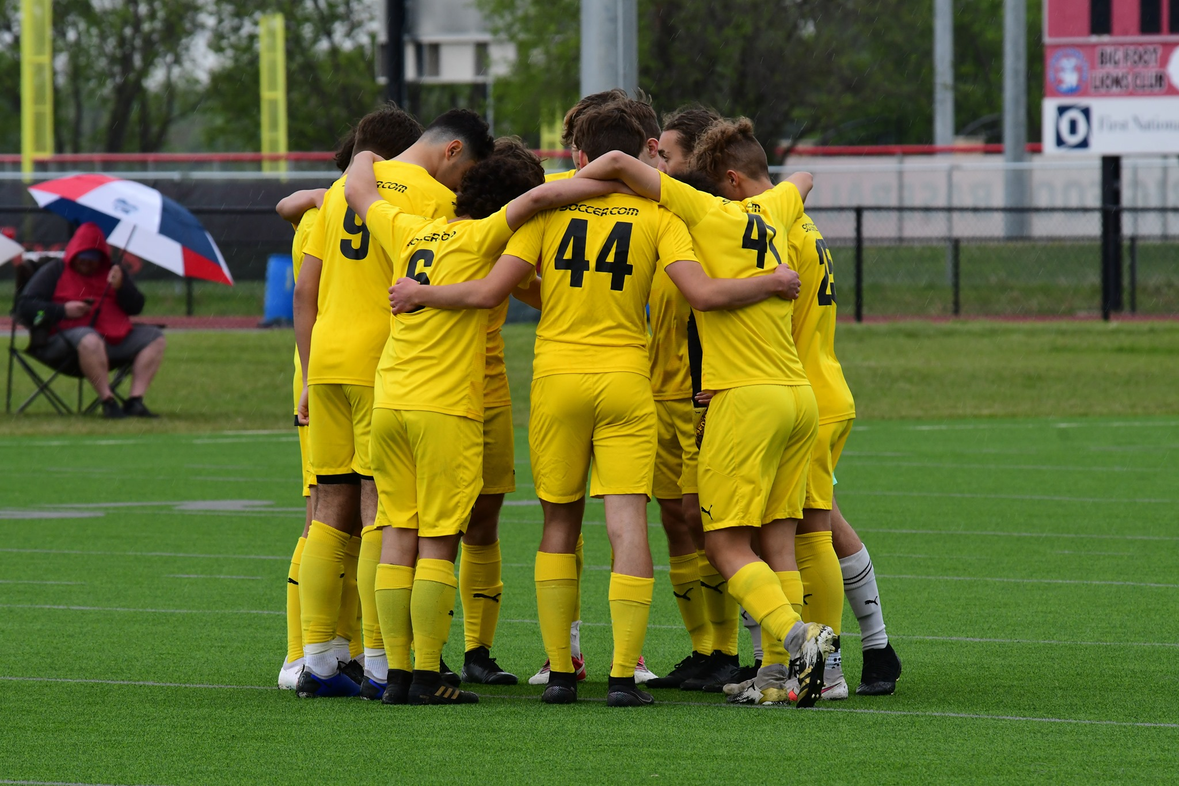
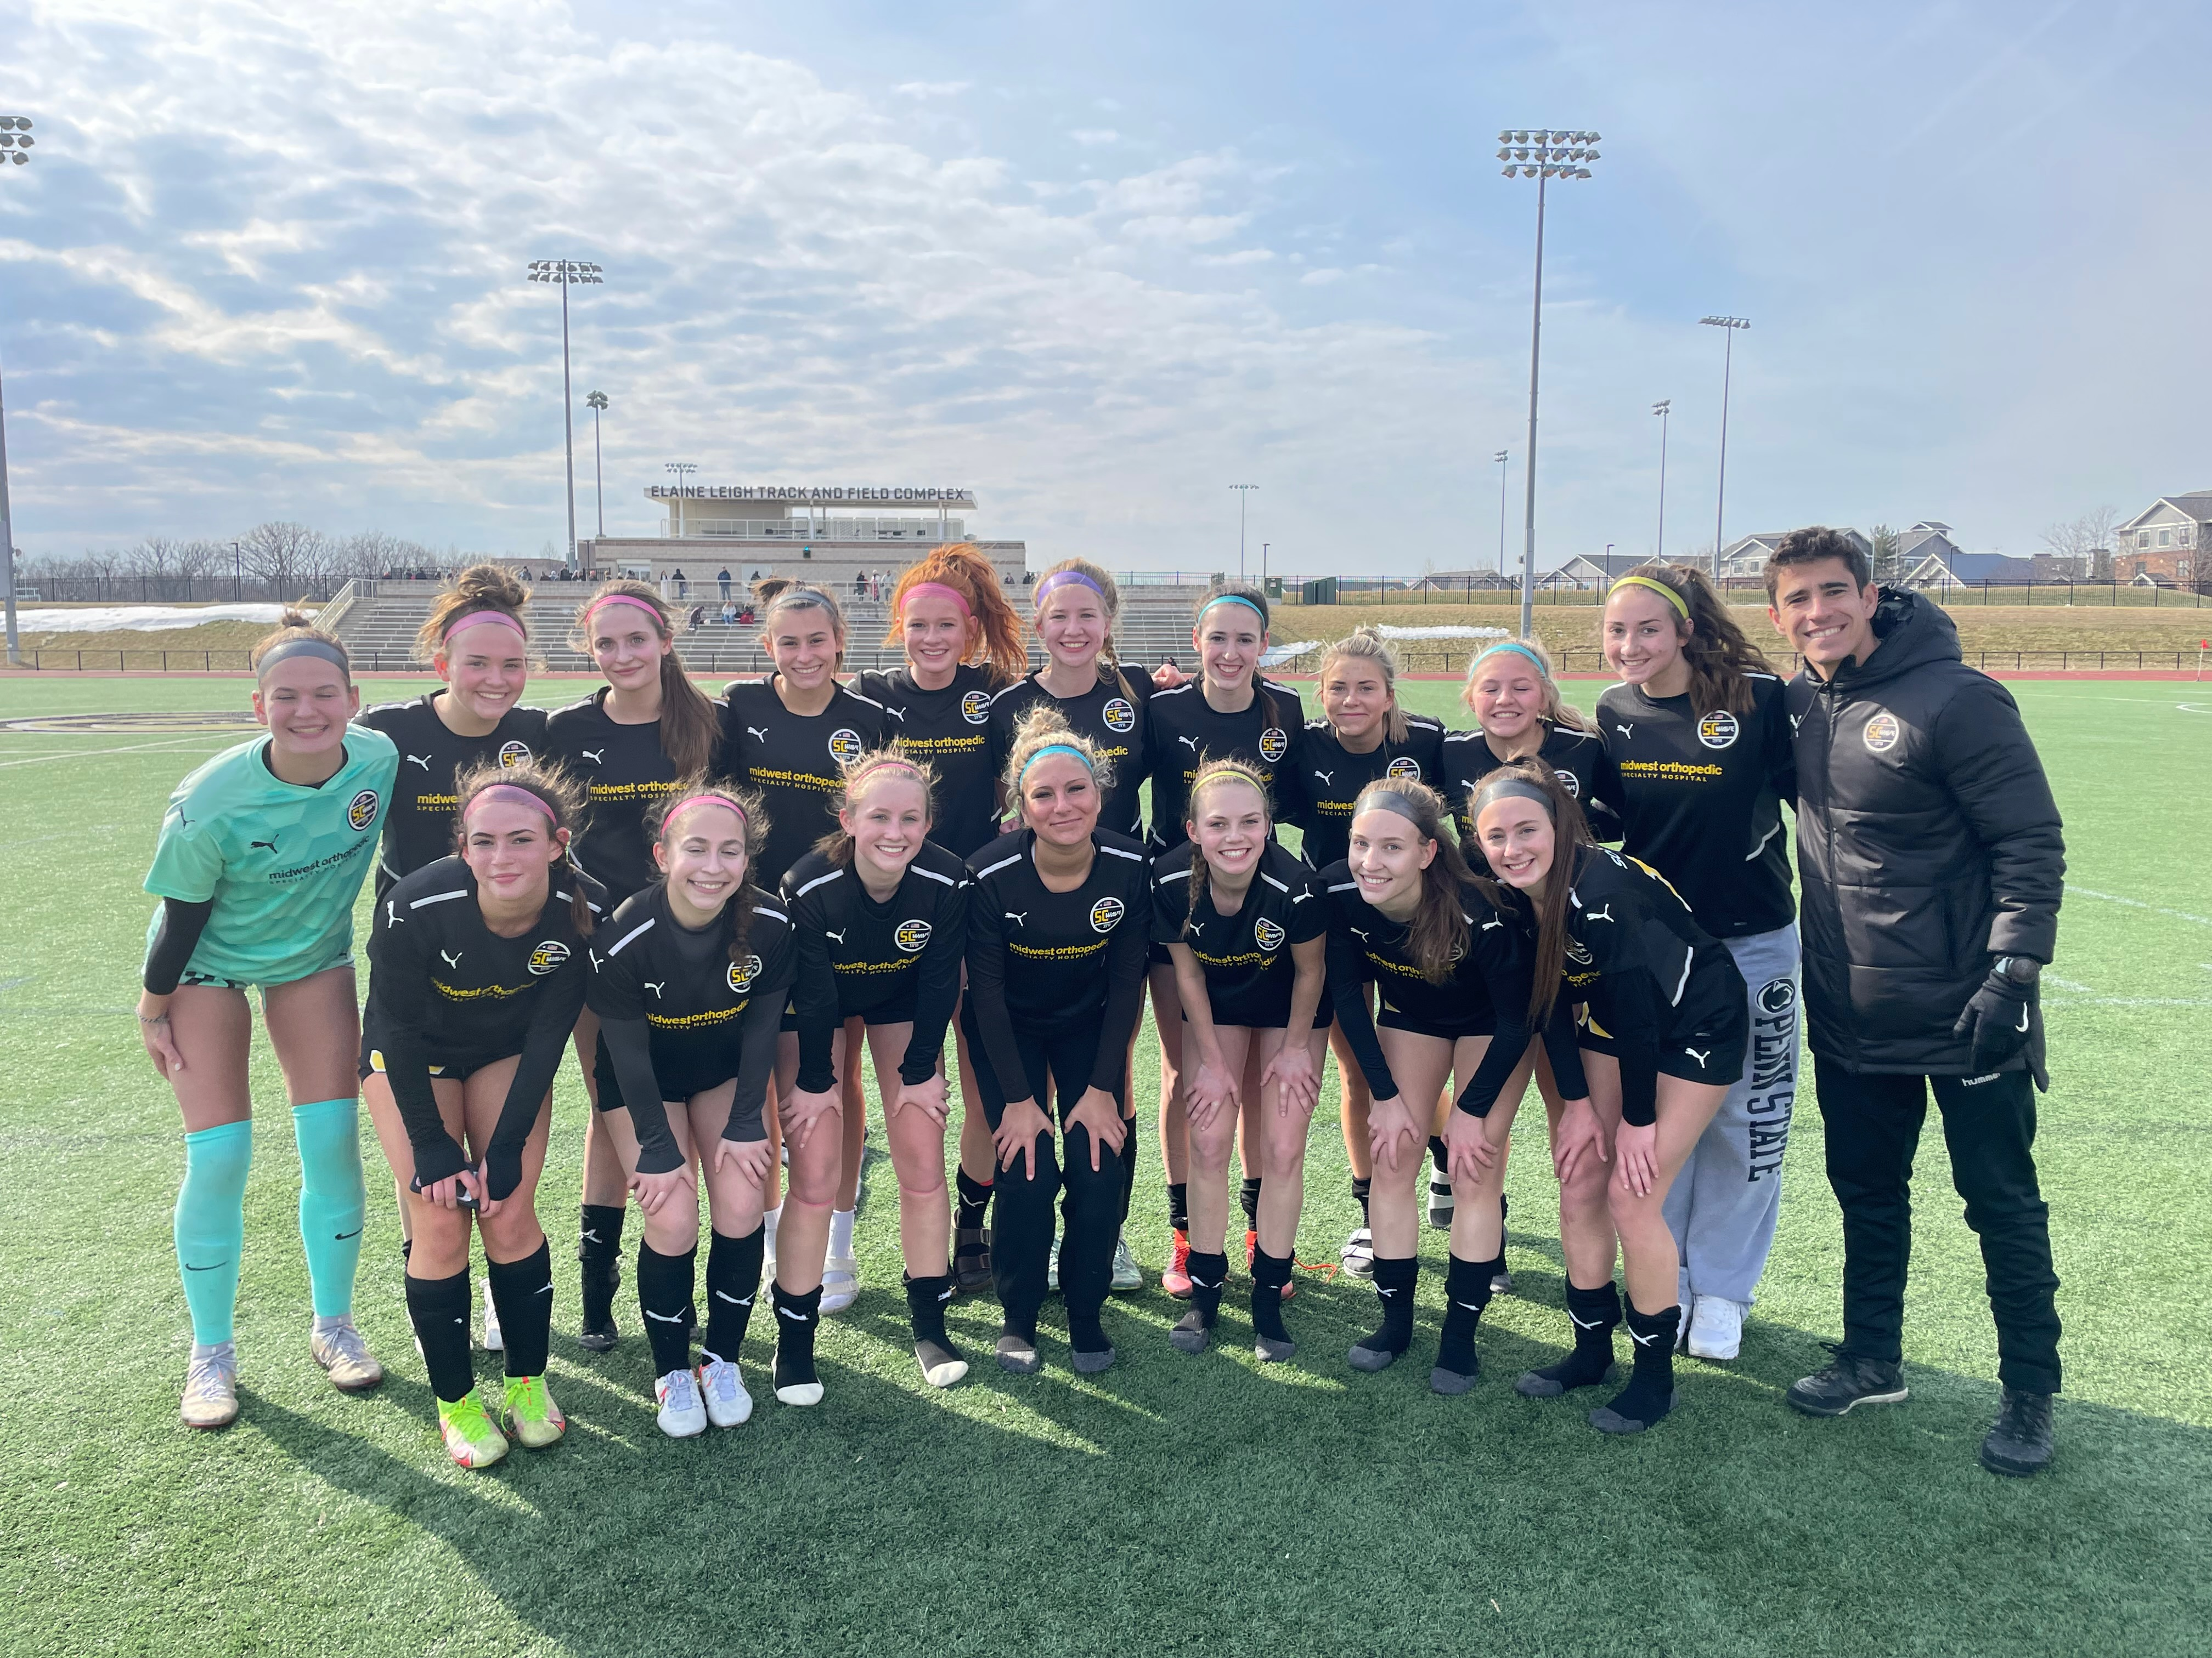
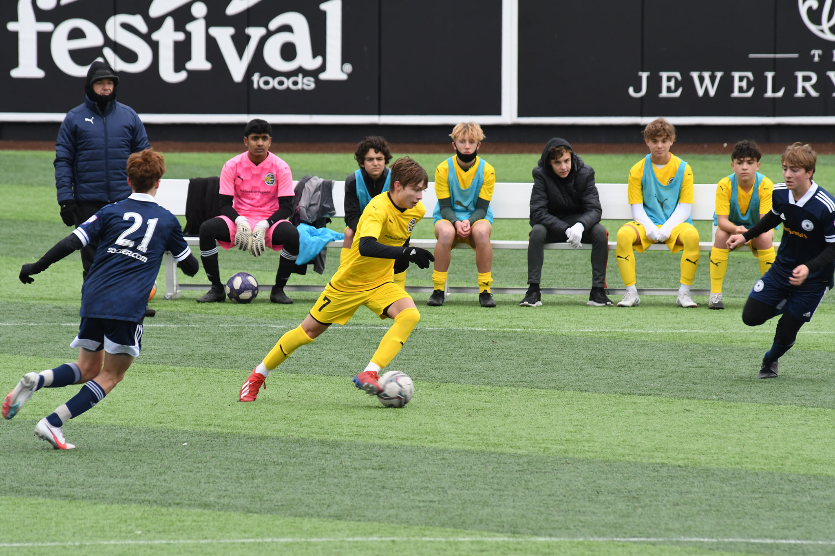
VALUES
MERITOCRACY
Our attitudes and behaviors reflect what we deserve
TEAM SPIRIT
Collective achievements generate individual benefits
RESPECT
We respect the environment; referees, opponents, teammates and facilities. We are proud to represent the club and our community
RESILIENCE
Giving up is not an option. You fail only when you quit
CREATIVITY
We are brave and confident to create/generate something unpredictable

Slide 4
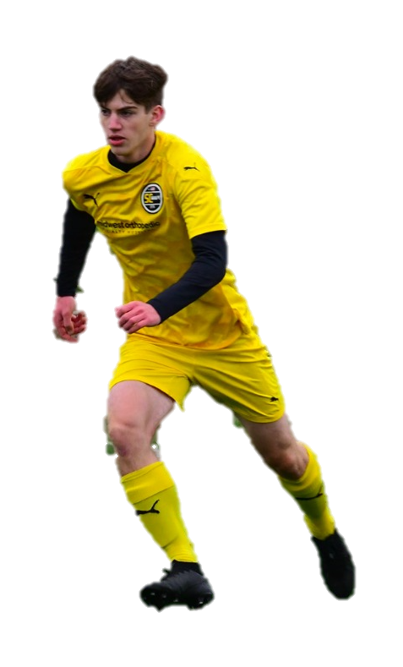
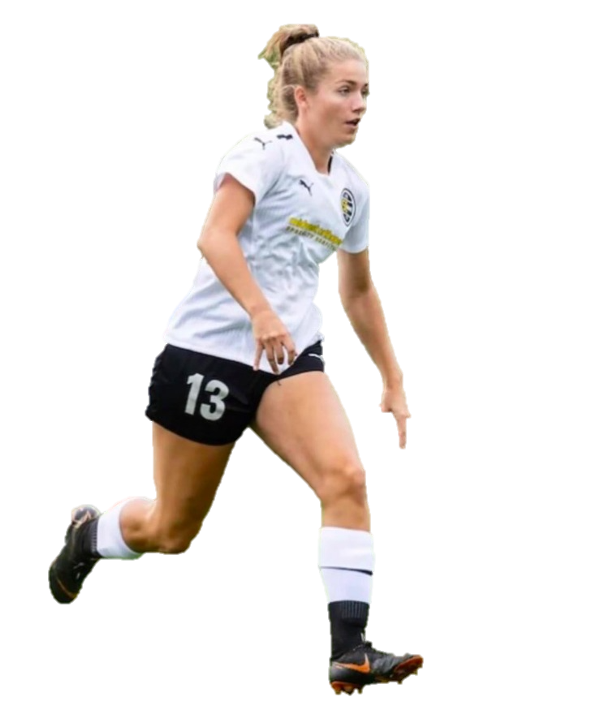
SC WAVE PLAYERS PATHWAY
GA & MLS NEXT
Regional Level
State Level
Recreational
Select
Academy
College & PRO

Slide 5
SC WAVE DNA
ATTACKING
Proactive and objective ball possession utilizing our positional play principles to create space and attack the opponent’s goal.
Immediate reaction to vertically attack opponent if space is available or keep the ball as we restructure our attacking organization.
DEFENDING
TO
ATTACKING
ATTACKING
TO
DEFENDING
When losing possession, we seek to react quickly, in an organized manner, immediately to recover the ball or protect our goal.
DEFENDING
Defensive organization seeking to gain ball possession high up the field utilizing a mid or high compact block structure. If we can’t, we will look to force opponent to pre-established trapping zones.

Slide 6

Key Qualities of a Player
#1 Goalkeeper
Confident
Athletic
Decisive
Coach on the field
Accurate, Confident Passing (short and long distances)

Slide 7
NO. 1
Goalkeeper
Player Actions
Attacking
DEFENSIVE 1/3:
Position to support for back pass if ball cannot be played forward
Pass forward or wide to spread out and/or begin build-up
MIDDLE 1/3:
Position to support for back pass if ball cannot be played forward
OFFENSIVE 1/3:
Push up the defensive line and organize (coach) teammates to position themselves to prevent counter attacks
Transition Defending to Attacking
DEFENSIVE 1/3:
Pass forward (long) quickly to exploit the opponent and create 1v1
Keep the ball when you cannot play forward
MIDDLE 1/3:
Push the defensive line up
Give support for back pass if ball cannot be played forward
OFFENSIVE 1/3:
Organize (coach) teammates to position themselves to prevent counter attacks
Transition Attacking to Defending
DEFENSIVE 1/3:
Stay connected to the back line – organize (coach) teammates
MIDDLE 1/3:
Organize (coach) teammates – balanced and compact
OFFENSIVE 1/3:
Position behind defensive line to take preventative defensive action
Defending
DEFENSIVE 1/3:
Organize (coach) teammates when to switch from zonal marking to player tracking (organization on set pieces)
Anticipate crosses and shots and position to stop or regain the ball
MIDDLE 1/3:
Position to provide cover to anticipate and intercept long balls behind defensive line
OFFENSIVE 1/3:
Position to provide cover to anticipate and intercept long balls behind defensive line

Slide 8
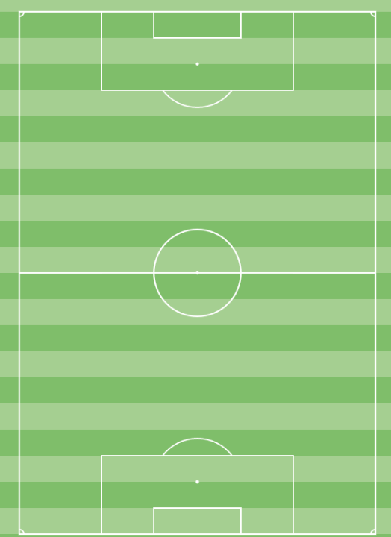
Principles and Player Qualities:
Disorganize opponent
Variety in distribution
Confidence in distribution
Principles and Player Qualities:
Disorganize opponent
Available for backward pass
Push up with the team
Awareness of field position
Principles and Player Qualities:
Push up with the team
Awareness of field position
#1
(GK)
O
F
F
E
N
S
I
V
E
Offensive Phase
Build Out
Offensive Phase
Advancement Phase
Offensive Phase
Chance Creation/Scoring Phase
1
1
1

Slide 9
Principles and Player Qualities:
Recover ball
Secure hands when catching
Command the box
Aggression and confidence
Read opponent’s body shape
Principles and Player Qualities:
Recover ball
Move forward when opponent plays backward
Ready to come off line to intercept
Principles and Player Qualities:
Organize teammates in front
Read opponent’s body language
#1
(GK)
D
E
F
E
N
S
I
V
E
Defensive Phase
Defensive Third
Defensive Phase
Middle Block
Defensive Phase
Press
1
1
1

Slide 10
Key Qualities of a Player
#4 & #5 Center Backs
Positionally Dominant
Vocal Leader
Technically Skilled
Athletic
Aerially Dominant

Slide 11
NO. 4, 5
Center Back
Player Actions
Attacking
DEFENSIVE 1/3:
Position to spread out & provide passing option (for GK) in relation to other center back & defensive midfielder to outnumber opponent
Make accurate forward/diagonal passes between (or behind) the opposition defensive lines
MIDDLE 1/3:
Move forward with (and without) the ball to create 2v1
Position to support if the ball cannot be played forward
OFFENSIVE 1/3:
Push up the defensive line & organize teammates to take up preventive defensive action
Transition Defending to Attacking
DEFENSIVE 1/3:
Move quickly into position to support in space
Pass or dribble forward
MIDDLE 1/3:
Coach the defensive line to push up as a unit
OFFENSIVE 1/3:
one
Transition Attacking to Defending
DEFENSIVE 1/3:
If closest to the situation, put pressure on the ball immediately to prevent danger
MIDDLE 1/3:
Quick decision to pressure the ball, delay the opponents attack, or drop back
OFFENSIVE 1/3:
Take preventive defensive action
Defending
DEFENSIVE 1/3:
Deny opposition in 1v1 situations (air & ground) and be first to the ball on all crosses
Clear ball from danger areas
MIDDLE 1/3:
Position to monitor opponent & analyze situation to determine correct defensive action: PCB, zone, man mark, etc.
Movements & decisions in partnership with other center back
OFFENSIVE 1/3:
Lead & organize defensive line & direct other teammates
Intercept long & through passes

Slide 12
Principles and Player Qualities:
Disorganize opponent
Eliminate defenders with pass
Variety in passing
Dribble forward when no pressure
Principles and Player Qualities:
Disorganize opponent
Eliminate defenders with pass or dribble
Overload one side to isolate opposite side
Variety in passing
Principles and Player Qualities:
Disorganize opponent
Eliminate defenders with pass or dribble
Crossing from variety of positions
Pass backward to restart attack
#4/5
(CB)
O
F
F
E
N
S
I
V
E
Offensive Phase
Build Out
Offensive Phase
Advancement Phase
Offensive Phase
Chance Creation/Scoring Phase
5
4
5
4
5
4

Slide 13
Principles and Player Qualities:
Organized and compact
Intercept and recover the ball
Connected sub-groups
Limit central penetration
Communication to teammates in front
Block crosses/shots
Limit opponent's entry into our box
Principles and Player Qualities:
Organized and compact
Intercept and recover the ball
Connected sub-groups
Limit central penetration
Communication to teammates in front
Step forward when opponent
plays backward
Principles and Player Qualities:
Organized and compact
Intercept and recover the ball
Connected sub-groups
Limit central penetration
Communication to teammates in front
Proactive marking to prevent counter
#4/5
(CB)
D
E
F
E
N
S
I
V
E
Defensive Phase
Defensive Third
Defensive Phase
Middle Block
Defensive Phase
Press
5
4
5
4
5
4

Slide 14
Key Qualities of a Player
#2 & #3 Full Backs
High Level of Endurance
Proficient Dribbler
High-concentration/anticipation
Proficient Cross/Long Passing
Proficient defending 1v1

Slide 15
NO. 2, 3
Full Back
Player Actions
Attacking
DEFENSIVE 1/3:
Position to support wide & high to receive ball and/or create space for teammates
Pass forward (diagonal or behind) or hold the ball
MIDDLE 1/3:
Support the attack wide & with runs behind
Provide balance to take preventive defensive action when team is in possession/attacking on opposite side, and monitor/organize (coach) teammates from this position.
OFFENSIVE 1/3:
Pass or dribble forward, create 1v1 or 2v1 with (e.g. overlapping runs)
Play the early cross when there is space behind the defensive line
Transition Attacking to Defending
DEFENSIVE 1/3:
If closest to the situation, put pressure on the ball immediately to prevent danger
MIDDLE 1/3:
If farthest from the situation, drop back quickly to re-position with defensive line to provide balance
Based on situation, make decision to put pressure on the ball or drop with defensive line
OFFENSIVE 1/3:
If closest to the situation, put pressure on the ball immediately
Transition Defending to Attacking
DEFENSIVE 1/3:
Give quick support in space (forward & wide)
MIDDLE 1/3:
Move up with the defensive line, as part of a collective unit
OFFENSIVE 1/3:
Pass or dribble forward quickly to exploit the opponent if disorganized
Defending
DEFENSIVE 1/3:
Pressure the player with the ball to regain the ball or delay the opponents attack
Deny penetration, prevent crosses in 1v1 situations
MIDDLE 1/3:
Monitor organization & coach fellow defenders & wide forward where necessary
Move centrally to provide cover & balance when ball is on opposite side
OFFENSIVE 1/3:
Position & reposition to intercept passes while monitoring opponent

Slide 16
Principles and Player Qualities:
Disorganize opponent
Create overloads
Counter movements to create space
Dribble the ball forward when no pressure
Overload one side to exploit the other
Principles and Player Qualities:
Create overloads
Disorganize opponent
Counter movements to create space
Overload one side to exploit the other
Movement centrally to provide double 6
Awareness of field position
Principles and Player Qualities:
Create overloads
Disorganize opponent
Eliminate defenders with pass or dribble
Crossing from variety of positions
Dynamic attacking runs behind opponent
Shooting from outside the box
#2/3
(FB)
O
F
F
E
N
S
I
V
E
Offensive Phase
Build Out
Offensive Phase
Advancement Phase
Offensive Phase
Chance Creation/Scoring Phase
2
3
3
2
3
2

Slide 17
Principles and Player Qualities:
Organized and compact
Intercept and recover the ball
Connected sub-groups
Limit central penetration
Communication to teammates in front
Block crosses/shots
Limit opponent's entry into our box
Principles and Player Qualities:
Organized and compact
Horizontal and vertical compactness
Intercept and recover the ball
Connected sub-groups
Limit central penetration
Communication to teammates in front
Angle of approach to force wide
Principles and Player Qualities:
Organized and compact
Horizontal and vertical compactness
Communication to teammates in front
Connected sub-groups
Intercept and recover the ball
#2/3
(FB)
D
E
F
E
N
S
I
V
E
Defensive Phase
Defensive Third
Defensive Phase
Middle Block
Defensive Phase
Press
3
2
3
2
3
2

Slide 18
Key Qualities of a Player
#6 Defensive Midfielder
Strong Tackling Ability
Athletic
Positionally Dominant
Accurate, Efficient Distribution
Control/Dictate tempo of the game

Slide 19
NO. 6
Defensive Midfielder
Player Actions
Attacking
DEFENSIVE 1/3:
Position in central areas to support diagonally in spaces between the lines in order to receive ball & play forward and/or to create space for teammate
Position to support if the ball cannot be played forward & make diagonal passes to unbalance or destabilize the opponent
MIDDLE 1/3:
Align movements with other central midfielders/rotate positions & triangulate
Dribble forward when there is no passing option & there is open space, look to create 2v1, switch the field
OFFENSIVE 1/3:
Support the attack with forward runs & scoring goals
Position to take preventive defensive action
Transition Defending to Attacking
DEFENSIVE 1/3:
Move quickly into position to support in space & wide
Make diagonal passes forward or dribble to create 2v1
MIDDLE 1/3:
Keep the ball when cannot play forward & manage the pace of the game
OFFENSIVE 1/3:
one
Transition Attacking to Defending
DEFENSIVE 1/3:
If closest to the situation, put pressure on the ball immediately to prevent danger
MIDDLE 1/3:
Quick decision to pressure the ball, delay the opponents attack when team is disorganized, or drop back
OFFENSIVE 1/3:
Position to take preventive defensive action
Defending
DEFENSIVE 1/3:
Make decision to switch from zonal marking to player tracking (also in middle third)
MIDDLE 1/3:
Position to defend the opponent & passing lanes/central space in front of center backs
Pressure the ball & help teammates to outnumber opponent
OFFENSIVE 1/3:
Organize (coach) teammates where necessary to make/keep team compact
Deny penetration in 1v1 situations

Slide 20
Principles and Player Qualities:
Disorganize the opponent
Create diamond shape
Rotation in midfield
Eliminate defenders with pass
Awareness of position on the field
Awareness of space to exploit
Principles and Player Qualities:
Create diamond shape
Create overloads
Eliminate defenders with pass
Disorganize opponent
Rotation in midfield
Overload one side to exploit the other
Principles and Player Qualities:
Awareness of position on field
Create overloads
Disorganize opponent
Rotation in midfield
Overload one side to exploit the other
Shooting from outside the box
#6
(DCM)
O
F
F
E
N
S
I
V
E
Offensive Phase
Build Out
Offensive Phase
Advancement Phase
Offensive Phase
Chance Creation/Scoring Phase
6
6
6

Slide 21
Principles and Player Qualities:
Organized and compact
Recover ball
Limit central penetration (opponent ½ space)
Communication to teammates in front
Condense field when ball played backward
Communication to teammates in front
Principles and Player Qualities:
Organized and compact
Horizontal and vertical compactness
Make play predictable
Connected sub-groups
Limit central penetration (opponent ½ space)
Communication to teammates in front
Principles and Player Qualities:
Organized and compact
Horizontal and vertical compactness
Connected sub-groups
Limit central penetration
Communication to teammates in front
#6
(DCM)
D
E
F
E
N
S
I
V
E
Defensive Phase
Defensive Third
Defensive Phase
Middle Block
Defensive Phase
Press
6
6
6
6
6
6

Slide 22
Key Qualities of a Player
#8 Central Midfielder
High Level of Endurance
Proficient Dribbler
Calm Under Pressure
Positionally Dominant
Accurate, Efficient Passing
Accurate Finishing from Long Range (18-30yd)

Slide 23
Key Qualities of a Player
#10 Attacking Central Midfielder
Dynamic Dribbler
Creative
Calm Under Pressure
Positionally Dominant
Accurate, Dynamic Passing
Accurate Finishing from all ranges
Ability to penetrate opponent’s back line with and without the ball

Slide 24
NO. 8, 10
Center Midfielders
Player Actions
Attacking
DEFENSIVE 1/3:
Position in central areas to support diagonally in spaces between the lines in order to receive ball & play forward and/or to create space for teammate
Align movements with other central midfielders/rotate positions & triangulate
MIDDLE 1/3:
Dribble forward when there is no passing option & there is open space, look to create 2v1, switch the field
Make diagonal & through passes to unbalance or destabilize the opponent
OFFENSIVE 1/3:
Support the attack with forward runs behind the defensive line to create chances & score goals
Position to support in the box, near the goal
Transition Defending to Attacking
DEFENSIVE 1/3:
Move quickly into position to support in space
Make diagonal passes forward or dribble to create 2v1
MIDDLE 1/3:
Keep the ball when cannot play forward & manage the pace of the game
OFFENSIVE 1/3:
Position & support quickly in space to exploit opponent & create chances
Transition Attacking to Defending
DEFENSIVE 1/3:
If closest to the situation , put pressure on the ball Immediately to prevent danger
MIDDLE 1/3:
Quick decision to pressure the ball, delay the opponents attack, or drop back
OFFENSIVE 1/3:
If closest to the situation , put pressure on the ball Immediately
Defending
DEFENSIVE 1/3:
Recover into defensive third to assist 6 & 8 when needed
Take anticipated attacking action/position
MIDDLE 1/3:
Prevent opponent from dribbling or passing forward
OFFENSIVE 1/3:
Organize & coach teammates to press in identified situations
Decide to pressure the ball, stay in zonal space, or track opposition holding midfielder

Slide 25
Principles and Player Qualities:
Create overloads
Create diamond shape
Disorganize opponent
Rotation in midfield
Principles and Player Qualities:
Occupy half space
Create overloads
Create diamond shape
Disorganize opponent
Draw opponent to one side to find
Isolation on opposite side
Penetrate opponent
Principles and Player Qualities:
Create overloads
Penetrate through dribble or pass
Disorganize opponent
Rotation in midfield
Dynamic runs into the box
Shooting from outside the box
#8/10
(CM/
ACM)
O
F
F
E
N
S
I
V
E
Offensive Phase
Build Out
Offensive Phase
Advancement Phase
Offensive Phase
Chance Creation/Scoring Phase
½ Space
½ Space
10
8
8
10
8
10

Slide 26
Principles and Player Qualities:
Organized and compact
Limit opponent’s time on ball
Follow midfielder opposition into the box
Recover the ball
Principles and Player Qualities:
Horizontal and vertical compactness
Make opponent play predictably
Move forward when opponent plays
backward
Limit opponent’s passes between line
Recover the ball
Principles and Player Qualities:
Organized and compact
Make play predictable
Identify and pressure hot spot
Recover ball in hot spot
Communication to teammates in front
#8/10
(CM/
ACM)
D
E
F
E
N
S
I
V
E
Defensive Phase
Defensive Third
Defensive Phase
Middle Block
Defensive Phase
Press
Hot Spot
10
8
Cover & Balance
Pressure Opponent
Recover Ball
10
8
Limit Penetrating Passes
Horizontal & Vertical Compactness
8
10

Slide 27
Key Qualities of a Player
#7 & 11 Wide Forwards
Dynamic Dribbler (1v1)
Creative
Positionally Dominant
Accurate, Dynamic Crossing
High Endurance, Good Speed
Accurate Finishing, Inside and Outside Penalty Area

Slide 28
NO. 7, 11
Wide Forwards
Player Actions
Attacking
DEFENSIVE 1/3:
Position high & wide as starting point to spread opposition & create space for teammates
MIDDLE 1/3:
Vary supporting movements in space between or behind the defensive line of the opponent
Pass or dribble forward, create 1v1, 2v1, in both wide & central areas
OFFENSIVE 1/3:
Take on defenders 1v1 to unbalance opponent – on outside to create chances from crosses or inside to score goals
Move into goal scoring positions in the box or at the back post
Transition Defending to Attacking
DEFENSIVE 1/3:
Move quickly into position to support in space
MIDDLE 1/3:
Keep the ball when cannot play forward
OFFENSIVE 1/3:
Position & support quickly in space to exploit opponent & create chances
Transition Attacking to Defending
DEFENSIVE 1/3:
If closest to the situation, put pressure on the ball immediately to prevent danger
MIDDLE 1/3:
Quick decision to pressure the ball, delay the opponents attack, or drop back. Follow direction from teammates behind.
OFFENSIVE 1/3:
If closest to the situation, put pressure on the ball immediately
Defending
DEFENSIVE 1/3:
Recover & track into defensive third to assist fullback when needed
MIDDLE 1/3:
Move centrally to provide cover & balance when ball is on opposite side
OFFENSIVE 1/3:
Monitor situation to defend both space & opponent & press in identified situations
Prevent opponent from dribbling or passing forward (1v1)

Slide 29
Principles and Player Qualities:
Stretch opponent
Occupy half space
Create overloads
Create diamond shape
Disorganize opponent
Draw opponent to one side to find
isolation on opposite side
Principles and Player Qualities:
Occupy half space
Create overloads
Create diamond shape
Disorganize opponent
Draw opponent to one side to find
Isolation on opposite side
Eliminate defender on pass or dribble
Principles and Player Qualities:
Eliminate defenders on pass or dribble
Occupy half space
Create overloads
Draw opponent to one side to find
isolation on opposite side
Penetrate opponent in half space / box
Score and assist goals
#7/11
(WIDE FWD)
O
F
F
E
N
S
I
V
E
Offensive Phase
Build Out
Offensive Phase
Advancement Phase
Offensive Phase
Chance Creation/Scoring Phase
11
½ Space
7
7
11
7
11

Slide 30
Principles and Player Qualities:
Horizontal and vertical compactness
Make opponent play predictably
Move forward when opponent plays
backward
Limit penetration in wide areas
Principles and Player Qualities:
Horizontal and vertical compactness
Make opponent play predictably
Move forward when opponent plays
backward
Limit opponent’s passes between line
Recover the ball in wide areas
Principles and Player Qualities:
Make opponent play predictably
Limit opponent’s passes between line
Recover the ball in wide areas
Identify and pressure the hot-spot
#7/11
(WIDE FWD)
D
E
F
E
N
S
I
V
E
Defensive Phase
Defensive Third
Defensive Phase
Middle Block
Defensive Phase
Press
Recover Ball in
Wide Areas
7
11
Make Play Predictable
Recover Ball in
Wide Areas
11
7
Vertical & Horizontal
Compactness
7
11
Prevent Central Penetration

Slide 31
Key Qualities of a Player
#9 Center Forward
Dynamic Dribbler
Creative
Good Touch/Control
Positionally Dominant
Aerially Dominant
Athletic
Accurate Finishing, Inside and Outside Penalty Area

Slide 32
NO. 9
Center Forward
Player Actions
Attacking
DEFENSIVE 1/3:
Position high & centrally as a target to occupy the opposition 4 & 5, to receive, hold/protect, lay-off the ball & create space for teammates (also for middle third to help team progress)
MIDDLE 1/3:
Make varied forward runs in space behind the defensive line of the opponent
Pass or dribble forward to create 1v1 or 2v1 in central areas
OFFENSIVE 1/3:
Position to support, unmark, with varied, well timed runs in the box, near the goal to finish chances, or create chances for teammates
Transition Defending to Attacking
DEFENSIVE 1/3:
Move quickly into position (onside) to support in space high up the field
MIDDLE 1/3:
Keep the ball when cannot play forward, hold & protect the ball while teammates support the attack
OFFENSIVE 1/3:
Position & support quickly in space to exploit opponent & create chances
Transition Attacking to Defending
DEFENSIVE 1/3:
Position & support on side of field for clearances
Prevent opponent from sustaining attack by playing backward
MIDDLE 1/3:
Quick decision to pressure the ball, delay the opponents attack, or drop back. Follow direction from teammates behind
OFFENSIVE 1/3:
If closest to the situation, put pressure on the ball immediately
Defending
DEFENSIVE 1/3:
Take anticipated attacking action & positioning
MIDDLE 1/3:
Position to force the opponent to play to one side/prevent opponent from switching the field
Pressure the ball & help teammates to outnumber opponent
OFFENSIVE 1/3:
Monitor situation to defend both space & opponent & press in identified situations
Decide to pressure the ball, stay in zonal space, or track opposition center back

Slide 33
Principles and Player Qualities:
Maintain possession for team
Occupy half space
Stretch opponent backline
Eliminate defenders on pass or dribble
Create overloads
Isolation on opposite side
Principles and Player Qualities:
Maintain possession for team
Eliminate defenders on pass or dribble
Occupy half space
Create overloads
Penetrate opponent in half space / box
Score and assist goals
Stretch opponent backline
Principles and Player Qualities:
Score and assist goals
Eliminate defenders on pass or dribble
Dribble forward
Create overloads
Penetrate opponent in half space / box
Dynamic runs in the box
Stretch opponent backline – create space
#9
(FWD)
O
F
F
E
N
S
I
V
E
Offensive Phase
Advancement Phase
Offensive Phase
Build Out
Offensive Phase
Chance Creation/Scoring Phase
9
9
9

Slide 34
Principles and Player Qualities:
Force play to one side of field
Limit central penetration
Limit opponent #6 time on ball
Back pressure opponent midfield
Recover the ball
Principles and Player Qualities:
Make play predictable
Force play to one side of the field
Pressure after first pass between CB
Back pressure opponent #6
Limit central penetration
Principles and Player Qualities:
Make play predictable
Force play to one side of the field
Recover the ball and attack
Connected sub-groups
Limit central penetration
Pressure after first pass from CB
#9
(FWD)
D
E
F
E
N
S
I
V
E
Defensive Phase
Defensive Third
Defensive Phase
Middle Block
Defensive Phase
Press
Make Play Predictable
Force to one side of field, recover ball
9
Make Play Predictable
Force to one side of field, recover ball
9
9

