Slide 1


SC WAVE SOCCER CLUB
MLS NEXT · Player Development
CLUB MODEL

Slide 2
MISSION & VISION
MISSION
VISION
SC Wave provides an enjoyable and positive environment for soccer players. Our mission is to promote individual development of all our players and assist them to reach their full potential, both within the game and outside of the game of soccer.
Our players focus on proper preparation through discipline, determination, dedication, hard work and teamwork while playing with a passion and competing every time they step on the field.
SC Wave will develop complete soccer players with excellent soccer intelligence, technical skills, and a competitive mentality.
Players will learn to love the game and will compete at their appropriate level, while experiencing life-lessons beyond the game.
We aim to prepare our players to the next level of College Soccer and in some instances professional soccer.

Slide 3
CLUB VALUES
MERITOCRACY
TEAM SPIRIT
RESPECT
RESILIENCE
CREATIVITY
Our attitudes and behaviors reflect what we deserve.
Collective achievements generate individual benefits.
We respect the environment — referees, opponents, teammates and facilities. We are proud to represent the club and our community.
Giving up is not an option. You fail only when you quit.
We are brave and confident to create and generate something unpredictable.

Slide 4
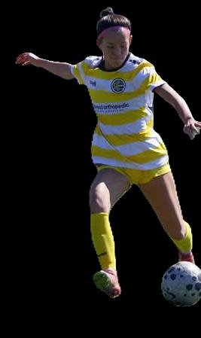
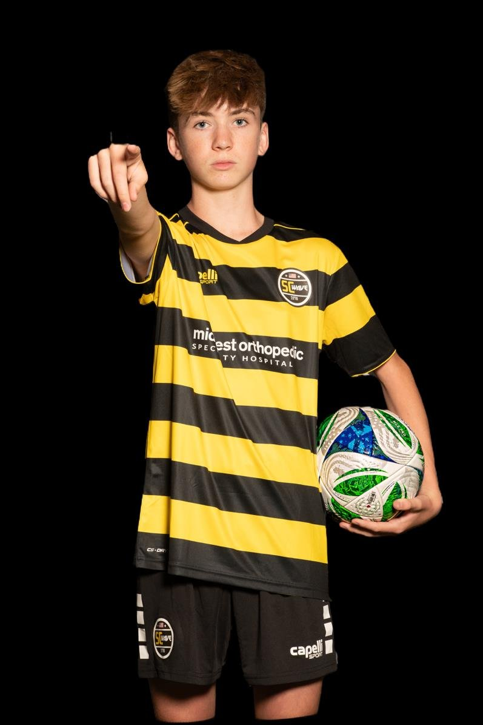
PLAYER PATHWAY
COLLEGE & PRO
GA & MLS NEXT
REGIONAL LEVEL
STATE LEVEL
SELECT
ACADEMY
RECREATIONAL
OUR PLAYERS

Slide 5
HOMEGROWN TRAINING ENVIRONMENT
FALL
Aug – Nov
WINTER
Dec – Mar
SPRING
Apr – Jun
4 SESSIONS / WEEK
2–3 SESSIONS / WEEK
4 SESSIONS / WEEK
MONDAY
U13–U16 FOCUS
MONDAY
Recovery Day — technical/skill day (free play). Tactical Focus: Individual
Futsal Training 1× per week — focus on technical and tactical benefits
Recovery Day — technical/skill day (free play). Tactical Focus: Individual
TUESDAY / WEDNESDAY
OPTIONAL PROGRAM
TUESDAY / WEDNESDAY
Tactical Focus: Group / Team
Speed / Agility / Strength Program
Tactical Focus: Group / Team
THURSDAY
LOCATION
THURSDAY
Organizational Sessions — set pieces/plays, patterns, detail oriented, Game Preparation
MOSH (Franklin) and New Berlin, WI
Organizational Sessions — set pieces/plays, patterns, detail oriented, Game Preparation
LOCATION
LOCATION
Waukesha and/or Franklin, WI
Waukesha and/or Franklin, WI

Slide 6
SC WAVE DNA — FOUR PHASES OF PLAY
PHASE 1
PHASE 2
PHASE 3
PHASE 4
ATTACKING
ATTACKING → DEFENDING
DEFENDING
DEFENDING → ATTACKING
Proactive and objective ball possession utilizing our positional play principles to create space and attack the opponent's goal.
When losing possession, we seek to react quickly, in an organized manner, immediately to recover the ball or protect our goal.
Defensive organization seeking to gain ball possession high up the field utilizing a mid or high compact block structure. If we can't, we will look to force opponent to pre-established trapping zones.
Immediate reaction to vertically attack opponent if space is available or keep the ball as we restructure our attacking organization.

Slide 7
PLAYER DEVELOPMENT STAGES
Player Behaviors and Team Tactical Principles — U13 through U19 age groups
U9
START OF THE PATHWAY
Introduction to the game and the SC Wave environment.
U12
INTRODUCTION TO THE KEY QUALITIES
Development of individual qualities in a team environment (not position-based). Continuous development of fundamentals.
ZONE 1
U13–U14
DEVELOP THE KEY QUALITIES
Development of individual qualities in a team concept. 11v11 Introduction. · Intro to Club's Game Model & Principles
ZONE 2
U15–U16
EXECUTE THE KEY QUALITIES SUCCESSFULLY
Development of specific qualities in position to maximize contribution to the result. · Development & Performance · Execute Club's Game Model & Principles
ZONE 2
U17–U19
EXECUTE THE KEY QUALITIES SUCCESSFULLY IN ORDER TO WIN
Development of specific qualities to be the best player in your position to win the game. · Performance & Results · Total Implementation of Club's Game Model & Principles
ZONE 2

Slide 8
U-13 & U-14 — ATTACKING & DEFENDING
ZONE | ATTACKING | DEFENDING
ATTACKING 1/3 | Different types of runs to get behind/between last line of defenders; Find key players; Find space to combine; Get numbers in the box; Move away from defender = creating space | Mix of zonal and man to man; Pressing: Recognize moment to make play predictable; Pressure the player on the ball; Stay compact, limit space between lines and units
MIDFIELD 1/3 | Movement of players to create numbers up; Full backs & wingers occupying different channels; Find space to combine; Create numbers up on one side to find teammate on the other side; Move away from defender = creating space | Keep the ball in front of us, force play wide; Pressure the player on the ball in your zone; Zonal defending – communicate player movement; Stay and keep it compact
DEFENDING 1/3 | Create numbers up to move the ball forward; Beat the first defender by passing or dribbling; Create diagonal passing lanes; Find separation = creating space; Occupy 5 vertical lanes with 5 defenders | Get compact and stay compact – don't allow passes through you; Get behind the ball, force play wide; Pressure the player on the ball; Inside the box man mark, outside the box mark space

Slide 9
U-13 & U-14 — TRANSITIONS (A→D & D→A)
ZONE | TRANSITION A→D | TRANSITION D→A
ATTACKING 1/3 | Pressure player immediately; Numbers behind ball; Ball orientated press; Force play back; When first pressure breaks, drop deep; No pressure, drop/delay | Play the highest player on the field if possible; Dribble towards the goal and shoot on target
MIDFIELD 1/3 | Pressure player immediately; Numbers behind ball; Ball orientated press; Force play outside; Zonal defending – don't cross in front or behind each other | Play the first pass to the closest player ahead; Pass backwards if you cannot go forward
DEFENDING 1/3 | Pressure player immediately; Numbers behind ball; Ball orientated press; Force play outside; Zonal, man to man within box; When pressure breaks, drop deep (edge of D) | Play the first pass to the closest player ahead; Pass backwards if you cannot go forward

Slide 10
U-15 & U-16 — ATTACKING & DEFENDING
ZONE | ATTACKING | DEFENDING
ATTACKING 1/3 | Vary the type of runs to get behind/between last defenders; Find key players; Utilize space and triangulate to create passing options; Get numbers in the box; Find separation = creating space | Stay compact — Vertical 5–7 yds, Horizontal 3–5 yds; Get behind the ball, force play wide; Pressure the player on the ball; In box man>zone, outside the box zone>man
MIDFIELD 1/3 | Movement of players to create numbers up; Wide players occupying different channels (full backs/wingers); Utilize space and triangulate; Create #s up one side to exploit opposite side isolation (1v1, open space) | Keep ball in front, force play wide; Pressure player in your zone; Zonal defending – don't cross in front or behind; Stay compact — Vertical 8–10 yds, Horizontal 5–7 yds
DEFENDING 1/3 | Create numbers up to advance ball; Break first line of defenders on dribble or pass; Create diagonal passing lanes; Getting unmarked; Occupy 5 vertical lanes with 5 defenders (Appropriate spacing of back 5) | Stay compact — Vertical 5–7 yds, Horizontal 3–5 yds; Get behind the ball, force play wide; Pressure the player on the ball; In box man>zone, outside the box zone>man

Slide 11
U-15 & U-16 — TRANSITIONS (A→D & D→A)
ZONE | TRANSITION A→D | TRANSITION D→A
ATTACKING 1/3 | Pressure player immediately; Numbers behind ball; Ball orientated press; Force play back; When first pressure breaks, drop deep; No pressure, drop/delay | Play the most goal dangerous pass immediately; Dribble toward goal and shoot on target
MIDFIELD 1/3 | Pressure player immediately; Numbers behind ball; Ball orientated press; Force play outside; Zonal defending – don't cross in front or behind each other | Play the first pass to the closest player ahead; Keep the ball if you can't play forward
DEFENDING 1/3 | Pressure the ball immediately; Numbers behind ball; Ball orientated press; Force play outside; Zonal, man to man within box; When pressure breaks, drop deep (edge of D) | Play the first pass to the closest player ahead; Keep the ball if you can't play forward

Slide 12
U-17, U-18 & U-19 — ATTACKING & DEFENDING
ZONE | ATTACKING | DEFENDING
ATTACKING 1/3 | Vary the type of runs to get behind/between last defenders; Find key players; Utilize space and triangulate to create passing options; Get numbers in the box; Find separation = creating space | Stay compact — Vertical 5–7 yds, Horizontal 3–5 yds; Get behind the ball, force play wide; Pressure the player on the ball; In box man>zone, outside the box zone>man
MIDFIELD 1/3 | Movement of players to create numbers up; Wide players occupying different channels (full backs/wingers); Utilize space and triangulate; Create #s up one side to exploit opposite side isolation (1v1, open space) | Keep ball in front, force play wide; Pressure player in your zone; Zonal defending – don't cross in front or behind; Stay compact — Vertical 8–10 yds, Horizontal 5–7 yds
DEFENDING 1/3 | Create numbers up to advance ball; Break first line of defenders on dribble or pass; Create diagonal passing lanes; Getting unmarked; Occupy 5 vertical lanes with 5 defenders (Appropriate spacing of back 5) | Stay compact — Vertical 5–7 yds, Horizontal 3–5 yds; Get behind the ball, force play wide; Pressure the player on the ball; In box man>zone, outside the box zone>man

Slide 13
U-17, U-18 & U-19 — TRANSITIONS (A→D & D→A)
ZONE | TRANSITION A→D | TRANSITION D→A
ATTACKING 1/3 | Pressure player immediately; Numbers behind ball; Ball orientated press; Force play back; When first pressure breaks, drop deep; No pressure, drop/delay | Play the most goal dangerous pass immediately; Dribble toward goal and shoot on target
MIDFIELD 1/3 | Pressure player immediately; Numbers behind ball; Ball orientated press; Force play outside; Zonal defending – don't cross in front or behind each other | Play the first pass to the closest player ahead; Keep the ball if you can't play forward
DEFENDING 1/3 | Pressure the ball immediately; Numbers behind ball; Ball orientated press; Force play outside; Zonal, man to man within box; When pressure breaks, drop deep (edge of D) | Play the first pass to the closest player ahead; Keep the ball if you can't play forward

Slide 14
POSITIONAL ROLES AND RESPONSIBILITIES
& KEY QUALITIES
In all moments of the game

Slide 15
#1
GOALKEEPER — GK
9
KEY QUALITIES:
Confident
Athletic
Decisive
Coach on the Field
Accurate, Confident Passing (short & long)
11
7
8
10
6
3
5
4
2
1
DEF 1/3
MID 1/3
OFF 1/3
ATTACKING
ATTACKING
ATTACKING
Position to support for back pass; Pass forward or wide to spread out and/or begin build-up
Position to support for back pass if ball cannot be played forward
Push up the defensive line and organize teammates to prevent counter attacks
DEFENDING
DEFENDING
DEFENDING
Organize teammates when to switch from zonal to player tracking; Anticipate crosses and shots
Position to provide cover to anticipate and intercept long balls behind defensive line
Position to provide cover to anticipate and intercept long balls behind defensive line
TRANSITIONS
TRANSITIONS
TRANSITIONS
D→A: Pass forward (long) quickly to exploit opponent and create 1v1; Keep the ball when cannot play forward · A→D: Stay connected to the back line – organize teammates
D→A: Push the defensive line up; Give support for back pass if cannot play forward · A→D: Organize teammates – balanced and compact
D→A: Organize teammates to position to prevent counter attacks · A→D: Position behind defensive line to take preventative defensive action
PRINCIPLES OF PLAY
BUILD OUT
ADVANCEMENT PHASE
CHANCE CREATION / SCORING
• Disorganize opponent
• Disorganize opponent
• Push up with the team
• Variety in distribution
• Available for backward pass
• Awareness of field position
• Confidence in distribution
• Push up with the team

Slide 16
#4 / #5
CENTER BACK — CB
9
KEY QUALITIES:
Positionally Dominant
Vocal Leader
Technically Skilled
Athletic
Aerially Dominant
11
7
8
10
6
3
5
4
2
1
DEF 1/3
MID 1/3
OFF 1/3
ATTACKING
ATTACKING
ATTACKING
Position to spread out & provide passing option (for GK); Make accurate forward/diagonal passes between/behind opposition lines
Move forward with/without ball to create 2v1; Position to support if ball cannot be played forward
Push up defensive line & organize teammates to take preventive defensive action
DEFENDING
DEFENDING
DEFENDING
Deny opposition in 1v1 (air & ground); Be first to the ball on all crosses; Clear ball from danger areas
Monitor opponent & analyze situation: PCB, zone, man mark etc.; Movements in partnership with other CB
Lead & organize defensive line; Intercept long & through passes
TRANSITIONS
TRANSITIONS
TRANSITIONS
D→A: Move quickly into position to support in space; Pass or dribble forward · A→D: If closest, put pressure on the ball immediately to prevent danger
D→A: Coach the defensive line to push up as a unit · A→D: Quick decision to pressure the ball, delay the attack, or drop back
A→D: Take preventive defensive action
PRINCIPLES OF PLAY
BUILD OUT
ADVANCEMENT PHASE
CHANCE CREATION / SCORING
• Disorganize opponent
• Disorganize opponent
• Disorganize opponent
• Eliminate defenders with pass
• Eliminate defenders with pass or dribble
• Eliminate defenders with pass or dribble
• Variety in passing
• Overload one side to isolate opposite side
• Crossing from variety of positions

Slide 17
#2 / #3
FULL BACK — FB
9
KEY QUALITIES:
High Level of Endurance
Proficient Dribbler
High-Concentration / Anticipation
Proficient Cross / Long Passing
11
7
Proficient Defending 1v1
8
10
6
3
2
5
4
1
DEF 1/3
MID 1/3
OFF 1/3
ATTACKING
ATTACKING
ATTACKING
Position wide & high to receive ball and/or create space; Pass forward (diagonal or behind) or hold the ball
Support attack wide & with runs behind; Provide balance on opposite side and monitor teammates
Pass or dribble forward, create 1v1 or 2v1 (overlapping runs); Play the early cross when space is behind the line
DEFENDING
DEFENDING
DEFENDING
Pressure the player with the ball to regain or delay attack; Deny penetration, prevent crosses in 1v1
Monitor organization & coach fellow defenders; Move centrally to provide cover when ball is on opposite side
Position & reposition to intercept passes while monitoring opponent
TRANSITIONS
TRANSITIONS
TRANSITIONS
D→A: Give quick support in space (forward & wide) · A→D: If closest, put pressure on the ball immediately
D→A: Move up with the defensive line, as part of a collective unit · A→D: If farthest, drop back quickly to re-position with defensive line; Based on situation, decide to press or drop
D→A: Pass or dribble forward quickly to exploit opponent if disorganized · A→D: If closest, put pressure on the ball immediately
PRINCIPLES OF PLAY
BUILD OUT
ADVANCEMENT PHASE
CHANCE CREATION / SCORING
• Disorganize opponent
• Create overloads
• Create overloads
• Create overloads
• Counter movements to create space
• Eliminate defenders with pass or dribble
• Counter movements to create space
• Movement centrally to provide double 6
• Crossing from variety of positions

Slide 18
#6
DEFENSIVE MIDFIELDER — DM
9
KEY QUALITIES:
Strong Tackling Ability
Athletic
Positionally Dominant
Accurate, Efficient Distribution
11
7
Control / Dictate Tempo of the Game
8
10
6
3
5
4
2
1
DEF 1/3
MID 1/3
OFF 1/3
ATTACKING
ATTACKING
ATTACKING
Position centrally to support diagonally in spaces between lines; Make diagonal passes to unbalance opponent
Align movements with other midfielders/rotate positions & triangulate; Dribble forward when no option
Support attack with forward runs & scoring goals; Position to take preventive defensive action
DEFENDING
DEFENDING
DEFENDING
Make decision to switch from zonal marking to player tracking (also in middle third)
Position to defend opponent & passing lanes/central space in front of CBs; Pressure the ball
Organize teammates to make/keep team compact; Deny penetration in 1v1 situations
TRANSITIONS
TRANSITIONS
TRANSITIONS
D→A: Move quickly to support in space & wide; Make diagonal passes or dribble to create 2v1 · A→D: If closest, put pressure on the ball immediately
D→A: Keep the ball when cannot play forward & manage the pace of the game · A→D: Quick decision to pressure, delay attack when team is disorganized, or drop back
A→D: Position to take preventive defensive action
PRINCIPLES OF PLAY
BUILD OUT
ADVANCEMENT PHASE
CHANCE CREATION / SCORING
• Disorganize the opponent
• Create diamond shape
• Awareness of position on field
• Create diamond shape
• Create overloads
• Create overloads
• Rotation in midfield
• Eliminate defenders with pass
• Rotation in midfield

Slide 19
#8 / #10
CENTRAL & ATTACKING MIDFIELDER — CM / ACM
9
KEY QUALITIES:
CM: High Endurance
Proficient Dribbler
Calm Under Pressure
Accurate, Efficient Passing
11
7
Accurate Finishing 18–30yd
ACM: Dynamic Dribbler
Creative
Accurate Finishing All Ranges
Penetrate Opponent's Back Line
8
10
6
3
5
4
2
1
DEF 1/3
MID 1/3
OFF 1/3
ATTACKING
ATTACKING
ATTACKING
Position centrally diagonally in spaces between lines; Align movements with other midfielders & triangulate
Dribble forward when no passing option; Make diagonal & through passes to unbalance opponent
Support attack with forward runs behind defensive line; Position to support in the box near goal
DEFENDING
DEFENDING
DEFENDING
Recover into defensive third to assist 6 & 8; Take anticipated attacking action/position
Prevent opponent from dribbling or passing forward
Organize & coach teammates to press in identified situations; Decide to pressure, stay in zone, or track opposition holding mid
TRANSITIONS
TRANSITIONS
TRANSITIONS
D→A: Move quickly to support in space; Make diagonal passes or dribble to create 2v1 · A→D: If closest, put pressure on the ball immediately
D→A: Keep the ball when cannot play forward & manage the pace of the game · A→D: Quick decision to pressure, delay the attack, or drop back
D→A: Position & support quickly in space to exploit opponent & create chances · A→D: If closest, put pressure on the ball immediately
PRINCIPLES OF PLAY
BUILD OUT
ADVANCEMENT PHASE
CHANCE CREATION / SCORING
• Create overloads
• Occupy half space
• Create overloads
• Create diamond shape
• Create overloads
• Penetrate through dribble or pass
• Disorganize opponent
• Create diamond shape
• Dynamic runs into the box

Slide 20
#7 / #11
WIDE FORWARD — WIDE FWD
9
KEY QUALITIES:
Dynamic Dribbler (1v1)
Creative
Positionally Dominant
Accurate, Dynamic Crossing
High Endurance, Good Speed
11
7
Accurate Finishing Inside & Outside Penalty Area
8
10
6
3
5
4
2
1
DEF 1/3
MID 1/3
OFF 1/3
ATTACKING
ATTACKING
ATTACKING
Position high & wide as starting point to spread opposition & create space for teammates
Vary supporting movements in space between/behind defensive line; Pass or dribble forward, create 1v1/2v1
Take on defenders 1v1; outside for crosses or inside to score; Move into goal scoring positions at back post
DEFENDING
DEFENDING
DEFENDING
Recover & track into defensive third to assist fullback when needed
Move centrally to provide cover & balance when ball is on opposite side
Monitor situation to defend space & opponent; Prevent opponent from dribbling/passing forward (1v1)
TRANSITIONS
TRANSITIONS
TRANSITIONS
D→A: Move quickly into position to support in space · A→D: If closest, put pressure on the ball immediately
D→A: Keep the ball when cannot play forward · A→D: Quick decision to pressure, delay, or drop back; Follow direction from teammates behind
D→A: Position & support quickly in space to exploit opponent & create chances · A→D: If closest, put pressure on the ball immediately
PRINCIPLES OF PLAY
BUILD OUT
ADVANCEMENT PHASE
CHANCE CREATION / SCORING
• Stretch opponent
• Occupy half space
• Eliminate defenders on pass or dribble
• Occupy half space
• Create overloads
• Occupy half space
• Create overloads
• Create diamond shape
• Create overloads

Slide 21
#9
FORWARD — FWD
9
KEY QUALITIES:
Dynamic Dribbler
Creative
Good Touch / Control
Positionally Dominant
Aerially Dominant
Athletic
11
7
Accurate Finishing Inside & Outside Penalty Area
8
10
6
3
5
4
2
1
DEF 1/3
MID 1/3
OFF 1/3
ATTACKING
ATTACKING
ATTACKING
Position high & centrally as a target to occupy opposition #4 & #5; Receive, hold/protect, lay-off the ball & create space
Make varied forward runs in space behind defensive line; Pass or dribble forward to create 1v1 or 2v1
Position with varied, well timed runs in the box near goal to finish chances or create for teammates
DEFENDING
DEFENDING
DEFENDING
Take anticipated attacking action & positioning
Position to force opponent to play to one side / prevent switching; Pressure the ball & help teammates outnumber opponent
Monitor situation to defend space & opponent; Decide to pressure, stay in zone, or track opposition center back
TRANSITIONS
TRANSITIONS
TRANSITIONS
D→A: Move quickly into position (onside) to support high up the field · A→D: Position & support on side of field for clearances; Prevent opponent from sustaining attack
D→A: Keep the ball, hold & protect while teammates support the attack · A→D: Quick decision to pressure, delay the attack, or drop back; Follow direction from teammates behind
D→A: Position & support quickly in space to exploit opponent & create chances · A→D: If closest, put pressure on the ball immediately
PRINCIPLES OF PLAY
BUILD OUT
ADVANCEMENT PHASE
CHANCE CREATION / SCORING
• Maintain possession for team
• Maintain possession; Eliminate defenders
• Score and assist goals
• Occupy half space
• Occupy half space; Create overloads
• Dynamic runs in the box
• Stretch opponent backline
• Penetrate opponent in half space / box
• Stretch opponent backline – create space

