Slide 1


Slide 2
1
The Ask – Where we started?

Slide 3
Framework for 4 Weeks
4 weeks plan
Every Day Discussion about Technologies topics.
Every day with SME/Trainer discussion of Project progress & transformation based on problem statement

Slide 4
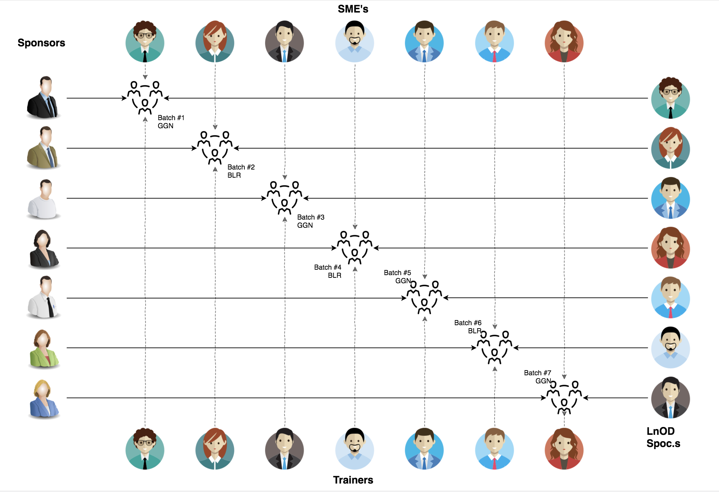
Stakeholders
Sponsors
Incedo
SME’s
1. Amit Balyan
Coordinator
Imarticus Learning

Slide 5
Our next starts
NOW
Notes:
Time – 1 min
Swati

Slide 6
4 Weeks of Training + Project demo
22 DAYS
176 HOURS
10,560 MINUTES
633,600 SECONDS
Limitless knowledge

Slide 7

Agenda
01
Developer
02
Our Journey
03
Project Goals
04
Tech Stack
05
Development
06
Challenges & Learnings
07
Demo
08
Questions
Notes:
Time – 1 min

Slide 8

Developer
Notes:
Time – 2 mins

Slide 9
David Masaka
Software Developer

Slide 10

Our Journey
Notes:
Time - 2 mins

Slide 11
Demo
Mindset
Process
5
Project Demo
Tools
4
Adapting to a developer
Mindset
Understand
3
Design Thinking and Patterns
2
Decide the Technologies JAVA/REST
1
Understanding Project Goals

Slide 12
Overview
The Journey
Core Java
Java Collections
Git Version Control
Database Programming
Java Streams and Lambda
Java JDBC
Java JPA
Spring Boot
Unit Testing and Mocking
Spring Microservice
HTML/CSS/Javascript
React.js & Redux

Slide 13

Project Goals
Notes:
Time – 3 mins

Slide 14




Our Vision
To create a Course Management System using full stack development tools and technologies, where students, professors, and admins can manage courses, grades, and payments.
1
2
Quality
Security
3
4
Interactivity
Speed
Notes:
User satisfaction and brand value

Slide 15

Tech Stack
Notes:
Time – 2 mins

Slide 16










Frontend
Backend
Infra
Data
Tools
Framework
Core Language
Automation Tool
SQL Database
SCM
Framework
Application Server
Testing
Notes:
Time – 1 min

Slide 17

Development
Notes:
Time – 1 min

Slide 18
Sprint Planning
Tools
Spring Grooming
Requirement understanding
Sprint Implementation
Development
Delivery
Integrate
Research and analysis
Estimation
Code Review
Commit
Deploy
Test
Thought Process
Notes:
Time – 1 min

Slide 19

Challenges & Learnings
Notes:
Time – 2 mins

Slide 20

Demo
Notes:
Time –
Architecture – 5 mins
NFR Dashboard – 3 mins
Demo – 10 mins
1. Show the Responsiveness and Wave tool first

Slide 21

Questions
Notes:
Time - ?

Slide 22
Thank you
Notes:
Time – After this show the testimonial video. 1 min

