Slide 1


Slide 2
1
The Ask – Where we started?

Slide 3
Framework for 4 Weeks
4 weeks plan
Every Day Discussion about Technologies topics.
Every day with SME/Trainer discussion of Project progress & transformation based on problem statement

Slide 4
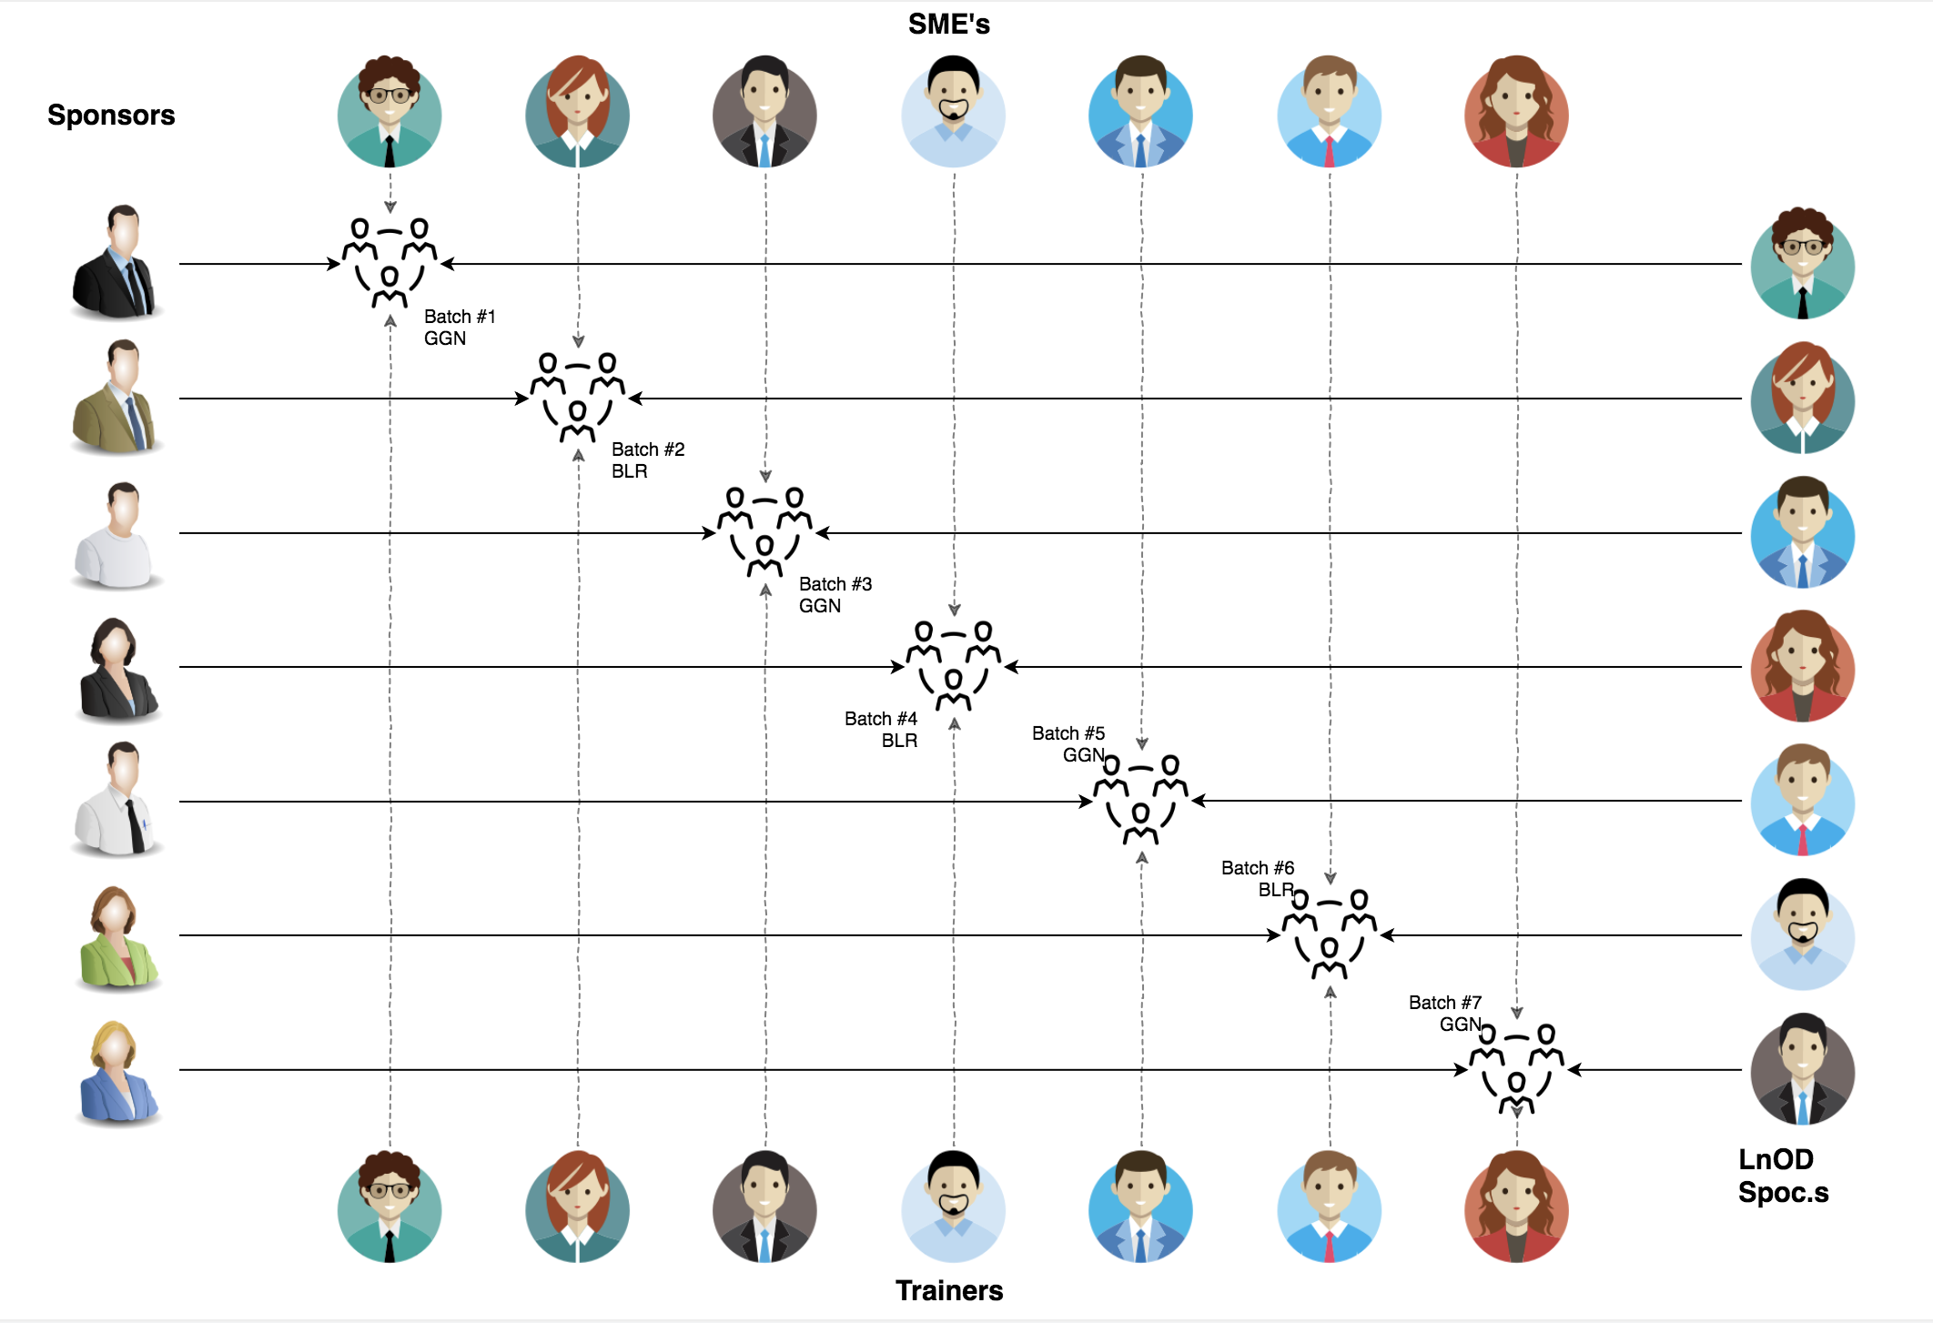
Stakeholders
Sponsors
Incedo
SME’s
1. Amit Balyan
Coordinator
Imarticus Learning

Slide 5
Our next starts
NOW
Notes:
Time – 1 min
Swati

Slide 6
4 Weeks of Training + Project demo
22 DAYS
176 HOURS
10,560 MINUTES
633,600 SECONDS
Limitless knowledge

Slide 7

Agenda
01
Our Journey
02
Developer
03
Project Goals
04
Tech Stack
05
Development
06
Challenges & Learnings
07
Demo
08
Questions
Notes:
Time – 1 min

Slide 8

Our Journey
Notes:
Time - 2 mins

Slide 9
Demo
Mindset
Process
5
Project Demo
Tools
4
Adapting to a developer
Mindset
Understand
3
Design Thinking and Patterns
2
Decide the Technologies JAVA/REST
1
Understanding Project Goals

Slide 10

Developer
Notes:
Time – 2 mins

Slide 11
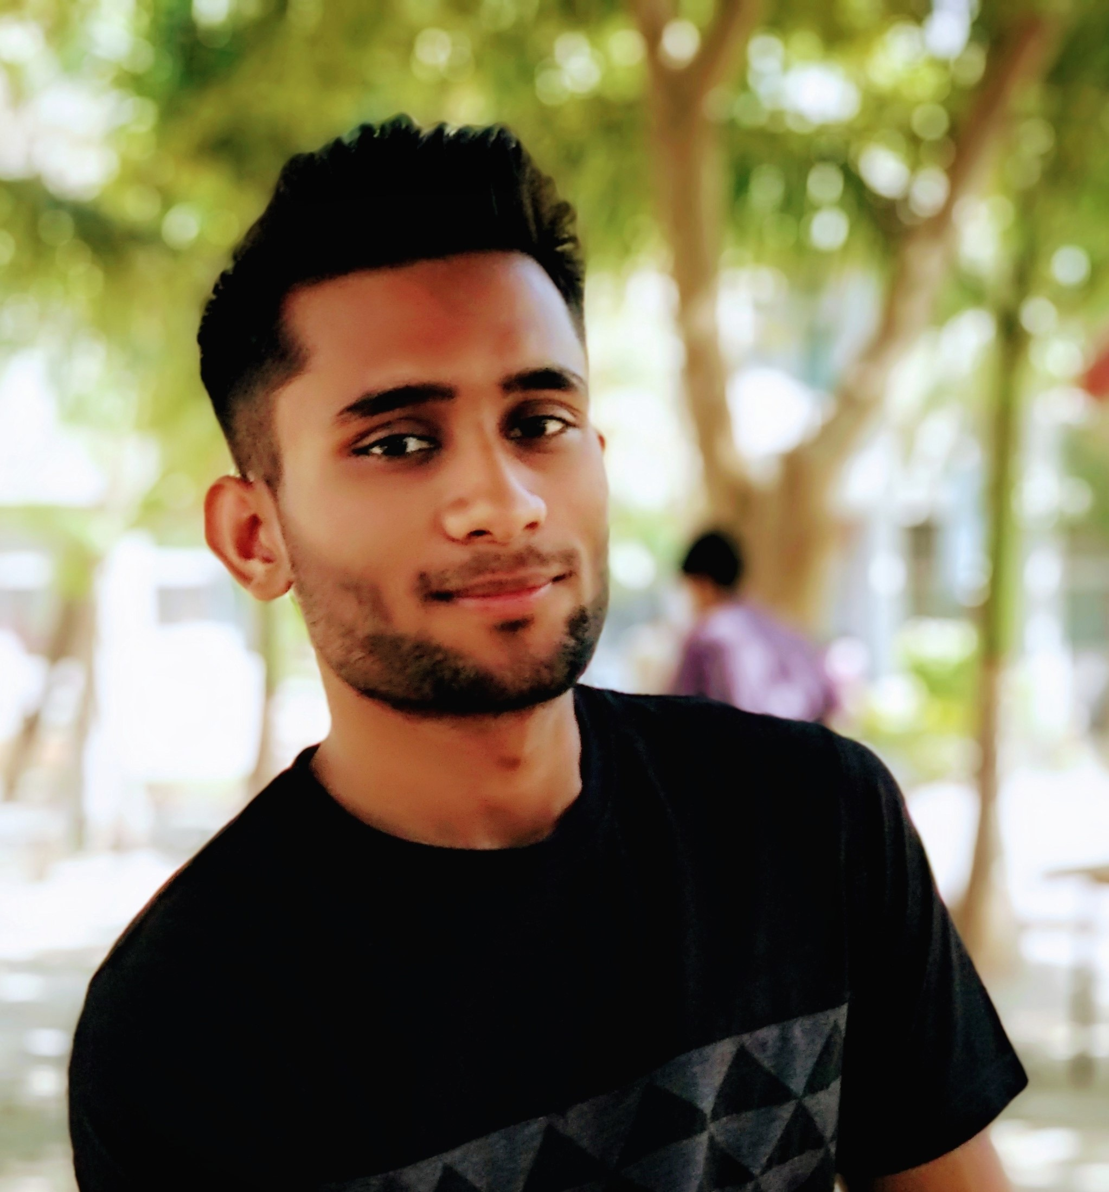
David Masaka
Java Developer

Slide 12

Project Goals
Notes:
Time – 3 mins

Slide 13




Our Vision
To create a Course Management System using full stack development tools and technologies, where students, professors, and admins can manage courses, grades, and payments.
1
2
Quality
Security
3
4
Interactivity
Speed
Notes:
User satisfaction and brand value

Slide 14

Tech Stack
Notes:
Time – 2 mins

Slide 15










Frontend
Backend
Infra
Data
Tools
Framework
Core Language
Automation Tool
SQL Database
SCM
Framework
Application Server
Testing
Notes:
Time – 1 min

Slide 16

Development
Notes:
Time – 1 min

Slide 17
Sprint Planning
Spring Grooming
Requirement understanding
Sprint Implementation
LLD
Delivery
Integrate
Research and analysis
Estimation
Development
Code Review
Commit
Deploy
Test
Notes:
Time – 1 min

Slide 18

Challenges & Learnings
Notes:
Time – 2 mins

Slide 19

Demo
Notes:
Time –
Architecture – 5 mins
NFR Dashboard – 3 mins
Demo – 10 mins
1. Show the Responsiveness and Wave tool first

Slide 20

Questions
Notes:
Time - ?

Slide 21
Thank you
Notes:
Time – After this show the testimonial video. 1 min

