Slide 1
Darren Mascioli
Embedded Software Engineer
Career Overview

Slide 2

University of Pittsburgh
B.S. in Computer Engineering
Graduated Summa Cum Laude in December 2020
GPA: 3.822

Slide 3
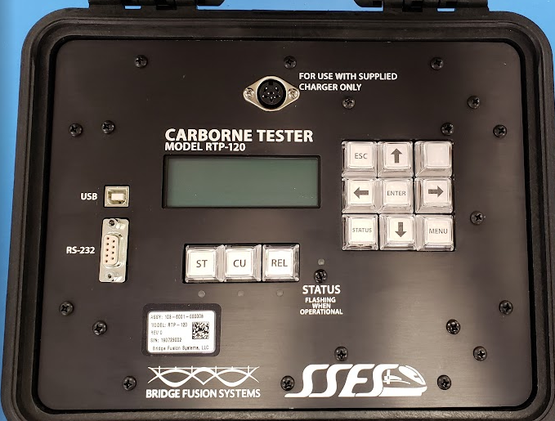
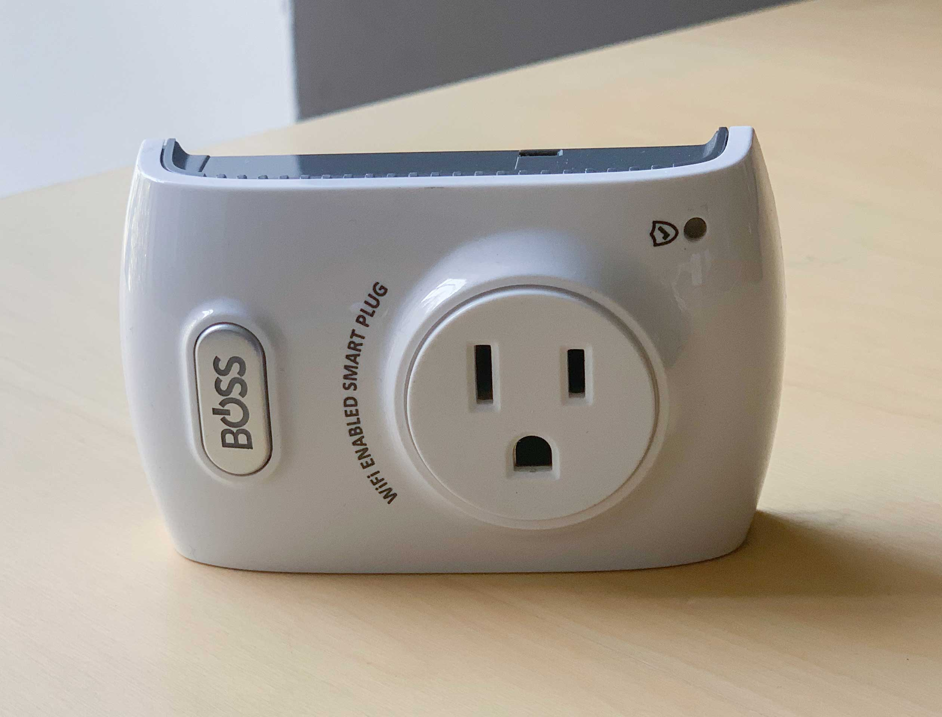
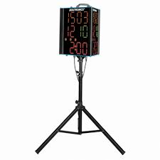
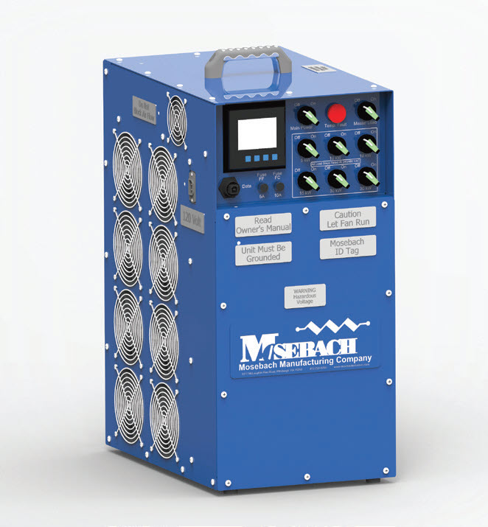
Bridge Fusion Systems: 2019 - 2020 Embedded Software Co-Op
SSES Rail
Added support for new SPI flash memory module
1-Wire driver for temperature sensor
STM32 Processor
Boss Controls
Manufacturing OTA firmware update for multiple devices
ARM Processor
Mosebach Manufacturing
Automated load bank configuration algorithm
NXP Processor
Score-Clocks
C# web GUI to interface with serial hardware adapter

Slide 4
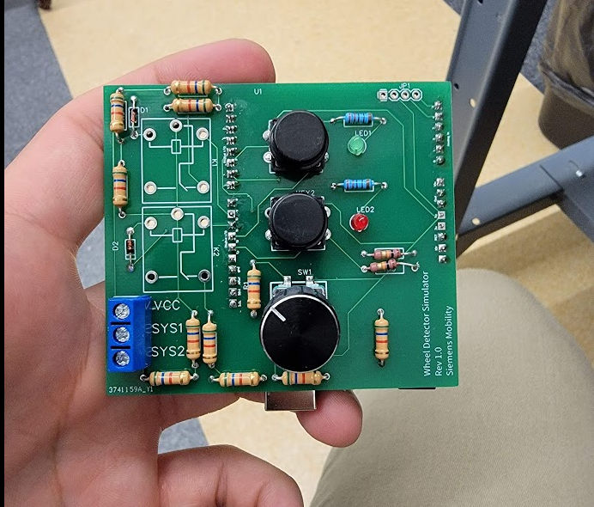
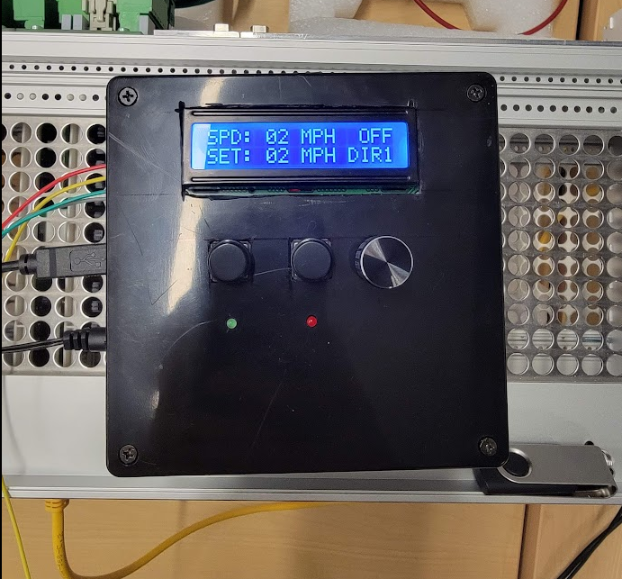
Siemens Mobility: 2021 - 2022 Engineering Development Program
Automated Rail Rotation
Distributed rail dispatch system
Kubernetes, DevOps experience
PTC Software
C++ embedded software
Wayside Engineering
PCB layout
Arduino interrupts/timers

Slide 5
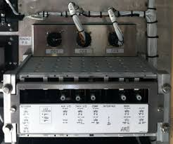
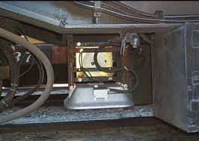
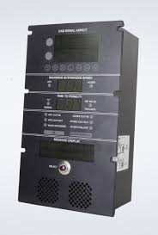
Siemens Mobility: 2022 - 2024 Onboard Software
ACSES: Advanced Civil Speed Enforcement System
NXP S12X processors
Motorola HC08 legacy processors
RTOS/Master loop code architecture
uCOS w/ task priorities
Serial and ethernet communications

Slide 6
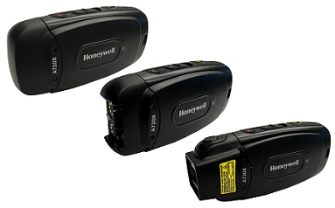
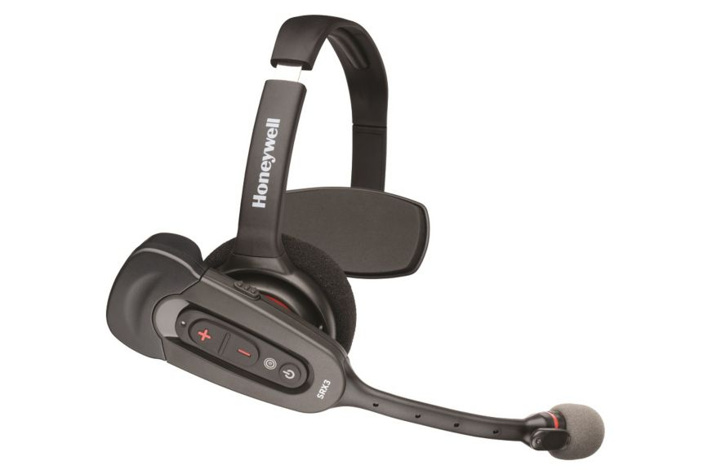
Honeywell: 2024 - Present Voice Hardware
Embedded Yocto Linux
Custom Linux services
Wi-Fi authentication & roaming
Power optimization
Sensor interaction
Drop Detect
Battery monitor
Kernel debugging
ALSA drivers
GitHub Actions CI/CD
Automated build & release system

Slide 7
Darren Mascioli
dmascioli1223@gmail.com
908-456-2123
Dmascioli.github.io

