Slide 1
Gear up
Run your first C program

Slide 2
Setting up environment
Windows: gcc
Equation solution: http://www.equation.com/servlet/equation.cmd?fa=fortran
Mac: Xcode, command line tools
Xcode: App Store -> xcode -> install
Command line tools: Xcode -> Preferences -> Downloads
Ubuntu: gcc
Type: sudo apt-get install build-essential
Or, go to Ubuntu Software Center and search for gcc
Verifying: Open Terminal, and type gcc –v.

Slide 3
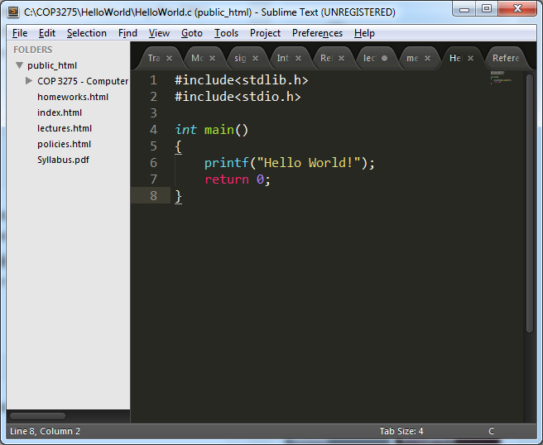
Code Editor
Sublime is highly recommended
Other: Notepad++, VIM, text editor, gedit, nano, etc.

Slide 4
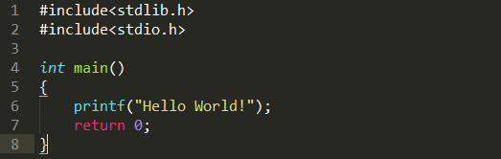
Hello World
Standard General Utilities Library
Input/Output operations
Main function
Print function
Return value

Slide 5
Run your first c program
1. Type the program in the text editor and save the file as HelloWorld.c
2. Open your terminal and jump to the folder that you have saved your .c file
3. Type gcc HelloWorld.c to compile the program
4. If no errors shown up, type ./a.out (in Windows, type a.exe)

Slide 6
a.out / a.exe
Why not b.out?
We did not specify
Look back at gcc HelloWorld.c
Compiler flags (A complete list https://gcc.gnu.org/onlinedocs/gcc/Option-Summary.html )
Most commonly used
-o: gcc HelloWorld.c –o SayHi
-Wall: gcc –Wall HelloWorld.c –o SayHi

Slide 7
Chapter 2
C Fundamentals
Copyright © 2008 W. W. Norton & Company.
All rights reserved.

Slide 8
Program: Printing HelloWorld
#include <stdio.h>
int main(void)
{
printf(“Hello World!\n");
return 0;
}
The file name doesn’t matter, but the .c extension is often required.

Slide 9
A few notes
gcc environment
To compile and run the code, you have to be in the same folder where you have put the code
A few most frequently used commands:
cd [folderName]
cd ..
ls (dir in windows)
pwd
“tab”

Slide 10
Compiling and Linking
Before a program can be executed, three steps are usually necessary:
Preprocessing. The preprocessor obeys commands that begin with # (known as directives)
Compiling. A compiler translates then translates the program into machine instructions (object code).
Linking. A linker combines the object code produced by the compiler with any additional code needed to yield a complete executable program.
The preprocessor is usually integrated with the compiler.

Slide 11
The GCC Compiler
GCC is one of the most popular C compilers.
GCC is supplied with Linux but is available for many other platforms as well.
Using this compiler is similar to using cc:
% gcc -o SayHi HelloWorld.c

Slide 12
Integrated Development Environments
An integrated development environment (IDE) is a software package that makes it possible to edit, compile, link, execute, and debug a program without leaving the environment.
Visual C++ (Windows)
Visual Studio (Windows)
Xcode (Mac)
Eclipse (Cross-platforms)
Netbeans
CodeBlocks, etc.

Slide 13
The General Form of a Simple Program
Simple C programs have the form
directives
int main(void)
{
statements
}

Slide 14
The General Form of a Simple Program
C uses { and } in much the same way that some other languages use words like begin and end.
Even the simplest C programs rely on three key language features:
Directives
Functions
Statements

Slide 15
Directives
Before a C program is compiled, it is first edited by a preprocessor.
Commands intended for the preprocessor are called directives.
Example:
#include <stdio.h>
<stdio.h> is a header containing information about C’s standard I/O library.

Slide 16
Directives
Directives always begin with a # character.
By default, directives are one line long; there’s no semicolon or other special marker at the end.

Slide 17
Functions
A function is a series of statements that have been grouped together and given a name.
Library functions are provided as part of the C implementation.
A function that computes a value uses a return statement to specify what value it “returns”:
return x + 1;

Slide 18
The main Function
The main function is mandatory.
main is special: it gets called automatically when the program is executed.
main returns a status code; the value 0 indicates normal program termination.
If there’s no return statement at the end of the main function, many compilers will produce a warning message.

Slide 19
Statements
A statement is a command to be executed when the program runs.
HelloWorld.c uses only two kinds of statements. One is the return statement; the other is the function call.
Asking a function to perform its assigned task is known as calling the function.
HelloWorld.c calls printf to display a string:
printf(“Hello World!\n");

Slide 20
Statements
C requires that each statement end with a semicolon.
There’s one exception: the compound statement.
Directives are normally one line long, and they don’t end with a semicolon.

Slide 21
Printing Strings
When the printf function displays a string literal—characters enclosed in double quotation marks—it doesn’t show the quotation marks.
printf doesn’t automatically advance to the next output line when it finishes printing.
To make printf advance one line, include \n (the new-line character) in the string to be printed.

Slide 22
Printing Strings
The statement
printf("To C, or not to C: that is the question.\n");
could be replaced by two calls of printf:
printf("To C, or not to C: ");
printf("that is the question.\n");
The new-line character can appear more than once in a string literal:
printf("Brevity is the soul of wit.\n --Shakespeare\n");

Slide 23
Comments
A comment begins with /* and end with */.
/* This is a comment */
Comments may appear almost anywhere in a program, either on separate lines or on the same lines as other program text.
Comments may extend over more than one line.
/* Name: HelloWorld.c
Purpose: Prints a greeting message.
Author: XXX */

Slide 24
Comments
Warning: Forgetting to terminate a comment may cause the compiler to ignore part of your program:
printf("My "); /* forgot to close this comment...
printf("cat ");
printf("has "); /* so it ends here */
printf("fleas");

Slide 25
Comments in C99
In C99, comments can also be written in the following way:
// This is a comment
This style of comment ends automatically at the end of a line.
Advantages of // comments:
Safer: there’s no chance that an unterminated comment will accidentally consume part of a program.
Multiline comments stand out better.

Slide 26
Variables and Assignment
Most programs need to a way to store data temporarily during program execution.
These storage locations are called variables.

Slide 27
Types
Every variable must have a type.
C has a wide variety of types, including int and float.
A variable of type int (short for integer) can store a whole number such as 0, 1, 392, or –2553.
The largest int value is typically 2,147,483,647 but can be as small as 32,767.

Slide 28
Types
A variable of type float (short for floating-point) can store much larger numbers than an int variable.
Also, a float variable can store numbers with digits after the decimal point, like 379.125.
Drawbacks of float variables:
Slower arithmetic
Approximate nature of float values

Slide 29
Declarations
Variables must be declared before they are used.
Variables can be declared one at a time:
int height;
float profit;
Alternatively, several can be declared at the same time:
int height, length, width, volume;
float profit, loss;

Slide 30
Declarations
When main contains declarations, these must precede statements:
int main(void)
{
declarations
statements
}

Slide 31
Assignment
A variable can be given a value by means of assignment:
height = 8;
The number 8 is said to be a constant.
Before a variable can be assigned a value—or used in any other way—it must first be declared.

Slide 32
Assignment
A constant assigned to a float variable usually contains a decimal point:
profit = 2150.48;

Slide 33
Assignment
An int variable is normally assigned a value of type int, and a float variable is normally assigned a value of type float.
Mixing types (such as assigning an int value to a float variable or assigning a float value to an int variable) is possible but not always safe.

Slide 34
Assignment
Once a variable has been assigned a value, it can be used to help compute the value of another variable:
height = 8;
length = 12;
width = 10;
volume = height * length * width;
/* volume is now 960 */
The right side of an assignment can be a formula (or expression, in C terminology) involving constants, variables, and operators.

Slide 35
Printing the Value of a Variable
printf can be used to display the current value of a variable.
To write the message
Height: h
where h is the current value of the height variable, we’d use the following call of printf:
printf("Height: %d\n", height);
%d is a placeholder indicating where the value of height is to be filled in.

Slide 36
Printing the Value of a Variable
%d works only for int variables; to print a float variable, use %f instead.
By default, %f displays a number with six digits after the decimal point.
To force %f to display p digits after the decimal point, put .p between % and f.
To print the line
Profit: $2150.48
use the following call of printf:
printf("Profit: $%.2f\n", profit);

Slide 37
Printing the Value of a Variable
There’s no limit to the number of variables that can be printed by a single call of printf:
printf("Height: %d Length: %d\n", height, length);

Slide 38
Steps to compile and run your program
MAC / Ubuntu:
Installing gcc environment (refer to the video url in the announcement), verify by gcc –v
Open text editor (sublime for example), write your code and save your file to some folder
For example, you can create a folder on your desktop named COP3275 and put all related codes inside of it
Open up your terminal, and navigate to that folder where you have saved your code (by using cd, cd.., etc.)
Type gcc FileName.c to compile your program
Run your program by typing ./a.out

Slide 39
Steps to compile and run your program
Windows:
Installing gcc environment (refer to the video url in the announcement), verify by gcc –v
Open text editor (sublime for example), write your code and save your file to some folder
For example, you can create a folder on your desktop named COP3275 and put all related codes inside of it
Open up your terminal, and navigate to that folder where you have saved your code (by using cd, cd.., etc.)
Type gcc FileName.c to compile your program
Run your program by typing a.exe

Slide 40
Printing the Value of a Variable
printf can be used to display the current value of a variable.
To write the message
Height: h
where h is the current value of the height variable, we’d use the following call of printf:
printf("Height: %d\n", height);
%d is a placeholder indicating where the value of height is to be filled in.

Slide 41
Printing the Value of a Variable
%d works only for int variables; to print a float variable, use %f instead.
By default, %f displays a number with six digits after the decimal point.
To force %f to display p digits after the decimal point, put .p between % and f.
To print the line
Profit: $2150.48
use the following call of printf:
printf("Profit: $%.2f\n", profit);

Slide 42
Printing the Value of a Variable
There’s no limit to the number of variables that can be printed by a single call of printf:
printf("Height: %d Length: %d\n", height, length);

Slide 43
Program: Computing the Dimensional Weight of a Box
Shipping companies often charge extra for boxes that are large but very light, basing the fee on volume instead of weight.
The usual method to compute the “dimensional weight” is to divide the volume by 166 (the allowable number of cubic inches per pound).
The dweight.c program computes the dimensional weight of a particular box:
Dimensions: 12x10x8
Volume (cubic inches): 960
Dimensional weight (pounds): 6

Slide 44
Program: Computing the Dimensional Weight of a Box
Division is represented by / in C, so the obvious way to compute the dimensional weight would be
weight = volume / 166;
In C, however, when one integer is divided by another, the answer is “truncated”: all digits after the decimal point are lost.
The volume of a 12” × 10” × 8” box will be 960 cubic inches.
Dividing by 166 gives 5 instead of 5.783.

Slide 45
Program: Computing the Dimensional Weight of a Box
One solution is to add 165 to the volume before dividing by 166:
weight = (volume + 165) / 166;
A volume of 166 would give a weight of 331/166, or 1, while a volume of 167 would yield 332/166, or 2.

Slide 46
dweight.c
/* Computes the dimensional weight of a 12" x 10" x 8" box */
#include <stdio.h>
int main(void)
{
int height, length, width, volume, weight;
height = 8;
length = 12;
width = 10;
volume = height * length * width;
weight = (volume + 165) / 166;
printf("Dimensions: %dx%dx%d\n", length, width, height);
printf("Volume (cubic inches): %d\n", volume);
printf("Dimensional weight (pounds): %d\n", weight);
return 0;
}

Slide 47
Test.c
/* Some tests */
#include <stdio.h>
int main(void)
{
int a = 5;
int b = 10;
int c1 = a/b;
float c2 = a/b;
return 0;
}

Slide 48
Initialization
Some variables are automatically set to zero when a program begins to execute, but most are not.
A variable that doesn’t have a default value and hasn’t yet been assigned a value by the program is said to be uninitialized.
Attempting to access the value of an uninitialized variable may yield an unpredictable result.
With some compilers, worse behavior—even a program crash—may occur.

Slide 49
Initialization
The initial value of a variable may be included in its declaration:
int height = 8;
The value 8 is said to be an initializer.
Any number of variables can be initialized in the same declaration:
int height = 8, length = 12, width = 10;
Each variable requires its own initializer.
int height, length, width = 10;
/* initializes only width */

Slide 50
Printing Expressions
printf can display the value of any numeric expression.
The statements
volume = height * length * width;
printf("%d\n", volume);
could be replaced by
printf("%d\n", height * length * width);

Slide 51
Reading Input
scanf is the C library’s counterpart to printf.
scanf requires a format string to specify the appearance of the input data.
Example of using scanf to read an int value:
scanf("%d", &i);
/* reads an integer; stores into i */

Slide 52
Reading Input
Reading a float value requires a slightly different call of scanf:
scanf("%f", &x);
"%f" tells scanf to look for an input value in float format (the number may contain a decimal point, but doesn’t have to).

Slide 53
Program: Computing the Dimensional Weight of a Box (Revisited)
dweight2.c is an improved version of the dimensional weight program in which the user enters the dimensions.
Each call of scanf is immediately preceded by a call of printf that displays a prompt.

Slide 54
dweight2.c
/* Computes the dimensional weight of a box from input provided by the user */
#include <stdio.h>
int main(void)
{
int height, length, width, volume, weight;
printf("Enter height of box: ");
scanf("%d", &height);
printf("Enter length of box: ");
scanf("%d", &length);
printf("Enter width of box: ");
scanf("%d", &width);
volume = height * length * width;
weight = (volume + 165) / 166;
printf("Volume (cubic inches): %d\n", volume);
printf("Dimensional weight (pounds): %d\n", weight);
return 0;
}

Slide 55
Program: Computing the Dimensional Weight of a Box (Revisited)
Sample output of program:
Enter height of box: 8
Enter length of box: 12
Enter width of box: 10
Volume (cubic inches): 960
Dimensional weight (pounds): 6
Note that a prompt shouldn’t end with a new-line character.

Slide 56
Programming Exercises
2.1
2.4
2.5

Slide 57
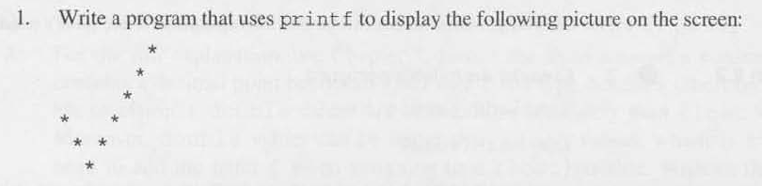
Programming Exercises
2.1

Slide 58
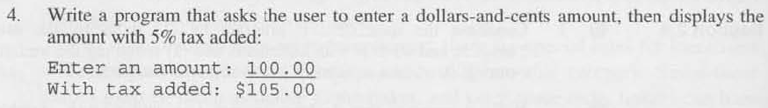
Programming Exercises
2.4

Slide 59
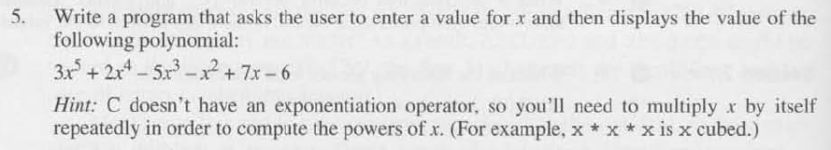
Programming Exercises
2.5

