Slide 1

EEL4712 Digital Design

Slide 2
Instructor
Dr. Greg Stitt
  gstitt@ece.ufl.edu
  http://www.gstitt.ece.ufl.edu
  Office Hours: Monday Period 3, Tuesday Period 4
    (Benton 323)
    Also, by appointment

Slide 3
Course Website
2 sites
  http://www.gstitt.ece.ufl.edu/courses/eel4712/
    Linked off my website
  Canvas E-learning
    http://elearning.ufl.edu/
      Select E-learning Canvas Login
      Login with GatorLink account
    Used for posting grades, turning in projects
Email Policy
  When sending an email, include the class name in brackets
    e.g. [EEL4712] Question about lab 2

Slide 4
Grading
EEL4712 Grading:
  Midterm 1: 20% (February 12)
  Midterm 2: 20% (March 18)
  Midterm 3: 20% (April 20)
  Labs: 40%
Final grade: curved average of all components

Slide 5
Lab Assignments
Linked off main website
  http://www.gstitt.ece.ufl.edu/courses/eel4712/labs/
Will provide realistic application of concepts covered during lecture
All labs will use Altera DE0 FPGA board
Each lab (after lab 0) will have a pre-lab assignment and an in-lab assignment
  Some may have a post-lab assignment
  See each lab for submission instructions
Lab quizzes
  Will test basic understanding of concepts

Slide 6
Lab Assignments, Cont.
Labs will require effort outside of lab
  Pre-lab assignments will be due at the beginning of lab
  Lab 0 posted on website. START NOW!
Labs will be VHDL intensive
  Spend time outside of lab exercises practicing
  Class website contains list of VHDL resources
  Note: lots of bad information online!
  Best source of information will be lectures
Altera Quartus II
  Download latest free version (web edition)
    http://www.altera.com/products/software/quartus-ii/web-edition/qts-we-index.html
  Do tutorials in appendix of the book!
Labs will also use Digilent Analog Discovery
  http://www.digilentinc.com/Products/Detail.cfm?Prod=ANALOG-DISCOVERY
  Logic analyzer for debugging outside of lab

Slide 7
Reading Material
Textbook:
  Brown, S. D. and Vranesic, Z. G., "Fundamentals of Digital Logic with VHDL Design", Second or Third Edition, McGraw-Hill
Supplemented by papers
  Check class website for daily requirements
  Will also post slides when used

Slide 8
Prerequisites
EEL 3701
Requires basic knowledge of:
  Boolean logic
  Sequential and combinational components
  Logic minimization
  State machines
  Assembly programming
Assumes no knowledge of VHDL

Slide 9
Goals
Understanding of how to design complex digital circuits by applying basic concepts
Basic understanding of reconfigurable and microprocessor architectures
Gain experience with VHDL
Training for research and graduate school
  Will invite exceptional students to participate in state-of-the-art research projects

Slide 10
Academic Dishonesty
Unless told otherwise, assignments must be done individually
  All assignments will be checked for cheating
Collaboration is allowed (and encouraged), but within limits
  Can discuss problems, how to use tools etc.
  Cannot show code, solutions, etc.
Cheating penalties
  First instance - 0 on corresponding assignment
  Second - 0 for entire class

Slide 11
Attendance Policy
I won’t take attendance
  But, attendance is highly recommended
If you are sick, stay at home!
  If obviously sick, you will be asked to leave
  Missed tests cannot be retaken, except with doctor’s note

Slide 12
Introduction
Why should you be excited about this class?
Digital design is important in all aspects of computing
  Microprocessor architecture, graphics processing units (GPUs)
  Embedded systems
    e.g., phones, portable game consoles, etc.
    Portable (low-power), high-performance functionality enabled by custom circuits implemented as ASICs (application-specific integrated circuits)
  Reconfigurable computing
    Enables custom circuits without creating an ASIC
    Combines flexibility of software with performance of ASIC
  High-performance computing
    Custom circuits are often 10x-1000x faster than microprocessors!!!
In this class, you will learn the fundamentals of creating circuits that are 10x-1000x faster than microprocessors

Slide 13
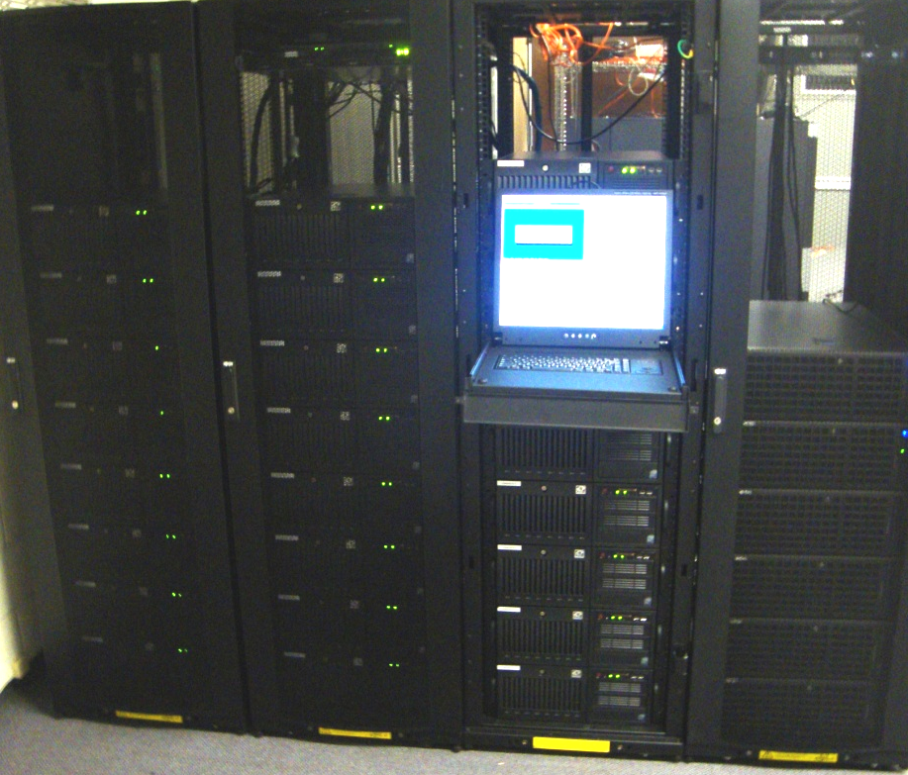
Novo-G Supercomputer
Reconfigurable Supercomputer at UF
  Pioneering top reconfigurable system in world
    Features 448 top-end Altera Stratix III, IV, and V FPGAs
      Focus: performance, energy-efficiency, productivity, scalability
    Dramatic speedups on apps in broad range of domains
      Image processing, bioinformatics, finance, crypto, et al.
  Upgrade in 2015: reconfigurable FPGA network
    3D torus directly connecting FPGAs; low latency, high throughput
    Enable comm-intensive apps (e.g., 3D-FFT, molecular dynamics)
  Leading IT companies following Novo-G’s lead
    Microsoft: Catapult FPGA system, Bing search-engine acceleration
    Baidu: FPGA system, neural networks for deep learning apps
    Intel, Google, Oracle, et al. also investing in these technologies

Slide 14
Reminder
Start reading details of lab 0
Review chapter 6
  Combinational-circuit building blocks

