Slide 1

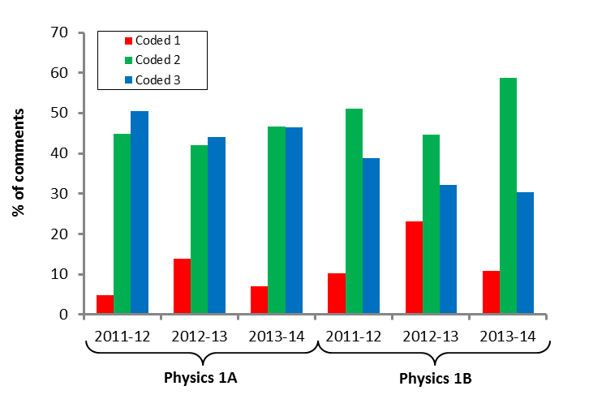
Poster title: An investigation into…
Supervisor: Prof XXX YYY
Conclusions
Discussion, conclusions and suggestions for future work.
A reader should be able to skim top the three boxes – Intro, Results, Conclusions - and get a good sense of what you did, why it was worth doing and what you achieved.
Introduction
A summary of the background and context of your project together with the aims of your work.
Make sure the body text is readable from around a metre away. Remember to cite your references.¹
Your name
Results
The key results from your project and a discussion of what they mean.
In this layout the results are placed centre stage. Use figures and/or graphs to show key findings.
Figure 1: Distribution of comment codes.
References
¹ Pollitt, A. (2012). The method of Adaptive Comparative Judgement. Assessment in Education: Principles, Policy & Practice, 19(3), 281–300
Methods
A summary of the methods you used.
This may not be of interest to everyone, so in this layout this section is tucked away at the bottom left hand side, although the poster still follows a logical flow.
Figure 1: Distribution of comment codes.
Acknowledgements
Thanks to…
Notes:
Copyright Colin Purrington (http://colinpurrington.com/tips/academic/posterdesign).

