Slide 1

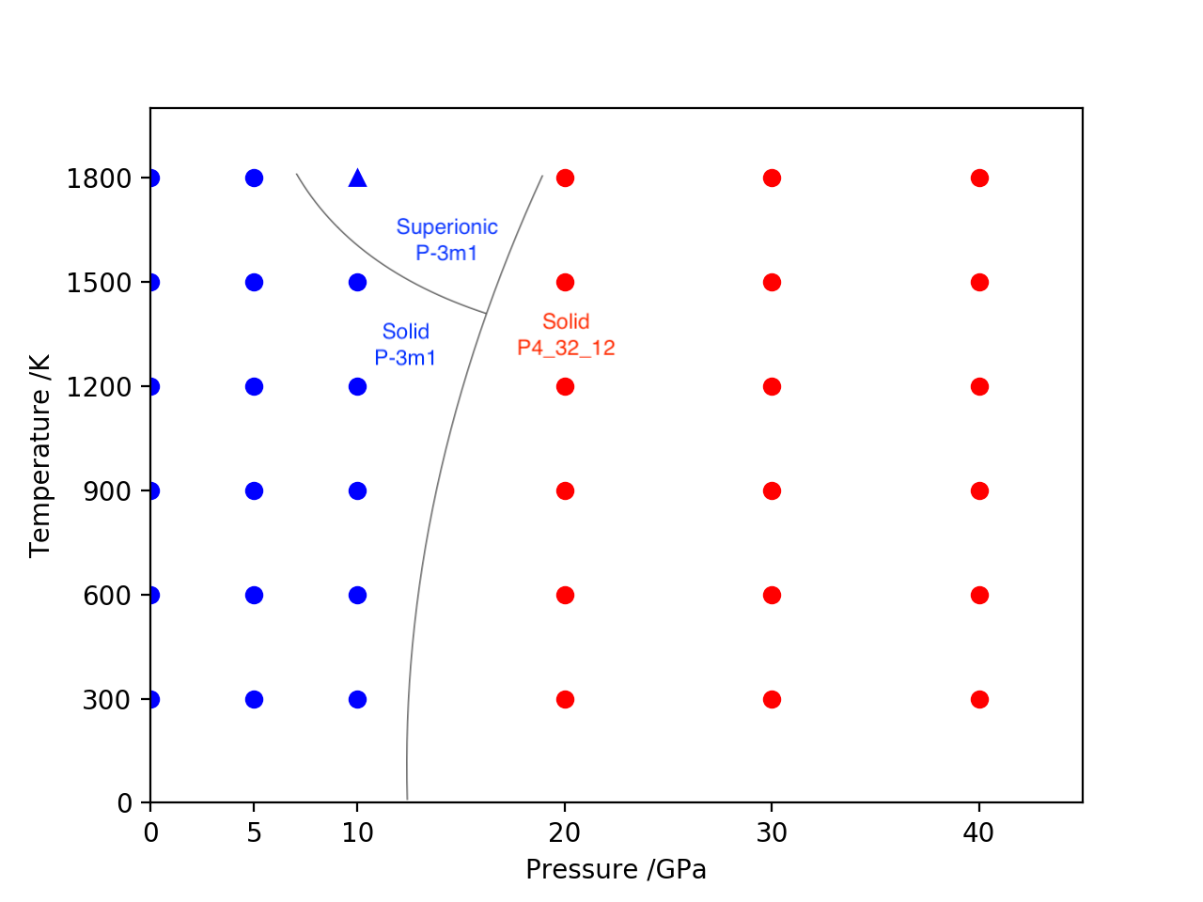
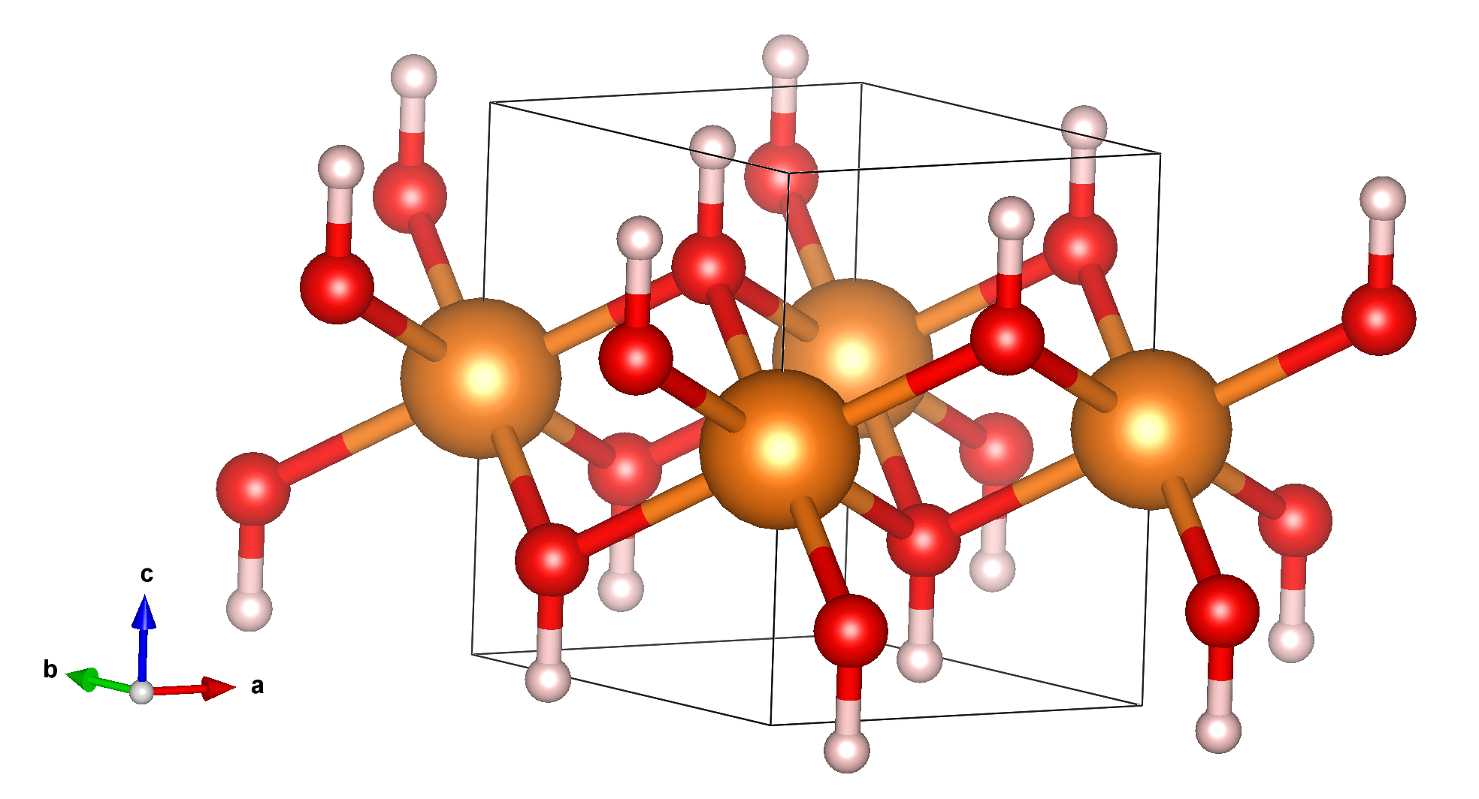
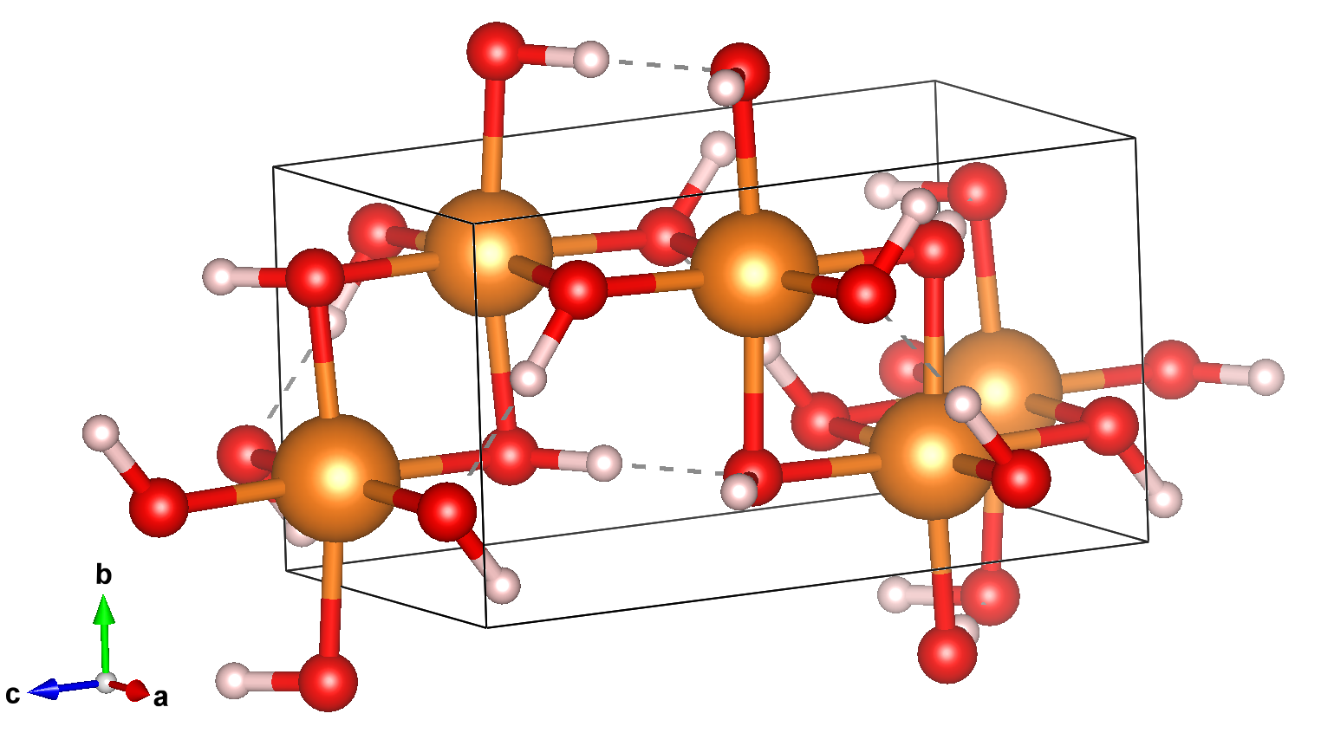
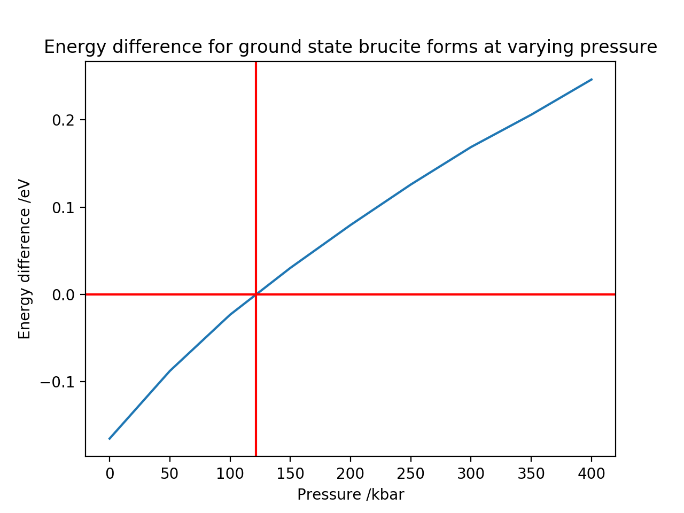
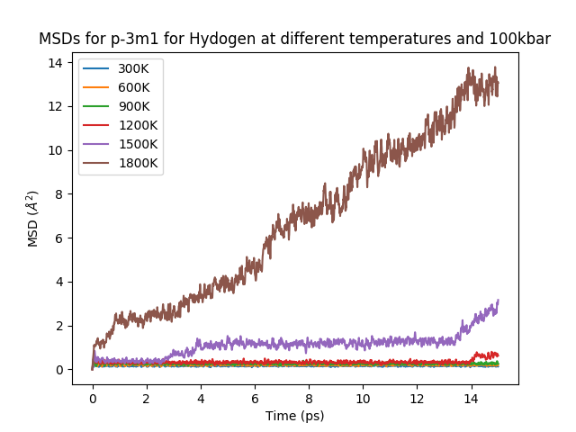
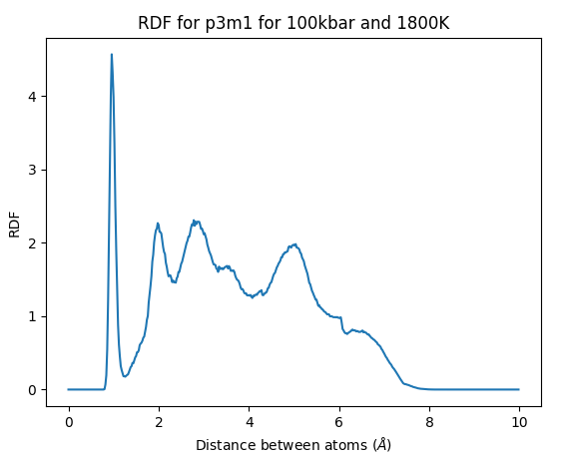
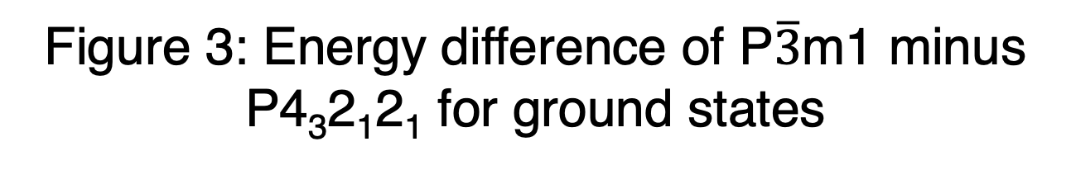
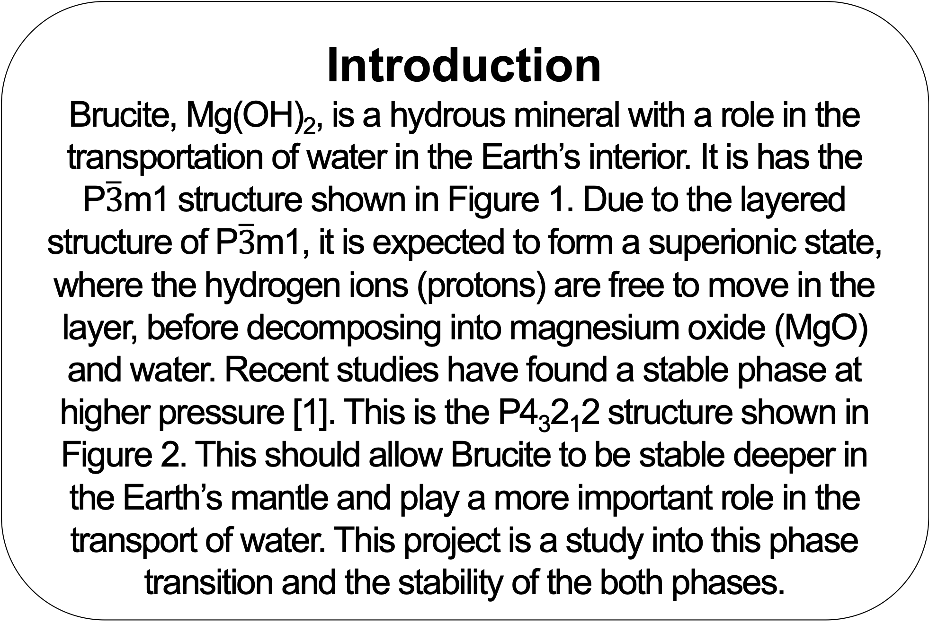
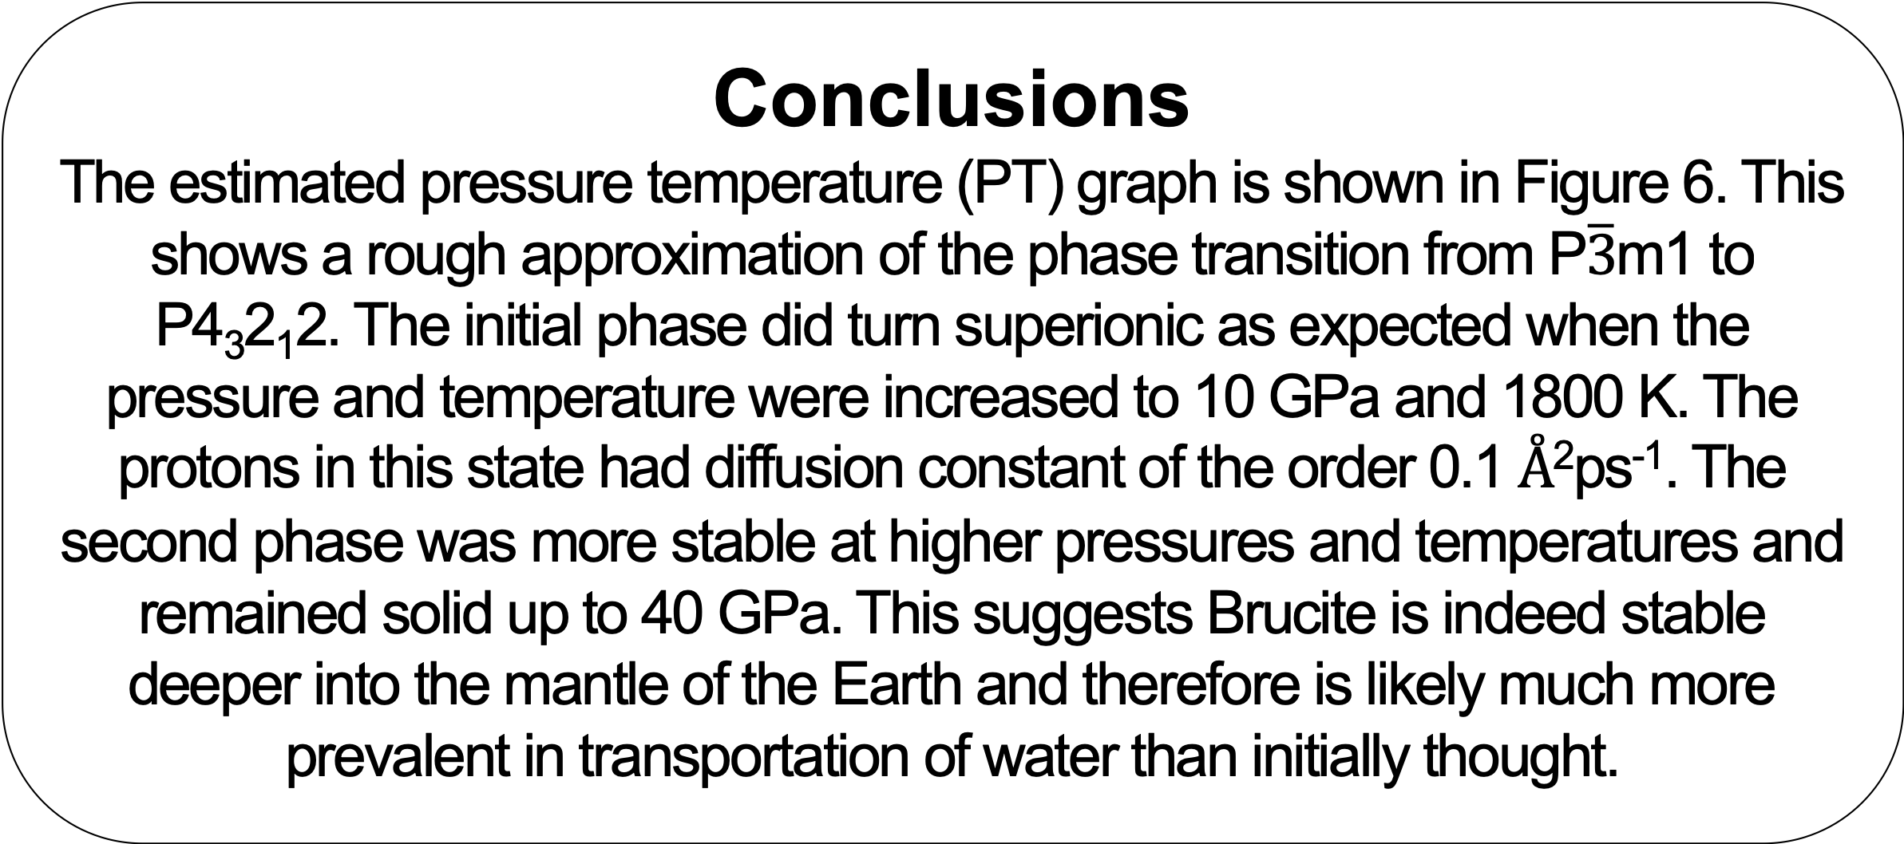

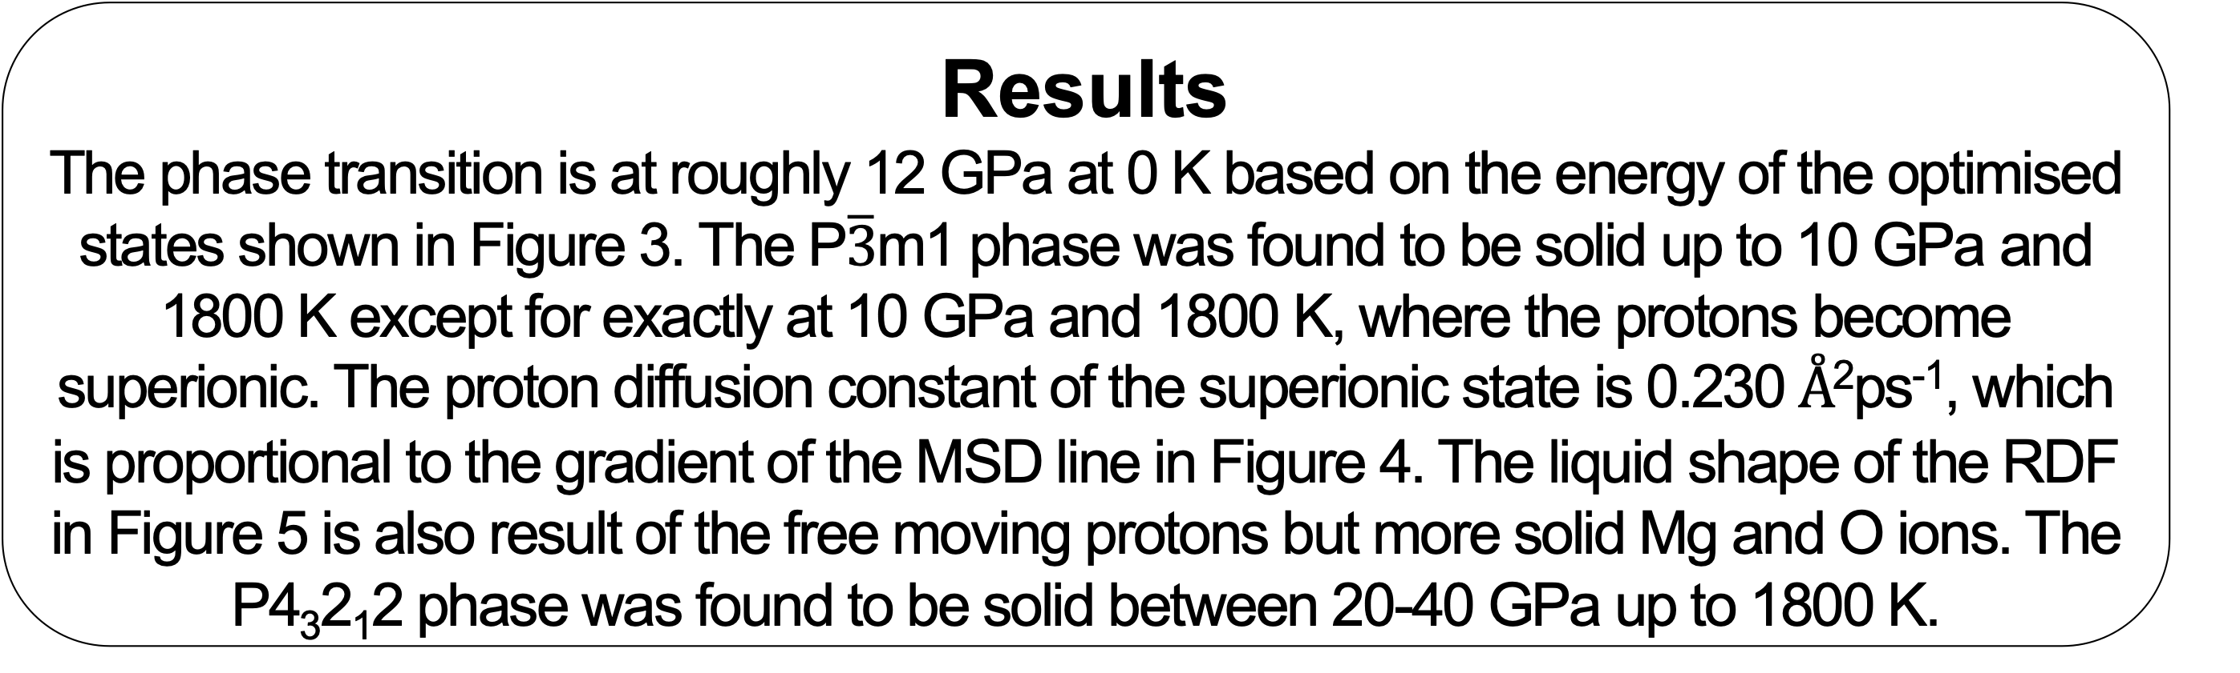

Planetary Interiors: Brucite Phase Transition
Declan Mathews
Supervisor: Dr. A. Hermann
Introduction
Brucite, Mg(OH)₂, is a hydrous mineral with a role in the transportation of water in the Earth’s interior. It is has the P$\overline{3}$m1 structure shown in Figure 1. Due to the layered structure of P$\overline{3}$m1, it is expected to form a superionic state, where the hydrogen ions (protons) are free to move in the layer, before decomposing into magnesium oxide (MgO) and water. Recent studies have found a stable phase at higher pressure [1]. This is the P4₃2₁2 structure shown in Figure 2. This should allow Brucite to be stable deeper in the Earth’s mantle and play a more important role in the transport of water. This project is a study into this phase transition and the stability of the both phases.
Conclusions
The estimated pressure temperature (PT) graph is shown in Figure 6. This shows a rough approximation of the phase transition from P$\overline{3}$m1 to P4₃2₁2. The initial phase did turn superionic as expected when the pressure and temperature were increased to 10 GPa and 1800 K. The protons in this state had diffusion constant of the order 0.1 Å²ps⁻¹. The second phase was more stable at higher pressures and temperatures and remained solid up to 40 GPa. This suggests Brucite is indeed stable deeper into the mantle of the Earth and therefore is likely much more prevalent in transportation of water than initially thought.
Figure 6: PT diagram approximation for Brucite
Results
The phase transition is at roughly 12 GPa at 0 K based on the energy of the optimised states shown in Figure 3. The P$\overline{3}$m1 phase was found to be solid up to 10 GPa and 1800 K except for exactly at 10 GPa and 1800 K, where the protons become superionic. The proton diffusion constant of the superionic state is 0.230 Å²ps⁻¹, which is proportional to the gradient of the MSD line in Figure 4. The liquid shape of the RDF in Figure 5 is also result of the free moving protons but more solid Mg and O ions. The P4₃2₁2 phase was found to be solid between 20-40 GPa up to 1800 K.
References
[1] Hermann & Mookherjee, High pressure phase of brucite stable at Earth’s mantle transition zone and lower mantle conditions (2016)
Acknowledgements
Many thanks to Dr. Hermann for his exceptional insight and guidance.
Figure 1: P$\overline{3}$m1 structure
Figure 2: P4₃2₁2 structure
Methods
Structure optimisations at various pressures were carried out and their energies compared to find when the P4₃2₁2 phase becomes more favourable. Molecular dynamics simulations using density functional theory (DFT) were then carried out at various temperatures on these optimised structures. The mean square displacement (MSD), diffusion constants, radial/partial distribution functions (RDF/PDF), hydrogen distributions and simulations were studied to classify the states.
Figure 3: Energy difference of P$\overline{3}$m1 minus P4₃2₁2₁ for ground states
Figure 4: MSD for P$\overline{3}$m1 at 10 GPa for varying temperatures
Figure 5: RDF for P$\overline{3}$m1 at 10 GPa 1800 K
Notes:
Copyright Colin Purrington (http://colinpurrington.com/tips/academic/posterdesign).

