Slide 1

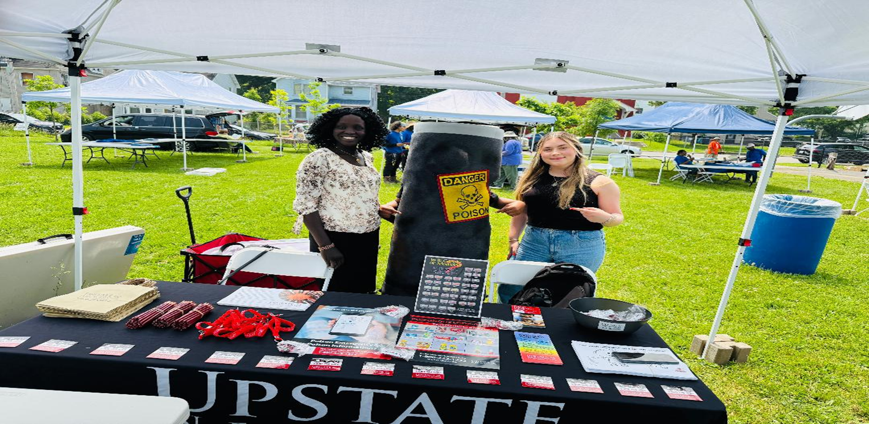
ILE Poster Presentation Nyantiok Bul
Author: Nyantiok Bul
Author: Dr.Foxx
Chamberlain College of Health Professions
Introduction/Purpose Statement
Approach/Methods/Data Analysis
Outcomes/Results/Evidence
Public health topic: Raising awareness about poison control, particularly lead poisoning and other common household chemicals, among refugees and immigrants in Syracuse, New York, is vital for ensuring their safety.
Relevant statistics:According to the CDC, approximately 20% of the U.S. population speaks a language other than English at home and may prefer to use a language other than English during healthcare encounters. Furthermore, 83% of the foreign-born population in the United States aged 5 and older speak a language other than English at home, with 46% having limited English proficiency. This indicates that language access is even more crucial for this group. Moreover, the CDC states that lead poisoning disproportionately impacts refugee and newcomer children resettled in the United States. Lead is a significant natural toxin found in the environment and many household materials, posing numerous health risks for children. According to a study by LuPone et al. (2020), among refugees in Syracuse, New York, 17% of newly arrived children had elevated blood lead levels (BLLs) (≥ 5 µg/dL); 10% had elevated BLLs upon follow-up; and 8.3% of the follow-up high BLLs were attributed to new exposures. Additionally, 30% were found to have increased blood lead levels (BLLs) at follow-up, regardless of their arrival status.
Description of the target population
The target population consists of refugees and immigrants in Syracuse, New York. This city has welcomed over 7,000 individuals in the past decade, with an expected intake of about 1,000 more each year.
Include a description of the target population
Poison control awareness will be evaluated using a pre-post-education survey. Focus groups will be conducted through community outreach in gathering places such as churches and schools to collect in-depth insights from the community regarding their knowledge, attitudes, and practices related to poison control. Sample data collection questions- Draft at least 5 survey or interview questions.
Which of the following household items could be poisonous?
How quickly should you contact Poison Control after a poisoning is suspected?
What types of incidents should be reported to Poison Control?
What would you do if your child accidentally ingested a cleaning product?
Have you checked your home for potentially poisonous products and labeled/stored them safely?
Poison control and prevention awareness improve the outcome, but it can also decrease incidents of accidental poisoning from household cleaners, medications, or pesticides due to better education on storage and usage.
Model/Table/Graphic/Chart
Background
Discussion/Conclusions/Implications
Brief literature review: The importance of poison control awareness is highlighted in this article by the University of Minnesota, published this year. Their study shows that effective communication is vital in healthcare settings, especially for Refugees, Immigrants, and Migrants (RIM) communities who may encounter language barriers. They found that limited English proficiency can cause misunderstandings, medication errors, and negative health outcomes. Providing translated materials and interpretation services is crucial to ensure non-English-speaking patients receive accurate information and proper care, which are services offered by the Poison Control Center.
Description of theory: With the Health Belief Model, health educators and public health officials can create targeted and effective poison control awareness campaigns aimed at addressing vulnerability and severity, highlighting benefits and overcoming barriers, and promoting cues to action while building self-efficacy.
Program overview: The goal for the project is to create awareness that will improve the understanding of poison control services among refugee and immigrant communities, ensuring they can recognize poisoning risks, identify poison, and increase access to appropriate emergency assistance
SMART Objective:
Specific: Educate refugee and immigrant families in Syracuse and around Upstate New York about poison prevention and how to contact the poison control center in case of an emergency.
Measurable: Aimed to reach at least 1,000 individuals through culturally and linguistically appropriate church meetings, workshops, and distribute 5,000 educational materials (flyers, videos, posters).
Achievable: I have partnered with three local community organizations: the Catholic charity, Rise New York, the Interfaith Work of Central New York, and the Poison Control Center’s translation services to deliver the program effectively.
Relevant: Refugees and immigrants often face language and system navigation barriers, putting them at higher risk of missing out on essential public services, like poison control services, or even at risk of unintentional poisonings from day-to-day household cleaning chemicals or medicines.
Time-bound: Complete outreach and education efforts within 4 months.
Implementation setting: This program will be implemented through collaboration between the Poison Control Center and a non-profit organization in Upstate New York, like the Catholic charity, Rise New York, the Interfaith Work of Central New York, and local Schools. The plan is to use brochures, flyers, videos, posters, Webinars, and in-person workshops to spread poison awareness among refugees and Immigrants/migrants.
recommendations: Strong collaborative efforts between refugee resettlement agencies, local health departments (Onondaga County Health Department), Poison Control Center, and nonprofits (like Interfaith of Central New York and Rise organization) to foster sustainable health education systems. Cooperation between community health workers with peer educators from within the immigrant communities acting as trusted messengers or interpreters
Dissemination of these findings to community stakeholders will be mostly through flyers/brochures, phone calls, and in-person announcements in churches and other places of worship, and schools. Nevertheless, community workshops or home visits help build trust with health professionals and reinforce safe
Behaviors and findings to community stakeholders: Using pesticides or chemicals without safety precautions, leaving products open and unattended, Improper storage of chemicals or medicine, and medication misuse, like using someone else’s prescription or taking non-prescribed herbal remedies.
Conclusions: Raising awareness about poison control, particularly lead poisoning and other common household chemicals, among refugees and immigrants in Syracuse, New York, is vital for ensuring their safety. This is because many refugees and immigrants in Syracuse reside in older housing, which may contain lead paint or pipes, and some have no access to poison control information or knowledge of household chemicals that could potentially pose hazards not only to children but also to adults.
References
Arnold JK, Borger J, Nappe TM. (2025). Poison Control in The United States. In: StatPearls [Internet]. Treasure Island (FL): StatPearls Publishing; Available from: https://www.ncbi.nlm.nih.gov/books/NBK537316/
Centers for Disease Control and Prevention. (2025). Childhood Lead Poisoning Prevention. Risk Factors and Refugees and Immigrants Retrieved from: https://www.cdc.gov/lead-prevention/risk-factors/refugees-immigrants.html
Centers for Disease Control and Prevention. (2023). Health Communication with Refugee, Immigrant, and Migrant Communities. Retrieved from: https://www.cdc.gov/yellow-book/hcp/refugees-immigrants-migrants/health-communication-with-refugee-immigrant-and-migrant-communities.html
LuPone, C. D., Daniels, D., Lammert, D., Borsuk, R., Hobart, T., Lane, S., & Shaw, A. (2020). Lead Exposure in Newly Resettled Pediatric Refugees in Syracuse, NY. Journal of immigrant and minority health, 22(1), 34–43. https://doi.org/10.1007/s10903-019-00880-y
Lau, L. S., & Rodgers, G. (2021). Cultural Competence in Refugee Service Settings: A Scoping Review. Health equity, 5(1), 124–134. https://doi.org/10.1089/heq.2020.0094
Pezzi C, Lee D, Kennedy L, Aguirre J, Titus M, Ford R, et. al. (2019). Blood Lead Levels Among Resettled Refugee Children in Select US States, 2010-2014. Pediatrics. 2019; 143(5):e20182591.
Syracuse, NY 13244. Retrieved from: https://www.thenewshouse.com/off-campus/refugees-are-making-a-positive-impact-on-syracuse-community/
University of Minnesota. (2025). Collaborating with Poison Control to Increase Equitable Language Access to Over-the-Counter Medicines. Retrieved from: https://nrcrim.org/collaborating-poison-control
Zenna P. (2024). Advocates say the pro-refugee stance creates a thriving Syracuse community. The S.I. Newhouse School of Public Communications 215 University Place,
Contact Information
Nyantiok Cellphone: 35 87042Poison Control Number: 1-800-222-122286

