Slide 1

BUSMART
Problem
Travel to a new place with public transportation system will highly rely on mobile phone GPS service. However, GPS is power consuming and will cause phone out of battery before reaching destination.
Solution
Develop A new notification system using PubNub for navigation without user's GPS service when people take a bus
Technologies
Data Stream Network
- PubNub DSN
Front End:
- iOS
- Android
Backend:
- GO Server
- Mongo DB

Slide 2
Goal
Bus Management System
First, Get real time information like location of passengers (by PubNUB)
Navigation without GPS
Second, Data analysis and Bus Resource Allocation

Slide 3


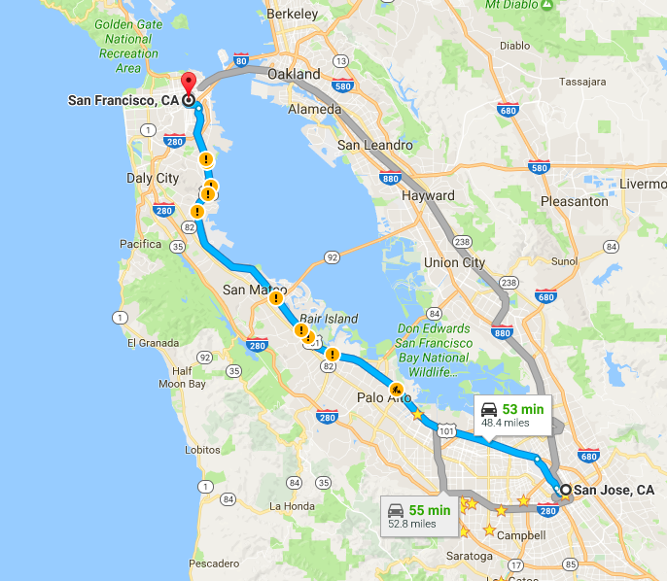




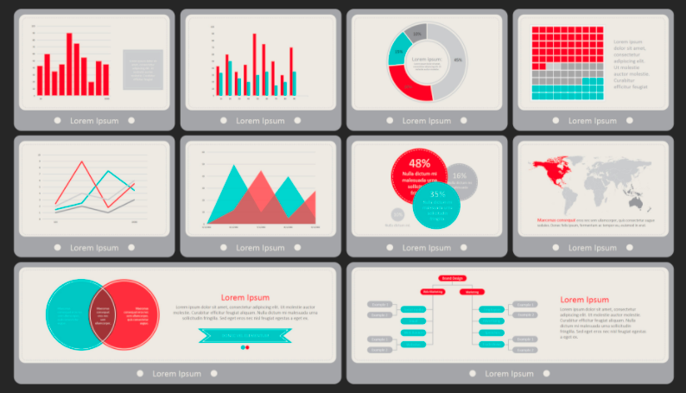
Setup start and end station
ex. SF→ San Jose
2
Notify bus driver to pick up passenger
1
publish
publish
subscribe
BusSmart
PubNub
Store to database
5
subscribe
subscribe
publish
4
Centralized dashboard
3
Notify passenger upon arrival

