Slide 1
Infrastructure As Code

Slide 2
Infrastructure As Code (IAC)
Infrastructure definition and configuration in code
Source control

Slide 3
IAC Motivation
Reduce delivery lead time
Increase deployment frequency
Reduce change fail percentage
Mean time to restore / recovery

Slide 4
IAC Principles
Assume systems are unreliable
Make everything reproducible
Add instances on demand to cope with high load
Replicate systems to give each customer a dedicated instance

Slide 5
IAC Benefits
Disaster Recovery
Consistency / Standards
Security – Least Privilege
Communication
Makes your life easier

Slide 6
IAC Options
Chef
Puppet
Ansible
Terraform
Pulumi
Salt
ARM / Bicep
PowerShell DSC
CloudFormation

Slide 7
Configuration Management vs. Provisioning
Provisioning – creating resources
Configuration Management – manage the configuration of existing resources
Not a clean separation

Slide 8
Provisioning Tools Uses
Create Virtual Machines
Load Balancers
Azure AD Accounts
Databases
…

Slide 9
Provisioning Tool Options
Terraform (2014)
CloudFormation (2011) – AWS
Pulumi (2019)

Slide 10
Configuration Management
Chef (2009)
Puppet (2005)
Ansible (2012)
Salt (~2014)

Slide 11
Chef, Puppet, Ansible
Configuration Management
Configure / Install software on existing VMs
Can use in coordination with Terraform

Slide 12
Chef
Procedural
Server Agent
Master

Slide 13
Puppet
Puppet
Server Agent
Master

Slide 14
Ansible
Procedural
Masterless
Agentless
Requires SSH Daemon

Slide 15
Procedural vs. Declarative
Procedural vs. Declarative
ansible.yaml
ansible.tf
Declarative describes the desired state

Slide 16
Pulumi
Similar to Terraform
Language Support (TypeScript, JavaScript, C#...)
Use a language you are familiar with – not necessarily a good idea

Slide 17
Hashicorp
Terraform
Vault
Consul
Nomad
Packer
Vagrant
Boundary
Waypoint

Slide 18
Terraform
Current Version 1.0.9
Hundreds of providers
Makes calls to the API of the cloud provider
Azure
AWS
Google Cloud
Digital Ocean

Slide 19
Terraform and Ansible
Mutable Infrastructure
Common to use Ansible and Terraform together
Terraform create the infrastructure
Ansible – deploy applications to the infrastructure

Slide 20
Terraform and Packer
Immutable infrastructure
Packer – package applications as VM images
Terraform – deployer server(s) with the VM images

Slide 21
Terraform, Packer, Docker and Kubernetes
Packer – create VM images with Docker and Kubernetes
Terraform – deploy VMs and supporting infrastructure

Slide 22
Terraform and Azure
Uses Azure Resource Manager API
Examples of usage
https://github.com/terraform-providers/terraform-provider-azurerm/tree/master/examples
https://www.terraform.io/docs/providers/azurerm/r/kubernetes_cluster.html#kubernetes_version

Slide 23
Terraform Workflow
Init
Validate
Plan
Apply
Destroy

Slide 24
Terraform Installation
Download from https://www.terraform.io/downloads.html
Extract
Update PATH

Slide 25
Terraform State
State file records the current state of a resource
Shared
Locked during apply

Slide 26
Demos and Hands On
001-resource-group
002-app-service

Slide 27
Terraform Modules
Set of configuration files in a folder
Root module
Code reuse
Remote or local source

Slide 28
Module Components
Variables
Resources
Outputs

Slide 29
Demos and Hands On
003-app-service-module
004-app-service-locals

Slide 30
Terraform CLI Local Environment Issues
Shared state
Secrets

Slide 31
Demo and Hands On
005-remote-state

Slide 32
Terraform Cloud
Cloud based offering
Benefits
Source control integration
Configuration management – including secrets
Team Visibility
Workflow
Modules

Slide 33
Terraform Cloud Offerings
https://www.hashicorp.com/products/terraform/pricing
Free
Up to 5 users
Team & Governance
$20 per user per month
Business

Slide 34
Terraform Cloud Free - Features
Version Control Integration / Remote Runs – Hooks
Workspace Management
Secure Variable Storage
Remote plan and apply
Full API Coverage
Private Module Registry

Slide 35
Terraform Team & Governance - Features
Terraform Team – Additional Features
Roles / Team Management

Slide 36
Terraform Business - Features
Sentinel
SSO
Private Datacenter networking
Audit

Slide 37
Terraform Cloud Demo
Managing resources via GitHub
https://app.terraform.io

Slide 38
Terraform With Azure Dev Ops
Walkthrough of Multi-stage pipeline
Challenges
What it solves

Slide 39
Dev Sec Ops
Incorporating security into the Dev Ops pipeline
Paved roads with guardrails as opposed to check points

Slide 40
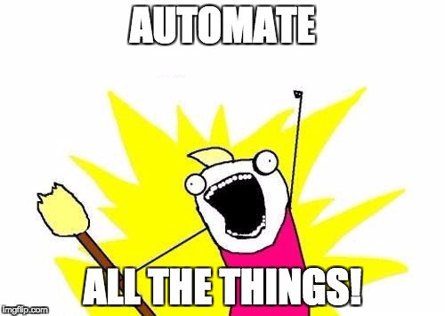
Automation

